Slide 1
INLINE EXPANSION
(内联拓展)

Slide 2
Yet another important optimization
Observation: functional programs tend to use many small functions
Loops are not used; replaced by recursive functions
Too many invocations cause performance overhead
Solution: inlining function invocations
Replacing a function call with a copy of a function body
The resulting program can be as efficient as a imperative one

Slide 3
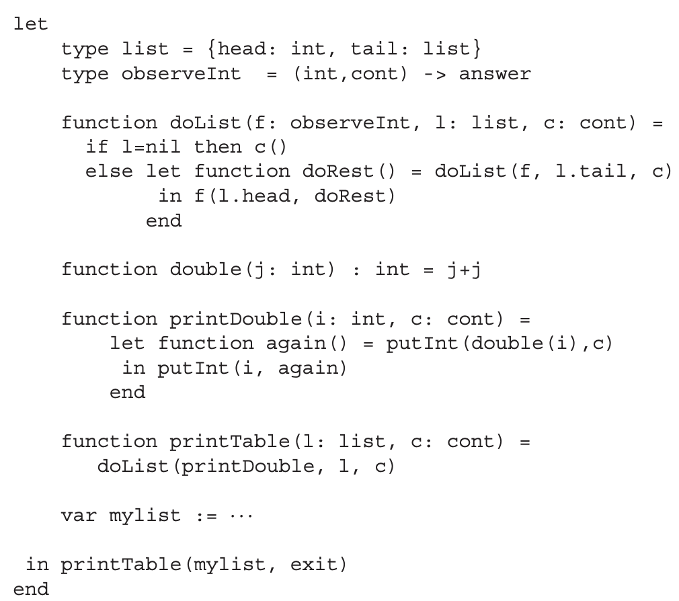
The example used in this part
print elements in a table/list

Slide 4
The example used in this part
print twice: i, i+i
suppose list = {1,2}
output: 1,2,2,4

Slide 5
Note: avoiding variable capture
Outer variables can have the same name with inners
let var x := 5
function g(y: int): int =
y+x
function f(x: int): int =
g(1)+x
in f(2)+x
end

Slide 6
Note: avoiding variable capture
Outer variables can have the same name with inners
Suppose we want to inline g(1) in f
let var x := 5
function g(y: int): int =
y+x
function f(x: int): int =
g(1)+x
in f(2)+x
end
1

Slide 7
Note: avoiding variable capture
Outer variables can have the same name with inners
Suppose we want to inline g(1) in f
The result is 1+x+x
let var x := 5
function g(y: int): int =
y+x
function f(x: int): int =
1+x+x
in f(2)+x
end

Slide 8
Note: avoiding variable capture
Outer variables can have the same name with inners
Suppose we want to inline g(1) in f
The result is 1+x+x
After inlining: f(2) = 1+2+2=5 (before is 1+5+2=8!)
Key reason: two “x”s are different!
let var x := 5
function g(y: int): int =
y+x
function f(x: int): int =
1+x+x
in f(2)+x
end

Slide 9
Note: avoiding variable capture
Solution: renaming the parameters of f
Now the synonym problem is gone
let var x := 5
function g(y: int): int =
y+x
function f(a: int): int =
g(1)+a -> (1+x)+a
in f(2)+x
end

Slide 10
Note: avoiding variable capture
Solution: renaming the parameters of f
Now the synonym problem is gone
A more general solution: adding an earlier pass
Renaming all variables so they never declare twice
即根据变量出现的顺序(无论是声明的变量还是函数参数)来给每一个变量加一个”时间戳”,类似于在compiler中的t100.
let var t0 := 5
function g(t1: int): int =
t1+t0
function f(t2: int): int =
g(1)+t2
in f(2)+t0
end

Slide 11
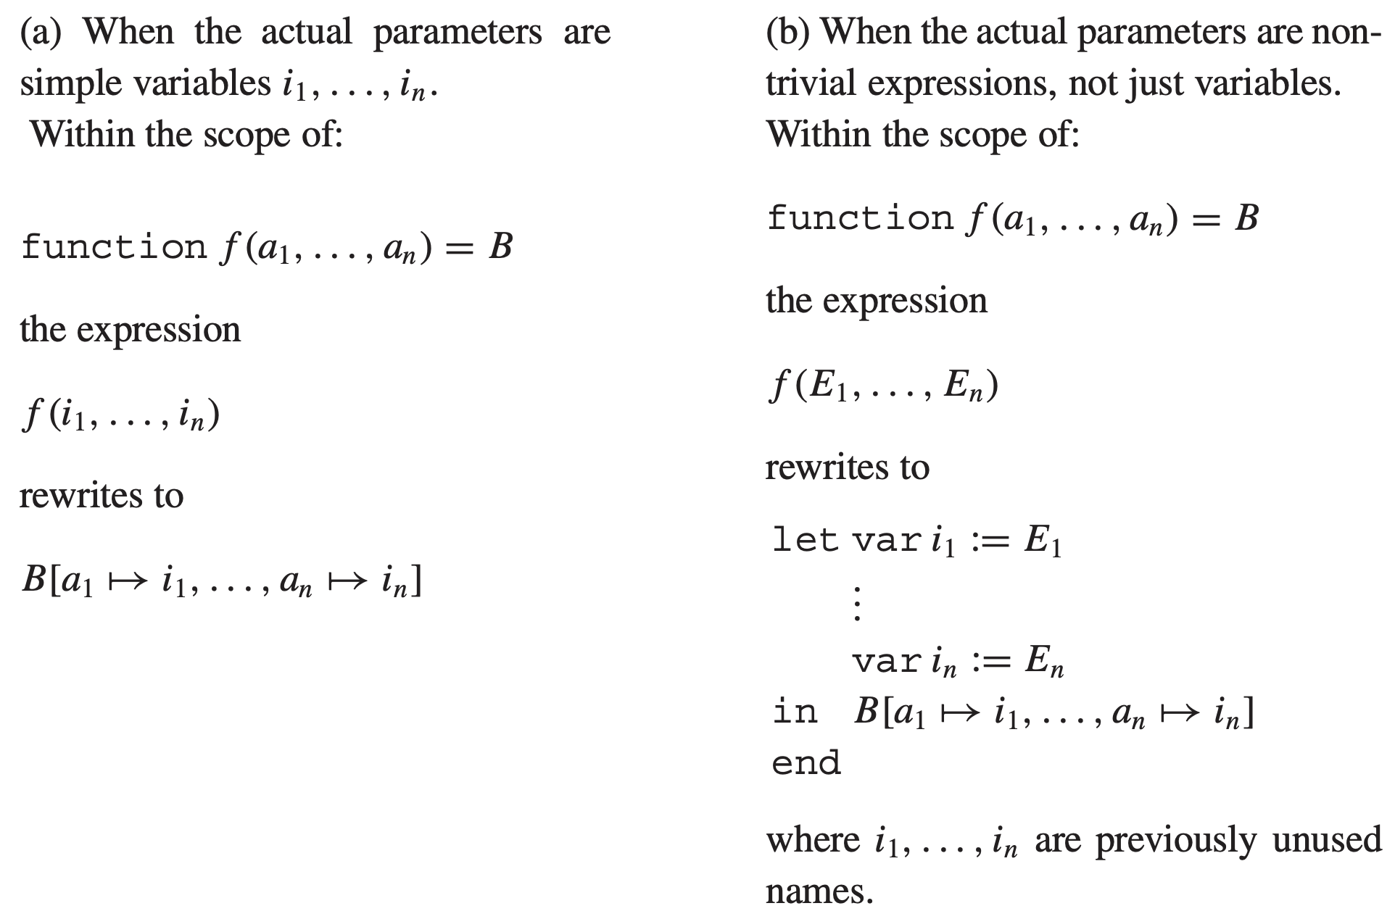
Algorithm for inline expansion
function body

Slide 12
Back to the original example
Suppose we want to inline the double(i) invocation
…
function double(j: int): int = j+j
function printDouble(i: int, c:cont) =
let function again() = putInt(double(i), c))
in putInt(i, again)
end
…

Slide 13
Back to the original example
Suppose we want to inline the double(i) invocation
Following (a): replace i in j+j -> i+i
…
function double(j: int): int = j+j
function printDouble(i: int, c:cont) =
let function again() = putInt(i+i, c))
in putInt(i, again)
end
…

Slide 14
A slightly different example
The invocation now becomes double(g(i))
We do not want to inline the g function
…
function double(j: int): int = j+j
function printDouble(i: int, c:cont) =
let function again() = putInt(double(g(i)), c))
in putInt(i, again)
end
function g(x: Int) = …
…

Slide 15
A slightly different example
The invocation now becomes double(g(i))
We do not want to inline the g function
Following (a): replace g(i) in j+j
…
function double(j: int): int = j+j
function printDouble(i: int, c:cont) =
let function again() = putInt((g(i)+g(i), c))
in putInt(i, again)
end
function g(x: Int) = …
…

Slide 16
A slightly different example
This inline expansion is not good enough
Efficiency: call g twice
Correctness: two calls can have different results for imperative programs(幂等/非幂等)
…
function double(j: int): int = j+j
function printDouble(i: int, c:cont) =
let function again() = putInt((g(i)+g(i), c))
in putInt(i, again)
end
function g(x: Int) = …
…

Slide 17
A slightly different example
Solution: following algorithm (b)
Using let-expression to catch the value of g(i)
Then using the new variable to replace j+j
…
function double(j: int): int = j+j
function printDouble(i: int, c:cont) =
let function again() = putInt(
let k:= g(i)
in k+k
end, c))
in putInt(i, again)
end
function g(x: Int) = …
…

Slide 18
Dead function elimination
Similar to dead code elimination (DCE)
Useless functions can be removed
The previous example: double() can be removed
…
function double(j: int): int = j+j
function printDouble(i: int, c:cont) =
let function again() = putInt(i+i, c))
in putInt(i, again)
end
…

Slide 19
Inlining recursive functions
Following (a), we can inline doList in printTable
…
function doList(f: observeInt, l: list, c: cont) =
if l = nil then c()
else let function doRest() = doList(f, l.tail, c)
in f(l.head, doRest)
end
function printTable(l: list, c: cont) =
doList(printDouble, l, c)
…

Slide 20
Inlining recursive functions
Following (a), we can inline doList in printTable
But invocations to doList still exist
We only inline “the first iteration”
…
function printTable(l: list, c: cont) =
if l = nil then c()
else let function doRest() =
doList(printDouble, l.tail, c)
in printDouble(l.head, doRest)
end
…

Slide 21
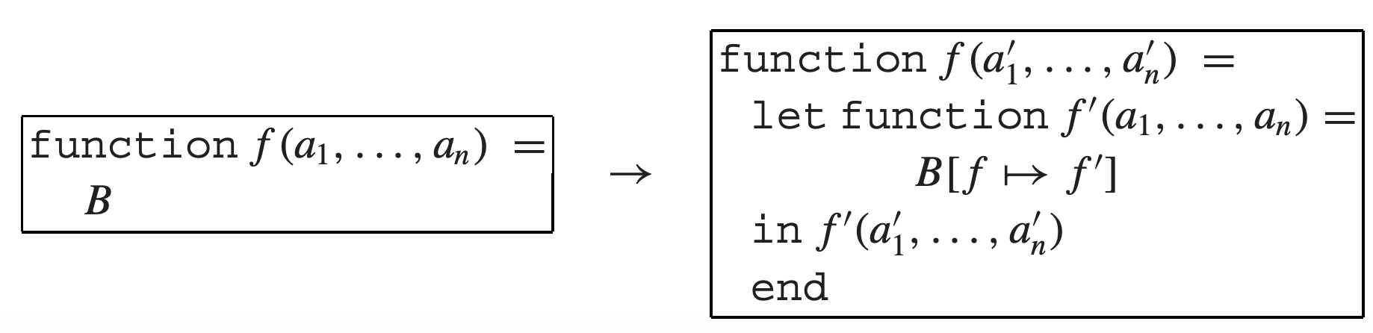
How to entirely inline recursive functions?
Simply inline them does not work
They can have infinite iterations
We need to refactor/customize them
Algorithm: loop-preheader transformation
Key idea: split the function into nested two
The outer one serves as a “hook” (or prelude)

Slide 22
How does this algorithm work?
Still use doList as an example
function doList(f: observeInt, l: list, c: cont) =
if l = nil then c()
else let function doRest() = doList(f, l.tail, c)
in f(l.head, doRest)
end
function doList(fX: observeInt, lX: list, cX: cont) =
let function doListX(f: observeInt, l: list, c: cont) =
if l = nil then c()
else let function doRest() = doListX(f, l.tail, c)
in f(l.head, doRest)
end
in doListX(fX, lX, cX)
end

Slide 23
How does this algorithm work?
Now doList is not calling itself (doListX is)
function doList(f: observeInt, l: list, c: cont) =
if l = nil then c()
else let function doRest() = doList(f, l.tail, c)
in f(l.head, doRest)
end
function doList(fX: observeInt, lX: list, cX: cont) =
let function doListX(f: observeInt, l: list, c: cont) =
if l = nil then c()
else let function doRest() = doListX(f, l.tail, c)
in f(l.head, doRest)
end
in doListX(fX, lX, cX)
end

Slide 24
Inline expand after transformation
Now if printTable inlines doList:
Following (a)
Note: the formal parameters do not need to change
…
function printTable(l: list, c: cont) =
let function doListX(f: observeInt, l: list, c: cont) =
if l = nil then c()
else let function doRest() = doListX(f, l.tail, c)
in f(l.head, doRest)
end
in doListX(printDouble, l, c)
…

Slide 25
Inline expand after transformation
Is it good enough?
Perhaps more potential optimizations
E.g., f is always printDouble in doListX
…
function printTable(l: list, c: cont) =
let function doListX(f: observeInt, l: list, c: cont) =
if l = nil then c()
else let function doRest() = doListX(f, l.tail, c)
in f(l.head, doRest)
end
in doListX(printDouble, l, c)
…

Slide 26
Loop-invariant arguments
doListX has two unchanged arguments in every calls
f (always fX); c (always cX)
They are invariants during recursive invocations
function doList(fX: observeInt, lX: list, cX: cont) =
let function doListX(f: observeInt, l: list, c: cont) =
if l = nil then c()
else let function doRest() = doListX(f, l.tail, c)
in f(l.head, doRest)
end
in doListX(fX, lX, cX)
end

Slide 27
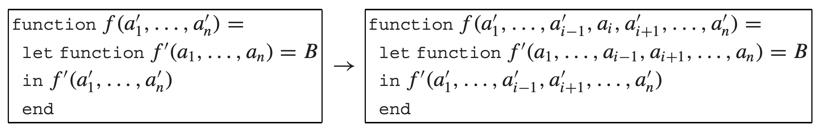
Loop-invariant hoisting
Algorithm: if every use of f’ within B is of the form f’(E₁, …, E_{i-1}, a_{i}, E_{i+1}, …, E_{n}) such that the ith argument is always a_{i}, then rewrite
where every call f’(E₁, …, E_{i-1}, a_{i}, E_{i+1}, …, E_{n}) within B is rewritten as f’(E₁, …, E_{i-1}, E_{i+1}, …, E_{n})
moved out
(相当于每次参数a_i都是一个固定的值，所以就干脆不把他作为一个参数而作为这个函数的一个常量来处理了。)

Slide 28
Loop-invariant hoisting in our example
Moving f and c out
Replacing the original name: fX and cX
function doList(fX: observeInt, lX: list, cX: cont) =
let function doListX(f: observeInt, l: list, c: cont) =
if l = nil then c()
else let function doRest() = doListX(f, l.tail, c)
in f(l.head, doRest)
end
in doListX(fX, lX, cX)
end

Slide 29
Loop-invariant hoisting in our example
Moving f and c out
Replacing the original name: fX and cX
Now doListX has only one parameter (l)
function doList(f: observeInt, lX: list, c: cont) =
let function doListX(l: list) =
if l = nil then c()
else let function doRest() = doListX(l.tail)
in f(l.head, doRest)
end
in doListX(lX)
end

Slide 30
Loop-invariant hoisting in our example
Moving f and c out
Replacing the original name: fX and cX
Now doListX has only one parameter (l)
The inlined result also changes
…
function printTable(l: list, c: cont) =
let function doListX(l: list) =
if l = nil then c()
else let function doRest() = doListX(l.tail)
in printDouble(l.head, doRest)
end
in doListX(l)
…
注意这里要换成那个新不变的参数对应的常量

Slide 31
Cascading inlining
Formal inline expands enable more opportunities
Before: printDouble is an argument to doListX
…
function printTable(l: list, c: cont) =
let function doListX(f: observeInt, l: list, c: cont) =
if l = nil then c()
else let function doRest() = doListX(f, l.tail, c)
in f(l.head, doRest)
end
in doListX(printDouble, l, c)
…

Slide 32
Cascading inlining
Formal inline expands enable more opportunities
Now it is clear that printDouble can be inlined
Following (b)
…
function printTable(l: list, c: cont) =
let function doListX(l: list) =
if l = nil then c()
else let function doRest() = doListX(l.tail)
in printDouble(l.head, doRest)
end
in doListX(l)
…

Slide 33
Cascading inlining
The result for inline expanding
Can we do more inlining? (sure, consider putInt)
…
function printTable(l: list, c: cont) =
let function doListX(l: list) =
if l = nil then c()
else let function doRest() = doListX(l.tail)
in let var i:= l.head
in let function again() = putInt(i+i,doRest)
in putInt(i,again)
end
end
end
in doListX(l)
…

Slide 34
Another opportunity: unnesting lets
Nested lets can be simplified
In our example: three nested lets
let dec1 in let dec2 in exp end end = let dec1 dec2 in exp end
function printTable(l: list, c: cont) =
let function doListX(l: list) =
if l = nil then c()
else let function doRest() = doListX(l.tail)
in let var i:= l.head
in let function again() = putInt(i+i,doRest)
in putInt(i,again)
end
end
end
in doListX(l)
end

Slide 35
Another opportunity: unnesting lets
Nested lets can be simplified
The optimized version (neat in source code)
let dec1 in let dec2 in exp end end = let dec1 dec2 in exp end
function printTable(l: list, c: cont) =
let function doListX(l: list) =
if l = nil then c()
else let function doRest() = doListX(l.tail)
var i:= l.head
function again() = putInt(i+i,doRest)
in putInt(i,again)
end
in doListX(l)
end

Slide 36
Tradeoff for inline expansion
Inline expansion can improve the performance
Call instructions are removed
Less register saving/restoring
However, it makes the program bigger
A function body might be copied in multiple callers
Can cause code explosion if handled incorrectly
对于functional language函数进行优化的目标：
使其具有与imperative language几乎相同的运行性能。

Slide 37
Heuristics to control inlining
Expand only call sites frequently executed
The most cost-effective
Frequency can be determined by static analysis or dynamic profiling
Expand functions with small bodies
Some functions (getter/setter) are even smaller than the call-related instruction sequence
A smart compiler automatic inlines them

Slide 38
Heuristics to control inlining
Expand only call sites frequently executed
Expand functions with small bodies
Expand functions called only once
The original body can be removed by DFE
The program size may not increase

Slide 39
CLOSURE CONVERSION

Slide 40
Recap: what is a closure?
A closure combines
A function pointer (to its machine code)
A means of accessing non-local (free) variables
We use heap-allocated records to implement closures
Stack frames
Heap records
SL
main’s escape
main
EP
add
SL
add’s escape
5
EP

Slide 41
Closures are complicated than normal functions
It contains not only code but also data
Making it harder for backend analysis
So we need a closure conversion phase
So none of the functions appears to access free variables
Basic idea: turning free variable access into formal parameter access

Slide 42
Formal rewriting rules
Given a function f(a₁, …, a_{n}) = B at nesting depth d with escaping variables x₁, x₂, …, x_{n} and non-escaping variables y₁, y₂, …, y_{n}; rewriting into:
a₀: static link
r: a record containing all escaping variables and static link
Acting as the static link(之后通过与record-field访问类似的方式来访问想要的escape var/SL) when calling functions of depth d+1
f(a₀, a₁, …, a_{n}) = let var r := {a₀, x₁, x₂, …, x_{n}} in B’ end

Slide 43
What about functions in the parameters?
They were represented as closures before
We create records on heap to store them
After closure conversion, we split them into two
One parameter as the code pointer
Another as the converted static link
Containing escaping variables

Slide 44
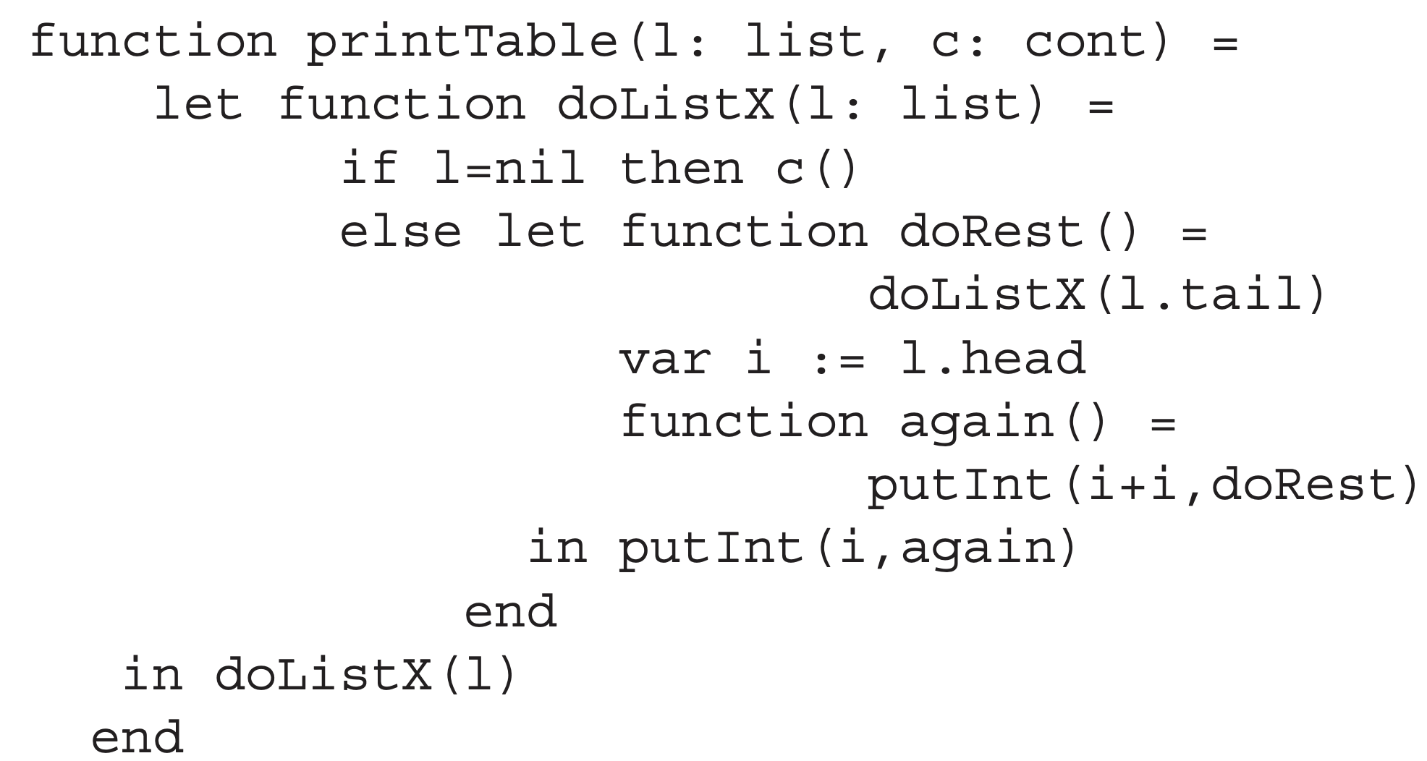
An example: printTable (before conversion)
escaping

Slide 45
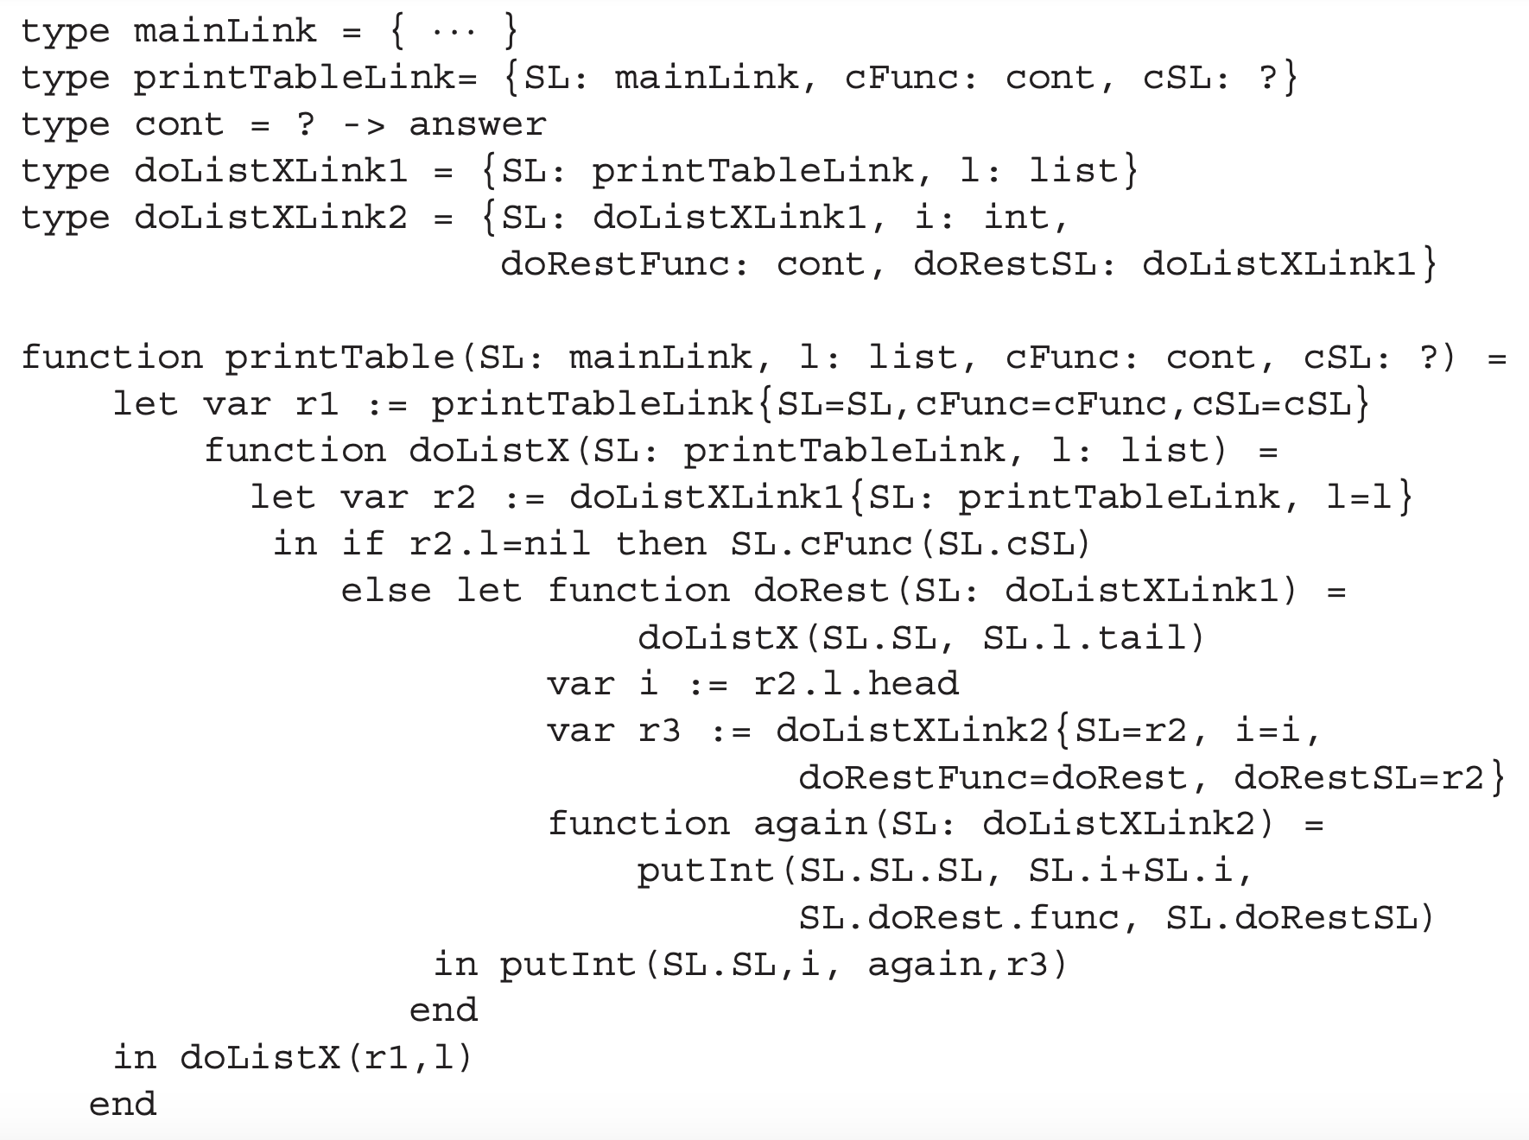
An example: printTable (after conversion)
split into two

Slide 46
An example: printTable (after conversion)
records for static link

Slide 47
An example: printTable (after conversion)
records for static link
(used in larger depths)

Slide 48
An example: printTable (after conversion)
link types

Slide 49
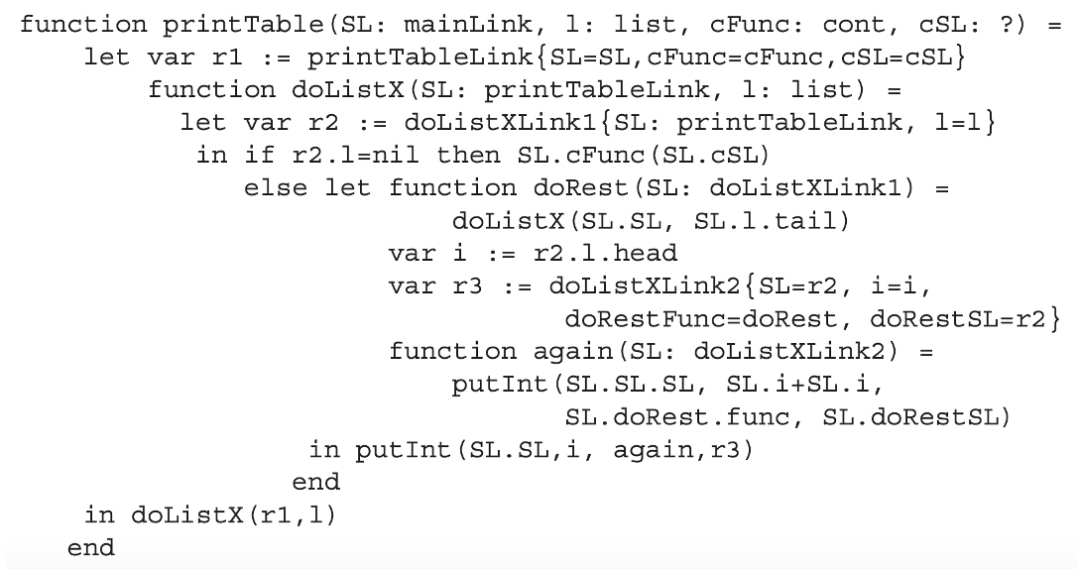

What is a ? Type?
The type of cont’s static link is unknown
Marked as a question mark (?)
Because cont’s static link has multiple functions
from main()
(acutally exit)

Slide 50
What is a ? Type?
The type of cont’s static link is unknown
Marked as a question mark (?)
Because cont’s static link has multiple functions
doListXLink1

Slide 51
What is a ? Type?
The type of cont’s static link is unknown
Marked as a question mark (?)
Because cont’s static link has multiple functions
doListXLink2

Slide 52
What is a ? Type?
The type of cont’s static link is unknown
Marked as a question mark (?)
Because cont’s static link has multiple functions
So its type cannot be determined
‘?’ suggests converted programs cannot be type-checked in a normal fashion

Slide 53
EFFICIENT TAIL CONVERSION

Slide 54
Functions in the tail position
Formal definition: f(x) within the body of g(y) is in tail position if
Calling f is the last thing that g does before return
Calling to f is referred as ‘tail call’
For example, B_{i} are in tail but C_{i} are not
let var x := C₁ in B₁ end
if C₁ then B₁ else B₂
C₁ + C₂

Slide 55
Why are tail calls important?
Tail calls can be implemented more efficiently than ordinary ones
A function has the same return value as its tail call
Perhaps we can avoid pushing the return value to stack
Optimization: implementing tail calls like a jump
Using jump instructions instead of calls

Slide 56
Implementing a tail call
A tail call has two missions
Passing the control flow to callee
Returning from the caller (as it ends after the call)
It contains four steps
Move actual parameters into argument registers
Restore callee-save registers
Pop the stack frame of the calling function
Jump to the callee

Slide 57
Implementing a tail call
A tail call has two missions
Passing the control flow to callee
Returning from the caller (as it ends after the call)
It contains four steps
Move actual parameters into argument registers
Restore callee-save registers
Pop the stack frame of the calling function
Jump to the callee (cheap)
removed by coalescing
not required for
simple functions

Slide 58
Functional PL has many tail calls
Functions are passed as parameters and invoked in the end of function body
Every call in printTable is a tail call!

Slide 59
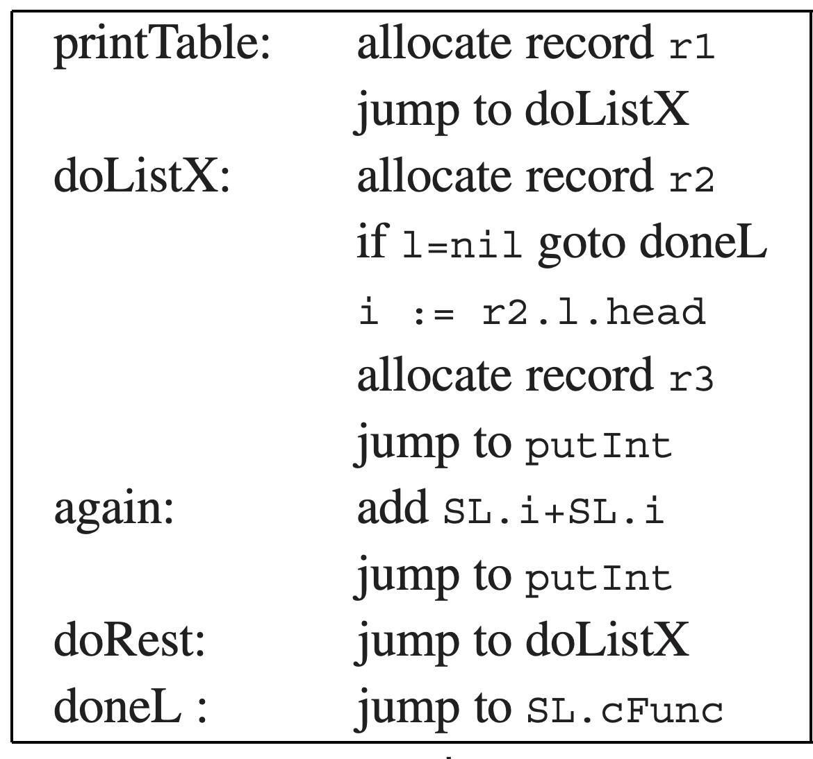
printTable after compilation
All calls are replaced with jumps
Now it looks like a loop-based function

Slide 60
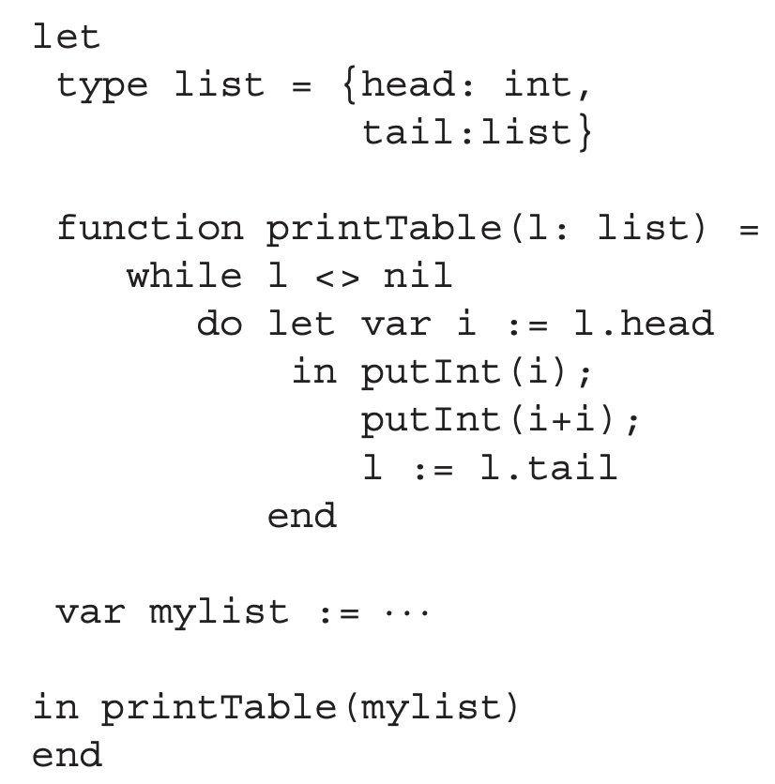
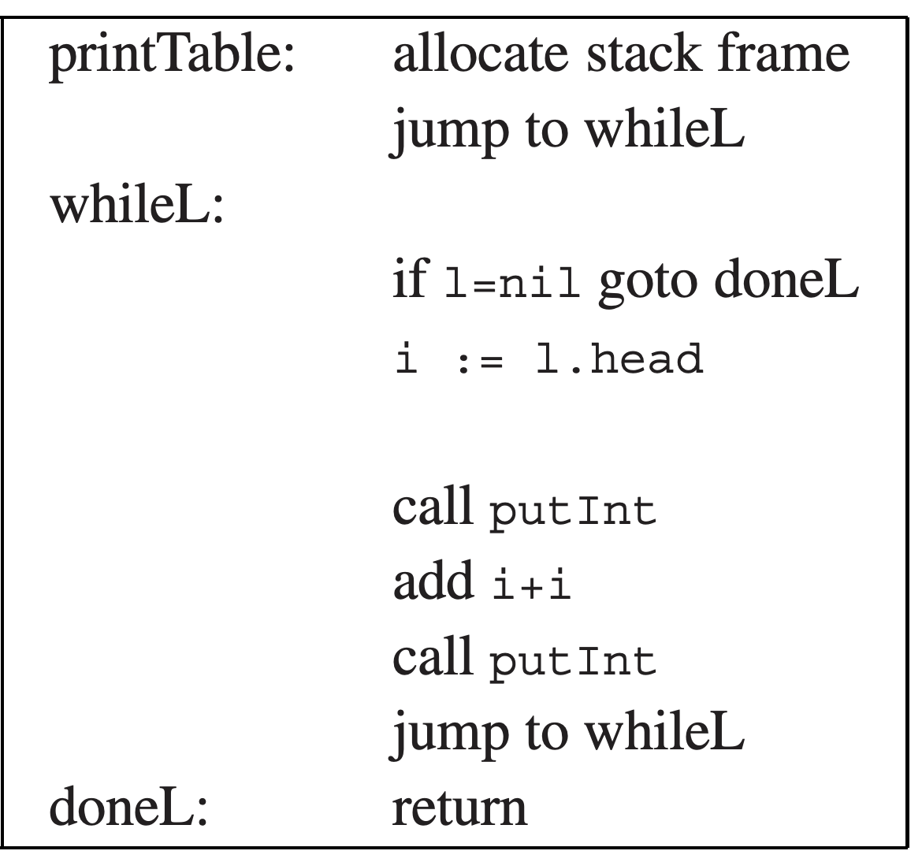
Compared with an imperative version

Slide 61
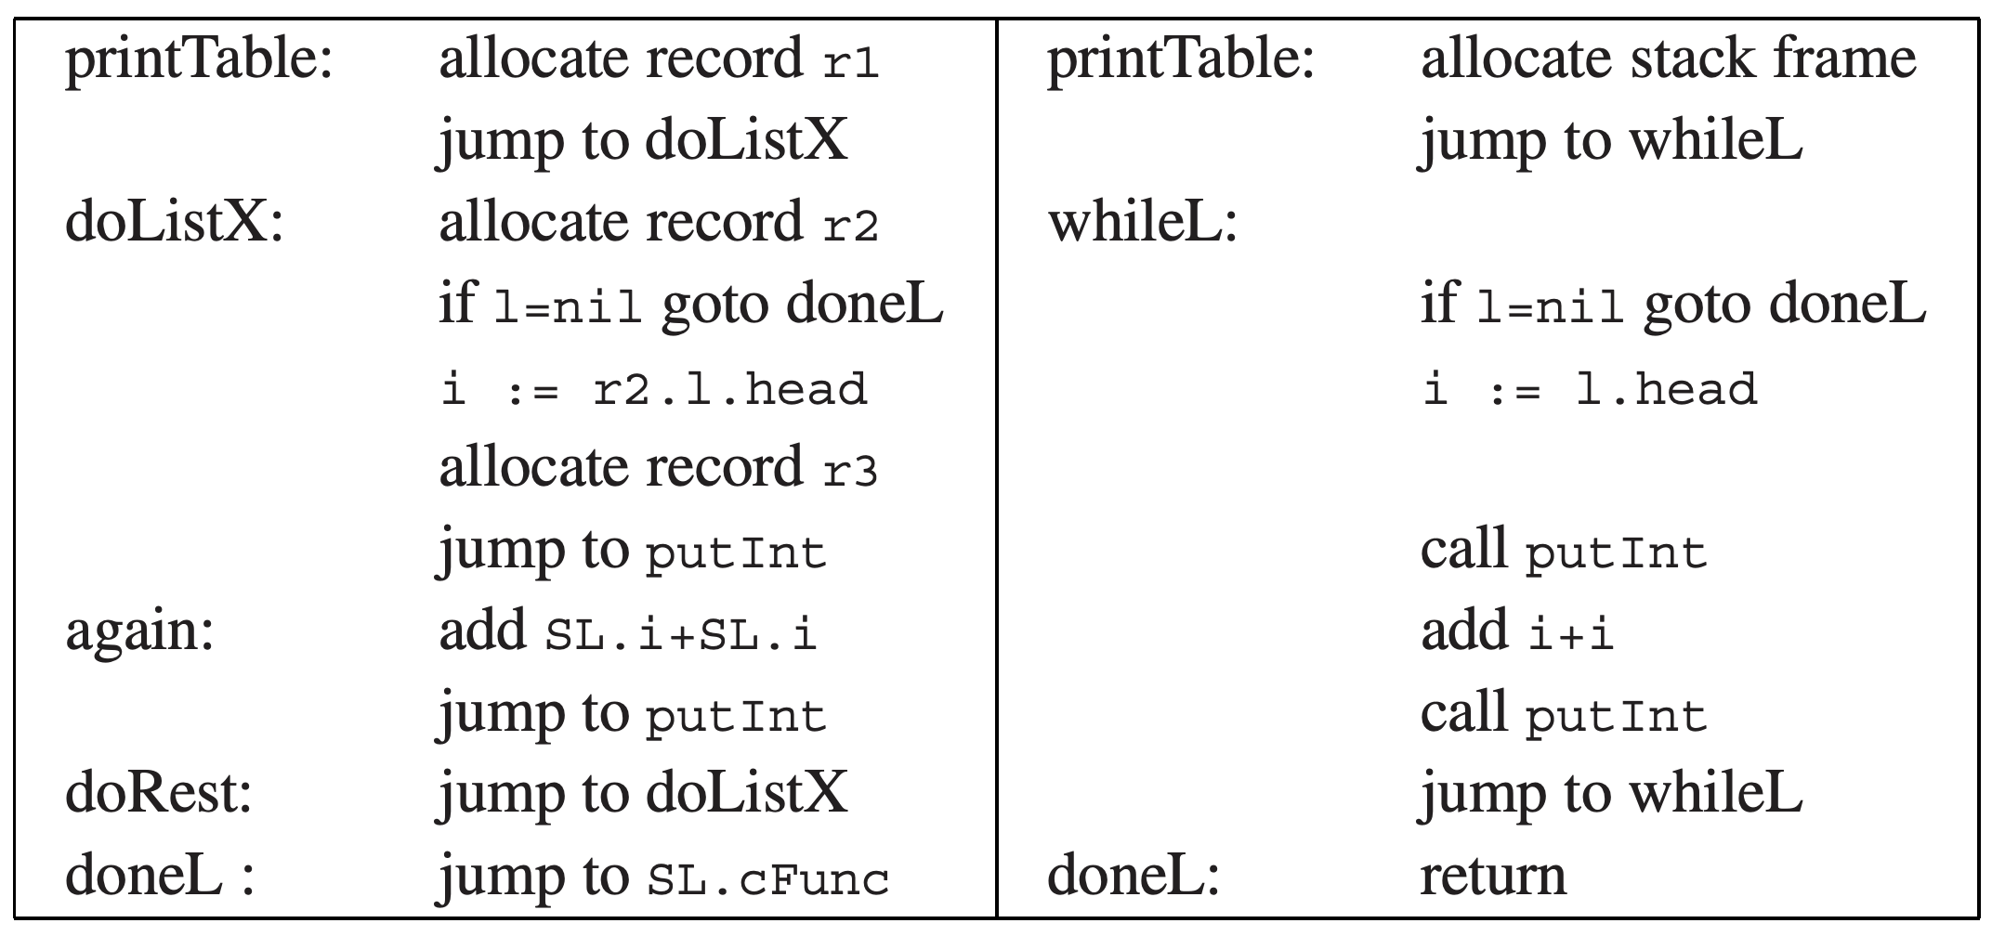
Now both lead to Rome!
The logic looks very similar after compilation
The most difference comes from heap vs. stack

Slide 62
The last inefficiency: heap-allocated record
Heap allocations are less efficient
The heap structure is usually more complex
Not to mention garbage collection
What can we do for further optimizations?
More advanced closure conversion: reducing heap allocation
Escape analysis: stack-allocated those records (r1)
Fast heap allocation and GC

Slide 63
LAZY EVALUATION

Slide 64
Does PureTiger always ensure equational reasoning?
An important principle is ß-substitution:
If f(x) = B with function body B, then any application f(E) to an expression E is equivalent to B with every occurrence of x replaced with E:
f(x) = B -> f(E) ≡ B[x |-> E]
An concrete example
B: x*2; f(i+i) ≡ (i+i)*2
let f(x: int):int=
x*2
in f(i+i)
end
let f(x: int):int=
x*2
in (i+i)*2
end

Slide 65
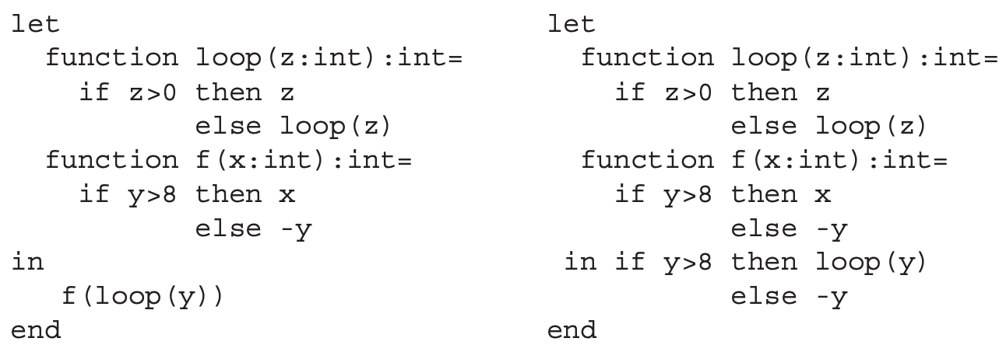
Does PureTiger always ensure equational reasoning?
But consider another example:
B: if y>8 then x else –y; seems equal
But if y = 0: the left hangs while the right returns 0

Slide 66
Does PureTiger always ensure equational reasoning?
What is the problem?
The order of evaluation is different
The left: loop(y) first; the right: f() first

Slide 67
Introducing lazy evaluation
A program compiled with lazy evaluation will not evaluate any expression unless its value is demanded by some other part of the computation
i.e., on-demand evaluation
A language with lazy evaluation is a lazy language
This part introduces Lazy-Tiger

Slide 68
Call-by-name evaluation
Most (strict) languages use call-by-value to pass function arguments
f(g(x)): first g(x) is evaluated even if f does not use it
Call-by-name replaces each variable with a thunk
E.g., each integer is replaced with a function value of type ()->int
let var a := 5+7 in a+10 end
let function a() := 5+7 in a()+10 end

Slide 69
Call-by-name transformation for binary-tree
Recap: the original imperative program
type key = string
type binding = int
type tree = {key: key,
binding: binding,
left: tree,
right: tree}
function look(t: tree, k: key): binding =
if k < t.key
then look(t.left, k)
else if k > t.key
then look(t.right, k)
else t.binding

Slide 70
Call-by-name transformation for binary-tree
Recap: the original imperative program
type key = string
type binding = int
type tree = {key: ()->key,
binding: ()->binding,
left: ()->tree,
right: ()->tree}
function look(t: ()->tree, k: ()->key): binding =
if k() < t().key()
then look(t().left, k)
else if k() > t().key()
then look(t().right, k)
else t().binding
must evaluate…

Slide 71
The problem with call-by-name
A thunk may be executed many times
In the tree example, a node is expanded every time it is traversed
Now the tree has to be reconstructed even in read-only look()!
The problem can be solved with call-by-need
Every thunk can be evaluated only once

Slide 72
Implementation of call-by-need
Key idea: store the evaluated result for each variable
Implementation: a per-thunk memo slot
Unevaluated: memo stores the static link (containing escaping parameters)
Evaluated: previously computed values

