Slide 1
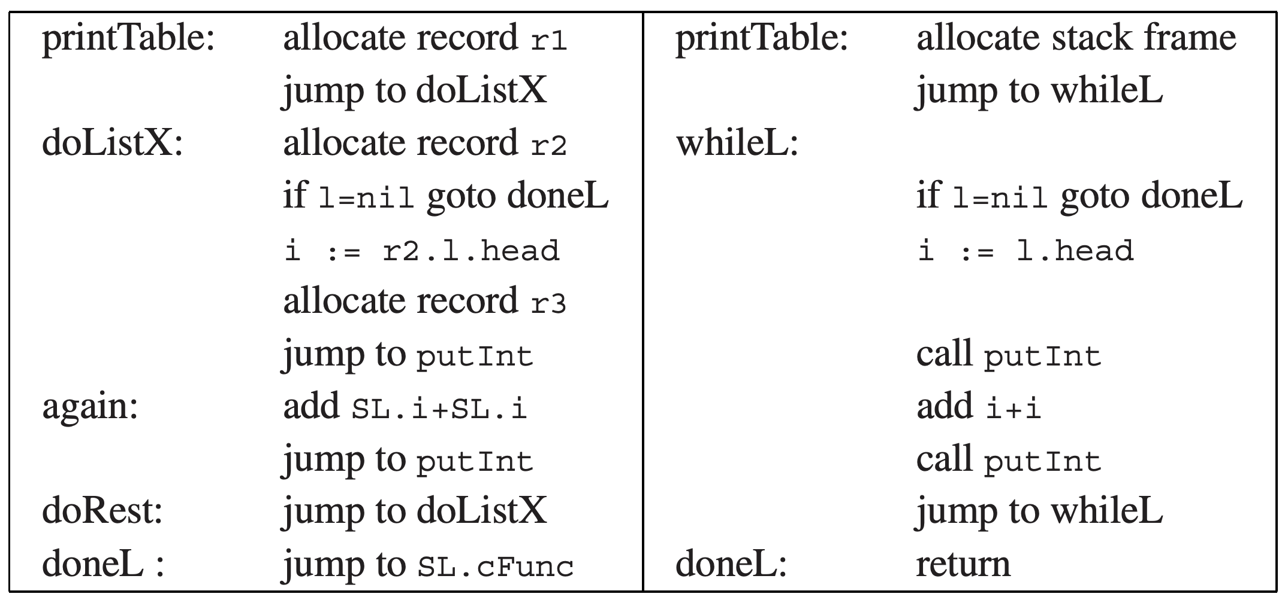
Now both lead to Rome!
The logic looks very similar after compilation
The most difference comes from heap vs. stack

Slide 2
The last inefficiency: heap-allocated record
Heap allocations are less efficient
The heap structure is usually more complex
Not to mention garbage collection
What can we do for further optimizations?
More advanced closure conversion: reducing heap allocation
Escape analysis: stack-allocated those records (r1)
Fast heap allocation and GC

Slide 3
LAZY EVALUATION

Slide 4
Does PureTiger always ensure equational reasoning?
An important principle is ß-substitution:
If f(x) = B with function body B, then any application f(E) to an expression E is equivalent to B with every occurrence of x replaced with E:
f(x) = B -> f(E) ≡ B[x |-> E]
An concrete example
B: x*2; f(i+i) ≡ (i+i)*2
let f(x: int):int=
x*2
in f(i+i)
end
let f(x: int):int=
x*2
in (i+i)*2
end

Slide 5
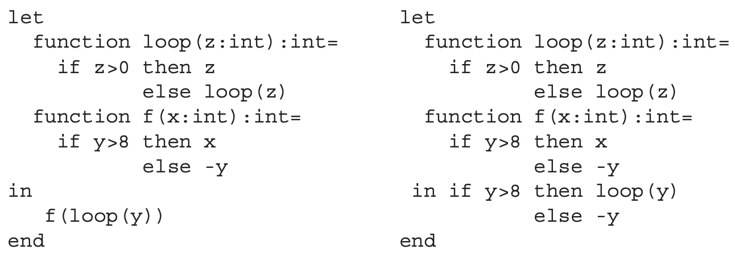
Does PureTiger always ensure equational reasoning?
But consider another example:
B: if y>8 then x else –y; seems equal
But if y = 0: the left hangs while the right returns 0

Slide 6
Does PureTiger always ensure equational reasoning?
What is the problem?
The order of evaluation is different
The left: loop(y) first; the right: f() first

Slide 7
Introducing lazy evaluation
A program compiled with lazy evaluation will not evaluate any expression unless its value is demanded by some other part of the computation
i.e., on-demand evaluation
A language with lazy evaluation is a lazy language
This part introduces Lazy-Tiger

Slide 8
Call-by-name evaluation
Most (strict) languages use call-by-value to pass function arguments
f(g(x)): first g(x) is evaluated even if f does not use it
Call-by-name replaces each variable with a thunk
E.g., each integer is replaced with a function value of type ()->int
let var a := 5+7 in a+10 end
let function a() := 5+7 in a()+10 end

Slide 9
Call-by-name transformation for binary-tree
Recap: the original imperative program
type key = string
type binding = int
type tree = {key: key,
binding: binding,
left: tree,
right: tree}
function look(t: tree, k: key): binding =
if k < t.key
then look(t.left, k)
else if k > t.key
then look(t.right, k)
else t.binding

Slide 10
Call-by-name transformation for binary-tree
Recap: the original imperative program
type key = string
type binding = int
type tree = {key: ()->key,
binding: ()->binding,
left: ()->tree,
right: ()->tree}
function look(t: ()->tree, k: ()->key): binding =
if k() < t().key()
then look(t().left, k)
else if k() > t().key()
then look(t().right, k)
else t().binding
must evaluate…

Slide 11
The problem with call-by-name
A thunk may be executed many times
In the tree example, a node is expanded every time it is traversed
Now the tree has to be reconstructed even in read-only look()!
The problem can be solved with call-by-need
Every thunk can be evaluated only once

Slide 12
Implementation of call-by-need
Key idea: store the evaluated result for each variable
Implementation: a per-thunk memo slot
Unevaluated: memo stores the static link (containing escaping parameters)
Evaluated: previously computed values

Slide 13
Call-by-name evaluation
Most (strict) languages use call-by-value to pass function arguments
f(g(x)): first g(x) is evaluated even if f does not use it
Call-by-name replaces each variable with a thunk
E.g., each integer is replaced with a function value of type ()->int
let var a := 5+7 in a+10 end
let function a() := 5+7 in a()+10 end

Slide 14
Call-by-name transformation for binary-tree
Recap: the original imperative program
type key = string
type binding = int
type tree = {key: key,
binding: binding,
left: tree,
right: tree}
function look(t: tree, k: key): binding =
if k < t.key
then look(t.left, k)
else if k > t.key
then look(t.right, k)
else t.binding

Slide 15
Call-by-name transformation for binary-tree
Recap: the original imperative program
type key = string
type binding = int
type tree = {key: ()->key,
binding: ()->binding,
left: ()->tree,
right: ()->tree}
function look(t: ()->tree, k: ()->key): binding =
if k() < t().key()
then look(t().left, k)
else if k() > t().key()
then look(t().right, k)
else t().binding
must evaluate…

Slide 16
The problem with call-by-name
A thunk may be executed many times
In the tree example, a node is expanded every time it is traversed
Now the tree has to be reconstructed even in read-only look()!
The problem can be solved with call-by-need
Every thunk can be evaluated only once

Slide 17
Implementation of call-by-need
Key idea: store the evaluated result for each variable
Implementation: a per-thunk memo slot
Unevaluated: memo stores the static link (containing escaping parameters)
Evaluated: previously computed values

Slide 18
An example: addFive
The original function in Fun-Tiger is eagerly evaluated
let
type intfun = int -> int
function add (n:int) : intfun =
let function h(m:int): int = n+m
in h
end
var addFive: intFun := add(5)
var twenty := addFive(15)
in …
end

Slide 19
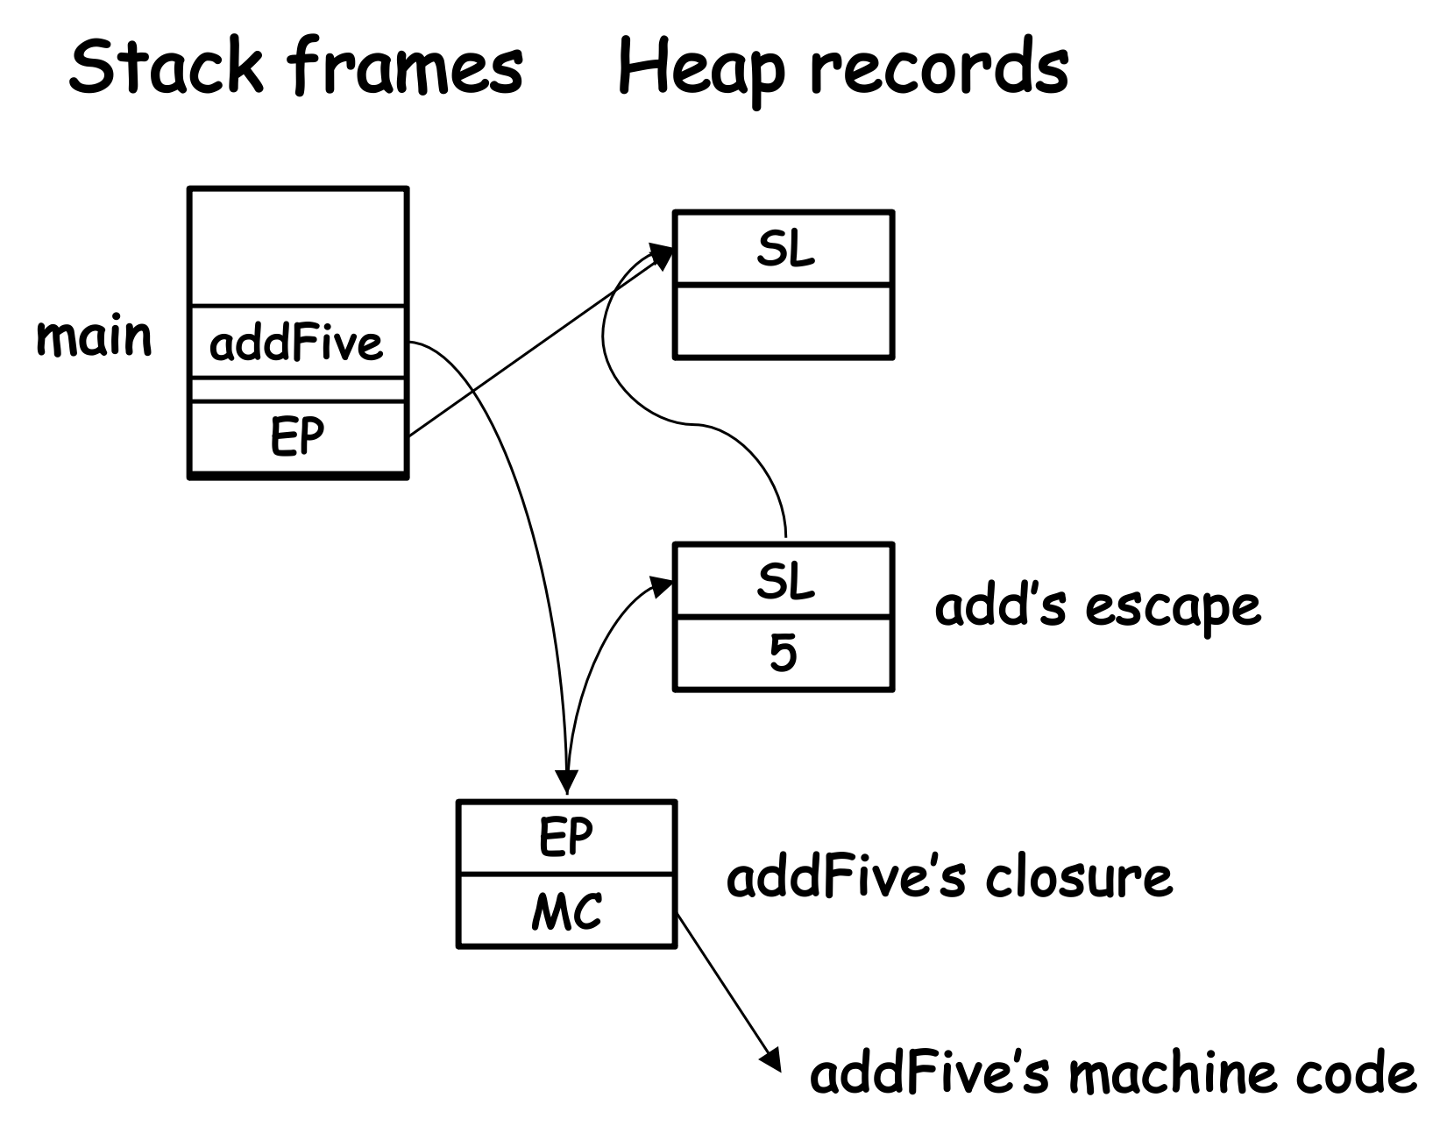
An example: addFive
Turning it into Lazy-Tiger
We should turn twenty into a lazy-evaluated thunk
let
type intfun = int -> int
function add (n:int) : intfun =
let function h(m:int): int = n+m
in h
end
var addFive: intFun := add(5)
var twenty := intThunk{func=twentyFunc, memo=EP}
in …
end

Slide 20
An example: addFive
Auxiliary declarations are required
type intThunk = {func: ?->int, memo: ?}
type intfunc = {func: (?,intThunk)->int, SL: ?}
type intfuncThunk = {func: ?->intfunc, memo: ?}
function evaluatedFunc(th: intThunk): int = th.memo
function twentyFunc(mythunk: intThunk): int =
let var EP := mythunk.memo
var add5thunk: intfuncThunk := EP.addFive
var add5: intfunc := add5thunk.func(add5thunk)
var fifteenThunk:=intThunk{func=evaluatedFunc,memo=15}
var result: int := add5.func(add5.SL, fifteenThunk)
in mythunk.memo := result;
mythunk.func := evaluatedFunc;
result
end
…
var twenty := intThunk{func=twentyFunc, memo=EP}

Slide 21
An example: addFive
Auxiliary declarations are required
type intThunk = {func: ?->int, memo: ?}
type intfunc = {func: (?,intThunk)->int, SL: ?}
type intfuncThunk = {func: ?->intfunc, memo: ?}
function evaluatedFunc(th: intThunk): int = th.memo
function twentyFunc(mythunk: intThunk): int =
let var EP := mythunk.memo
var add5thunk: intfuncThunk := EP.addFive
var add5: intfunc := add5thunk.func(add5thunk)
var fifteenThunk:=intThunk{func=evaluatedFunc,memo=15}
var result: int := add5.func(add5.SL, fifteenThunk)
in mythunk.memo := result;
mythunk.func := evaluatedFunc;
result
end
…
var twenty := intThunk{func=twentyFunc, memo=EP}
SL/EP

Slide 22
An example: addFive
Auxiliary declarations are required
type intThunk = {func: ?->int, memo: ?}
type intfunc = {func: (?,intThunk)->int, SL: ?}
type intfuncThunk = {func: ?->intfunc, memo: ?}
function evaluatedFunc(th: intThunk): int = th.memo
function twentyFunc(mythunk: intThunk): int =
let var EP := mythunk.memo
var add5thunk: intfuncThunk := EP.addFive
var add5: intfunc := add5thunk.func(add5thunk)
var fifteenThunk:=intThunk{func=evaluatedFunc,memo=15}
var result: int := add5.func(add5.SL, fifteenThunk)
in mythunk.memo := result;
mythunk.func := evaluatedFunc;
result
end
…
var twenty := intThunk{func=twentyFunc, memo=EP}
twenty’s EP stores addFive

Slide 23
An example: addFive
Auxiliary declarations are required
type intThunk = {func: ?->int, memo: ?}
type intfunc = {func: (?,intThunk)->int, SL: ?}
type intfuncThunk = {func: ?->intfunc, memo: ?}
function evaluatedFunc(th: intThunk): int = th.memo
function twentyFunc(mythunk: intThunk): int =
let var EP := mythunk.memo
var add5thunk: intfuncThunk := EP.addFive
var add5: intfunc := add5thunk.func(add5thunk)
var fifteenThunk:=intThunk{func=evaluatedFunc,memo=15}
var result: int := add5.func(add5.SL, fifteenThunk)
in mythunk.memo := result;
mythunk.func := evaluatedFunc;
result
end
…
var twenty := intThunk{func=twentyFunc, memo=EP}
get addFive
t.func(t)

Slide 24
An example: addFive
Auxiliary declarations are required
type intThunk = {func: ?->int, memo: ?}
type intfunc = {func: (?,intThunk)->int, SL: ?}
type intfuncThunk = {func: ?->intfunc, memo: ?}
function evaluatedFunc(th: intThunk): int = th.memo
function twentyFunc(mythunk: intThunk): int =
let var EP := mythunk.memo
var add5thunk: intfuncThunk := EP.addFive
var add5: intfunc := add5thunk.func(add5thunk)
var fifteenThunk:=intThunk{func=evaluatedFunc,memo=15}
var result: int := add5.func(add5.SL, fifteenThunk)
in mythunk.memo := result;
mythunk.func := evaluatedFunc;
result
end
…
var twenty := intThunk{func=twentyFunc, memo=EP}
const (15);
no evaluation required

Slide 25
An example: addFive
Auxiliary declarations are required
type intThunk = {func: ?->int, memo: ?}
type intfunc = {func: (?,intThunk)->int, SL: ?}
type intfuncThunk = {func: ?->intfunc, memo: ?}
function evaluatedFunc(th: intThunk): int = th.memo
function twentyFunc(mythunk: intThunk): int =
let var EP := mythunk.memo
var add5thunk: intfuncThunk := EP.addFive
var add5: intfunc := add5thunk.func(add5thunk)
var fifteenThunk:=intThunk{func=evaluatedFunc,memo=15}
var result: int := add5.func(add5.SL, fifteenThunk)
in mythunk.memo := result;
mythunk.func := evaluatedFunc;
result
end
…
var twenty := intThunk{func=twentyFunc, memo=EP}
evaluate result (5+15)

Slide 26
An example: addFive
Auxiliary declarations are required
type intThunk = {func: ?->int, memo: ?}
type intfunc = {func: (?,intThunk)->int, SL: ?}
type intfuncThunk = {func: ?->intfunc, memo: ?}
function evaluatedFunc(th: intThunk): int = th.memo
function twentyFunc(mythunk: intThunk): int =
let var EP := mythunk.memo
var add5thunk: intfuncThunk := EP.addFive
var add5: intfunc := add5thunk.func(add5thunk)
var fifteenThunk:=intThunk{func=evaluatedFunc,memo=15}
var result: int := add5.func(add5.SL, fifteenThunk)
in mythunk.memo := result;
mythunk.func := evaluatedFunc;
result
end
…
var twenty := intThunk{func=twentyFunc, memo=EP}
turning thunk into an evaluated slot

Slide 27
Back to the previous example
When f(loop(y)) is called, loop(y) is lazily evaluated
As no one uses the value of loop(y) when it is called
loop(y) remains a binding until its value is used
let
…
function f(x:int):int=
if y>8 then x
else -y
in f(loop(y))
end

Slide 28
Back to the previous example
When f(loop(y)) is called, loop(y) is lazily evaluated
As no one uses the value of loop(y) when it is called
loop(y) remains a binding until its value is used
let
…
function f(x:int):int=
if y>8 then x
else -y
in if y>8 then loop(y)
else -y
end

Slide 29
Back to the previous example
When f(loop(y)) is called, loop(y) is lazily evaluated
As no one uses the value of loop(y) when it is called
loop(y) remains a binding until its value is used
y=0: loop(0) is never called
let
…
function f(x:int):int=
if y>8 then x
else -y
in if 0>8 then loop(0)
else -0
end

Slide 30
Optimizations of lazy functional programs
Many optimizations in strict functional and even imperative programs can be used
E.g., Loop-based, CSE
But lazy compilers can do unique optimizations
Relying on equational reasoning
E.g., invariant hoisting, dead-code removal, deforestation

Slide 31
Invariant hoisting
Equational reasoning helps by finding all ‘fixed’ values
Consider the following program
h(i) always returns the same value for a given i
type intfun = int->int
function f(i: int): intfun =
let function g(j: int) = h(i) * j
in g
end

Slide 32
Invariant hoisting
Equational reasoning helps by finding all ‘fixed’ values
Consider the following program
h(i) always returns the same value for a given i
Optimization: moving h(i) outside g
type intfun = int->int
function f(i: int): intfun =
let var hi := h(i)
function g(j: int) = hi * j
in g
end

Slide 33
Invariant hoisting
Can we do this for strict language?
Possibly no: we change the order of computation
Now hi must be computed before g(j) is called
Suppose we have var a := f(8) and never use a, and h(8) infinite-loops
type intfun = int->int
function f(i: int): intfun =
let var hi := h(i)
function g(j: int) = hi * j
in g
end

Slide 34
Invariant hoisting
Can we do this for imperative language?
Possibly no: we may cause side-effects during calling h
In C++ we have const keyword to mark no-side-effect
Another alternative property is called ‘idempotent’
type intfun = int->int
function f(i: int): intfun =
let var hi := h(i)
function g(j: int) = hi * j
in g
end

Slide 35
Dead code removal
Equational reasoning can find determine more dead code
The following program: g(x) can be removed
Strict functional: g(x) may infinite-loop
Imperative: g(x) may have side effects
function f(i:int): int =
let var d := g(x)
in i+2
end

Slide 36
Deforestation
We may break programs into modules
E.g., producers and consumers (pipes)
type intList = {head: int, tail: intList}
type intfun = int->int
type int2fun = (int,int)->int
function sumSq(inc: intfun, mul: int2fun, add: int2fun): int =
let
function range(i: int, j: int) : intList =
if i>j then nil else intList{head=i, tail=range(inc(i),j)}
function squares(l: intList) : intList =
if l=nil then nil
else intList{head=mul(l.head,l.head), tail=squares(l.tail)}
function sum(accum: int, l: intList) : int =
if l=nil then accum else sum(add(accum,l.head), l.tail)
in sum(0,squares(range(1,100)))
end

Slide 37
Deforestation
We may break programs into modules
E.g., producers and consumers (pipes)
type intList = {head: int, tail: intList}
type intfun = int->int
type int2fun = (int,int)->int
function sumSq(inc: intfun, mul: int2fun, add: int2fun): int =
let
function range(i: int, j: int) : intList =
if i>j then nil else intList{head=i, tail=range(inc(i),j)}
function squares(l: intList) : intList =
if l=nil then nil
else intList{head=mul(l.head,l.head), tail=squares(l.tail)}
function sum(accum: int, l: intList) : int =
if l=nil then accum else sum(add(accum,l.head), l.tail)
in sum(0,squares(range(1,100)))
end
generate a list {1, 2, …, 100}
i+1

Slide 38
Deforestation
We may break programs into modules
E.g., producers and consumers (pipes)
type intList = {head: int, tail: intList}
type intfun = int->int
type int2fun = (int,int)->int
function sumSq(inc: intfun, mul: int2fun, add: int2fun): int =
let
function range(i: int, j: int) : intList =
if i>j then nil else intList{head=i, tail=range(inc(i),j)}
function squares(l: intList) : intList =
if l=nil then nil
else intList{head=mul(l.head,l.head), tail=squares(l.tail)}
function sum(accum: int, l: intList) : int =
if l=nil then accum else sum(add(accum,l.head), l.tail)
in sum(0,squares(range(1,100)))
end
generate a list from previous one: {1, 4, 9, …, 10000}
l.head * l.head

Slide 39
Deforestation
We may break programs into modules
E.g., producers and consumers (pipes)
type intList = {head: int, tail: intList}
type intfun = int->int
type int2fun = (int,int)->int
function sumSq(inc: intfun, mul: int2fun, add: int2fun): int =
let
function range(i: int, j: int) : intList =
if i>j then nil else intList{head=i, tail=range(inc(i),j)}
function squares(l: intList) : intList =
if l=nil then nil
else intList{head=mul(l.head,l.head), tail=squares(l.tail)}
function sum(accum: int, l: intList) : int =
if l=nil then accum else sum(add(accum,l.head), l.tail)
in sum(0,squares(range(1,100)))
end
Summing up to an int from the previous list
accum + l.head

Slide 40
Deforestation
What is the problem for the program?
Too many intermediate lists!
type intList = {head: int, tail: intList}
type intfun = int->int
type int2fun = (int,int)->int
function sumSq(inc: intfun, mul: int2fun, add: int2fun): int =
let
function range(i: int, j: int) : intList =
if i>j then nil else intList{head=i, tail=range(inc(i),j)}
function squares(l: intList) : intList =
if l=nil then nil
else intList{head=mul(l.head,l.head), tail=squares(l.tail)}
function sum(accum: int, l: intList) : int =
if l=nil then accum else sum(add(accum,l.head), l.tail)
in sum(0,squares(range(1,100)))
end

Slide 41
Deforestation
What is the problem for the program?
Too many intermediate lists!
More list allocation during runtime
Perhaps more overhead on GC
A possible optimization: deforestation
type intList = {head: int, tail: intList}
type intfun = int->int
type int2fun = (int,int)->int
function sumSq(inc: intfun, mul: int2fun, add: int2fun): int =
let
function f(accum: int, i: int, j: int) : int =
if i>j then accum else f(add(accum,mul(i,i)),inc(i))
in f(0,1,100)
end
Notes:
We need more explanation

Slide 42
The basic idea behind deforestation
From list-wise operation to element-wise operation
Previous functions: accept lists and return lists
Optimized functions: accept int and return int
type intList = {head: int, tail: intList}
type intfun = int->int
type int2fun = (int,int)->int
function sumSq(inc: intfun, mul: int2fun, add: int2fun): int =
let
function f(accum: int, i: int, j: int) : int =
if i>j then accum else f(add(accum,mul(i,i)),inc(i))
in f(0,1,100)
end

Slide 43
The real effect: changing the invocation order
Previously:
inc(1), inc(2), ... inc(100), mul(1,1), mul(2,2), …, mul(100,100), add(0, 1), add(1, 4), …, add(328350, 100)
type intList = {head: int, tail: intList}
type intfun = int->int
type int2fun = (int,int)->int
function sumSq(inc: intfun, mul: int2fun, add: int2fun): int =
let
function range(i: int, j: int) : intList =
if i>j then nil else intList{head=i, tail=range(inc(i),j)}
function squares(l: intList) : intList =
if l=nil then nil
else intList{head=mul(l.head,l.head), tail=squares(l.tail)}
function sum(accum: int, l: intList) : int =
if l=nil then accum else sum(add(accum,l.head), l.tail)
in sum(0,squares(range(1,100)))
end

Slide 44
The real effect: changing the invocation order
After:
mul(1,1), add(0,1), inc(1), mul(2,2), add(1,4), inc(2), …, mul(100,100), add(328350, 10000), inc(100)
type intList = {head: int, tail: intList}
type intfun = int->int
type int2fun = (int,int)->int
function sumSq(inc: intfun, mul: int2fun, add: int2fun): int =
let
function f(accum: int, i: int, j: int) : int =
if i>j then accum else f(add(accum,mul(i,i)),inc(i))
in f(0,1,100)
end

Slide 45
The real effect: changing the invocation order
Previously:
inc(1), inc(2), ... inc(100), mul(1,1), mul(2,2), …, mul(100,100), add(0, 1), add(1, 4), …, add(328350, 10000)
After:
mul(1,1), add(0,1), inc(1), mul(2,2), add(1,4), inc(2), …, mul(100,100), add(328350, 10000), inc(100)
Equal this time, but not always;
Function invocations have side effects
But a lazy language can always use this optimization

Slide 46
Conclusion for lazy language optimizations
Lazy evaluation fixes the partial failure in the pure functional language
Now the equational reasoning always holds regardless of halts
This enables more optimization opportunities
A function always returns the same result regardless of its body
Getting rid of annotations (like C++)
And analysis for the function body

Slide 47
Object-oriented Languages

Slide 48
Object-oriented languages are common
Well-known languages include: C++, Java, Python, JavaScript, Swift……
You must have used them!
Designed to support information hiding
The internal (private) states are hidden
Users can only ‘peek’ them through methods
Ease of extension with inheritance

Slide 49
OBJECT-TIGER

Slide 50
What if Tiger becomes object-oriented?
Aka. OBJECT-Tiger
Which keywords/syntax rules should be added?
Class? (class A extends B)
Fields? (private/public)
Method? (A::abc())
……

Slide 51
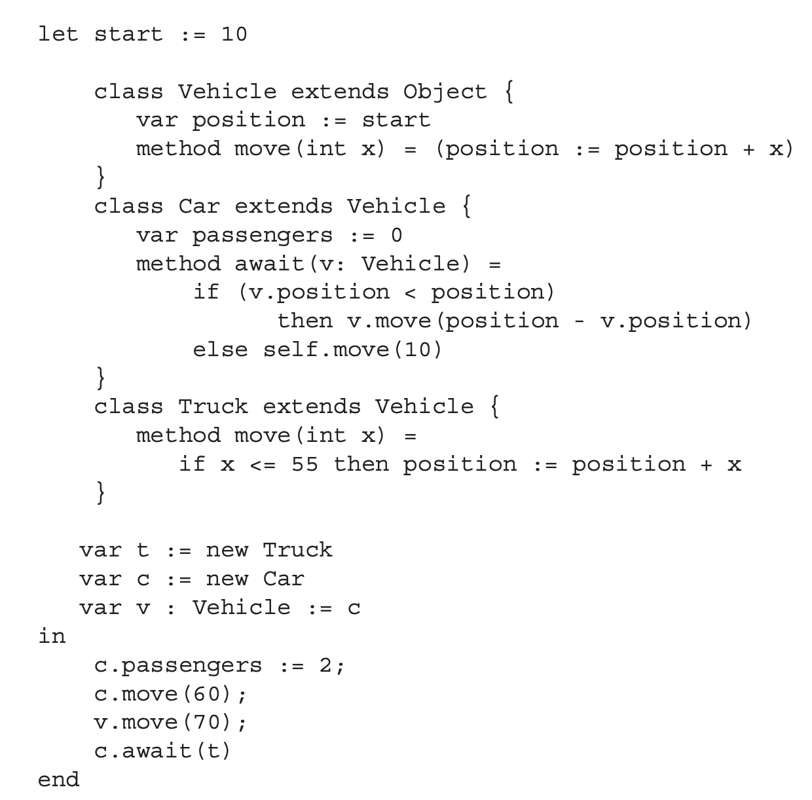
An OBJECT-Tiger example
wrapped in let

Slide 52
An OBJECT-Tiger example
predefined class
class definition

Slide 53
An OBJECT-Tiger example
field definition (same as vardef)

Slide 54
An OBJECT-Tiger example
method definition (similar to funcdef)

Slide 55
An OBJECT-Tiger example
self (similar to this)

Slide 56
An OBJECT-Tiger example
object creation

Slide 57
An OBJECT-Tiger example
field update

Slide 58
An OBJECT-Tiger example
method invocation

Slide 59
Syntax rules
Adding descriptions
Adding expressions
dec → classdec
classdec → class
class-id extends class-id { {classfield } }
classfield → vardec
classfield → method
method → method id(tyfields) = exp
method → method id(tyfields) : type-id = exp
exp → new class-id
exp → lvalue . id()
exp → lvalue . id(exp{, exp})

Slide 60
What about self?
Self is not a keyword in OBJECT-Tiger
It is an implicit parameter for each method
Automatically bound to the object during runtime
Class Car extends Vehicle {
…
method await(/*self: Car,*/ v: Vehicle) {
if (v.position < position)
then v.move(position – v.position)
else self.move(10)
}
}
var c := new Car
c.move(60); -> move(c, 60);

Slide 61
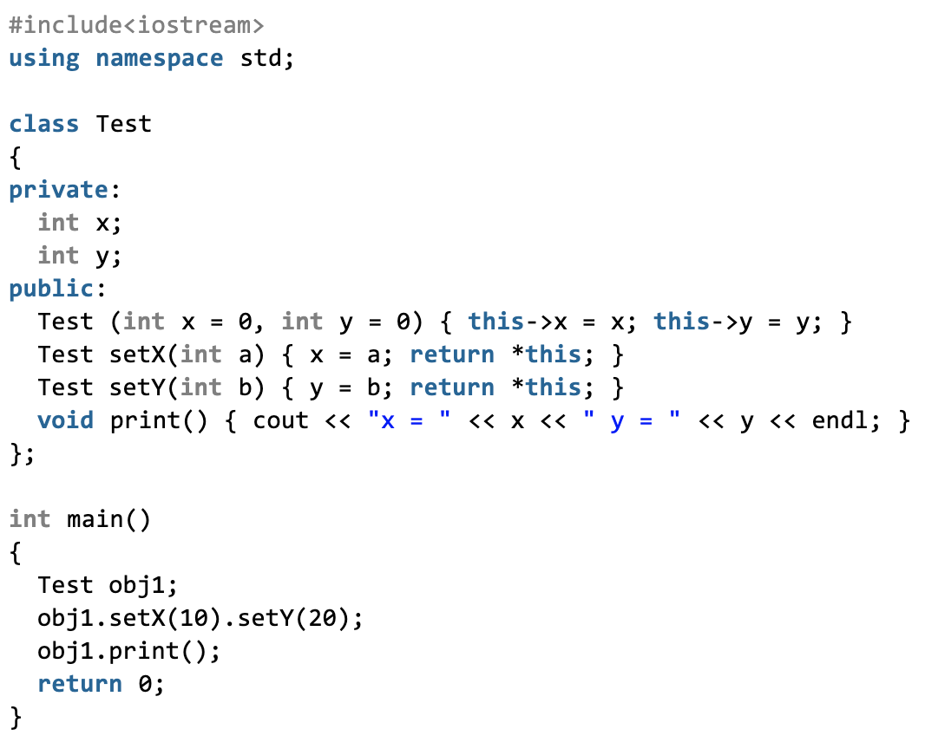
Self in other OO languages
C++/Java: this keyword as a hidden argument
But this is a pointer in C++, a reference in Java
chained calls
Source: https://www.geeksforgeeks.org/this-pointer-in-c/

Slide 62
Self in other OO languages
C++/Java: this keyword as a hidden argument
But this is a pointer in C++, a reference in Java
Python: The first parameter is forced to be self
But the name is not necessarily self
OK!
def __init__(self) -> def __init__(anyname)

Slide 63
SINGLE INHERITANCE

Slide 64
What is single inheritance?
Each class can have at most one parent class
OBJECT-Tiger is a single-inheritance language
Other languages include: Java, Swift, C#, Ruby
class Vehicle extends Object
Class Car extends Vehicle
Class Truck extends Vehicle
…

Slide 65
Field inheritance
Fields are inherited from the parent class
How to co-locate them with newly-defined fields?
Simple for single-inheritance: prefixing
Recap: object layout in memory
fields
A
class descriptor
ClassInfo A
Fields: …
Methods: …

Slide 66
Field inheritance
Fields are inherited from the parent class
How to co-locate them with newly-defined fields?
Simple for single-inheritance: prefixing
Recap: object layout in memory
Inherited fields are put at the beginning, in the same order
A
grandparent
parent
child

Slide 67
An example in OBJECT-Tiger
code
type hierarchy
class A extends Object {
var a := 0
}
class B extends A {
var b := 0
var c := 0
}
class C extends A {
var d := 0
}
class D extends B {
var e := 0
}
Object
a
A
b
B
C
d
c
D
e

Slide 68
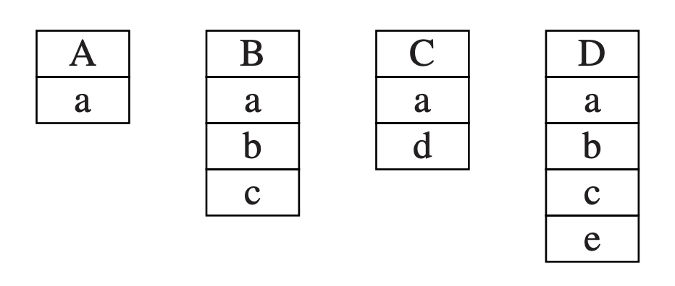
An example in OBJECT-Tiger
type hierarchy
object layout
Object
a
A
b
B
C
d
c
D
e
Fields are ordered by following the path!

Slide 69
Method inheritance
Methods are similar to fields
Except overriding

Slide 70
Method inheritance
Methods are similar to fields
Except overriding
Methods declared in different classes should be differentiated
In our class, we use “classname_methodname”
E.g. Truck_move/Vehicle_move

Slide 71
Dynamic (Overridden) methods
We do not know which method should be called before the function is running
For example, the type depends on user input
Solution: looking up the class descriptor, finding the corresponding method
var v := if input() new Truck else new Car
v.move(60)
—— which move?

Slide 72
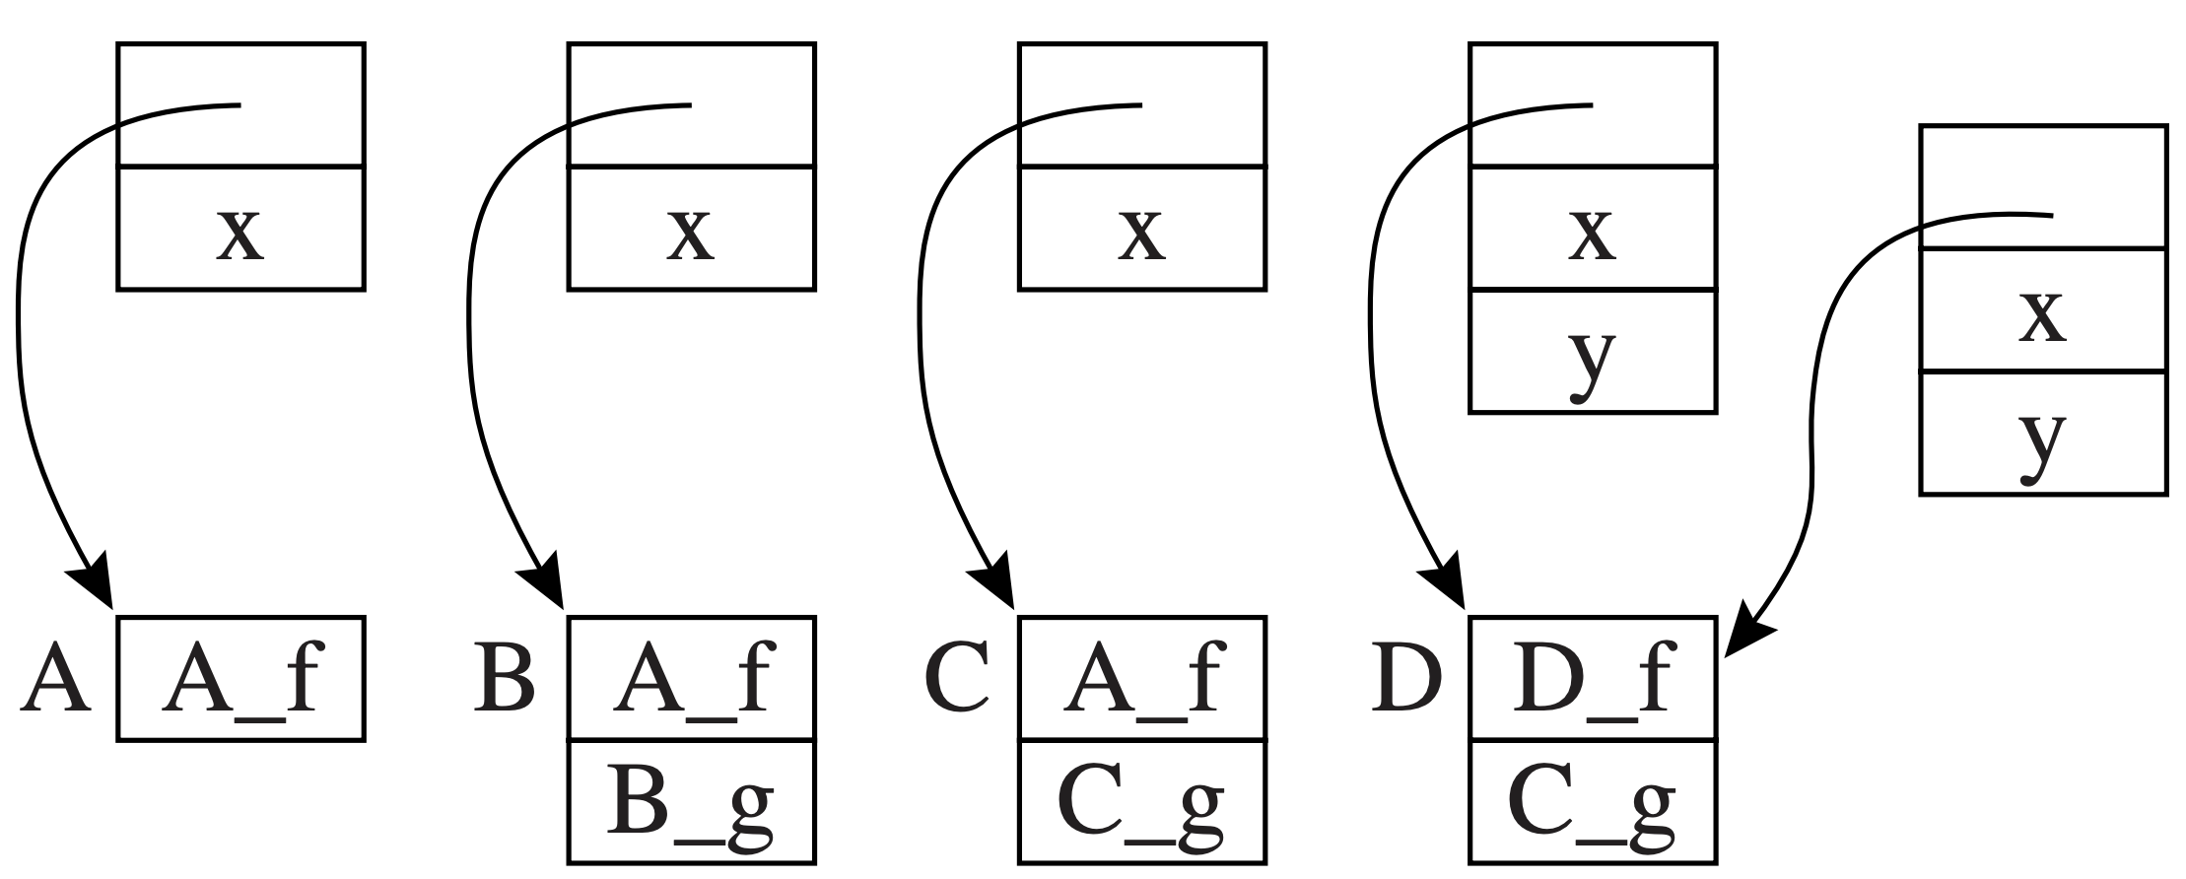
An example for class descriptors
code
object & class descriptors
class A extends Object {
var x := 0
method f() {…}
}
class B extends A {
method g() {…}
}
class C extends B {
method g() {…}
}
Class D extends C {
var y := 0
method f() {…}
}
override
override
stores real targets (pointers to code)

Slide 73
Instructions in dynamic method lookup
Suppose object c is in Type c, then c.f() should
Fetch the class descriptor at offset 0 from c
Fetch the method pointer p for f from the descriptor
Call p
object c

Slide 74
Discussion: overhead of dynamic method lookup
Is table lookup very costly?
Not really! Overridden methods are at the same offset
The memory access pattern is fixed: M[M[obj+0]+16] for f() with any types
The overall overhead: 2 more memory accesses
object c

Slide 75
MULTIPLE INHERITANCE

Slide 76
Multiple inheritance is also common
Many languages allow classes to inherit from multiple parents
Including C++, Perl, Python, Scala
Multiple inheritance causes conflicts for object/class layout
E.g. class A extends B, C
We cannot put both of them at the beginning

Slide 77
Solution: global graph coloring
Modeling the type relationship as a graph
Node: distinct field names
Edge: fields coexisting in the same class
code
graph
class A extends Object { var a := 0 }
class B extends Object { var b := 0
var c := 0 }
class C extends A { var d := 0 }
Class D extends A,B,C { var e := 0 }
e
a
d
b
c

Slide 78
Solution: global graph coloring
Modeling the type relationship as a graph
Node: distinct field names
Edge: fields coexisting in the same class
code
graph
class A extends Object { var a := 0 }
class B extends Object { var b := 0
var c := 0 }
class C extends A { var d := 0 }
Class D extends A,B,C { var e := 0 }
e
a
d
b
c
Consider class B (b, c)

Slide 79
Solution: global graph coloring
Modeling the type relationship as a graph
Node: distinct field names
Edge: fields coexisting in the same class
code
graph
class A extends Object { var a := 0 }
class B extends Object { var b := 0
var c := 0 }
class C extends A { var d := 0 }
Class D extends A,B,C { var e := 0 }
e
a
d
b
c
Consider class C (a, d)

Slide 80
Solution: global graph coloring
Modeling the type relationship as a graph
Node: distinct field names
Edge: fields coexisting in the same class
code
graph
class A extends Object { var a := 0 }
class B extends Object { var b := 0
var c := 0 }
class C extends A { var d := 0 }
Class D extends A,B,C { var e := 0 }
e
a
d
b
c
Consider class D (a, b, c, d, e)

Slide 81
Solution: global graph coloring
Modeling the type relationship as a graph
Node: distinct field names
Edge: fields coexisting in the same class
code
graph
5
e
class A extends Object { var a := 0 }
class B extends Object { var b := 0
var c := 0 }
class C extends A { var d := 0 }
Class D extends A,B,C { var e := 0 }
2
1
4
a
d
b
c
coloring (with offset)
3

Slide 82
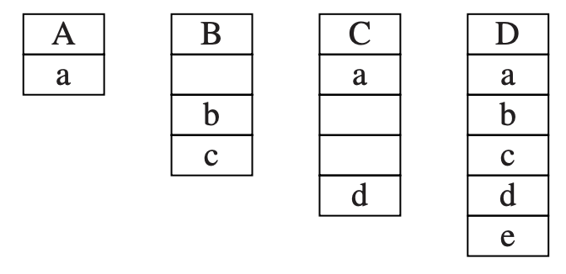
Solution: global graph coloring
Modeling the type relationship as a graph
Node: distinct field names
Edge: fields coexisting in the same class
graph
object layout
5
e
2
1
4
a
d
b
c
3
Problem: wasted empty slots!

Slide 83
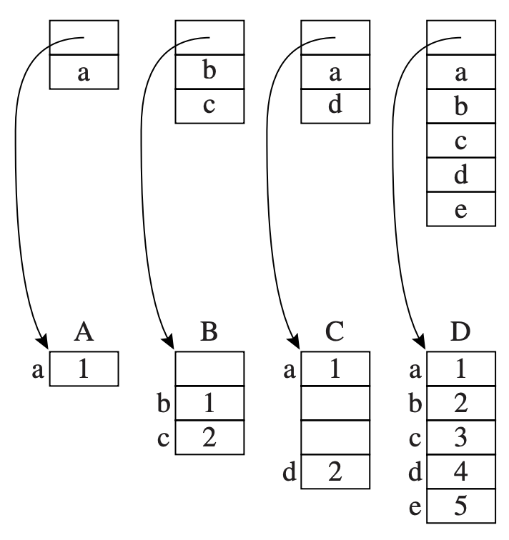
Advanced solution: coloring on classes
Real colors (offsets) are presented in class descriptors
Fields are compacted in objects

Slide 84
Advanced solution: coloring on classes
Why preferring class descriptors for coloring?
The number of types << the number of objects
Problem: the offset for each field is not fixed
E.g., the offset for b is 0 in B, 1 in D
Dynamic lookup is required for field access

Slide 85
Field access for multiple inheritance
A data fetch needs three steps:
Fetch the descriptor from offset 0
Fetch the field-offset value from the descriptor
Fetch the data at the offset

Slide 86
What about methods?
Still using the global coloring strategy
Method names can be mixed with field names in the same graph
Field entries -> offset
Method entries -> code address for method
The cost for dynamic lookup is similar
Single inheritance also requires a lookup

Slide 87
New problems with dynamic linking
Global graph coloring assumes classes are statically linked together
A special-purpose linker can help achieve that
However: many OO systems can load classes during runtime
E.g., Java‘s dynamic class loader
loading

Slide 88
Solution: Hashing
Building a hash table for each class descriptor
Ftab: containing field offsets and method code address
Ktab: containing field/method names
The table is agnostic to multiple inheritance
Fields do not need to have fixed offsets
Ktab
Ftab
a
1
e
5
H
c
3
d
4
b
2

Slide 89
Solution: Hashing
Steps to fetch a field (say field b)
Fetch the class descriptor at offset 0
Fetch the field name from offset Ktab + hash_{b}
Compare field name with the input name (EQUAL!)
Ktab
Ftab
b
a
1
e
5
class descriptor
H
c
3
d
4
b
2

Slide 90
Solution: Hashing
Steps to fetch a field (say field b)
Fetch the class descriptor at offset 0
Fetch the field name from offset Ktab + hash_{b}
Compare field name with the input name (EQUAL!)
Fetch the field offset from Ftab + hash_{b} (2)
Fetch the field from object + 2
Ktab
Ftab
b
a
1
e
5
class descriptor
H
c
3
d
4
b
2

Slide 91
Overhead analysis
Four more instructions (seems tolerable)
However, it is much more costly than coloring
Hashing: usually requires several binops
String equality check: O(N)
Hash entries can collide (leading to more accesses)
Perhaps a reason why Java does not have MI

