Slide 1
Object-oriented Languages

Slide 2
Object-oriented languages are common
Well-known languages include: C++, Java, Python, JavaScript, Swift……
You must have used them!
Designed to support information hiding
The internal (private) states are hidden
Users can only ‘peek’ them through methods
Ease of extension with inheritance

Slide 3
OBJECT-TIGER

Slide 4
What if Tiger becomes object-oriented?
Aka. OBJECT-Tiger
Which keywords/syntax rules should be added?
Class? (class A extends B)
Fields? (private/public)
Method? (A::abc())
……

Slide 5
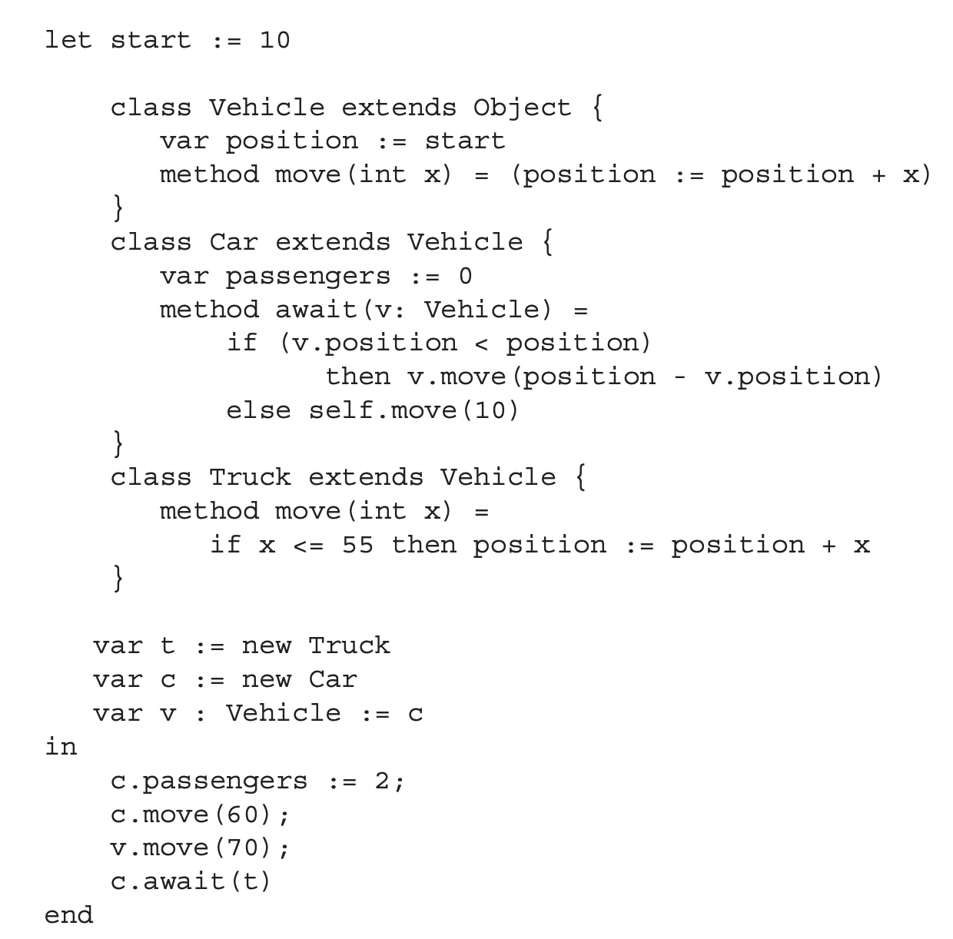
An OBJECT-Tiger example
wrapped in let
在tiger中，object是一个预先定义好的父类，是一个顶层的类。
tiger还要支持一些是每一个类的子类的类。比如exception。

Slide 6
An OBJECT-Tiger example
predefined class
class definition

Slide 7
An OBJECT-Tiger example
field definition (same as vardef)

Slide 8
An OBJECT-Tiger example
method definition (similar to funcdef)

Slide 9
An OBJECT-Tiger example
self (similar to this)

Slide 10
An OBJECT-Tiger example
object creation

Slide 11
An OBJECT-Tiger example
field update

Slide 12
An OBJECT-Tiger example
method invocation

Slide 13
Syntax rules
Adding descriptions
Adding expressions
dec → classdec
classdec → class
class-id extends class-id { {classfield } }
classfield → vardec
classfield → method
method → method id(tyfields) = exp
method → method id(tyfields) : type-id = exp
exp → new class-id
exp → lvalue . id()
exp → lvalue . id(exp{, exp})

Slide 14
What about self?
Self is not a keyword in OBJECT-Tiger
It is an implicit parameter for each method(类似于static-link)
Automatically bound to the object during runtime
Class Car extends Vehicle {
…
method await(/*self: Car,*/ v: Vehicle) {
if (v.position < position)
then v.move(position – v.position)
else self.move(10)
}
}
var c := new Car
c.move(60); -> move(c, 60);

Slide 15
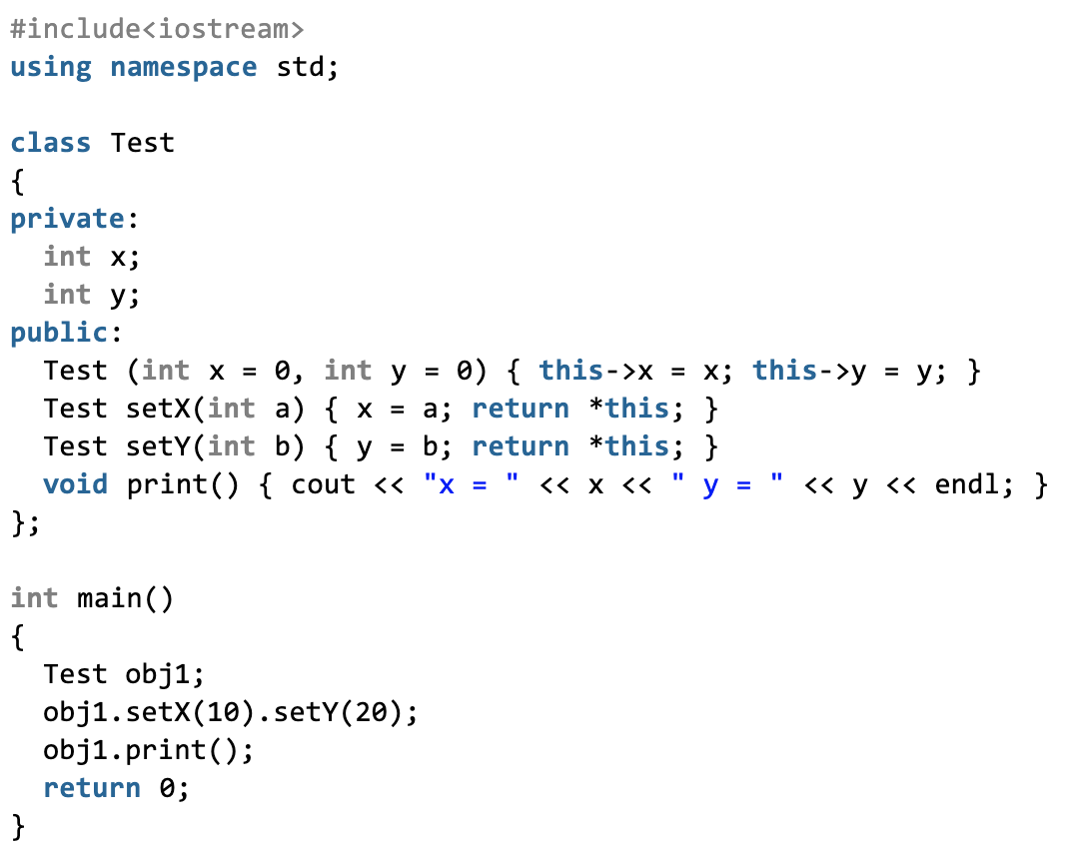
Self in other OO languages
C++/Java: this keyword as a hidden argument
But this is a pointer in C++, a reference in Java
chained calls
Source: https://www.geeksforgeeks.org/this-pointer-in-c/

Slide 16
Self in other OO languages
C++/Java: this keyword as a hidden argument
But this is a pointer in C++, a reference in Java
Python: The first parameter is forced to be self
But the name is not necessarily self
OK!
def __init__(self) -> def __init__(anyname)

Slide 17
SINGLE INHERITANCE
(单继承)

Slide 18
What is single inheritance?
Each class can have at most one parent class
OBJECT-Tiger is a single-inheritance language
Other languages include: Java, Swift, C#, Ruby
class Vehicle extends Object
Class Car extends Vehicle
Class Truck extends Vehicle
…

Slide 19
Field inheritance
Fields are inherited from the parent class
How to co-locate them with newly-defined fields?
Simple for single-inheritance: prefixing
Recap: object layout in memory
fields
A
class descriptor
ClassInfo A
Fields: …
Methods: …

Slide 20
Field inheritance
Fields are inherited from the parent class
How to co-locate them with newly-defined fields?
Simple for single-inheritance: prefixing
Recap: object layout in memory
Inherited fields are put at the beginning, in the same order
A
grandparent
parent
child

Slide 21
An example in OBJECT-Tiger
code
type hierarchy
class A extends Object {
var a := 0
}
class B extends A {
var b := 0
var c := 0
}
class C extends A {
var d := 0
}
class D extends B {
var e := 0
}
Object
a
A
b
B
C
d
c
D
e

Slide 22
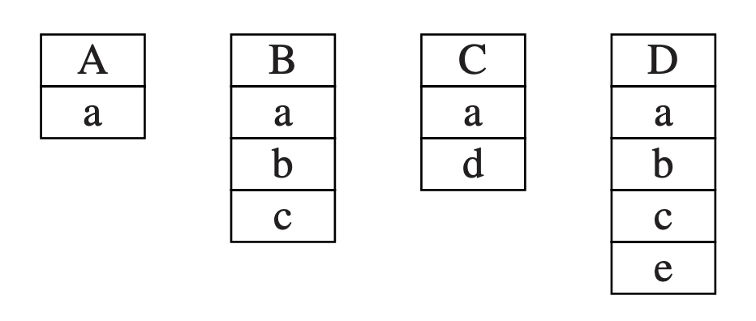
An example in OBJECT-Tiger
type hierarchy
object layout
layout中的descriptor应该实现成一个指针
Object
a
A
b
B
C
d
c
D
e
Fields are ordered by following the path!

Slide 23
Method inheritance
Methods are similar to fields
Except overriding

Slide 24
Method inheritance
Methods are similar to fields
Except overriding
Methods declared in different classes should be differentiated
In our class, we use “classname_methodname”
E.g. Truck_move/Vehicle_move

Slide 25
Dynamic (Overridden) methods
We do not know which method should be called before the function is running
For example, the type depends on user input
Solution: looking up the class descriptor, finding the corresponding method
var v := if input() new Truck else new Car
v.move(60)
—— which move?

Slide 26
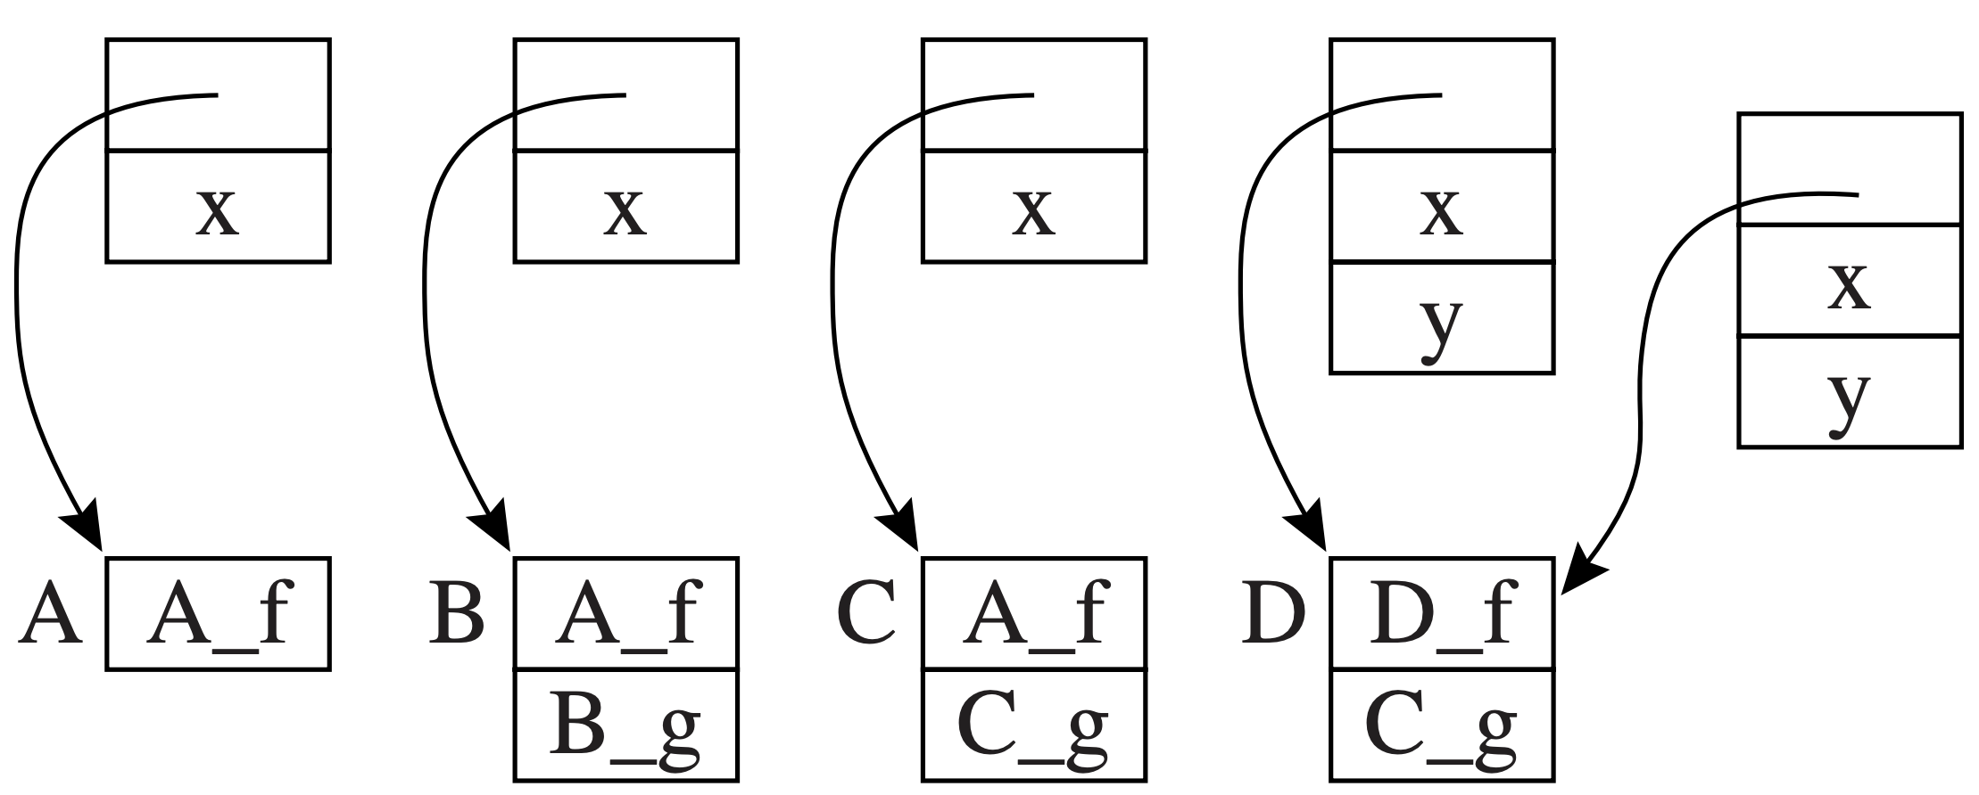
An example for class descriptors
code
object & class descriptors
class A extends Object {
var x := 0
method f() {…}
}
class B extends A {
method g() {…}
}
class C extends B {
method g() {…}
}
Class D extends C {
var y := 0
method f() {…}
}
override
override
stores real targets (pointers to code)

Slide 27
Instructions in dynamic method lookup
Suppose object c is in Type c, then c.f() should
Fetch the class descriptor at offset 0 from c
Fetch the method pointer p for f from the descriptor
Call p
object c

Slide 28
Discussion: overhead of dynamic method lookup
Is table lookup very costly?
Not really! Overridden methods are at the same offset
The memory access pattern is fixed: M[M[obj+0]+16] for f() with any types
The overall overhead: 2 more memory accesses
object c

Slide 29
MULTIPLE INHERITANCE
(多继承)

Slide 30
Multiple inheritance is also common
Many languages allow classes to inherit from multiple parents
Including C++, Perl, Python, Scala
Multiple inheritance causes conflicts for object/class layout
E.g. class A extends B, C
We cannot put both of them at the beginning

Slide 31
Solution: global graph coloring
Modeling the type relationship as a graph
Node: distinct field names
Edge: fields coexisting in the same class
code
graph
class A extends Object { var a := 0 }
class B extends Object { var b := 0
var c := 0 }
class C extends A { var d := 0 }
Class D extends A,B,C { var e := 0 }
e
a
d
b
c

Slide 32
Solution: global graph coloring
Modeling the type relationship as a graph
Node: distinct field names
Edge: fields coexisting in the same class
code
graph
class A extends Object { var a := 0 }
class B extends Object { var b := 0
var c := 0 }
class C extends A { var d := 0 }
Class D extends A,B,C { var e := 0 }
e
a
d
b
c
Consider class B (b, c)

Slide 33
Solution: global graph coloring
Modeling the type relationship as a graph
Node: distinct field names
Edge: fields coexisting in the same class
code
graph
class A extends Object { var a := 0 }
class B extends Object { var b := 0
var c := 0 }
class C extends A { var d := 0 }
Class D extends A,B,C { var e := 0 }
e
a
d
b
c
Consider class C (a, d)

Slide 34
Solution: global graph coloring
Modeling the type relationship as a graph
Node: distinct field names
Edge: fields coexisting in the same class
code
graph
class A extends Object { var a := 0 }
class B extends Object { var b := 0
var c := 0 }
class C extends A { var d := 0 }
Class D extends A,B,C { var e := 0 }
e
a
d
b
c
Consider class D (a, b, c, d, e)

Slide 35
Solution: global graph coloring
Modeling the type relationship as a graph
Node: distinct field names
Edge: fields coexisting in the same class
code
graph
5
e
class A extends Object { var a := 0 }
class B extends Object { var b := 0
var c := 0 }
class C extends A { var d := 0 }
Class D extends A,B,C { var e := 0 }
2
1
4
a
d
b
c
coloring (with offset)
3

Slide 36
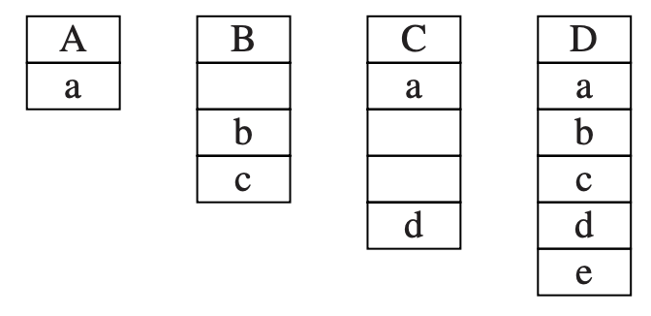
Solution: global graph coloring
Modeling the type relationship as a graph
Node: distinct field names
Edge: fields coexisting in the same class
第一种处理：直接在descriptor中通过染色编号确定
offset，但是会引入大量的empty slot。
graph
object layout
5
e
2
1
4
a
d
b
c
3
Problem: wasted empty slots!

Slide 37
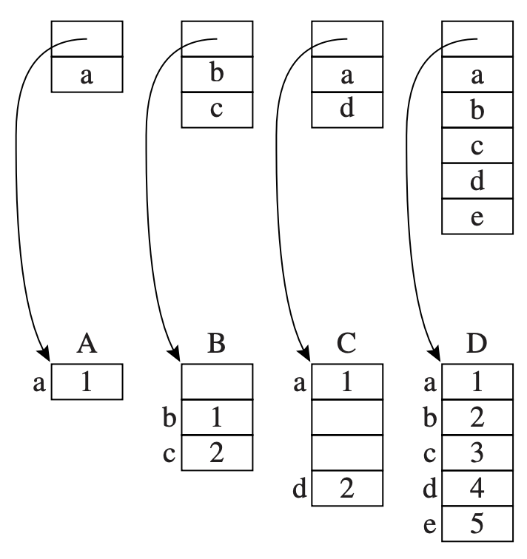
Advanced solution: coloring on classes
Real colors (offsets) are presented in class descriptors
Fields are compacted in objects

Slide 38
Advanced solution: coloring on classes
Why preferring class descriptors for coloring?
The number of types << the number of objects
Problem: the offset for each field is not fixed(压缩之后)
E.g., the offset for b is 0 in B, 1 in D
Dynamic lookup is required for field access

Slide 39
Field access for multiple inheritance
A data fetch needs three steps:
Fetch the descriptor from offset 0
Fetch the field-offset value from the descriptor
Fetch the data at the offset

Slide 40
What about methods?
Still using the global coloring strategy
Method names can be mixed with field names in the same graph
Field entries -> offset
Method entries -> code address for method
The cost for dynamic lookup is similar
Single inheritance also requires a lookup

Slide 41
New problems with dynamic linking
Global graph coloring assumes classes are statically linked together
A special-purpose linker can help achieve that
However: many OO systems can load classes during runtime
E.g., Java‘s dynamic class loader
loading

Slide 42
Solution: Hashing
Building a hash table for each class descriptor
Ftab: containing field offsets and method code address
Ktab: containing field/method names
The table is agnostic to multiple inheritance
Fields do not need to have fixed offsets
Ktab
Ftab
a
1
e
5
H
c
3
d
4
b
2

Slide 43
Solution: Hashing
Steps to fetch a field (say field b)
Fetch the class descriptor at offset 0
Fetch the field name from offset Ktab + hash_{b}
Compare field name with the input name (EQUAL!)
Ktab
Ftab
b
a
1
e
5
class descriptor
H
c
3
d
4
b
2

Slide 44
Solution: Hashing
Steps to fetch a field (say field b)
Fetch the class descriptor at offset 0
Fetch the field name from offset Ktab + hash_{b}
Compare field name with the input name (EQUAL!)
Fetch the field offset from Ftab + hash_{b} (2)
Fetch the field from object + 2
Ktab
Ftab
b
a
1
e
5
class descriptor
H
c
3
d
4
b
2

Slide 45
Overhead analysis
Four more instructions (seems tolerable)
However, it is much more costly than coloring
Hashing: usually requires several binops
String equality check: O(N)
Hash entries can collide (leading to more accesses)
Perhaps a reason why Java does not have MI(多继承)

Slide 46
Another disadvantages of MI
Can cause ambiguity with multiple super classes
Also known as a “diamond problem”
Both B and C overrides f
Now which f is used by D?
A
method f
@override
method f
@override
method f
B
C
f() which?
D

Slide 47
Another disadvantages of MI
Can cause ambiguity with multiple super classes
Also known as a “diamond problem”
Interface avoids this problem
B and C (interfaces) cannot override f
A
interface f
B
C
interface f
D
f() must implement!

Slide 48
But what does Java have? Interface
An interface is an abstract class with no concrete components
Usually only contains a collection of methods
“Specify what a class can do but not how”
Fields must be public, static, and final
So it can only become a constant
Multiple inheritance can also be implemented with interfaces (implements A,B)
But with more restrictions

Slide 49
MEMBERSHIP TESTING

Slide 50
Recap: which type cast is safe?
Casting to a super type is always safe (upcast)
Fields/methods in the super class can be accessed by the sub-class
Casting to a sub-type is not (downcast)
Child class may define new methods/fields not present in the super class
How to allow upcast while avoid incorrect downcast?

Slide 51
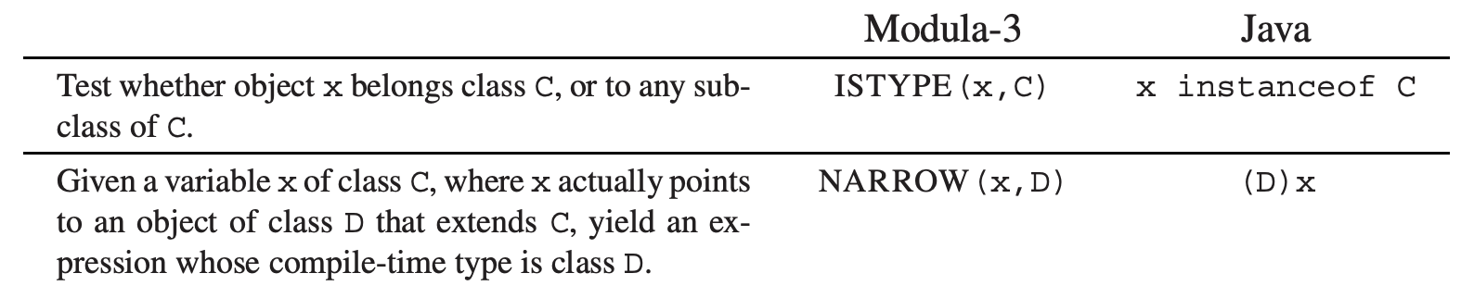
Type testing and casting
A normal type testing and casting would be:
OO languages have supported this feature
if (a.isClass(A)) {
A b = (A)a;
b.somemethod();
}

Slide 52
How to implement instanceof?
A simple way is to perform the following loop:
Recursively compare types with the input type (C)
The recursive comparison takes time
Can we have a faster approach?
t1 <- x.descriptor
L1: if t1 = C goto true
t1 <- t1.super
if t1 = nil goto false
goto L1

Slide 53
Solution: displays of parent classes
Each class descriptor stores such a display
E.g., class D extends A extends B extends Object
The display should look like below:
0
Object
1
B
2
A
3
D
…

Slide 54
Solution: displays of parent classes
Each class descriptor stores such a display
E.g., class D extends A extends B extends Object
To implement x instanceof D:
Fetch the class descriptor at offset 0
Fetch the 3rd class-pointer slot
Compare with D
Why is it true?
0
Object
1
B
2
A
3
D
…

Slide 55
An alternative solution: typecase
instanceof testing is not that ‘object-oriented’
Programmers are expected to use dynamic methods
The dynamic lookup can directly reach the correct method
Modula-3 has typecase – more beautiful and efficient
TYPECASE expr
OF C1 (v1) => S1
| C2 (v2) => S2
| Cn (vn) => Sn
ELSE S0
END
…

Slide 56
Implementation of typecase
Typecase looks similar to traditional switch operations
Only the matched statement would be implemented
However: switch only supports integer values
That is why switch can be implemented with jump tables
TYPECASE expr
OF C1 (v1) => S1
| C2 (v2) => S2
| Cn (vn) => Sn
ELSE S0
END
switch (i) {
case 0: s0; break;
case 1: s1; break;
case 2: s2; break;
case 3: s3; break;
default: sd;
}
…
VS.

Slide 57
Implementation of typecase
Is it possible to implement Typecase with jump tables? (NO)
Modules are separately compiled, with conflicting integers
Even integers can be assigned, we may miss clauses with super classes
TYPECASE expr
OF C1 (v1) => S1
| C2 (v2) => S2
| Cn (vn) => Sn
ELSE S0
END
switch (i) {
case 0: s0; break;
case 1: s1; break;
case 2: s2; break;
case 3: s3; break;
default: sn;
}
…

Slide 58
Implementation of typecase
In Modula-3, typecase are a chain of else-ifs
A clever system may optimize it with jumps if:
All classes are final classes (cannot be extended)
Java has final keyword (but no typecase)
if (expr instanceof C1) {
S1(v1)
} else if (expr instanceof C2) {
S2(v2)
} else if (expr instanceof Cn) {
Sn(vn)
}
…
TYPECASE expr
OF C1 (v1) => S1
| C2 (v2) => S2
| Cn (vn) => Sn
ELSE S0
END
…

Slide 59
Features in modern OO languages: case class
Scala uses case class for pattern matching
Objects in case classes are not initialized with new
Pattern matching can directly use both classes and fields
More powerful than traditional switch operations
case class Student (ID: String)
val Mingyu = Student(“5150379000”)
person match {
case Student(id) => id
}

Slide 60
What about C++?
C++ has different kinds of type cast instructions
Static cast: casting without runtime check
You usually knows the original type of the object
Unsafe
void meth(void *data){
A *a = static_cast<A*>(data);
}

Slide 61
What about C++?
C++ has different kinds of type cast instructions
Static cast: casting without runtime check
Unsafe
Dynamic cast: casting with runtime checks
Similar to membership testing in Java
A* a = new A();
B* b = dynamic_cast<B*>(a); //OK

Slide 62
What about C++?
C++ has different kinds of type cast instructions
Static cast: casting without runtime check
Unsafe
Dynamic cast: casting with runtime checks
Similar to membership testing in Java
If casting fails, return null
A* a = new A();
C* b = dynamic_cast<C*>(a);
// b is null

Slide 63
What about C++?
C++ has different kinds of type cast instructions
Static cast: casting without runtime check
Unsafe
Dynamic cast: casting with runtime checks
Reinterpret cast: forced conversion
Compilers keep silence on your (possibly evil) conversion
Const cast: add/remove the const modifier
Used when the compiler complains on related issues
Regular cast (C-style cast)
Using casting methods above until one succeeds

Slide 64
MISCELLANEOUS

Slide 65
Private fields and methods
The private keyword can be used for information hiding
Private fields/methods cannot be accessed outside the object
Privacy is enforced by type-checking
Encountering c.x/c.f() -> check if x/f is private

Slide 66
Private fields and methods
Different languages have different protection rules for private fields/methods
Accessible only to the class that declares them
Accessible to the declaring class and any subclasses (protected in C++)
Accessible only within the same module as the declaring class (package, namespace)
Read-only outside the declaring class, but writable by methods of the class

Slide 67
Classless languages
Some OO languages do not use class at all
Each object has whatever methods/fields it wants
Type checking is usually dynamic (done at runtime)
A typical classless language is JavaScript
var myObj = {
method0() {
return 0;
}
}
define methods in an object

Slide 68
Object creation in classless languages
Many objects are created by cloning
Copying from an existing object and then modifying/extending it
Copied objects share the same descriptor with the original (template) object → “pseudo-classes”
JavaScript can create objects with constructor functions

Slide 69
A JavaScript example for object creation
First, defining an object constructor
Similar to the constructor in a class
Then creating objects with the new keyword
Not that different with class-based, right?
function Person(name, id) {
this.name = name;
this.id = id;
}
referred to new object
var me = new Person(“Mingyu”, 5150379000);

Slide 70
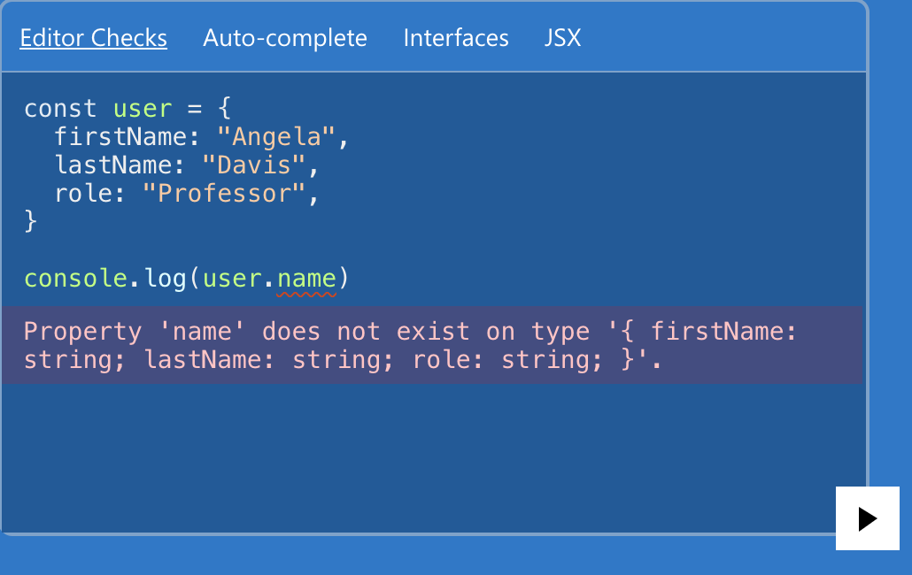
TypeScript: JavaScript + Types
Dynamic check disables opportunities to find bugs during compilation (static)
A bug might be exposed when being deployed…
TypeScript enforces static checks for JS

Slide 71
Compilation issues with classless languages
The techniques are similar to those for class-based languages with MI and dynamic linking
Each pseudo-class descriptor has a hash table
Global program analysis and optimizations are still useful

Slide 72
De-virtualizing dynamic method calls
A very important optimization for OO programs
Why is it important?
Method lookup is costly
Even SI is costly as it hinders sw/hw optimizations
MI/classless is even more complicated

Slide 73
How to de-virtualize?
A global program analysis is required
The type hierarchy for each call site should be analyzed
Rule 1: A method can be de-virtualized with no overridden alternatives
All call sites should invoke the same method

Slide 74
How to de-virtualize?
Rule 2: A method can be de-virtualized if the caller‘s type can be determined
Combined with other analysis (type propagation)
E.g., although a function f can be overridden, but we can determine that the caller c must be type C
c’s type: C
c <- new C
…
c.f()
must be C_f

Slide 75
How to de-virtualize?
Rule 3: A method can be de-virtualized if the virtual method is copied for sub-classes
class D extends C
method D_f(…) {
…
D_g()
…
}
class C
copy
method f(…) {
…
g()
…
}
class E extends C
method E_f(…) {
…
E_g()
…
}
copy

Slide 76
How to de-virtualize? (more aggressive)
A method can be de-virtualized if the virtual method has only one implementation in all loaded classes
Only loaded classes can be used
De-optimize(负优化，就是把这个函数在改回动态方法) if the invariant is violated
class D extends C
No overridden method on f
class C
method f(…) {…}
class E extends C
@override
method f(…) {…}

