Slide 1
MEMBERSHIP TESTING

Slide 2
Recap: which type cast is safe?
Casting to a super type is always safe (upcast)
Fields/methods in the super class can be accessed by the sub-class
Casting to a sub-type is not (downcast)
Child class may define new methods/fields not present in the super class
How to allow upcast while avoid incorrect downcast?

Slide 3
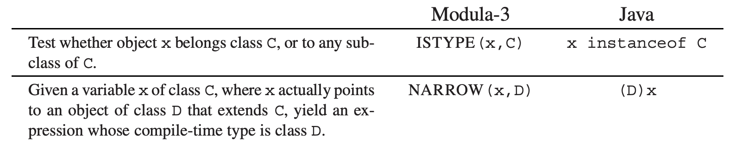
Type testing and casting
A normal type testing and casting would be:
OO languages have supported this feature
if (a.isClass(A)) {
A b = (A)a;
b.somemethod();
}

Slide 4
How to implement instanceof?
A simple way is to perform the following loop:
Recursively compare types with the input type (C)
The recursive comparison takes time
Can we have a faster approach?
t1 <- x.descriptor
L1: if t1 = C goto true
t1 <- t1.super
if t1 = nil goto false
goto L1

Slide 5
Solution: displays of parent classes
Each class descriptor stores such a display
E.g., class D extends A extends B extends Object
The display should look like below:
0
Object
1
B
2
A
3
D
…

Slide 6
Solution: displays of parent classes
Each class descriptor stores such a display
E.g., class D extends A extends B extends Object
To implement x instanceof D:
Fetch the class descriptor at offset 0
Fetch the 3rd class-pointer slot
Compare with D
Why is it true?
0
Object
1
B
2
A
3
D
…

Slide 7
An alternative solution: typecase
instanceof testing is not that ‘object-oriented’
Programmers are expected to use dynamic methods
The dynamic lookup can directly reach the correct method
Modula-3 has typecase – more beautiful and efficient
TYPECASE expr
OF C1 (v1) => S1
| C2 (v2) => S2
| Cn (vn) => Sn
ELSE S0
END
…

Slide 8
Implementation of typecase
Typecase looks similar to traditional switch operations
Only the matched statement would be implemented
However: switch only supports integer values
That is why switch can be implemented with jump tables
TYPECASE expr
OF C1 (v1) => S1
| C2 (v2) => S2
| Cn (vn) => Sn
ELSE S0
END
switch (i) {
case 0: s0; break;
case 1: s1; break;
case 2: s2; break;
case 3: s3; break;
default: sd;
}
…
VS.

Slide 9
Implementation of typecase
Is it possible to implement Typecase with jump tables? (NO)
Modules are separately compiled, with conflicting integers
Even integers can be assigned, we may miss clauses with super classes
TYPECASE expr
OF C1 (v1) => S1
| C2 (v2) => S2
| Cn (vn) => Sn
ELSE S0
END
switch (i) {
case 0: s0; break;
case 1: s1; break;
case 2: s2; break;
case 3: s3; break;
default: sn;
}
…

Slide 10
Implementation of typecase
In Modula-3, typecase are a chain of else-ifs
A clever system may optimize it with jumps if:
All classes are final classes (cannot be extended)
Java has final keyword (but no typecase)
if (expr instanceof C1) {
S1(v1)
} else if (expr instanceof C2) {
S2(v2)
} else if (expr instanceof Cn) {
Sn(vn)
}
…
TYPECASE expr
OF C1 (v1) => S1
| C2 (v2) => S2
| Cn (vn) => Sn
ELSE S0
END
…

Slide 11
Features in modern OO languages: case class
Scala uses case class for pattern matching
Objects in case classes are not initialized with new
Pattern matching can directly use both classes and fields
More powerful than traditional switch operations
case class Student (ID: String)
val Mingyu = Student(“5150379000”)
person match {
case Student(id) => id
}

Slide 12
What about C++?
C++ has different kinds of type cast instructions
Static cast: casting without runtime check
You usually knows the original type of the object
Unsafe
void meth(void *data){
A *a = static_cast<A*>(data);
}

Slide 13
What about C++?
C++ has different kinds of type cast instructions
Static cast: casting without runtime check
Unsafe
Dynamic cast: casting with runtime checks
Similar to membership testing in Java
A* a = new A();
B* b = dynamic_cast<B*>(a); //OK

Slide 14
What about C++?
C++ has different kinds of type cast instructions
Static cast: casting without runtime check
Unsafe
Dynamic cast: casting with runtime checks
Similar to membership testing in Java
If casting fails, return null
A* a = new A();
C* b = dynamic_cast<C*>(a);
// b is null

Slide 15
What about C++?
C++ has different kinds of type cast instructions
Static cast: casting without runtime check
Unsafe
Dynamic cast: casting with runtime checks
Reinterpret cast: forced conversion
Compilers keep silence on your (possibly evil) conversion
Const cast: add/remove the const modifier
Used when the compiler complains on related issues
Regular cast (C-style cast)
Using casting methods above until one succeeds

Slide 16
MISCELLANEOUS

Slide 17
Private fields and methods
The private keyword can be used for information hiding
Private fields/methods cannot be accessed outside the object
Privacy is enforced by type-checking
Encountering c.x/c.f() -> check if x/f is private

Slide 18
Private fields and methods
Different languages have different protection rules for private fields/methods
Accessible only to the class that declares them
Accessible to the declaring class and any subclasses (protected in C++)
Accessible only within the same module as the declaring class (package, namespace)
Read-only outside the declaring class, but writable by methods of the class

Slide 19
Classless languages
Some OO languages do not use class at all
Each object has whatever methods/fields it wants
Type checking is usually dynamic (done at runtime)
A typical classless language is JavaScript
var myObj = {
method0() {
return 0;
}
}
define methods in an object

Slide 20
Object creation in classless languages
Many objects are created by cloning
Copying from an existing object and then modifying/extending it
Copied objects share the same descriptor with the original (template) object → “pseudo-classes”
JavaScript can create objects with constructor functions

Slide 21
A JavaScript example for object creation
First, defining an object constructor
Similar to the constructor in a class
Then creating objects with the new keyword
Not that different with class-based, right?
function Person(name, id) {
this.name = name;
this.id = id;
}
referred to new object
var me = new Person(“Mingyu”, 5150379000);

Slide 22
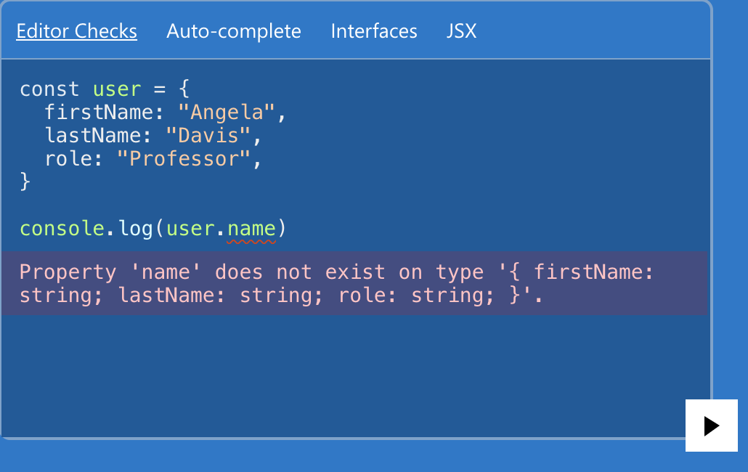
TypeScript: JavaScript + Types
Dynamic check disables opportunities to find bugs during compilation (static)
A bug might be exposed when being deployed…
TypeScript enforces static checks for JS

Slide 23
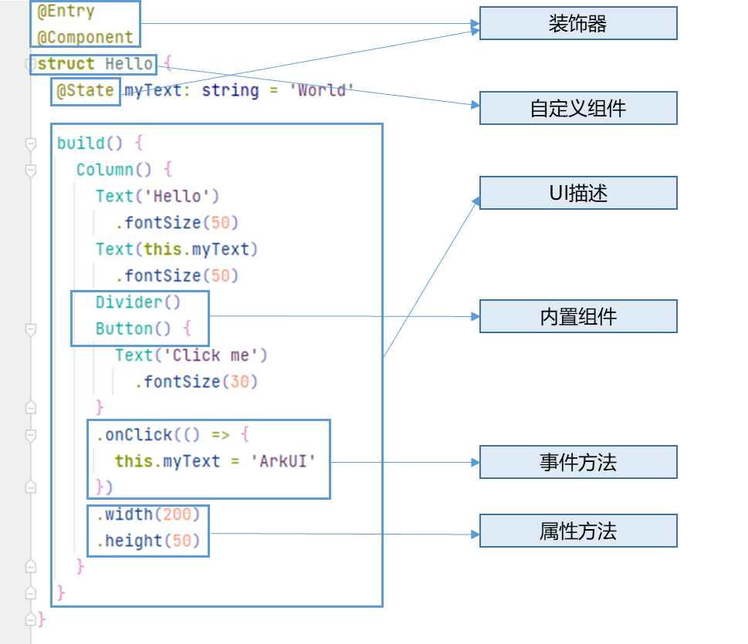
eTS: Extending TypeScript for UI Development
ArkUI recommends eTS for UI description
Using declarations to describe your interfaces

Slide 24
Compilation issues with classless languages
The techniques are similar to those for class-based languages with MI and dynamic linking
Each pseudo-class descriptor has a hash table
Global program analysis and optimizations are still useful

Slide 25
De-virtualizing dynamic method calls
A very important optimization for OO programs
Why is it important?
Method lookup is costly
Even SI is costly as it hinders sw/hw optimizations
MI/classless is even more complicated

Slide 26
How to de-virtualize?
A global program analysis is required
The type hierarchy for each call site should be analyzed
Rule 1: A method can be de-virtualized with no overridden alternatives
All call sites should invoke the same method

Slide 27
How to de-virtualize?
Rule 2: A method can be de-virtualized if the caller‘s type can be determined
Combined with other analysis (type propagation)
E.g., although a function f can be overridden, but we can determine that the caller c must be type C
c’s type: C
c <- new C
…
c.f()
must be C_f

Slide 28
How to de-virtualize?
Rule 3: A method can be de-virtualized if the virtual method is copied for sub-classes
class D extends C
method D_f(…) {
…
D_g()
…
}
class C
copy
method f(…) {
…
g()
…
}
class E extends C
method E_f(…) {
…
E_g()
…
}
copy

Slide 29
How to de-virtualize? (more aggressive)
A method can be de-virtualized if the virtual method has only one implementation in all loaded classes
Only loaded classes can be used
De-optimize if the invariant is violated
class D extends C
No overridden method on f
class C
method f(…) {…}
class E extends C
@override
method f(…) {…}

Slide 30
Loop Optimizations

Slide 31
What is a Loop?
A control flow graph with…
A set of nodes (S)
A header node (h)
And the following properties
From any node in S there is a path of directed edges leading to h
There is a path of directed edges from h to any node in S
There is no edge from any node outside S to any node in S other than h

Slide 32
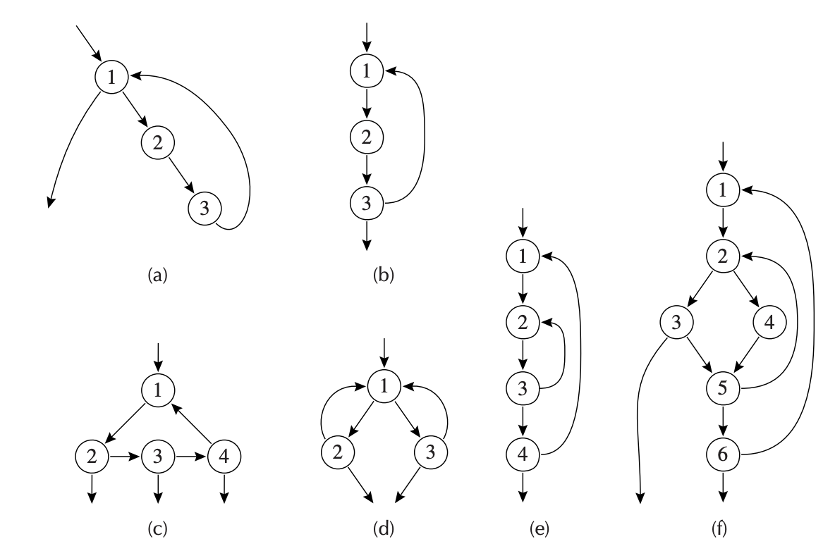
They are All Loops
Node 1 is headers for all
Loop entry: with some predecessor outside the loop
Loop exit: with a successor outside the loop

Slide 33
How to Tell if A Structure is A Loop?
We can reduce them into simpler graphs
The following one is NOT a loop
No node is a header
1
2
3

Slide 34
How to Tell if A Structure is A Loop?
We can reduce them into simpler graphs
Harder to tell for a larger one
1
4
5
6
2
3
7
9
8

Slide 35
How to Tell if A Structure is A Loop?
We can reduce them into simpler graphs
Harder to tell for a larger one
Removing edge (x,y) if x is the only predecessor of y and collapse them together
1
del 6->9, 5->4
merge (7,9), (3,7), (7,8),
(5,6), (1,5), (1,4)
4
5
6
4
2
3
7
9
2
3
8

Slide 36
Naming It: Reducible Flow Graph
Irreducible: containing the following subgraph after ”simplification”
Reducible: does not contain the subgraph
1
4
5
6
4
2
3
7
9
2
3
8

Slide 37
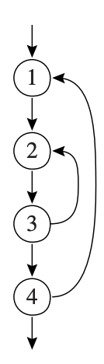
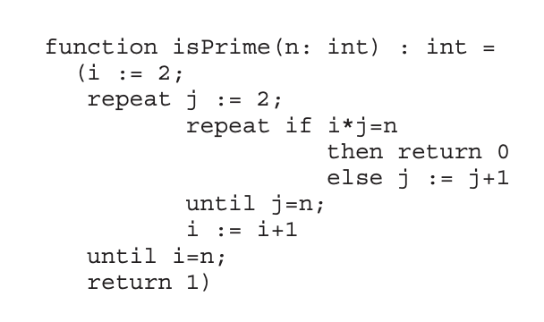
Naming It: Reducible Flow Graph
Common control-flow constructs can only generate reducible flow graphs
If-then, if-then-else, while-do, repeat-until, break…

Slide 38
Naming It: Reducible Flow Graph
Common control-flow constructs can only generate reducible flow graphs
If-then, if-then-else, while-do, repeat-until, break…
Also a kind of “flow graph”
Prior optimizations can be done atop them

Slide 39
Dominators
Before optimizing loops, we should first find them!
So we need the notion dominator
Defining s₀: the entry point
A node d dominates n if all paths from s₀ to n must go through d

Slide 40
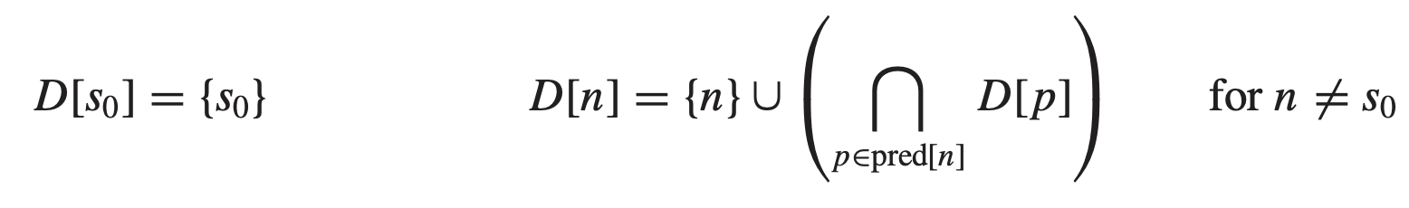
Finding Dominators
Let D[n] be the set of nodes that dominate n, then:
The algorithm iterates until a fixed-point
Needs to dominate all predecessors
Initial state
Every node dominates itself

Slide 41
Immediate Dominators
We have the following theorem:
In a connected graph, suppose d dominates n, and e dominates n, then it must be that:
Either d dominates e or e dominates d
This theorem tells us:
Every node n has no more than one immediate dominator, idom(n), such that
idom(n) is not the same node as n
idom(n) dominates n
idom(n) does not dominate any other dominator of n

Slide 42
Immediate Dominators
We have the following theorem:
In a connected graph, suppose d dominates n, and e dominates n, then it must be that:
Either d dominates e or e dominates d
This theorem tells us:
Every node n has no more than one immediate dominator, idom(n)
Every node except s₀ has exactly one idom

Slide 43
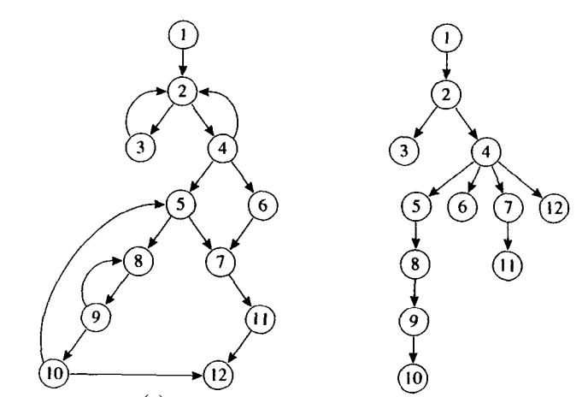
Dominator Trees
For each node n: leave the edge from idom(n) to n
Now we can create a tree from the flow graph
flowgraph
tree

Slide 44
Dominator Trees
For each node n: leave the edge from idom(n) to n
Some edges are in the graph (others are not)
flowgraph
tree

Slide 45
Dominator Trees
Some edges in the graph point from n to idom(n)
We can call them back edges
flowgraph
tree

Slide 46
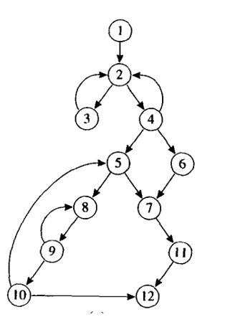
Nature Loops from Back Edges
The nature loop of a back edge n->h
Where h dominates n
Is the set of nodes x such that:
h dominates x and
There is a path from x to n not containing h
For example: for edge 10->5
A nature loop with 4 nodes
5, 8, 9, 10

Slide 47
Loop Optimizations and Nature Loops
Loops are not necessarily nature ones
For example, we can merge loops with headers together
The merged results are no longer nature loops
No worries: Most optimizations still apply

