Slide 1
Loop Optimizations

Slide 2
What is a Loop?
A control flow graph with…
A set of nodes (S)
A header node (h)
And the following properties
From any node in S there is a path of directed edges leading to h
There is a path of directed edges from h to any node in S
There is no edge from any node outside S to any node in S other than h

Slide 3
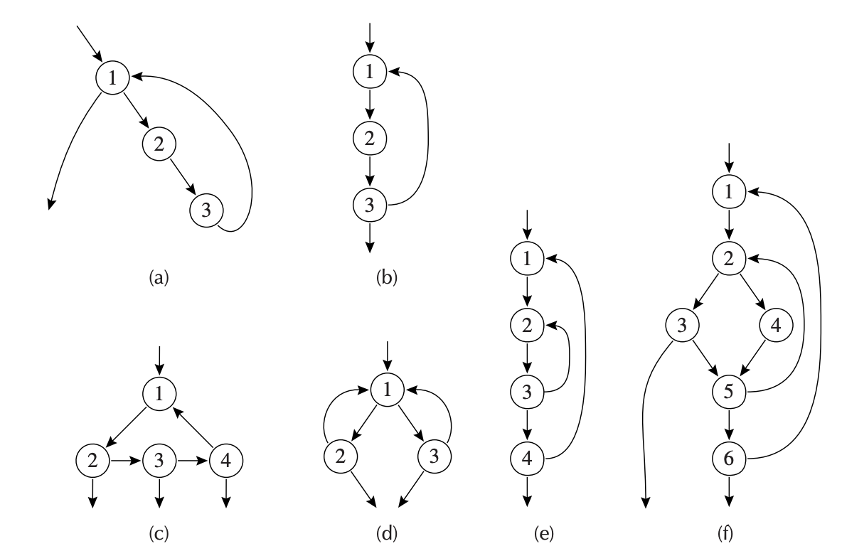
They are All Loops
Node 1 is headers for all
Loop entry: with some predecessor outside the loop
Loop exit: with a successor outside the loop

Slide 4
How to Tell if A Structure is A Loop?
We can reduce them into simpler graphs
The following one is NOT a loop
No node is a header
1
2
3

Slide 5
How to Tell if A Structure is A Loop?
We can reduce them into simpler graphs
Harder to tell for a larger one
1
4
5
6
2
3
7
9
8

Slide 6
How to Tell if A Structure is A Loop?
We can reduce them into simpler graphs
Harder to tell for a larger one
Removing edge (x,y) if x is the only predecessor of y and collapse them together
1
del 6->9, 5->4
merge (7,9), (3,7), (7,8),
(5,6), (1,5), (1,4)
4
5
6
4
2
3
7
9
2
3
8

Slide 7
Naming It: Reducible Flow Graph
Irreducible: containing the following subgraph after ”simplification”
Reducible: does not contain the subgraph
1
4
5
6
4
2
3
7
9
2
3
8

Slide 8
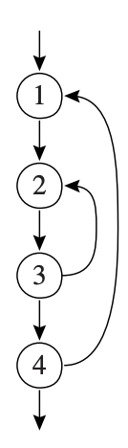
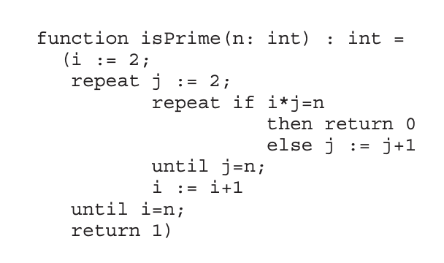
Naming It: Reducible Flow Graph
Common control-flow constructs can only generate reducible flow graphs
If-then, if-then-else, while-do, repeat-until, break…

Slide 9
Naming It: Reducible Flow Graph
Common control-flow constructs can only generate reducible flow graphs
If-then, if-then-else, while-do, repeat-until, break…
Also a kind of “flow graph”
Prior optimizations can be done atop them

Slide 10
Dominators
Before optimizing loops, we should first find them!
So we need the notion dominator
Defining s₀: the entry point
A node d dominates n if all paths from s₀ to n must go through d

Slide 11
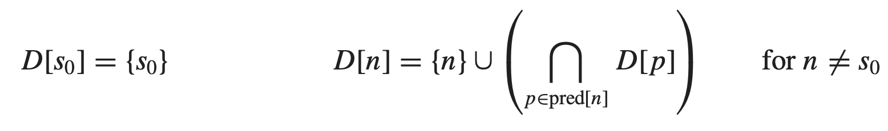
Finding Dominators
Let D[n] be the set of nodes that dominate n, then:
The algorithm iterates until a fixed-point
Needs to dominate all predecessors
Initial state
Every node dominates itself

Slide 12
Immediate Dominators
We have the following theorem:
In a connected graph, suppose d dominates n, and e dominates n, then it must be that:
Either d dominates e or e dominates d
This theorem tells us:
Every node n has no more than one immediate dominator, idom(n), such that
idom(n) is not the same node as n
idom(n) dominates n
idom(n) does not dominate any other dominator of n

Slide 13
Immediate Dominators
We have the following theorem:
In a connected graph, suppose d dominates n, and e dominates n, then it must be that:
Either d dominates e or e dominates d
This theorem tells us:
Every node n has no more than one immediate dominator, idom(n)
Every node except s₀ has exactly one idom

Slide 14
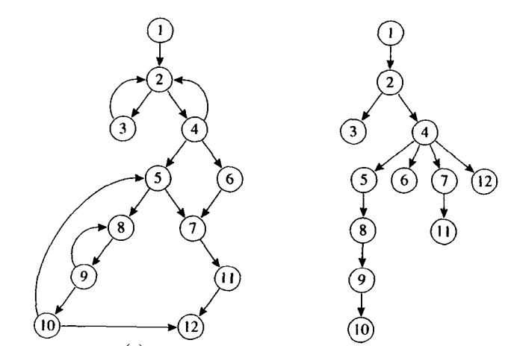
Dominator Trees
For each node n: leave the edge from idom(n) to n
Now we can create a tree from the flow graph
flowgraph
tree

Slide 15
Dominator Trees
For each node n: leave the edge from idom(n) to n
Some edges are in the graph (others are not)
flowgraph
tree

Slide 16
Dominator Trees
Some edges in the graph point from n to idom(n)
We can call them back edges
flowgraph
tree

Slide 17
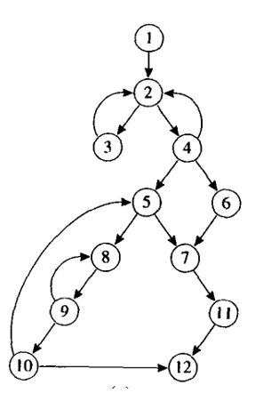
Nature Loops from Back Edges
The nature loop of a back edge n->h
Where h dominates n
Is the set of nodes x such that:
h dominates x and
There is a path from x to n not containing h
For example: for edge 10->5
A nature loop with 4 nodes
5, 8, 9, 10

Slide 18
Loop Optimizations and Nature Loops
Loops are not necessarily nature ones
For example, we can merge loops with headers together
The merged results are no longer nature loops
No worries: Most optimizations still apply

Slide 19
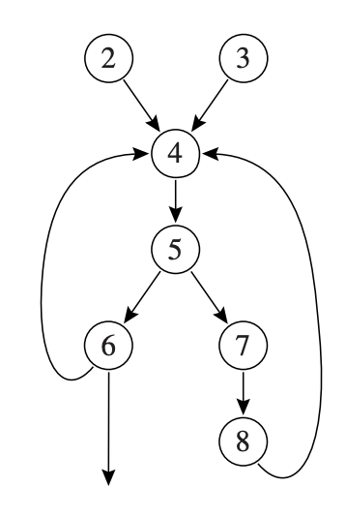
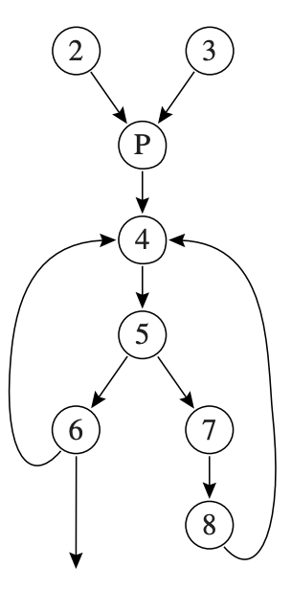
Loop Preheaders
Loop optimizations usually ‘move sth out’
Where do we put them outside the loops?
Solution: adding a new ‘indirection’
Header: 4
Adding a new node (P)

Slide 20
LOOP-INVARIANT COMPUTATIONS

Slide 21
Loop Invariants
A value inside loops may be a constant for all iterations
Then the value is an invariant
Formally: the def d: t->a₁⊕a₂ is loop-invariant if
a_{i} is a constant or
all the definition of a_{i} that reach d are outside the loop or
only one definition of a_{i} reaches d which is an invariant
for i := 0 to N
do j := 3 + 5
end

Slide 22
Loop-invariant Hoisting
Suppose we have found loop-invariants
Commonly we move them outside loops to reduce optimizations
But: not all invariants can be hoisted
Let j := 3 + 5 in
for i := 0 to N
do …
end

Slide 23
Loop-invariant Hoisting
Looking at the following loops:
Invariant? Yes
Hoisting? Yes
Invariant? Yes
Hoisting? NO!
L0
t <- 0
t <- a ⊕ b
L1
i <- i + 1
t <- a ⊕ b
M[i] <- t
if i < N goto L1
L2
x <- t
L0
t <- 0
t <- a ⊕ b
L1
if i ≥ N goto L2
i <- i + 1
t <- a ⊕ b
M[i] <- t
goto L1
L2
x <- t

Slide 24
Loop-invariant Hoisting
Looking at the following loops:
Invariant? Yes
Hoisting? Yes
Invariant? Yes
Hoisting? NO!
L0
t <- 0
t <- a ⊕ b
L1
i <- i + 1
t <- a ⊕ b
M[i] <- t
if i < N goto L1
L2
x <- t
L0
t <- 0
t <- a ⊕ b
L1
if i(10) ≥ N(1) goto L2
i <- i + 1
M[i] <- t
goto L1
L2
x <- t (wrong!)

Slide 25
Loop-invariant Hoisting
Looking at the following loops:
Invariant? Yes
Hoisting? NO!
L0
t <- 0
t <- a ⊕ b
L1
i <- i + 1
t <- a ⊕ b
M[i] <- t
t <- 0 (another def)
M[j] <- t
if i < N goto L1
L2
x <- t

Slide 26
Loop-invariant Hoisting
Looking at the following loops:
Invariant? Yes
Hoisting? NO!
Invariant? Yes
Hoisting? NO!
L0
t <- 0
t <- a ⊕ b
L1
i <- i + 1
t <- a ⊕ b
M[i] <- t
t <- 0
M[j] <- t
if i < N goto L1
L2
x <- t
L0
t <- 0
t <- a ⊕ b
L1
M[j] <- t
i <- i + 1
t <- a ⊕ b
if i < N goto L1
L2
x <- t

Slide 27
Loop-invariant Hoisting
Looking at the following loops:
Invariant? Yes
Hoisting? NO!
Invariant? Yes
Hoisting? NO!
L0
t <- 0
t <- a ⊕ b
L1
i <- i + 1
t <- a ⊕ b
M[i] <- t
t <- 0
M[j] <- t
if i < N goto L1
L2
x <- t
L0
t <- 0
t <- a ⊕ b
L1
M[j] <- t (wrong)
i <- i(2) + 1
if i(3) < N(2) goto L1
L2
x <- t

Slide 28
Summary on Hoisting
Hoisting cannot change the evaluation order
Especially when a variable is defined multiple times
Formally: d: t->a₁⊕a₂ can be hoisted if:
d dominates all loop exits at which t is live-out and
there is only one definition of t in the loop and
(no repetitive definitions)
t is not live-out of the loop preheader

Slide 29
Going Back to Examples
L0
t <- 0
t <- a ⊕ b
L1
i <- i + 1
t <- a ⊕ b
M[i] <- t
if i < N goto L1
L2
x <- t
L0
t <- 0
t <- a ⊕ b
L1
if i ≥ N goto L2
i <- i + 1
t <- a ⊕ b
M[i] <- t
goto L1
L2
x <- t
does not dominate the exit node

Slide 30
Going Back to Examples
L0
t <- 0
t <- a ⊕ b
L1
i <- i + 1
t <- a ⊕ b
M[i] <- t
t <- 0
M[j] <- t
if i < N goto L1
L2
x <- t
L0
t <- 0
t <- a ⊕ b
L1
M[j] <- t
i <- i + 1
t <- a ⊕ b
if i < N goto L1
L2
x <- t
multiple definitions to t
t live-out in the pre-header

Slide 31
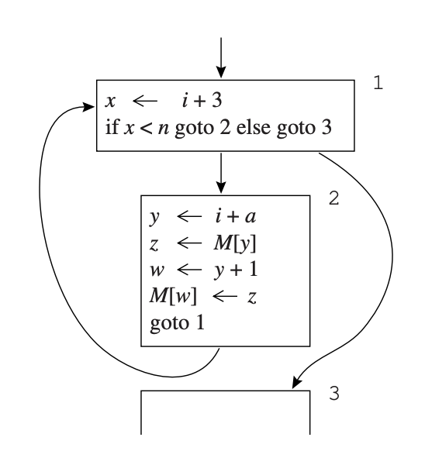
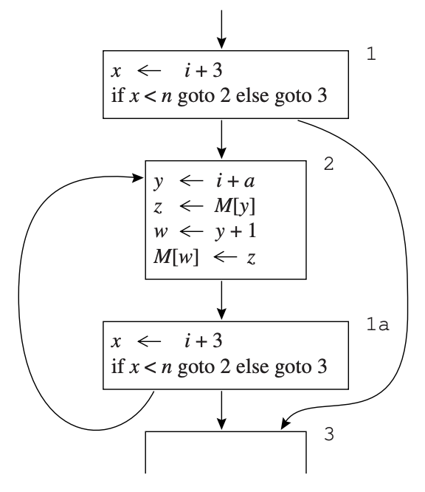
Discussions on While-loops
Hoisting is hard for while loops
The exit node is at the beginning
Statements in the loop body cannot dominate it
Solution: modifying into repeat-until loops

Slide 32
INDUCTION VARIABLES

Slide 33
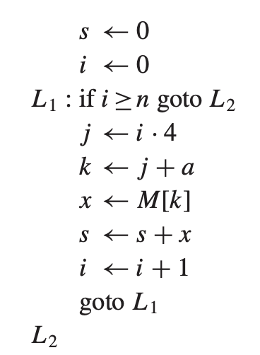
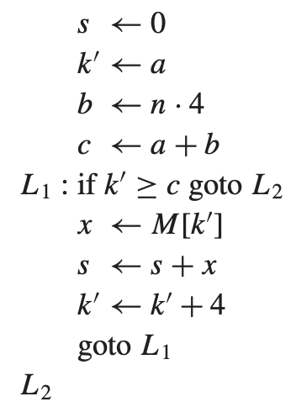
Induction-related Optimizations
i and j are related
j is inducted by I
After optimizations: moving multiplications out

Slide 34
Induction-related Concepts
Both j and k are calculated (derived) from I
i: basic induction variable
j/k: derived induction variables in the family of I
j = a_{j} + i*b_{j} (a_{j}=0, b_{j}=4, a_{j}/ b_{j} are loop invariants)
Simplified as (i, a, b)
s <- 0
i <- 0
L1:if i>=n goto L2
j <- i*4
k <- j+a
x <- M[k]
s <- s+x
i <- i+1
goto L1
L2

Slide 35
Strength Reduction
Multiplication is usually more expensive than addition
Optimization: modify multiplications to additions
For j(i,a,b) namely j <- a + i * b
Create j’: when i <- i+c, let j’ <- j’+c*b
c*b is a loop-invariant and can be hoisted
Replace assignment to j with j <- j’
Initialize j’ at the end of the loop preheader:
j’ <- a + i * b

Slide 36
Example
For j: (i, 0, 4), k: (i, a, 4)
Add j’ and k’
s <- 0
i <- 0
j’ <- 0
k’ <- a
L1:if i>=n goto L2
j <- j’
k <- k’
x <- M[k]
s <- s+x
i <- i+1
goto L1
L2
s <- 0
i <- 0
L1:if i>=n goto L2
j <- i*4
k <- j+a
x <- M[k]
s <- s+x
i <- i+1
goto L1
L2

Slide 37
Example
For j: (i, 0, 4), k: (i, a, 4)
Add j’ and k’
When i+c(1), j’+c*b(4)
s <- 0
i <- 0
j’ <- 0
k’ <- a
L1:if i>=n goto L2
j <- j’
k <- k’
x <- M[k]
s <- s+x
i <- i+1
j’ <- j’+4
k’ <- k’+4
goto L1
L2
s <- 0
i <- 0
L1:if i>=n goto L2
j <- i*4
k <- j+a
x <- M[k]
s <- s+x
i <- i+1
goto L1
L2

Slide 38
Dead Code Elimination
Now j becomes useless in the loop
Defined once and never used
s <- 0
i <- 0
j’ <- 0
k’ <- a
L1:if i>=n goto L2
j <- j’
k <- k’
x <- M[k]
s <- s+x
i <- i+1
j’ <- j’+4
k’ <- k’+4
goto L1
L2
Can also be seen as
“constant propagation”

Slide 39
Rewriting Comparisons
Now i is almost useless
Only used in a comparison and a self-definition
s <- 0
i <- 0
k’ <- a
L1:if i>=n goto L2
k <- k’
x <- M[k]
s <- s+x
i <- i+1
k’ <- k’+4
goto L1
L2

Slide 40
Coordinated Induction Variables
Two induction variables are coordinated if:
(x −ax )/bx = (y −ay )/by at every time during the loop
In the example: k’ and i are coordinated
(k’ – a)/4 = (i – 0)/1
i >= n -> k’ >= 4*n+a

Slide 41
Rewriting Comparisons
The rewritten program should be like:
Now i becomes useless, removing it
s <- 0
i <- 0
k’<- a
b <- n*4
c <- a+b
L1:if k’>= c goto L2
k <- k’
x <- M[k]
s <- s+x
i <- i+1
k’ <- k’+4
goto L1
L2

Slide 42
Rewriting Comparisons
Using constant propagation: removing k<-k’
s <- 0
k’<- a
b <- n*4
c <- a+b
L1:if k’>= c goto L2
x <- M[k’]
s <- s+x
k’ <- k’+4
goto L1
L2

