Slide 1
Architecture of Enterprise Applications 3 Messaging - JMS
Haopeng Chen
REliable, INtelligent and Scalable Systems Group (REINS)
Shanghai Jiao Tong University
Shanghai, China
http://reins.se.sjtu.edu.cn/~chenhp
e-mail: chen-hp@sjtu.edu.cn

Slide 2
Contents and Objective
Contents
Messaging in Java EE Applications
What is a Messaging?
What is JMS API?
JMS Programming Model
Objective
能够根据系统需求，分析后端适用于异步通信机制的业务场景，并设计并实现基于消息中间件的实现方案

Slide 3
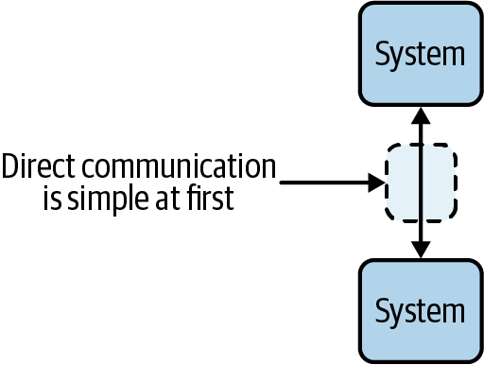
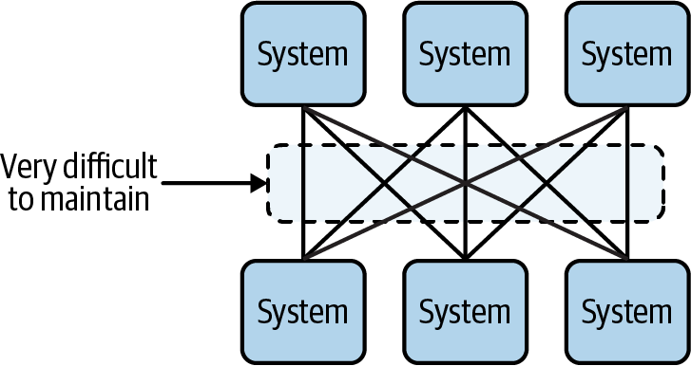
Communication Model
Synchronous client-server model
tightly coupled
no delivery guarantees
software speciation
without a request buffer
too much emphasis on requests and responses
Communication is not replayable
From:
Mastering Kafka Streams and ksqlDB - Building Real-Time Data Systems by Example
Mitch Seymour

Slide 4
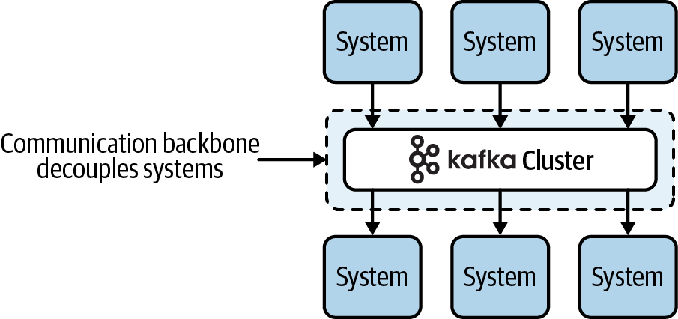
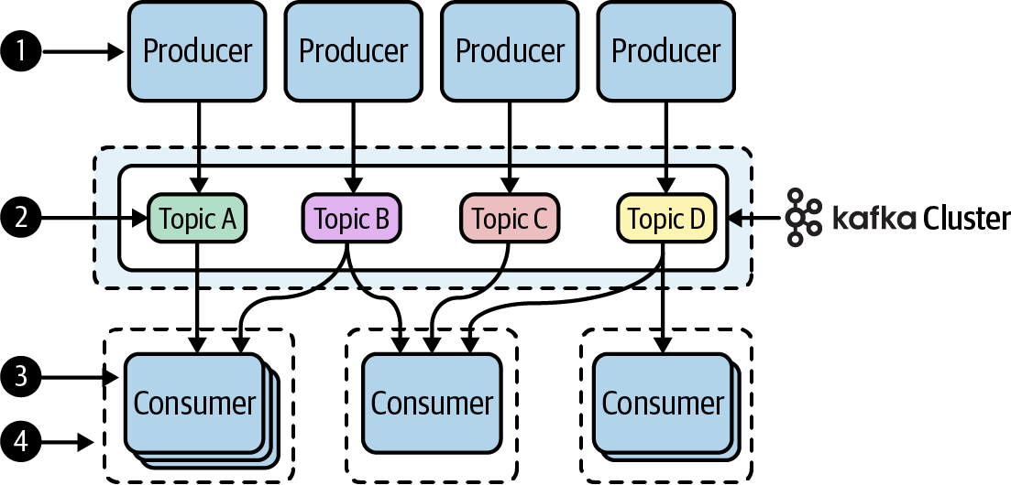
Communication Model
Asynchronous model
From:
Mastering Kafka Streams and ksqlDB - Building Real-Time Data Systems by Example
Mitch Seymour

Slide 5
What Is Messaging?
Messaging is a method of communication between software components or applications.
A messaging system is a peer-to-peer facility:
A messaging client can send messages to, and receive messages from, any other client.
Each client connects to a messaging agent that provides facilities for creating, sending, receiving, and reading messages.
Messaging enables distributed communication that is loosely coupled.

Slide 6
What Is the JMS API?
The Java Message Service is a Java API that allows applications to create, send, receive, and read messages.
JMS enables communication that is not only loosely coupled but also:
Asynchronous: A receiving client does not have to receive messages at the same time the sending client sends them. The sending client can send them and go on to other tasks; the receiving client can receive them much later.
Reliable: A messaging provider that implements the JMS API can ensure that a message is delivered once and only once. Lower levels of reliability are available for applications that can afford to miss messages or to receive duplicate messages.

Slide 7
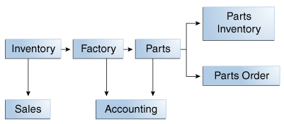
When Can We Use Messaging?

Slide 8
JMS API Work with the Java EE Platform
The JMS API in the Java EE platform has the following features.
Application clients, Enterprise JavaBeans (EJB) components, and web components can send or synchronously receive a JMS message. Application clients can in addition set a message listener that allows JMS messages to be delivered to it asynchronously by being notified when a message is available.
Message-driven beans, which are a kind of enterprise bean, enable the asynchronous consumption of messages in the EJB container. An application server typically pools message-driven beans to implement concurrent processing of messages.
Message send and receive operations can participate in Java Transaction API (JTA) transactions, which allow JMS operations and database accesses to take place within a single transaction.

Slide 9
Message
Applications produce or consume messages
The format of message is elastic, including three parts:
A header
Properties (optional)
A body (optional)

Slide 10
header
Includes some pre-defined fields
JMSDestination (S)
JMSDeliveryMode (S)
JMSMessageID (S)
JMSTimestamp (S)
JMSCorrelationID (C)
JMSReplyTo (C)
JMSRedelivered (P)
JMSType (C)
JMSExpiration (S)
JMSPriority (S)
Clients can not extend the fields

Slide 11
Properties
Includes some pre-defined fields
JMSXUserID (S)
JMSXAppID (S)
JMSXDeliveryCount (S)
JMSXGroupID (C)
JMSXGroupSeq (C)
JMSXProducerTXID (S)
JMSXConsumerTXID (S)
JMSXRcvTimestamp (S)
JMSXState (P)
Clients can extend the fields
Property name: follows the rule of naming selectors
Property value: boolean, byte, short, int, long, float, double, String

Slide 12
Body
Message Type | Body Contains
TextMessage | A java.lang.String object (for example, the contents of an XML file).
MapMessage | A set of name-value pairs, with names as String objects and values as primitive types in the Java programming language. The entries can be accessed sequentially by enumerator or randomly by name. The order of the entries is undefined.
BytesMessage | A stream of uninterpreted bytes. This message type is for literally encoding a body to match an existing message format.
StreamMessage | A stream of primitive values in the Java programming language, filled and read sequentially.
ObjectMessage | A Serializable object in the Java programming language.
Message | Nothing. Composed of header fields and properties only. This message type is useful when a message body is not required.

Slide 13
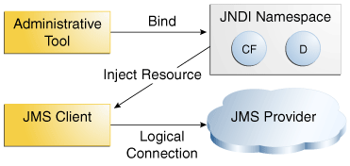
JMS API Architecture

Slide 14
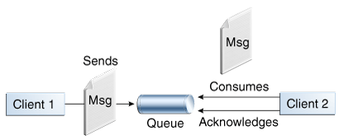
Messaging Styles
A point-to-point (PTP) product or application is built on the concept of message queues, senders, and receivers.
Each message has only one consumer.
The receiver can fetch the message whether or not it was running when the client sent the message.

Slide 15
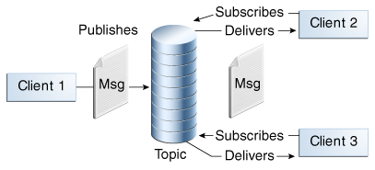
Messaging Styles
In a publish/subscribe (pub/sub) product or application, clients address messages to a topic, which functions somewhat like a bulletin board. Publishers and subscribers can dynamically publish or subscribe to the topic.
Each message can have multiple consumers.
A client that subscribes to a topic can consume only messages sent after the client has created a subscription, and the consumer must continue to be active in order for it to consume messages.

Slide 16
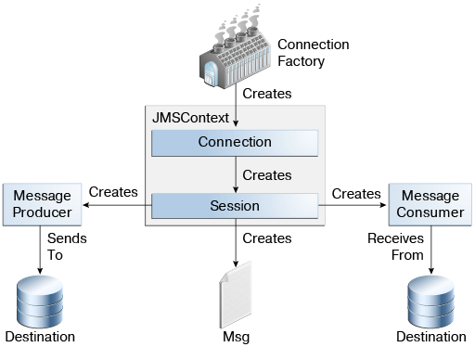
The JMS API Programming Model

Slide 17
JMS programming model
Get a reference to ConnectionFactory
A connection factory is the object a client uses to create a connection to a provider.
import javax.naming.*;
import javax.jms.*;
QueueConnectionFactory queueConnectionFactory;
Context messaging = new InitialContext();
queueConnectionFactory = (QueueConnectionFactory)
messaging.lookup(“QueueConnectionFactory”);
Or
@Resource(lookup = "java:comp/DefaultJMSConnectionFactory")
private static ConnectionFactory connectionFactory;

Slide 18
JMS programming model
A destination is the object a client uses to specify the target of messages it produces and the source of messages it consumes.
In the PTP messaging style, destinations are called queues.
In the pub/sub messaging style, destinations are called topics.
Queue queue;
queue = (Queue)messaging.lookup(“theQueue");
Topic topic;
topic = (Topic)messaging.lookup(“theTopic");
Or
@Resource(lookup = "jms/MyQueue")
private static Queue queue;
@Resource(lookup = "jms/MyTopic")
private static Topic topic;

Slide 19
JMS programming model
Get a Connection and a Session
A connection encapsulates a virtual connection with a JMS provider.
A session is a single-threaded context for producing and consuming messages.
You normally create a session (as well as a connection) by creating a JMSContext object
JMSContext context = connectionFactory.createContext();

Slide 20
JMS programming model
Create a Producer or a Consumer
try (JMSContext context = connectionFactory.createContext();) {
JMSProducer producer = context.createProducer();
...
context.createProducer().send(dest, message);
Or
try (JMSContext context = connectionFactory.createContext();) {
JMSConsumer consumer = context.createConsumer(dest);
...
Message m = consumer.receive();
Message m = consumer.receive(1000);

Slide 21
JMS programming model
Create a message
TextMessage message = context.createTextMessage();
message.setText(msg_text); // msg_text is a String
context.createProducer().send(message);
Message m = consumer.receive();
if (m instanceof TextMessage) {
String message = m.getBody(String.class);
System.out.println("Reading message: " + message);
} else {
// Handle error or process another message type
}

Slide 22
JMS programming model
JMS Message Listener
A message listener is an object that acts as an asynchronous event handler for messages.
Listener myListener = new Listener();
consumer.setMessageListener(myListener);
Listener:
void onMessage(Message inMessage)

Slide 23
JMS programming model
Selection of messages
Producer:
String data;
TextMessage message;
message = session.createTextMessage();
message.setText(data);
message.setStringProperty("Selector", "Technology");

Slide 24
JMS programming model
Selection of messages
Consumer:
String selector;
selector = new String(“ (Selector = ‘Technology’) ”);
JMSConsumer consumer = context.createConsumer(dest, selector);

Slide 25
JMS programming model
Durable subscription
String subName = "MySub";
JMSConsumer consumer = context.createDurableConsumer(myTopic, subName);
consumer.close();
context.unsubscribe(subName);
JMSConsumer consumer =
context.createSharedDurableConsumer(topic, "MakeItLast");

Slide 26
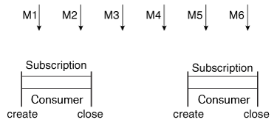
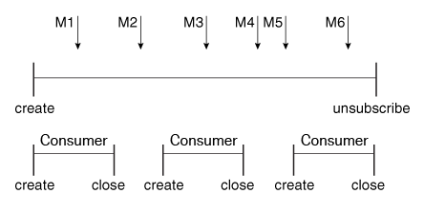
JMS programming model

Slide 27
JMS programming model
JMS Browser
allows you to browse the messages in the queue and display the header values for each message.
QueueBrowser browser = context.createBrowser(queue);

Slide 28
JMS programming model
JMS Exception Handling
The root class for all checked exceptions in the JMS API is JMSException

Slide 29

A JMS Sample
Intellij IDEA 创建消息驱动Bean - 接收JMS消息
https://www.cnblogs.com/yangyquin/p/5346104.html
Wildfly Messaging Configuration
https://docs.jboss.org/author/display/WFLY/Messaging+configuration

Slide 30
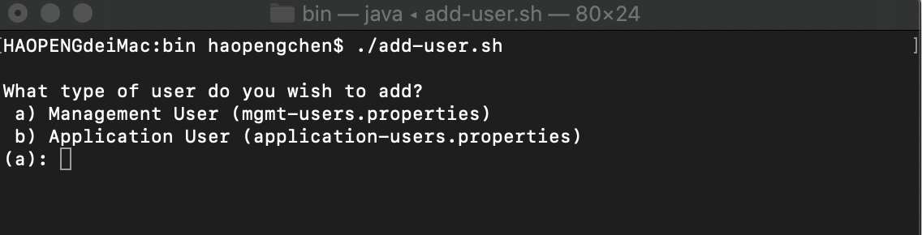
A JMS Sample
Add User
$WILDFLY_HOME/bin/add-user.sh
Add a mgmt-user
For example: username: root, password: wildfly2020!
In $WILDFLY_HOME/standalone/configuration/mgmt-users.properties

Slide 31
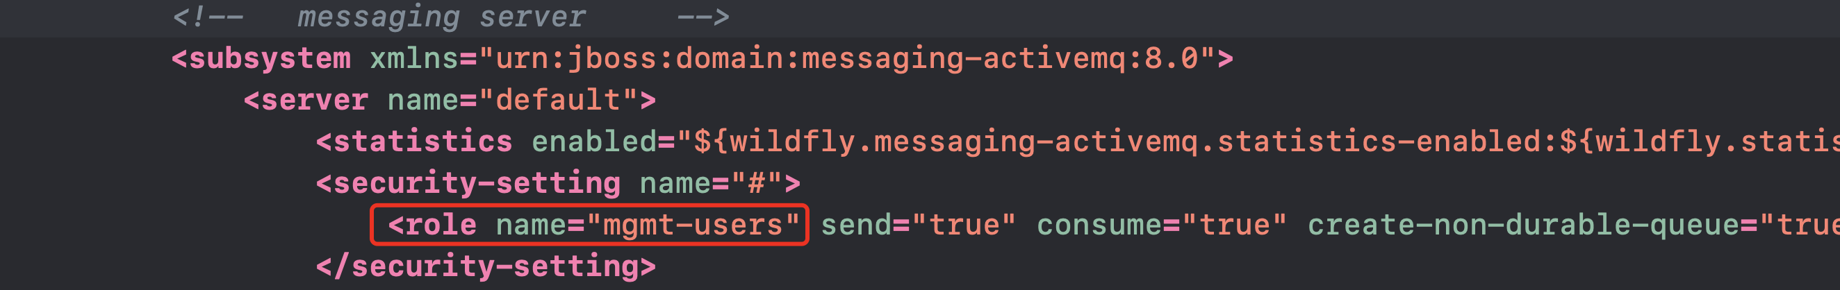
A JMS Sample
Assign a role to the new user
In /standalone/configuration/appications-roles.properties
Add JMS Server & Destination in standalone.xml

Slide 32
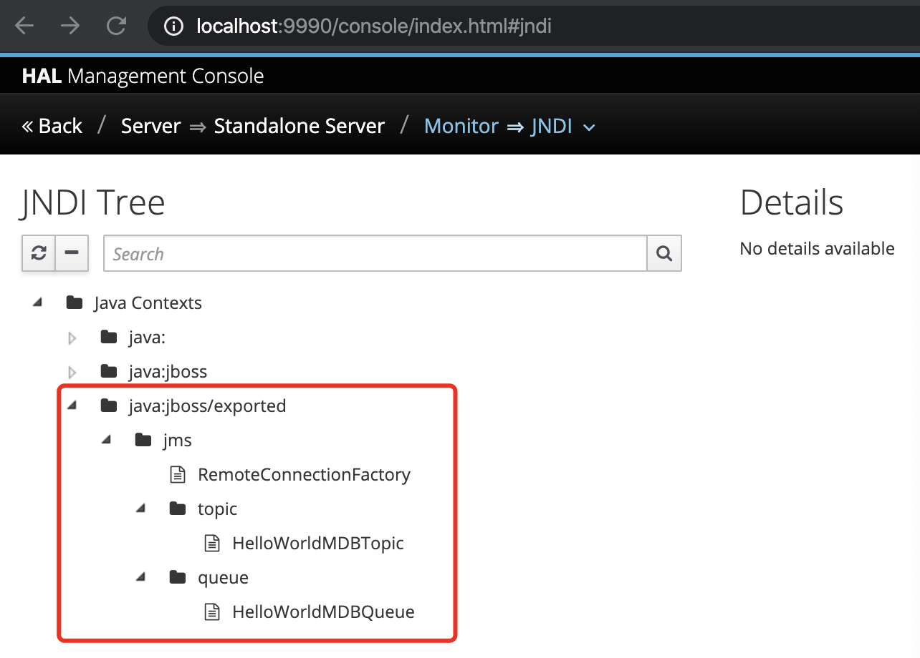
A JMS Sample
Run Wildfly Server, and check the JMS conf on console

Slide 33
A JMS Sample - Queue
JMSProducer.java
public class JMSProducer { private static final Logger log = Logger.getLogger(JMSProducer.class.getName()); private static final String DEFAULT_MESSAGE = "这是JMS信息....."; private static final String DEFAULT_CONNECTION_FACTORY = "jms/RemoteConnectionFactory"; private static final String DEFAULT_DESTINATION = "/jms/queue/HelloWorldMDBQueue"; private static final String DEFAULT_MESSAGE_COUNT = "10"; private static final String DEFAULT_USERNAME = "root"; private static final String DEFAULT_PASSWORD = "reins2011!"; private static final String INITIAL_CONTEXT_FACTORY = "org.wildfly.naming.client.WildFlyInitialContextFactory"; private static final String PROVIDER_URL = "http-remoting://localhost:8080"; public static void main(String[] args) throws Exception { Context context=null; Connection connection=null; try { final Properties env = new Properties(); env.put(Context.INITIAL_CONTEXT_FACTORY, INITIAL_CONTEXT_FACTORY);
// 该KEY的值为初始化Context的工厂类,JNDI驱动的类名 env.put(Context.PROVIDER_URL, PROVIDER_URL);
// 该KEY的值为Context服务提供者的URL.命名服务提供者的URL env.put(Context.SECURITY_PRINCIPAL, DEFAULT_USERNAME); env.put(Context.SECURITY_CREDENTIALS, DEFAULT_PASSWORD);//应用用户的登录名,密码. // 获取到InitialContext对象. context = new InitialContext(env);
Destination destination = (Destination) context.lookup(DEFAULT_DESTINATION);
前面这些final常量是在做基础的属性配置
root
查找对应的object

Slide 34
A JMS Sample - Queue
JMSProducer.java
// 创建JMS连接、会话、生产者和消费者 connection = connectionFactory.createConnection(DEFAULT_USERNAME, DEFAULT_PASSWORD); Session session = connection.createSession(false, Session.AUTO_ACKNOWLEDGE); MessageProducer producer = session.createProducer(destination); connection.start(); int count = Integer.parseInt(DEFAULT_MESSAGE_COUNT); // 发送特定数目的消息 TextMessage message = null; for (int i = 0; i < count; i++) { message = session.createTextMessage(DEFAULT_MESSAGE); producer.send(message); } // 等待30秒退出 CountDownLatch latch = new CountDownLatch(1); latch.await(30, TimeUnit.SECONDS); } catch (Exception e) { log.severe(e.getMessage()); throw e; } finally { if (context != null) { context.close(); } if (connection != null) { connection.close(); } } } }

Slide 35
A JMS Sample - Queue
JMSConsumer.java
public class JMSConsumer { private static final Logger log = Logger.getLogger(JMSConsumer.class.getName()); private static final String DEFAULT_CONNECTION_FACTORY = "jms/RemoteConnectionFactory"; private static final String DEFAULT_DESTINATION = "/jms/queue/HelloWorldMDBQueue"; private static final String DEFAULT_USERNAME = "root"; private static final String DEFAULT_PASSWORD = "reins2011!"; private static final String INITIAL_CONTEXT_FACTORY = "org.wildfly.naming.client.WildFlyInitialContextFactory"; private static final String PROVIDER_URL = "http-remoting://localhost:8080"; private static final int WAIT_COUNT = 5; public static void main(String[] args) throws Exception { ConnectionFactory connectionFactory = null; Connection connection = null; Session session = null; MessageConsumer consumer = null; Destination destination = null; TextMessage message = null; Context context = null; try { final Properties env = new Properties(); env.put(Context.INITIAL_CONTEXT_FACTORY, INITIAL_CONTEXT_FACTORY); env.put(Context.PROVIDER_URL, PROVIDER_URL); env.put(Context.SECURITY_PRINCIPAL, DEFAULT_USERNAME); env.put(Context.SECURITY_CREDENTIALS, DEFAULT_PASSWORD); context = new InitialContext(env); connectionFactory = (ConnectionFactory) context.lookup(DEFAULT_CONNECTION_FACTORY); destination = (Destination) context.lookup(DEFAULT_DESTINATION);

Slide 36
A JMS Sample - Queue
JMSConsumer.java
connection = connectionFactory.createConnection(DEFAULT_USERNAME, DEFAULT_PASSWORD); session = connection.createSession(false, Session.AUTO_ACKNOWLEDGE); consumer = session.createConsumer(destination); connection.start(); // 等待30秒退出 CountDownLatch latch = new CountDownLatch(1); log.info("开始从JBOSS端接收信息-----"); int i = 0; for (; i < WAIT_COUNT; i++) { if (message != null) { log.info("接收到的消息的内容:" + message.getText()); i = 0; } log.info("开始从JBOSS端接收信息-----"); message = (TextMessage) consumer.receive(5000); latch.await(1, TimeUnit.SECONDS); } } catch (Exception e) { log.severe(e.getMessage()); throw e; } finally { if (context != null) { context.close(); } if (connection != null) { connection.close(); } } } }

Slide 37
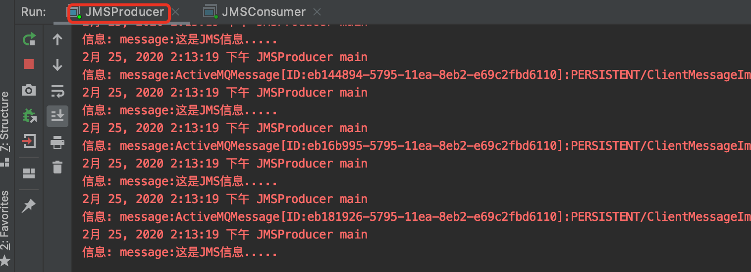
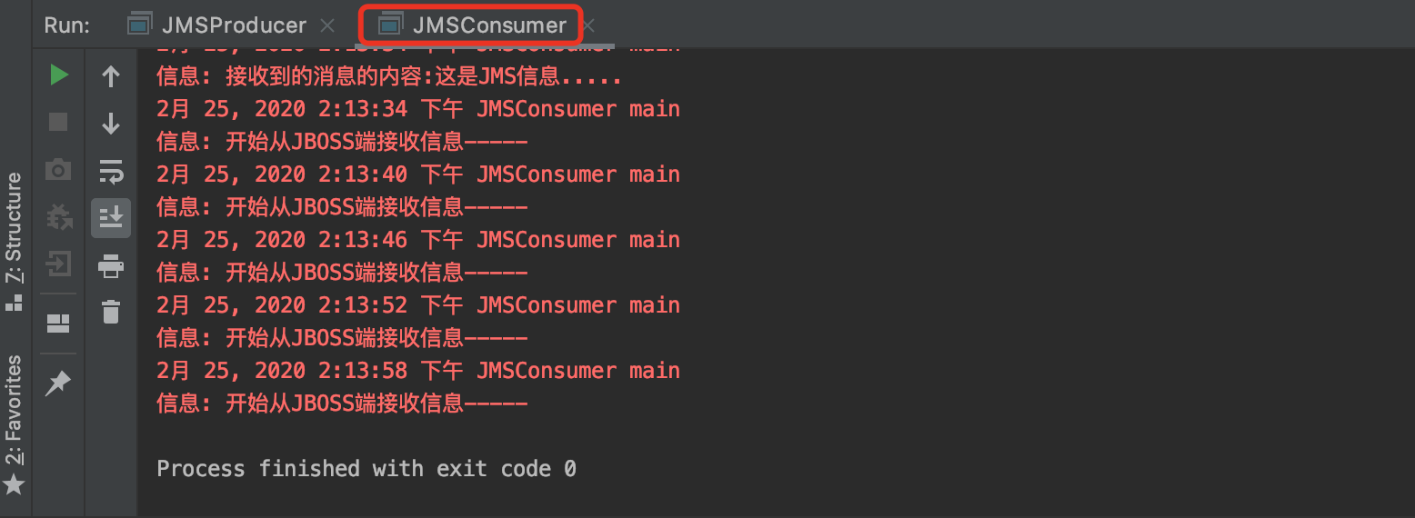
A JMS Sample - Queue
Run JMSProducer
Run JMSConsumer

Slide 38
A JMS Sample - Topic
JMSPub.java
System.out.print("输入要发送的消息：(数字0退出)"); line = msgStream.readLine(); if (line != null && line.trim().length() != 0) { TextMessage textMessage = session.createTextMessage(); textMessage.setText(line); textMessage.setStringProperty("Selector", "Funny"); producer.send(textMessage); quitNow = line.equalsIgnoreCase("0"); }
JMSSub.java
String selector; selector = new String("(Selector = 'Funny')"); consumer = session.createConsumer(topic, selector); consumer.setMessageListener(new javax.jms.MessageListener() { public void onMessage(Message message) { try { TextMessage tm = (TextMessage) message; System.out.println("接收到的消息内容: " + tm.getText().toString()); System.out.println("JMS目的地: " + tm.getJMSDestination()); System.out.println("JMS回复: " + tm.getJMSReplyTo()); System.out.println("JMS消息ID号: " + tm.getJMSMessageID()); System.out.println("是否重新接收: " + tm.getJMSRedelivered()); } catch (JMSException e1) { e1.printStackTrace(); } } });
send函数之前的操作是在进行消息格式
的组装
通过setListener的方式实现了异步的消息接收

Slide 39
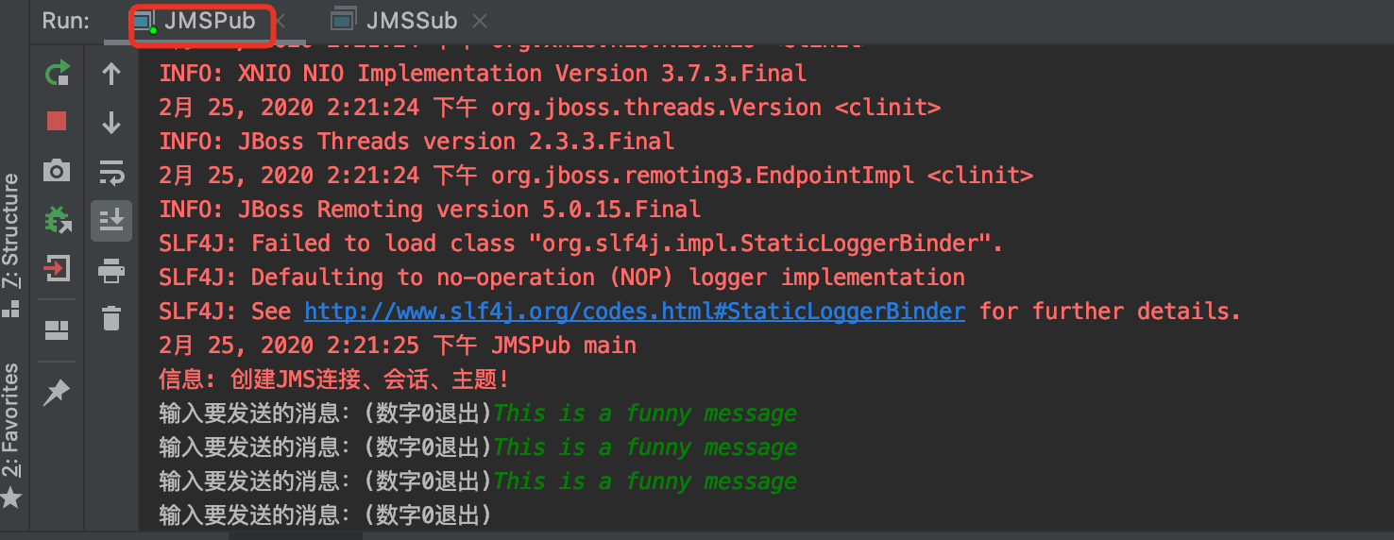
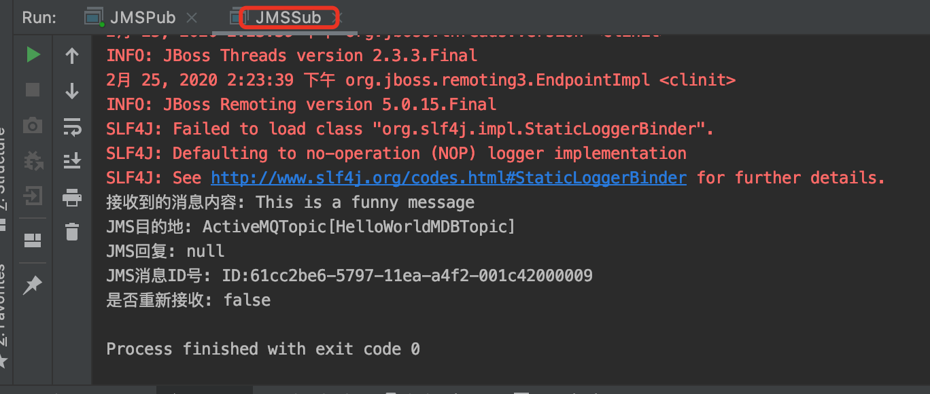
A JMS Sample - Topic
Run JMSPub
Run JMSSub

Slide 40
Messaging with JMS
Spring provides the means to publish messages to any POJO (Plain Old Java Object).
Email.java public class Email { private String to; private String body; public Email() { } public Email(String to, String body) { this.to = to; this.body = body; } public String getTo() { return to; } public void setTo(String to) { this.to = to; }
public String getBody() { return body; } public void setBody(String body) { this.body = body; } @Override public String toString() { return String.format("Email{to=%s, body=%s}", getTo(), getBody()); } }
This POJO is quite simple, containing two fields (to and body), along with the presumed set of getters and setters.

Slide 41
Messaging with JMS
Message Receiver
Receiver.java
package org.reins.demo; import org.springframework.jms.annotation.JmsListener; import org.springframework.stereotype.Component; @Component public class Receiver { @JmsListener(destination = "mailbox")//, containerFactory = "myFactory") public void receiveMessage(Email email) { System.out.println("Received <" + email + ">"); } }
检测到要变成string类型，所以会调用toString方法

Slide 42
Messaging with JMS
Send and receive JMS messages with Spring
Application.java package org.reins.demo; @SpringBootApplication @EnableJms public class Application { @Bean public JmsListenerContainerFactory<?> myFactory(@Qualifier("jmsConnectionFactory") ConnectionFactory
connectionFactory, DefaultJmsListenerContainerFactoryConfigurer configurer) { DefaultJmsListenerContainerFactory factory = new DefaultJmsListenerContainerFactory(); // This provides all boot's default to this factory, including the message converter configurer.configure(factory, connectionFactory); // You could still override some of Boot's default if necessary. return factory; } @Bean // Serialize message content to json using TextMessage public MessageConverter jacksonJmsMessageConverter() { MappingJackson2MessageConverter converter = new MappingJackson2MessageConverter(); converter.setTargetType(MessageType.TEXT); converter.setTypeIdPropertyName("_type"); return converter; }

Slide 43
Messaging with JMS
Send and receive JMS messages with Spring
Application.java
public static void main(String[] args) { // Launch the application ConfigurableApplicationContext context = SpringApplication.run(Application.class, args); JmsTemplate jmsTemplate = context.getBean(JmsTemplate.class); // Send a message with a POJO - the template reuse the message converter System.out.println("Sending an email message."); jmsTemplate.convertAndSend("mailbox", new Email("info@example.com", "Hello")); } }

Slide 44
Messaging with JMS
Send and receive JMS messages with Spring
MsgController.java
@RestController public class MsgController { @Autowired WebApplicationContext applicationContext; @GetMapping(value = "/msg") public void findOne( ) { JmsTemplate jmsTemplate = applicationContext.getBean(JmsTemplate.class); // Send a message with a POJO - the template reuse the message converter System.out.println("Sending an email message."); jmsTemplate.convertAndSend("mailbox", new Email("info@example.com", "Hello Msg")); }; }

Slide 45
References
Messaging with JMS
https://spring.io/guides/gs/messaging-jms/
Java Message Service Concepts
https://javaee.github.io/tutorial/jms-concepts.html
Mastering Kafka Streams and ksqlDB - Building Real-Time Data Systems by Example
https://www.confluent.io/resources/ebook/mastering-kafka-streams-and-ksqldb/

Slide 46

Thank You!

