Slide 1
Architecture of Enterprise Applications 4 Messaging - kafka
Haopeng Chen
REliable, INtelligent and Scalable Systems Group (REINS)
Shanghai Jiao Tong University
Shanghai, China
http://reins.se.sjtu.edu.cn/~chenhp
e-mail: chen-hp@sjtu.edu.cn

Slide 2
Contents and Objective
Contents
Kafka
Introduction
Quick start
Communication with Kafka
Objective
能够根据系统需求，使用Kafka消息中间件来实现异步通信，包括跨编程语言的通信

Slide 3


Apache Kafka Resource
from：https://kafka.apache.org/books-and-papers
Apache Kafka Quick Start
https://kafka.apache.org/quickstart

Slide 4
Apache Kafka
http://kafka.apache.org
Apache Kafka
is an open-source distributed event streaming.
To publish (write) and subscribe to (read) streams of events, including continuous import/export of your data from other systems.
To store streams of events durably and reliably for as long as you want.
To process streams of events as they occur or retrospectively.

Slide 5
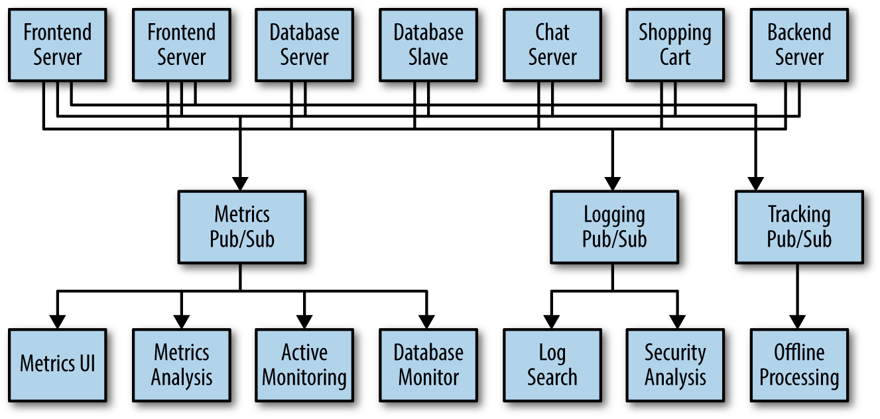
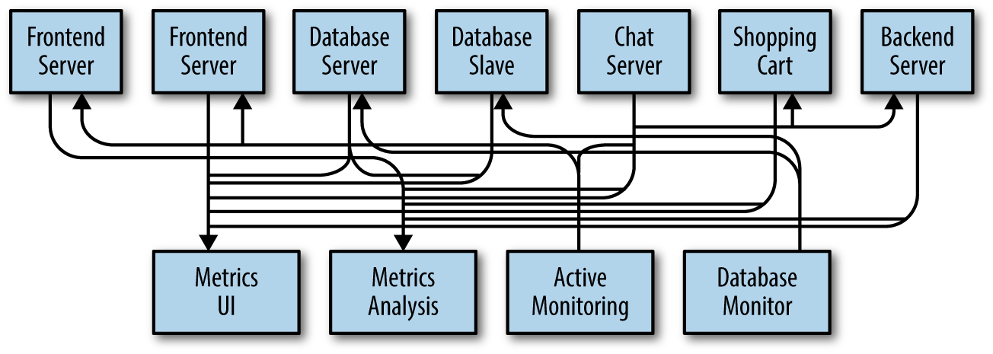
Publish/Subscribe Messaging

Slide 6
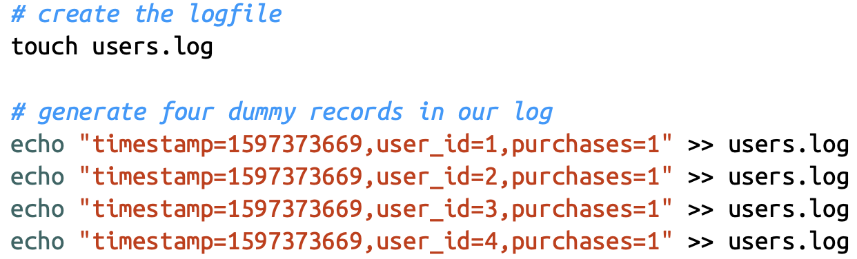
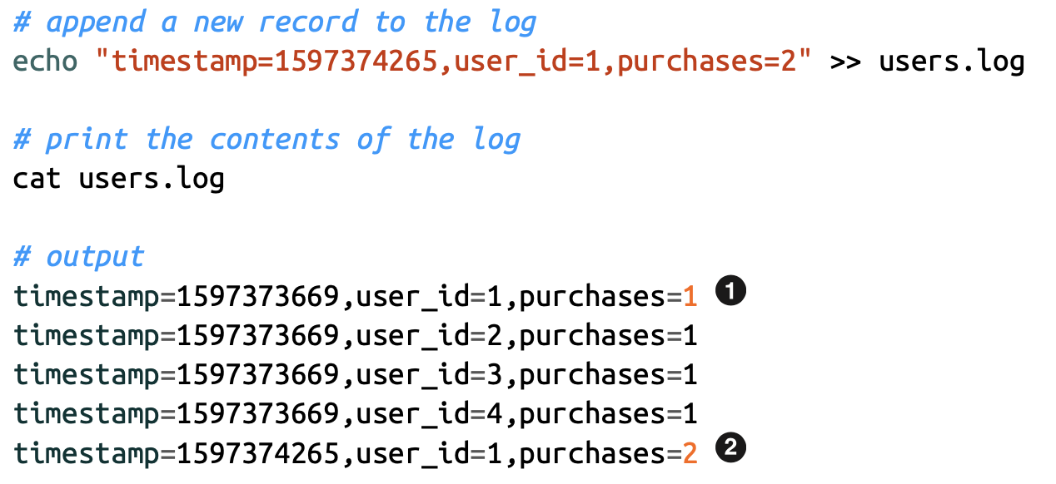
How Are Streams Stored?
Logs are append-only data structures that capture an ordered sequence of events.

Slide 7
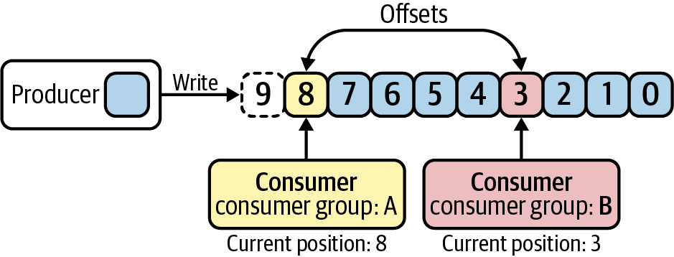
Offset
Kafka refers to the position of each entry in its distributed log as an offset.
multiple consumer groups can each read from the same log, and maintain their own positions in the log/stream they are reading from.

Slide 8
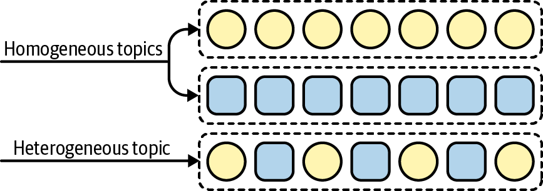
Topics and Partitions
Topics
homogeneous topics that contain only one type of data, or heterogeneous topics that contain multiple types of data
同构
异构

Slide 9
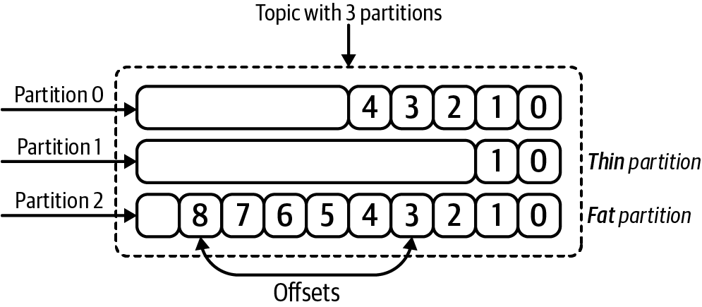
Topics and Partitions
Kafka topics are broken into smaller units called partitions.
Partitions are individual logs where data is produced and consumed from
The number of partitions for a given topic is configurable, and having more partitions in a topic generally translates to more parallelism and throughput

Slide 10
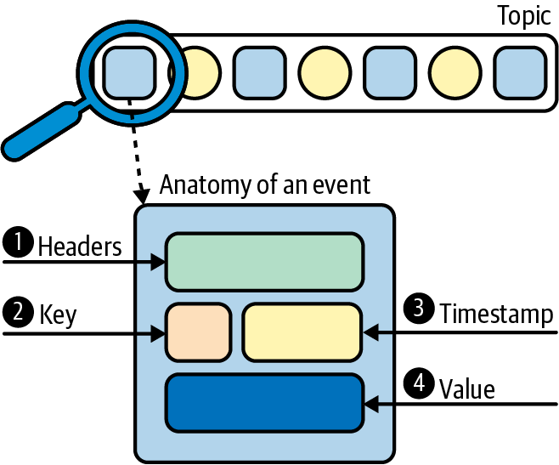
Events
An event is a timestamped key-value pair that records something that happened.
Application-level headers contain optional metadata about an event.
Keys are also optional, but play an important role in how data is distributed across partitions.
Each event is associated with a timestamp.
The value contains the actual message contents, encoded as a byte array.

Slide 11
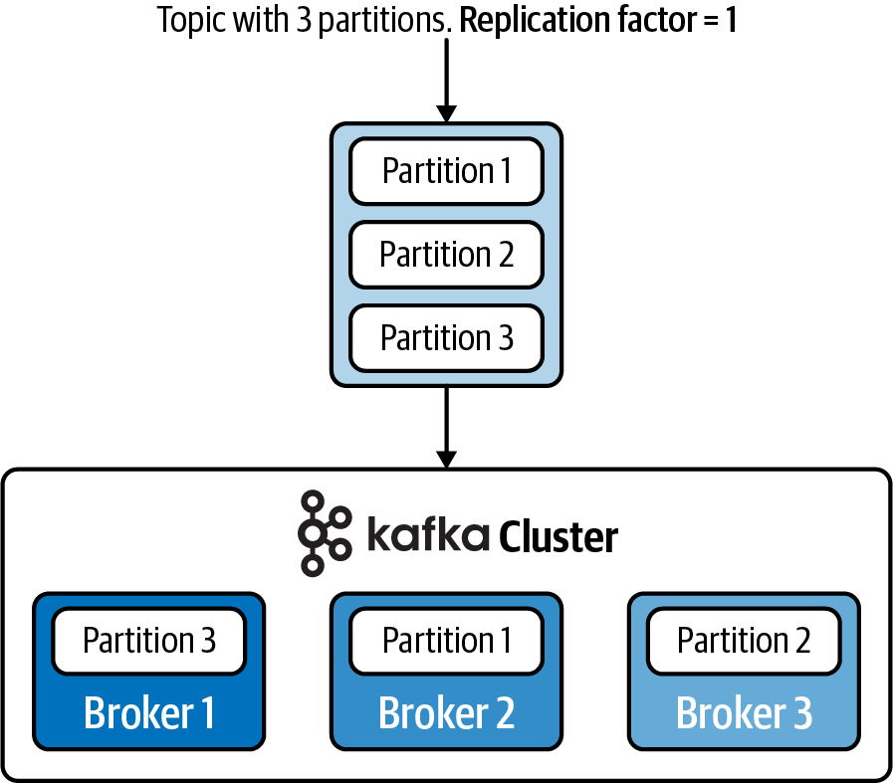
Kafka Cluster and Broker
Kafka operates as a cluster, and multiple machines, called brokers, are involved in the storage and retrieval of data.
Kafka clusters can be quite large, and can even span multiple data centers and geo‐ graphic regions.

Slide 12
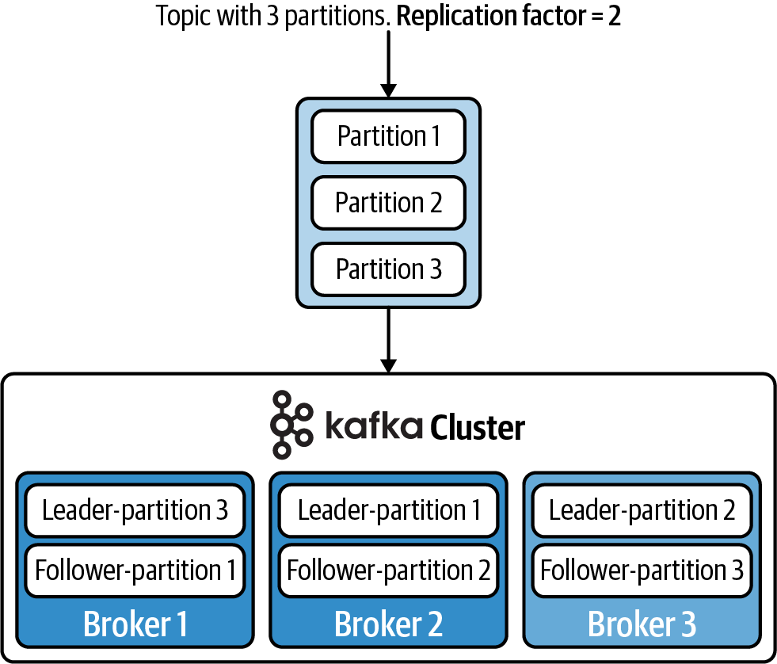
Kafka Cluster and Broker
To achieve fault tolerance and high availability, you can set a replication factor when configuring the topic.
备份

Slide 13
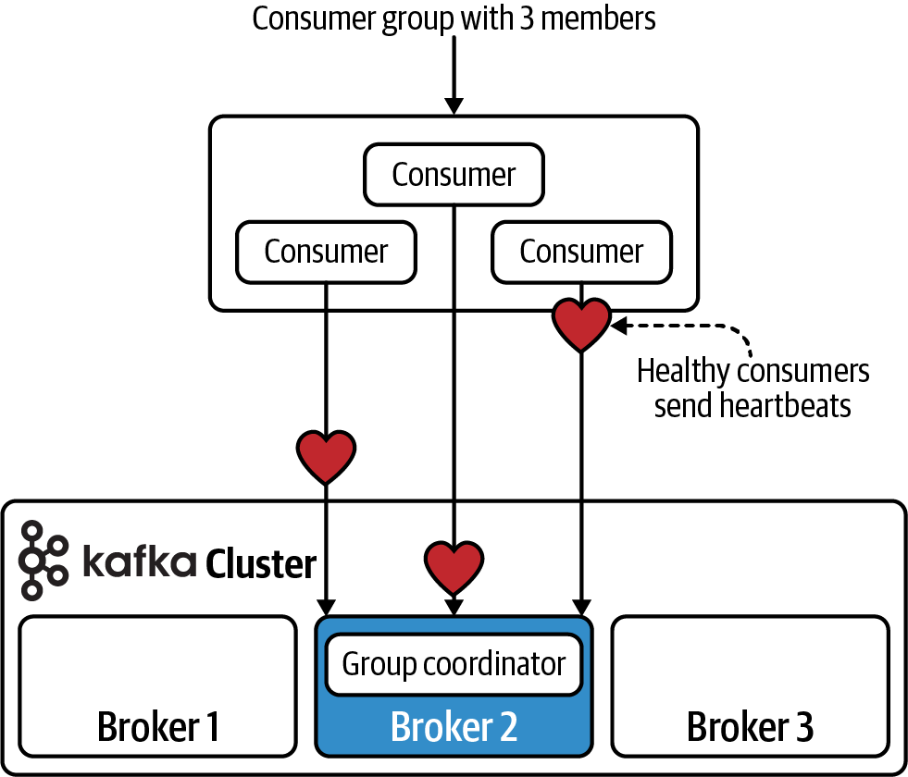
Customer Groups
Consumer groups are made up of multiple cooperating consumers, and the member‐ ship of these groups can change over time.
every consumer group is assigned to a special broker called the group coordinator, which is responsible for receiving heartbeats from the consumers, and triggering a rebalance of work whenever a consumer is marked as dead.
group coordinator：
组内协调器

Slide 14
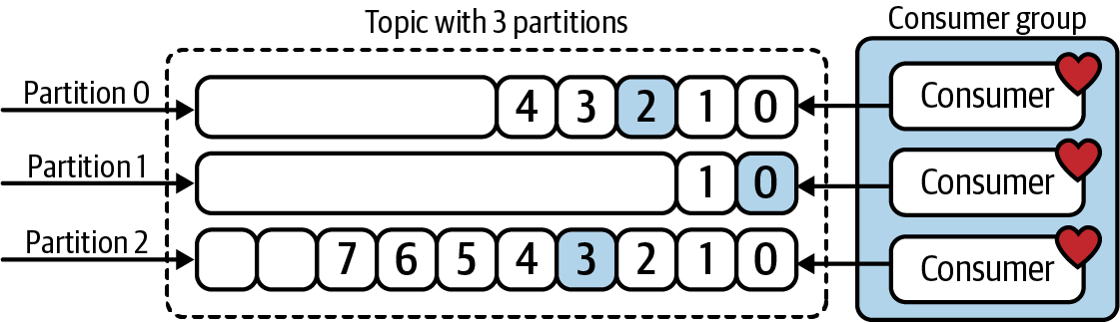
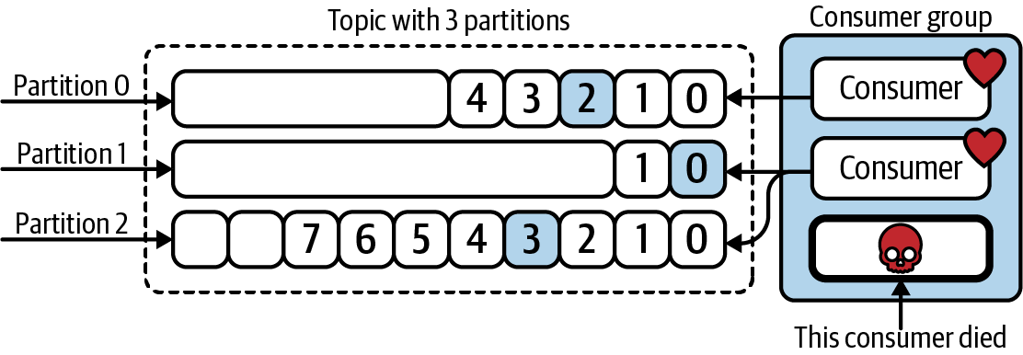
Customer Groups
Every active member of the consumer group is eligible to receive a partition assignment.
eligible：
有资格的

Slide 15
Apache Kafka Core APIs
Kafka has four core APIs:
The Producer API allows an application to publish a stream of records to one or more Kafka topics.
The Consumer API allows an application to subscribe to one or more topics and process the stream of records produced to them.
The Streams API allows an application to act as a stream processor, consuming an input stream from one or more topics and producing an output stream to one or more output topics, effectively transforming the input streams to output streams.
The Connector API allows building and running reusable producers or consumers that connect Kafka topics to existing applications or data systems. For example, a connector to a relational database might capture every change to a table.

Slide 16
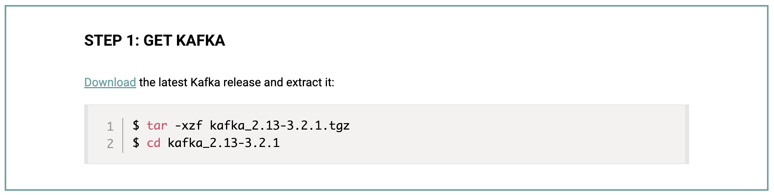
Kafka - Quickstart
Quickstart
https://kafka.apache.org/quickstart

Slide 17
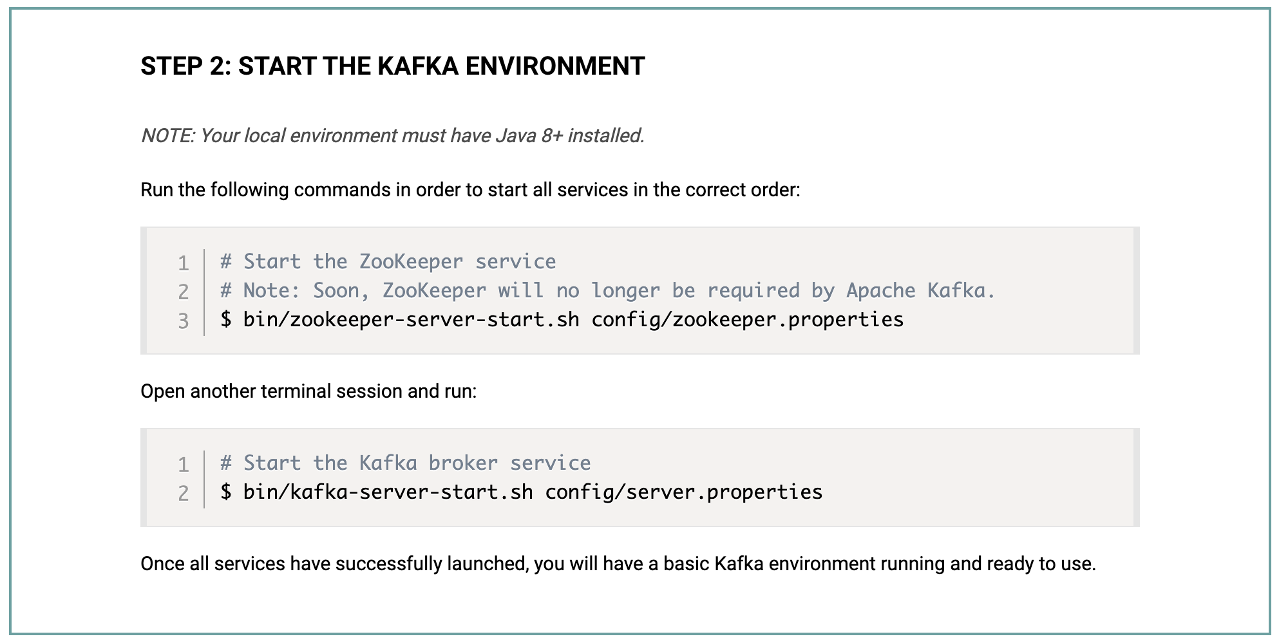
Kafka - Quickstart
Notes:
bin/zookeeper-server-start.sh config/zookeeper.properties
bin/kafka-server-start.sh config/server.properties
./bin/zkServer.sh start

Slide 18
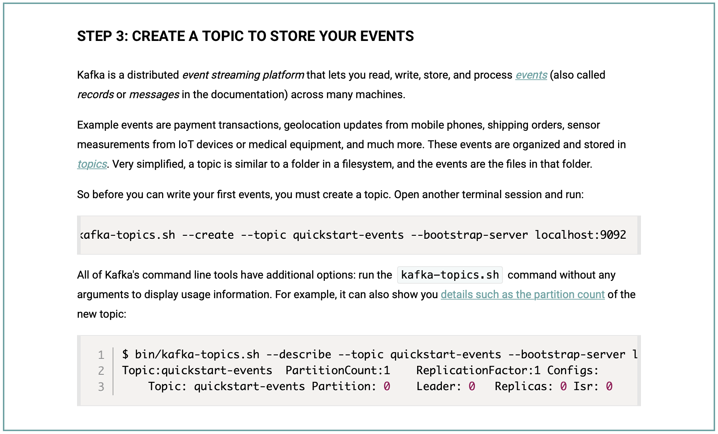

Kafka - Quickstart
Notes:
bin/kafka-topics.sh --create --topic quickstart-events --bootstrap-server localhost:9092
bin/kafka-topics.sh --describe --topic quickstart-events --bootstrap-server localhost:9092

Slide 19
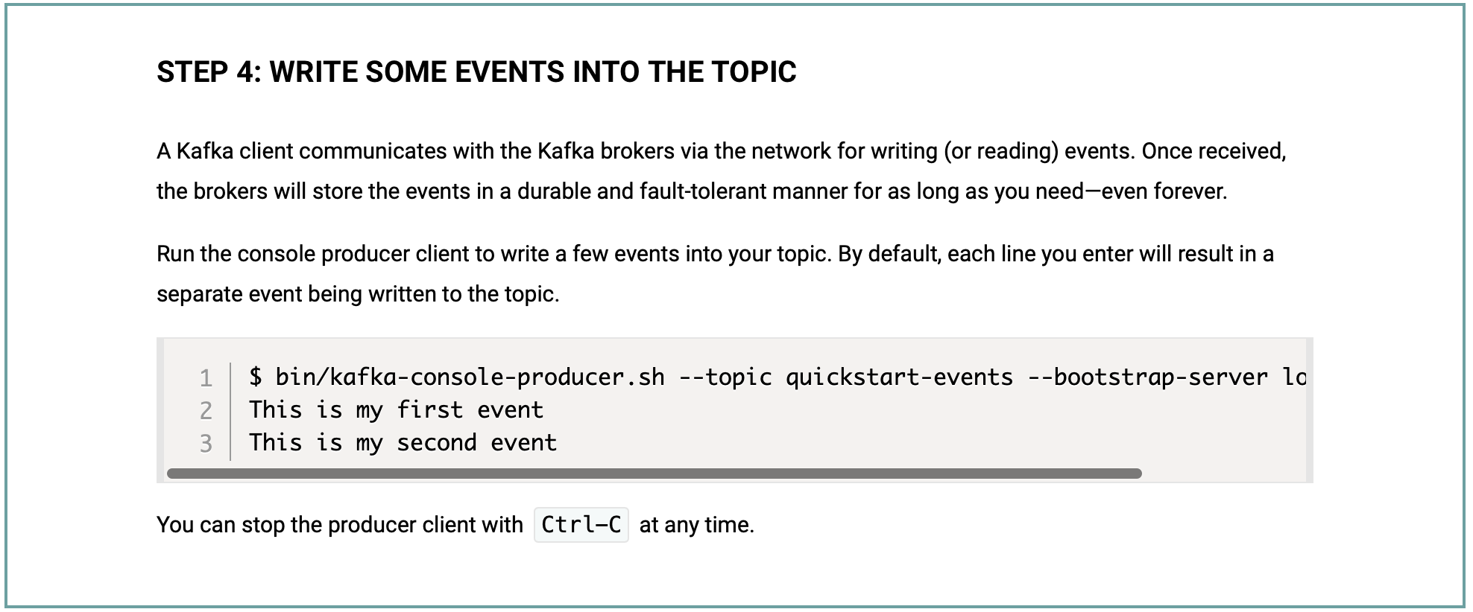

Kafka - Quickstart
Notes:
bin/kafka-console-producer.sh --topic quickstart-events --bootstrap-server localhost:9092

Slide 20
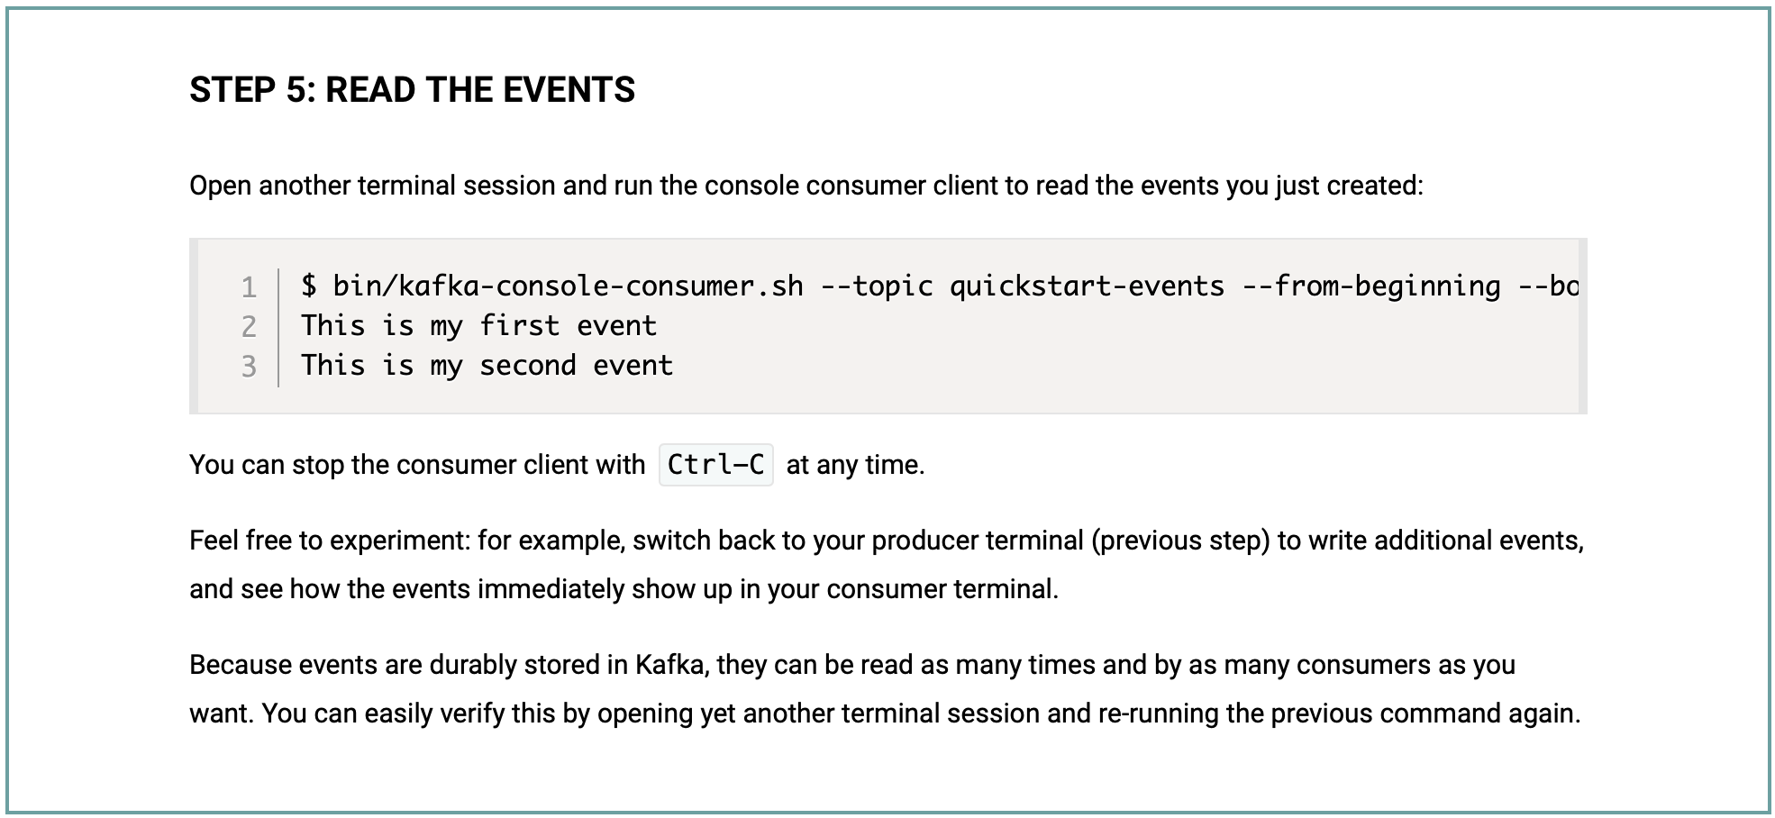

Kafka - Quickstart
Notes:
bin/kafka-console-consumer.sh --topic quickstart-events --from-beginning --bootstrap-server localhost:9092

Slide 21
Apache Kafka
Access Kafka with Java
To use Producer API and Consumer API, you can use the following maven dependency:
<dependency> <groupId>org.apache.kafka</groupId> <artifactId>kafka-clients</artifactId> <version>3.2.1</version> </dependency>

Slide 22
Apache Kafka
KafkaPro.java
public class KafkaPro { public static void main(String[] args) throws Exception { Properties props = new Properties(); props.put("bootstrap.servers", "localhost:9092"); props.setProperty("transactional.id", "my-transactional-id"); Producer<String, String> producer = null; try { producer = new KafkaProducer<String, String>(props, new StringSerializer(), new StringSerializer()); producer.initTransactions(); producer.beginTransaction(); for (int i = 0; i < 100; i++) producer.send(new ProducerRecord<>("test", Integer.toString(i), "Message " + Integer.toString(i))); producer.commitTransaction(); } catch (ProducerFencedException e) { producer.close(); } catch (OutOfOrderSequenceException e) { producer.close(); } catch (AuthorizationException e) { producer.close(); } catch (KafkaException e) { producer.abortTransaction(); } producer.close(); } }
MOM-->RM-->Transaction

Slide 23
Apache Kafka
KafkaCon.java
public class KafkaCon { public static void main(String[] args) throws Exception { Properties props = new Properties(); props.setProperty("bootstrap.servers", "localhost:9092"); props.setProperty("group.id", "test"); props.setProperty("enable.auto.commit", "true"); props.setProperty("auto.commit.interval.ms", "1000"); props.setProperty("key.deserializer", "org.apache.kafka.common.serialization.StringDeserializer"); props.setProperty("value.deserializer", "org.apache.kafka.common.serialization.StringDeserializer"); KafkaConsumer<String, String> consumer = new KafkaConsumer<>(props); consumer.subscribe(Arrays.asList("test")); while (true) { ConsumerRecords<String, String> records = consumer.poll(Duration.ofMillis(100)); for (ConsumerRecord<String, String> record : records) System.out.printf("offset = %d, key = %s, value = %s%n", record.offset(), record.key(), record.value()); } } }
Notes:
bin/zookeeper-server-start.sh config/zookeeper.properties
bin/kafka-server-start.sh config/server.properties

Slide 24
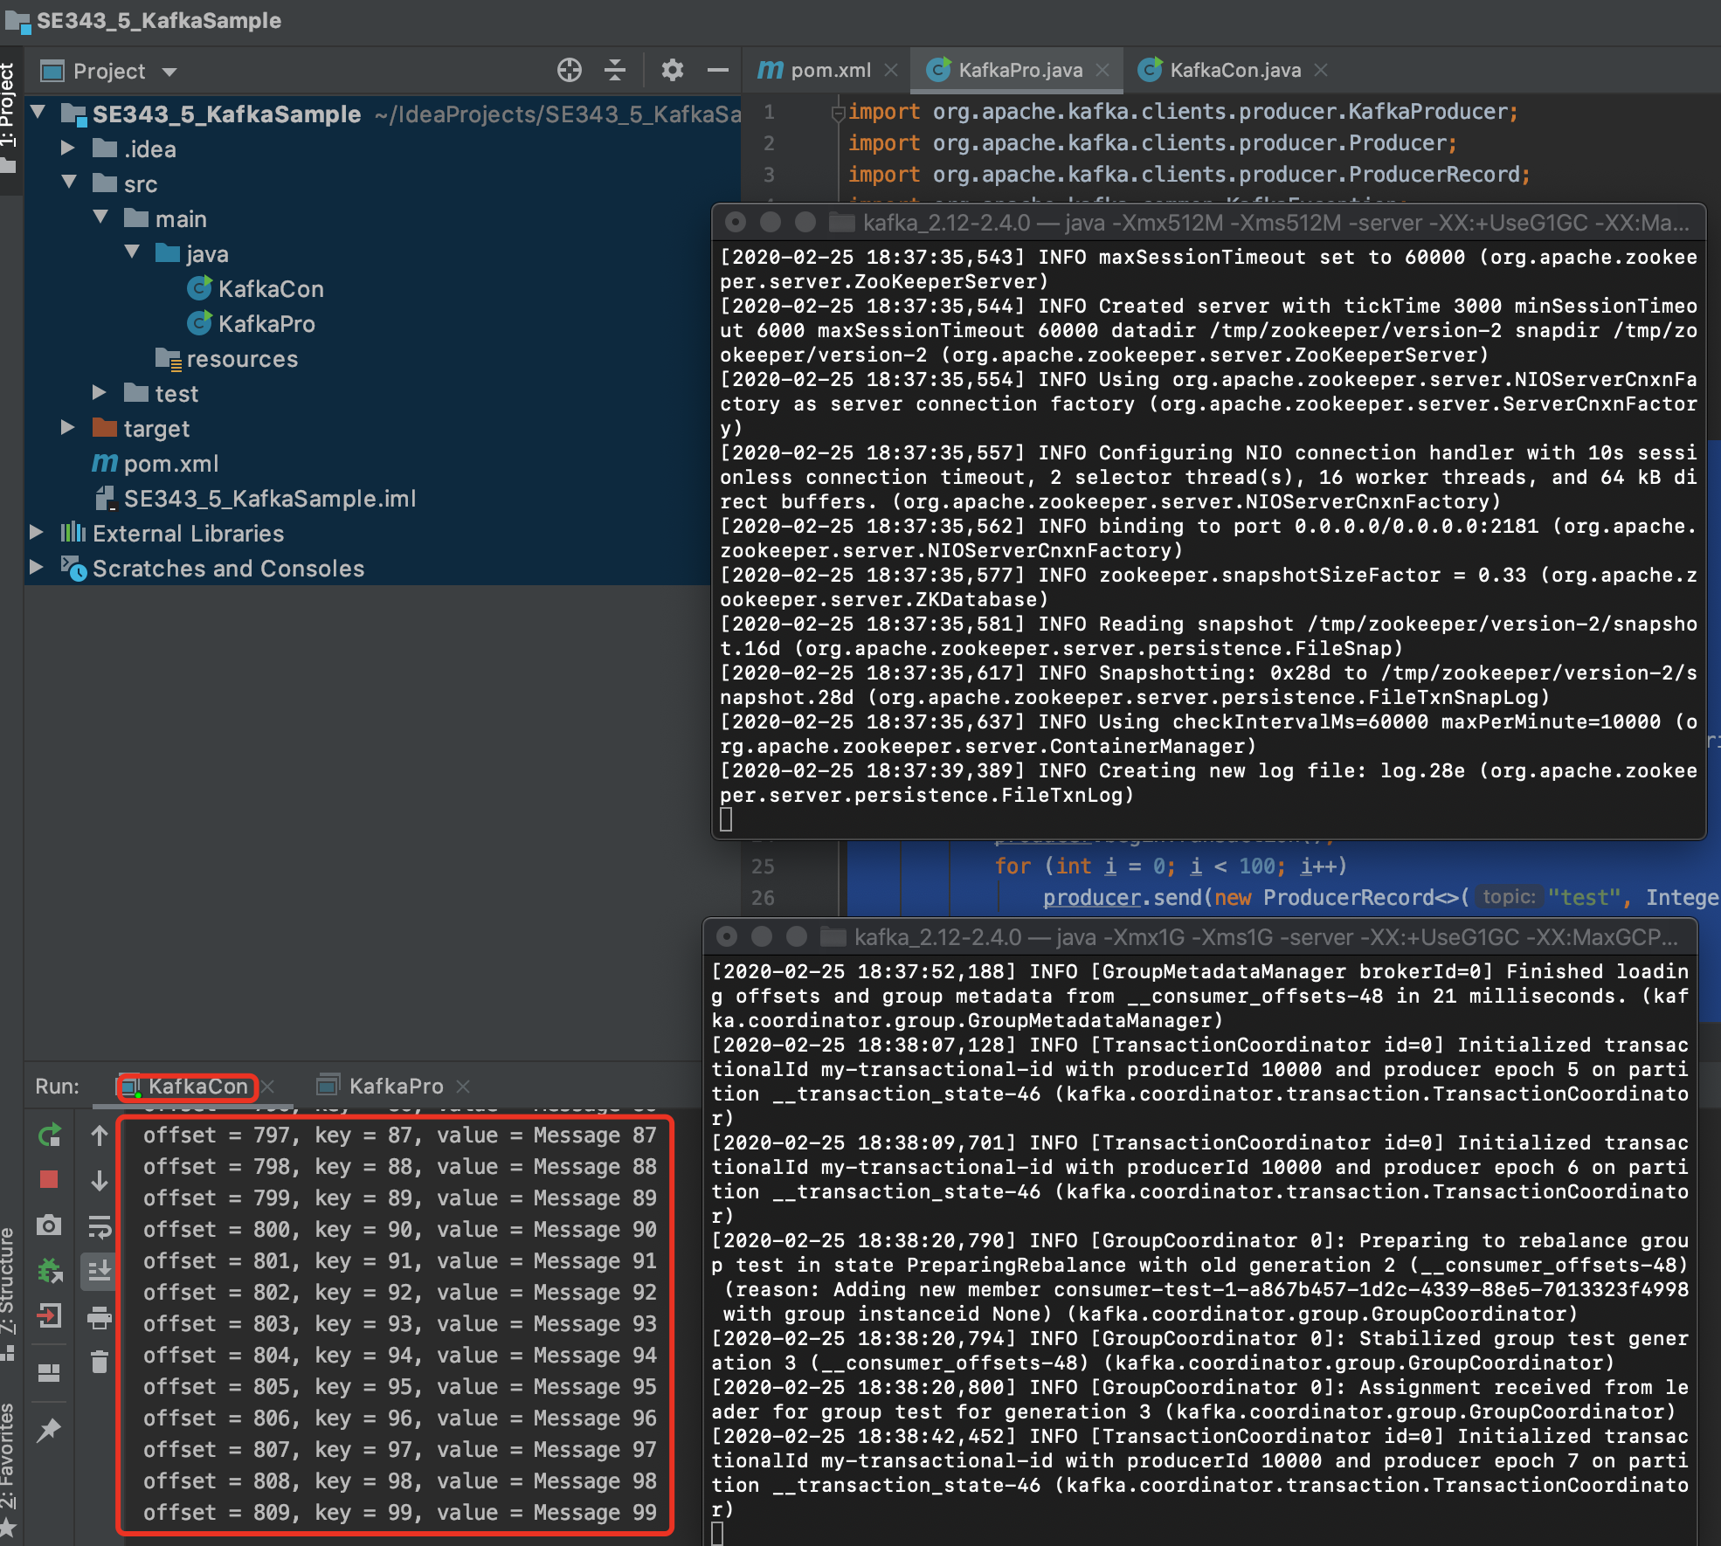
Apache Kafka

Slide 25
Spring for Kafka
Consumer
@SpringBootApplication
public class Se33534SpringKafkaConsumerApplication { public static void main(String[] args) { SpringApplication.run(Se33534SpringKafkaConsumerApplication.class, args); } @Bean public NewTopic topic() { return TopicBuilder.name("topic1") .partitions(10) .replicas(1) .build(); } @KafkaListener(id = "myId", topics = "topic1") public void listen(String in) { System.out.println(in); } }

Slide 26
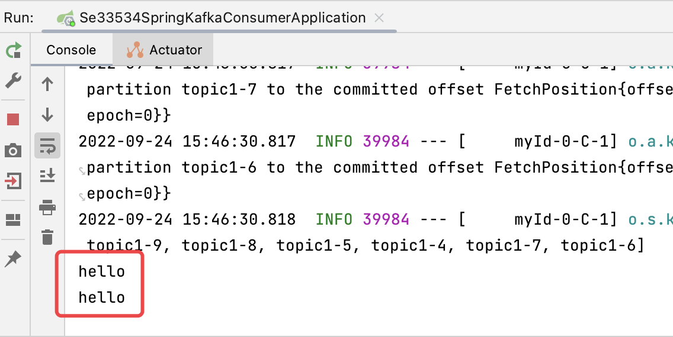
Spring for Kafka
Producer
@SpringBootApplication public class Se33534SpringKafkaProducerApplication { public static void main(String[] args) { SpringApplication.run(Se33534SpringKafkaProducerApplication.class, args); } @Bean public NewTopic topic() { return TopicBuilder.name("topic1") .partitions(10) .replicas(1) .build(); } @Bean public ApplicationRunner runner(KafkaTemplate<String, String> template) { return args -> { template.send("topic1", "hello"); }; } }

Slide 27
Place Order with Kafka
BankController
@RestController public class BankController { @Autowired private KafkaTemplate<String, String> kafkaTemplate; @RequestMapping("/send") public void send() { String data = "Tom,Jerry,80"; kafkaTemplate.send("topic1", "key", data); System.out.println(data); } }

Slide 28
Place Order with Kafka
BankListener
@Component public class BankListener { @Autowired private BankService bankService; @KafkaListener(topics = "topic1", groupId = "group_topic_test") public void topicListener(ConsumerRecord<String, String> record) { String[] value = record.value().split(","); bankService.transfer(value[0], value[1], Integer.valueOf(value[2])); } }

Slide 29
References
Apache Kafka Quick Start
https://kafka.apache.org/quickstart
Spring for Apache Kafka
https://docs.spring.io/spring-kafka/docs/3.0.0-SNAPSHOT/reference/html/#spring-boot-consumer-app
如何轻松在SpringBoot中正确配置并运行Kafka
https://blog.csdn.net/Eternal_Blue/article/details/125293622

Slide 30

Thank You!

