Slide 1
Architecture of Enterprise Applications 5 WebSocket
Haopeng Chen
REliable, INtelligent and Scalable Systems Group (REINS)
Shanghai Jiao Tong University
Shanghai, China
http://reins.se.sjtu.edu.cn/~chenhp
e-mail: chen-hp@sjtu.edu.cn

Slide 2
Contents and Objectives
Contents
Introduction to WebSocket
WebSocket Programming Model
WebSocket Samples
Objectives
能够根据系统需求，分析前后端之间适用于异步通信机制的业务场景，并设计并实现基于WebSocket的实现方案

Slide 3
WebSocket
WebSocket is an application protocol that provides full-duplex(可以理解为双向通信) communications between two peers(因为可以双向通信,所以对于ws而言其两端是等价的，类似于kafka的MOM) over the TCP protocol.
In the traditional request-response model used in HTTP, the client requests resources and the server provides responses.
The exchange is always initiated by the client; the server cannot send any data without the client requesting it first. (原始的HTTP模式一定是需要用户驱动的，ws希望解决的是server主动推送/接收)
The WebSocket protocol provides a full-duplex communication channel between the client and the server.
Combined with other client technologies, such as JavaScript and HTML5, WebSocket enables web applications to deliver a richer user experience.
websocket是基于TCP的长连接来实现的，提高了数据的实时性
Notes:
This model worked well for the World Wide Web when clients made occasional requests for documents that changed infrequently, but the limitations of this approach are increasingly relevant as content changes quickly and users expect a more interactive experience on the web. The WebSocket protocol addresses these limitations by providing a full-duplex communication channel between the client and the server. Combined with other client technologies, such as JavaScript and HTML5, WebSocket enables web applications to deliver a richer user experience.

Slide 4
Introduction to WebSocket
In a WebSocket application, the server publishes a WebSocket endpoint and the client uses the endpoint's URI to connect to the server.
The WebSocket protocol is symmetrical after the connection has been established:
The client and the server can send messages to each other at any time while the connection is open, and they can close the connection at any time.
Clients usually connect only to one server, and servers accept connections from multiple clients.
The WebSocket protocol has two parts:
handshake and data transfer.

Slide 5
Introduction to WebSocket
The client initiates the handshake by sending a request to a WebSocket endpoint using its URI.
The handshake is compatible with existing HTTP-based infrastructure:
web servers interpret it as an HTTP connection upgrade request.
An example handshake from a client looks like this:
GET /path/to/websocket/endpoint HTTP/1.1
Host: localhost
Upgrade: websocket
Connection: Upgrade
Sec-WebSocket-Key: xqBt3ImNzJbYqRINxEFlkg==
Origin: http://localhost
Sec-WebSocket-Version: 13

Slide 6
Introduction to WebSocket
The client initiates the handshake by sending a request to a WebSocket endpoint using its URI.
The handshake is compatible with existing HTTP-based infrastructure:
web servers interpret it as an HTTP connection upgrade request.
An example handshake from the server in response to the client looks like this:
HTTP/1.1 101 Switching Protocols
Upgrade: websocket
Connection: Upgrade
Sec-WebSocket-Accept: K7DJLdLooIwIG/MOpvWFB3y3FE8=

Slide 7
Introduction to WebSocket
The server applies a known operation to
the value of the Sec-WebSocket-Key header to generate the value of the Sec-WebSocket-Accept header.
The client applies the same operation to
the value of the Sec-WebSocket-Key header, and the connection is established successfully if the result matches the value received from the server.
The client and the server can send messages to each other after a successful handshake.

Slide 8
Introduction to WebSocket
WebSocket endpoints are represented by URIs that have the following form:
ws://host:port/path?query
wss://host:port/path?query
The ws scheme represents an unencrypted WebSocket connection, and
the wss scheme represents an encrypted connection.
The port component is optional;
the default port number is 80 for unencrypted connections and
443 for encrypted connections.
The path component indicates the location of an endpoint within a server.
The query component is optional.
Notes:
Modern web browsers implement the WebSocket protocol and provide a JavaScript API to connect to endpoints, send messages, and assign callback methods for WebSocket events (such as opened connections, received messages, and closed connections).

Slide 9
Creating WebSocket Applications
The Java API for WebSocket consists of the following packages:
The javax.websocket.server package contains annotations, classes, and interfaces to create and configure server endpoints.
The javax.websocket package contains annotations, classes, interfaces, and exceptions that are common to client and server endpoints.
WebSocket endpoints are instances of the javax.websocket.Endpoint class.
The Java API for WebSocket enables you to create two kinds of endpoints: programmatic endpoints and annotated endpoints.
To create a programmatic endpoint, you extend the Endpoint class and override its lifecycle methods.
To create an annotated endpoint, you decorate a Java class and some of its methods with the annotations provided by the packages above.
After you have created an endpoint, you deploy it to an specific URI in the application so remote clients can connect to it.

Slide 10
Creating and Deploying a WebSocket Endpoint
The process for creating and deploying a WebSocket endpoint:
Create an endpoint class.
Implement the lifecycle methods of the endpoint.
Add your business logic to the endpoint.
Deploy the endpoint inside a web application.
The process is slightly different for programmatic endpoints and annotated endpoints

Slide 11
Programmatic Endpoints
EchoEndpoint
public class EchoEndpoint extends Endpoint {
@Override
public void onOpen(final Session session, EndpointConfig config)
{
session.addMessageHandler(
new MessageHandler.Whole<String>() {
@Override
public void onMessage(String msg) {
try {
session.getBasicRemote().sendText(msg);
} catch (IOException e) { ... }
}
});
}
}
Notes:
This endpoint echoes every message received. The Endpoint class defines three lifecycle methods: onOpen, onClose, and onError. The EchoEndpoint class implements the onOpen method, which is the only abstract method in the Endpoint class.
The Session parameter represents a conversation between this endpoint and the remote endpoint. The addMessageHandler method registers message handlers, and the getBasicRemote method returns an object that represents the remote endpoint.
The Session interface is covered in detail in the rest of this chapter.
The message handler is implemented as an anonymous inner class. The onMessage method of the message handler is invoked when the endpoint receives a text message.
To deploy this programmatic endpoint, use the following code in your Java EE application:
ServerEndpointConfig.Builder.create(EchoEndpoint.class, "/echo").build();
When you deploy your application, the endpoint is available at ws://<host>:<port>/<application>/echo;
for example, ws://localhost:8080/echoapp/echo.

Slide 12
Programmatic Endpoints
To deploy this programmatic endpoint, use the following code in your Java EE application:
ServerEndpointConfig.Builder.create(EchoEndpoint.class, "/echo").build();
When you deploy your application, the endpoint is available at ws://<host>:<port>/<application>/echo;
for example, ws://localhost:8080/echoapp/echo.

Slide 13
Annotated Endpoints
EchoEndpoint
@ServerEndpoint("/echo")
public class EchoEndpoint {
@OnMessage
public void onMessage(Session session, String msg) {
try {
session.getBasicRemote().sendText(msg);
} catch (IOException e) { ... }
}
}

Slide 14
Annotated Endpoints
Annotation | Event | Example
OnOpen | Connection opened. | @OnOpen public void open(Session session, EndpointConfig conf) { }
OnMessage | Message received. | @OnMessage public void message (Session session, String msg) { }
OnError | Connection error. | @OnError public void error(Session session, Throwable error) { }
OnClose | Connection closed. | @OnClose public void close(Session session, CloseReason reason) { }

Slide 15
Sending Messages to All Peers Connected to an Endpoint
Send messages
@ServerEndpoint("/echoall")
public class EchoAllEndpoint {
@OnMessage
public void onMessage(Session session, String msg)
{
try {
for (Session sess : session.getOpenSessions()) {
if (sess.isOpen())
sess.getBasicRemote().sendText(msg);
}
} catch (IOException e) { ... }
}
}
获得与此session相关得还处于在线状态的session

Slide 16
Receiving Messages
Receive messages
@ServerEndpoint("/receive")
public class ReceiveEndpoint {
@OnMessage
public void textMessage(Session session, String msg)
{ System.out.println("Text message: " + msg); }
@OnMessage
public void binaryMessage(Session session, ByteBuffer msg)
{ System.out.println("Binary message: " + msg.toString()); }
@OnMessage
public void pongMessage(Session session, PongMessage msg)
{
System.out.println("Pong message: " +
msg.getApplicationData().toString());
}
}

Slide 17
An example
ETFEndPoint.java
@ServerEndpoint("/dukeetf")
public class ETFEndpoint {
private static final Logger logger =
Logger.getLogger("ETFEndpoint");
static Queue<Session> queue = new ConcurrentLinkedQueue<>();
public static void send(double price, int volume) {
String msg = String.format("%.2f, %d", price, volume);
try {
for (Session session : queue) {
session.getBasicRemote().sendText(msg);
logger.log(Level.INFO, "Sent: {0}", msg);
}
} catch (IOException e) {
logger.log(Level.INFO, e.toString());
}
}
这里使用的ConcurrentLinkedQueue主要是利用其线程安全性，来保证多个session并发操作时的正确性。

Slide 18
An example
ETFEndPoint.java
@OnOpen
public void openConnection(Session session) {
queue.add(session);
logger.log(Level.INFO, "Connection opened.");
}
@OnClose
public void closedConnection(Session session) {
queue.remove(session);
logger.log(Level.INFO, "Connection closed.");
}
@OnError
public void error(Session session, Throwable t) {
queue.remove(session);
logger.log(Level.INFO, t.toString());
logger.log(Level.INFO, "Connection error.");
}
}

Slide 19
An example
ETFListener.java
@WebListener
public class ETFListener implements ServletContextListener {
private Timer timer = null;
public void contextInitialized(ServletContextEvent event) {
timer = new Timer(true);
event.getServletContext().log("The Timer is started");
timer.schedule(new ReportBean(event.getServletContext()), 0, 1000);
event.getServletContext().log("The task is added");
}
}

Slide 20
An example
ReportBean.java
public class ReportBean extends TimerTask {
private ServletContext context = null;
private Random random = new Random();
private double price = 100.0;
private int volume = 300000;
public ReportBean(ServletContext context)
{ this.context = context; }
public void run() {
context.log("Task started");
price += 1.0*(random.nextInt(100)-50)/100.0;
volume += random.nextInt(5000) - 2500;
ETFEndpoint.send(price, volume);
context.log("Task ended");
}
}

Slide 21
An example
Index.html
<html>
<head>
<title>Duke's WebSocket ETF</title>
<script type="text/javascript">
var wsocket;
function connect() {
wsocket = new WebSocket
("ws://localhost:8080/WebSocketSamples/dukeetf");
wsocket.onmessage = onMessage;
}
function onMessage(evt) {
var arraypv = evt.data.split(",");
document.getElementById("price").innerHTML = arraypv[0];
document.getElementById("volume").innerHTML = arraypv[1];
}
window.addEventListener("load", connect, false);
</script>
</head>

Slide 22
An example
Index.html
<body>
<h1>Duke's WebSocket ETF</h1>
<table>
<tr>
<td width="100">Ticker</td>
<td align="center">Price</td>
<td id="price"
style="font-size:24pt;font-weight:bold;">--.--</td>
</tr>
<tr>
<td style="font-size:18pt;font-weight:bold;"
width="100">DKEJ</td>
<td align="center">Volume</td>
<td id="volume" align="right">--</td>
</tr>
</table>
</body>
</html>

Slide 23
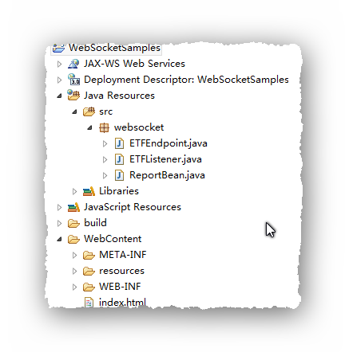
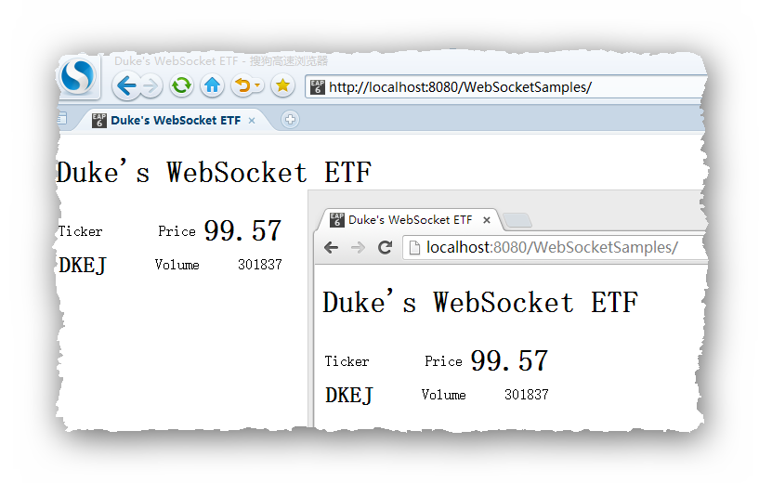
An example

Slide 24
Using Encoders and Decoders
The Java API for WebSocket provides
support for converting between WebSocket messages and custom Java types using encoders and decoders.
An encoder takes a Java object and produces a representation that can be transmitted as a WebSocket message;
for example, encoders typically produce JSON, XML, or binary representations.
A decoder performs the reverse function: it reads a WebSocket message and creates a Java object.
This mechanism simplifies WebSocket applications, because it decouples the business logic from the serialization and deserialization of objects.

Slide 25
Encoders
Implement one of the following interfaces:
Encoder.Text<T> for text messages
Encoder.Binary<T> for binary messages
public class MessageATextEncoder implements Encoder.Text<MessageA> {
@Override
public void init(EndpointConfig ec) { }
@Override
public void destroy() { }
@Override
public String encode(MessageA msgA) throws EncodeException {
// Access msgA's properties and convert to JSON text...
return msgAJsonString;
}
}

Slide 26
Encoders
Then, add the encoders parameter to the ServerEndpoint annotation as follows:
@ServerEndpoint(
value = "/myendpoint",
encoders = {
MessageATextEncoder.class,
MessageBTextEncoder.class } )
public class EncEndpoint { ... }
Now you can send MessageA and MessageB objects as WebSocket messages using the sendObject method as follows:
MessageA msgA = new MessageA(...);
MessageB msgB = new MessageB(...);
session.getBasicRemote.sendObject(msgA);
session.getBasicRemote.sendObject(msgB);

Slide 27
Decoders
Implement one of the following interfaces:
Decoder.Text<T> for text messages
Decoder.Binary<T> for binary messages
public class MessageTextDecoder implements Decoder.Text<Message> {
@Override
public void init(EndpointConfig ec) { }
@Override
public void destroy() { }
@Override
public Message decode(String string) throws DecodeException {
// Read message...
if ( /* message is an A message */ ) return new MessageA(...);
else if ( /* message is a B message */ ) return new MessageB(...);
}
@Override
public boolean willDecode(String string) {
// Determine if the message can be converted into either a
// MessageA object or a MessageB object...
return canDecode;
}
}
这里的decode函数只能返回Message
的父类型，因为在decode之前也不知
道传入的string会被转化成那种类型
的message，只能后续通过instanceof
的方式来判断到底是MessageA还是
essageB了。

Slide 28
Decoders
Then, add the decoders parameter to the ServerEndpoint annotation as follows:
@ServerEndpoint(
value = "/myendpoint",
encoders = {
MessageATextEncoder.class,
MessageBTextEncoder.class }
decoders = { MessageTextDecoder.class }
)
public class EncEndpoint { ... }
Now define a method in the endpoint class that receives MessageA and MessageB objects as follows:
@OnMessage public void message(Session session, Message msg) {
if (msg instanceof MessageA) {
// We received a MessageA object...
else if (msg instanceof MessageB) {
// We received a MessageB object... }
}

Slide 29
Handling Errors
To designate a method that handles errors in an annotated WebSocket endpoint, decorate it with @OnError:
@ServerEndpoint("/testendpoint")
public class TestEndpoint {
...
@OnError
public void error(Session session, Throwable t)
{
t.printStackTrace();
...
}
}

Slide 30
Using WebSocket in Spring Application
pom.xml
<dependency>
<groupId>org.webjars</groupId>
<artifactId>webjars-locator-core</artifactId>
</dependency>
<dependency>
<groupId>org.webjars</groupId>
<artifactId>sockjs-client</artifactId>
<version>1.0.2</version>
</dependency>
<dependency>
<groupId>org.webjars</groupId>
<artifactId>stomp-websocket</artifactId>
<version>2.3.3</version>
</dependency>
<dependency>
<groupId>org.webjars</groupId>
<artifactId>bootstrap</artifactId>
<version>3.3.7</version>
</dependency>
<dependency>
<groupId>org.webjars</groupId>
<artifactId>jquery</artifactId>
<version>3.1.1-1</version>
</dependency>

Slide 31
Using WebSocket in Spring Application
HelloMessage.java
package com.example.messagingstompwebsocket; public class HelloMessage { private String name; public HelloMessage() { } public HelloMessage(String name) { this.name = name; } public String getName() { return name; } public void setName(String name) { this.name = name; } }
The service will accept messages that contain a name in a STOMP message whose body is a JSON object.
{
"name": "Fred"
}

Slide 32
Using WebSocket in Spring Application
Greeting.java
package com.example.messagingstompwebsocket; public class Greeting { private String content; public Greeting() { } public Greeting(String content) { this.content = content; } public String getContent() { return content; } }
Upon receiving the message and extracting the name, the service will process it by creating a greeting and publishing that greeting on a separate queue to which the client is subscribed.
{
"content": "Hello, Fred!"
}

Slide 33
Using WebSocket in Spring Application
GreetingController.java
package com.example.messagingstompwebsocket; import org.springframework.messaging.handler.annotation.MessageMapping; import org.springframework.messaging.handler.annotation.SendTo; import org.springframework.stereotype.Controller; import org.springframework.web.util.HtmlUtils; @Controller public class GreetingController { @MessageMapping("/hello") @SendTo("/topic/greetings") public Greeting greeting(HelloMessage message) throws Exception { Thread.sleep(1000); // simulated delay return new Greeting("Hello, " + HtmlUtils.htmlEscape(message.getName()) + "!"); } }
In Spring’s approach to working with STOMP messaging, STOMP messages can be routed to @Controller classes.

Slide 34
Using WebSocket in Spring Application
WebSocketConfig.java
package com.example.messagingstompwebsocket; import org.springframework.context.annotation.Configuration; import org.springframework.messaging.simp.config.MessageBrokerRegistry; import org.springframework.web.socket.config.annotation.EnableWebSocketMessageBroker; import org.springframework.web.socket.config.annotation.StompEndpointRegistry; import org.springframework.web.socket.config.annotation.WebSocketMessageBrokerConfigurer; @Configuration @EnableWebSocketMessageBroker public class WebSocketConfig implements WebSocketMessageBrokerConfigurer { @Override public void configureMessageBroker(MessageBrokerRegistry config) { config.enableSimpleBroker("/topic"); config.setApplicationDestinationPrefixes("/app"); } @Override public void registerStompEndpoints(StompEndpointRegistry registry) { registry.addEndpoint("/gs-guide-websocket").withSockJS(); } }
Now that the essential components of the service are created, you can configure Spring to enable WebSocket and STOMP messaging.

Slide 35
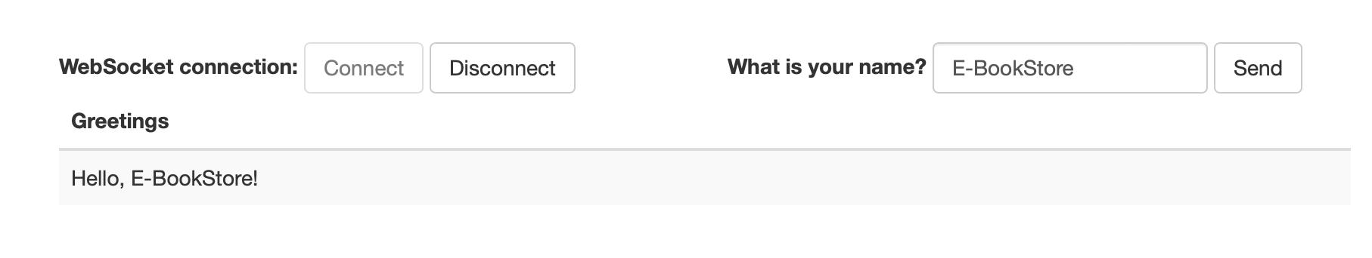
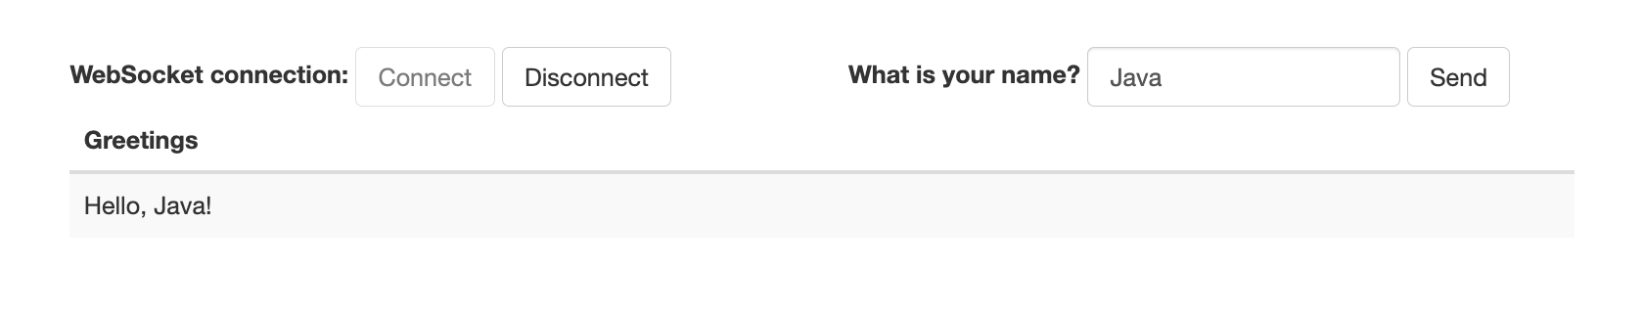
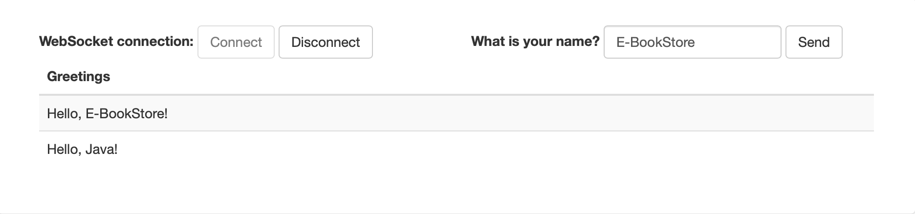
Using WebSocket in Spring Application
index.html

Slide 36
Using WebSocket in Spring Application
app.js
var stompClient = null; function setConnected(connected) { $("#connect").prop("disabled", connected); $("#disconnect").prop("disabled", !connected); if (connected) { $("#conversation").show(); } else { $("#conversation").hide(); } $("#greetings").html(""); } function connect() { var socket = new SockJS('/gs-guide-websocket'); stompClient = Stomp.over(socket); stompClient.connect({}, function (frame) { setConnected(true); console.log('Connected: ' + frame); stompClient.subscribe('/topic/greetings', function (greeting) { showGreeting(JSON.parse(greeting.body).content); }); }); }
function disconnect() { if (stompClient !== null) { stompClient.disconnect(); } setConnected(false); console.log("Disconnected"); } function sendName() { stompClient.send("/app/hello", {}, JSON.stringify({'name': $("#name").val()})); } function showGreeting(message) { $("#greetings").append("<tr><td>" + message + "</td></tr>"); } $(function () { $("form").on('submit', function (e) { e.preventDefault(); }); $( "#connect" ).click(function() { connect(); }); $( "#disconnect" ).click(function() { disconnect(); }); $( "#send" ).click(function() { sendName(); }); });

Slide 37
Transfer with WebSocket
WebSocketConfig.java(通用)
@Configuration public class WebSocketConfig { @Bean public ServerEndpointExporter serverEndpointExporter(){ return new ServerEndpointExporter(); } }

Slide 38
Transfer with WebSocket
WebSocketServer.java
@ServerEndpoint("/websocket/transfer/{userId}") @Component public class WebSocketServer { private static final ConcurrentHashMap<String, Session> SESSIONS
= new ConcurrentHashMap<>(); public void sendMessage(Session toSession, String message) { if (toSession != null) { try { toSession.getBasicRemote().sendText(message); } catch (IOException e) { e.printStackTrace(); } } else { System.out.println("对方不在线"); } } public void sendMessageToUser(String user, String message) { System.out.println(user); Session toSession = SESSIONS.get(user); sendMessage(toSession, message); System.out.println(message); }
@OnMessage public void onMessage(String message) { System.out.println("服务器收到消息：" + message); } @OnOpen public void onOpen(Session session, @PathParam("userId") String userId) { if (SESSIONS.get(userId) != null) { return; }//已经在线的用户无需重复登录 SESSIONS.put(userId, session); System.out.println(userId + "上线了，当前在线人数：" + COUNT); } @OnClose public void onClose(@PathParam("userId") String userId) { SESSIONS.remove(userId); System.out.println(userId + "下线了，当前在线人数：" + COUNT); } @OnError public void onError(Session session, Throwable throwable) { System.out.println("发生错误"); throwable.printStackTrace(); } }

Slide 39
Transfer with WebSocket
BankListener.java
public class BankListener { @Autowired private WebSocketServer ws; @KafkaListener(topics = "topic1", groupId = "group_topic_test") public void topic1Listener(ConsumerRecord<String, String> record) { String[] value = record.value().split(","); bankService.transfer(value[0], value[1], Integer.valueOf(value[2])); kafkaTemplate.send("topic2", "key", "Done"); } @KafkaListener(topics = "topic2", groupId = "group_topic_test") public void topic2Listener(ConsumerRecord<String, String> record) { String value = record.value(); System.out.println(value); ws.sendMessageToUser("Tom","Done"); } }

Slide 40
Transfer with WebSocket
frontend-app.js
import './App.css'; import $ from 'jquery' var socket; function setConnected(connected) { $("#connect").prop("disabled", connected); $("#disconnect").prop("disabled", !connected); if (connected) { $("#conversation").show(); } else { $("#conversation").hide(); } $("#greetings").html(""); } function showGreeting(message) { $("#greetings").append("<tr><td>" + message + "</td></tr>"); }

Slide 41
Transfer with WebSocket
frontend-app.js
function openSocket() { if (typeof (WebSocket) == “undefined”) { alert(“您的浏览器不支持WebSocket”); } else { if (socket != null) { return; } var userId = document.getElementById('name').value; var socketUrl = "ws://localhost:8080/websocket/transfer/" + userId; console.log(socketUrl); setConnected(true); socket = new WebSocket(socketUrl); //打开事件 socket.onopen = function () { console.log("websocket已打开"); //socket.send("这是来自客户端的消息" + location.href + new Date()); };
//获得消息事件 socket.onmessage = function (msg) { var serverMsg = "收到服务端信息：" + msg.data; console.log(serverMsg); //发现消息进入 开始处理前端触发逻辑 showGreeting(msg.data); }; //关闭事件 socket.onclose = function () { console.log("websocket已关闭"); }; //发生了错误事件 socket.onerror = function () { console.log("websocket发生了错误"); } } }

Slide 42
Transfer with WebSocket
frontend-app.js
function closeSocket() { if (socket === undefined || socket === null) { alert("请先连接"); return; } socket.close(); socket = null; setConnected(false); } function sendMessage() { if (socket === undefined || socket === null) { alert("请先连接"); return; } if (typeof (WebSocket) == "undefined") { console.log("您的浏览器不支持WebSocket"); } else { console.log("您的浏览器支持WebSocket"); var msg = JSON.stringify({'userId': $("#name").val()}); console.log(msg);
// socket.send(msg); $.ajax({ type: "get", url: "http://localhost:8080/send", dataType: 'jsonp' //【jsonp进行跨域请求 只支持get】 }); } }
$(function () { $("form").on('submit', function (e) { e.preventDefault(); }); $( "#connect" ).click(function() { openSocket(); }); $( "#disconnect" ).click(function() { closeSocket(); }); $( "#send" ).click(function() { sendMessage(); }); });

Slide 43
Transfer with WebSocket
frontend-app.js
function App() { return ( <div className="App"> <div id="main-content" className="container"> <div className="row"> <div className="col-md-6"> <form className="form-inline"> <div className="form-group"> <label htmlFor="connect">WebSocket connection:</label> <button id="connect" className="btn btn-default”
type="submit">Connect</button> <button id="disconnect" className="btn btn-default”
type="submit" disabled="disabled">Disconnect </button> </div> </form> </div> <div className="col-md-6"> <form className="form-inline"> <div className="form-group"> <label htmlFor="name">What is your name?</label> <input type="text" id="name" className="form-control"
placeholder="Your name here..."/> </div> <button id="send" className="btn btn-default" type="submit">Send</button> </form> </div> </div>
<div className="row"> <div className="col-md-12"> <table id="conversation"
className="table table-striped"> <thead> <tr> <th>Greetings</th> </tr> </thead> <tbody id="greetings"> </tbody> </table> </div> </div> </div> </div> ); } export default App;

Slide 44
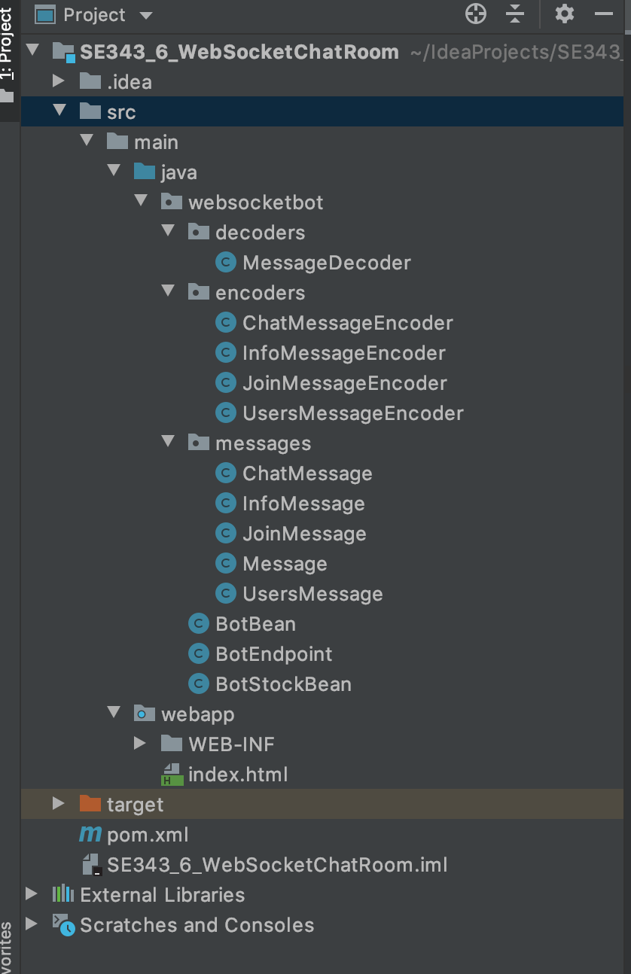
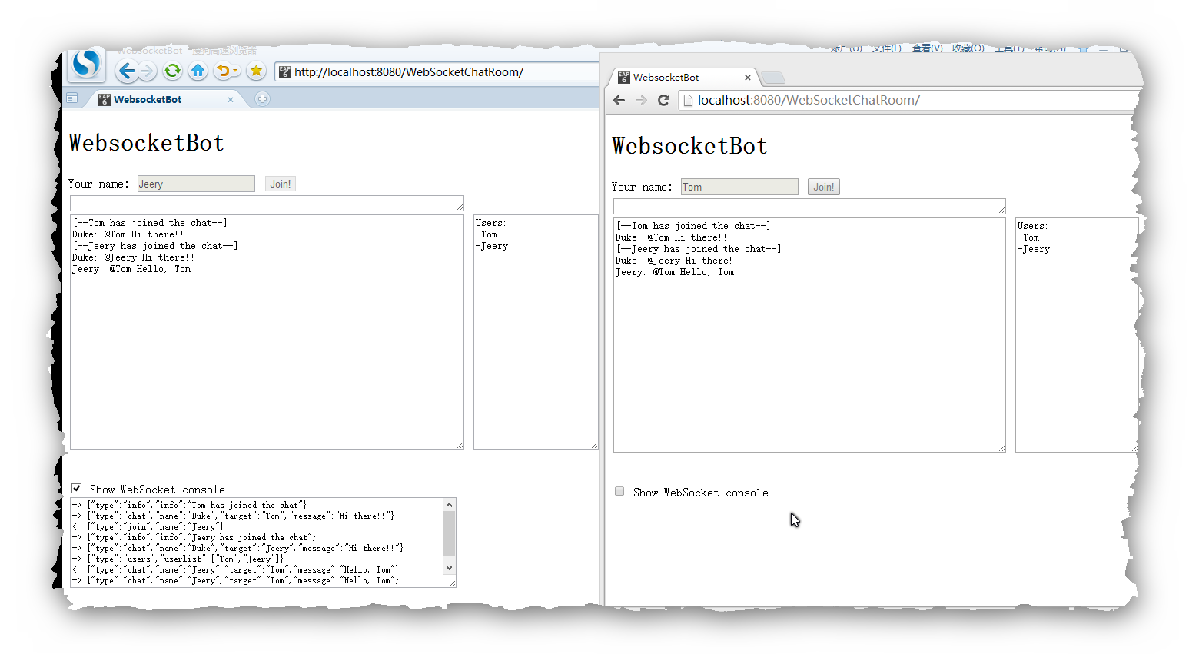
An example - Chatroom

Slide 45
An example - Chatroom
index.html
<html xmlns="http://www.w3.org/1999/xhtml">
<head>
<title>WebsocketBot</title>
<script type="text/javascript">
var wsocket; // Websocket connection
var userName; // User's name
var textarea; // Chat area
var wsconsole; // Websocket console area
var userlist; // User list area
function connect() {
textarea = document.getElementById("textarea");
wsconsole = document.getElementById("wsconsole");
userlist = document.getElementById("userlist");
wsocket = new WebSocket(
"ws://localhost:8080/WebSocketChatRoom/websocketbot");
wsocket.onmessage = onMessage;
document.getElementById("name").focus();
document.getElementById("consolediv").style.visibility ='hidden';
}
tomcat格式的request

Slide 46
An example - Chatroom
index.html
function onMessage(evt) {//接收后端发过来的消息
var line = "";
var msg = JSON.parse(evt.data);
if (msg.type === "chat") {
line = msg.name + ": ";
if (msg.target.length > 0)
line += "@" + msg.target + " ";
line += msg.message + "\n";
textarea.value += "" + line;
} else if (msg.type === "info") {
line = "[--" + msg.info + "--]\n";
textarea.value += "" + line;
} else if (msg.type === "users") {
line = "Users:\n";
for (var i=0; i < msg.userlist.length; i++)
line += "-" + msg.userlist[i] + "\n";
userlist.value = line;
}
textarea.scrollTop = 999999;//滑到最下面，即默认显示最新的消息
wsconsole.value += "-> " + evt.data + "\n";
wsconsole.scrollTop = 999999;
}

Slide 47
An example - Chatroom
index.html
function sendJoin() {
var input = document.getElementById("input");
var name = document.getElementById("name");
var join = document.getElementById("join");
var jsonstr;
if (name.value.length > 0) {
var joinMsg = {};
joinMsg.type = "join";
joinMsg.name = name.value;
jsonstr = JSON.stringify(joinMsg);
wsocket.send(jsonstr);
name.disabled = true;
join.disabled = true;
input.disabled = false;
userName = name.value;
wsconsole.value += "<- " + jsonstr + "\n";
wsconsole.scrollTop = 999999;
}
}

Slide 48
An example - Chatroom
index.html
function sendMessage(evt) {
var input = document.getElementById("input");
var jsonstr;
var msgstr;
if (evt.keyCode === 13 && input.value.length > 0) {
var chatMsg = {};
chatMsg.type = "chat";
chatMsg.name = userName;
msgstr = input.value;
chatMsg.target = getTarget(msgstr.replace(/,/g, ""));
chatMsg.message = cleanTarget(msgstr);
chatMsg.message =
chatMsg.message.replace(/(\r\n|\n|\r)/gm,"");
jsonstr = JSON.stringify(chatMsg);
wsocket.send(jsonstr);
input.value = "";
wsconsole.value += "<- " + jsonstr + "\n";
wsconsole.scrollTop = 999999;
}
}

Slide 49
An example - Chatroom
index.html
function checkJoin(evt) {
var name = document.getElementById("name");
var input = document.getElementById("input");
if (evt.keyCode === 13 && name.value.length > 0) {
sendJoin();
input.focus();
}
}
function getTarget(str) {
var arr = str.split(" ");
var target = "";
for (var i=0; i<arr.length; i++) {
if (arr[i].charAt(0) === '@') {
target = arr[i].substring(1,arr[i].length);
target = target.replace(/(\r\n|\n|\r)/gm,"");
}
}
return target;
}

Slide 50
An example - Chatroom
index.html
function cleanTarget(str) {
var arr = str.split(" ");
var cleanstr = "";
for (var i=0; i<arr.length; i++) {
if (arr[i].charAt(0) !== '@')
cleanstr += arr[i] + " ";
}
return cleanstr.substring(0,cleanstr.length-1);
}
function showHideConsole() {
var chkbox = document.getElementById("showhideconsole");
var consolediv = document.getElementById("consolediv");
if (chkbox.checked)
consolediv.style.visibility = 'visible';
else
consolediv.style.visibility = 'hidden';
}
window.addEventListener("load", connect, false);
</script>
</head>

Slide 51
An example - Chatroom
index.html
<body>
<h1>WebsocketBot</h1>
Your name: <input id="name" type="text" size="20" maxlength="20"
onkeyup="checkJoin(event);"/>
<input type="submit" id="join" value="Join!"
onclick="sendJoin();"/><br/>
<textarea id="input" cols="70" rows="1" disabled="true"
onkeyup="sendMessage(event);"></textarea><br/>
<textarea id="textarea" cols="70" rows="20"
readonly="true"></textarea>
<textarea id="userlist" cols="20" rows="20"
readonly="true"></textarea>
<br/><br/><br/>
<input id="showhideconsole" type="checkbox"
onclick="showHideConsole();"/>
Show WebSocket console<br/>
<div id="consolediv"><textarea id="wsconsole" cols="80" rows="8"
readonly="true" style="font-size:8pt;"></textarea></div>
</body>
</html>

Slide 52
An example - Chatroom
BotEndPoint.java
@ServerEndpoint(
value = "/websocketbot",
decoders = { MessageDecoder.class },
encoders = { JoinMessageEncoder.class, ChatMessageEncoder.class,
InfoMessageEncoder.class, UsersMessageEncoder.class }
)
public class BotEndpoint {
private static final Logger logger = Logger.getLogger("BotEndpoint");
private static Queue<Session> mySession = new ConcurrentLinkedQueue<>();
@OnOpen
public void openConnection(Session session) {
mySession.add(session);
logger.log(Level.INFO, "Connection opened.");
}

Slide 53
An example - Chatroom
BotEndPoint.java
@OnMessage
public void message(final Session session, Message msg) {
if (msg instanceof JoinMessage) {
JoinMessage jmsg = (JoinMessage) msg;
session.getUserProperties().put("name", jmsg.getName());
session.getUserProperties().put("active", true);
logger.log(Level.INFO, "Received: {0}", jmsg.toString());
sendAll(session, new InfoMessage(jmsg.getName() + " has
joined the chat"));
sendAll(session, new ChatMessage("Duke", jmsg.getName(),
"Hi there!!"));
sendAll(session, new UsersMessage(this.getUserList(session)));
} else if (msg instanceof ChatMessage) {
final ChatMessage cmsg = (ChatMessage) msg;
logger.log(Level.INFO, "Received: {0}", cmsg.toString());
sendAll(session, cmsg);
}
}

Slide 54
An example - Chatroom
BotEndPoint.java
@OnClose
public void closedConnection(Session session) {
session.getUserProperties().put("active", false);
if (session.getUserProperties().containsKey("name")) {
String name =
session.getUserProperties().get("name").toString();
sendAll(session, new InfoMessage(name +
" has left the chat"));
sendAll(session, new UsersMessage(this.getUserList(session)));
}
logger.log(Level.INFO, "Connection closed.");
}
@OnError
public void error(Session session, Throwable t) {
logger.log(Level.INFO, "Connection error ({0})", t.toString());
}

Slide 55
An example - Chatroom
BotEndPoint.java
public synchronized void sendAll(Session session, Object msg) {
try {
for (Session s : session.getOpenSessions()) {
if (s.isOpen()) {
s.getBasicRemote().sendObject(msg);
logger.log(Level.INFO, "Sent: {0}", msg.toString());
}
}
} catch (IOException | EncodeException e) {
logger.log(Level.INFO, e.toString());
}
}
public List<String> getUserList(Session session) {
List<String> users = new ArrayList<>();
for (Session s : session.getOpenSessions()) {
if (s.isOpen()&&(boolean) s.getUserProperties().get("active"))
users.add(s.getUserProperties().get("name").toString());
}
return users;
}
}
广播机制

Slide 56
An example - Chatroom
Message.java
public class Message {}
ChatMessage.java
public class ChatMessage extends Message {
private String name;
private String target;
private String message;
public ChatMessage(String name, String target, String message) {
this.name = name;
this.target = target;
this.message = message;
}
……
public String getMessage() { return message; }
public void setMessage(String message) { this.message = message; }
……
}

Slide 57
An example - Chatroom
UserMessage.java
public class Message {}
public class UsersMessage extends Message {
private List<String> userlist;
public UsersMessage(List<String> userlist) {
this.userlist = userlist;
}
public List<String> getUserList() { return userlist; }
……
}
JoinMessage.java
public class JoinMessage extends Message {
private String name;
public JoinMessage(String name) { this.name = name; }
public String getName() { return name; }
……
}

Slide 58
An example - Chatroom
InfoMessage.java
public class InfoMessage extends Message {
private String info;
public InfoMessage(String info) {
this.info = info;
}
public String getInfo() {
return info;
}
/* For logging purposes */
@Override
public String toString() {
return "[InfoMessage] " + info;
}
}

Slide 59
An example - Chatroom
ChatMessageEncoder.java
public class ChatMessageEncoder implements Encoder.Text<ChatMessage> {
@Override
public void init(EndpointConfig ec) { }
@Override
public void destroy() { }
@Override
public String encode(ChatMessage chatMessage) throws EncodeException
{
StringWriter swriter = new StringWriter();
try (JsonGenerator jsonGen = Json.createGenerator(swriter)) {
jsonGen.writeStartObject()
.write("type", "chat")
.write("name", chatMessage.getName())
.write("target", chatMessage.getTarget())
.write("message", chatMessage.getMessage())
.writeEnd();
}
return swriter.toString();
}
}

Slide 60
An example - Chatroom
JoinMessageEncoder.java
public class JoinMessageEncoder implements Encoder.Text<JoinMessage> {
@Override
public void init(EndpointConfig ec) { }
@Override
public void destroy() { }
@Override
public String encode(JoinMessage joinMessage) throws EncodeException
{
StringWriter swriter = new StringWriter();
try (JsonGenerator jsonGen = Json.createGenerator(swriter)) {
jsonGen.writeStartObject()
.write("type", "join")
.write("name", joinMessage.getName())
.writeEnd();
}
return swriter.toString();
}
}

Slide 61
An example - Chatroom
InfoMessageEncoder.java
public class InfoMessageEncoder implements Encoder.Text<InfoMessage> {
@Override
public void init(EndpointConfig ec) { }
@Override
public void destroy() { }
@Override
public String encode(InfoMessage joinMessage) throws EncodeException
{
StringWriter swriter = new StringWriter();
try (JsonGenerator jsonGen = Json.createGenerator(swriter)) {
jsonGen.writeStartObject()
.write("type", "info")
.write("info", joinMessage.getInfo())
.writeEnd();
}
return swriter.toString();
}
}

Slide 62
An example - Chatroom
UsersMessageEncoder.java
public class UsersMessageEncoder implements Encoder.Text<UsersMessage> {
@Override
public void init(EndpointConfig ec) { }
@Override
public void destroy() { }
@Override
public String encode(UsersMessage usersMessage) throws
EncodeException {
StringWriter swriter = new StringWriter();
try (JsonGenerator jsonGen = Json.createGenerator(swriter)) {
jsonGen.writeStartObject()
.write("type", "users")
.writeStartArray("userlist");
for (String user : usersMessage.getUserList())
jsonGen.write(user);
jsonGen.writeEnd().writeEnd();
}
return swriter.toString();
}
}

Slide 63
An example - Chatroom
MessageDecoder.java
public class MessageDecoder implements Decoder.Text<Message> {
private Map<String,String> messageMap;
@Override
public void init(EndpointConfig ec) { }
@Override
public void destroy() { }
/* Create a new Message object if the message can be decoded */
@Override
public Message decode(String string) throws DecodeException {
Message msg = null;
if (willDecode(string)) {
switch (messageMap.get("type")) {
case "join":
msg = new JoinMessage(messageMap.get("name"));
break;
case "chat":
msg = new ChatMessage(messageMap.get("name"),
messageMap.get("target"),
messageMap.get("message"));
}
} else {
throw new DecodeException(string, "[Message] Can't decode.");
}
return msg;
}

Slide 64
An example - Chatroom
MessageDecoder.java
@Override
public boolean willDecode(String string) {
boolean decodes = false;
messageMap = new HashMap<>();
JsonParser parser = Json.createParser(new StringReader(string));
while (parser.hasNext()) {
if (parser.next() == JsonParser.Event.KEY_NAME) {
String key = parser.getString();
parser.next();
String value = parser.getString();
messageMap.put(key, value);
}
}
Set keys = messageMap.keySet();
if (keys.contains("type")) {
switch (messageMap.get("type")) {
case "join":
if (keys.contains("name"))
decodes = true;
break;
case "chat":
String[] chatMsgKeys = {"name", "target", "message"};
if (keys.containsAll(Arrays.asList(chatMsgKeys)))
decodes = true;
break;
}
}
return decodes;
}
}

Slide 65
An example - Chatroom
BotEndpoint.java
@ServerEndpoint(
value = "/websocketbot",
decoders = { MessageDecoder.class },
encoders = { JoinMessageEncoder.class, ChatMessageEncoder.class,
InfoMessageEncoder.class, UsersMessageEncoder.class }
)
public class BotEndpoint {
@OnOpen
public void openConnection(Session session) {
logger.log(Level.INFO, "Connection opened.");
}
@OnMessage
public void message(final Session session, Message msg) {
logger.log(Level.INFO, "Received: {0}", msg.toString());
if (msg instanceof JoinMessage) {
JoinMessage jmsg = (JoinMessage) msg;
session.getUserProperties().put("name", jmsg.getName());
session.getUserProperties().put("active", true);
logger.log(Level.INFO, "Received: {0}", jmsg.toString());
sendAll(session, new InfoMessage(jmsg.getName() + " has joined the chat"));
sendAll(session, new ChatMessage("Duke", jmsg.getName(), "Hi there!!"));
sendAll(session, new UsersMessage(this.getUserList(session)));
} else if (msg instanceof ChatMessage) {
final ChatMessage cmsg = (ChatMessage) msg;
logger.log(Level.INFO, "Received: {0}", cmsg.toString());
sendAll(session, cmsg);
}
}

Slide 66
An example - Chatroom
BotEndpoint.java
@OnClose
public void closedConnection(Session session) {
session.getUserProperties().put("active", false);
if (session.getUserProperties().containsKey("name")) {
String name = session.getUserProperties().get("name").toString();
sendAll(session, new InfoMessage(name + " has left the chat"));
sendAll(session, new UsersMessage(this.getUserList(session)));
}
logger.log(Level.INFO, "Connection closed.");
}
@OnError
public void error(Session session, Throwable t) {
logger.log(Level.INFO, "Connection error ({0})", t.toString());
}
public synchronized void sendAll(Session session, Object msg) {
try {
for (Session s : session.getOpenSessions()) {
if (s.isOpen()) {
s.getBasicRemote().sendObject(msg);
logger.log(Level.INFO, "Sent: {0}", msg.toString());
}
}
} catch (IOException | EncodeException e) {
logger.log(Level.INFO, e.toString());
}
}

Slide 67
An example - Chatroom
BotEndpoint.java
public List<String> getUserList(Session session) {
List<String> users = new ArrayList<>();
for (Session s : session.getOpenSessions()) {
if (s.isOpen() && (boolean) s.getUserProperties().get("active"))
users.add(s.getUserProperties().get("name").toString());
}
return users;
}
}
}

Slide 68
An example - Chatroom

Slide 69
References
The Java EE 8 Tutorial
https://javaee.github.io/tutorial/toc.html
Java API for WebSocket
https://javaee.github.io/tutorial/websocket.html
The dukeetf2 Example Application
https://javaee.github.io/tutorial/websocket011.html
The websocketbot Example Application
https://javaee.github.io/tutorial/websocket012.html
Java EE 8 Tutorial Examples
https://github.com/javaee/tutorial-examples
Using WebSocket to build an interactive web application
https://spring.io/guides/gs/messaging-stomp-websocket/
springboot整合websocket两种方式
https://blog.csdn.net/qq_35249342/article/details/119324967

Slide 70

Thank You!

