Slide 1
Architecture of Enterprise Applications 07 Security
Haopeng Chen
REliable, INtelligent and Scalable Systems Group (REINS)
Shanghai Jiao Tong University
Shanghai, China
http://reins.se.sjtu.edu.cn/~chenhp
e-mail: chen-hp@sjtu.edu.cn

Slide 2
Contents and Objectives
Contents
Spring Security Samples
SECURITY
DIGITAL SIGNATURES
CODE SIGNING
ENCRYPTION
Objectives
能够根据业务需求，配置使用合理的加密通信方式，并能够理解其基本原理与工作方式

Slide 3
Spring Security
Spring Security
provides comprehensive support for authentication, authorization, and protection against common exploits. It also provides integration with other libraries to simplify its usage.
https://docs.spring.io/spring-security/site/docs/current/reference/html5/#features

Slide 4
Spring Security - Login Sample
MvcConfig.java
@Configuration public class MvcConfig implements WebMvcConfigurer { public void addViewControllers(ViewControllerRegistry registry) { registry.addViewController("/home").setViewName("home"); registry.addViewController("/").setViewName("home"); registry.addViewController("/hello").setViewName("hello"); registry.addViewController("/login").setViewName("login"); } }
这里是在设置页面与其对应的路径，即设置页面路由。

Slide 5
Login Sample
WebSecurityConfigureAdapter.java
@Configuration @EnableWebSecurity(启动webSecurity的注解) public class WebSecurityConfig extends WebSecurityConfigurerAdapter { @Override protected void configure(HttpSecurity http) throws Exception { http .authorizeRequests() .antMatchers("/", "/home").permitAll() .anyRequest().authenticated()//这个authenticated指的是这个路径的访问需要session认证 .and() .formLogin() .loginPage("/login")//login一般不需要权限认证 .permitAll() .and() .logout() .permitAll(); }

Slide 6
Spring Security - Login Sample
WebSecurityConfigureAdapter.java
@Bean @Override public UserDetailsService userDetailsService() { UserDetails user = User.withDefaultPasswordEncoder() .username("user") .password("password") .roles("USER") .build(); return new InMemoryUserDetailsManager(user); } }

Slide 7
Spring Security - Login Sample
home.html
<!DOCTYPE html> <html xmlns="http://www.w3.org/1999/xhtml" xmlns:th="https://www.thymeleaf.org" xmlns:sec="https://www.thymeleaf.org/thymeleaf-extras-springsecurity3"> <head> <title>Spring Security Example</title> </head> <body> <h1>Welcome!</h1> <p>Click <a th:href="@{/hello}">here</a> to see a greeting.</p> </body> </html>

Slide 8
Login Sample
hello.html
<!DOCTYPE html> <html xmlns="http://www.w3.org/1999/xhtml" xmlns:th="https://www.thymeleaf.org" xmlns:sec="https://www.thymeleaf.org/thymeleaf-extras-springsecurity3"> <head> <title>Hello World!</title> </head> <body> <h1 th:inline="text">Hello [[${#httpServletRequest.remoteUser}]]!</h1> <form th:action="@{/logout}" method="post"> <input type="submit" value="Sign Out"/> </form> </body> </html>

Slide 9
Login Sample
login.html
<!DOCTYPE html> <html xmlns="http://www.w3.org/1999/xhtml" xmlns:th="https://www.thymeleaf.org" xmlns:sec="https://www.thymeleaf.org/thymeleaf-extras-springsecurity3"> <head> <title>Spring Security Example </title> </head> <body> <div th:if="${param.error}"> Invalid username and password. </div> <div th:if="${param.logout}"> You have been logged out. </div> <form th:action="@{/login}" method="post"> <div><label> User Name : <input type="text" name="username"/> </label></div> <div><label> Password: <input type="password" name="password"/> </label></div> <div><input type="submit" value="Sign In"/></div> </form> </body> </html>

Slide 10
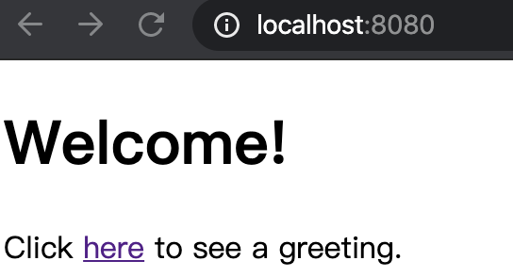
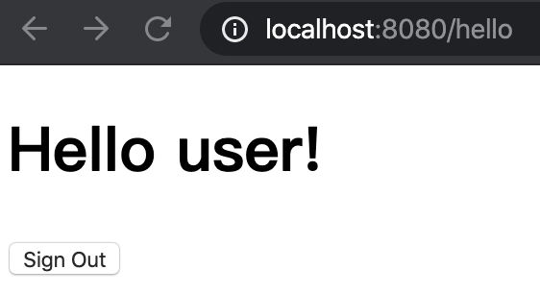
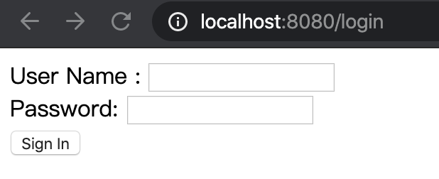
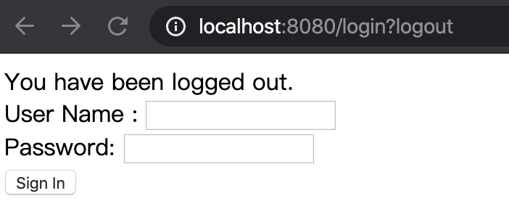
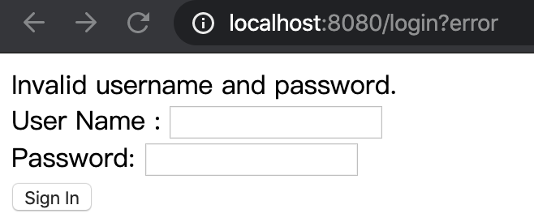
Login Sample

Slide 11
React + Spring Security: Front-end
App.js
import React from 'react'; import {BrowserRouter as Router, Switch, Route, Link} from "react-router-dom"; import Info from './component/Info'; function App() { return ( <Router> <div> <nav> <ul> <li><Link to="/">Home</Link></li> <li><Link to="/about">About</Link></li> <li><Link to="/users">Users</Link></li> </ul> </nav> <Switch> <Route path="/about"><Info menu="about"/></Route> <Route path="/users"><Info menu="users"/></Route> <Route path="/"><Info menu=""/></Route> </Switch> </div> </Router> ); } export default App;

Slide 12
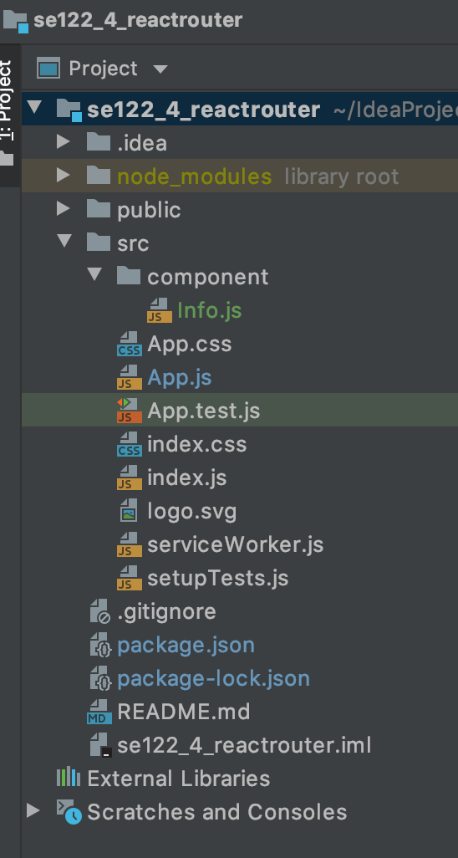
React + Spring Security: Front-end
Info.js
base64:指的是对于一个给定的数据，将其二进制表示的每六位转化成一个对应的ASCII码字符。这种编码格式主要适用于处理一些特殊格式文件的传输，如图片，大字符串等。
import React from 'react'; function Info(props) { let url = 'http://localhost:8080/' + props.menu; let username = 'root'; let password = '123'; let headers = new Headers(); headers.set('Authorization', 'Basic ' + Buffer.from(username + ":" + password).toString('base64')); //这里的header主要作用就是传到后端时进行权限认证 fetch(url, { method: 'GET', headers: headers, credentials: 'include' //这是在将使用的**证书**也发送到后端,认证后实现跨域 }).then(response => response.text()) .then(data => { document.getElementById("info").innerText = data }).catch(function (ex) { console.log('parsing failed', ex) }) return ( <div> <h1 id="info">Welcome</h1> </div> ); } export default Info;

Slide 13
React + Spring Security: Back-end
SpringSecurityApplication.java
application.properties
@SpringBootApplication(exclude= {DataSourceAutoConfiguration.class}) public class SpringSecurityApplication { public static void main(String[] args) { SpringApplication.run(SpringSecurityApplication.class, args); } }
spring.security.user.name=root spring.security.user.password=123

Slide 14
React + Spring Security: Back-end
GreetingController.java
@CrossOrigin(maxAge = 3600//设置跨域权限过期时间，单位为秒) @RestController public class GreetingController { @GetMapping("/about") public String getAbout() { return "This is a Spring security sample"; } @GetMapping("/users") public String getUser() { return "I am a user"; } @GetMapping("/") public String getHome() { return "Let' start!"; } }

Slide 15
React + Spring Security: Back-end
@Configuration public class SecurityConfig extends WebSecurityConfigurerAdapter { @Override protected void configure(HttpSecurity http) throws Exception { http.cors()
.and() .authorizeRequests(authorize -> authorize .antMatchers(“/”).permitAll() .antMatchers(“/users”,“/about”).authenticated() ) .httpBasic(withDefaults()) } @Bean public CorsConfigurationSource corsConfigurationSource() { final CorsConfiguration configuration = new CorsConfiguration(); configuration.setAllowedOrigins(ImmutableList.of("*")); configuration.setAllowedMethods(ImmutableList.of("HEAD", "GET", "POST", "PUT", "DELETE", "PATCH")); configuration.setAllowCredentials(true); configuration.setAllowedHeaders(ImmutableList.of("Authorization", "Cache-Control", "Content-Type")); final UrlBasedCorsConfigurationSource source = new UrlBasedCorsConfigurationSource(); source.registerCorsConfiguration("/**", configuration); return source; } }
SecurityConfig.java

Slide 16
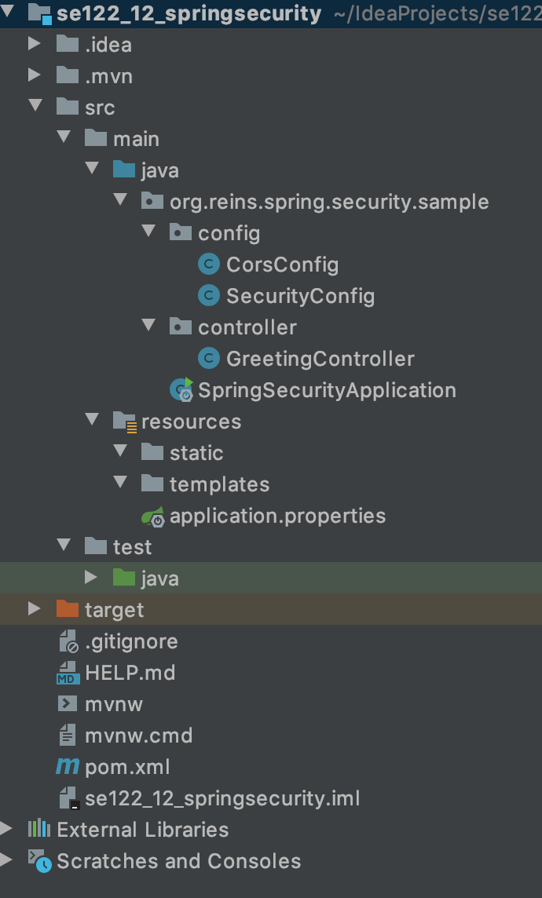
React + Spring Security: Back-end
CorsConfig.java
@Configuration public class CorsConfig implements WebMvcConfigurer { @Override public void addCorsMappings(CorsRegistry registry) { registry.addMapping("/**") .allowedOrigins("*") .allowedMethods("*") .allowedHeaders("*") .exposedHeaders(HttpHeaders.SET_COOKIE) .allowCredentials(true).maxAge(1800); } }

Slide 17
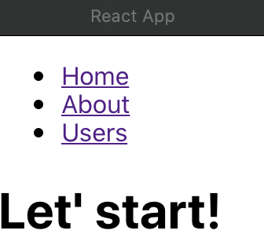
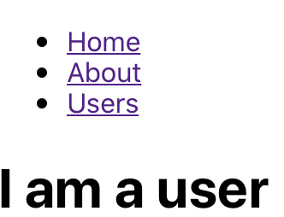
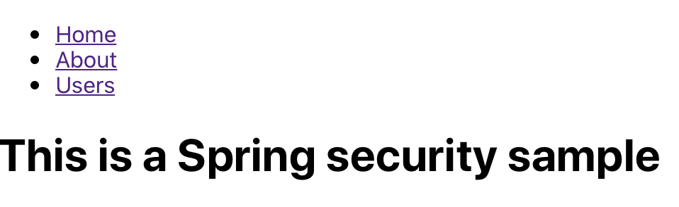
Run the application
注意事项：
这里的”认证”指的是对于登录用户的session进行认证，再一次认证成功之后，只有等到session过期或者session被人为的移除(logout等)才会需要重新认证。

Slide 18
Digital Signatures
To give more trust to an applet, we need to know two things:
Where did the applet come from?//确认发出者
Was the code corrupted(破坏，损坏) in transit?//确认传输过程安全

Slide 19
Message Digests(数字摘要)
A message digest is a digital fingerprint of a block of data.
For example, the so-called SHA1 (secure hash algorithm #1) condenses any data block, no matter how long, into a sequence of 160 bits (20 bytes).
A message digest has two essential properties:
If one bit or several bits of the data are changed, then the message digest also changes.(并且即使少量数据被修改SHA1码也会大量变化)
A forger who is in possession of a given message cannot construct a fake message that has the same message digest as the original.(因为一共有160位，最大可以表示到2^160-1,所以想要让不同的数据还要映射到完全相同的hash bucket基本是不可能的)

Slide 20
Message Digests
Consider the following message by the billionaire father:
"Upon my death, my property shall be divided equally among my children; however, my son George shall receive nothing."
That message has an SHA1 fingerprint of
2D 8B 35 F3 BF 49 CD B1 94 04 E0 66 21 2B 5E 57 70 49 E1 7E
Now, suppose George wants to change the message so that Bill gets nothing. That changes the fingerprint to a completely different bit pattern:
2A 33 0B 4B B3 FE CC 1C 9D 5C 01 A7 09 51 0B 49 AC 8F 98 92

Slide 21
Message Digests
MessageDigest alg = MessageDigest.getInstance("SHA-1");
InputStream(输入数据流) in = . . .
int ch;
while ((ch = in.read( )) != -1)
alg.update((byte) ch);
byte[ ] bytes = . . .;
alg.update(bytes);
byte[ ] hash = alg.digest( );

Slide 22
Message Signing
The message digest algorithms are publicly known, and they don't require secret keys.
In that case, the recipient of the forged message and the recomputed fingerprint would never know that the message has been altered.
Digital signatures solve this problem.
这里说的是，由于数字虚拟摘要的生成算法是公开的，所以在数据接收端如果没有一个关于正确的SHA1码的数据的话，其他人是可以使用相同算法生成另外一个不同的信息对应的SHA1码，而这时接受者也还是无法判断信息是否正确，因为无法去进行比对。所以必须要先给信息的接受者传递一个正确的SHA1码的”备份”

Slide 23
Message Signing
The keys are quite long and complex. For example, here is a matching pair of public and private Digital Signature(数字签名) Algorithm (DSA) keys.
Public key:
Code View:
p: fca682ce8e12caba26efccf7110e526db078b05edecbcd1eb4a208f3ae1617ae01f35b91a47e6df63413c5e12ed0899 bcd132acd50d99151bdc43ee737592e17 q: 962eddcc369cba8ebb260ee6b6a126d9346e38c5 g:678471b27a9cf44ee91a49c5147db1a9aaf244f05a434d6486931d2d14271b9e35030b71fd73da179069b32e29356 30e 1c2062354d0da20a6c416e50be794ca4 y: c0b6e67b4ac098eb1a32c5f8c4c1f0e7e6fb9d832532e27d0bdab9ca2d2a8123ce5a8018b8161a760480fadd040b927 281ddb22cb9bc4df596d7de4d1b977d50
Private key:
Code View:
p: fca682ce8e12caba26efccf7110e526db078b05edecbcd1eb4a208f3ae1617ae01f35b91a47e6df63413c5e12ed0899 bcd132acd50d99151bdc43ee737592e17 q: 962eddcc369cba8ebb260ee6b6a126d9346e38c5 g: 678471b27a9cf44ee91a49c5147db1a9aaf244f05a434d6486931d2d14271b9e35030b71fd73da179069b32e2935630 e1c2062354d0da20a6c416e50be794ca4 x: 146c09f881656cc6c51f27ea6c3a91b85ed1d70a
public与private key是唯一配对的。
只有使用private加密，public解密，或者public加密，private解密才能成功，使用同一类型的ley同时进行加密和解密是不会成功的。

Slide 24
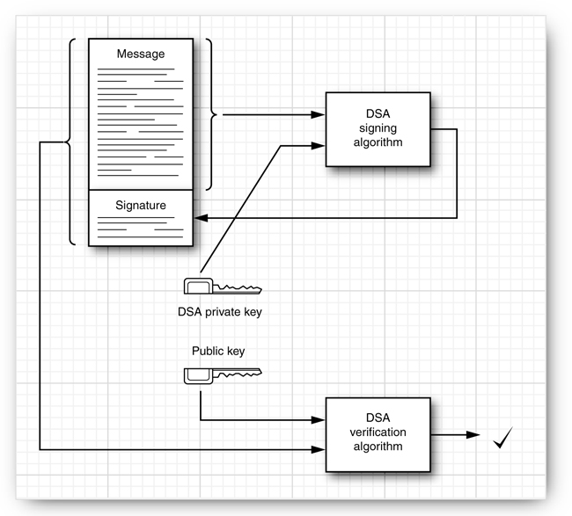
Message Signing
这张图是在说：在对于要传输的明文message生成数字摘要之后，对其使用private key进行加密，这个由摘要加密之后生成的序列串就被称作digital sign。之后，在接受者那一端，在接受到消息时(注意到这里还没有对于真正要传输的数据进行加密，只是对于摘要进行加密用于身份认证)，使用public key(至于接受者是如何得到public的，在后面PPT有)对加密的认证信息进行解码，若仍然能够正确解码(即能解开传过来的签名，并且其中的摘要与传过来的明文生成的摘要完全相等)，则说明身份认证成功。若不能成功解码，则是被修改过了，则认证失败，不再接受。(因为中途如果修改，在发出者的private key未泄露的情况下，修改者只能获取public key，而其要么使用public进行对于修改信息的加密(这种会由于public不能解密public而出错)要么是用自己的private对于数据进行加密(这种会由于接收者这部分得public不认识这个private而报错)，而这两种情况都会失败)

Slide 25
X.509 Certificate
To take advantage of public key cryptography, the public keys must be distributed. (public key应该被其他人共享)
One of the most common distribution formats is called X.509.
The keytool program manages keystores, databases of certificates and private/public key pairs.
Each entry in the keystore has an alias(别名).
Here is how Alice creates a keystore, alice.certs, and generates a key pair with alias alice.
keytool -genkeypair -keystore(指明存储这个key的数据库) alice.certs -alias alice

Slide 26
X.509 Certificate
When generating a key, you are prompted for the following information:
Enter keystore password: password
What is your first and last name?
[Unknown]: Alice Lee
What is the name of your organizational unit?
[Unknown]: Engineering Department
What is the name of your organization?
[Unknown]: ACME Software
What is the name of your City or Locality?
[Unknown]: Cupertino
What is the name of your State or Province?
[Unknown]: California
What is the two-letter country code for this unit?
[Unknown]: US
Is <CN=Alice Lee, OU=Engineering Department, O=ACME Software, L=Cupertino, ST=California,
C=US> correct?
[no]: Y
基于对这些问题的回答，来生成新的public key。

Slide 27
X.509 Certificate
Alice exports a certificate file:(信息发出者将生成的新的public key文件共享出去)
keytool -exportcert -keystore alice.certs -alias alice -file alice.cer
Bob receives the certificate, he can print it:
keytool -printcert -file alice.cer
The printout looks like this:
Owner: CN=Alice Lee, OU=Engineering Department, O=ACME Software,
L=San Francisco, ST=CA, C=US
Issuer: CN=Alice Lee, OU=Engineering Department, O=ACME Software,
L=San Francisco, ST=CA, C=US
Serial number: 470835ce
Valid from: Sat Oct 06 18:26:38 PDT 2007 until: Fri Jan 04 17:26:38 PST 2008
Certificate fingerprints:
MD5: BC:18:15:27:85:69:48:B1:5A:C3:0B:1C:C6:11:B7:81
SHA1: 31:0A:A0:B8:C2:8B:3B:B6:85:7C:EF:C0:57:E5:94:95:61:47:6D:34
Signature algorithm name: SHA1withDSA
Version: 3
Notes:
最通用的一种签名证书格式是X.509格式。X.509证书包括以下数据：
证书格式的版本
证书序列号
签名算法标识符（算法ID + 对证书签名所使用算法的参数）
证书签名者的姓名
有效期限（开始/结束日期）
被认证身份的名字
被认证身份的公共密钥（算法ID + 算法参数 + 公共密钥值）
签名（以上所有字段的散列码，用签名者的私有密钥编码）

Slide 28
X.509 Certificate
Once Bob trusts the certificate, he can import it into his keystore.
keytool -importcert -keystore bob.certs -alias alice -file alice.cer
Now Alice can start sending signed documents to Bob.
jar cvf document.jar document.txt
jarsigner -keystore alice.certs document.jar alice
When Bob receives the file, he uses the -verify option of the jarsigner program.
jarsigner -verify -keystore bob.certs document.jar
If the JAR file is not corrupted and the signature matches, then the jarsigner program prints
jar verified.
Otherwise, the program displays an error message.

Slide 29
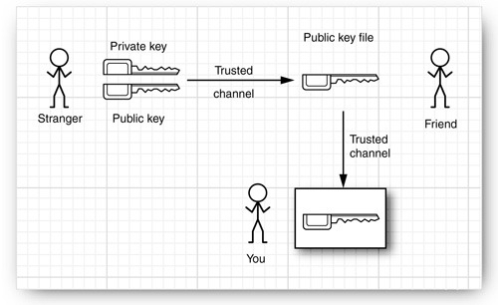
Authentication Problem
Be careful:
You still have no idea who wrote the message. Anyone could have generated a pair of public and private keys, signed the message with the private key, and sent the signed message and the public key to you.
The problem of determining the identity of the sender is called the authentication(身份认证) problem.

Slide 30
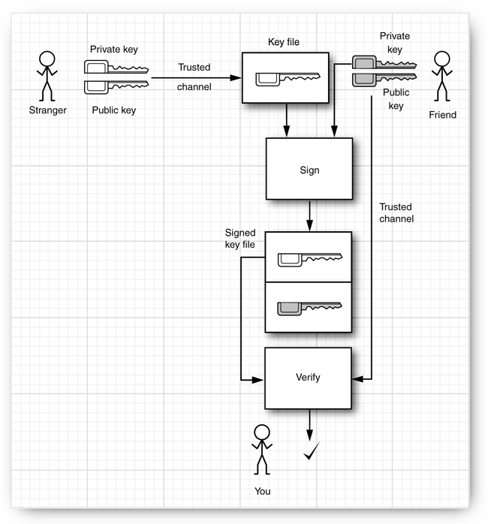
Authentication Problem
这张图说的是获取一个你暂时不信任的用户的public key的可能路径。而这需要一个通过一个你与这个stranger都信任的一个friend用户来实现。首先由于你是信任friend的，所以你拥有这个friend的public key，之后这个friend使用自己的private key对于stranger的public key进行加密，生成一个数字签名，之后在这个签名传递到你这边时，你就可以通过你拥有的friend的public key对于signature进行解密，从而获取之前被加密的stranger的public key，之后如果你信任这个stranger，则可以将其public key加入到keystore中去，从而将其变为一个新的”friend”。
这张图中的”friend”,一般都是一些第三方的认证公司的产品。

Slide 31
Certificate Signing
Suppose Alice wants to send her colleague Cindy a signed message
but Cindy doesn't want to bother with verifying lots of signature fingerprints.
Now suppose that there is an entity that Cindy trusts to verify signatures. In this example, Cindy trusts the Information Resources Department at ACME Software.
That department operates a certificate authority (CA).
Everyone at ACME has the CA's public key in their keystore, installed by a system administrator who carefully checked the key fingerprint.
The CA signs the keys of ACME employees.
When they install each other's keys, then the keystore will trust them implicitly because they are signed by a trusted key.

Slide 32
Certificate Signing
public key传输时需要签名->自签名
->即使用自己对应的private进行加密来生成一个自签名
Here is how you can simulate this process.
Create a keystore acmesoft.certs.
Generate a key par and export the public key:
keytool -genkeypair -keystore acmesoft.certs -alias acmeroot
keytool -exportcert -keystore acmesoft.certs -alias acmeroot -file acmeroot.cer
The public key is exported into a "self-signed"(自签名) certificate.
Then add it to every employee's keystore.
keytool -importcert -keystore cindy.certs -alias acmeroot -file acmeroot.cer
An authorized staff member at ACME Software would verify Alice's identity and generate a signed certificate as follows:
java CertificateSigner -keystore acmesoft.certs -alias acmeroot -infile alice.cer -outfile alice_signedby_acmeroot.cer
Now Cindy imports the signed certificate into her keystore:
keytool -importcert -keystore cindy.certs -alias alice -file alice_signedby_acmeroot.cer

Slide 33
Code Signing
One of the most important uses of authentication technology is signing executable programs.
You now know how to implement this sophisticated scheme.
Use authentication to verify where the code came from.
Run the code with a security policy that enforces the permissions that you want to grant the program, depending on its origin.

Slide 34
JAR File Signing
ACME decides to sign the JAR files that contain the program code.
First, ACME generates a root certificate:
keytool -genkeypair -keystore acmesoft.certs -alias acmeroot
Therefore, we create a second keystore client.certs for the public certificates and add the public acmeroot certificate into it.
keytool -exportcert -keystore acmesoft.certs -alias acmeroot -file acmeroot.cer
keytool -importcert -keystore client.certs -alias acmeroot -file acmeroot.cer
To make a signed JAR file, programmers add their class files to a JAR file in the usual way. For example,
javac FileReadApplet.java
jar cvf FileReadApplet.jar *.class
Then a trusted person at ACME runs the jarsigner tool, specifying the JAR file and the alias of the private key:
jarsigner -keystore acmesoft.certs FileReadApplet.jar acmeroot

Slide 35
JAR File Signing
ACME decides to sign the JAR files.
Next, let us turn to the client machine configuration. A policy file must be distributed to each client machine.
To reference a keystore, a policy file starts with the line
keystore "keystoreURL", "keystoreType";
The URL can be absolute or relative.
keystore "client.certs", "JKS";
Then grant clauses can have suffixes signedBy "alias", such as this one:
grant signedBy "acmeroot" { . . . };
Now create a policy file applet.policy with the contents:
keystore "client.certs", "JKS";
grant signedBy "acmeroot" {
permission java.lang.RuntimePermission "usePolicy";
permission java.io.FilePermission "/etc/*", "read";
};

Slide 36
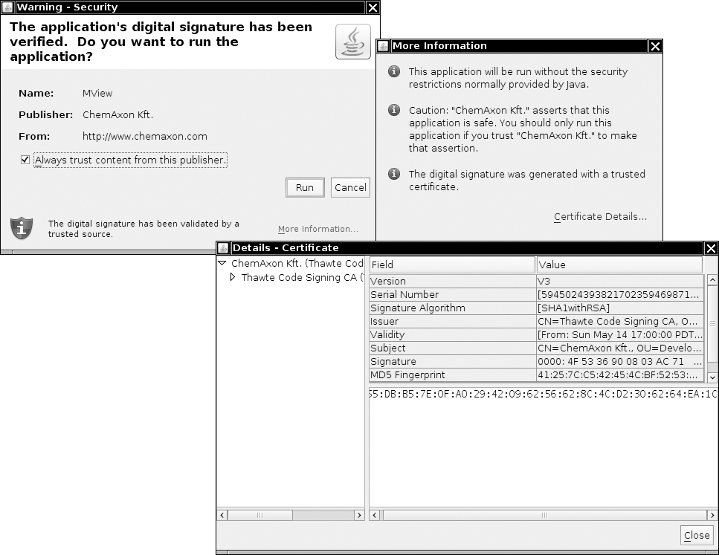
Software Developer Certificates
A program signed with a software developer certificate that is issued by a CA will trigger a pop-up dialog box identifies the software developer and the certificate issuer.
You now have two choices:
Run the program with full privileges.
Confine the program to the sandbox. (The Cancel button in the dialog box is misleading. If you click that button, the applet is not canceled. Instead, it runs in the sandbox.)

Slide 37
Symmetric Ciphers(对称密钥)
Cipher
Cipher cipher = Cipher.getInstance(algorithName);
or
Cipher cipher = Cipher.getInstance(algorithName, providerName);
The JDK comes with ciphers by the provider named "SunJCE".
The algorithm name is a string such as "AES" or "DES/CBC/PKCS5Padding".
int mode = . . .; Key key = . . .; cipher.init(mode, key);(根据传入的key生成一对对称密钥)
The mode is one of
Cipher.ENCRYPT_MODE
Cipher.DECRYPT_MODE
Cipher.WRAP_MODE
Cipher.UNWRAP_MODE
对称密钥是用于对真正要传输的文本信息进行加密的。

Slide 38
Symmetric Ciphers
int blockSize = cipher.getBlockSize();
byte[] inBytes = new byte[blockSize];
. . . // read inBytes
int outputSize= cipher.getOutputSize(inLength);
byte[] outBytes = new byte[outputSize];
int outLength = cipher.update(inBytes, 0, outputSize, outBytes);
. . . // write outBytes
outBytes = cipher.doFinal(inBytes, 0, inLength);
Or
outBytes = cipher.doFinal();
The call to doFinal is necessary to carry out padding of the final block.
L 01 if length(L) = 7
L 02 02 if length(L) = 6
L 03 03 03 if length(L) = 5
. . .
L 07 07 07 07 07 07 07 if length(L) = 1
08 08 08 08 08 08 08 08
doFinal一般需要长度为 8 bytes，若小于8，会在后面补上对应数量的、数值等于缺少数量的byte
Notes:
a block size of 8 bytes

Slide 39
Key generation
Follow these steps:
Get a KeyGenerator for your algorithm.
Initialize the generator with a source for randomness. If the block length of the cipher is variable, also specify the desired block length.
Call the generateKey method.
KeyGenerator keygen = KeyGenerator.getInstance("AES");
SecureRandom random = new SecureRandom();
keygen.init(random);
Key key = keygen.generateKey();
Or
SecretKeyFactory keyFactory = SecretKeyFactory.getInstance("AES");
byte[] keyData = . . .; // 16 bytes for AES
SecretKeySpec keySpec = new SecretKeySpec(keyData, "AES");
Key key = keyFactory.generateSecret(keySpec);

Slide 40
Cipher Streams
The JCE library provides a convenient set of stream classes that automatically encrypt or decrypt stream data.
Encryption
Cipher cipher = . . .;
cipher.init(Cipher.ENCRYPT_MODE, key);
CipherOutputStream out = new CipherOutputStream(new FileOutputStream(outputFileName), cipher);
byte[] bytes = new byte[BLOCKSIZE];
int inLength = getData(bytes); // get data from data source
while (inLength != -1) {
out.write(bytes, 0, inLength);
inLength = getData(bytes); // get more data from data source
} out.flush(); //以输出流的形式将加密之后的信息传递出去

Slide 41
Cipher Streams
The JCE library provides a convenient set of stream classes that automatically encrypt or decrypt stream data.
Decryption
Cipher cipher = . . .;
cipher.init(Cipher.DECRYPT_MODE, key);
CipherInputStream in = new CipherInputStream(new FileInputStream(inputFileName), cipher);
byte[] bytes = new byte[BLOCKSIZE];
int inLength = in.read(bytes);
while (inLength != -1) {
putData(bytes, inLength); // put data to destination
inLength = in.read(bytes);
}

Slide 42
Public Key Ciphers
对称密钥相对之前的public private非对称密钥而言性能更好，但是问题是两端的密钥相同，要是传输过程中被劫持就会被攻击。
The Achilles heel of symmetric ciphers is key distribution.
Public key cryptography solves that problem.
All known public key algorithms are much slower than symmetric key algorithms such as DES or AES.
It would not be practical to use a public key algorithm to encrypt large amounts of information.
This problem can easily be overcome by combining a public key cipher with a fast symmetric cipher, like this:
Alice generates a random symmetric encryption key. She uses it to encrypt her plaintext.
Alice encrypts the symmetric key with Bob's public key.
Alice sends Bob both the encrypted symmetric key and the encrypted plaintext.
Bob uses his private key to decrypt the symmetric key.
Bob uses the decrypted symmetric key to decrypt the message.
解决对称密钥安全问题的方式：在传递加密文本数据同时，使用接受者的public key对其进行加密，之后接受者使用自己的private key进行解密，获取对称密钥信息。即执行一次强制的非对称加密传输。

Slide 43
Introduction to SSL/TLS
Transport Layer Security (TLS) and its predecessor, Secure Sockets Layer (SSL)(安全套接字层，即HTTPS中S的含义),
are technologies which allow web browsers and web servers to communicate over a secured connection.
This means that the data being sent is encrypted by one side, transmitted, then decrypted by the other side before processing.
This is a two-way process, meaning that both the server AND the browser encrypt all traffic before sending out data.
Another important aspect of the SSL/TLS protocol is Authentication.
This means that during your initial attempt to communicate with a web server over a secure connection, that server will present your web browser with a set of credentials, in the form of a "Certificate", as proof the site is who and what it claims to be.
In certain cases, the server may also request a Certificate from your web browser, asking for proof that you are who you claim to be.
This is known as "Client Authentication", although in practice this is used more for business-to-business (B2B) transactions than with individual users. Most SSL-enabled web servers do not request Client Authentication.

Slide 44
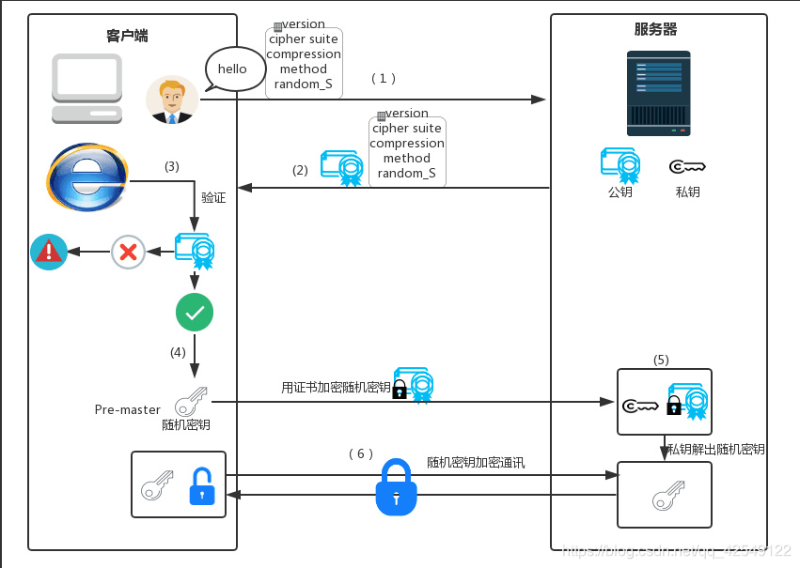
SSL in Tomcat
https://blog.csdn.net/qq_42549122/article/details/90272299

Slide 45
Configuration in Tomcat
Create a keystore file to store the server's private key and self-signed certificate by executing the following command:
Windows:
“%JAVA_HOME%\bin\keytool” -genkey -alias tomcat -keyalg RSA -keystore “C:\Tomcat\conf\key\tomcat.keystore” -validity 365
Unix:
$JAVA_HOME/bin/keytool -genkey -alias tomcat -keyalg RSA -keystore ./conf/key/tomcat.keystore -validity 365

Slide 46
Configuration in Tomcat
For External Tomcat -> Edit the Tomcat Configuration File ./conf/server.xml
<Connector port=“8443”
protocol="org.apache.coyote.http11.Http11NioProtocol"
maxThreads="150" SSLEnabled="true"
keystoreFile="/Users/chenhaopeng/apache-tomcat-9.0.31/conf/key/tomcat.keystore"
keystorePass="changeit">
</Connector>
For Spring nested Tomcat -> Edit application.properties
server.port=8443 server.ssl.key-store=/Users/chenhaopeng/apache-tomcat-9.0.31/conf/key/tomcat.keystore server.ssl.key-store-password=changeit server.ssl.keyAlias=tomcat

Slide 47
Test SSL in Tomcat
Spring-boot Project
@SpringBootApplication public class DemoApplication { @Bean public TomcatServletWebServerFactory tomcatServletWebServerFactory(Connector connector){ TomcatServletWebServerFactory tomcat=new TomcatServletWebServerFactory(){ @Override protected void postProcessContext(Context context) { SecurityConstraint securityConstraint=new SecurityConstraint(); securityConstraint.setUserConstraint("CONFIDENTIAL"); SecurityCollection collection=new SecurityCollection(); collection.addPattern("/*"); securityConstraint.addCollection(collection); context.addConstraint(securityConstraint); } }; tomcat.addAdditionalTomcatConnectors(connector); return tomcat; }

Slide 48
Test SSL in Tomcat
Spring-boot Project
@SpringBootApplication public class DemoApplication { @Bean public Connector connector(){ Connector connector=new Connector("org.apache.coyote.http11.Http11NioProtocol"); connector.setScheme("http"); connector.setPort(8080); connector.setSecure(false); connector.setRedirectPort(8443);//https在tomcat中默认使用的是8443端口，需要重定向 return connector; } public static void main(String[] args) { SpringApplication.run(DemoApplication.class, args); } }

Slide 49
Test SSL in Tomcat
MsgController.java
@RestController public class MsgController { @Autowired WebApplicationContext applicationContext; @GetMapping(value = "/msg") public String findOne( ) { System.out.println("Sending an email message."); return "Hello World!"; }; }

Slide 50
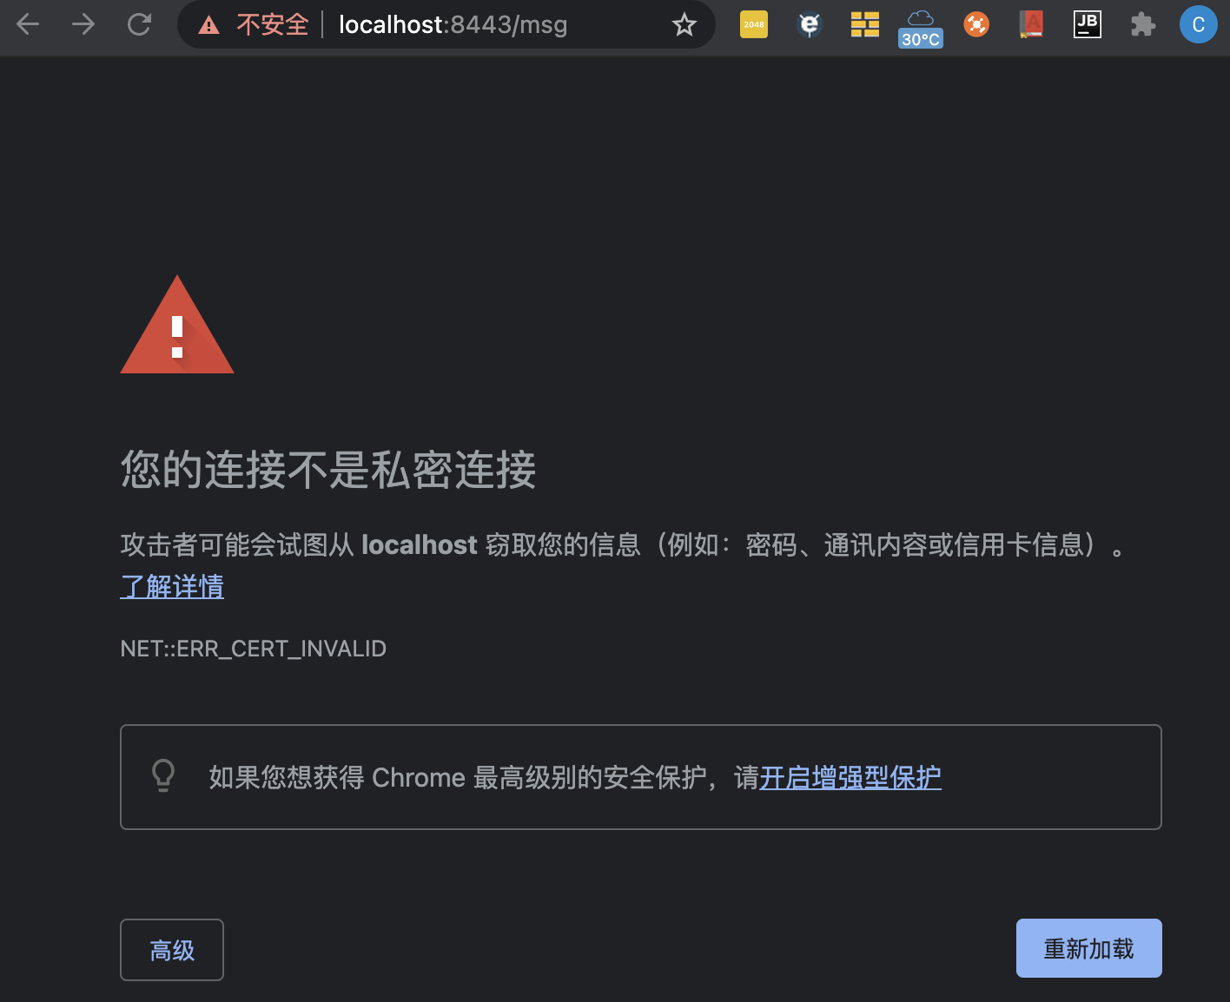

Test SSL in Tomcat
MsgController.java
@RestController public class MsgController { @Autowired WebApplicationContext applicationContext; @GetMapping(value = "/msg") public String findOne( ) { System.out.println("Sending an email message."); return "Hello World!"; }; }

Slide 51
References
Core Java (volume II) 11th edition
http://horstmann.com/corejava.html
The Java EE 7 Tutorial
http://docs.oracle.com/javaee/7/tutorial/doc/javaeetutorial7.pdf
Software Architecture in Practice, Second Edition
By Len Bass, Paul Clements, Rick Kazman
Publisher : Addison Wesley
如何在Spring启动时在Spring Security级别启用CORS(How to enable CORS at Spring Security level in Spring boot)
http://www.it1352.com/978249.html
Securing a Web Application
https://spring.io/guides/gs/securing-web/
SSL/TLS Configuration How-To
https://tomcat.apache.org/tomcat-10.0-doc/ssl-howto.html - Configuration
spring boot进行开启SSL安全验证（application.properties不能配置两个端口）
https://blog.csdn.net/lan12334321234/article/details/84912188
Springboot配置ssl证书踩坑记
https://blog.csdn.net/qq_16410733/article/details/89518650
Tomcat8.5配置https和SpringBoot配置https
https://blog.csdn.net/wangxudongx/article/details/89534071

Slide 52

Thank You!

