Slide 1
Architecture of Enterprise Applications 08 Security 2
Haopeng Chen
REliable, INtelligent and Scalable Systems Group (REINS)
Shanghai Jiao Tong University
Shanghai, China
http://reins.se.sjtu.edu.cn/~chenhp
e-mail: chen-hp@sjtu.edu.cn

Slide 2
Contents and Objectives
Contents
JWT
Single Sign-On
Overview
Kerberos protocol
Objectives
能够根据业务需求，掌握使用JWT认证的方式，并且掌握单点认证模式

Slide 3
What is JSON Web Token?
JSON Web Token (JWT)
is an open standard (RFC 7519) that defines a compact and self-contained way for securely transmitting information between parties as a JSON object.
This information can be verified and trusted because it is digitally signed.
JWTs can be signed using a secret (with the HMAC algorithm) or a public/private key pair using RSA or ECDSA.
Although JWTs can be encrypted to also provide secrecy between parties, we will focus on signed tokens.
Signed tokens can verify the integrity(整体性,是否被修改过) of the claims contained within it, while encrypted tokens hide those claims from other parties.
When tokens are signed using public/private key pairs, the signature also certifies that only the party holding the private key is the one that signed it.

Slide 4
When should you use JSON Web Tokens?
Here are some scenarios where JSON Web Tokens are useful:
Authorization:
This is the most common scenario for using JWT.
Once the user is logged in, each subsequent request will include the JWT, allowing the user to access routes, services, and resources that are permitted with that token.
Single Sign On is a feature that widely uses JWT nowadays, because of its small overhead and its ability to be easily used across different domains.
Information Exchange:
JSON Web Tokens are a good way of securely transmitting information between parties.
Because JWTs can be signed—for example, using public/private key pairs—you can be sure the senders are who they say they are.
Additionally, as the signature is calculated using the header and the payload, you can also verify that the content hasn't been tampered with.
区分几个概念：Authentication：认证，Authorization：授权，Audit：审计<-->(安全方面的三个A的概念)

Slide 5
What is the JSON Web Token structure?
In its compact form, JSON Web Tokens consist of three parts separated by dots (.), which are:
Header
Payload
Signature
Therefore, a JWT typically looks like the following.
xxxxx.yyyyy.zzzzz

Slide 6
Header
The header typically consists of two parts: the type of the token, which is JWT, and the signing algorithm being used, such as HMAC SHA256 or RSA.
For example:
{
"alg": "HS256",
"typ": "JWT"
}
Then, this JSON is Base64Url(可以消解由于ASCII码超过127而引起的用户不可读问题) encoded to form the first part of the JWT.

Slide 7
Payload
The second part of the token is the payload, which contains the claims.
Claims are statements about an entity (typically, the user) and additional data.
There are three types of claims: registered, public, and private claims.
Registered claims: These are a set of predefined claims which are not mandatory but recommended, to provide a set of useful, interoperable claims.
Some of them are: iss (issuer), exp (expiration time), sub (subject), aud (audience), and others.
Public claims: These can be defined at will by those using JWTs.
But to avoid collisions they should be defined in the IANA JSON Web Token Registry or be defined as a URI that contains a collision resistant namespace.
Private claims: These are the custom claims created to share information between parties that agree on using them and are neither registered or public claims.

Slide 8
Payload
An example payload could be:
{
"sub": "1234567890",
"name": "John Doe",
"admin": true
}
The payload is then Base64Url encoded to form the second part of the JSON Web Token.

Slide 9
Signature
To create the signature part you have to take the encoded header, the encoded payload, a secret, the algorithm specified in the header, and sign that.
For example
if you want to use the HMAC SHA256 algorithm, the signature will be created in the following way:
HMACSHA256(
base64UrlEncode(header) + "." +
base64UrlEncode(payload),
secret)
The signature is used to
verify the message wasn't changed along the way,
and, in the case of tokens signed with a private key, it can also verify that the sender of the JWT is who it says it is.

Slide 10
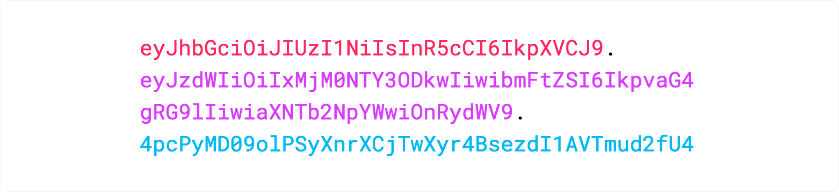
Putting all together
The following shows a JWT that has the previous header and payload encoded, and it is signed with a secret.

Slide 11
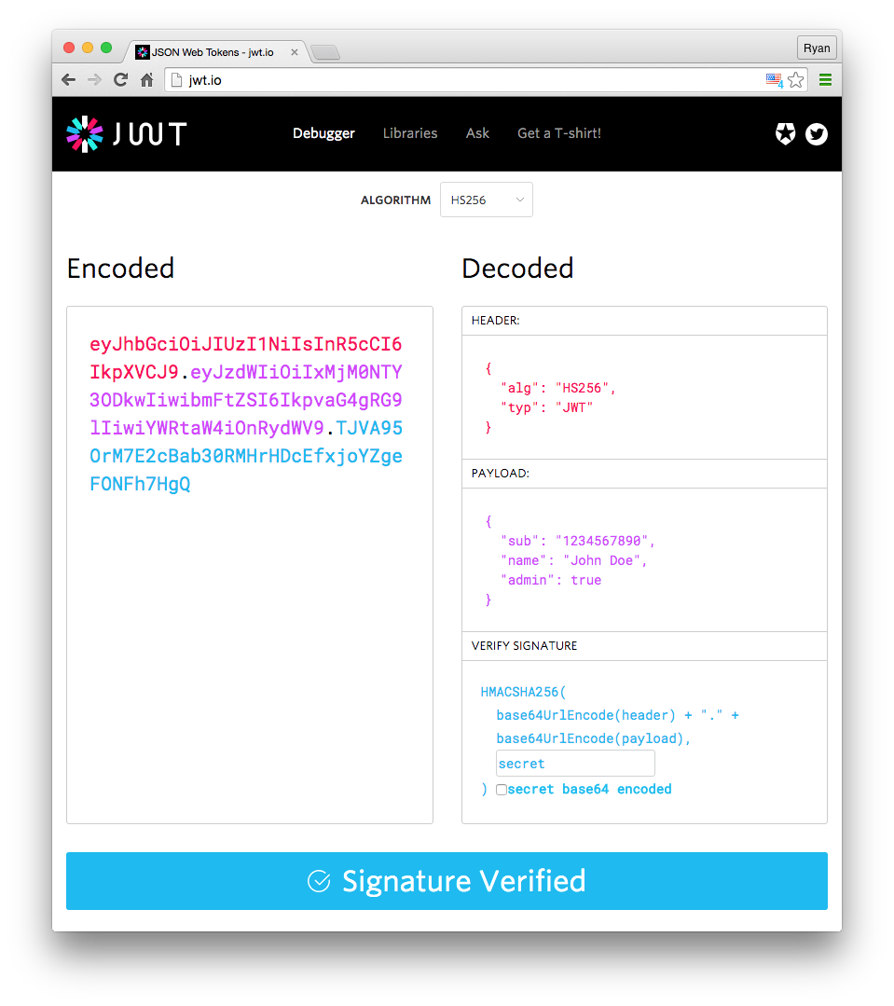
Putting all together

Slide 12
How do JSON Web Tokens work?
In authentication,
when the user successfully logs in using their credentials, a JSON Web Token will be returned.
Since tokens are credentials, great care must be taken to prevent security issues.
In general, you should not keep tokens longer than required.
You also should not store sensitive session data in browser storage due to lack of security.
Whenever the user wants to access a protected route or resource,
the user agent should send the JWT, typically in the Authorization header

Slide 13
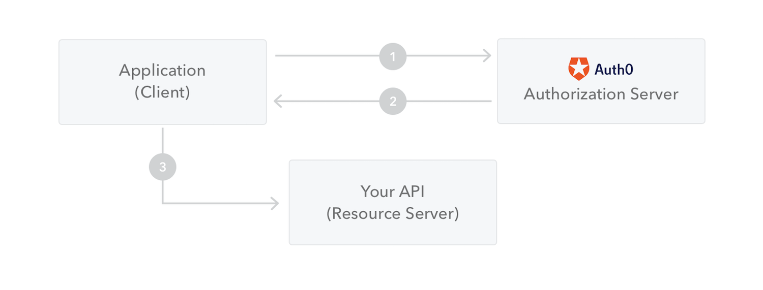
How do JSON Web Tokens work?
The following diagram shows how a JWT is obtained and used to access APIs or resources:

Slide 14
Spring Security + JWT
TokenController.java
@RestController public class TokenController { @Resource private JwtConfig jwtConfig ;
@PostMapping(“/login”) public JSONObject login (@RequestParam(“userName”) String userName, @RequestParam(“passWord”) String passWord){ JSONObject json = new JSONObject(); String userId = 5 + "";//这里只是一个模拟，实际上操作应该是去数据库检查信息是否填写正确，错误就没必要生成token了 String token = jwtConfig.createToken(userId) ; if (!StringUtils.isEmpty(token)) { json.put("token",token) ; } return json; } @PostMapping("/info") public String info (){ return "info"; } @GetMapping("/getUserInfo") public String getUserInfo(HttpServletRequest request){ String usernameFromToken = jwtConfig.getUsernameFromToken(request.getHeader("token")); return usernameFromToken; } }

Slide 15
Spring Security + JWT
public Claims getTokenClaim (String token) { try { return Jwts.parser().setSigningKey(secret)
.parseClaimsJws(token).getBody(); }catch (Exception e){ return null; } } public boolean isTokenExpired (Date expirationTime) { return expirationTime.before(new Date()); } public Date getExpirationDateFromToken(String token) { return getTokenClaim(token).getExpiration(); } public String getUsernameFromToken(String token) { return getTokenClaim(token).getSubject(); } public Date getIssuedAtDateFromToken(String token) { return getTokenClaim(token).getIssuedAt(); }
JwtConfig.java
@ConfigurationProperties(prefix = “config.jwt”) @Component public class JwtConfig { private String secret; private long expire; private String header; public String createToken (String subject){ Date nowDate = new Date(); Date expireDate = new Date(nowDate.getTime() + expire * 1000); return Jwts.builder() .setHeaderParam(“typ”, “JWT”) .setSubject(subject) .setIssuedAt(nowDate) .setExpiration(expireDate) .signWith(SignatureAlgorithm.HS512, secret) .compact(); }

Slide 16
Spring Security + JWT
application.properties
config.jwt.secret=abcdefg1234567 config.jwt.expire=3600 config.jwt.header=token
TokenController.java
// --------------------- getter & setter --------------------- public String getSecret() { return secret; } public void setSecret(String secret) { this.secret = secret; } public long getExpire() { return expire; } public void setExpire(long expire) { this.expire = expire; } public String getHeader() { return header; } public void setHeader(String header) { this.header = header; } }

Slide 17
Spring Security + JWT
TokenInterceptor.java
@Component public class TokenInterceptor extends HandlerInterceptorAdapter { @Resource private JwtConfig jwtConfig ; @Override public boolean preHandle(HttpServletRequest request, HttpServletResponse response, Object handler) throws SignatureException { /** 地址过滤 */ String uri = request.getRequestURI() ; if (uri.contains("/login")){ return true ; } /** Token 验证 */ String token = request.getHeader(jwtConfig.getHeader()); if(StringUtils.isEmpty(token)){ token = request.getParameter(jwtConfig.getHeader()); } if(StringUtils.isEmpty(token)){ throw new SignatureException(jwtConfig.getHeader()+ "不能为空"); }
Claims claims = null; try{ claims = jwtConfig.getTokenClaim(token); if(claims == null ||
jwtConfig.isTokenExpired(claims.getExpiration())){ throw new SignatureException(jwtConfig.getHeader()
+ "失效，请重新登录。"); } }catch (Exception e){ throw new SignatureException(jwtConfig.getHeader()
+ "失效，请重新登录。"); } /** 设置 identityId 用户身份ID */ request.setAttribute("identityId", claims.getSubject()); return true; } }

Slide 18
Spring Security + JWT
WebConfig.java
@Configuration public class WebConfig implements WebMvcConfigurer { @Resource private TokenInterceptor tokenInterceptor ; public void addInterceptors(InterceptorRegistry registry) { registry.addInterceptor(tokenInterceptor).addPathPatterns("/**"); } }
PermissionHandler.java
@RestControllerAdvice public class PermissionHandler { @ExceptionHandler(value = { SignatureException.class }) @ResponseBody public String authorizationException(SignatureException e){ return new String(e.getMessage()); } }

Slide 19
Spring Security + JWT
pom.xml
<dependencies> <dependency> <groupId>com.auth0</groupId> <artifactId>java-jwt</artifactId> <version>4.1.0</version> </dependency> <dependency> <groupId>io.jsonwebtoken</groupId> <artifactId>jjwt</artifactId> <version>0.9.1</version> </dependency> <dependency> <groupId>org.springframework.boot</groupId> <artifactId>spring-boot-configuration-processor</artifactId> <optional>true</optional> </dependency> </dependencies>

Slide 20
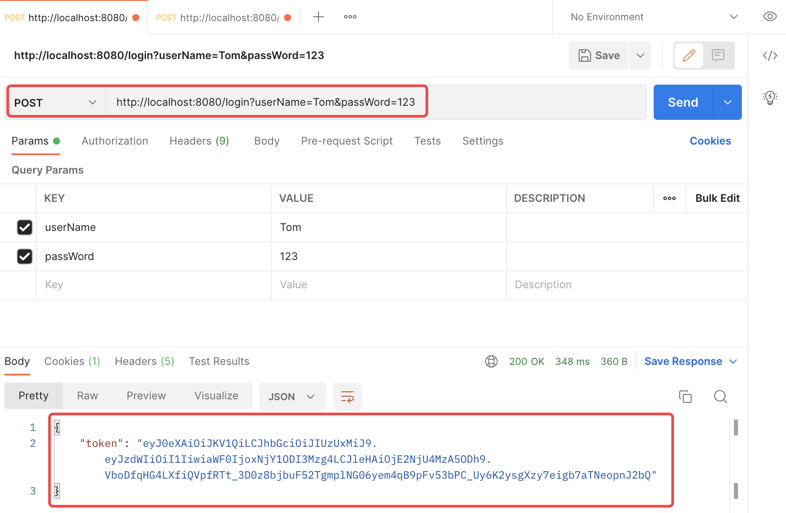
Spring Security + JWT

Slide 21
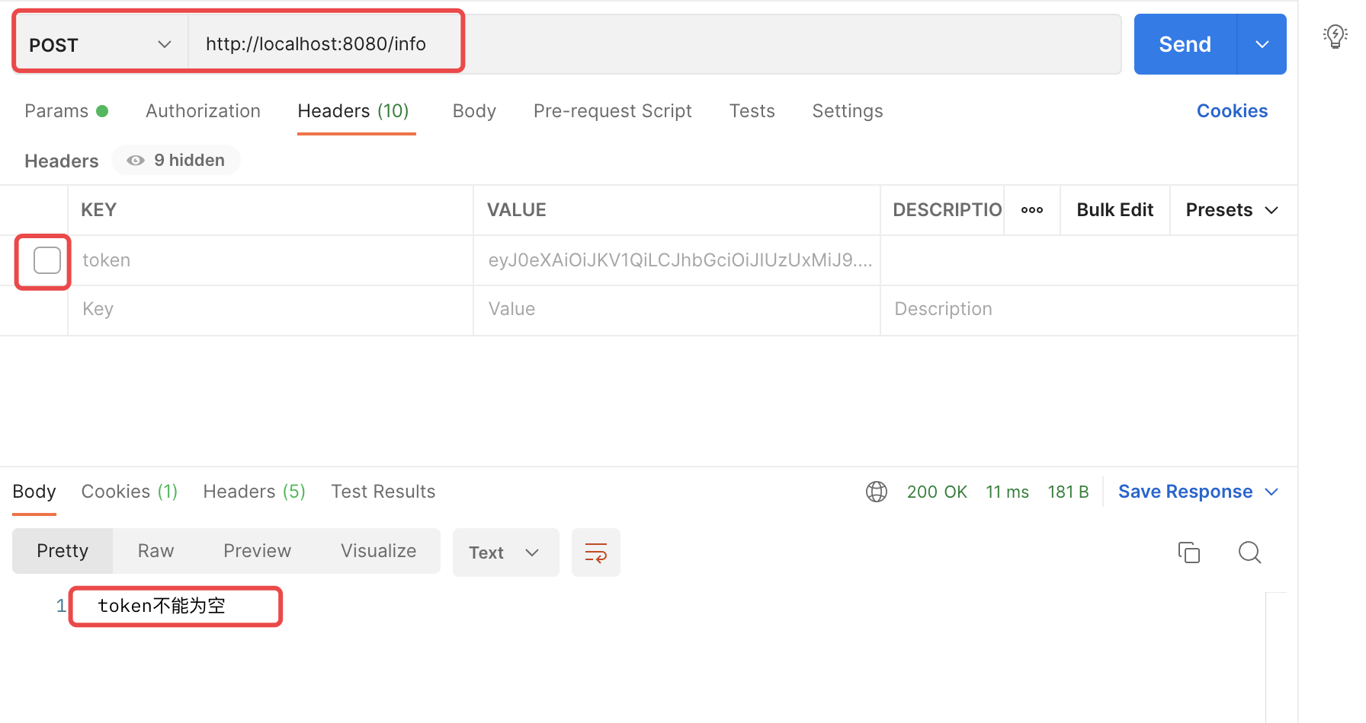
Spring Security + JWT

Slide 22
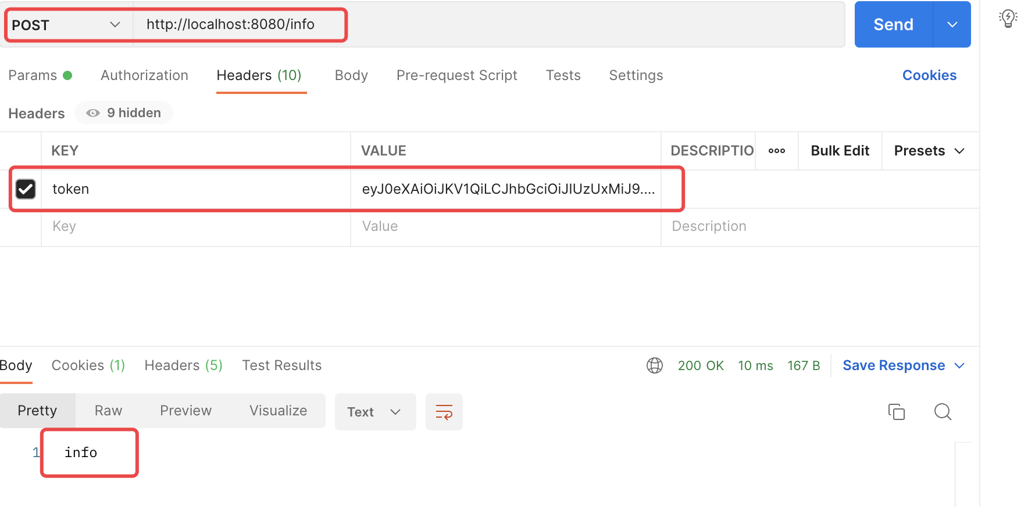
Spring Security + JWT

Slide 23
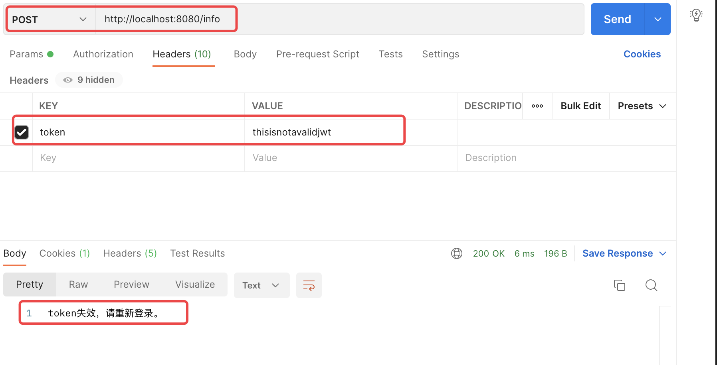
Spring Security + JWT

Slide 24
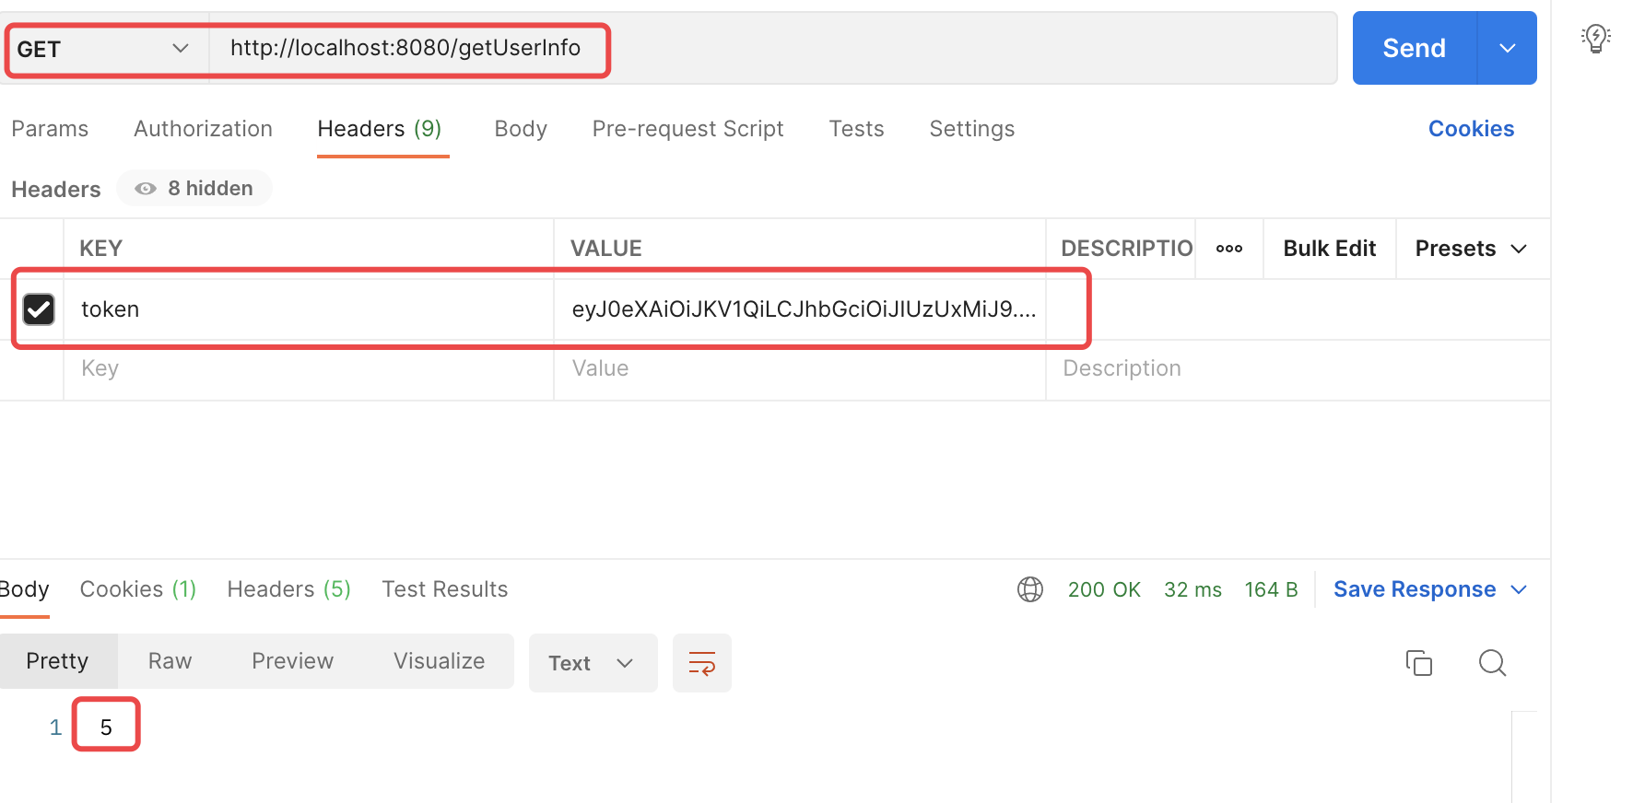
Spring Security + JWT

Slide 25
Single Sign-On - wikipedia
Single sign-on (SSO) is a property of access control of multiple related, but independent software systems.
With this property a user logs in once and gains access to all systems without being prompted to log in again at each of them.
Conversely, Single sign-off is the property whereby a single action of signing out terminates access to multiple software systems.
As different applications and resources support different authentication mechanisms,
single sign-on has to internally translate to and store different credentials compared to what is used for initial authentication.

Slide 26
Single Sign-On - wikipedia
Benefits include:
Reduces phishing success, because users are not trained to enter password everywhere without thinking.
Reducing password fatigue from different user name and password combinations
Reducing time spent re-entering passwords for the same identity
Reducing IT costs due to lower number of IT help desk calls about passwords
Security on all levels of entry/exit/access to systems without the inconvenience of re-prompting users
Centralized reporting for compliance adherence.

Slide 27
Common Single Sign-on
Kerberos(三头狗) based
MIT Kerberos protocol
Smart card based
Initial sign-on prompts the user for the smart card.
Additional software applications also use the smart card, without prompting the user to re-enter credentials.
Smart card-based single sign-on can either use certificates or passwords stored on the smart card.
OTP token
Also referred to as one-time password token.
Security Assertion Markup Language
Security Assertion Markup Language (SAML) is an XML-based solution for exchanging user security information between an enterprise and a service provider.

Slide 28
Kerberos
Kerberos
is a computer network authentication protocol which works on the basis of "tickets" to allow nodes communicating over a non-secure network to prove their identity to one another in a secure manner.
MIT developed Kerberos to protect network services provided by Project Athena.
The protocol was named after the character Kerberos (or Cerberus) from Greek mythology which was a monstrous three-headed guard dog of Hades.

Slide 29
Kerberos
User Client-based Logon
A user enters a username and password on the client machines.
The client performs a one-way function (hash usually) on the entered password, and this becomes the secret key of the client/user.(注意在这个协议下用户输入的密码不会通过网络传输)
Client Authentication
The client sends a clear text message of the user ID to the AS requesting services on behalf of the user. (Note: Neither the secret key nor the password is sent to the AS.)
The AS generates the secret key by hashing the password of the user found at the database (e.g. Active Directory in Windows Server).

Slide 30
Kerberos
The AS checks to see if the client is in its database. If it is, the AS sends back the following two messages to the client:
Message A: Client/TGS Session Key encrypted using the secret key of the client/user.
Message B: Ticket-Granting-Ticket (which includes the client ID, client network address, ticket validity period, and the client/TGS session key) encrypted using the secret key of the TGS(授权服务器).

Slide 31
Kerberos
Once the client receives messages A and B, it attempts to decrypt message A with the secret key generated from the password entered by the user.
If the user entered password does not match the password in the AS database, the client's secret key will be different and thus unable to decrypt message A.
With a valid password and secret key the client decrypts message A to obtain the Client/TGS Session Key. This session key is used for further communications with the TGS. (Note: The client cannot decrypt Message B, as it is encrypted using TGS's secret key.)
At this point, the client has enough information to authenticate itself to the TGS.

Slide 32
Kerberos
Client Service Authorization
When requesting services, the client sends the following two messages to the TGS:
Message C: Composed of the TGT(ticket-granting-ticket) from message B and the ID of the requested service.
Message D: Authenticator (which is composed of the client ID and the timestamp), encrypted using the Client/TGS Session Key(from message A).

Slide 33
Kerberos
Upon receiving messages C and D, the TGS retrieves message B out of message C. It decrypts message B using the TGS secret key. This gives it the "client/TGS session key". Using this key, the TGS decrypts message D (Authenticator) and sends the following two messages to the client:
Message E: Client-to-server ticket (which includes the client ID, client network address, validity period and Client/Server Session Key) encrypted using the service's secret key.(与MessageB类似，client端都是不能直接解码的)
Message F: Client/Server Session Key encrypted with the Client/TGS Session Key.

Slide 34
Kerberos
Client Service Request
Upon receiving messages E and F from TGS, the client has enough information to authenticate itself to the SS(service server). The client connects to the SS and sends the following two messages:
Message E from the previous step (the client-to-server ticket, encrypted using service's secret key).
Message G: a new Authenticator, which includes the client ID, timestamp and is encrypted using Client/Server Session Key.

Slide 35
Kerberos
The SS decrypts the ticket using its own secret key to retrieve the Client/Server Session Key. Using the sessions key, SS decrypts the Authenticator and sends the following message to the client to confirm its true identity and willingness to serve the client:
Message H: the timestamp found in client's Authenticator plus 1, encrypted using the Client/Server Session Key.
The client decrypts the confirmation using the Client/Server Session Key and checks whether the timestamp is correctly updated. If so, then the client can trust the server and can start issuing service requests to the server.
The server provides the requested services to the client.

Slide 36
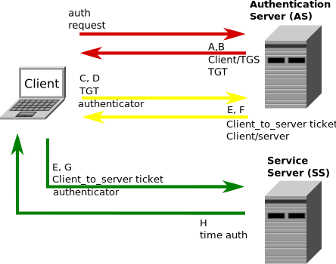
Kerberos

Slide 37
Kerberos
Drawbacks and Limitations
Single point of failure.(单点故障会导致整个系统的崩溃)
Kerberos has strict time requirements, which means the clocks of the involved hosts must be synchronized within configured limits.
The administration protocol is not standardized and differs between server implementations.
Since all authentication is controlled by a centralized KDC, compromise of this authentication infrastructure will allow an attacker to impersonate any user.
Each network service which requires a different host name will need its own set of Kerberos keys. This complicates virtual hosting and clusters.

Slide 38
CAS
Enterprise Single Sign-On - CAS provides
a friendly open source community that actively supports and contributes to the project.
While the project is rooted in higher-ed open source, it has grown to an international audience spanning Fortune 500 companies and small special-purpose installations.
CAS provides enterprise single sign-on service for the Web:
An open and well-documented protocol
An open-source Java server component
Pluggable authentication support (LDAP, database, X.509, 2-factor)
Support for multiple protocols (CAS, SAML, OAuth, OpenID)
A library of clients for Java, .Net, PHP, Perl, Apache, uPortal, and others
Integrates with uPortal, BlueSocket, TikiWiki, Mule, Liferay, Moodle and others
Community documentation and implementation support
An extensive community of adopters

Slide 39
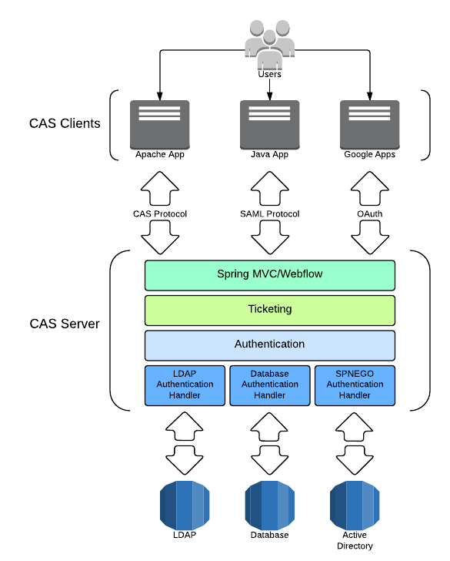
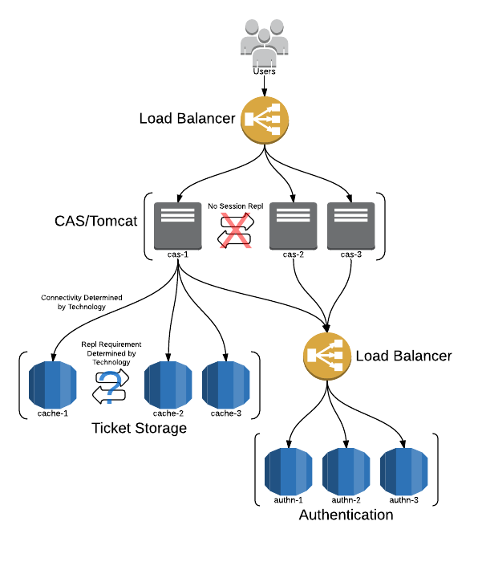
CAS
Architecture

Slide 40
Security Characteristics
Security can be characterized as
a system providing nonrepudiation, confidentiality, integrity, assurance, availability, and auditing.
Nonrepudiation(不可否认性)
is the property that a transaction (access to or modification of data or services) cannot be denied by any of the parties to it.
This means you cannot deny that you ordered that item over the Internet if, in fact, you did.
Confidentiality(保密性)
is the property that data or services are protected from unauthorized access.
This means that a hacker cannot access your income tax returns on a government computer.

Slide 41
Security Characteristics
Integrity (整体性)
is the property that data or services are being delivered as intended.
This means that your grade has not been changed since your instructor assigned it.
Assurance(保证性)
is the property that the parties to a transaction are who they purport(自称) to be.
This means that, when a customer sends a credit card number to an Internet merchant, the merchant is who the customer thinks they are.

Slide 42
Security Characteristics
Availability (可用性)
is the property that the system will be available for legitimate use.
This means that a denial-of-service attack won't prevent your ordering this book.
Auditing (审计特点)
is the property that the system tracks activities within it at levels sufficient to reconstruct them.
This means that, if you transfer money out of one account to another account, in Switzerland, the system will maintain a record of that transfer.

Slide 43
Security Tactics
Tactics for achieving security can be divided into
those concerned with resisting attacks, (抵御攻击)
those concerned with detecting attacks, (检测攻击)
and those concerned with recovering from attacks.(从攻击中恢复)
Using a familiar analogy,
putting a lock on your door is a form of resisting an attack,
having a motion sensor inside of your house is a form of detecting an attack,
and having insurance is a form of recovering from an attack.

Slide 44
Security Tactics-resisting attacks
we identified
nonrepudiation, confidentiality, integrity, and assurance as goals in our security characterization.
The following tactics can be used in combination to achieve these goals.
Authenticate users.
Authorize users.
Maintain data confidentiality.
Encryption
Communication links
virtual private network (VPN)
Secure Sockets Layer (SSL)
Maintain integrity.
checksums
hash results
Limit exposure
Limit access
Firewalls

Slide 45
Security Tactics-detecting attacks
The detection of an attack is usually through an intrusion detection system.
Such systems work by comparing network traffic patterns to a database.
In the case of misuse detection, the traffic pattern is compared to historic patterns of known attacks.
In the case of anomaly detection, the traffic pattern is compared to a historical baseline of itself.
Frequently, the packets must be filtered in order to make comparisons.
Filtering can be on the basis of protocol, TCP flags, payload sizes, source or destination address, or port number.
Intrusion detectors must have
some sort of sensor to detect attacks,
managers to do sensor fusion,
databases for storing events for later analysis,
tools for offline reporting and analysis,
and a control console so that the analyst can modify intrusion detection actions.
如在一些数据库中,系统会通过对于系统记录的LOG进行分析,来判断某一个或一系列操作是否被认定为一次攻击。

Slide 46
Security Tactics-recovering from attacks
Tactics involved in recovering from an attack can be divided into
those concerned with restoring state and (恢复原始状态)
those concerned with attacker identification. (确定攻击者身份)
The tactics used in restoring the system or data to a correct state overlap with those used for availability
since they are both concerned with recovering a consistent state from an inconsistent state.
The tactic for identifying an attacker is
to maintain an audit trail.
几种可能的恢复方式:1.使用SnapShot。注意的是，snapshot只有在最开始一次会记录系统的完整状态,之后(到下一次恢复前)的快照只会记录相对于前一次的增量，即发生了变化的内容部分。缺点是文件全部保存内容可能过大，还有就是可能会与系统绑定，不方便迁移
2.log记录。与CSE中的write-ahead-log类似。

Slide 47
References
Introduction to JSON Web Tokens
https://jwt.io/introduction
JWT Handbook
https://auth0.com/resources/ebooks/jwt-handbook/thankyou
SpringBoot整合JWT
https://blog.csdn.net/AkiraNicky/article/details/99307713
Single Sign On,
http://en.wikipedia.org/wiki/Single_sign-on
Kerberos: The Network Authentication Protocol,
http://web.mit.edu/kerberos/
Kerberos(protocol),
http://en.wikipedia.org/wiki/Kerberos_(protocol)
CAS
https://www.apereo.org/projects/cas
【CAS学习之一】CAS入门
https://www.cnblogs.com/cac2020/p/13719609.html

Slide 48

Thank You!

