Slide 1
Architecture of Enterprise Applications 9
Memory Caching
Haopeng Chen
REliable, INtelligent and Scalable Systems Group (REINS)
Shanghai Jiao Tong University
Shanghai, China
http://reins.se.sjtu.edu.cn/~chenhp
e-mail: chen-hp@sjtu.edu.cn

Slide 2
Contents and Objectives
Contents
  MemCached
  Redis
  Caching Samples in Spring Web Applications
Objectives
  能够根据业务需求，设计并实现基于分布式缓存的数据访问方案，实现数据访问性能的优化

Slide 3
MemCached
Memcached
  Free & open source, high-performance, distributed memory object caching system, generic in nature, but intended for use in speeding up dynamic web applications by alleviating database load.
Memcached is an in-memory key-value store for small chunks of arbitrary data (strings, objects) from results of database calls, API calls, or page rendering.
Memcached is simple yet powerful.
  Its simple design promotes quick deployment, ease of development, and solves many problems facing large data caches.
  Its API is available for most popular languages.
At heart it is a simple Key/Value store.

Slide 4
MemCached
Installing memcached with Homebrew and Lunchy
Step 1 — Install Homebrew
  $ ruby -e "$(curl -fsSL https://raw.github.com/Homebrew/homebrew/go/install)”
Step 2 — Install memcached
  $ brew install Memcached
Step 3 — Install Lunchy
  $ gem install lunchy
Step 4 — Start/Stop memcached
  $ mkdir ~/Library/LaunchAgents
  $ cp /usr/local/Cellar/memcached/$version/homebrew.mxcl.memcached.plist ~/Library/LaunchAgents/
  $ lunchy start memcached
  $ lunchy stop memcached

Slide 5
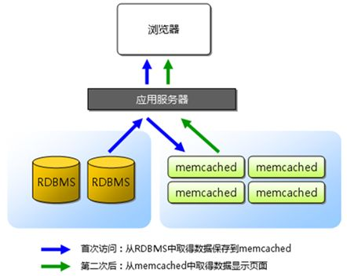
MemCached - Principle

Slide 6
MemCached - Example
LocalSSMConfiguration.java
@Configuration
public class LocalSSMConfiguration extends AbstractSSMConfiguration {
@Bean
@Override
public CacheFactory defaultMemcachedClient() {
final CacheConfiguration conf = new CacheConfiguration();
conf.setConsistentHashing(true);
final CacheFactory cf = new CacheFactory();
cf.setCacheClientFactory(new com.google.code.ssm.providers.xmemcached.MemcacheClientFactoryImpl());
cf.setAddressProvider(new DefaultAddressProvider("127.0.0.1:11211"));
cf.setConfiguration(conf);
return cf;
}
}

Slide 7
MemCached - Example
Person.java
@Entity
@Table(name = "persons", schema = "ormsample")
@JsonIgnoreProperties(value = {"handler","hibernateLazyInitializer","fieldHandler"})
@JsonIdentityInfo(
generator = ObjectIdGenerators.PropertyGenerator.class,
property = "personId")
public class Person implements Serializable {
private int personId;
private int age;
private String firstname;
private String lastname;
@Id
@Column(name = "id")
public int getPersonId() {
return personId;
}
…….

Slide 8
MemCached - Example
PersonRepository.java
PersonDao.java
PersonDaoImpl.java
public interface PersonRepository extends JpaRepository<Person, Integer>{}
public interface PersonDao {
Person findOne(Integer id);
}
@Repository
public class PersonDaoImpl implements PersonDao {
@Autowired
private PersonRepository personRepository;
@Override
@ReadThroughSingleCache(namespace = "Alpha", expiration = 3600)
public Person findOne(@ParameterValueKeyProvider Integer id) {
return personRepository.getOne(id);
}
}

Slide 9
MemCached - Example
PersonService.java
PersonServiceImpl.java
public interface PersonService {
Event findPersonById(Integer id);
}
@Transactional
@Service
public class PersonServiceImpl implements PersonService {
@Autowired
private PersonDao personDao;
@Override
public Person findPersonById(Integer id){
return personDao.findOne(id);
}
}

Slide 10
MemCached - Example
pom.xml
<!-- https://mvnrepository.com/artifact/com.googlecode.xmemcached/xmemcached -->
<dependency>
<groupId>com.google.code.simple-spring-memcached</groupId>
<artifactId>xmemcached-provider</artifactId>
<version>4.1.3</version>
</dependency>

Slide 11
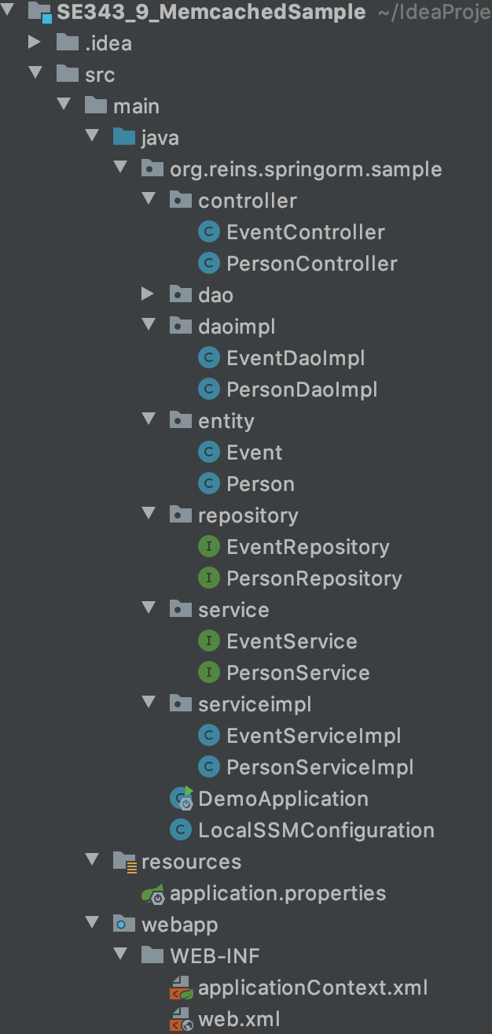
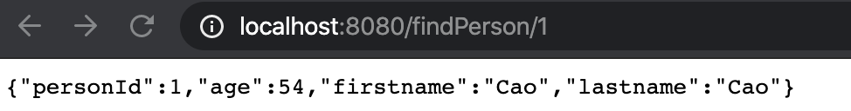
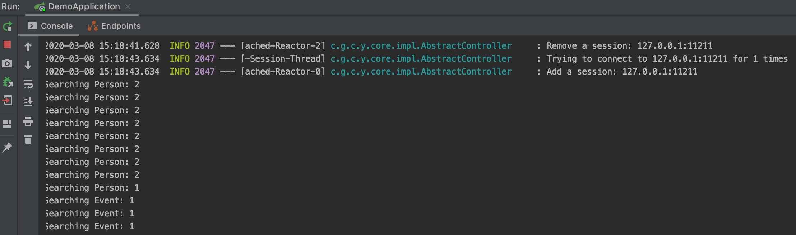

MemCached - Example
Start Memcached
  $lunchy start Memcached
  $telnet localhost 11211

Slide 12
MemCached - Storage Commands
set
  Most common command. Store this data, possibly overwriting any existing data. New items are at the top of the LRU.
add
  Store this data, only if it does not already exist. New items are at the top of the LRU. If an item already exists and an add fails, it promotes the item to the front of the LRU anyway.
replace
  Store this data, but only if the data already exists. Almost never used, and exists for protocol completeness (set, add, replace, etc)
append
  Add this data after the last byte in an existing item. This does not allow you to extend past the item limit. Useful for managing lists.
prepend
  Same as append, but adding new data before existing data.
cas
  Check And Set (or Compare And Swap). An operation that stores data, but only if no one else has updated the data since you read it last. Useful for resolving race conditions on updating cache data.

Slide 13
MemCached - Retrieval Commands
get
  Command for retrieving data. Takes one or more keys and returns all found items.
gets
  An alternative get command for using with CAS. Returns a CAS identifier (a unique 64bit number) with the item. Return this value with the cas command. If the item's CAS value has changed since you gets'ed it, it will not be stored.
delete
  Removes an item from the cache, if it exists.
incr/decr
  Increment and Decrement. If an item stored is the string representation of a 64bit integer, you may run incr or decr commands to modify that number. You may only incr by positive values, or decr by positive values. They does not accept negative values.
  If a value does not already exist, incr/decr will fail.

Slide 14
MemCached
memcached also allows you to make better use of your memory.
  Each node is completely independent (top).
  Each node can make use of memory from other nodes (bottom)

Slide 15
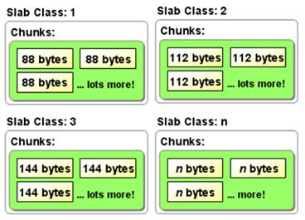
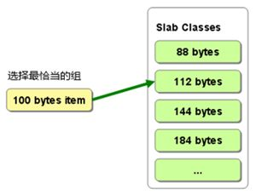
MemCached - Memory Management

Slide 16
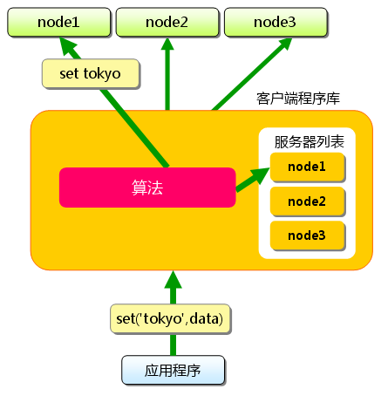
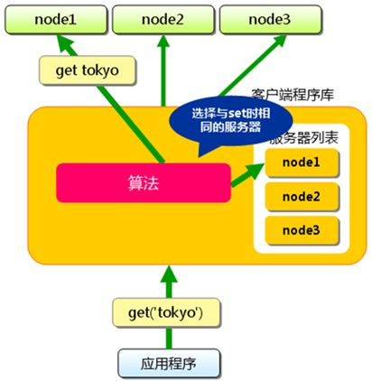
MemCached - Distribution
黄色区域及以下都是运行在client端的。

Slide 17
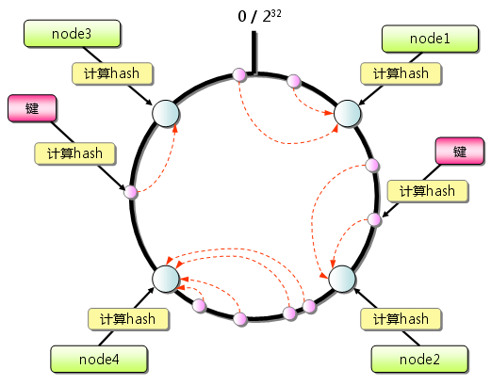
MemCached - Distribution

Slide 18
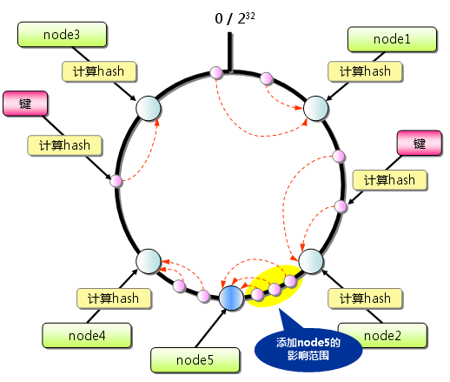
MemCached - Distribution

Slide 19
Redis
Redis is what is called a key-value store,
  often referred to as a NoSQL database.
  The essence of a key-value store is the ability to store some data, called a value, inside a key.
Redis is an open source, BSD licensed, advanced key-value store.
  It is often referred to as a data structure server since keys can contain strings, hashes, lists, sets and sorted sets.
In order to achieve its outstanding performance, Redis works with an in-memory dataset.
  Depending on your use case, you can persist it either by dumping the dataset to disk every once in a while, or by appending each command to a log.
Redis also supports trivial-to-setup master-slave replication,
  with very fast non-blocking first synchronization, auto-reconnection on net split and so forth.

Slide 20
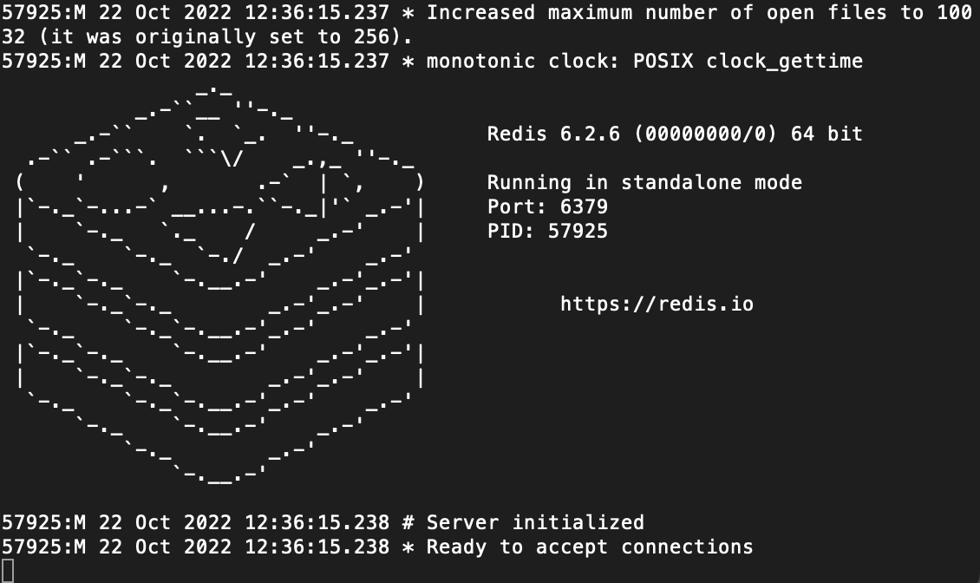
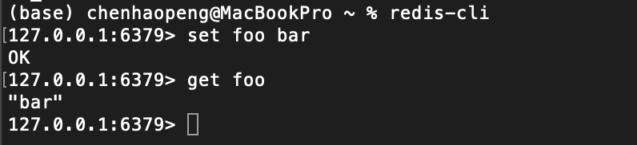
Redis
https://redis.io/docs/getting-started/installation/
Download, extract and compile Redis with:
  $ brew install redis
Start and Stop redis server
  $ redis-server
  Ctrl-C
Run redis Client
  $ redis-cli
  redis> set foo bar
  OK
  redis> get foo
  "bar"

Slide 21
Redis - structure in Redis

Slide 22
Redis - String
String in Redis

Slide 23
Redis - List
List in Redis
尾部插入，头部移除

Slide 24
Redis - Set
Set in Redis
无序性，不重复性

Slide 25
Redis - Hash
Hash in Redis

Slide 26
Redis - Sorted Set
Sorted set in Redis

Slide 27
Redis

Slide 28
Redis - Example
RedisConfig.java
@Configuration
@EnableCaching
public class RedisConfig extends CachingConfigurerSupport {
@Bean
public RedisTemplate<String, Object> redisTemplate(RedisConnectionFactory factory) {
RedisTemplate<String, Object> template = new RedisTemplate<String, Object>();
template.setConnectionFactory(factory);
Jackson2JsonRedisSerializer jacksonSeial = new Jackson2JsonRedisSerializer(Object.class);
ObjectMapper om = new ObjectMapper();
om.setVisibility(PropertyAccessor.ALL, JsonAutoDetect.Visibility.ANY);
om.enableDefaultTyping(ObjectMapper.DefaultTyping.NON_FINAL);
jacksonSeial.setObjectMapper(om);
template.setValueSerializer(jacksonSeial);
template.setKeySerializer(new StringRedisSerializer());
template.setHashKeySerializer(new StringRedisSerializer());
template.setHashValueSerializer(jacksonSeial);
template.afterPropertiesSet();
return template;
}

Slide 29
Redis - Example
application.properties
  # Redis数据库索引（默认为0）
  spring.redis.database=0
  # Redis服务器地址
  spring.redis.host=localhost
  # Redis服务器连接端口
  spring.redis.port=6379
  # Redis服务器连接密码（默认为空）
  spring.redis.password=
  #连接池最大连接数（使用负值表示没有限制）
  spring.redis.jedis.pool.max-active=8
  # 连接池最大阻塞等待时间（使用负值表示没有限制）
  spring.redis.jedis.pool.max-wait=-1
  # 连接池中的最大空闲连接
  spring.redis.jedis.pool.max-idle=8
  # 连接池中的最小空闲连接
  spring.redis.jedis.pool.min-idle=0
  # 连接超时时间（毫秒）
  spring.redis.timeout=300

Slide 30
Redis - Example
RedisConfig.java
@Configuration
@EnableCaching
public class RedisConfig extends CachingConfigurerSupport {
@Bean
public HashOperations<String, String, Object> hashOperations(RedisTemplate<String, Object> redisTemplate) {
return redisTemplate.opsForHash();
}
@Bean
public ValueOperations<String, Object> valueOperations(RedisTemplate<String, Object> redisTemplate) {
return redisTemplate.opsForValue();
}
@Bean
public ListOperations<String, Object> listOperations(RedisTemplate<String, Object> redisTemplate) {
return redisTemplate.opsForList();
}

Slide 31
Redis - Example
RedisConfig.java
@Configuration
@EnableCaching
public class RedisConfig extends CachingConfigurerSupport {
@Bean
public SetOperations<String, Object> setOperations(RedisTemplate<String, Object> redisTemplate) {
return redisTemplate.opsForSet();
}
@Bean
public ZSetOperations<String, Object> zSetOperations(RedisTemplate<String, Object> redisTemplate) {
return redisTemplate.opsForZSet();
}
}

Slide 32
Redis - Example
PersonDaoImpl.java
@Repository
public class PersonDaoImpl implements PersonDao {
@Autowired
private PersonRepository personRepository;
@Autowired
RedisUtil redisUtil;
@Override
public Person findOne(Integer id) {
Person person = null;
Object p = redisUtil.get("user" + id);//先查找cache
if (p == null) {
person = personRepository.getOne(id);//cache种没找到，则只能直接去数据库中去获取了
redisUtil.set("user" + id, JSONArray.toJSON(person));
} else {
person = JSONArray.parseObject(p.toString(), Person.class);//找到了就需要把对象转化为对应的JSON对象
}
return person;
}
}

Slide 33
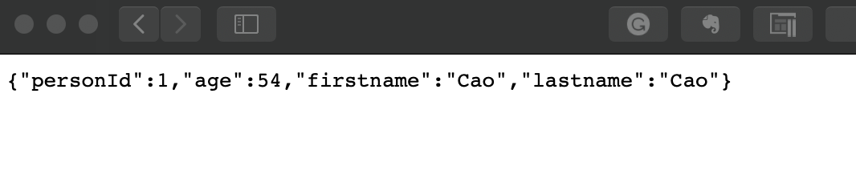
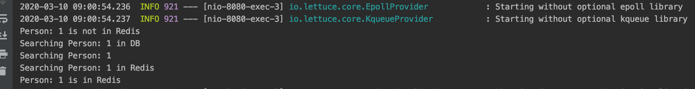
Redis - Example

Slide 34
Messaging with Redis
MessagingRedisApplication.java
@SpringBootApplication
public class MessagingRedisApplication {
private static final Logger LOGGER = LoggerFactory.getLogger(MessagingRedisApplication.class);
@Bean
RedisMessageListenerContainer container(RedisConnectionFactory connectionFactory,
MessageListenerAdapter listenerAdapter) {
RedisMessageListenerContainer container = new RedisMessageListenerContainer();
container.setConnectionFactory(connectionFactory);
container.addMessageListener(listenerAdapter, new PatternTopic("chat"));
return container;
}

Slide 35
Messaging with Redis
MessagingRedisApplication.java
@Bean
MessageListenerAdapter listenerAdapter(Receiver receiver) {
return new MessageListenerAdapter(receiver, "receiveMessage");
}
@Bean
Receiver receiver() {
return new Receiver();
}
@Bean
StringRedisTemplate template(RedisConnectionFactory connectionFactory) {
return new StringRedisTemplate(connectionFactory);
}
public static void main(String[] args) throws InterruptedException {
ApplicationContext ctx = SpringApplication.run(MessagingRedisApplication.class, args);
}
}

Slide 36
Messaging with Redis
Receiver.java
  package com.example.messagingredis;
  import java.util.concurrent.atomic.AtomicInteger;
  import org.slf4j.Logger;
  import org.slf4j.LoggerFactory;
  public class Receiver {
  private static final Logger LOGGER = LoggerFactory.getLogger(Receiver.class);
  private AtomicInteger counter = new AtomicInteger();
  public void receiveMessage(String message) {
  LOGGER.info("Received <" + message + ">");
  counter.incrementAndGet();
  LOGGER.info("counter <" + counter.get() + ">");
  }
  public int getCount() {
  return counter.get();
  }
  }

Slide 37
Messaging with Redis
MsgController.java
  package com.example.messagingredis;
  import org.springframework.beans.factory.annotation.Autowired;
  import org.springframework.data.redis.core.StringRedisTemplate;
  import org.springframework.web.bind.annotation.*;
  import org.springframework.web.context.WebApplicationContext;
  @RestController
  public class MsgController {
  @Autowired
  WebApplicationContext applicationContext;
  @GetMapping(value = "/msg")
  public void findOne( ) {
  StringRedisTemplate template = applicationContext.getBean(StringRedisTemplate.class);
  // Send a message with a POJO - the template reuse the message converter
  System.out.println("Sending an email message.");
  template.convertAndSend("chat", "Hello from Redis in HTTP!");
  };
  }

Slide 38
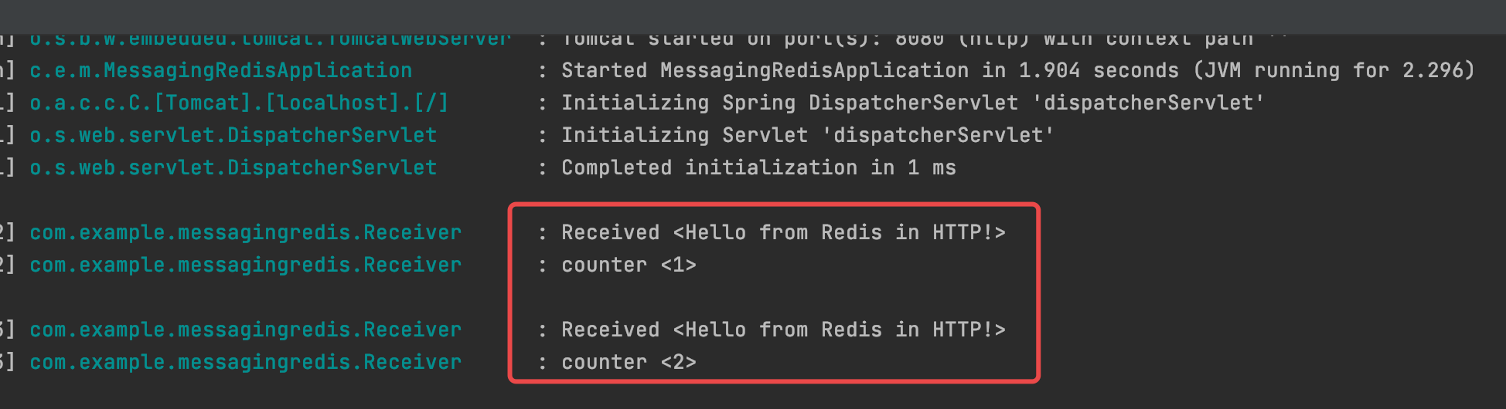
Messaging with Redis
pom.xml
  <dependency>
  <groupId>org.springframework.boot</groupId>
  <artifactId>spring-boot-starter-data-redis</artifactId>
  </dependency>

Slide 39
References
MemCached
  https://memcached.org/
MemCached
  https://github.com/memcached/memcached/wiki
  xmemcached
  https://code.google.com/archive/p/xmemcached/
分布式缓存-Memcached
  http://blog.sina.com.cn/s/blog_493a845501013ei0.html
HomeBrew
  https://brew.sh
Installing memcached on Mac with Homebrew and Lunchy
  https://gist.github.com/tomysmile/ba6c0ba4488ea51e6423d492985a7953
Memcached结合Spring
  https://www.jianshu.com/p/56d9d79d75b3
Accessing Memcached from the command line
  http://www.alphadevx.com/a/90-Accessing-Memcached-from-the-command-line

Slide 40
References
Redis
  https://redis.io
Spring Data Redis
  https://docs.spring.io/spring-data/redis/docs/2.2.5.RELEASE/reference/html/#get-started
  https://github.com/ZhangZiSheng001/spring-data-projects/tree/master/spring-data-redis-demo
Retwis
  http://retwis.redis.io
  https://github.com/spring-projects/spring-data-keyvalue-examples
  https://docs.spring.io/spring-data/data-keyvalue/examples/retwisj/current/
Jedis
  https://github.com/xetorthio/jedis
SpringBoot整合Redis实战项目
  https://www.cnblogs.com/david1216/p/11473764.html
Redis in Action
  JOSIAH L. CARLSON, Manning Publications Co, 2013
Messaging with Redis
  https://spring.io/guides/gs/messaging-redis/

Slide 41

Thank You!

