Slide 1
Architecture of Enterprise Applications 10 Full-text Searching
Haopeng Chen
REliable, INtelligent and Scalable Systems Group (REINS)
Shanghai Jiao Tong University
Shanghai, China
http://reins.se.sjtu.edu.cn/~chenhp
e-mail: chen-hp@sjtu.edu.cn

Slide 2
Contents and Objectives
Contents
Lucene
Solr
Elasticsearch
Objectives
能够根据业务需求，识别适合全文搜索引擎的场景，设计并实现基于搜索引擎的全文搜索方案

Slide 3
Lucene
Lucene is a high performance, scalable Information Retrieval (IR) library.
It lets you add indexing and searching capabilities to your applications.
Lucene is a mature, free, open-source project implemented in Java.
it’s a member of the popular Apache Jakarta family of projects, licensed under the liberal Apache Software License.
Lucene provides a simple yet powerful core API
that requires minimal understanding of full-text indexing and searching.

Slide 4
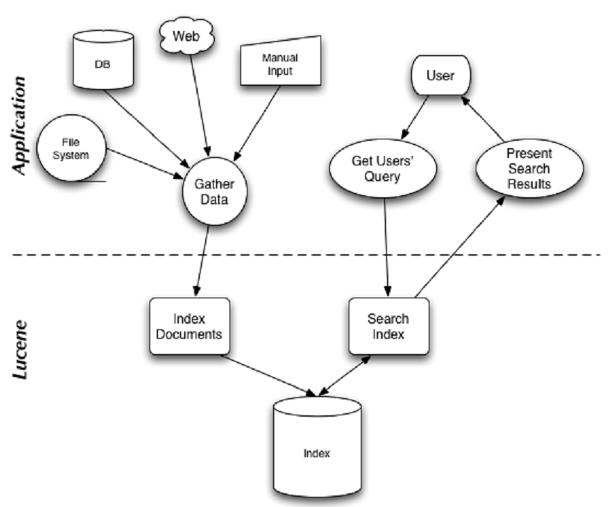
Lucene

Slide 5
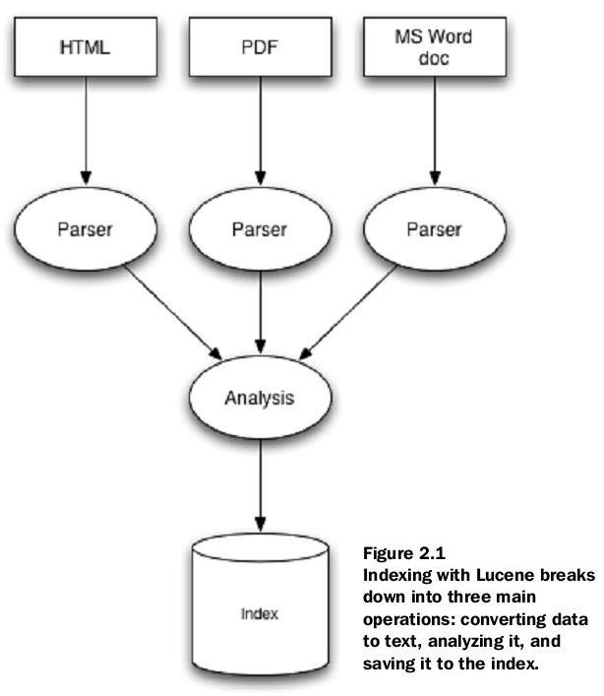
Indexing
这个parser类似于编译器里面讲的lex，就是将文本里面的token给分离出来

Slide 6
indexing
At the heart of all search engines is the concept of indexing:
processing the original data into a highly efficient cross-reference lookup in order to facilitate rapid searching.
Suppose you needed to search a large number of files, and you wanted to be able to find files that contained a certain word or a phrase
A naïve approach would be to sequentially scan each file for the given word or phrase.
This approach has a number of flaws, the most obvious of which is that it doesn’t scale to larger file sets or cases where files are very large.

Slide 7
indexing
This is where indexing comes in:
To search large amounts of text quickly, you must first index that text and convert it into a format that will let you search it rapidly, eliminating the slow sequential scanning process.
This conversion process is called indexing, and its output is called an index.
You can think of an index as a data structure that allows fast random access to words stored inside it.

Slide 8
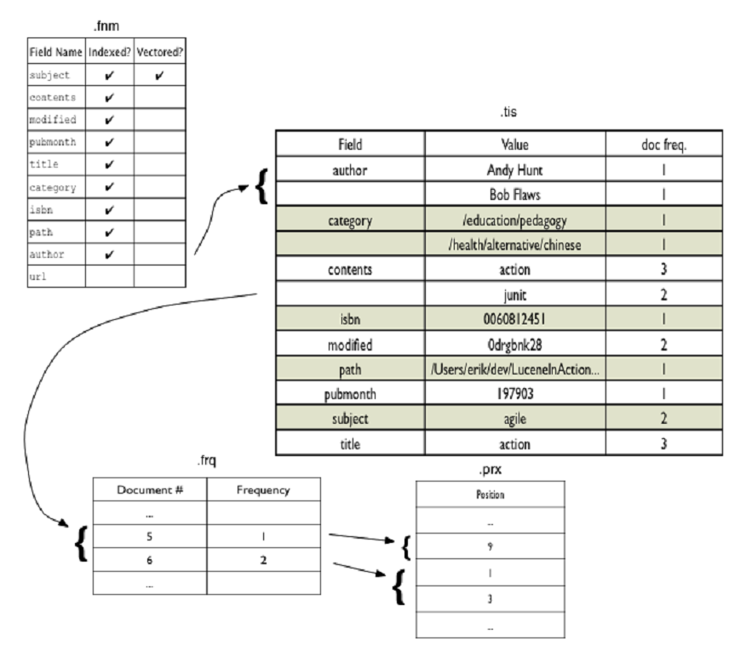
Inverting index(反向索引)

Slide 9
Searching
Searching is the process of looking up words in an index to find documents where they appear.
The quality of a search is typically described using precision(准确率) and recall(查全率) metrics.
Recall measures how well the search system finds relevant documents, whereas precision measures how well the system filters out the irrelevant documents.
A number of other factors
speed and the ability to quickly search large quantities of text.
Support for single and multi term queries, phrase queries, wildcards, result ranking, and sorting are also important, as is a friendly syntax for entering those queries.

Slide 10
A sample application
Suppose you need to index and search files stored in a directory tree, not just in a single directory
These example applications will familiarize you with Lucene’s API, its ease of use, and its power.
The code listings are complete, ready-to-use command-line programs.

Slide 11
Creating an Index
/**
* This code was originally written for
* Erik's Lucene intro java.net article
*/
public class Indexer {
public static void main(String[] args) throws Exception {
if (args.length != 2) {
throw new Exception("Usage: java " + Indexer.class.getName()
+ " <index dir> <data dir>");
}
File indexDir = new File(args[0]);
File dataDir = new File(args[1]);
long start = new Date().getTime();
int numIndexed = index(indexDir, dataDir);
long end = new Date().getTime();
System.out.println("Indexing " + numIndexed + " files took " + (end - start) + " milliseconds");
}
Create Lucene index in this directory
Index files in this directory

Slide 12
Creating an Index
// open an index and start file directory traversal
public static int index(File indexDir, File dataDir) throws IOException {
if (!dataDir.exists() || !dataDir.isDirectory()) {
throw new IOException(dataDir
+ " does not exist or is not a directory");
}
IndexWriter writer = new IndexWriter(indexDir,
new StandardAnalyzer(), true);
writer.setUseCompoundFile(false);
indexDirectory(writer, dataDir);
int numIndexed = writer.docCount();
writer.optimize(); (这个optimize是将新生成的index文件写入disk)
writer.close();
return numIndexed;
}
Create Lucene index
Close index

Slide 13
Creating an Index
// recursive method that calls itself when it finds a directory
private static void indexDirectory(IndexWriter writer, File dir)
throws IOException {
File[] files = dir.listFiles();
for (int i = 0; i < files.length; i++) {
File f = files[i];
if (f.isDirectory()) {
indexDirectory(writer, f);
} else if (f.getName().endsWith(".txt")) {
indexFile(writer, f);
}
}
}
recurse
Index .txt files only

Slide 14
Creating an Index
// method to actually index a file using Lucene
private static void indexFile(IndexWriter writer, File f)
throws IOException {
if (f.isHidden() || !f.exists() || !f.canRead()) {
return;
}
System.out.println("Indexing " + f.getCanonicalPath());
Document doc = new Document();
doc.add(Field.Text("contents", new FileReader(f)));
doc.add(Field.Keyword("filename", f.getCanonicalPath()));
writer.addDocument(doc);
}
}
Index file content
Index file name
Add document to Lucene index

Slide 15
Running Indexer
% java lia.meetlucene.Indexer build/index/lucene
Indexing /lucene/build/test/TestDoc/test.txt
Indexing /lucene/build/test/TestDoc/test2.txt
Indexing /lucene/BUILD.txt
Indexing /lucene/CHANGES.txt
Indexing /lucene/LICENSE.txt
Indexing /lucene/README.txt
Indexing /lucene/src/jsp/README.txt
Indexing /lucene/src/test/org/apache/lucene/analysis/ru/stemsUnicode.txt
Indexing /lucene/src/test/org/apache/lucene/analysis/ru/test1251.txt
Indexing /lucene/src/test/org/apache/lucene/analysis/ru/testKOI8.txt
Indexing /lucene/src/test/org/apache/lucene/analysis/ru/testUnicode.txt
Indexing /lucene/src/test/org/apache/lucene/analysis/ru/wordsUnicode.txt
Indexing /lucene/todo.txt
Indexing 13 files took 2205 milliseconds

Slide 16
Searching an index
/**
* This code was originally written for
* Erik's Lucene intro java.net article
*/
public class Searcher {
public static void main(String[] args) throws Exception {
if (args.length != 2) {
throw new Exception("Usage: java " + Searcher.class.getName()
+ " <index dir> <query>");
}
File indexDir = new File(args[0]);
String q = args[1];
if (!indexDir.exists() || !indexDir.isDirectory()) {
throw new Exception(indexDir +
" does not exist or is not a directory.");
}
search(indexDir, q);
}
Index directory created by Indexer
Query string

Slide 17
Searching an index
public static void search(File indexDir, String q)
throws Exception {
Directory fsDir = FSDirectory.getDirectory(indexDir, false);
IndexSearcher is = new IndexSearcher(fsDir);
Query query = QueryParser.parse(q, "contents", new StandardAnalyzer());
long start = new Date().getTime();
Hits hits = is.search(query);
long end = new Date().getTime();
System.err.println("Found " + hits.length() + " document(s) (in " + (end - start) +
" milliseconds) that matched query '" + q + "':");
for (int i = 0; i < hits.length(); i++) {
Document doc = hits.doc(i);
System.out.println(doc.get("filename"));
}
}
}
Open Index
Parse query
Search Index
Write search stats
Retrieve matching document
Display filename

Slide 18
Running Searcher
%java lia.meetlucene.Searcher build/index 'lucene'
Found 6 document(s) (in 66 milliseconds) that matched query 'lucene':
/lucene/README.txt
/lucene/src/jsp/README.txt
/lucene/BUILD.txt
/lucene/todo.txt
/lucene/LICENSE.txt
/lucene/CHANGES.txt

Slide 19
Core indexing classes
IndexWriter
This class creates a new index and adds documents to an existing index.
Directory
The Directory class represents the location of a Lucene index.
Analyzer
The Analyzer, specified in the IndexWriter constructor, is in charge of extracting tokens out of text to be indexed and eliminating the rest.
Document
A Document represents a collection of fields.
Field
Each field corresponds to a piece of data that is either queried against or retrieved from the index during search.

Slide 20
Core searching classes
IndexSearcher
IndexSearcher is to searching what IndexWriteris to indexing
Term
A Term is the basic unit for searching.
Query
Query is the common, abstract parent class. It contains several utility methods
TermQuery
TermQuery is the most basic type of query supported by Lucene, and it’s one of the primitive query types.
Hits
The Hits class is a simple container of pointers to ranked search results

Slide 21
Adding documents to an index
public abstract class BaseIndexingTestCase extends TestCase {
protected String[] keywords = {"1", "2"};
protected String[] unindexed = {"Netherlands", "Italy"};
protected String[] unstored = {"Amsterdam has lots of bridges",
"Venice has lots of canals"};
protected String[] text = {"Amsterdam", "Venice"};
protected Directory dir;
protected void setUp() throws IOException {
String indexDir =
System.getProperty("java.io.tmpdir", "tmp") +
System.getProperty("file.separator") + "index-dir";
dir = FSDirectory.getDirectory(indexDir, true);
addDocuments(dir);
}

Slide 22
Adding documents to an index
protected void addDocuments(Directory dir) throws IOException {
IndexWriter writer = new IndexWriter(dir, getAnalyzer(), true);
writer.setUseCompoundFile(isCompound());
for (int i = 0; i < keywords.length; i++) {
Document doc = new Document();
doc.add(Field.Keyword("id", keywords[i]));
doc.add(Field.UnIndexed("country", unindexed[i]));
doc.add(Field.UnStored("contents", unstored[i]));
doc.add(Field.Text("city", text[i]));
writer.addDocument(doc);
}
writer.optimize();
writer.close();
}
protected Analyzer getAnalyzer() { return new SimpleAnalyzer();}
protected boolean isCompound() { return true; }
}

Slide 23
Fields
All fields consist of a name and value pair.
Keyword—Isn’t analyzed, but is indexed and stored in the index verbatim.
UnIndexed—Is neither analyzed nor indexed, but its value is stored in the index as is.
UnStored—The opposite of UnIndexed. This field type is analyzed and indexed but isn’t stored in the index.
Text—Is analyzed, and is indexed. This implies that fields of this type can be searched against, but be cautious about the field size.

Slide 24
Adding documents to an index
Heterogeneous Documents
One handy feature of Lucene is that it allows Documents with different sets of Fields to coexist in the same index.
This means you can use a single index to hold Documents that represent different entities.
For instance, you could have Documents that represent retail products with Fields such as name and price, and Documents that represent people with Fields such as name, age, and gender.

Slide 25
Adding documents to an index
Appendable Fields
Suppose you have an application that generates an array of synonyms for a given word, and you want to use Lucene to index the base word plus all its synonyms.
like this:
String baseWord = "fast";
String synonyms[] = String {"quick", "rapid", "speedy"};
Document doc = new Document();
doc.add(Field.Text("word", baseWord));
for (int i = 0; i < synonyms.length; i++) {
doc.add(Field.Text("word", synonyms[i]));
}
Internally, Lucene appends all the words together and index them in a single Field called word, allowing you to use any of the given words when searching.

Slide 26
Removing Documents from an index
public class DocumentDeleteTest extends BaseIndexingTestCase {
public void testDeleteBeforeIndexMerge() throws IOException {
IndexReader reader = IndexReader.open(dir);
assertEquals(2, reader.maxDoc());
assertEquals(2, reader.numDocs());
reader.delete(1);
assertTrue(reader.isDeleted(1));
assertTrue(reader.hasDeletions());
assertEquals(2, reader.maxDoc());
assertEquals(1, reader.numDocs());
reader.close();
reader = IndexReader.open(dir);
assertEquals(2, reader.maxDoc());
assertEquals(1, reader.numDocs());
reader.close();
}

Slide 27
Removing Documents from an index
public void testDeleteAfterIndexMerge() throws IOException {
IndexReader reader = IndexReader.open(dir);
assertEquals(2, reader.maxDoc());
assertEquals(2, reader.numDocs());
reader.delete(1);
reader.close();
IndexWriter writer = new IndexWriter(dir, getAnalyzer(), false);
writer.optimize();
writer.close();
reader = IndexReader.open(dir);
assertFalse(reader.isDeleted(1));
assertFalse(reader.hasDeletions());
assertEquals(1, reader.maxDoc());
assertEquals(1, reader.numDocs());
reader.close();
}

Slide 28
Undeleting Documents
Because Document deletion is deferred until the closing of the IndexReader instance,
Lucene allows an application to change its mind and undelete Documents that have been marked as deleted.
A call to IndexReader’s undeleteAll()method undeletes all deleted Documents
by removing all .del files from the index directory.
Subsequently closing the IndexReader instance therefore leaves all Documents in the index.
Documents can be undeleted only if the call to undeleteAll()was done using the same instance of IndexReader that was used to delete the Documents in the first place.

Slide 29
Updating Documents in an index
“How do I update a document in an index?”
is a frequently asked question on the Lucene user mailing list.
Lucene doesn’t offer an update(Document)method;
instead, a Document must first be deleted from an index and then re-added to it
IndexReader reader = IndexReader.open(dir);
reader.delete(new Term("city", "Amsterdam"));
reader.close();
IndexWriter writer = new IndexWriter(dir, getAnalyzer(), false);
Document doc = new Document();
doc.add(Field.Keyword("id", "1"));
doc.add(Field.UnIndexed("country", "Netherlands"));
doc.add(Field.UnStored("contents", "Amsterdam has lots of bridges"));
doc.add(Field.Text("city", "Haag"));
writer.addDocument(doc);
writer.optimize();
writer.close();

Slide 30
Boosting Documents and Fields
Not all Documents and Fields are created equal
Document boosting is a feature that makes such a requirement simple to implement.
By default, all Documents have no boost—or, rather, they all have the same boost factor of 1.0.
By changing a Document’s boost factor, you can instruct Lucene to consider it more or less important with respect to other Documents in the index.
The API for doing this consists of a single method, setBoost(float)

Slide 31
Boosting Documents and Fields
public static final String COMPANY_DOMAIN = "example.com";
public static final String BAD_DOMAIN = "yucky-domain.com";
Document doc = new Document();
String senderEmail = getSenderEmail();
String senderName = getSenderName();
String subject = getSubject();
String body = getBody();
doc.add(Field.Keyword("senderEmail”, senderEmail));
doc.add(Field.Text("senderName", senderName));
doc.add(Field.Text("subject", subject));
doc.add(Field.UnStored("body", body));
if (getSenderDomain().endsWithIgnoreCase(COMPANY_DOMAIN)) {
doc.setBoost(1.5);
}
else if (getSenderDomain().endsWithIgnoreCase(BAD_DOMAIN)) {
doc.setBoost(0.1);
}
writer.addDocument(doc);

Slide 32
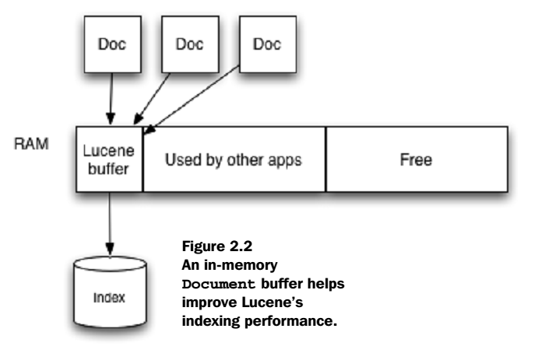
Tuning indexing performance

Slide 33
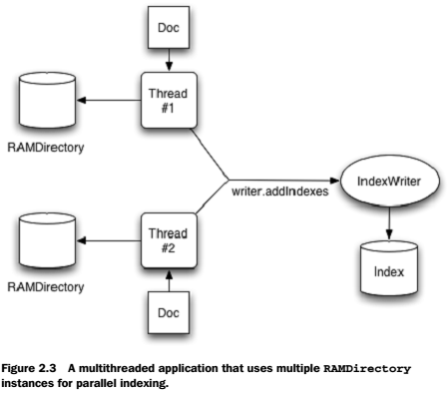
Parallelizing indexing by working with multiple indexes

Slide 34
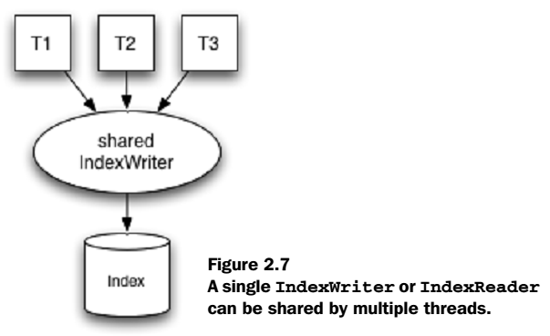
Concurrency

Slide 35
Searching for a specific term
A term is a value that is paired with its containing field.
IndexSearcher searcher = new IndexSearcher(directory);
Term t = new Term("subject", "ant");
Query query = new TermQuery(t);
Hits hits = searcher.search(query);
t = new Term("subject", "junit");
hits = searcher.search(new TermQuery(t));
searcher.close();

Slide 36
Parsing a user-entered query expression: QueryParser
IndexSearcher searcher = new IndexSearcher(directory);
Query query = QueryParser.parse("+JUNIT +ANT -MOCK", "contents",
new SimpleAnalyzer());
Hits hits = searcher.search(query);
Document d = hits.doc(0);
query = QueryParser.parse("mock OR junit", "contents",
new SimpleAnalyzer());
hits = searcher.search(query);

Slide 37
Understanding Lucene scoring
The score is computed for each document (d) matching a specific.
This score is the raw score.
Scores returned from Hits aren’t necessarily the raw score, however.
If the top-scoring document scores greater than 1.0, all scores are normalized from that score, such that all scores from Hits are guaranteed to be 1.0 or less.

Slide 38

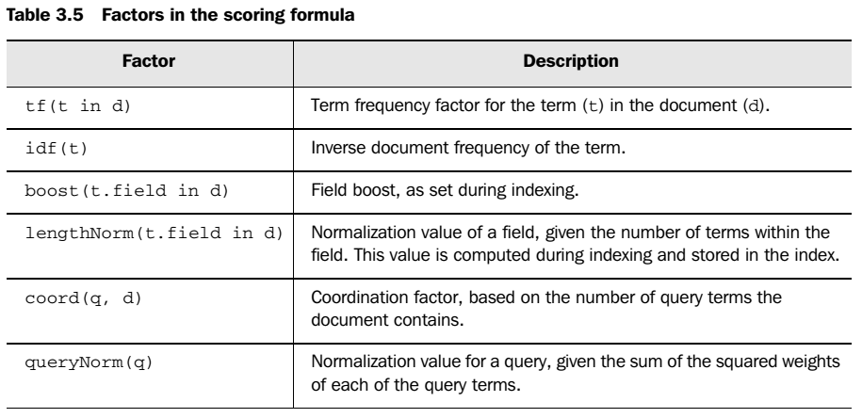
Understanding Lucene scoring

Slide 39


Apache Solr
APACHE SOLR™
is the popular, blazing-fast, open source enterprise search platform built on Apache Lucene™.
is highly reliable, scalable and fault tolerant, providing distributed indexing, replication and load-balanced querying, automated failover and recovery, centralized configuration and more.
Solr powers the search and navigation features of many of the world's largest internet sites.

Slide 40
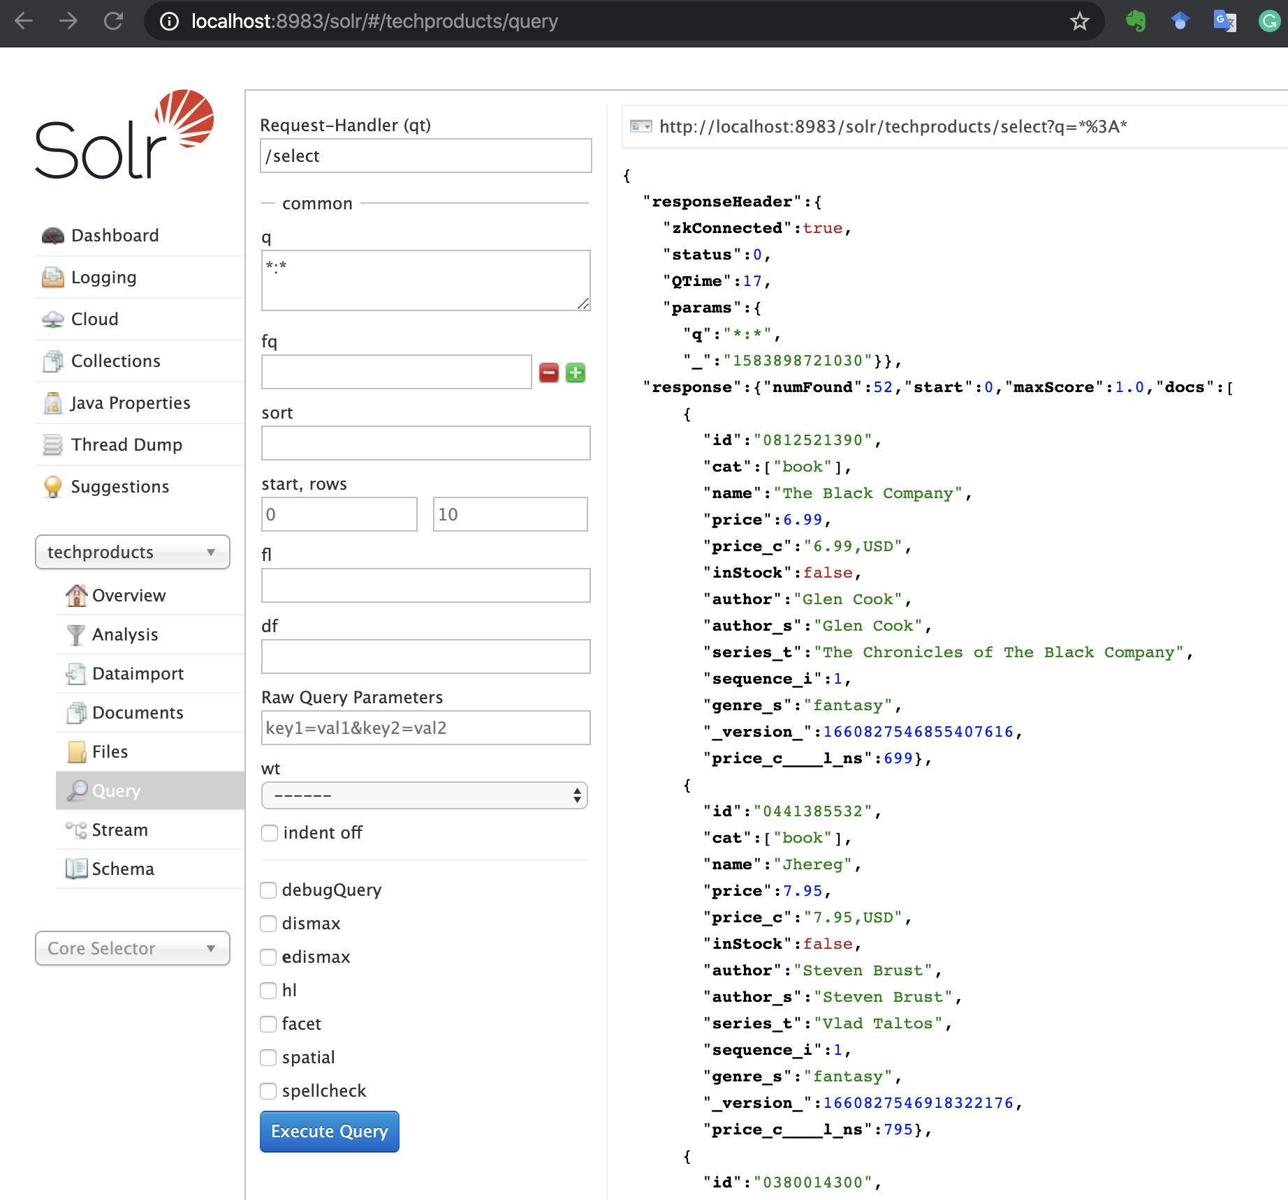
Solr
Launch Solr in SolrCloud Mode
$ ./bin/solr start -e cloud

Slide 41
Using SolrJ
SolrJ
is an API that makes it easy for applications written in Java (or any language based on the JVM) to talk to Solr.
For projects built with Maven, place the following in your pom.xml:
<dependency>
<groupId>org.apache.solr</groupId>
<artifactId>solr-solrj</artifactId>
<version>9.0.0</version>
</dependency>

Slide 42
Using SolrJ
Querying.java
public class Querying { public static void main(String[] args) throws IOException, SolrServerException { final SolrClient client = getSolrClient(); final Map<String, String> queryParamMap = new HashMap<String, String>(); queryParamMap.put("q", "*:*"); queryParamMap.put("fl", "id, name"); queryParamMap.put("sort", "id asc"); MapSolrParams queryParams = new MapSolrParams(queryParamMap); final QueryResponse response = client.query("techproducts", queryParams); final SolrDocumentList documents = response.getResults(); System.out.println("Found " + documents.getNumFound() + " documents"); for (SolrDocument document : documents) { final String id = (String) document.getFirstValue("id"); final String name = (String) document.getFirstValue("name"); System.out.println("id: " + id + "; name: " + name); } }

Slide 43
Using SolrJ
Querying.java
public static SolrClient getSolrClient() { final String solrUrl = "http://localhost:8983/solr"; return new HttpSolrClient.Builder(solrUrl) .withConnectionTimeout(10000) .withSocketTimeout(60000) .build(); } }

Slide 44
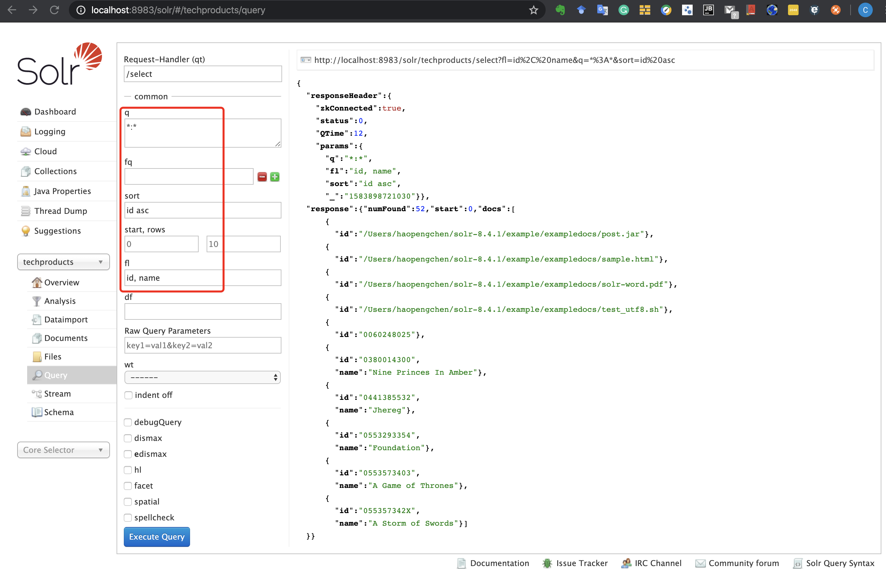
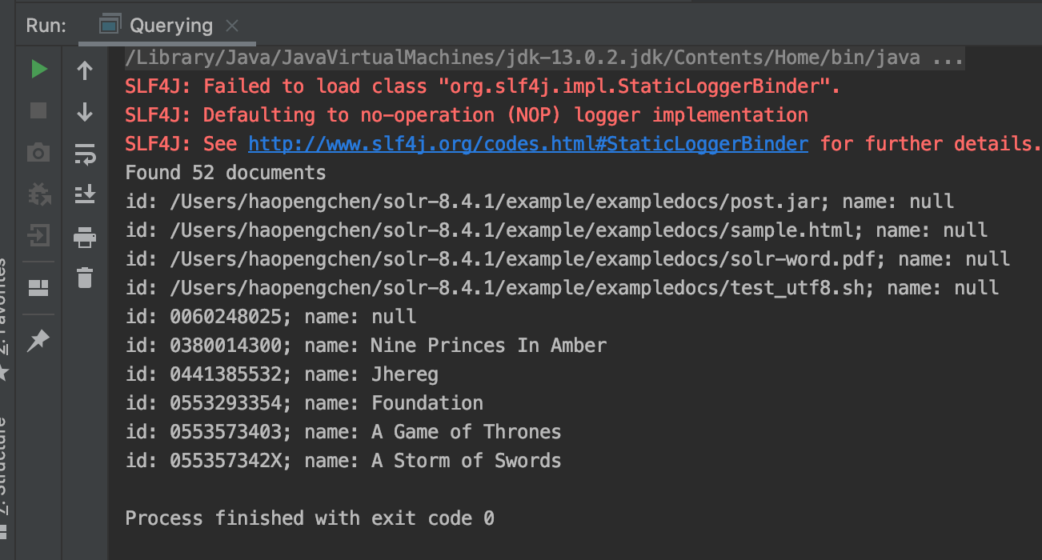
Using SolrJ

Slide 45
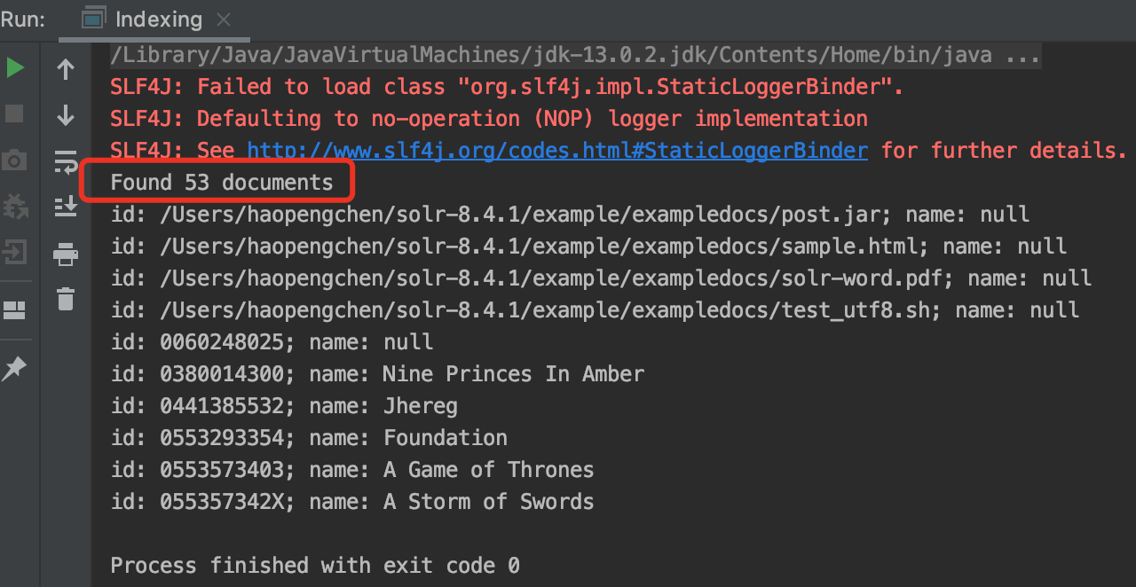
Indexing
Indexing.java
final SolrInputDocument doc = new SolrInputDocument(); doc.addField(“id”, UUID.randomUUID().toString()); doc.addField(“name”, “Amazon Kindle Paperwhite”); final UpdateResponse updateResponse = client.add("techproducts", doc); // Indexed documents must be committed client.commit("techproducts");

Slide 46
Java Object Binding
public class TechProduct { @Field public String id; @Field public String name; public TechProduct(String id, String name) { this.id = id; this.name = name; } public TechProduct() { } public String getId() { return this.id; } public String getName() { return this.name; } }
TechProduct.java

Slide 47
Java Object Binding
ObjectBinding.java
public class ObjectBinding { public static void main(String[] args) throws IOException, SolrServerException { final SolrClient client = getSolrClient(); final TechProduct kindle = new TechProduct("kindle-id-4", "Amazon Kindle Paperwhite"); final UpdateResponse response = client.addBean("techproducts", kindle); client.commit("techproducts");
final SolrQuery query = new SolrQuery("*:*"); query.addField("id"); query.addField("name"); query.setSort("id", SolrQuery.ORDER.asc); final QueryResponse responseOne = client.query("techproducts", query); final List<TechProduct> products = responseOne.getBeans(TechProduct.class); for (TechProduct product : products) { final String id = product.getId(); final String name = product.getName(); System.out.println("id: " + id + "; name: " + name); } }

Slide 48
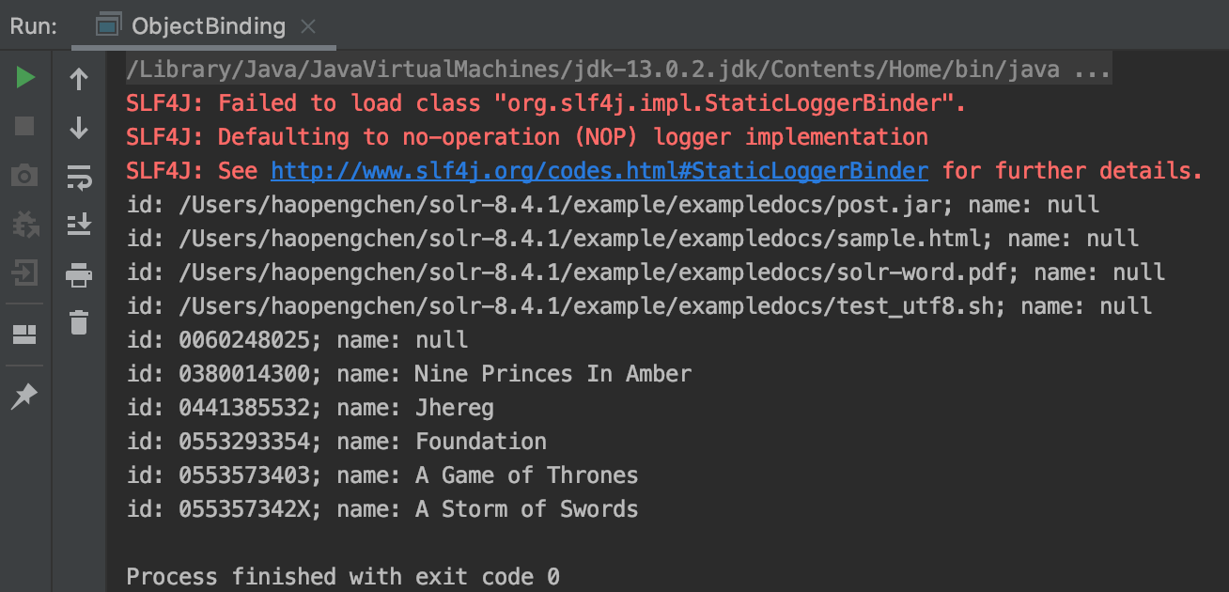
Java Object Binding
ObjectBinding.java
public static SolrClient getSolrClient() { final String solrUrl = "http://localhost:8983/solr"; return new HttpSolrClient.Builder(solrUrl) .withConnectionTimeout(10000) .withSocketTimeout(60000) .build(); } }

Slide 49

Elasticsearch
Elasticsearch is a highly scalable open-source full-text search and analytics engine.
It allows you to store, search, and analyze big volumes of data quickly and in near real time.
It is generally used as the underlying engine/technology that powers applications that have complex search features and requirements.
https://www.elastic.co

Slide 50
Elasticsearch – Basic Concepts
Near Real Time
Elasticsearch is a near real time search platform. What this means is there is a slight latency (normally one second) from the time you index a document until the time it becomes searchable.
Document
A document is a basic unit of information that can be indexed.
This document is expressed in JSON (JavaScript Object Notation) which is a ubiquitous internet data interchange format.
Index
An index is a collection of documents that have somewhat similar characteristics.
An index is identified by a name (that must be all lowercase) and this name is used to refer to the index when performing indexing, search, update, and delete operations against the documents in it.

Slide 51
Elasticsearch – Basic Concepts
Shards & Replicas
An index can potentially store a large amount of data that can exceed the hardware limits of a single node.
To solve this problem, Elasticsearch provides the ability to subdivide your index into multiple pieces called shards.
Sharding is important for two primary reasons:
It allows you to horizontally split/scale your content volume
It allows you to distribute and parallelize operations across shards (potentially on multiple nodes) thus increasing performance/throughput
Replication is important for two primary reasons:
It provides high availability in case a shard/node fails. For this reason, it is important to note that a replica shard is never allocated on the same node as the original/primary shard that it was copied from.
It allows you to scale out your search volume/throughput since searches can be executed on all replicas in parallel.

Slide 52
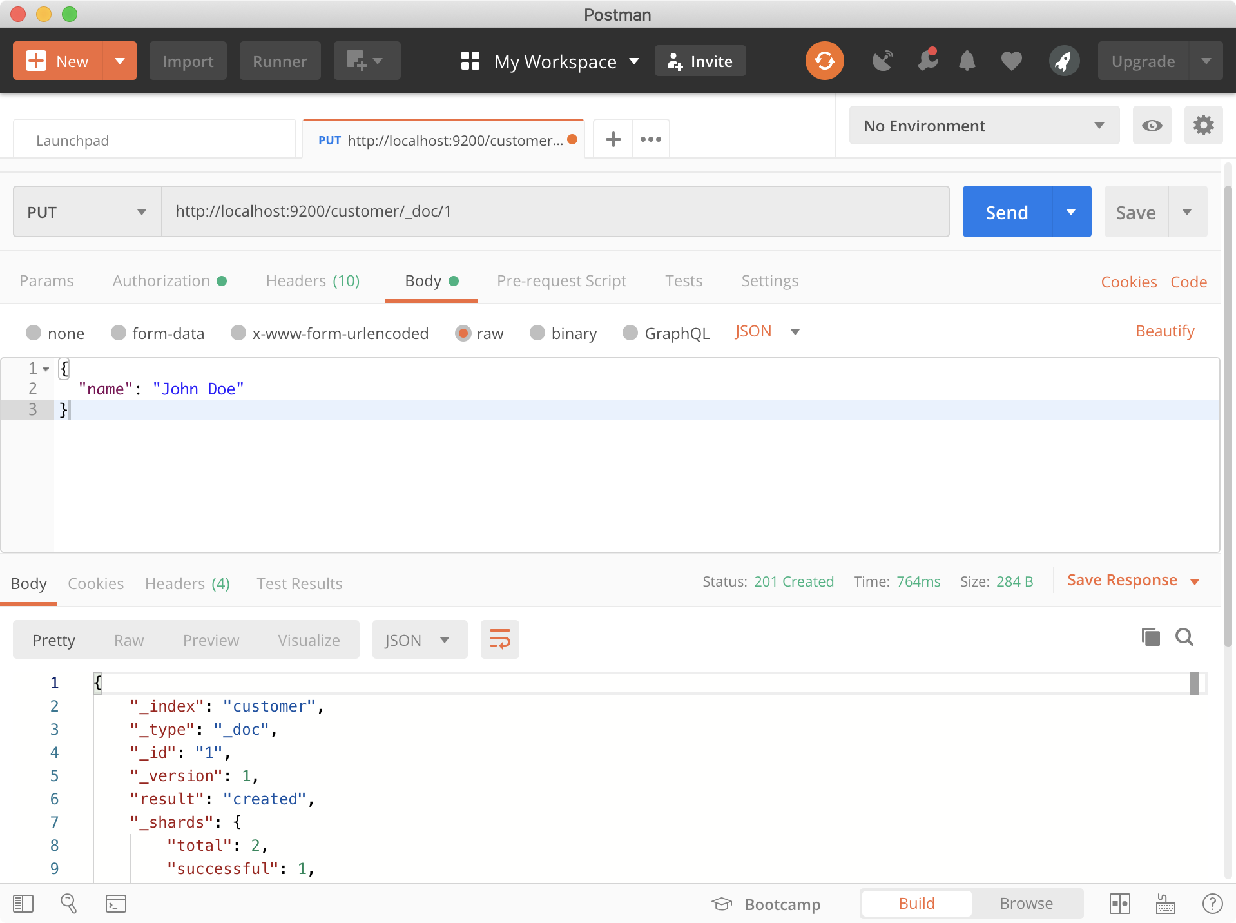
Elasticsearch
Index some documents
PUT /customer/_doc/1 (http://localhost:9200/customer/_doc/1 )
Notes:
curl -X PUT "localhost:9200/customer/_doc/1?pretty" -H 'Content-Type: application/json' -d'
{
"name": "John Doe"
}
'

Slide 53
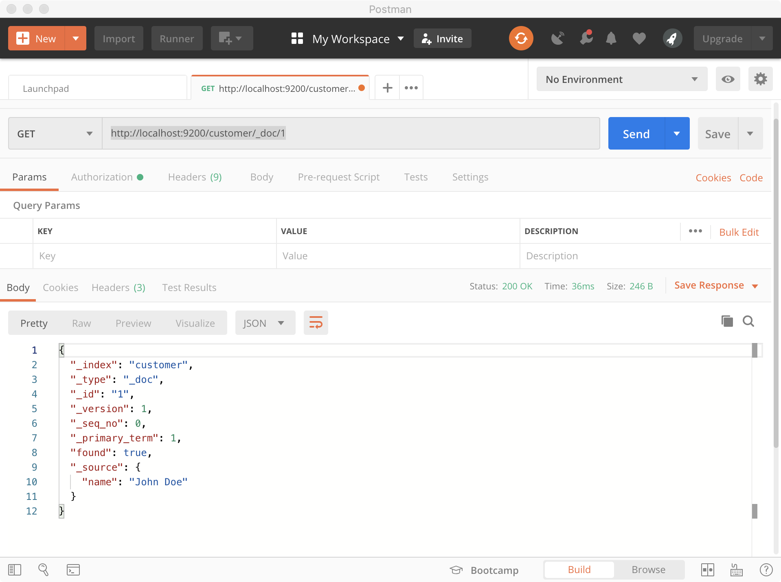
Elasticsearch
Index some documents
GET /customer/_doc/1(http://localhost:9200/customer/_doc/1 )
Notes:
curl -X GET "localhost:9200/customer/_doc/1?pretty"

Slide 54
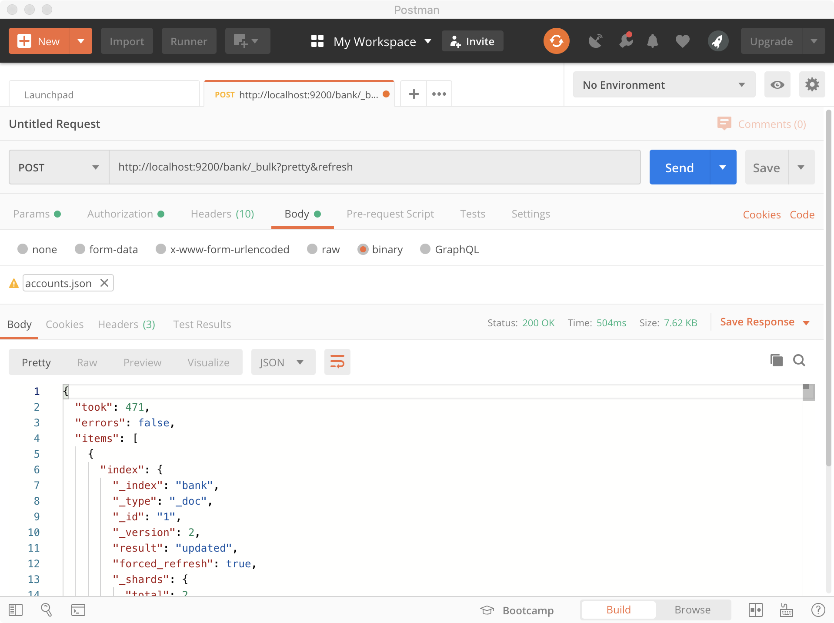
Elasticsearch
Indexing documents in bulk
http://localhost:9200/bank/_bulk?pretty&refresh
Notes:
curl -H "Content-Type: application/json" -XPOST "localhost:9200/bank/_bulk?pretty&refresh" --data-binary "@accounts.json"

Slide 55
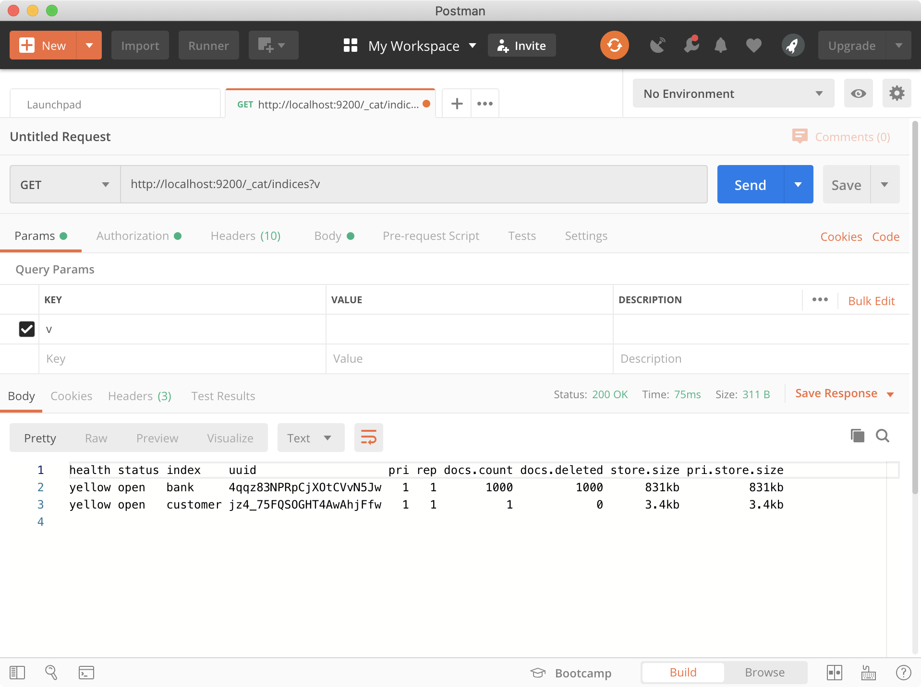
Elasticsearch
Indexing documents in bulk
http://localhost:9200/_cat/indices?v
Notes:
curl "localhost:9200/_cat/indices?v"

Slide 56
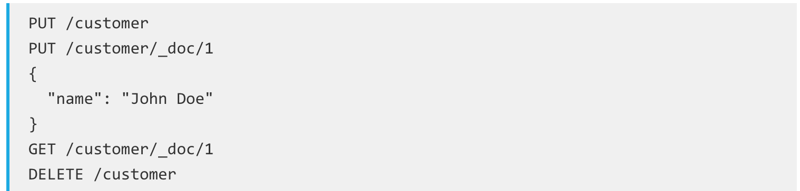
Elasticsearch
Delete Index
Now let’s delete the index that we just created and then list all the indexes again:
And the response:
Before we move on, let’s take a closer look again at some of the API commands that we have learned so far:

Slide 57
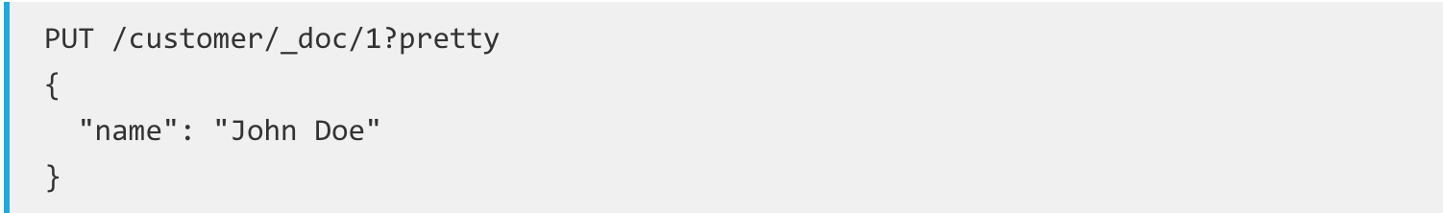
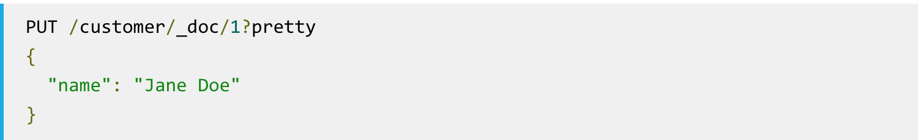
Elasticsearch
Indexing and Replacing Documents
Let’s recall that command again:
If we then executed the above command again with a different (or same) document, Elasticsearch will replace (i.e. reindex) a new document on top of the existing one with the ID of 1:

Slide 58
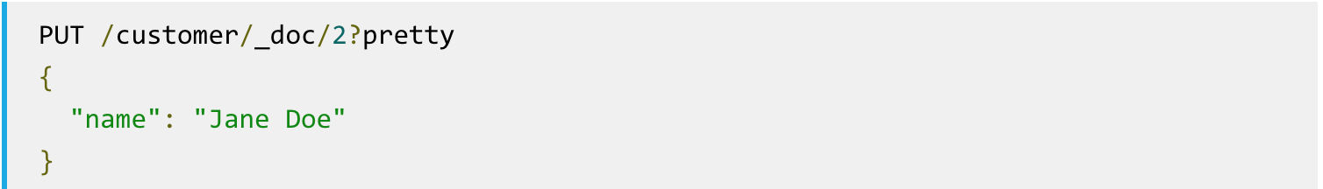
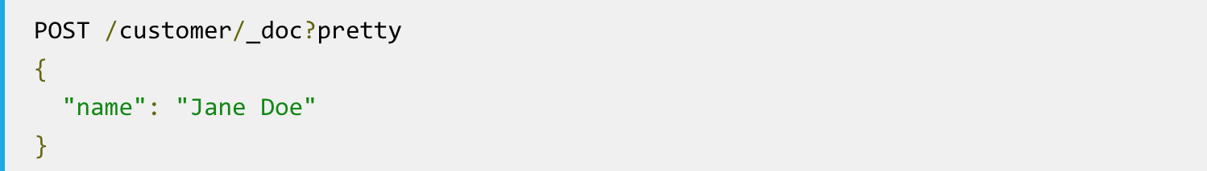
Elasticsearch
Indexing and Replacing Documents
If, on the other hand, we use a different ID, a new document will be indexed and the existing document(s) already in the index remains untouched.
This example shows how to index a document without an explicit ID:
Notes:
When indexing, the ID part is optional. If not specified, Elasticsearch will generate a random ID and then use it to index the document. The actual ID Elasticsearch generates (or whatever we specified explicitly in the previous examples) is returned as part of the index API call.

Slide 59
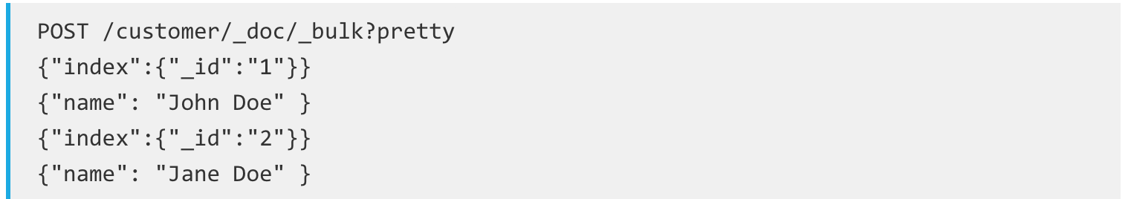
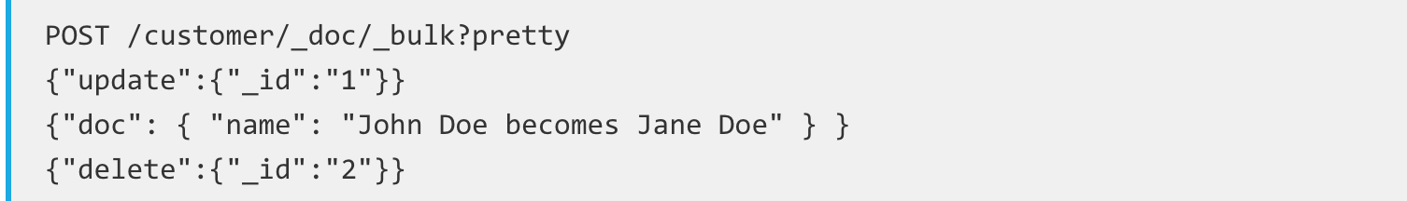
Elasticsearch
Deleting Documents
Deleting a document is fairly straightforward.
Batch Processing

Slide 60
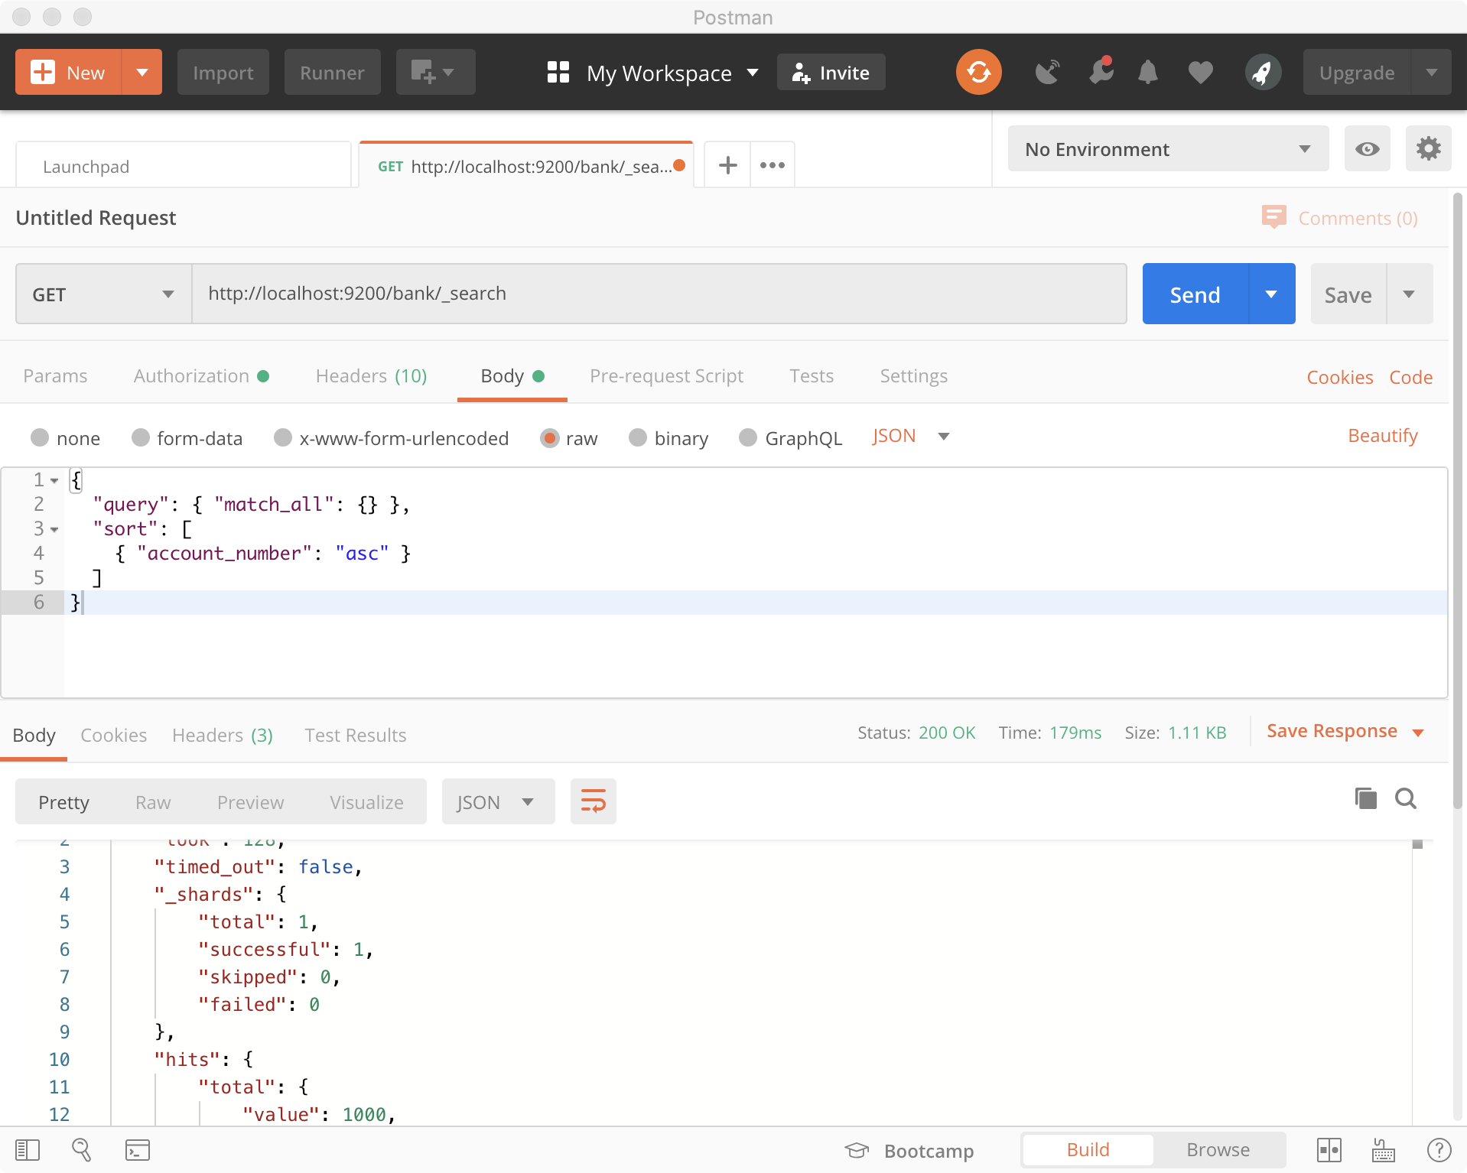
Elasticsearch
Start searching
http://localhost:9200/bank/_search
{
"query": { "match_all": {} },
"sort": [
{ "account_number": "asc" }
]
}
Notes:
{
"query": { "match_all": {} },
"sort": [
{ "account_number": "asc" }
]
}

Slide 61
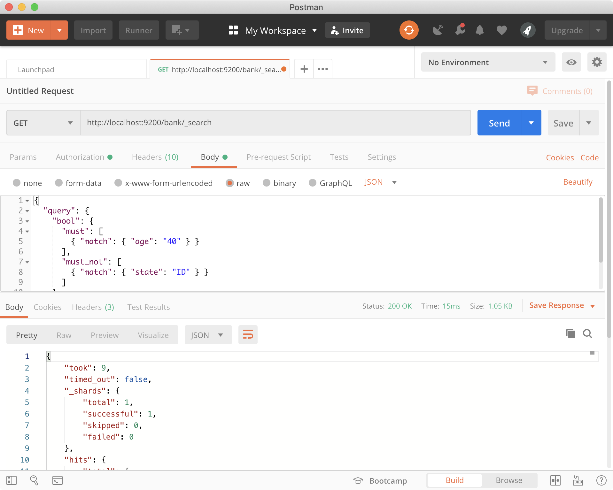
Elasticsearch
Start searching
http://localhost:9200/bank/_search
{
"query": {
"bool": {
"must": [
{ "match": { "age": "40" } }
],
"must_not": [
{ "match": { "state": "ID" } }
]
}
}
}
Notes:
{
"query": { "match_all": {} },
"sort": [
{ "account_number": "asc" }
]
}

Slide 62
References
Apache Lucene
http://lucene.apache.org/
Lucene in Action
By Otis Gospodnetic & Erik Hatcher
MANNING Publishing
Lucene 9.4.1 demo API
https://lucene.apache.org/core/9_4_1/demo/index.html
Apache Solr
https://lucene.apache.org/solr/
Solr Tutorial
https://lucene.apache.org/solr/guide/8_4/solr-tutorial.html#launch-solr-in-solrcloud-mode
Using SolrJ
https://solr.apache.org/guide/solr/latest/
Getting started with Elasticsearch
https://www.elastic.co/guide/en/welcome-to-elastic/current/getting-started-general-purpose.htm

Slide 63
References
ES 写索引报错 FORBIDDEN/12/index read-only / allow delete (api)解决方案
https://blog.csdn.net/weixin_42716596/article/details/125205538
elasticsearch 中的测试数据 accounts.json
https://blog.csdn.net/qq_20667511/article/details/109614359

Slide 64

Thank You!

