Slide 1
Architecture of Enterprise Applications 23 Clustering
Haopeng Chen
REliable, INtelligent and Scalable Systems Group (REINS)
Shanghai Jiao Tong University
Shanghai, China
http://reins.se.sjtu.edu.cn/~chenhp
e-mail: chen-hp@sjtu.edu.cn

Slide 2
Contents and Objectives
Contents
Overview of Clustering
Nginx
MySQL Clustering
Objectives
能够根据业务需求和系统被访问的模式，设计合理的集群部署方式和负载均衡策略

Slide 3
Clustering
A large-scale system typically:
Has many user, potentially in many different places
Is long-running, that is, required to be “always up”
Processes large numbers of transactions per second
May see increases in both its user population and system load
Represents considerable business value
Is operated and managed by multiple persons
Essential requirements on large-scale systems are often summarized by the following three properties(RAS):
Reliability
Availability
Serviceability
Scalability

Slide 4
Clustering
Clustering addresses many of the issues faced by large-scale systems at the same time.
A cluster is a loosely coupled group of servers that provide unified services to their clients.
The client’s view of the cluster is a single, simple system, not a group of collaborating servers. This is referred to as a single-system view or single-system image.
Computers in a cluster are called nodes.

Slide 5
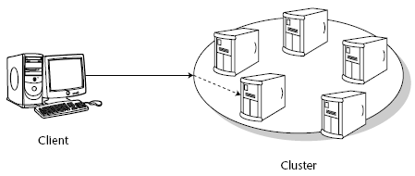
Clustering
Clustering can be a very involved technology, potentially encompassing group communication and replication protocols, and network components such as load balancers and traffic redirectors at different layers in the protocol stack.

Slide 6
Clustering
The main principle behind clustering is that of redundancy.
Reliability
Remove single points of failure
Availability
Overall availability is 1-(1-f%)^{n}
Serviceability
More complex than a single application server
But we could get ability for hot upgrade
Scalability
It is cheaper to build a cluster using standard hardware than to rely on multiprocessor machines.
Extending a cluster by adding extra servers can be done during operation and hence is less disruptive than plugging in another CPU board.

Slide 7
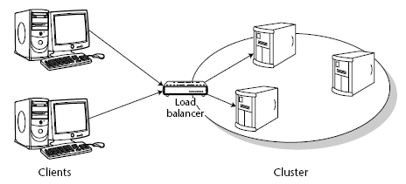
Load balancing and Failover
Load balancing means distributing the requests among cluster nodes to optimize the performance of the whole system.
The algorithm that the load balancer uses to decide which target node to pick for a request can be systematic or random.
Alternatively, the load balancer could try to monitor the load on the different nodes in the cluster and pick node that appears less loaded than others.
An important feature for Web load balancers is session stickiness, which means that all requests in a client’s session are directed to the same server.

Slide 8
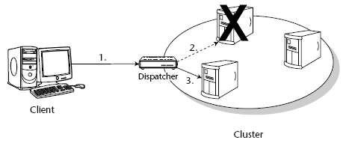
Load balancing and Failover
For a cluster to provide higher availability to clients that a single server, the cluster must be able to failover from a primary server to another, secondary server when failures occur.
Request-level failover. It occurs when a request that is directed to one node for servicing cannot be serviced and is subsequently redirected to another node.
Session failover. If session state is shared between clients and servers, request-level failover may not be sufficient to continue operations. In this case, the session state must also be reconstructed at server node.

Slide 9
The concept of idempotence
An idempotent method is one that can be called repeatedly with the same arguments and achieves the same results each time.
HTTP GET
Generally, any methods that alter a persistent store based on its current state are not idempotent, since two invocations of the same method will alter the persistent store twice.
A failed request could have occurred at one of three points:
After the request has been initiated but before method invocation on the server has begun to execute.
After the method invocation on the server has begun to execute, but before the method has completed.
After the method invocation on the server has completed but before the response has been successfully transmitted to the remote client.

Slide 10
nginx
nginx [engine x] is an HTTP and reverse proxy server, as well as a mail proxy server, written by Igor Sysoev.
For a long time, it has been running on many heavily loaded Russian sites including
Yandex, Mail.Ru, VKontakte, and Rambler.
According to Netcraft nginx served or proxied 25.68% busiest sites in February 2020.
Here are some of the success stories:
Dropbox, Netflix, Wordpress.com, FastMail.FM.

Slide 11
nginx
Starting, Stopping, and Reloading Configuration
To start nginx, run the executable file.
Once nginx is started, it can be controlled by invoking the executable with the -s parameter.
Use the following syntax:
nginx -s signal Where signal may be one of the following:
stop — fast shutdown
quit — graceful shutdown
reload — reloading the configuration file
reopen — reopening the log files

Slide 12
nginx
Serving Static Content
First, create the /data/www directory and put an index.html file with any text content into it and create the /data/images directory and place some images in it.
Next, open the configuration file. The default configuration file already includes several examples of the server block, mostly commented out.
server {
location / {
root /data/www;
}
location /images/ {
root /data;
}
}

Slide 13
nginx
Serving Static Content
This is already a working configuration of a server that listens on the standard port 80 and is accessible on the local machine at http://localhost/.
In response to requests with URIs starting with /images/, the server will send files from the /data/images directory.
For example, in response to the http://localhost/images/example.png request nginx will send the /data/images/example.png file. If such file does not exist, nginx will send a response indicating the 404 error.
Requests with URIs not starting with /images/ will be mapped onto the /data/www directory.
For example, in response to the http://localhost/some/example.html request nginx will send the /data/www/some/example.html file.

Slide 14
nginx
Setting Up a Simple Proxy Server
The configuration of a proxy server will look like this:
server {
location / {
proxy_pass http://localhost:8080/;
}
location ~ \.(gif|jpg|png)$ {
root /data/images;
}
}
This server will filter requests ending with .gif, .jpg, or .png and map them to the /data/images directory (by adding URI to the root directive’s parameter) and pass all other requests to the proxied server configured above.

Slide 15
nginx
Load balancing methods
The following load balancing mechanisms (or methods) are supported in nginx:
round-robin — requests to the application servers are distributed in a round-robin fashion,
least-connected — next request is assigned to the server with the least number of active connections,
ip-hash — a hash-function is used to determine what server should be selected for the next request (based on the client’s IP address).

Slide 16
nginx
Default load balancing configuration
The simplest configuration for load balancing with nginx may look like the following:
http {
upstream myapp1 {
server srv1.example.com;
server srv2.example.com;
server srv3.example.com;
}
server {
listen 80;
location / {
proxy_pass http://myapp1;
}
}
}
Reverse proxy implementation in nginx includes load balancing for HTTP, HTTPS, FastCGI, uwsgi, SCGI, and memcached.

Slide 17
nginx
Least connected load balancing
http {
upstream myapp1 {
least_conn;
server srv1.example.com;
server srv2.example.com;
server srv3.example.com;
}
server {
listen 80;
location / {
proxy_pass http://myapp1;
}
}
}

Slide 18
nginx
Session persistence
Please note that with round-robin or least-connected load balancing, each subsequent client’s request can be potentially distributed to a different server.
There is no guarantee that the same client will be always directed to the same server.
If there is the need to tie a client to a particular application server
in other words, make the client’s session “sticky” or “persistent” in terms of always trying to select a particular server — the ip-hash load balancing mechanism can be used.
http {
upstream myapp1 {
ip_hash;
server srv1.example.com;
server srv2.example.com;
server srv3.example.com;
}
server {
listen 80;
location / {
proxy_pass http://myapp1;
}
}
}
Notes:
ip_hash;

Slide 19
nginx
Weighted load balancing
http {
upstream myapp1 {
server srv1.example.com weight=3;
server srv2.example.com;
server srv3.example.com;
}
server {
listen 80;
location / {
proxy_pass http://myapp1;
}
}
}

Slide 20
Install and Run Nginx
Mac OS
$ sudo chown -R `whoami` /usr/local/Homebrew/
$ sudo chown -R $(whoami) $(brew --prefix)/*
$ sudo mkdir /usr/local/Frameworks
$ sudo chown -R `whoami` /usr/local/Frameworks/
$ brew install nginx
$ nginx
Windows
Download and Unzip the stable version of Nginx on http://nginx.org/en/download.html
Run nginx.exe

Slide 21
Configuration of Nginx
Mac OS
$ cd /usr/local/etc/nginx/
Edit nginx.conf
nginx
nginx -s stop / reopen
Windows
cd %NGINX_HOME%/conf
Edit nginx.conf
http {
upstream pancm{
#ip_hash;
#least_conn;
server 127.0.0.1:8080; #weight=3;
server 127.0.0.1:8090;
}
server {
listen 8000;
server_name localhost;
location / {
root html;
proxy_pass http://pancm;
index index.html index.htm;
}

Slide 22
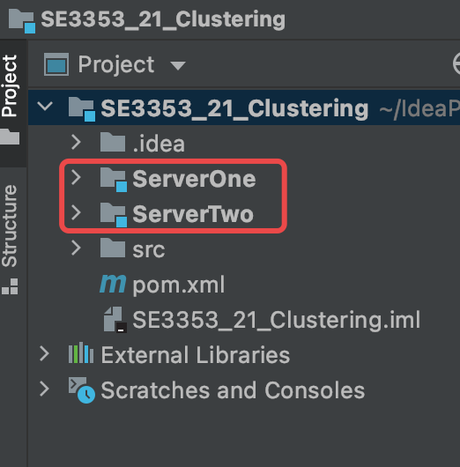
Prepare Two Spring Boot Projects
pom.xml
<?xml version="1.0" encoding="UTF-8"?> <project xmlns="http://maven.apache.org/POM/4.0.0" xmlns:xsi="http://www.w3.org/2001/XMLSchema-instance" xsi:schemaLocation="http://maven.apache.org/POM/4.0.0 http://maven.apache.org/xsd/maven-4.0.0.xsd"> <modelVersion>4.0.0</modelVersion> <groupId>org.example</groupId> <artifactId>SE3353_21_Clustering</artifactId> <version>1.0-SNAPSHOT</version> <packaging>pom</packaging> <properties> <maven.compiler.source>13</maven.compiler.source> <maven.compiler.target>13</maven.compiler.target> </properties> <modules> <module>ServerOne</module> <module>ServerTwo</module> </modules> </project>

Slide 23
Prepare Two Spring Boot Projects
ServerOne
GreetingController.java
@CrossOrigin(maxAge = 3600) @RestController public class GreetingController { @GetMapping("/") public String getHome() { return "Let' start! Server One"; } }
application.properties
server.port=8080
ServerTwo
GreetingController.java
@CrossOrigin(maxAge = 3600) @RestController public class GreetingController { @GetMapping("/") public String getHome() { return "Let' start! Server Two"; } }
application.properties
server.port=8090

Slide 24
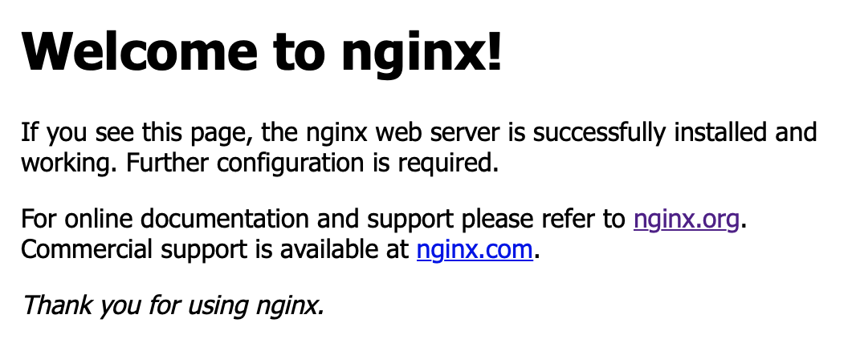


Test Nginx
Run Nginx
http://localhost:8000
Run the two web modules with the following nginx configurations in turn.
default(round-robin)
ip_hash
least_conn
With different weights
http://localhost:8000

Slide 25
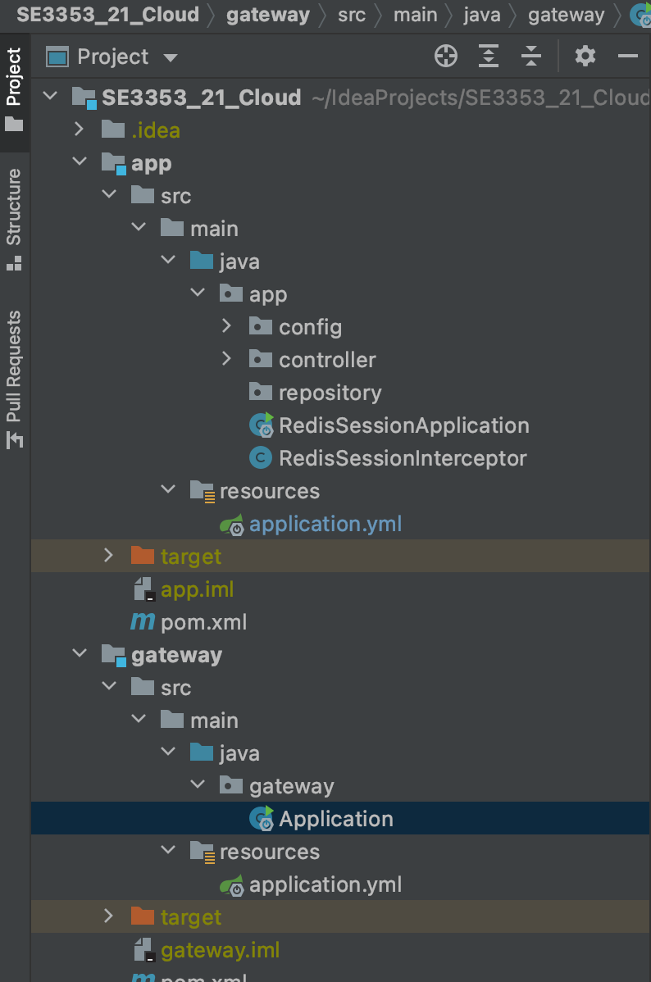
Clustering with Redis for Sessions
Getway Module
Run at 8001 port and route request
App Module
Run at 8002 port and process request
Redis
Run at 6379 port and store sessions

Slide 26
Clustering with Redis for Sessions
Application.java
package gateway; @SpringBootApplication public class Application { @Bean public RouteLocator myRoutes(RouteLocatorBuilder builder) { return builder.routes() .route(p->p.path("/login").filters(f -> f.rewritePath("/login", "/session/login")).uri("http://localhost:8002")) .route(p->p.path("/logout").filters(f->f.rewritePath("/logout", "/session/logout")).uri("http://localhost:8002")) .route(p->p.path("/getInfo").filters(f->f.rewritePath("/getInfo", "/session/getInfo")).uri("http://localhost:8002")) .build(); } public static void main(String[] args) { SpringApplication.run(Application.class, args); } }
Application.yml
server: port: 8002

Slide 27
Clustering with Redis for Sessions
Application.yml
server: port: 8002 spring: application: name: service-session-redis session: store-type: redis redis: namespace: spring:session redis: host: localhost port: 6379 password: timeout: 6000 jedis: pool: max-active: 8 max-wait: -1ms max-idle: 8 min-idle: 0 database: 0 management: endpoints: web: exposure: include: "*" cors: allowed-origins: "*" allowed-methods: "*"
RedisSessionApplication.java
@RestController @SpringBootApplication public class RedisSessionApplication { public static void main(String[] args) { SpringApplication.run(RedisSessionApplication.class, args); } }

Slide 28
Clustering with Redis for Sessions
RedisConfig.java
@Configuration public class RedisConfig extends CachingConfigurerSupport { @Value("${spring.redis.host}") private String host; @Value("${spring.redis.port}") private int port; @Value("${spring.redis.password}") private String password; @Value("${spring.redis.timeout}") private int timeout; @Bean public JedisPool redisPoolFactory() { JedisPoolConfig jedisPoolConfig = new JedisPoolConfig(); return new JedisPool(jedisPoolConfig, host, port, timeout, password); }

Slide 29
Clustering with Redis for Sessions
RedisConfig.java
@Bean(name = "redisTemplate") public RedisTemplate<String, Object> redisTemplate(RedisConnectionFactory redisConnectionFactory){ RedisTemplate<String, Object> redisTemplate = new RedisTemplate<>(); redisTemplate.setConnectionFactory(redisConnectionFactory); ObjectMapper objectMapper = new ObjectMapper(); objectMapper.setVisibility(PropertyAccessor.ALL, JsonAutoDetect.Visibility.ANY); objectMapper.enableDefaultTyping(ObjectMapper.DefaultTyping.NON_FINAL); Jackson2JsonRedisSerializer<Object> jsonRedisSerializer = new Jackson2JsonRedisSerializer<>(Object.class); jsonRedisSerializer.setObjectMapper(objectMapper); redisTemplate.setDefaultSerializer(jsonRedisSerializer); redisTemplate.setKeySerializer(new StringRedisSerializer()); redisTemplate.afterPropertiesSet(); return redisTemplate; } }

Slide 30
Clustering with Redis for Sessions
RedisSessionConfig.java
@Configuration @EnableRedisHttpSession(maxInactiveIntervalInSeconds = 60) public class RedisSessionConfig { }
WebSecurityConfig.java
@Configuration public class WebSecurityConfig extends WebMvcConfigurerAdapter { @Autowired RedisSessionInterceptor redisSessionInterceptor; @Override public void addInterceptors(InterceptorRegistry registry){ registry.addInterceptor(redisSessionInterceptor)
.addPathPatterns("/session/**")
.excludePathPatterns("/session/login"); super.addInterceptors(registry); } }

Slide 31
Clustering with Redis for Sessions
userManagementController.java
@RestController public class userManagementController { private StringRedisTemplate redisTemplate; @Autowired public userManagementController(StringRedisTemplate redisTemplate){ this.redisTemplate = redisTemplate; } @GetMapping("/session/login") public String login(HttpServletRequest request){ HttpSession session = request.getSession(); session.setAttribute("username", "zzt"); redisTemplate.opsForValue().set("username:zzt", session.getId()); return "login finished"; } @GetMapping("/session/logout") public String logout(HttpSession session){ session.invalidate(); return "logout finished"; }

Slide 32
Clustering with Redis for Sessions
userManagementController.java
@GetMapping(value = "/session/getInfo") public Map<String, String> addSession (HttpServletRequest request){ HttpSession session = request.getSession(); String sessionId = session.getId(); String username = (String) session.getAttribute("username"); String requestURI = request.getRequestURI(); Map<String, String> sessionInfoMap = new HashMap<>(); sessionInfoMap.put("sessionId", sessionId); sessionInfoMap.put("username", username); sessionInfoMap.put("requestURI", requestURI); return sessionInfoMap; } }

Slide 33
Clustering with Redis for Sessions
RedisSessionInterceptor.java
@Slf4j @Component public class RedisSessionInterceptor implements HandlerInterceptor { private final StringRedisTemplate redisTemplate; @Autowired public RedisSessionInterceptor(StringRedisTemplate redisTemplate){ this.redisTemplate = redisTemplate; } @Override public boolean preHandle(HttpServletRequest request, HttpServletResponse response, Object handler) throws Exception{ HttpSession session = request.getSession(); String username = (String) session.getAttribute("username"); if(username != null){ String loginSessionId = redisTemplate.opsForValue().get(String.format("username:%s", username)); if(loginSessionId != null && loginSessionId.equals(session.getId())){ // success return true; }else if(loginSessionId != null && !loginSessionId.equals(session.getId())){ log.info("id mismatch, session invalidate: {}", session.getId()); } }else{ log.info("please login"); } response401(response); return false; }

Slide 34
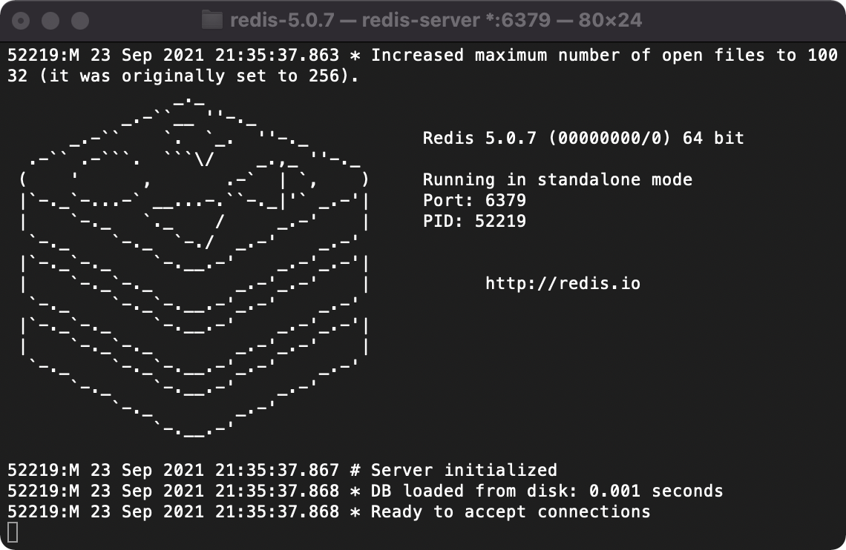
Clustering with Redis for Sessions
RedisSessionInterceptor.java
private void response401(HttpServletResponse response) throws Exception{ response.setCharacterEncoding("UTF-8"); response.setContentType("application/json; charset=utf-8"); response.getWriter().print("401"); } }

Slide 35


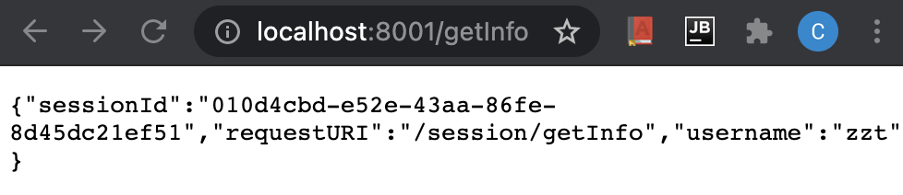
Clustering with Redis for Sessions

Slide 36
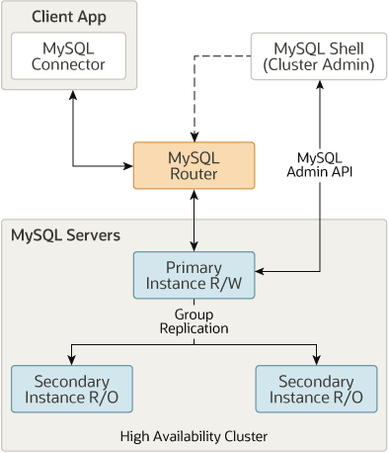
MySQL InnoDB Cluster
MySQL InnoDB Cluster provides a complete high availability solution for MySQL.

Slide 37
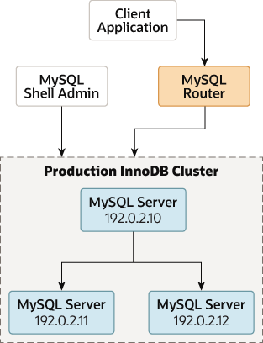
Deploying a Production InnoDB Cluster
When working in a production environment,
the MySQL server instances which make up an InnoDB Cluster run on multiple host machines as part of a network rather than on single machine.

Slide 38
Deploying a New Production InnoDB Cluster
Configuring Production Instances
AdminAPI provides the dba.configureInstance() function that checks if an instance is suitably configured for InnoDB Cluster usage, and configures the instance if it finds any settings which are not compatible with InnoDB Cluster.
dba.configureInstance([instance][, options])
for example:
dba.configureInstance(user@example:3306)
A report is displayed which shows the settings required by InnoDB Cluster .

Slide 39
Creating a Cluster
Once you have prepared your instances,
use the dba.createCluster() function to create the cluster,
using the instance which MySQL Shell is connected to as the seed instance for the cluster.
The seed instance is replicated to the other instances that you add to the cluster, making them replicas of the seed instance.
mysql-js> var cluster = dba.createCluster('testCluster’)
Validating instance at icadmin@ic-1:3306...
This instance reports its own address as ic-1
Instance configuration is suitable.
Creating InnoDB cluster 'testCluster' on 'icadmin@ic-1:3306'...
Adding Seed Instance...
Cluster successfully created. Use Cluster.addInstance() to add MySQL instances.
At least 3 instances are needed for the cluster to be able to withstand up to one server failure.

Slide 40
Adding instance to a Cluster
Use the Cluster.addInstance(instance) function to add more instances to the cluster
You need a minimum of three instances in the cluster to make it tolerant to the failure of one instance.
Adding further instances increases the tolerance to failure of an instance.
mysql-js> cluster.addInstance('icadmin@ic-2:3306’)
A new instance will be added to the InnoDB cluster. Depending on the amount of data on the cluster this might take from a few seconds to several hours.
Please provide the password for 'icadmin@ic-2:3306': ********
Adding instance to the cluster ...
Validating instance at ic-2:3306...
This instance reports its own address as ic-2 Instance configuration is suitable.
The instance 'icadmin@ic-2:3306' was successfully added to the cluster.

Slide 41
Adding instance to a Cluster
If you are using MySQL 8.0.17 or later
you can choose how the instance recovers the transactions it requires to synchronize with the cluster.
Only when the joining instance has recovered all of the transactions previously processed by the cluster can it then join as an online instance and begin processing transactions.
Depending on which option you chose to recover the instance from the cluster,
you see different output in MySQL Shell.
Suppose that you are adding the instance ic-2 to the cluster, and ic-1 is the seed or donor.

Slide 42
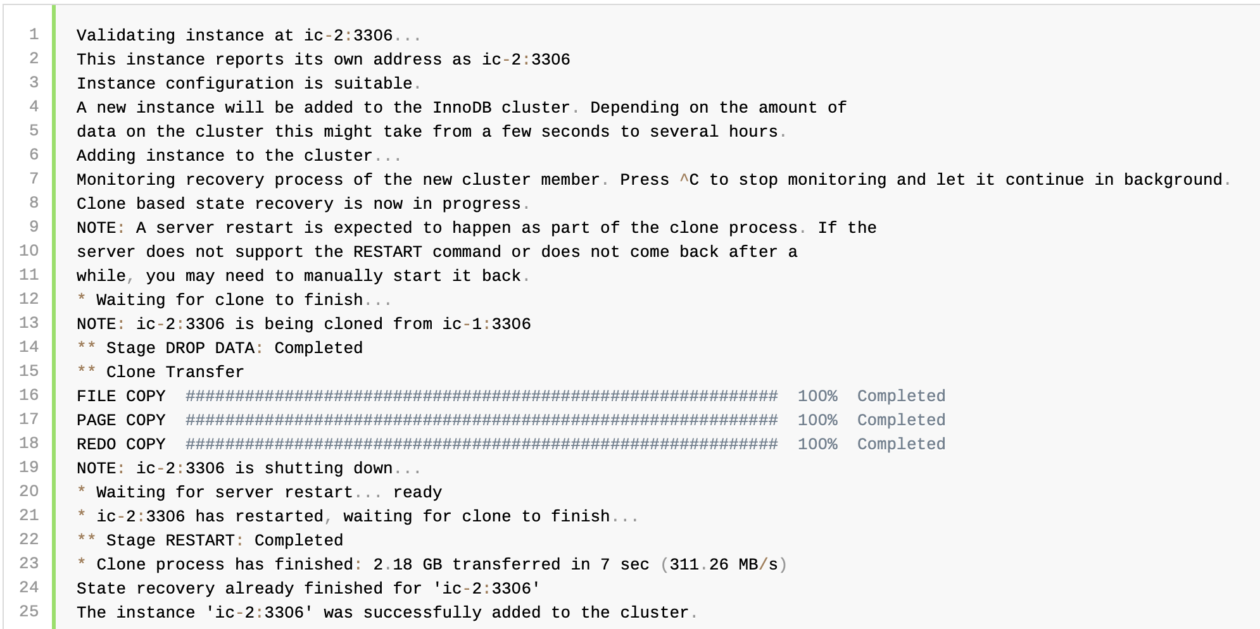
Adding instance to a Cluster
When you use MySQL Clone to recover an instance from the cluster, the output looks like:

Slide 43
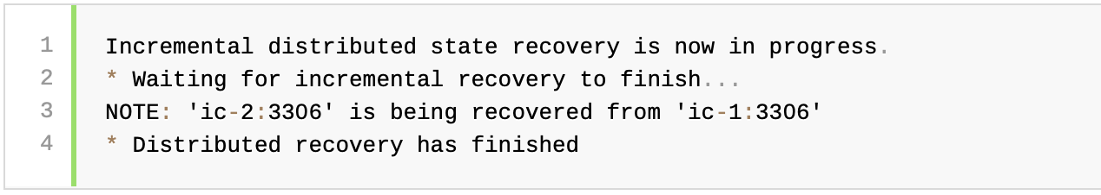
Adding instance to a Cluster
When you use incremental recovery to recover an instance from the cluster, the output looks like:

Slide 44
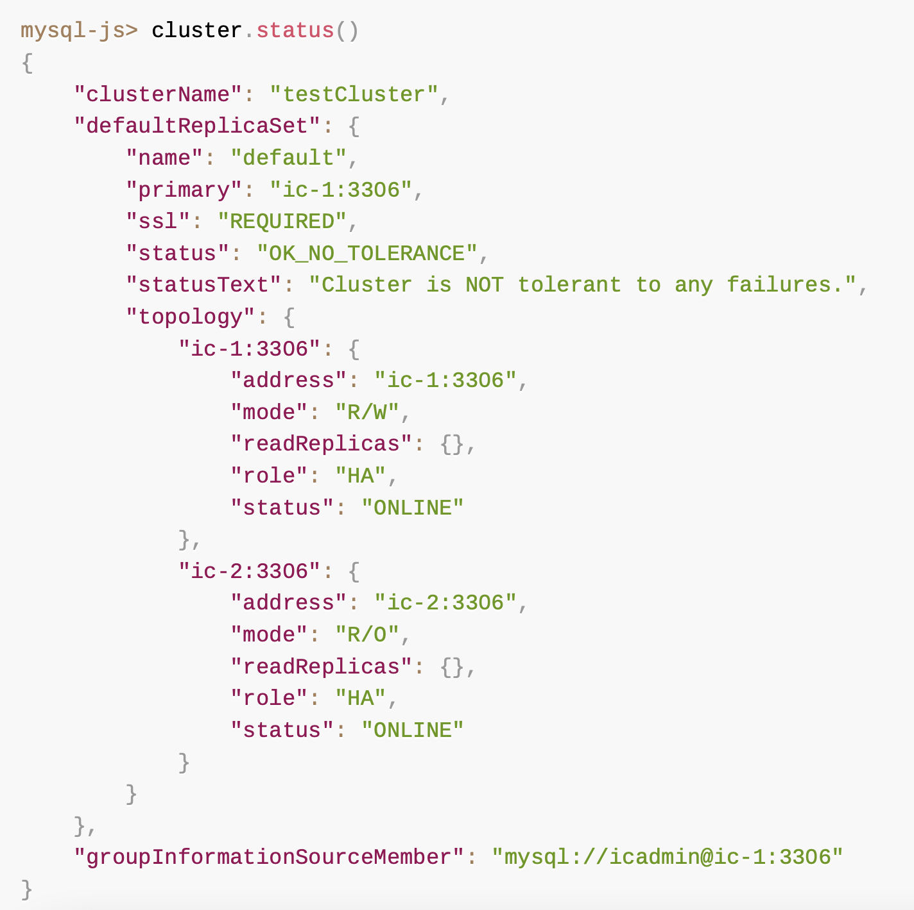
Adding instance to a Cluster
To verify the instance has been added, use the cluster instance's status() function.
For example this is the status output of a sandbox cluster after adding a second instance:

Slide 45
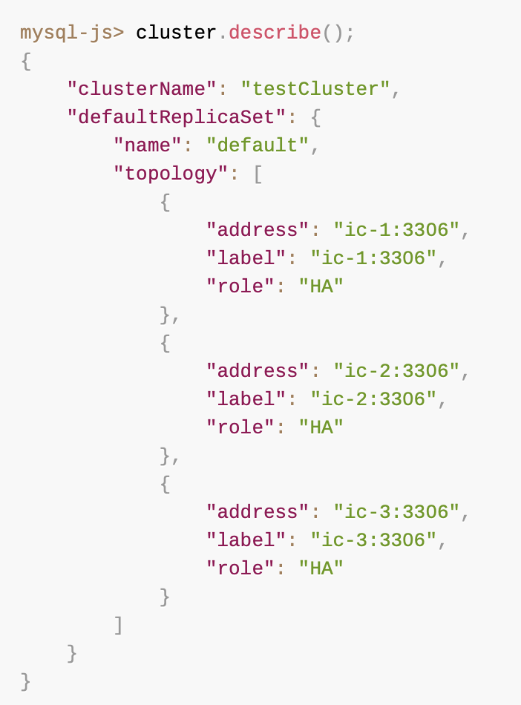
Monitoring InnoDB Cluster
Using Cluster.describe()

Slide 46
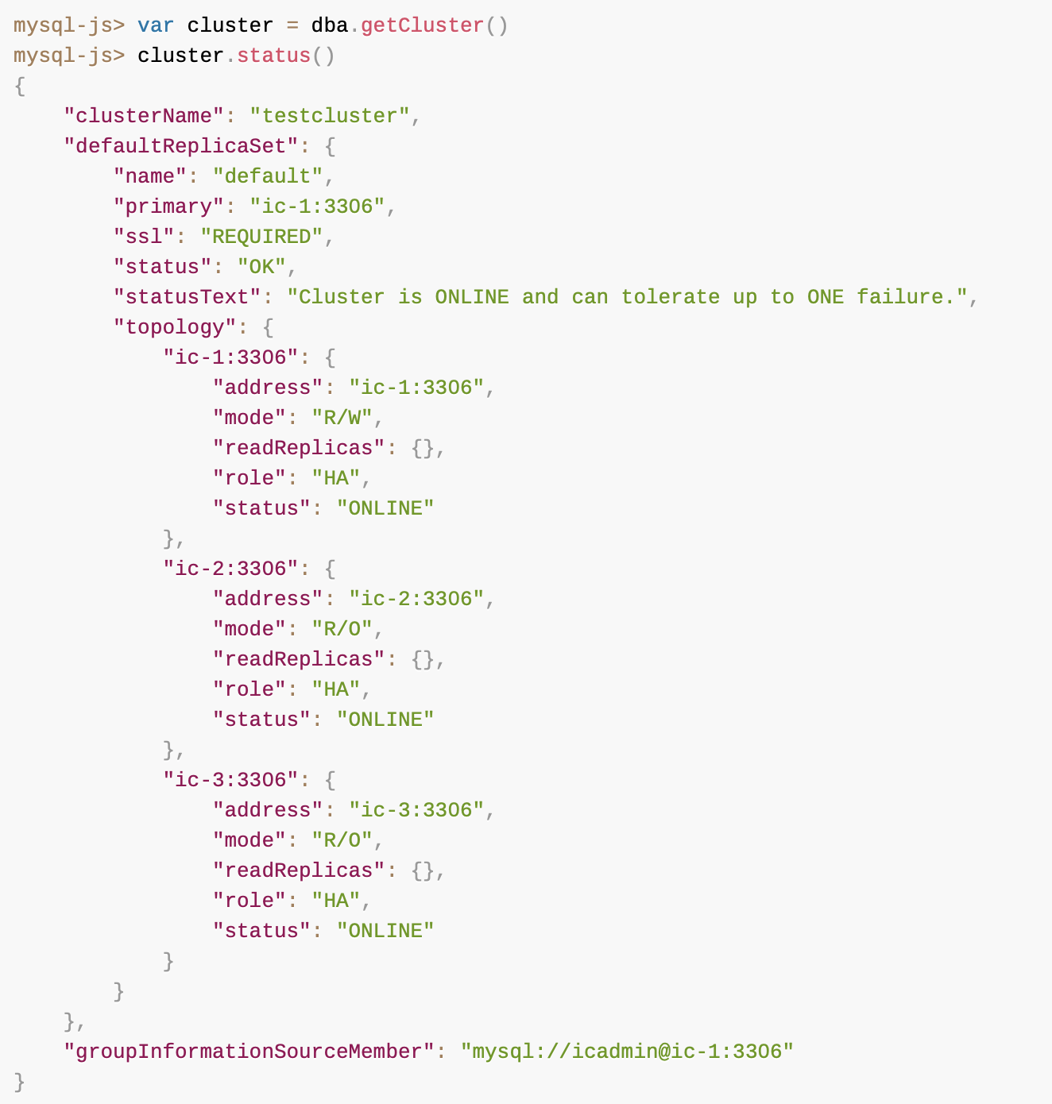
Monitoring InnoDB Cluster
Checking a cluster's Status with Cluster.status()

Slide 47
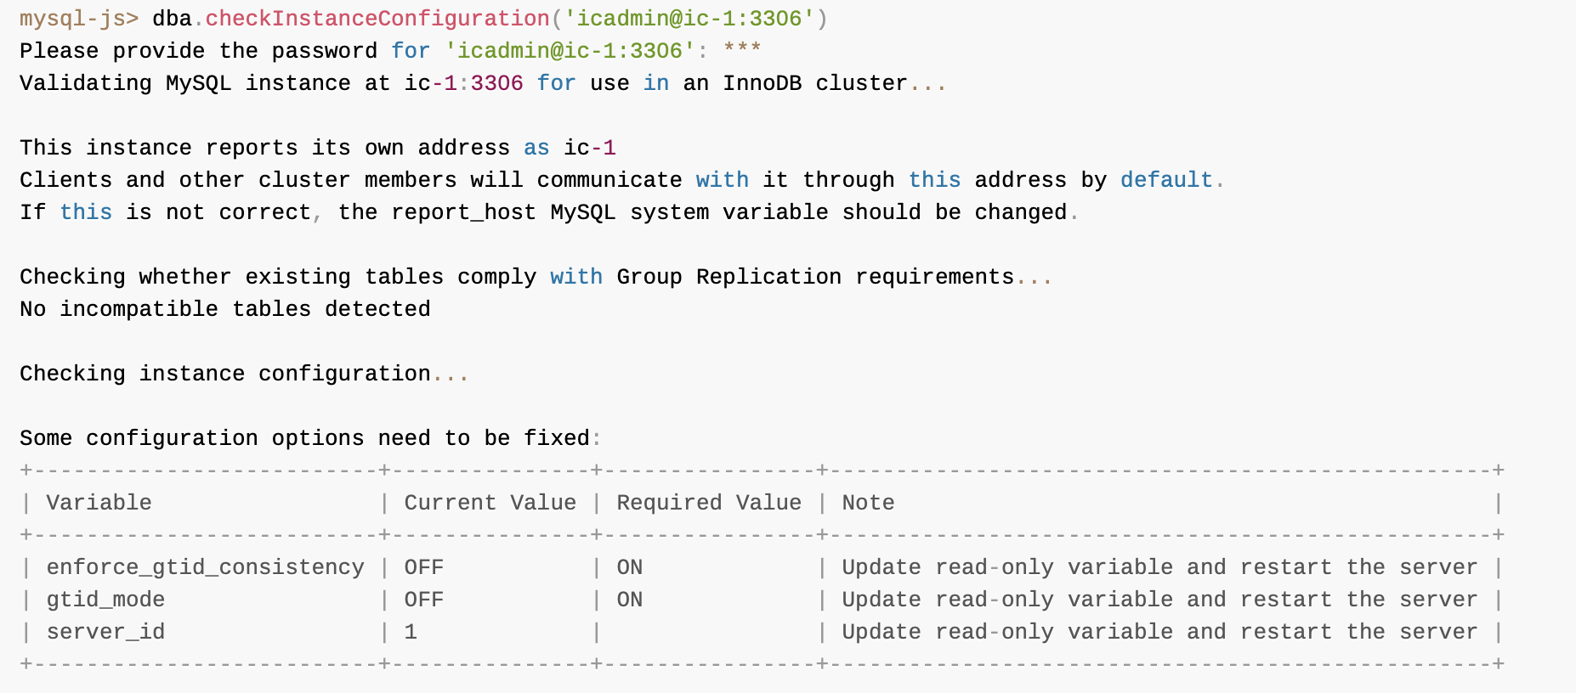
Working with Instances
Using dba.checkInstanceConfiguration()

Slide 48
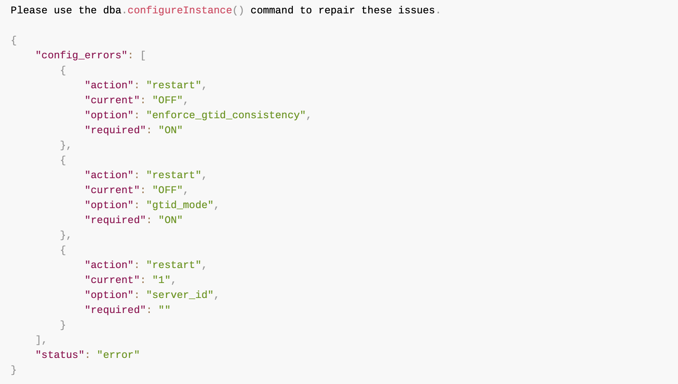
Working with Instances
Using dba.checkInstanceConfiguration()

Slide 49
Working with Instances
Configuring Instances with dba.configureLocalInstance()
If you issue dba.configureLocalInstance(), it enables MySQL Shell to modify the instance's option file after running the following commands against a remote instance:
dba.configureInstance()
dba.createCluster()
Cluster.addInstance()
Cluster.removeInstance()
Cluster.rejoinInstance()

Slide 50
Working with Instances
Checking Instance State
The cluster.checkInstanceState() function can be used to verify the existing data on an instance does not prevent it from joining a cluster.
The output of this function can be one of the following:
OK new: the instance has not executed any GTID transactions, therefore it cannot conflict with the GTIDs executed by the cluster
OK recoverable: the instance has executed GTIDs which do not conflict with the executed GTIDs of the cluster seed instances
ERROR diverged: the instance has executed GTIDs which diverge with the executed GTIDs of the cluster seed instances
ERROR lost_transactions: the instance has more executed GTIDs than the executed GTIDs of the cluster seed instances

Slide 51
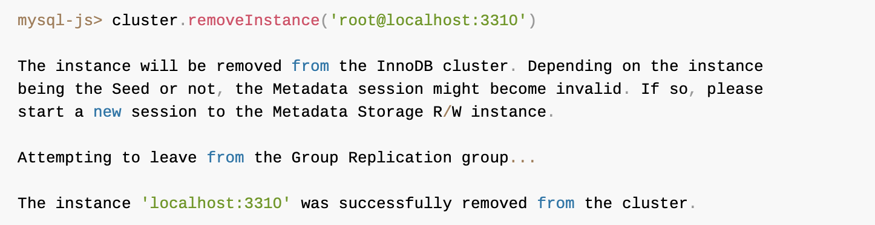
Working with InnoDB Cluster
Removing Instances from the InnoDB Cluster

Slide 52
Working with InnoDB Cluster
Dissolving an InnoDB Cluster
The Cluster.dissolve() operation can only configure instances which are ONLINE or reachable. If members of a cluster cannot be reached by the member where you issued the Cluster.dissolve() command you have to decide how the dissolve operation should proceed.
mysql-js> Cluster.dissolve({force: true})
mysql-js> Cluster.dissolve({interactive: true})

Slide 53
Working with InnoDB Cluster
Changing a Cluster's Topology
Cluster.switchToMultiPrimaryMode(), which switches the cluster to multi-primary mode. All instances become primaries.
Cluster.switchToSinglePrimaryMode([instance]), which switches the cluster to single-primary mode.
If instance is specified, it becomes the primary and all the other instances become secondaries.
If instance is not specified, the new primary is the instance with the highest member weight (and the lowest UUID in case of a tie on member weight).

Slide 54
Working with InnoDB Cluster
Changing a Cluster's Topology
By default,
an InnoDB Cluster runs in single-primary mode, where the cluster has one primary server that accepts read and write queries (R/W),
and all of the remaining instances in the cluster accept only read queries (R/O).
When you configure a cluster to run in multi-primary mode, all of the instances in the cluster are primaries, which means that they accept both read and write queries (R/W).
If a cluster has all of its instances running MySQL server version 8.0.15 or later, you can make changes to the topology of the cluster while the cluster is online.
In previous versions it was necessary to completely dissolve and re-create the cluster to make the configuration changes.

Slide 55
Configuring InnoDB Cluster
You can check and modify the settings in place for an InnoDB Cluster while the instances are online.
To check the current settings of a cluster, use the following operation:
Cluster.options(), which lists the configuration options for the cluster and its instances.
A boolean option all can also be specified to include information about all Group Replication system variables in the output.
Cluster.setOption(option, value) to change the settings of all cluster instances globally or cluster global settings such as clusterName.
Cluster.setInstanceOption(instance, option, value) to change the settings of individual cluster instances

Slide 56
Configuring InnoDB Cluster
These options are changeable at both the cluster (all instances) and per instance level:
autoRejoinTries: integer value to define the number of times an instance attempts to rejoin the cluster after being expelled.
exitStateAction: string value indicating the Group Replication exit state action.
memberWeight: integer value with a percentage weight for automatic primary election on failover.
tag:option: built-in and user-defined tags to be associated to the cluster.

Slide 57
Configuring InnoDB Cluster
These options are changeable at the cluster level only:
clusterName: string value to define the cluster name
disableClone: boolean value used to disable the clone usage on the cluster.
expelTimeout: integer value to define the time period in seconds that cluster members should wait for a non-responding member before evicting it from the cluster.
failoverConsistency: string value indicating the consistency guarantees that the cluster provides.
This option is changeable at the per instance level only:
label: a string identifier of the instance

Slide 58
Configuring InnoDB Cluster
Customizing InnoDB Clusters
To customize the name of the replication group created by InnoDB Cluster,
pass the groupName option to the dba.createCluster() command.
To customize the address which an instance provides for connections from other instances,
pass the localAddress option to the dba.createCluster() and cluster.addInstance() commands.
To customize the instances used as seeds when an instance joins the cluster,
pass the groupSeeds option to the dba.createCluster() and Cluster.addInstance() operations.

Slide 59
Configuring InnoDB Cluster
Configuring the Election Process
Use the memberWeight option and pass it to the dba.createCluster() and Cluster.addInstance() methods when creating your cluster.
The memberWeight option accepts an integer value between 0 and 100, which is a percentage weight for automatic primary election on failover.
dba.createCluster('cluster1', {memberWeight:35})
var mycluster = dba.getCluster()
mycluster.addInstance('icadmin@ic2', {memberWeight:25})
mycluster.addInstance('icadmin@ic3', {memberWeight:50})

Slide 60
References
Nginx
http://nginx.org/en/docs/beginners_guide.html
完美解决Error: Running Homebrew as root is extremely dangerous and no longer supported.
https://blog.csdn.net/meifannao789456/article/details/105083605
Spring boot集群 + Nginx
https://blog.csdn.net/chali1314/article/details/113310981
启动tomcat: Permission denied错误
https://blog.csdn.net/Pompeii/article/details/40262785
MySQL InnoDB Cluster
https://dev.mysql.com/doc/mysql-shell/8.0/en/mysql-innodb-cluster.html

Slide 61

Thank You!

