Slide 1

Weather App Live Weather Forecast App
Presented By:
Gaurav Srivastava (191500294)
Siddharth Vikram Singh(181500711)
Mentor:
Mr. Mandeep Singh
Assistant Professor
Department of Computer Science & Engineering

Slide 2
OUTLINE:
About the project
Objectives
Technology Used Requirements
Snapshots from the project

Slide 3
About the Project:
Weather App is an android application made to facilitate users with has a solution so that user are able to fetch live weather update. Whether you’re looking to fetch weather data when you are going to office or to fetch another city data by sitting at home, This app would be better for that. This application is designed to help you to acknowledge better with live weather forecast.It is a hassle- free and pinpoint accurate platform with retrieving information of each and everything related to basic weather application, including live weather of the required city using React Native and Weather API. To check temperature, wind speed, humidity and weather of required location. We also provide background suited for respective weather conditions.
The main goal of the service is to develop a Live Weather Forecast Expo App which provide live weather of the required city using React Native and Weather api. To check temperature, wind speed, humidity and weather of required location.

Slide 4
Objectives:
The main goal of the service is to develop a Live Weather Forecast Expo App which provide live weather of the required city using React Native and Weather api. To check temperature, wind speed, humidity and weather of required location.

Slide 5
Technology Used:
Visual Studio Code is a lightweight but powerful source code editor which runs on your desktop and is available for Windows, macOS and Linux. It comes with built-in support for JavaScript, TypeScript and Node.js and has a rich ecosystem of extensions for other languages (such as C++, C#, Java, Python, PHP, Go) and runtimes (such as .NET and Unity).
Expo CLI : Expo is an open-source platform for making universal native apps for Android, iOS, and the web with JavaScript and React. Expo CLI is a command line app that is the main interface between a developer and Expo tools. Expo CLI also has a web-based GUI that pops up in your web browser when you start your project — you can use the GUI instead of the command line interface if you're not yet comfortable using a terminal or prefer GUIs, both have similar capabilities.
React Native is a JavaScript framework created by Facebook for writing real mobile applications especially for iOS and Android. It comes out of React, Facebook’s JavaScript library used for building user interfaces but it mainly focuses on Mobile Platforms. Now the web developers can write mobile applications all from the comfort of a JavaScript library that they already know. Most of the codes now can be shared between platforms, React Native makes it easy to develop for both Android and iOS simultaneously.

Slide 6
REQUIREMENTS:
Hardware Requirements
Processor Required: Intel i5
Operating System: Windows 10
RAM: 4GB
Hardware Devices: Computer System
Hard Disk: 256GB
Software Requirements
Technology Implemented: React Native
Languages/Technologies Used: JSX,React
IDE Used: Visual Studio Code
Device: Android
GitHub: GitHub is a code hosting platform for version control and collaboration. It lets you and others work together on projects from anywhere. GitHub Repository: A GitHub repository can be used to store a development project.

Slide 7
THIS IS HOW OUR Application LOOKS
Hope you will like it...

Slide 8
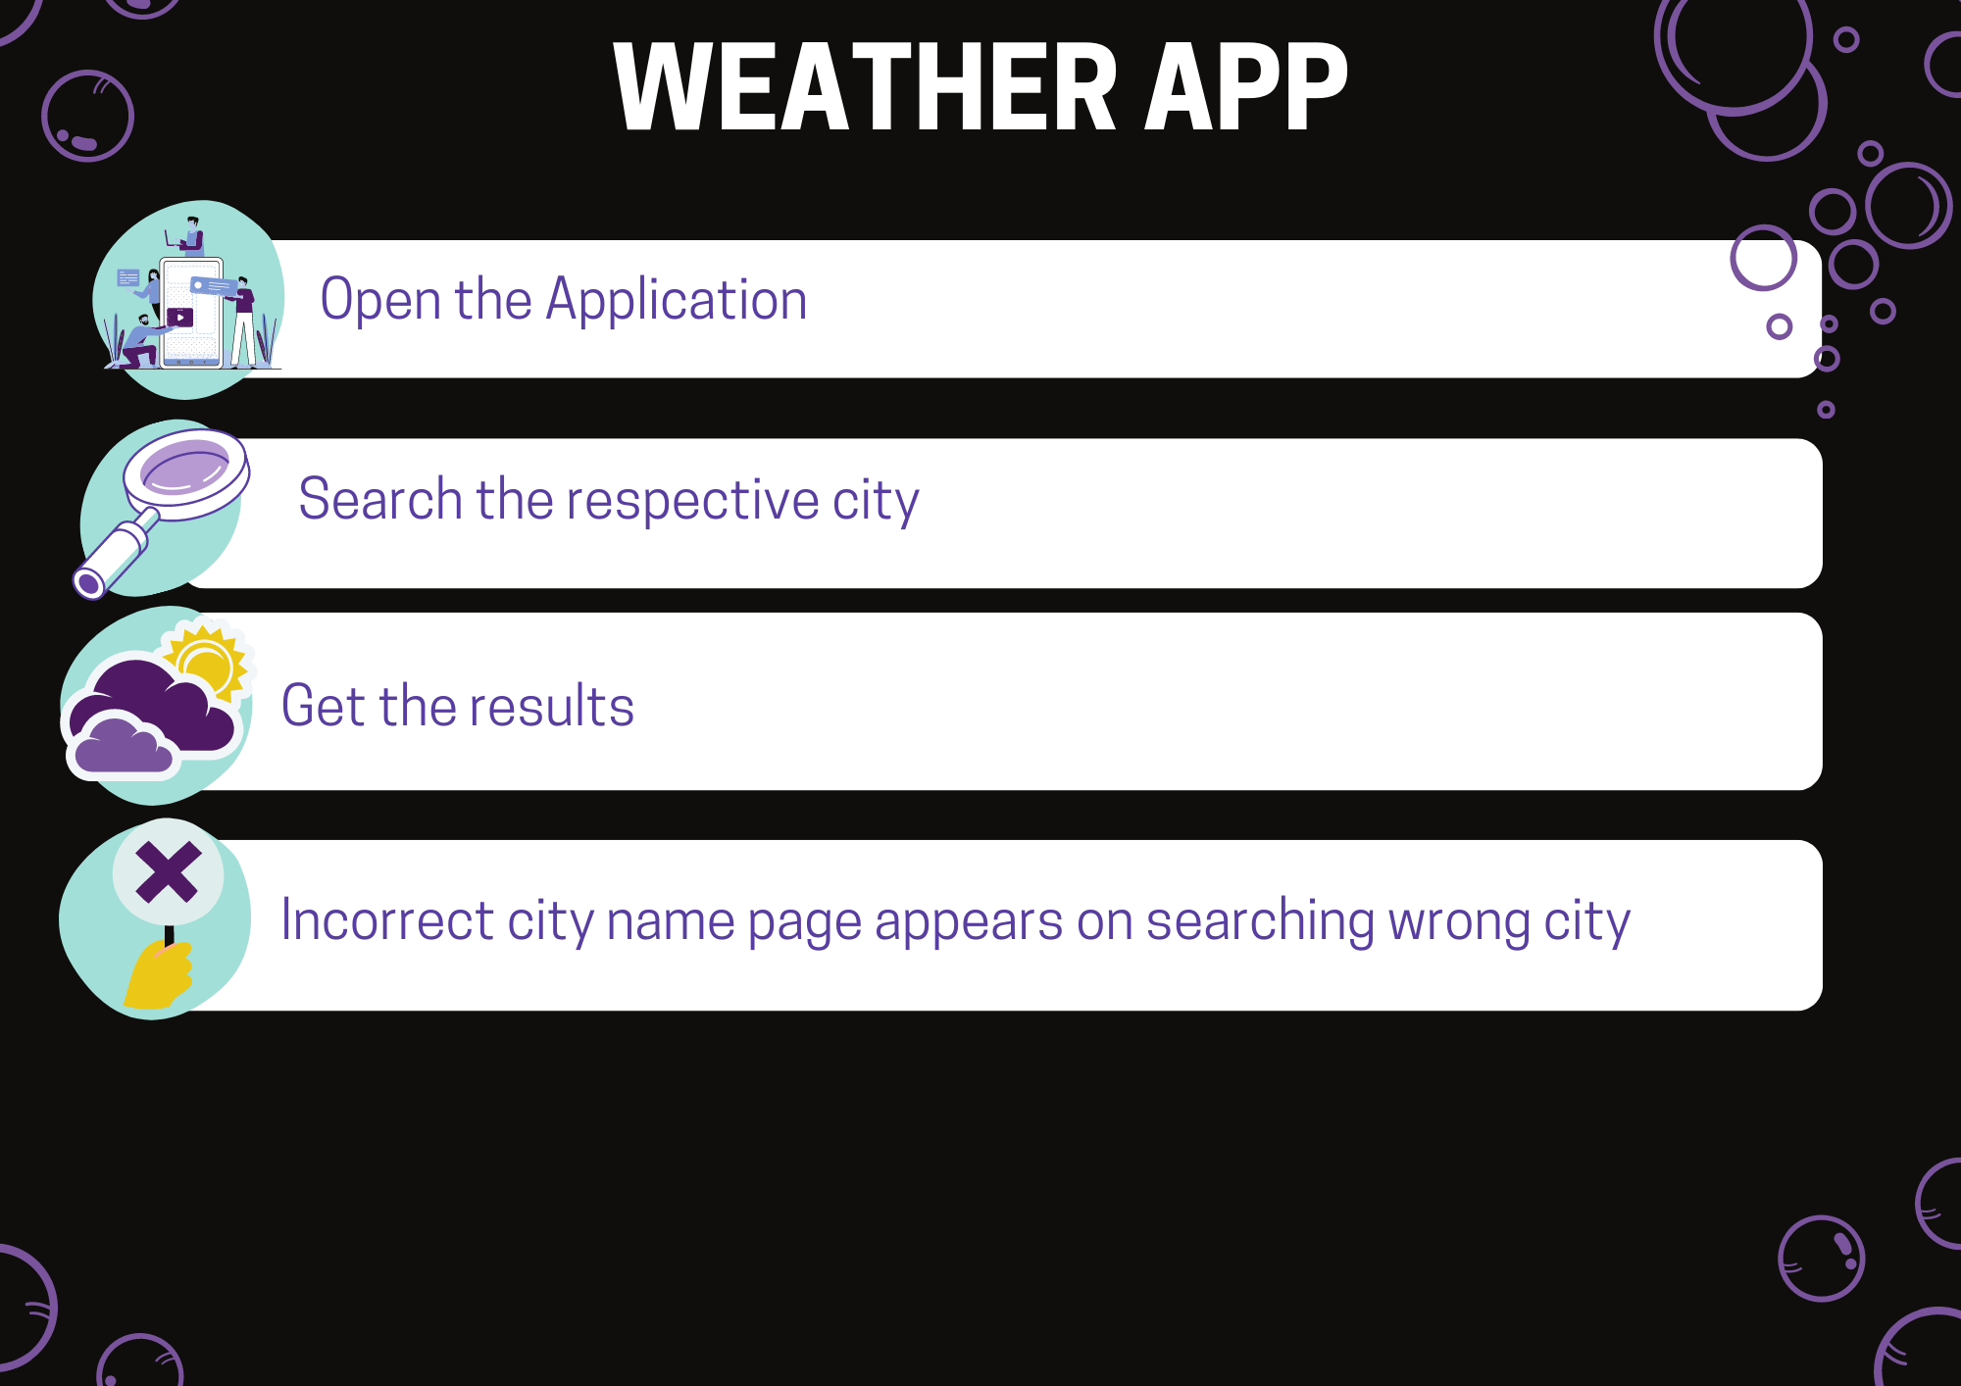
Flow Chart For User:

Slide 9
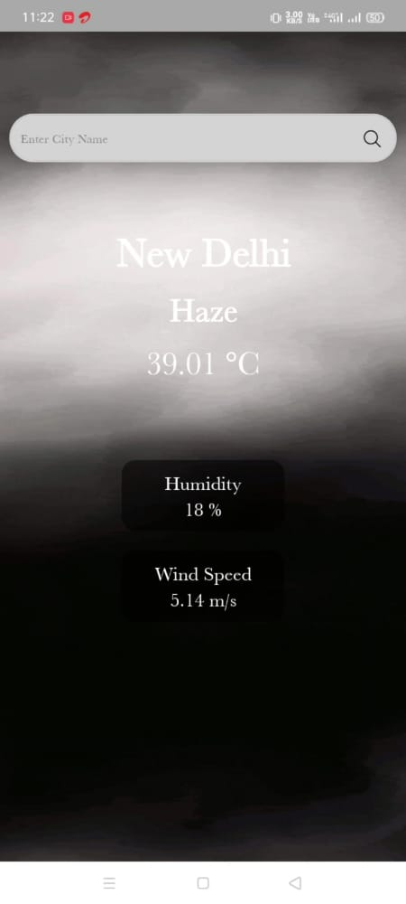
USER INTERFACE: Default Screen:

Slide 10
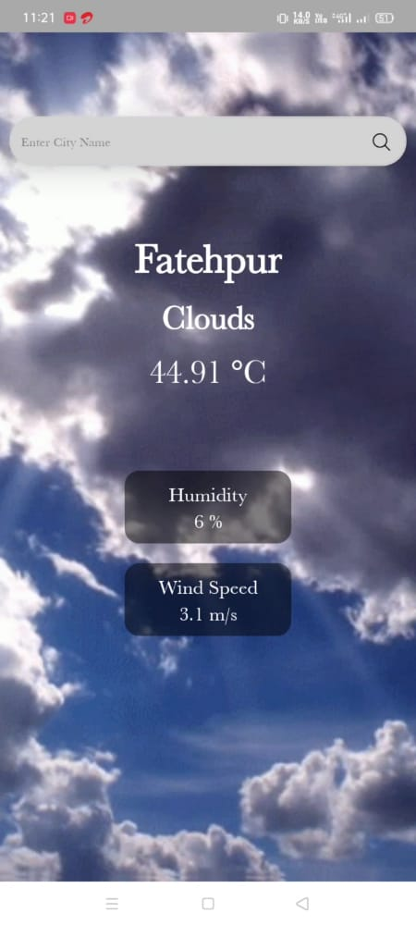
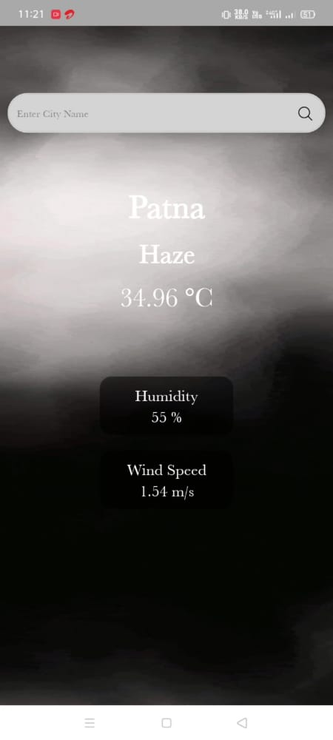
Desired Screens:

Slide 11
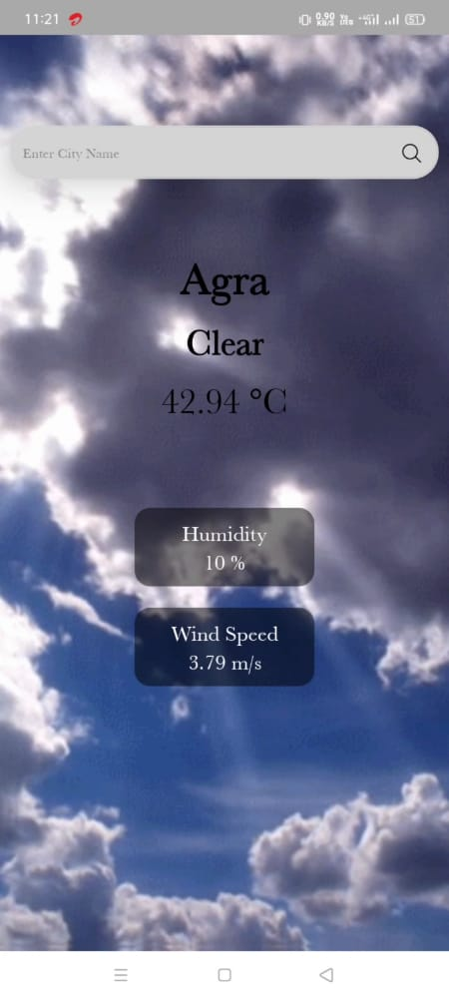
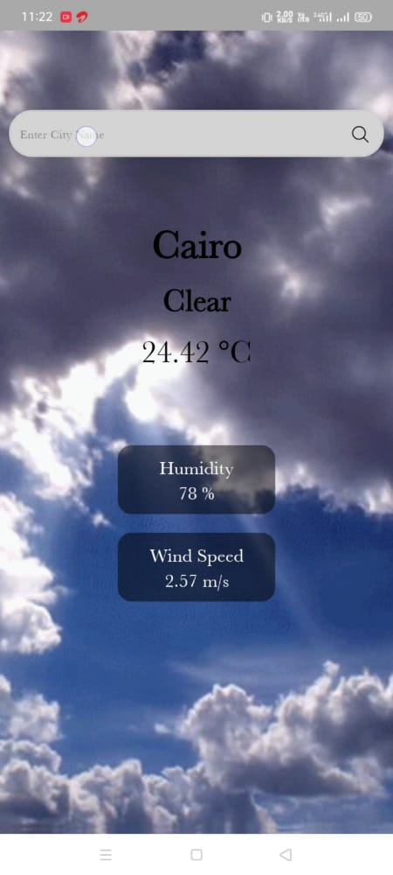
Desired Screens:

Slide 12

Error Screens:

Slide 13
Project
The source of our project (including all the project work, documentations and presentations) will be available at the following link –
https://github.com/719711711497118/weatherapp

Slide 14
THANK YOU

