Slide 1
SQL2Mongo
BCSE307L / BCSE307P · COMPILER DESIGN · PHASE 3 REVIEW
SQL
SELECT name, age FROM students
WHERE age >= 20
ORDER BY age DESC LIMIT 3;
A SQL-to-MongoDB query compiler and execution engine
↓ seven compiler phases
MONGODB
db.students.aggregate([
{ "$match": { "age": { "$gte": 20 } } },
{ "$sort": { "age": -1 } },
{ "$limit": 3 },
{ "$project": { "_id": 0, "name": 1, "age": 1 } }
]);
Alan James · 24BCT0181
School of Computer Science and Engineering, VIT Vellore
Fall Semester 2026–27
github.com/71percentbanana/MQL
Notes:
SQL2Mongo compiles SQL SELECT queries into MongoDB aggregation pipelines and runs them on JSON collection files. This is the Phase 3 review: the compiler is now complete end to end.

Slide 2
Translating SQL to MongoDB by hand is error-prone
THE PROBLEM
During my internship I knew the SQL for every query I needed, but the project used MongoDB. Every query had to be rewritten by hand, and a mistake returned the wrong documents instead of an error.
THE SAME QUERY IN BOTH LANGUAGES
WHERE HAND TRANSLATION GOES WRONG
1
Operator mapping
SELECT name, city FROM students
WHERE city = 'Seattle' OR city = 'Boston'
ORDER BY name;
>= becomes $gte, != and <> become $ne, and equality is written with no operator at all.
2
Logical structure
db.students.aggregate([
{ "$match": { "$or": [
{ "city": "Seattle" },
{ "city": "Boston" } ] } },
{ "$sort": { "name": 1 } },
{ "$project": { "_id": 0, "name": 1, "city": 1 } }
]);
a AND b OR c must become an $or array that contains an $and array. Precedence is easy to lose.
3
Silent schema errors
A misspelled field, or a string compared with a number, is not an error in MongoDB. The query just returns nothing.
Notes:
The motivation comes from my internship. The three failure points on the right are what the compiler is designed to remove: it maps operators, preserves precedence, and checks the schema before generating any code.

Slide 3
Phase 3 completes the compiler end to end
PROJECT PHASES
PHASE 1
PHASE 2
PHASE 3 · THIS REVIEW
Front end
Analysis
Back end, data and validation
Query language and grammar
Lexer with token table
Recursive-descent parser
Symbol table and semantic checks
Abstract syntax tree
Three-address code
Quadruples and triples
Optimizer: predicate pushdown, projection pruning
MongoDB pipeline generator
Execution on JSON collection files
Web dashboard with three pages
21 test queries, 9 automated tests
OUTPUT
OUTPUT
OUTPUT
Token table and a valid or invalid verdict
Checked AST and three-address code
MongoDB pipeline and the documents it returns
Notes:
Phases 1 and 2 built the front end and the analysis. Phase 3 adds the whole back end: the remaining intermediate forms, optimization, code generation, execution on real data files, the dashboard, and the test suite.

Slide 4
All nine objectives are met
OBJECTIVES
1
Lexer with line and column tracking
2
Recursive-descent parser, parse tree and AST
3
Symbol table with name and type checks
✓ Done · Report §7.2
✓ Done · Report §7.3–7.4
✓ Done · Report §7.5
4
Three-address code, quadruples and triples
5
Predicate pushdown and projection pruning
6
MongoDB aggregation pipeline generation
✓ Done · Report §7.6
✓ Done · Report §7.7
✓ Done · Report §7.8
7
Execution on JSON collection files
8
Web dashboard showing every phase
9
Validation with valid, invalid and boundary queries
✓ Done · Report §7.9, §8.4
✓ Done · Report §8.5
✓ Done · Report ch. 9
Notes:
Each objective set at the start is complete. The evidence column points to the section of the report where it is demonstrated.

Slide 5
Seven phases share one abstract syntax tree
ARCHITECTURE
SQL query
Abstract syntax tree (ASTQuery): built by the parser, read by every later phase
1
2
3
4
5
6
7
Lexer
Parser
Semantics
IR generation
Optimizer
MongoDB code
Execution
sql_lexer.c
sql_parser.c
schema_table.c
tac.c
optimizer.c
mongo_codegen.c
engine.c
Tokens
Parse tree, AST
Checked AST
TAC, quads, triples
Optimization report
Aggregation pipeline
Result documents
Symbol table
Collection files
2 collections, 10 typed fields
students.json, employees.json in data/
EXIT CODES
0
Success: pipeline and documents
1
Lexical or syntax error (phases 1–2)
2
Semantic error (phase 3)
3
Collection file missing or invalid (phase 7)
Notes:
The phases run in the order set by main.c. The parser builds one AST and every later phase reads it. The symbol table feeds only semantic analysis; the collection files feed only execution. Each kind of error stops compilation with its own exit code, so later phases never see an invalid query.

Slide 6
Each SQL clause maps onto a pipeline stage
SOURCE AND TARGET LANGUAGE
SQL | MongoDB
FROM t | db.t.aggregate([...])
WHERE | $match
ORDER BY f ASC / DESC | $sort: { f: 1 } / { f: -1 }
LIMIT n | $limit: n
SELECT a, b | $project: { _id: 0, a: 1, b: 1 }
SELECT * | no $project stage
f = v | { f: v } (implicit equality)
!= <> > >= < <= | $ne $ne $gt $gte $lt $lte
AND, OR | $and: [...], $or: [...]
Supported
Single-collection SELECT with columns or *
WHERE with six comparisons, AND, OR and parentheses
ORDER BY one field, and LIMIT
Case-insensitive keywords and comments
Not yet supported
JOIN, GROUP BY, subqueries
NOT, IN, LIKE, BETWEEN
INSERT, UPDATE, DELETE; nested documents
Notes:
The target forms follow MongoDB's own SQL to aggregation mapping chart. Everything on the left is implemented; the items at the bottom right are the planned extensions.

Slide 7
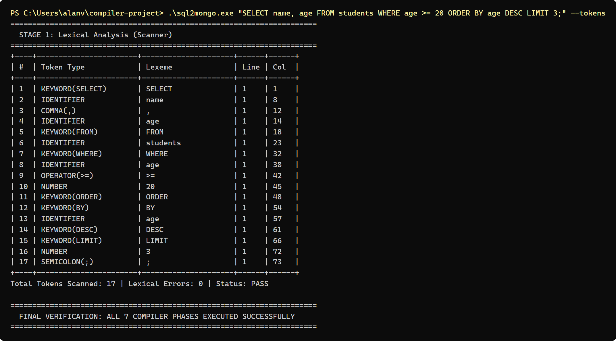
The lexer turns characters into positioned tokens
PHASE 1 · LEXICAL ANALYSIS
Maximal munch with one character of lookahead separates > from >=, < from <= and <>, and - from a -- comment.
Token classes: 11 case-insensitive keywords, identifiers, numbers, strings, 7 comparison lexemes and 5 delimiters.
Positions: every token records its line and column for error messages.
Lexical errors (exit 1): an unknown character such as @, a lone !, an unterminated string.
Token table from sql2mongo.exe --tokens for test case 1
Notes:
The scanner is hand-written, without Flex. Keywords are recognised after an identifier is scanned, by upper-casing it and checking the keyword list.

Slide 8
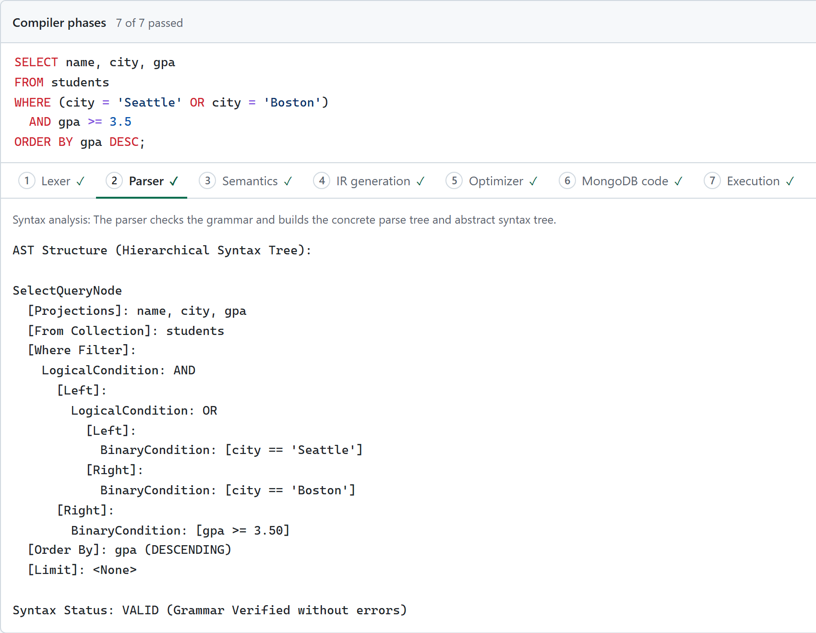
Recursive descent builds precedence into the grammar
PHASE 2 · SYNTAX ANALYSIS
GRAMMAR (WHERE CLAUSE, EBNF)
where_clause → "WHERE" or_expr
or_expr → and_expr { "OR" and_expr }
and_expr → primary { "AND" primary }
primary → "(" or_expr ")"
| IDENT comp_op literal
LL(1): one function per non-terminal, one token of lookahead.
Precedence by layering: comparisons bind tightest, then AND, then OR.
Left-associative: loops fold a AND b AND c into (a AND b) AND c.
Syntax errors (exit 1) name the expected construct, line and column.
AST for (city = 'Seattle' OR city = 'Boston') AND gpa >= 3.5: OR is the left child of AND
Notes:
The parse tree records every rule matched; the AST keeps only the meaning. The screenshot shows the dashboard's Parser tab: the parenthesised OR became the left child of the AND node, exactly as the grammar requires.

Slide 9
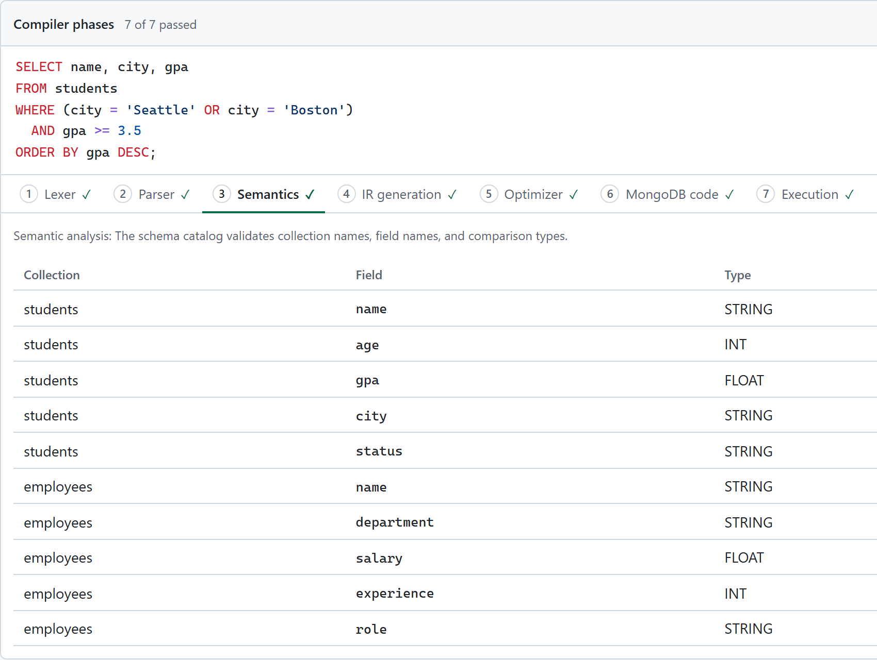
The symbol table catches schema errors before codegen
PHASE 3 · SEMANTIC ANALYSIS
FOUR CHECKS, IN ORDER
1
The FROM collection exists
2
Every SELECT column exists in it
3
Every WHERE field exists and its type matches the literal
4
The ORDER BY field exists
WHERE age = 'twenty'
Semantic Type Error: Cannot compare numeric field 'age' with string literal 'twenty'
Exit code 2 · no pipeline is generated
Symbol table: 2 collections, 10 typed fields (Semantics tab)
Notes:
MongoDB itself would accept a query on a misspelled field and silently return nothing. The symbol table rejects it at compile time. The same table also gives each number read from a collection file its declared type.

Slide 10
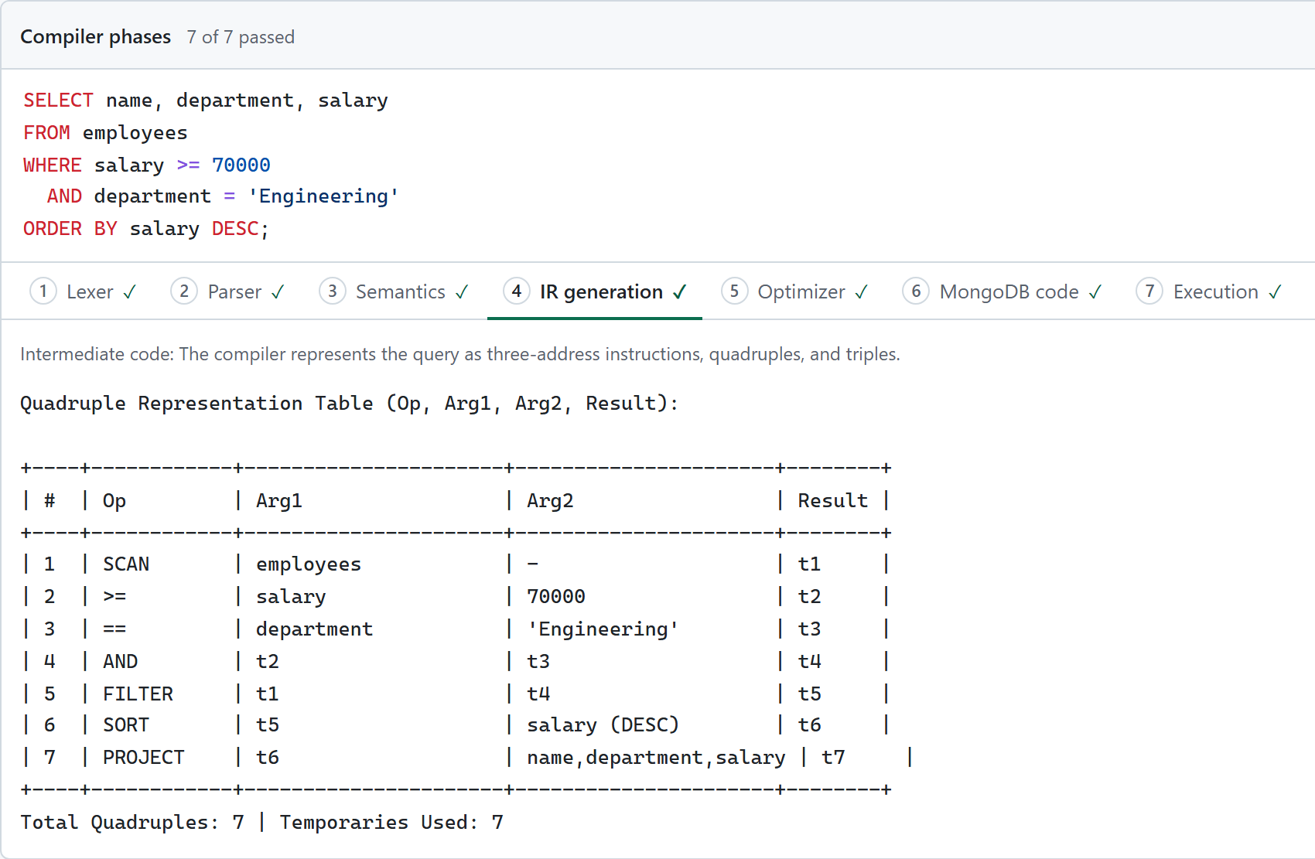
One query, three intermediate forms
PHASE 4 · INTERMEDIATE CODE
THREE-ADDRESS CODE · TEST CASE 2
(1) t1 = SCAN(employees)
(2) t2 = salary >= 70000
(3) t3 = department == 'Engineering'
(4) t4 = t2 AND t3
(5) t5 = FILTER(t1, t4)
(6) t6 = SORT(t5, salary (DESC))
(7) t7 = PROJECT(t6, [name,department,salary])
TRIPLES
The result column is dropped; operands point at earlier instructions instead:
(4) AND (2) (3)
(5) FILTER (1) (4)
Quadruples (op, arg1, arg2, result) for test case 2, on the IR generation tab
Notes:
Test case 2 selects engineers earning at least 70000. A post-order walk of the WHERE tree gives each comparison a fresh temporary; then SCAN, FILTER, SORT, LIMIT and PROJECT are chained in a fixed order, skipping absent clauses. Quadruples store the result temporary explicitly; triples refer to earlier results by index.

Slide 11
The pipeline filters first and projects last
PHASES 5–6 · OPTIMIZATION AND CODE GENERATION
STAGE ORDER
SELECT name FROM students
WHERE (age > 19 AND gpa >= 3.5) OR status = 'Graduated'
ORDER BY gpa DESC;
$match
$sort
$limit
$project
Predicate pushdown
db.students.aggregate([
{ "$match": { "$or": [
{ "$and": [ { "age": { "$gt": 19 } },
{ "gpa": { "$gte": 3.50 } } ] },
{ "status": "Graduated" } ] } },
{ "$sort": { "gpa": -1 } },
{ "$project": { "_id": 0, "name": 1 } }
]);
$match is always the first stage, so documents are discarded before the O(N log N) sort, not after it.
Projection pruning
$project is emitted only for named columns and placed last, as MongoDB's optimization guide recommends. For SELECT * it is left out.
Generated pipeline (reformatted): $and nested inside $or, as the AST requires
Notes:
Stages appear only for clauses present in the query. The code generator walks the AST recursively, so nested AND and OR come out with the correct structure. This query returns Diana Prince, Alice Walker and Evan Wright.

Slide 12
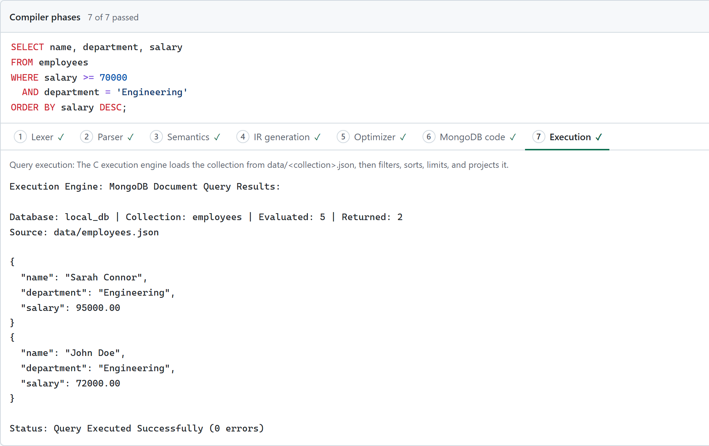
Queries run on JSON collection files
PHASE 7 · EXECUTION
mongoexport format: each collection is a JSON array in data/, importable into MongoDB unchanged.
Hand-written JSON reader: a second small recursive-descent parser inside engine.c.
Typed by the symbol table: 95000 and 95000.0 are both read as FLOAT for salary.
Tree-walking interpreter: evaluates the WHERE tree per document, then sorts, limits and projects.
Read on every run: editing a file changes the next result with no rebuild.
Missing or invalid file: exit code 3, with the file name and position.
Execution tab: 5 documents evaluated, 2 returned from data/employees.json
Notes:
Phase 3 replaced the records that were built into the C code with real JSON files. The engine evaluates the same AST the code generator used, so its results confirm the pipeline means what the SQL means.

Slide 13
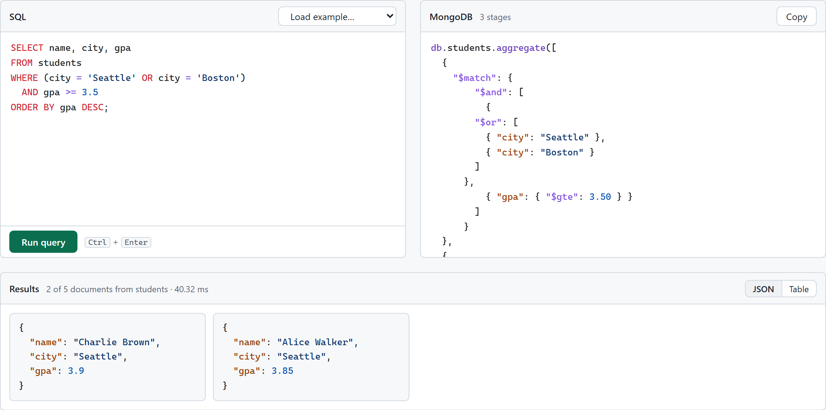
A local dashboard shows every phase in the browser
WEB DASHBOARD
1
Query
SQL editor with examples, the generated pipeline, and results as JSON or a table.
2
Compiler phases
One tab per phase, marked passed, failed or not reached.
3
Database
Each collection file as JSON or a table, with its field types.
Query page: nested AND/OR query, its 3-stage pipeline and the 2 matching documents
Node.js server with no third-party packages. Each query runs the real sql2mongo.exe with --all, so the page and the command line cannot disagree.
Notes:
The dashboard has three pages. I will demonstrate it live after the slides: npm start in the dashboard folder, then localhost:3000.

Slide 14
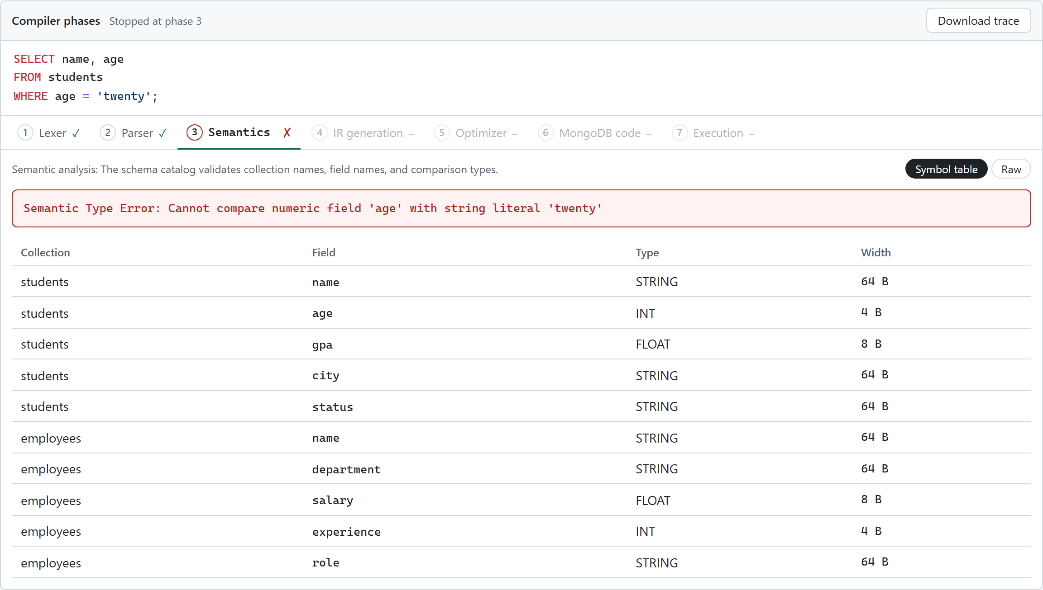
Each error stops at its phase with its own exit code
ERROR HANDLING
0
Success
Pipeline printed and documents returned.
1
Lexical or syntax error
e.g. unrecognized token '@' at line 1, column 42.
2
Semantic error
Unknown collection or column, or a type mismatch.
3
Execution error
WHERE age = 'twenty': phase 3 fails and phases 4 to 7 are not reached
Collection file missing, or invalid JSON.
Notes:
Compilation stops at the first error with its position. The exit code tells the test suite, and the dashboard, which phase failed.

Slide 15
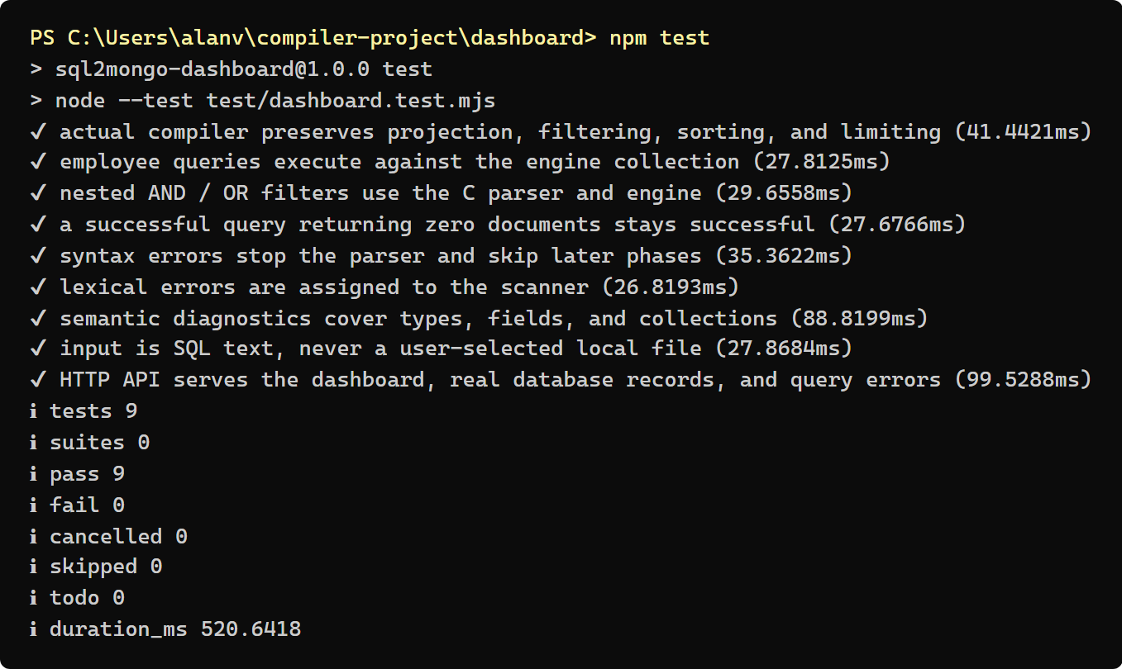
19 of 21 queries pass; all 9 automated tests pass
TESTING AND RESULTS
19 / 21
2
9 / 9
50 ms
test queries behave exactly as expected
partial results, in cases 7 and 8
automated integration tests pass
full seven-phase run, average of 100
npm test: 9 integration tests on the real executable and server
Notes:
Tests cover valid, boundary and error input in every phase, including two new execution-error cases. Process start-up is about 31 ms of the 50 ms, so the compiler phases themselves take around 20 ms.

Slide 16
Two gaps found, and what comes next
FINDINGS AND FUTURE WORK
FOUND BY TESTING
NEXT STEPS
Case 7: identifier casing
Richer filters
Aggregation and joins
Lookups ignore case, but the generator copies names as typed, so db.STUDENTS would match nothing on a real server.
NOT, IN, LIKE, BETWEEN and OFFSET
GROUP BY to $group, JOIN to $lookup
Fix: emit the catalog spelling.
Real IR optimizations
Error recovery
Flatten AND chains, merge ranges
Panic mode: several errors per run
Case 8: LIMIT 0
MongoDB's $limit stage needs a positive integer, but LIMIT 0 is accepted.
One schema source
Live validation
Read or infer field types from data/
Run pipelines on MongoDB via the C driver
Fix: reject it in semantic analysis.
Notes:
Both partial cases run correctly in the built-in engine; they only affect the MQL that a real MongoDB server would receive. They are the first items of future work.

Slide 17
SQL in, verified MongoDB out
CONCLUSION
7 phases
4 exit codes
21 + 9 tests
Hand-written in 2,456 lines of C, using only the standard library.
Errors stop at their phase, with the line, the column and what was expected.
Every translation is checked by running it on mongoexport-format JSON.
Thank you. Questions?
github.com/71percentbanana/MQL · Live demo: npm start in dashboard/, then localhost:3000
Notes:
The classic compiler pipeline carries over directly to query translation, and the visible output of every phase makes the translation easy to check and to learn from.

