Slide 1

Book Recommendation
Team 4
Wenhuan Liu, Letian Zheng, Jiale Zhang

Slide 2

Goals of the project
The goal of this project is to develop model-based book recommendation engine that recommends books for users
A Recommender System employs statistical algorithm that aims to predict users' ratings for an entity, based on the similarity between the different entities or similarity between the users that previously rated entities

Slide 3




Methodology
Extract the book data and rating data from kaggle dataset website (https://www.kaggle.com/bahramjannesarr/goodreads-book-datasets-10m)
Clean data and merge the file use python
Use ALS to Train the model
Calculating the result of Recommendation List

Slide 4
Why we use ALS
ALS recommender is a matrix factorization algorithm that uses Alternating Least Squares with Weighted-Lamda-Regularization (ALS-WR). It factors the user to item matrix A into the user-to-feature matrix U and the item-to-feature matrix M: It runs the ALS algorithm in a parallel fashion. The ALS algorithm should uncover the latent factors that explain the observed user to item ratings and tries to find optimal factor weights to minimize the least squares between predicted and actual ratings.

Slide 5
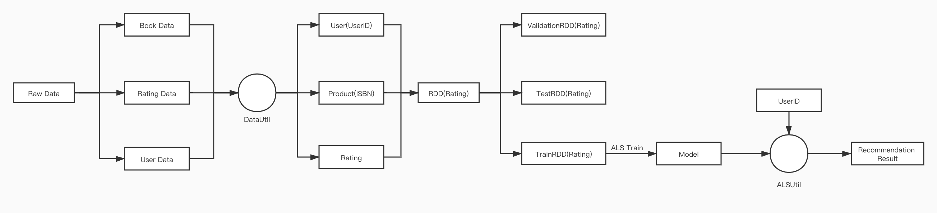
Recommendation workflow

Slide 6
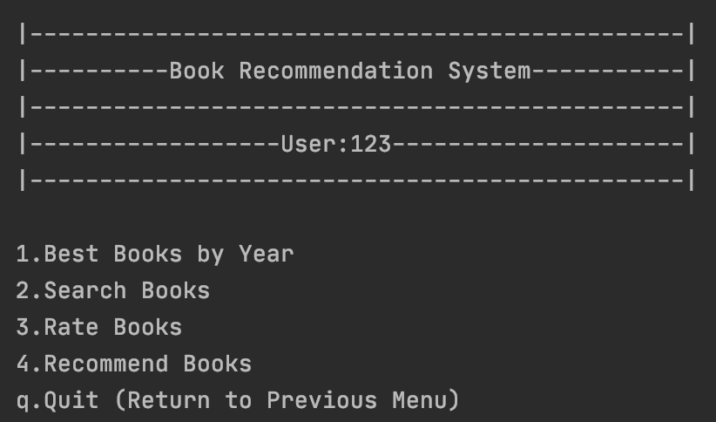
Use Cases

Slide 7
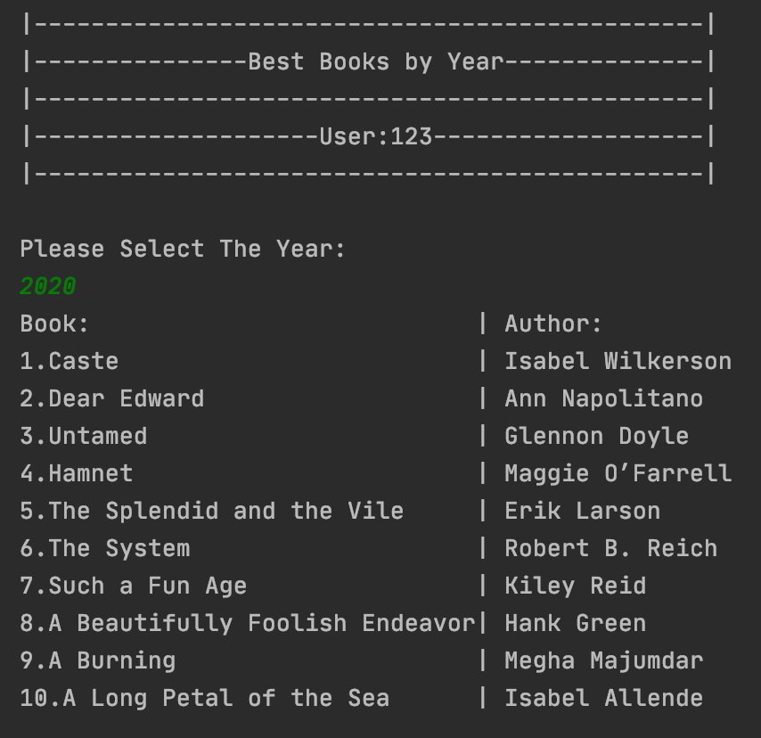
Use Case 1 Users can input a publish year and the system will display a 'Top 10 Books Bucket List' sorted by rating descending

Slide 8
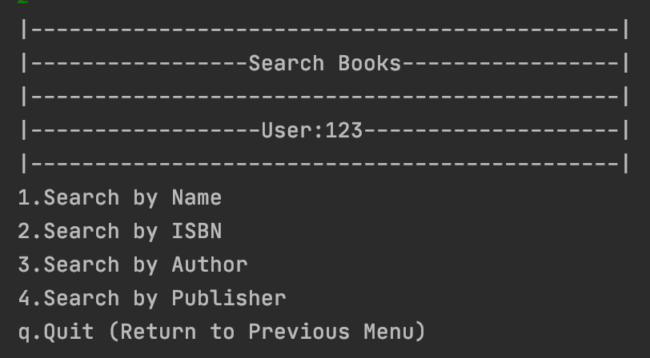
Use Case 2 Users can search for a particular book and view the rating and description of that book

Slide 9
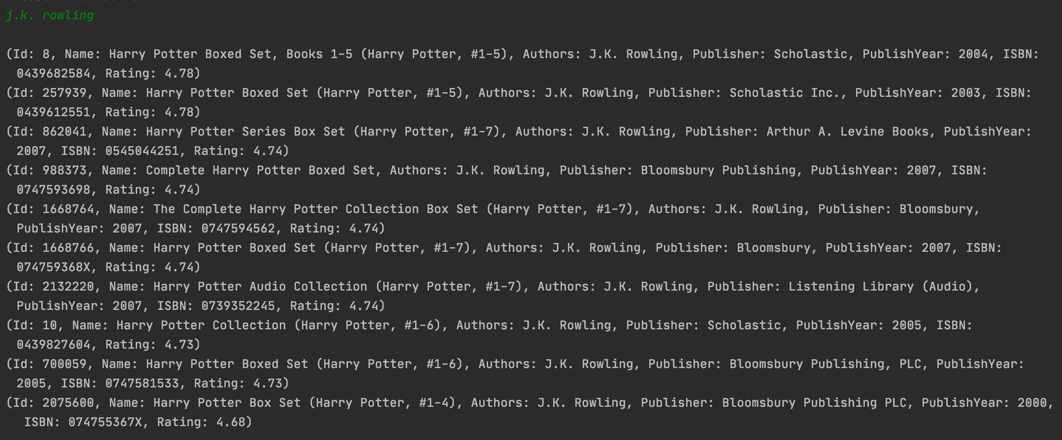

Slide 10
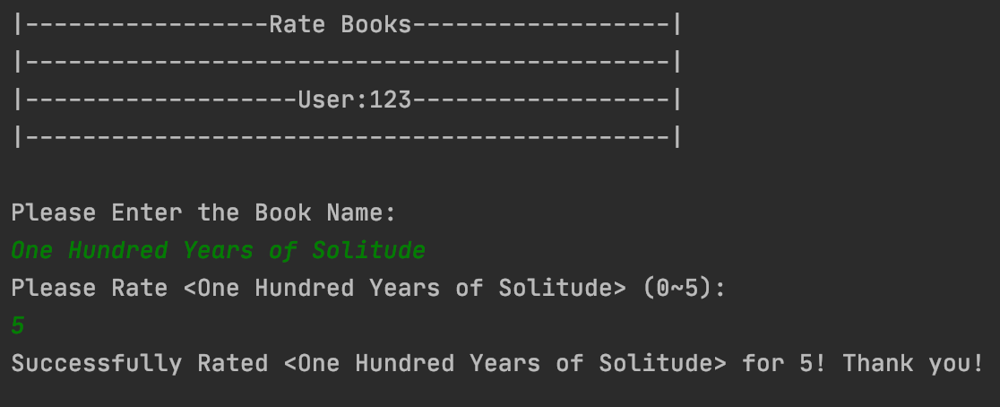
Use case 3 User can write rating for books

Slide 11
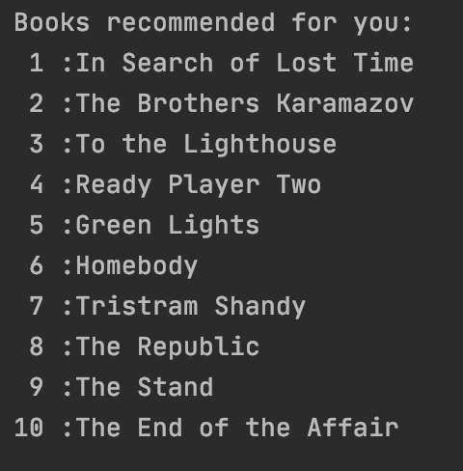
Use Case 4 User will get a list of books that they may also like based on the rating the user made to other book through Machine Learning Model

Slide 12
Acceptance criteria
RMSE is a measure of how spread out those residual are. In other words, it is used to measure the difference between values that predicted and values that actually observed.
The smaller the Square Error(<1), the better the model.
Users will receive the result within 5 seconds

Slide 13



Data Source
https://www.kaggle.com/bahramjannesarr/goodreads-book-datasets-10m
This dataset contains ~10M books' rating and ~11K uses' review scraped from GoodReads (goodreads.com).
Total number of rows:
books_rating: 10,000,000
users_rating: 353,113

Slide 14
Thank you
https://github.com/7200FinalProjectTeam4/Final-Team4

