Slide 1

Visvesvaraya Technological University Belagavi
Major Project Synopsis presentation on
“Design and Analysis of 6T SRAM Cell Using Cadence Virtuoso ”
by
Under the guidance of
AJAY BETUR P
Assistant Professor
Department of Electronics and Communication Engineering
JNN College of Engineering, Shivamogga- 577204
2026
ABHISHEK B P : 4JN23EC002
ARJUN R : 4JN23EC016
JEEVAN JM : 4JN23EC036
MITHUN SV : 4JN23EC049
Batch 03

Slide 2
Presentation Flow
Introduction
Literature Survey
Aim of the Project
Objectives
Methodology
Results
Action plan
References

Slide 3
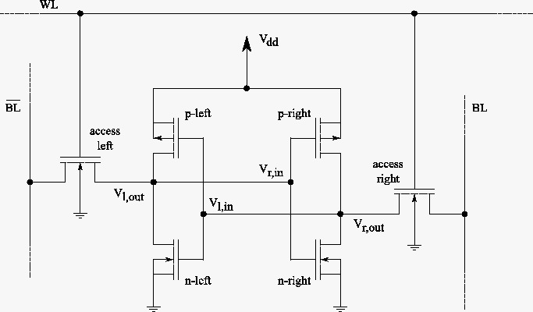
Introduction
Static Random-Access Memory (SRAM) is a semiconductor memory used in high-speed applications such as cache memory and embedded systems. The 6T SRAM cell consists of six transistors—two cross-coupled CMOS inverters formed by PMOS and NMOS transistors, and two access transistors that control read/write operations. Unlike DRAM, SRAM retains data without periodic refreshing, making it ideal for VLSI systems requiring fast and reliable memory access.
Fig1:circuit diagram

Slide 4
Aim of the Project
To design and analyze the 6T SRAM cell using Cadence Virtuoso, evaluating its performance characteristics including read/write stability, power consumption, and operational behavior in CMOS technology.

Slide 5
Literature Survey
Authors, Year of publication, type of journal | Methodology | Results obtained | Advantages | Disadvantages
Paper 1 Design and Analysis of CMOS based 6T SRAM Cell at Different Technology Nodes K. Agarwal et al. (2020) | The paper analyzes the performance of a 6T SRAM cell at different CMOS technology nodes by evaluating parameters such as power consumption, delay, and Static Noise Margin (SNM). | The study shows that scaling down the technology node improves SRAM performance, especially in terms of speed, stability, and reduced delay. | Improved speed and stability, reduced delay, better SRAM efficiency at smaller technology nodes. | Increased fabrication complexity and leakage issues in lower technology nodes.

Slide 6
Authors, Year of publication, type of journal | Methodology | Results obtained | Advantages | Disadvantages
Paper 2 Performance Evaluation of 6T SRAM in Sub-3nm CFET Technology Anirban Kar et al. (2025) | The proposed work evaluates a 6T SRAM cell using advanced Sub-3nm CFET technology to improve memory density, scalability, and performance. | The results demonstrate that CFET technology provides better scalability, higher efficiency, and improved memory density compared to traditional CMOS technology. | Higher scalability, better efficiency, improved memory density and performance. | Advanced fabrication complexity and high implementation cost.

Slide 7
Authors, Year of publication, type of journal | Methodology | Results obtained | Advantages | Disadvantages
Paper 3 Parametric Inspection of 6T SRAM Cell Prince Kumar Pandey et al. (2021) | This paper performs a parametric analysis of the 6T SRAM cell by studying SNM, power consumption, and delay characteristics. | The study identifies important factors affecting SRAM stability and overall performance. | Better understanding of SRAM parameters and stability improvement techniques. | Performance variations due to process and environmental changes.

Slide 8
Authors,
Year of publication, type of journalAuthors,
Year ofAuthors,
Year of publication, type of journal
publication, type of journal
Authors, Year of publication, type of journal | Methodology | Results obtained | Advantages | Disadvantages
Paper 4 Low Voltage 6T SRAM Cell Design Using 90nm and 45nm CMOS Technology T. Kalpana et al. (2024 | The paper designs and analyzes a low-voltage 6T SRAM cell using 90nm and 45nm CMOS technologies and compares their performance | Results show that lower technology nodes help reduce power consumption while improving SRAM efficiency. | Reduced power consumption, improved low-voltage operation, better efficiency | Reduced noise margin and increased sensitivity at low voltages.

Slide 9
Authors,
Year of publication, type of journalAuthors,
Year ofAuthors,
Year of publication, type of journal
publication, type of journal
Authors, Year of publication, type of journal | Methodology | Results obtained | Advantages | Disadvantages
Paper 5 Performance Analysis of 6T SRAM Cell and 64×64 Memory Array Tushar Singh et al. (2023) | This paper analyzes a 6T SRAM cell integrated with a 64×64 memory array focusing on scalability and power efficiency. | The study highlights the importance of optimization techniques for large-scale SRAM array implementation. | Good scalability, suitable for large memory arrays, improved optimization. | Increased design complexity and higher area requirement for large arrays.

Slide 10
Objectives
1. To design 6T SRAM cell at transistor level.
2. To implement the layout of a single 6T SRAM cell.
3. To perform schematic simulation of an 8-bit SRAM.
4. To extract parasitic parameters and carry out post-layout simulation.
5. To evaluate key SRAM performance metrics.

Slide 11
Methodology
Paper 1 – K. Agarwal et al. (2020)
The proposed methodology investigates the behavior of a CMOS-based 6T SRAM cell across multiple technology nodes by performing detailed simulations on power consumption, propagation delay, and Static Noise Margin (SNM). Advanced CMOS scaling techniques and stability analysis are used to evaluate SRAM performance under different operating conditions.
Paper 2 – Anirban Kar et al. (2025)
This work implements a high-performance 6T SRAM architecture using advanced Sub-3nm Complementary FET (CFET) technology. The methodology focuses on enhancing memory density, improving scalability, and optimizing transistor stacking techniques to achieve higher efficiency and reduced leakage power.

Slide 12
Paper 3 – Prince Kumar Pandey et al. (2021)
The paper adopts a parametric evaluation methodology for analyzing 6T SRAM cell characteristics. It systematically studies parameters such as Static Noise Margin (SNM), read/write stability, delay, and power dissipation using simulation-based performance analysis under varying operating conditions.
Paper 4 – T. Kalpana et al. (2024)
The methodology involves the design and comparative analysis of a low-voltage 6T SRAM cell using 90nm and 45nm CMOS technologies. Simulation tools are used to evaluate voltage scaling effects, leakage current, power optimization, and stability performance for low-power memory applications.

Slide 13
Paper 5 – Tushar Singh et al. (2023) This paper proposes a scalable 6T SRAM architecture integrated with a 64×64 memory array. The methodology includes array-level performance evaluation, optimization of power efficiency, and analysis of large-scale memory operations using advanced SRAM design and simulation techniques.

Slide 14
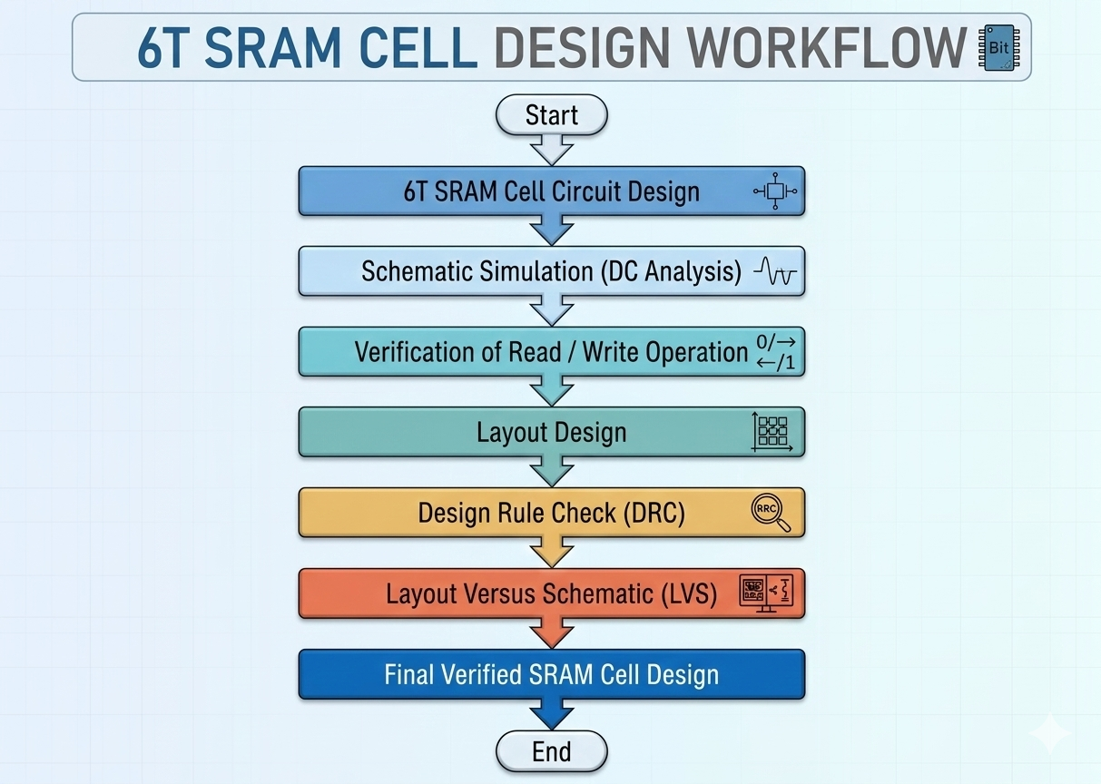
Flowchart

Slide 15
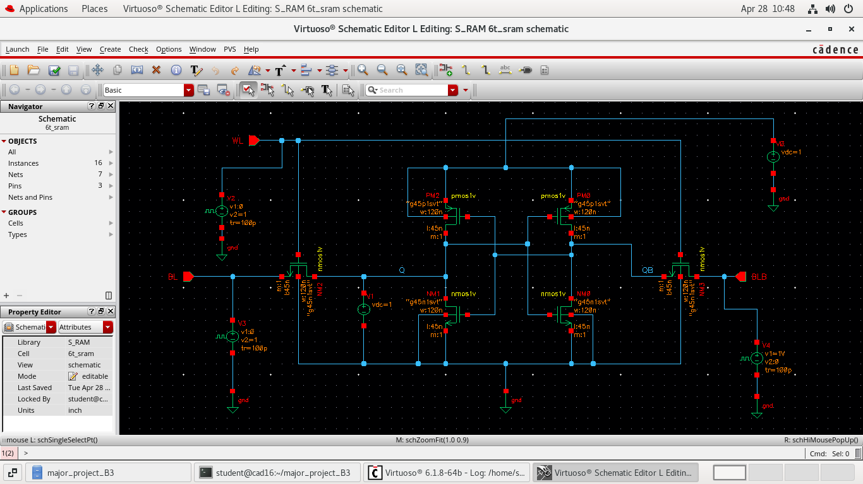
Results

Slide 16
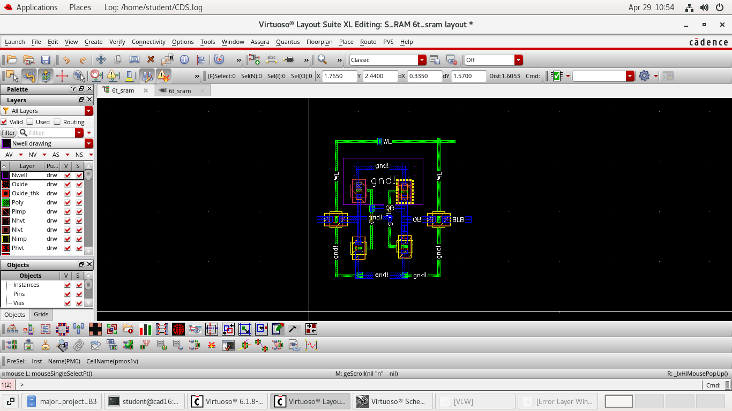

Slide 17
6T SRAM schematic was successfully designed in Cadence Virtuoso
Cross-coupled inverter structure with access transistors implemented correctly
Bit lines (BL, BLB) and word line (WL) connections verified
Layout of 6T SRAM cell was completed with proper CMOS design rules
PMOS and NMOS transistors placed and routed correctly
Compact and symmetrical layout achieved
Design Rule Check (DRC) passed with no errors
Layout Versus Schematic (LVS) verification successful
Write operation performed successfully through bit lines
Read operation verified without disturbing stored data
Hold operation confirmed when word line is disabled
SRAM cell stores one bit of data reliably
Overall design shows correct functionality

Slide 18
References
K. Agarwal, S. K. Gupta, “Design and Analysis of CMOS based 6T SRAM Cell at Different Technology Nodes”, Materials Today: Proceedings, Elsevier, 2020, pp. 1-6.
Anirban Kar, Mahdi Benkhelifa, Yogesh Singh, Hussam Amrouch, “Performance Evaluation of 6T-Sram in Sub-3 nm Complementary Fet”, 2025 9th IEEE Electron Device Technology & Manufacturing Confernce ,2025.
Prince Kumar Pandey,Dharmendra Singh Yadav, “Parametric Inspection of 6T SRAM Cell”,2021 5th International Conference on Trends in Electronics and information, 2021.
T.Kalpana,Challa Lakshmi Reddy,Bandaru Saranya, “A Low Voltage 6T SRAM Cell Design and Analysis Using Cadence 90nm And 45nm CMOS Technology”,2024 7th International Conference on Device and System,2024.
Tushar Singh,V. Prakash;S.S. Anwer,Gufran Ahmad, “Analyzing the Performance of 6T SRAM Cell and 64×64 Memory Array at Lower Technology Nodes for Low Power Design”, 2023 1st International Conference on Circuits, Power and Intelligent Systems (CCPIS), 2023.

