Slide 1

ASSIGENMENT – 2
Problem Solving
BBA 1st SEM (2022-23)
Submitted By-
Shankh Bansal
Submitted To-
Dr. Meenal Sharma

Slide 2
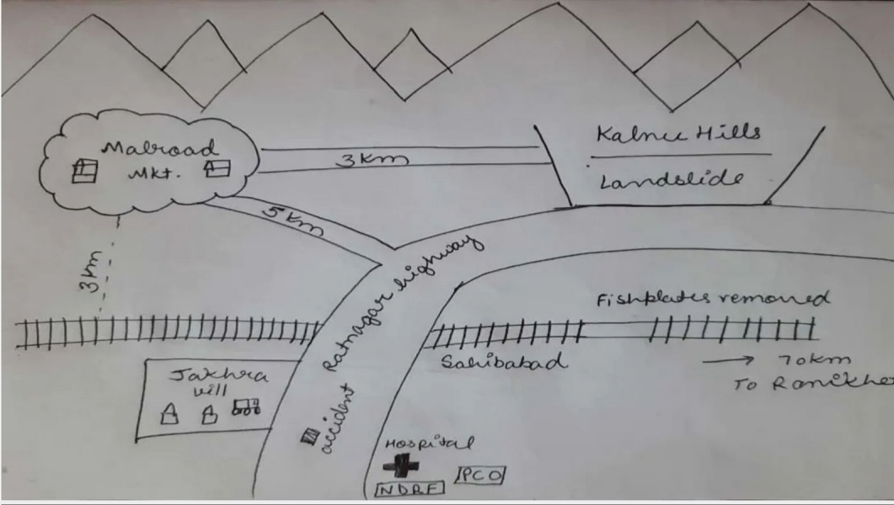
About the case

Slide 3
Learning Objective
To test the case study design.
To improve the research process.
To enhance planning skills.
To provide a tentative solution.

Slide 4
Planning
What are the problems?
Saving land slide victims at Kalnu Hills.
Saving Ratnanagar highway accident victims.
Restoring the fish plates.
Numbers of member available:8
Time now:5 PM
Time needed for discussion and planning: 10 Minutes
Time now: 5:10 PM
Number of teams: 3 Teams
All the three teams will dispatch at 5:10 pm to address their respective tasks.

Slide 5
PROBLEM 1: To save the land slide victims.
Number of men deployed: 4
Solution: 1) They will call the NDRF and hospital team with phone\PCO.
2) They will now reach kalnu hills by taxi.
3) They will take some basic equipment to help the people.
4) While the NDRF team reaches and assist them.
Distance: 3 km.
Speed of taxi:60kmph.
Time Now:5:10 pm
Time of reaching the spot: 5:20 pm.

Slide 6
PROBLEM 2: To save the Ratnanagar road accident victims.
Number of men deployed:2
Solution: 1)Will hire another taxi and reach the accident spot.
2) First aid the victims and take them to the hospital.
Time now: 5:10 PM.
Time when reached the accident sport: 5:20 PM.
Time when reached the hospital: 5:40 PM.
after finishing this task the team will move forward to the market.
Collect all the luggage and will reach the railway station.

Slide 7
PROBLEM 3: To restore the fish plates.
Number of men deployed:2
Solution:1)The 2 members will board the same taxi hired for problem 2 and get down at railway track crossing.
2)Reach the railway station and inform the officials.
3) With the help of railway officials and labors, reach the spot and ensures restoring of the fish plates.
Time before activity: 5:10 PM
Time required: 50 minutes
Time after activity: 6:00 PM

Slide 8

Learning outcomes
Importance of researcher humility
Importance of preventing misunderstanding rather than troubleshooting
Defining priorities
Authentic collaboration

