Slide 1

ASSIGENMENT – 1
VRIO analysis
BBA 1st SEM (2022-23)
Submitted By-
Shankh Bansal
Submitted To-
Dr. Meenal Sharma

Slide 2
Objective
To understand VRIO analysis.
List the key areas of internal company analysis.
To analysis the targeted market.
To gain in-depth knowledge of the company.

Slide 3
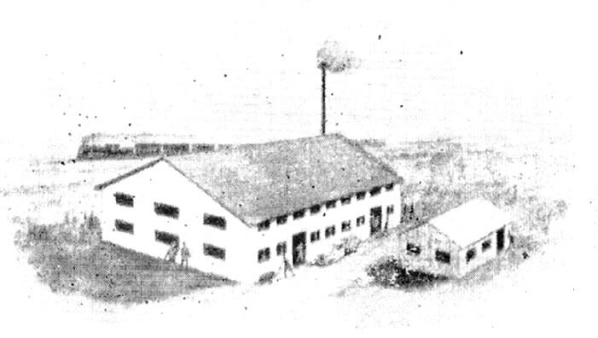
About the brand parle
Since 1929, we have grown to become India's leading manufacturer of biscuits and confectionery.
The Parle name symbolizes quality, nutrition and superior taste.
Founder – Mr. Mohanlal Dayal
First factory
REFERENCE - https://www.parleproducts.com/brands/parle-g

Slide 4
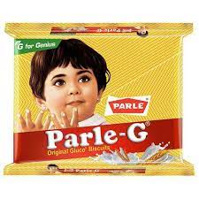
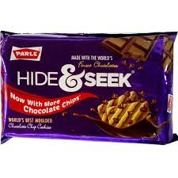
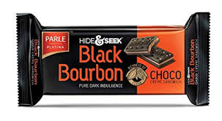

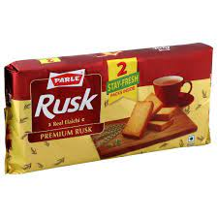

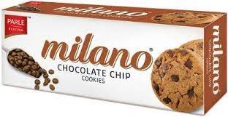
Most popular products

Slide 5
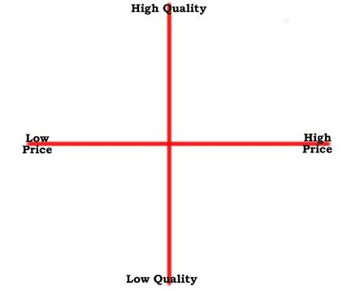
positioning mapping
Melody
Black bourbon
Parle G
Hide & seek
Milano
Rusk
Poppins

Slide 6
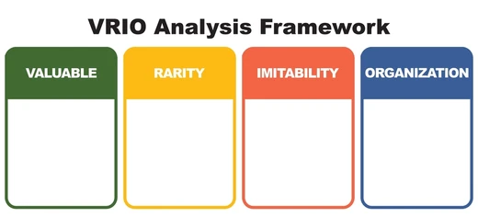
Offering superior taste
Offering affordable rates
Available at very low prices
Pricing
Supreme distributing network.
Product
Was the first to launch biscuits in market
Packaging
Renowned brand
Branding

Slide 7
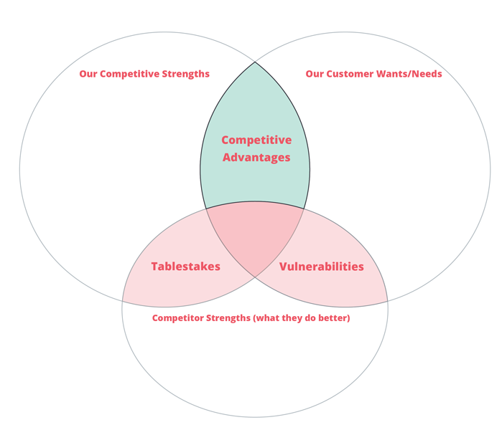
Personal relationship
Competitive
Genuine
Local
Advantage
Mapping
Long standing in community
To be empowered
Quality of service
People,staff,value
Community integration
Best product at low prize
Committed
Service providers
Better marketing
Pushy/arrogant!
Multiple factories
Offers similar services
Access to more resources
Access to multiple services
Follow same standard of regulation
Additional resources

Slide 8

LEARNING OUTCOMES
Came to find various pros and corns of the company.
Came to know about competitive advantages.
Improves research process.
Helps In grooming organization.

