Slide 1

Assignment - 4
Organizational communication chain
BBA 1st SEM (2022-23)
Submitted By-
Shankh Bansal
AU22C1013
Submitted To-
Dr. Gaurav Bagra

Slide 2
Objective
Encourages Discipline
Promotes and Enhances Vocabulary
Promotes Team Building
Promotes the Sharing of Ideas

Slide 3
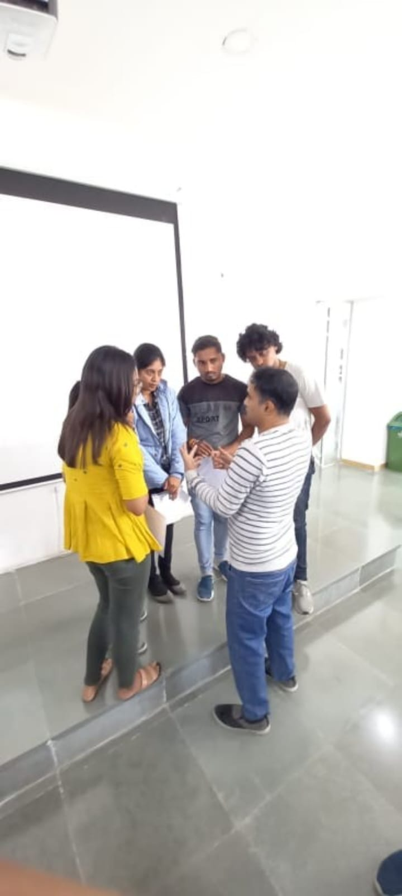
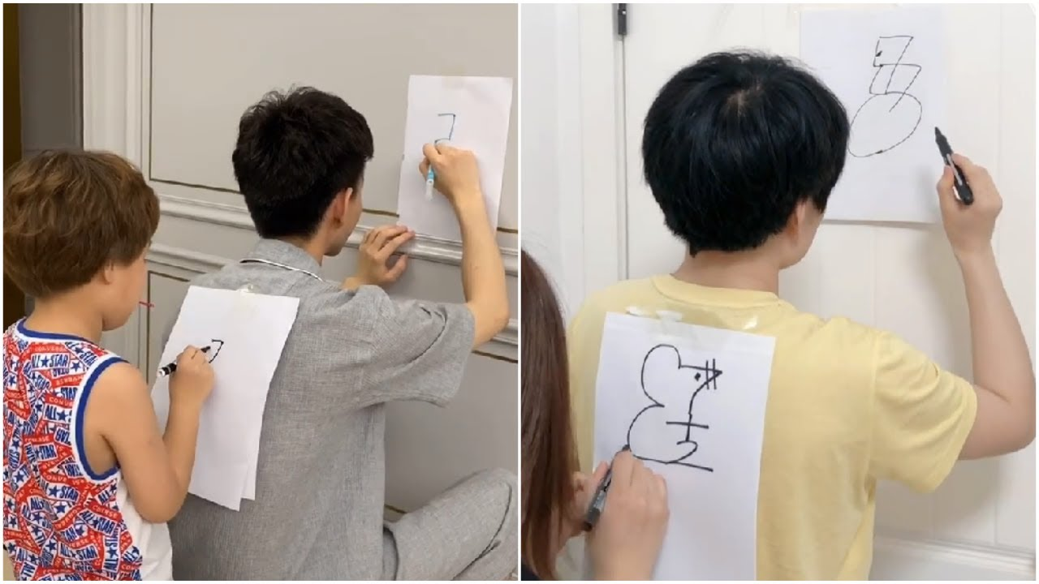
Activity-1
Team of 4 member.
Drawing a figure blindfolded.

Slide 4
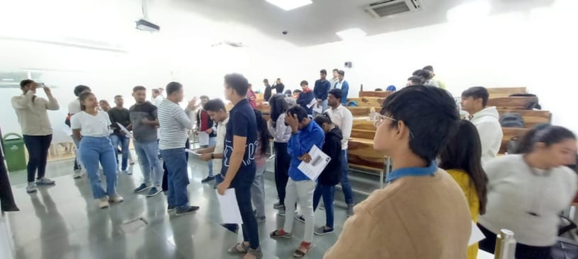
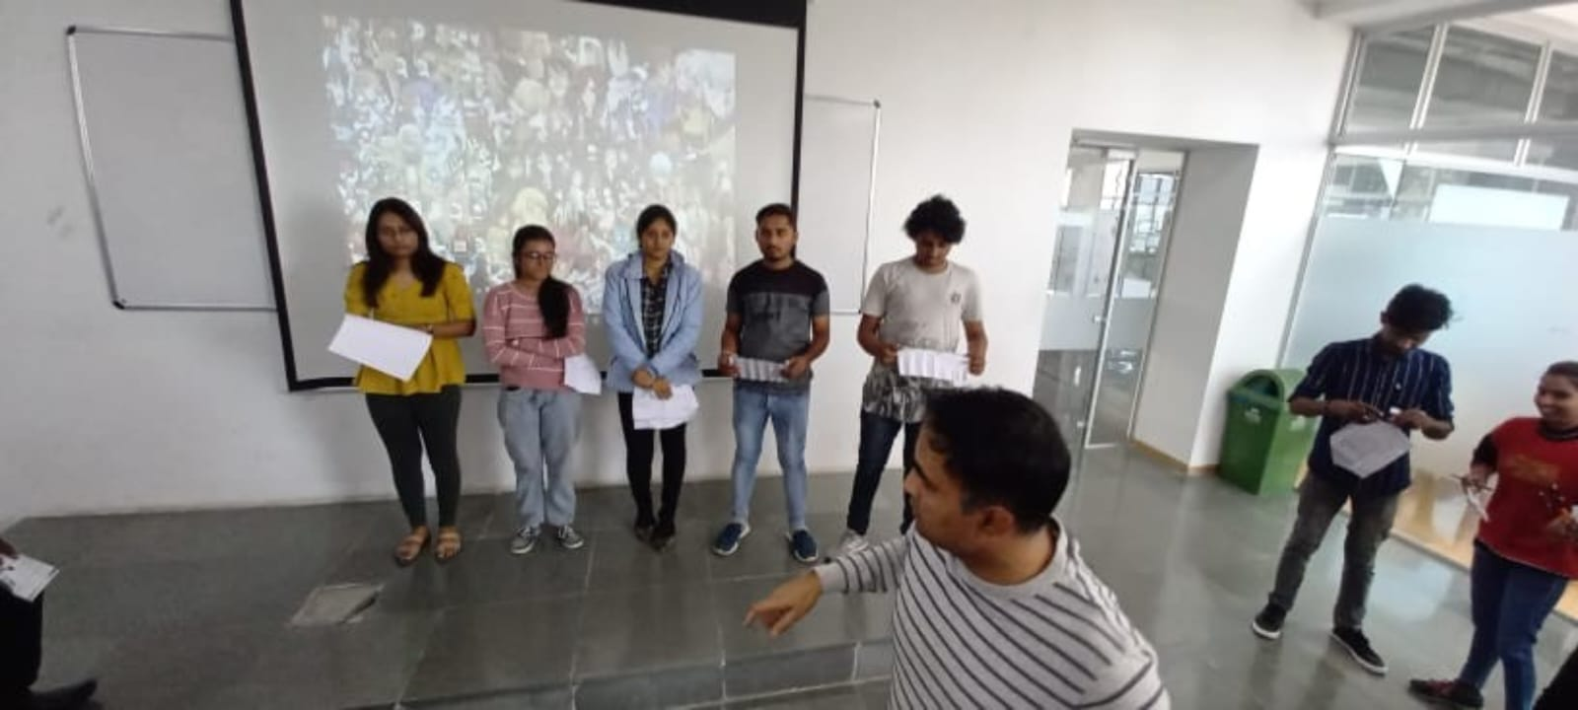
Activity-2
Group of 4 members.
Creating a figure by paper.

Slide 5
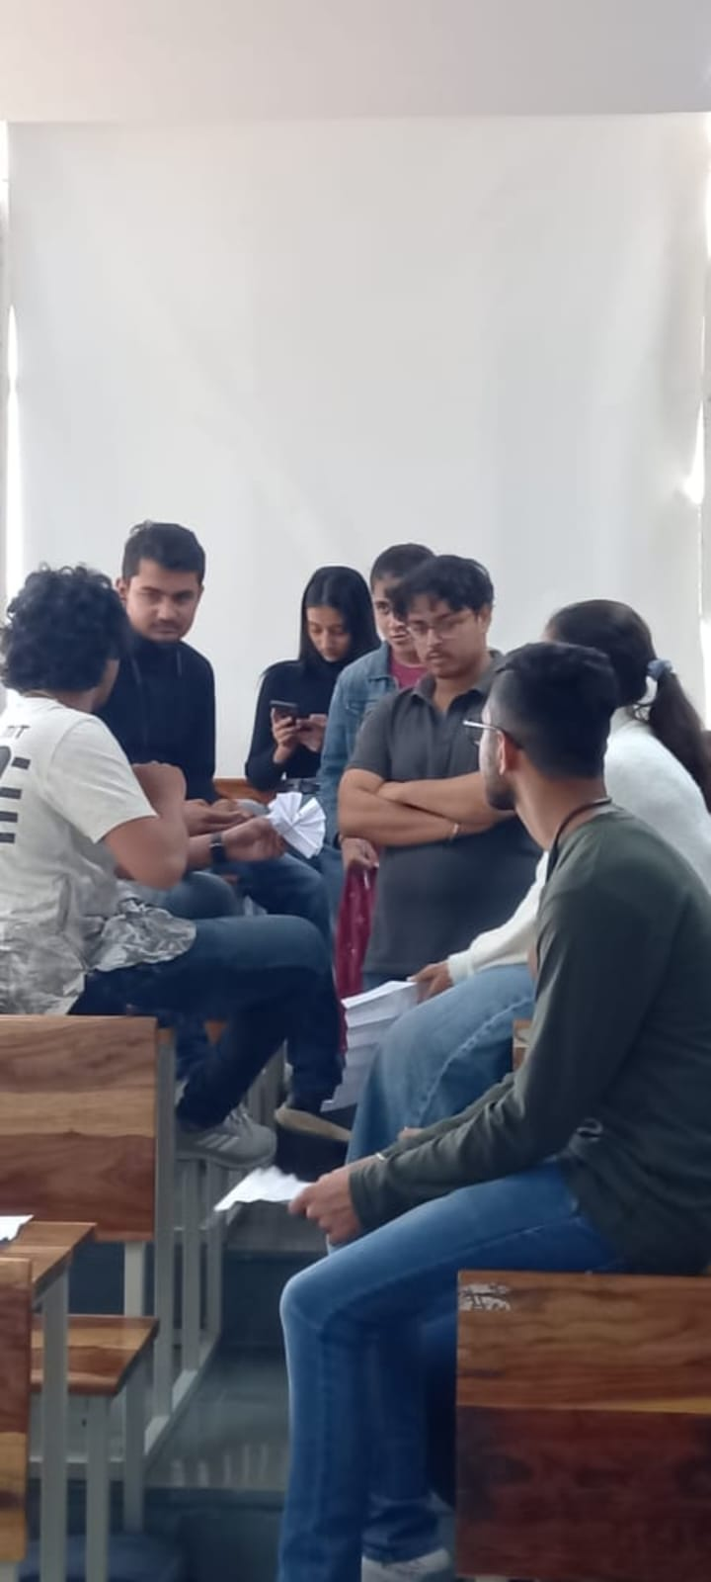
Activity-3
Group of 8 members.
In that there was two-two members team.
Need to create 4 different design of watches.

Slide 6
Learning outcomes
Helps in visualizing concepts and promotes positive group dynamics.
It Promotes Creativity
Enhances Logical Thinking Skills
Promotes Healthy Communication Skills
Creates a Platform for Trust

