Slide 1

ASSIGENMENT ON
DILO
BBA 1st SEM (2022-23)
Submitted By-
Shankh Bansal
Submitted To-
Dr. Amber Tiwari

Slide 2
Why to do a dilo study?
It helps busy individuals identify value added and non-value added tasks that they are performing daily.
By becoming aware of the amount of time spent on NVA tasks, choices can be made on what to do differently.
Get a full understanding of what someone really does; to replicate very effective people or to review to improve.
Before a DILO VA activities are, on average, only 21-40% of a role.

Slide 3
There are eight steps to perform a dilo
Validate it is possible to perform job observations.
Define the exact objective.
Define where, when, how long, how many, and who.
Customise and validate the DILO templates.
Prepare the observation.
Execute the observation.
Build the report and feedback.
Perform additional analysis – value add increase.

Slide 4
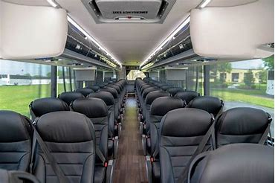
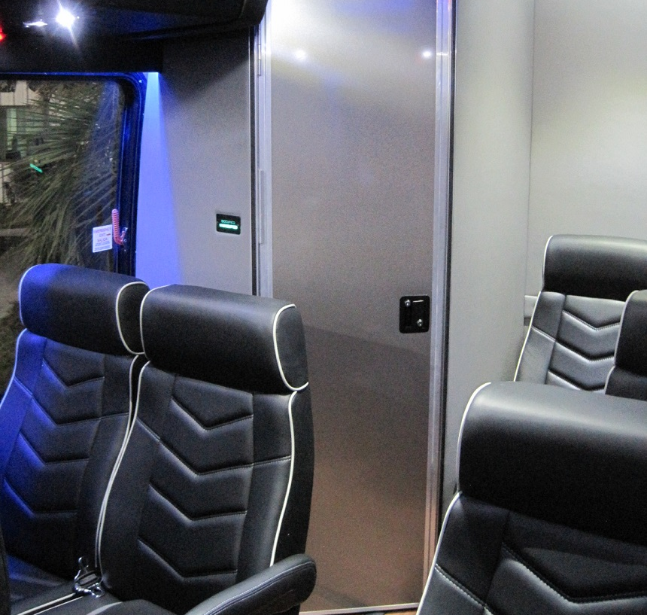
the problem why is there no washroom facility in buses?
Before
After

Slide 5
Background Information
What is your research?
People find it difficult to use washroom at any petrol pump, restaurants because they are poorly maintained.
sometimes people are shy to ask the driver to stop the bus.
sometimes people have the fear to go in washroom alone at night.
How did you discover this problem?
We came to discover the problem by a past incidence that has happened with me in the bus only.
we got the information to research about this problem and attempt to solve by-
Interviews
Personal experience
Internet/Books

