Slide 1

ASSIGENMENT – 1
Monitory policy
BBA 1st SEM (2022-23)
Submitted By-
Shankh Bansal
Submitted To-
Dr. Amber Tiwari

Slide 2

Objectives
To know about the effluence of the monitory policy in our daily routine.
To gain a brief knowledge of monitory policy.

Slide 3

MONETARY POLICY
Definition:
Monetary policy refers to the credit control measures adopted by the central bank of a country.
Monetary policy “as policy employing central banks control of the supply of money as an instrument for achieving achieves of general economic policy”.

Slide 4
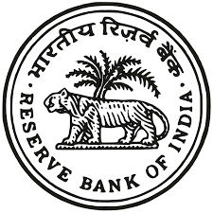
Objective of monetary policy
Full Employment
Price stability
Economic growth
Balance of payments
Exchange rate stability
Neutrality of money
Equal income distribution

Slide 5


Full employment
Price stability
Full employment has been ranked among the foremost objectives of monetary policy.
It is an important goal not only because unemployment leads to wastage of potential outputs, but also because of the loss of social standing and self respect.
One of the policy objective of monetary policy is to stabilize the price level.
Both economics and favor this policy because fluctuation in price bring uncertainty and instability to the economy.

Slide 6


Economic Growth
Balance of Payments
One of the most important objectives of monetary policy in recent years has been the rapid economic growth of an economy.
Economic growth is defined as “the process where by the real per capita income of a country increases over a long period of time”.
Another objectives of monetary policy since the 1950s has been to maintain equilibrium in the balance of payments.

Slide 7


Exchange rate stability
Neutrality of money
Exchange rate is the price of a home currency expressed in the terms of any foreign currency.
The monetary policy aims at maintaining the relative stability in the exchange rate.
Economist such as Wicksted, Robertson has considered money as a passive factor.
According to them, money should pay only a role of medium of exchange and not more than that.
Therefore, the monetary policy should regulate the supply of money.

Slide 8

Equal income distribution
Many economists used to justify the role of the fiscal policy is maintaining economic equality. However in recent years economists have given the opinion that the monetary policy can help and play a supplementary role in attaining an economic equality.

Slide 9

Types of monetary policy
Expansionary monetary policy
Contractionary monetary policy
Rule based monetary policy
Discretionary monetary policy

Slide 10

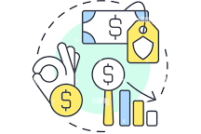
Expansionary monetary policy
Contractionary monetary policy
Expansionary or easy monetary policy aims at encouraging spending on goods and services by expanding the supply of credit and money by lowering the policy rates (bank rate) lowering the reserve requirements and purchasing the government securities from the market.
Contractionary or tight monetary policy aims at preventing inflation by contracting the money supply.
Contraction in money supply is achieved by increasing the policy rates, increasing the reserve requirements and purchasing the government securities from the market.

Slide 11


Rule based monetary policy
Discretionary monetary policy
Under rule based policy money supply and related variables are controlled by predetermined rules, norms and standards.
The central bank authorities cannot use their discretion to change the value of these variables.
Discretionary monetary policy allows the central bank greater autonomy in the conduct of monetary policy.
Under such a policy rather than getting constrained by the pre-set rule, the central banks, after assessing the emerging economics scenario and using its own judgment, can change the value of money supply and the related variables.

Slide 12
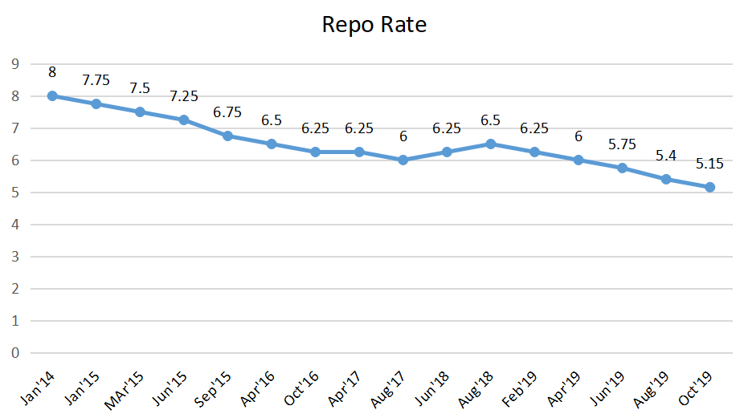

Slide 13
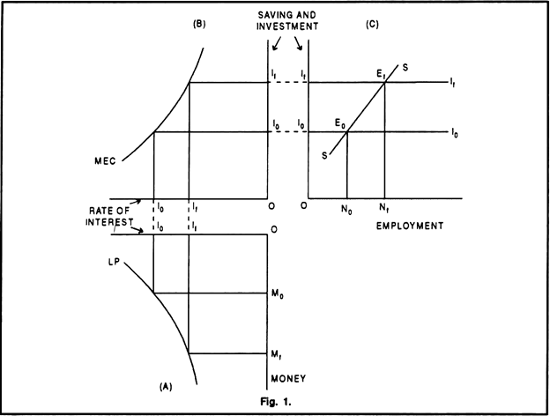

Slide 14


Instruments of monetary policy
Quantitative
Qualitative
Bank rate
Open market operations
Variations in the require
Repo rate
Liquidity adjustment facility
Rationing of credit
Margin requirements
Variable interest rate
Regulation of consum
Licensing

Slide 15
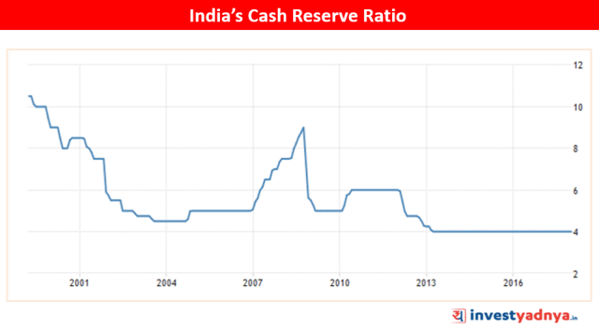

Slide 16

Significance of monitory policy
Control inflation or deflation.
Availability of the supply of money & credit.
Integrated interest rate structure.
Effective central banking.
Long term loans for industrial development.
Creation of financial institutions.

Slide 17
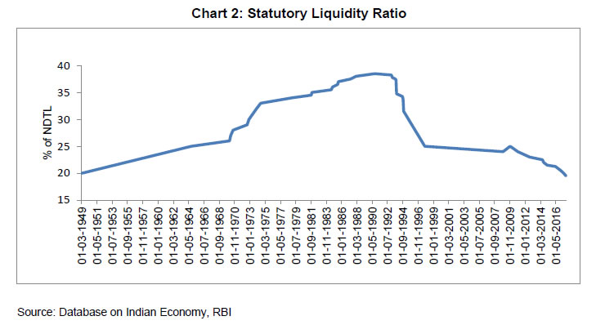

Slide 18


Indian monetary policy
Features
Objectives
Active policy
Controlled money supply
Seasonal variations
Flexible
Investment & saving oriented
Neutrality of money
Exchange rate stability
Economic growth
Prise stabilization
BOP equilibrium

Slide 19
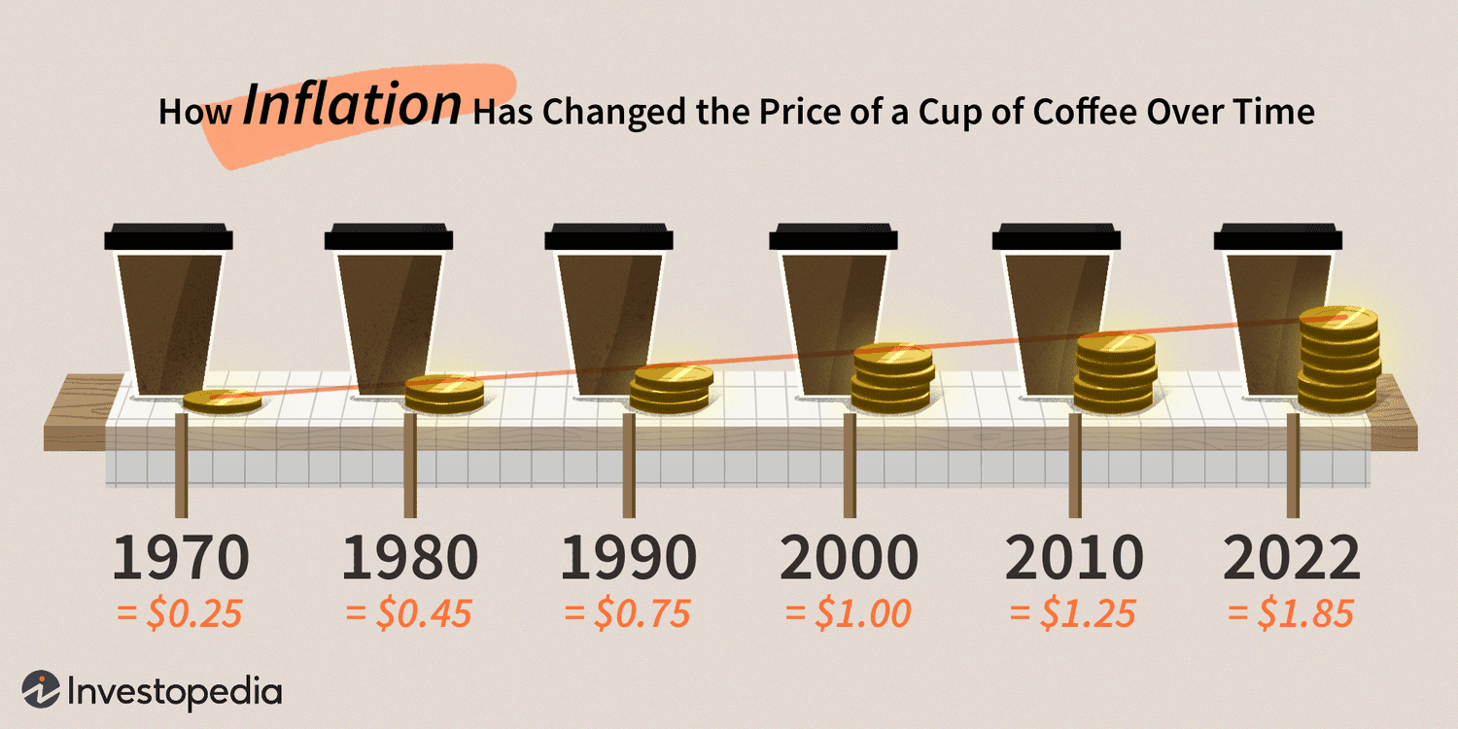

Slide 20

Limitation of monetary policy
Time lag:
It is referred to as the time taken in cheeking the policy action its implementation and response time.
2 types
Inside lag
Outside lag

Slide 21

Problem in forecasting
For the forecasting of monetary policy the magnitude of the problem that is inflation or recession should be properly assessed for determining the appropriate policy.
The lower degree of reliability of forecasting predictions of the out come of a policy action & formulation of appropriate monetary policy has remained an extremely difficult task.

Slide 22

Key takeaways
Central banks today primarily use inflation targeting in order to keep economic growth steady and prices stable.
With a 2-3% inflation target, when prices in an economy deviate the central bank can enact monetary policy to try and restore that target.
If inflation heats up, raising interest rates or restricting the money supply are both contractionary monetary policies designed to lower inflation.

Slide 23

Conclusion
All the objectives of monetary policy, i. e., exchange stability, price stability, full employment, economic growth, etc., are important and have their relative merits and demerits; None of these objectives is completely undesirable and should be abandoned. But the problem is that these objectives are not compatible with each other and, therefore, cannot be achieved simultaneously.

Slide 24

Learning outcomes
Grasped in-depth knowledge about monitory policy.
Got to know who change in policy will change my business.

