Slide 1

BBA Sem 2 Session(2023-24) Accounting Analysis
Submitted To:
Mennal Sharma
Submitted By:
Vani Saxena
Shankh Bansal

Slide 2
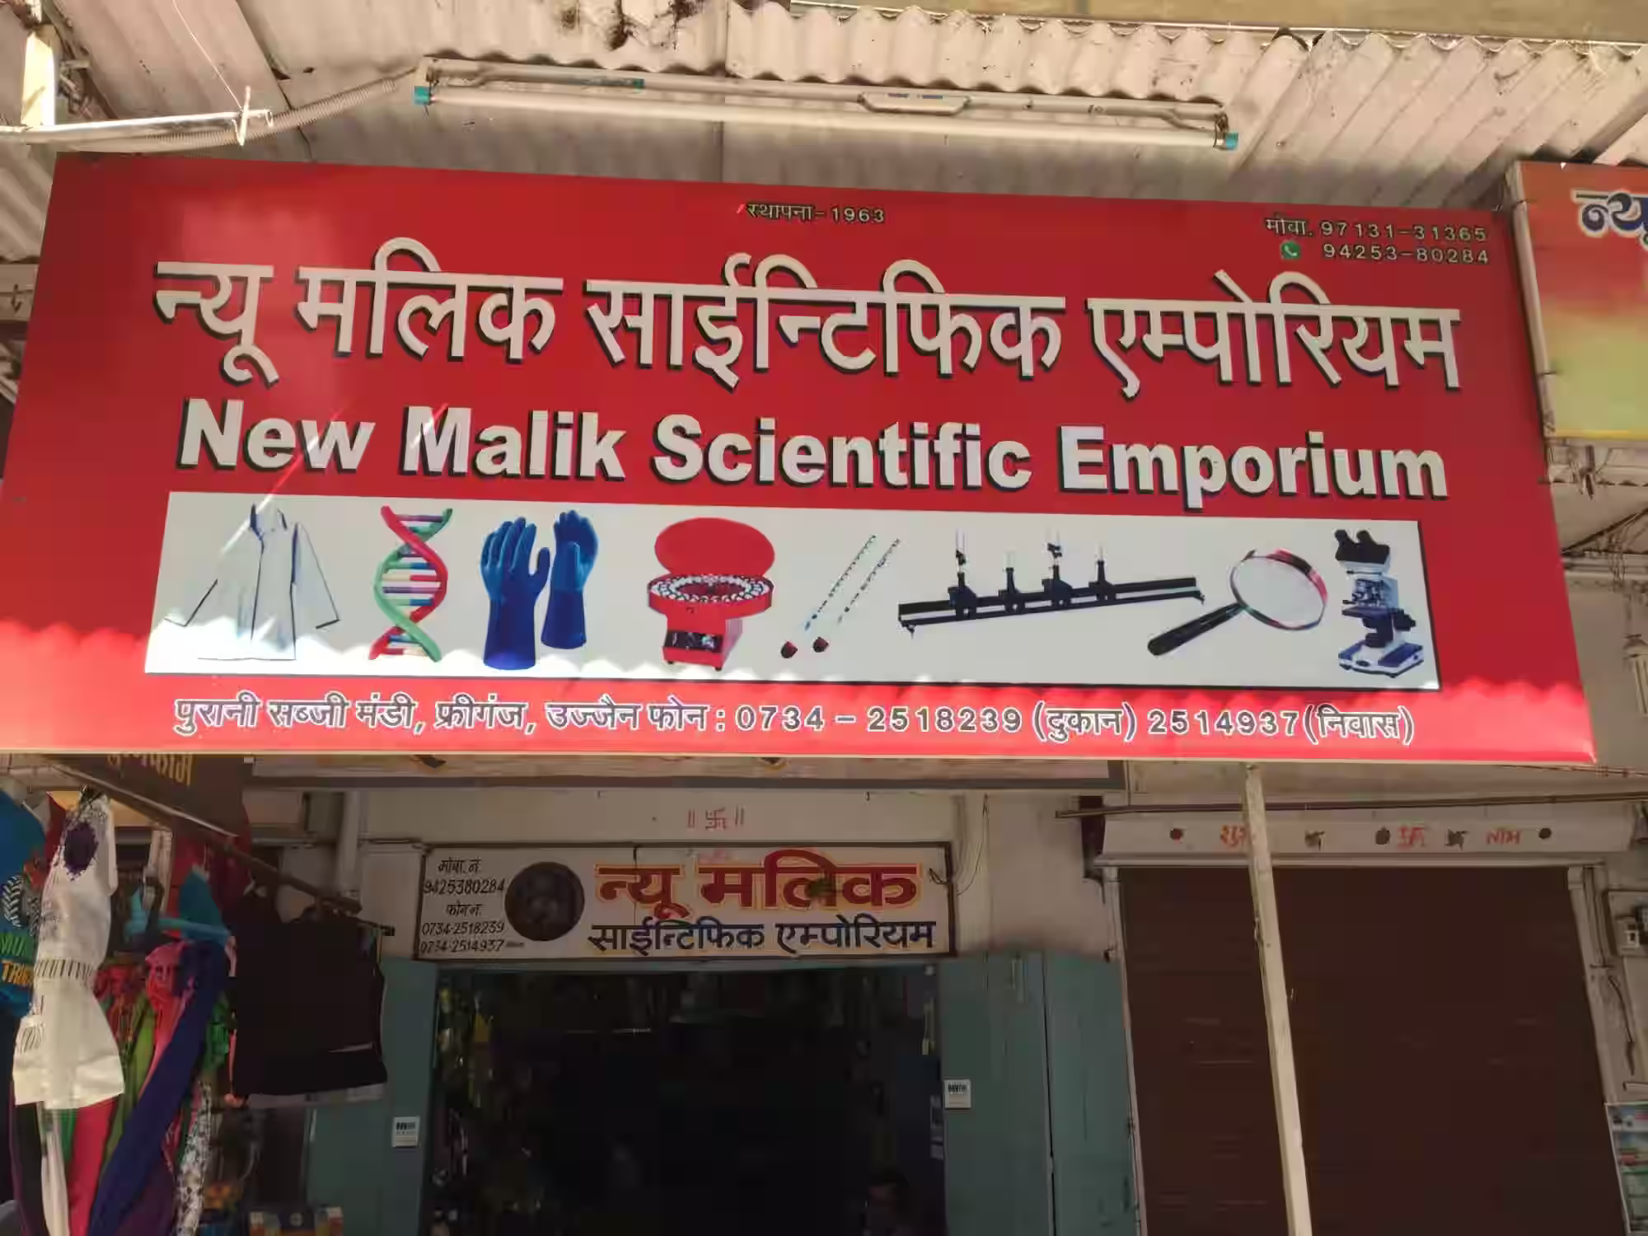
New Malik Scientific Emporium
New Malik Scientific Emporium is a laboratory equipment supplier. The business was established in 1963 and has since been then a pioneer in this field. They offer
Biological goods and charts
Milk Testing equipment
Physical lab goods
Lab chemicals
Glass wares
Microscopes

Slide 3
Legal aspects (to be known by accountant in case of a chemical business)
The accountant should be familiar with the patent application. The formal parts of a patent application are the petition, the specification with the claims, the oath and the official filing fee.
The accountant is asked to present this cost data as well as other cost information relating to commodity rates, carrier service rates, commission costs, freight equalizations per customer.

Slide 4
Present accounting practices followed by the organization
The organization follows accrual basis of accounting and the Tally as a software to maintain its records and accounts. They follow all the accounting principles, conventions and accounting standards accepted by ICAI.

Slide 5
Analysis of Top Line and Bottom Line of the organization
The top line refers to the sales or the revenues of a company which is the total income generated during a particular period.
Bottom Line = Gross Sales (or Top Line) – Total Expenses
The company's top line stands at Rs.64250 and company is experiencing growth at this stage for this month.
For this particular month the bottom line saw rent as the only expense and rest is sales of the organization.

Slide 6
Factors affecting top line!
Unable to figure out the ideal customer.
Poor knowledge about the competitors.
Unable to Understand your brand.
Short conversations.
No referrals in the market.
Less brand awareness.

Slide 7
Factors affecting bottom line!
Approaching wrong customer's.
Unable to create conversions.
Laging in automating everything.
Adjusting the prices.
Unable to get paid of any deal.
Think about moving

Slide 8

Consolidated & financial statements of Malik Emporium
accounting

