Slide 1


Diognostics with Deep Neural Networks
Hüseyin Yağız Devre
Code Available at: github.com/7228TigersFan/The-Mandalorian

Slide 2

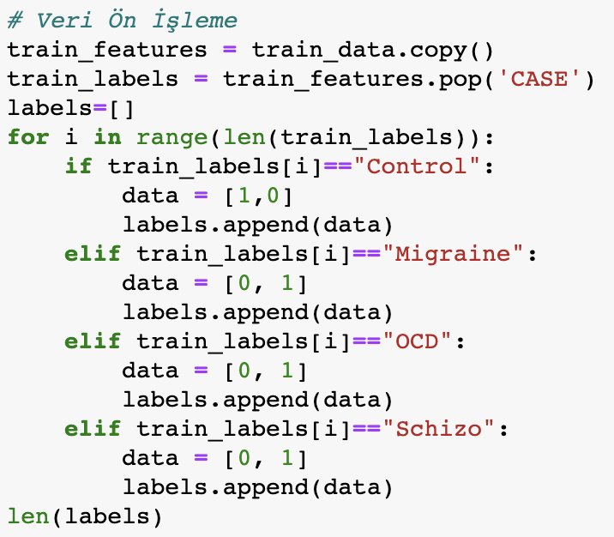

Data Pre-Processing
Data is preprocessed to fit into the needed structure
Sampling of 4 datapoints is performed for testing stage

Slide 3
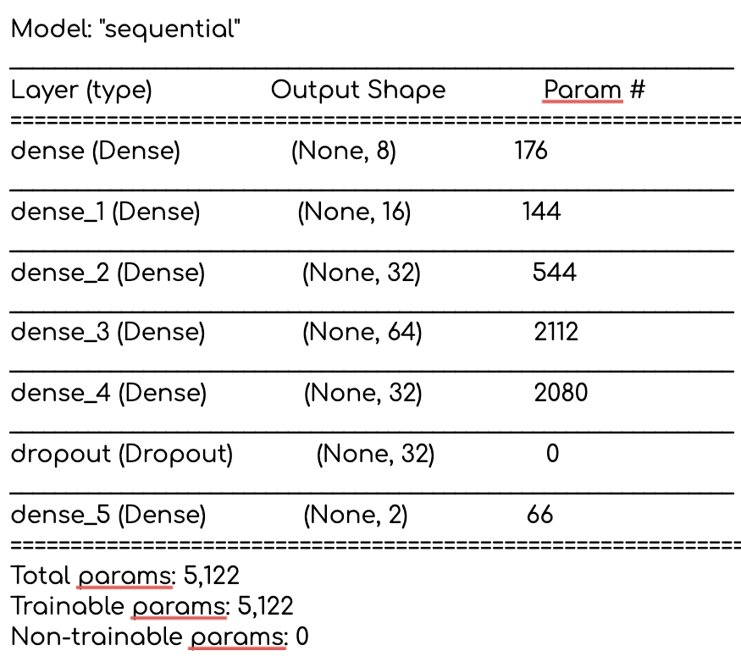
Model
Deep Neural Network
Total of 5122 Parameters
Binary Classification
5 Hidden Layers
Dropout of 0.3

Slide 4
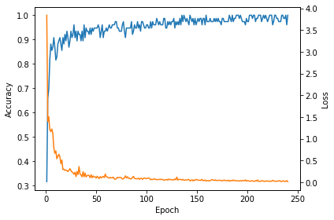
Training
%100 Accuracy
Near 0.0 Loss
No Overfitting
240 epochs
Binary Cross Entropy Loss Function is Used
Adam Optimizer is Used

Slide 5

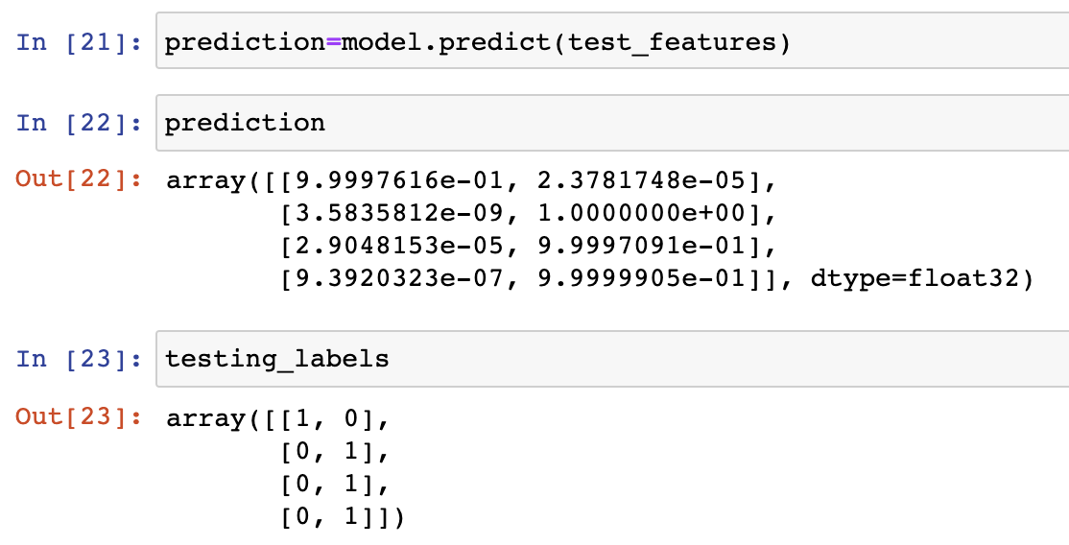
Results

