Slide 1

Analysis of Customer Service Data Excel Project

Slide 2
Table of contents
01
02
03
04
05
06
Business Objectives
Dashboard 1(Key Insights)
Sentiment, Root Cause & Response Time
Dashboard 2 Segmentation
Trends & Pattern Identifications
Recommendations

Slide 3

01
Business Objectives

Slide 4
Objectives
Business Objective
Project Goals
The analysis aims to leverage data-driven approaches to optimize customer service processes, enhance customer experience, and drive overall business growth. By examining historical customer service data, the project seeks to identify patterns, trends, and opportunities for improvement, ultimately leading to enhanced customer loyalty and increased operational efficiency.
• Customer Sentiment Analysis
• Root Cause Analysis
• Service Response Time Analysis
• Customer Segmentation
• Trends and Patterns Identification

Slide 5
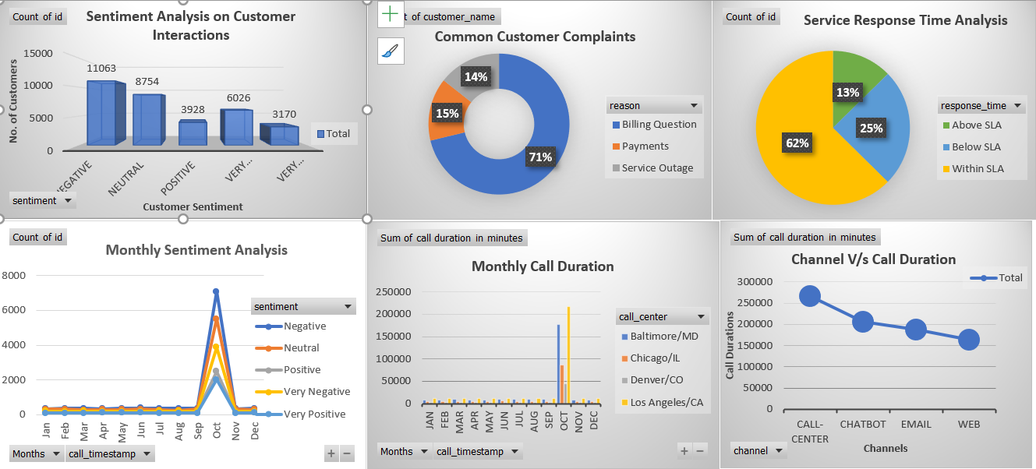
Dashboard of Key Insights

Slide 6
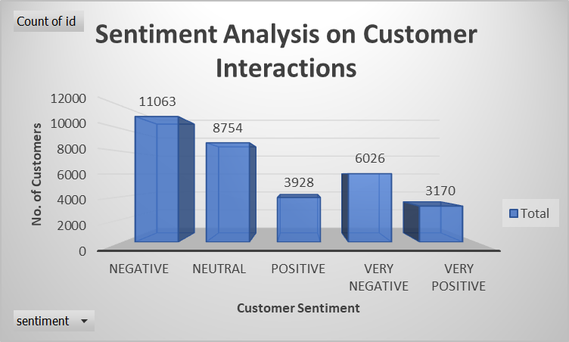
1.1 Customer Sentiment Analysis
Sentiment Analysis
In this, We found that Mostly Customers are not happy with Customers Service and given Negative feedback of 51.87% (Negative+ Very Negative)

Slide 7
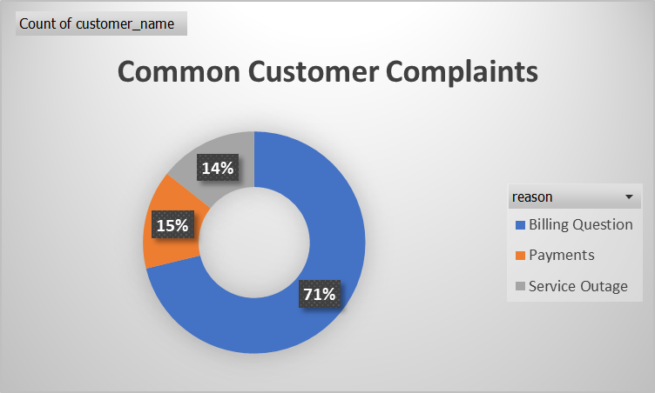
1.2 Root Cause Analysis
Common Complaints
Mostly Customers Complaints are related to Billing Questions i.e. 23462 (71%).

Slide 8
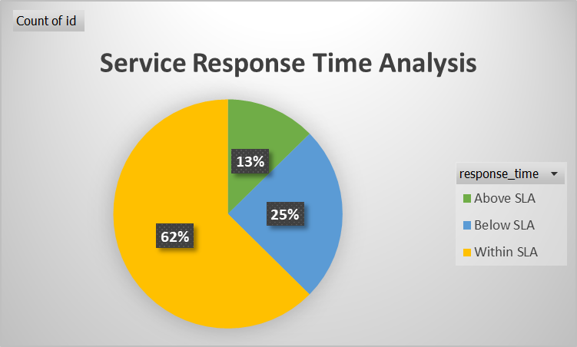
1.3 Service Response Time Analysis
Response Time
About 62% of Service Response Time is within SLA. So, We have to optimize in order to improve the Customers’ experience.

Slide 9
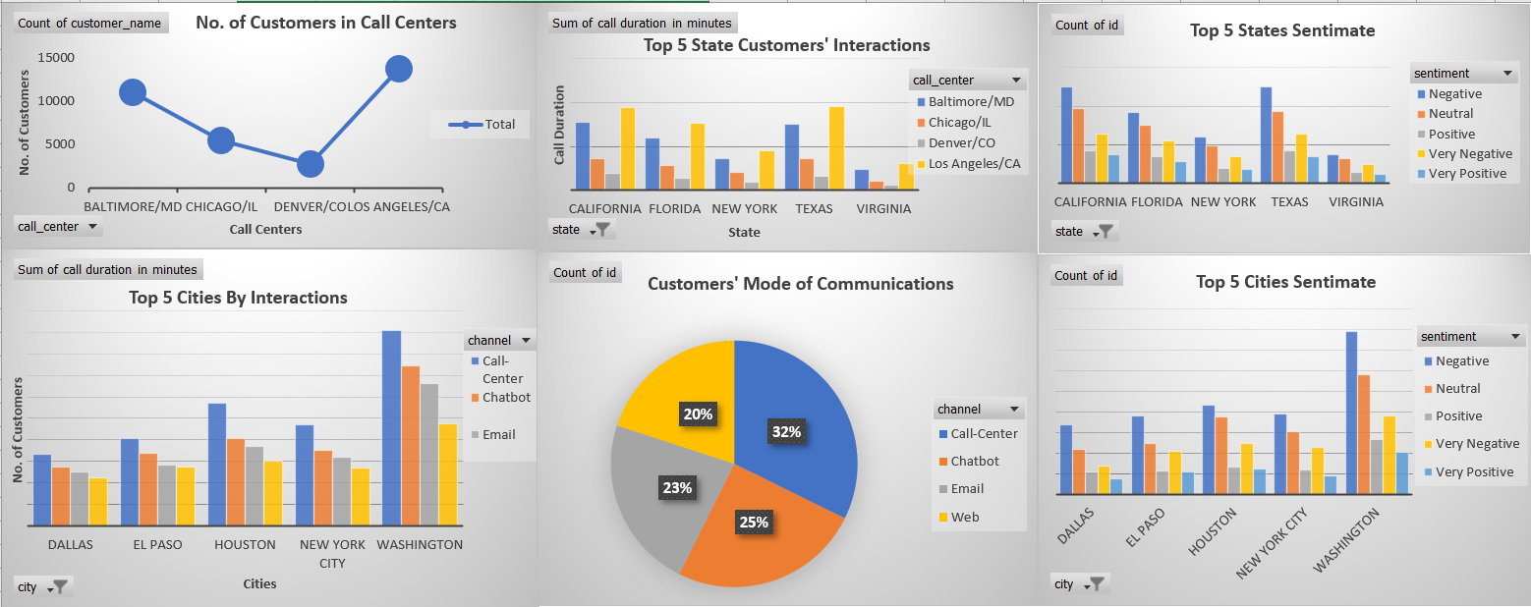
2. Dashboard Customer Segmentation

Slide 10
2.1 Customers Segmentation
Customers in Call Centers
Mode of Communication
Top 5 States of Interaction
Los Angeles/CA Call Center has highest No. of customers followed by Baltimore/MD
Customers Use 32% in Call centers, 25% Chatbot, 23% Email and 20% Web
California
Florida
New York
Texas
Virginia
Top 5 Cities of Interaction
Top 5 States Sentiment
Top 5 Cities Sentiment
Dallas
El Paso
Houston
New York City
Washington
California
Florida
New York
Texas
Virginia
Dallas
El Paso
Houston
New York City
Washington

Slide 11
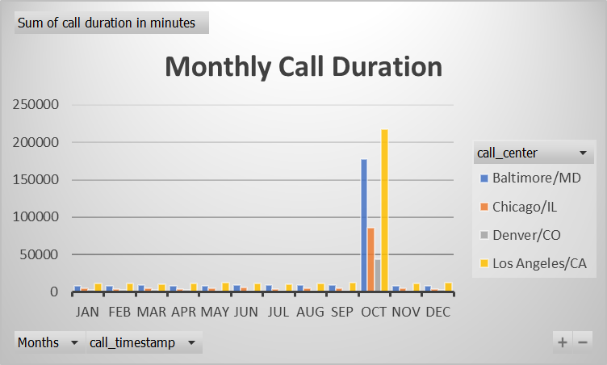
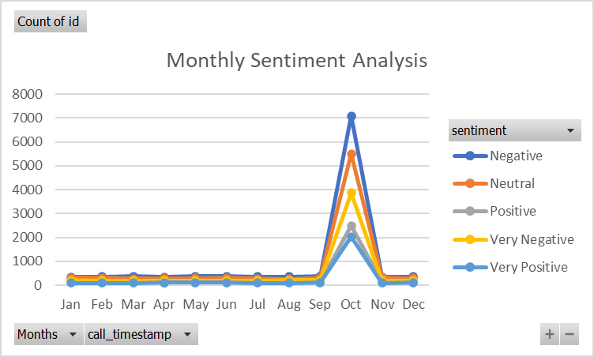
2.2 Trends and Pattern Identification
Pattens
In October We have Received most of the Call Durations and Maximum No. of Sentiments. In all the Month We are response on 10 of every month except October

Slide 12
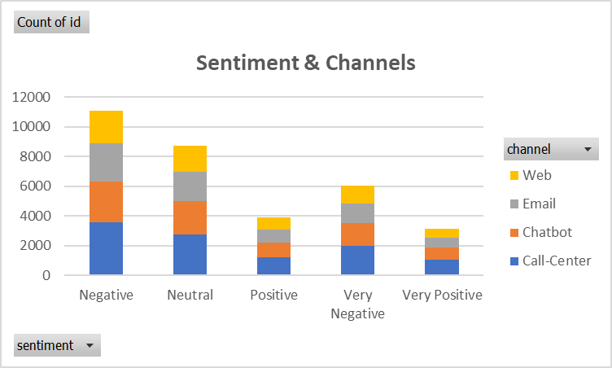
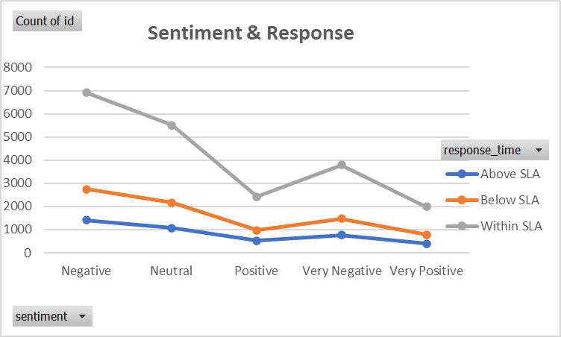
2.2 Trends and Pattern Identification
Sentiment Analysis
Mostly Negative
Root Cause
Billing Questions
Call Response
Within SLA
Mostly Customers Use Email Mode of Communication in case of “Negative”, “Billing Question” & “Within SLA”

Slide 13
Recommendations
With the Sentiment Analysis, We found most Negative feedback and Root cause for this is Billing Question. So, Nile has to Improves their Billing Process by training their Caller to how to deal with this in a optimal way. By this Not only Negative feedback reduced it enhance the Customer Support efficiency also they spend 60% time in this only.
Improve Payment Gateways to reduce the Billing Issues.
Optimized Response Time in order to caters the customer queries and enhance customer experience.
Focus on 1st Top 5 Cities and Top 5 States in order to solve the issues.
As Most Queries Comes on 10th of Every Month. So, Add extra person in order solve the issues frequently.

Slide 14

Thanks!
Do you have any questions?

