Slide 1

Project Title – Seasonal Agriculture Performance Analysis
Student Name – Rohit Medishetti
College Name – Methodist College of Engineering and Technology
AICTE STU ID : STU6a6c93fde0e6e1785500669

Slide 2

PROBLEM STATEMENT
Agricultural activities are influenced by seasonal variations in environmental conditions, farming practices, resource availability and market conditions. As a result, agricultural performance may differ from one season to another.
However, raw agricultural data does not clearly explain how agricultural performance changes across seasons or what patterns can be observed in different seasonal conditions.
The problem is to analyze the given agricultural dataset and investigate seasonal differences in agricultural performance by identifying meaningful patterns, trends, relationships and variations within the available data.

Slide 3
Project Description
Seasonal Agriculture Performance Analysis Using Data Analytics is a data analytics project that studies agricultural performance across different crops, seasons, and regions.
The project analyzes factors such as rainfall, temperature, soil conditions, irrigation, fertilizers, crop yield, production, market price, cost, profit, water efficiency, and disease/pest risk.
Using Python-based data analytics and visualization techniques, the project identifies seasonal patterns, crop profitability, resource efficiency, and factors affecting agricultural performance. The insights obtained can support better crop planning, resource management, and data-driven agricultural decision-making.

Slide 4

WHO ARE THE END USERS?
Farmers - To make better decisions about crop selection, irrigation, fertilizers, and resource usage.
Agricultural Planners - To analyze seasonal and regional agricultural performance for planning purposes.
Agricultural Researchers - To study relationships between environmental factors, crop yield, profitability, and risks.
Government & Agricultural Departments - To support data-driven agricultural policies and resource allocation.
Agri-Businesses & Consultants - To evaluate crop profitability, market performance, and resource efficiency.

Slide 5

Technology Used
Python - Main programming language for data analysis
Pandas - Data loading, cleaning, manipulation, and aggregation
NumPy - Numerical computations and statistical operations
Matplotlib - Data visualization and plotting
Seaborn - Statistical visualizations, correlation heatmaps, boxplots, and pairplots
Google Colab - Development and execution environment
Microsoft Excel - Dataset storage and initial data organization

Slide 6
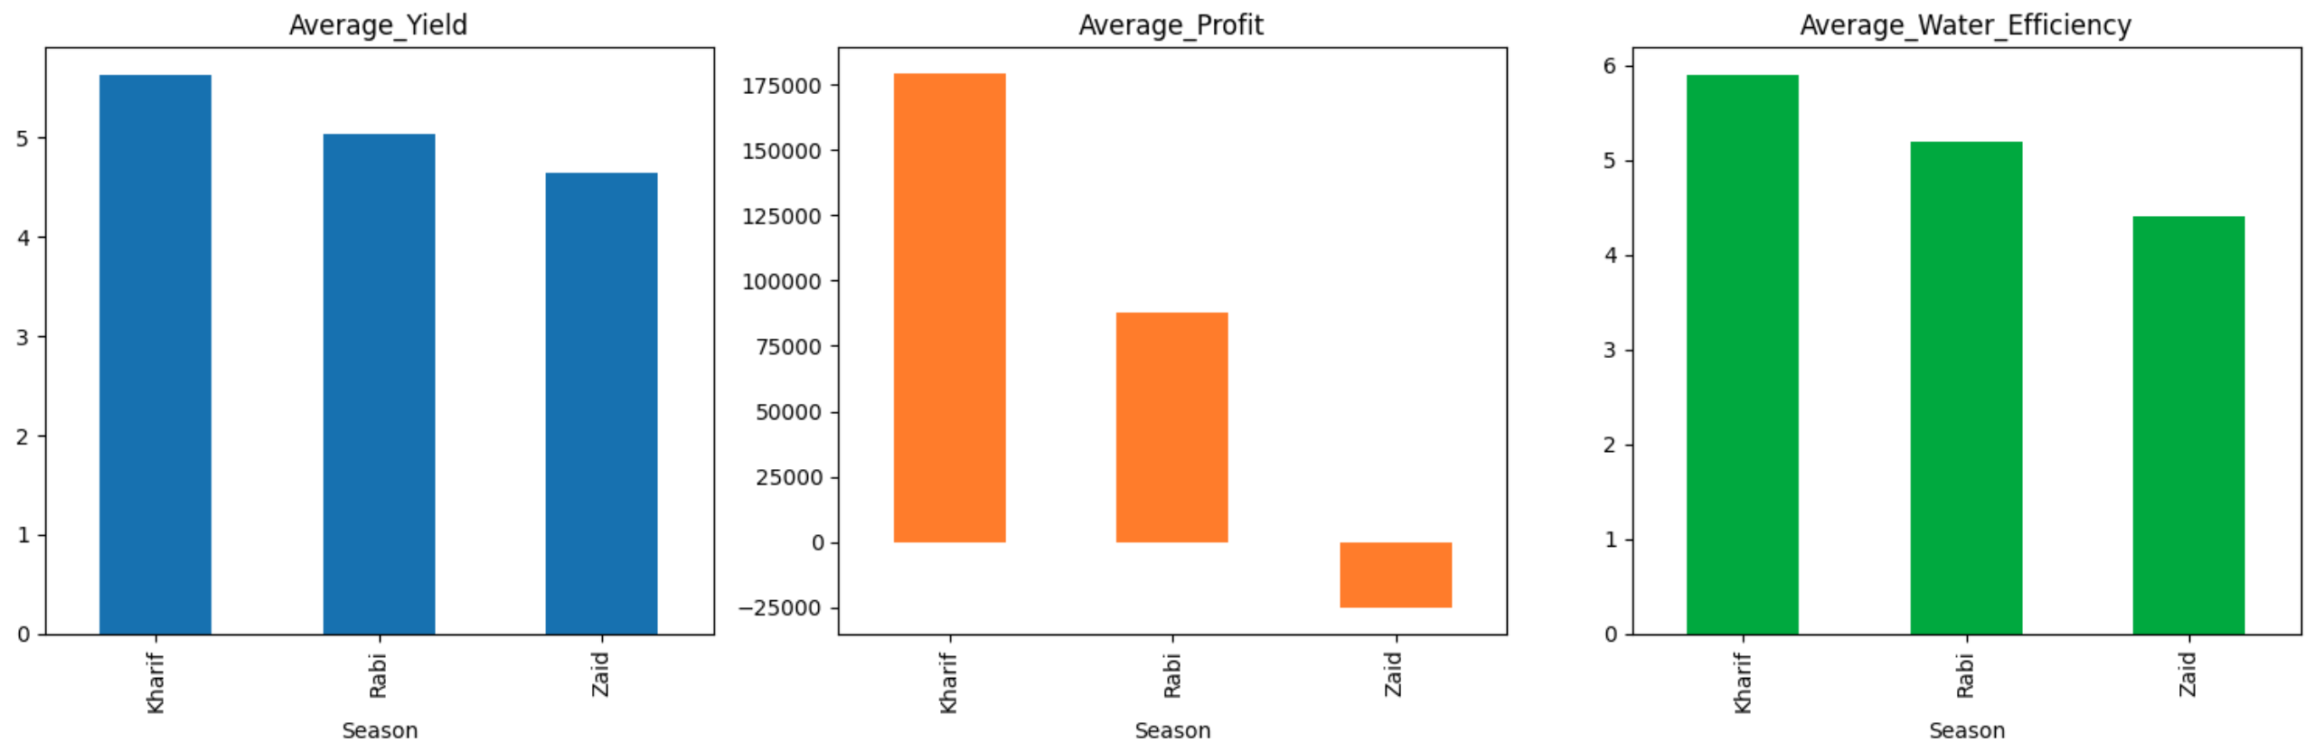
RESULTS
Seasonal Agricultural Performance
This chart compares average profit across the three seasons. Kharif records the highest average profit (₹1.79L), followed by Rabi (₹0.88L), while Zaid shows a net loss (–₹0.25L) on average. Yield and water efficiency were also assessed but are on a much smaller numeric scale, so they aren't visible in this combined chart — refer to the summary table for those figures.
Key takeaway: Kharif is the most profitable season, while Zaid consistently underperforms across profitability.

Slide 7
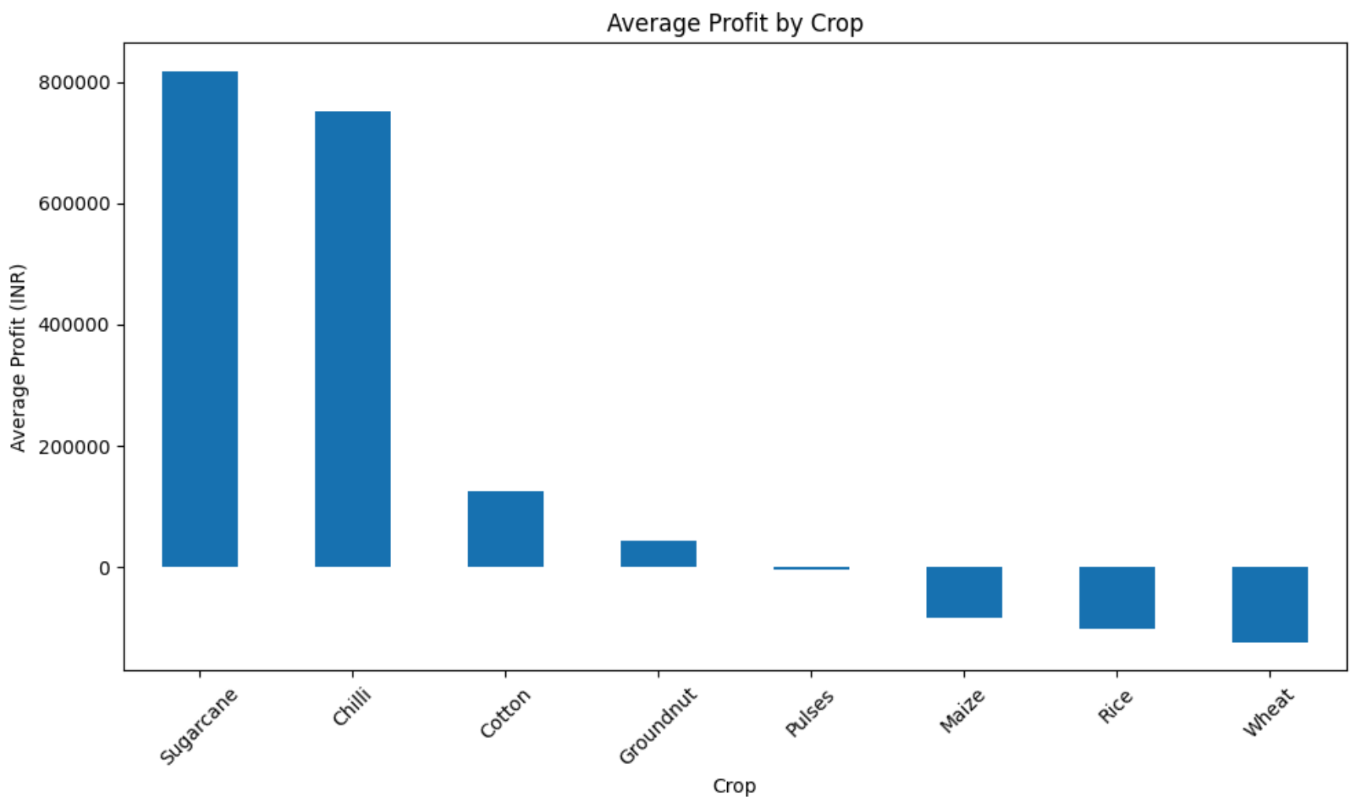
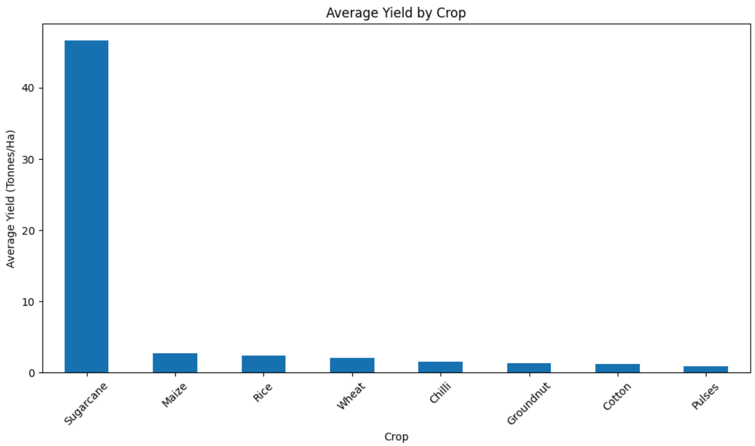
RESULTS
Sugarcane Dominates Both Yield and Profit
Sugarcane clearly outperforms all other crops in the dataset, recording the highest average yield (~46.6 tonnes/ha) — nearly 17 times higher than the next-best crop, Maize (~2.7 t/ha). This exceptional yield translates directly into profitability: Sugarcane also leads in average profit (₹8.17 lakh), followed by Chilli (₹7.51 lakh) and Cotton (₹1.25 lakh).
Notably, several crops — Maize, Rice, and Wheat — show negative average profit, indicating that production costs exceed revenue for these crops on average across the dataset. Pulses hover near breakeven.
Key takeaway: Crop choice has a major impact on farm profitability. High-yield crops like Sugarcane and Chilli substantially outperform staple grain crops (Wheat, Rice, Maize) in economic returns, despite the latter being more commonly cultivated.

Slide 8
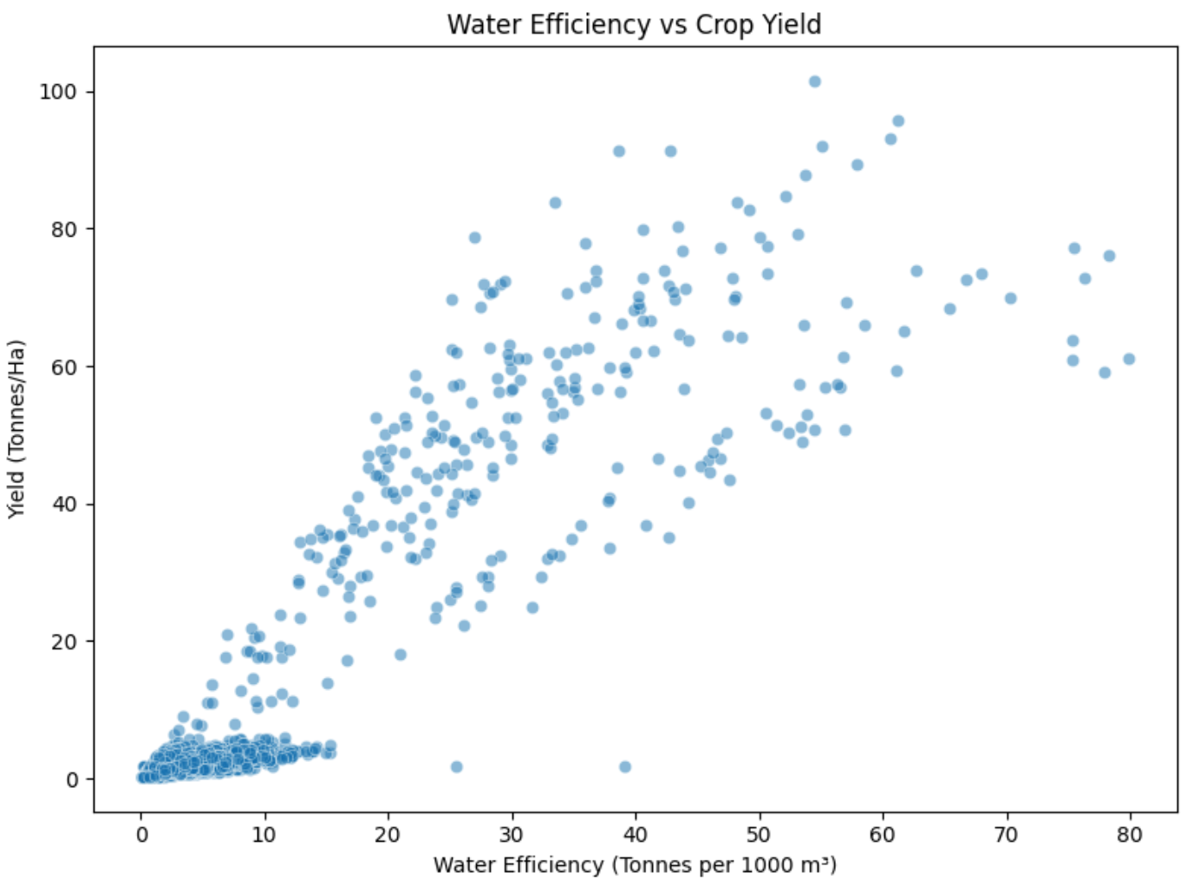
RESULTS
Water Efficiency Has a Strong Positive Relationship with Yield
Water efficiency (tonnes of yield per 1000 m³ of water used) shows the strongest correlation with crop yield among all variables analyzed (r = 0.91) — far stronger than raw water volume used (r = 0.39), fertilizer application, or rainfall. This indicates that how efficiently water is used matters more to productivity than how much water is applied.
Key takeaway: Farms that convert water into yield more efficiently — regardless of total water volume — consistently achieve higher output. This supports prioritizing water-use efficiency (e.g., through irrigation method choice) over simply increasing water input.

Slide 9
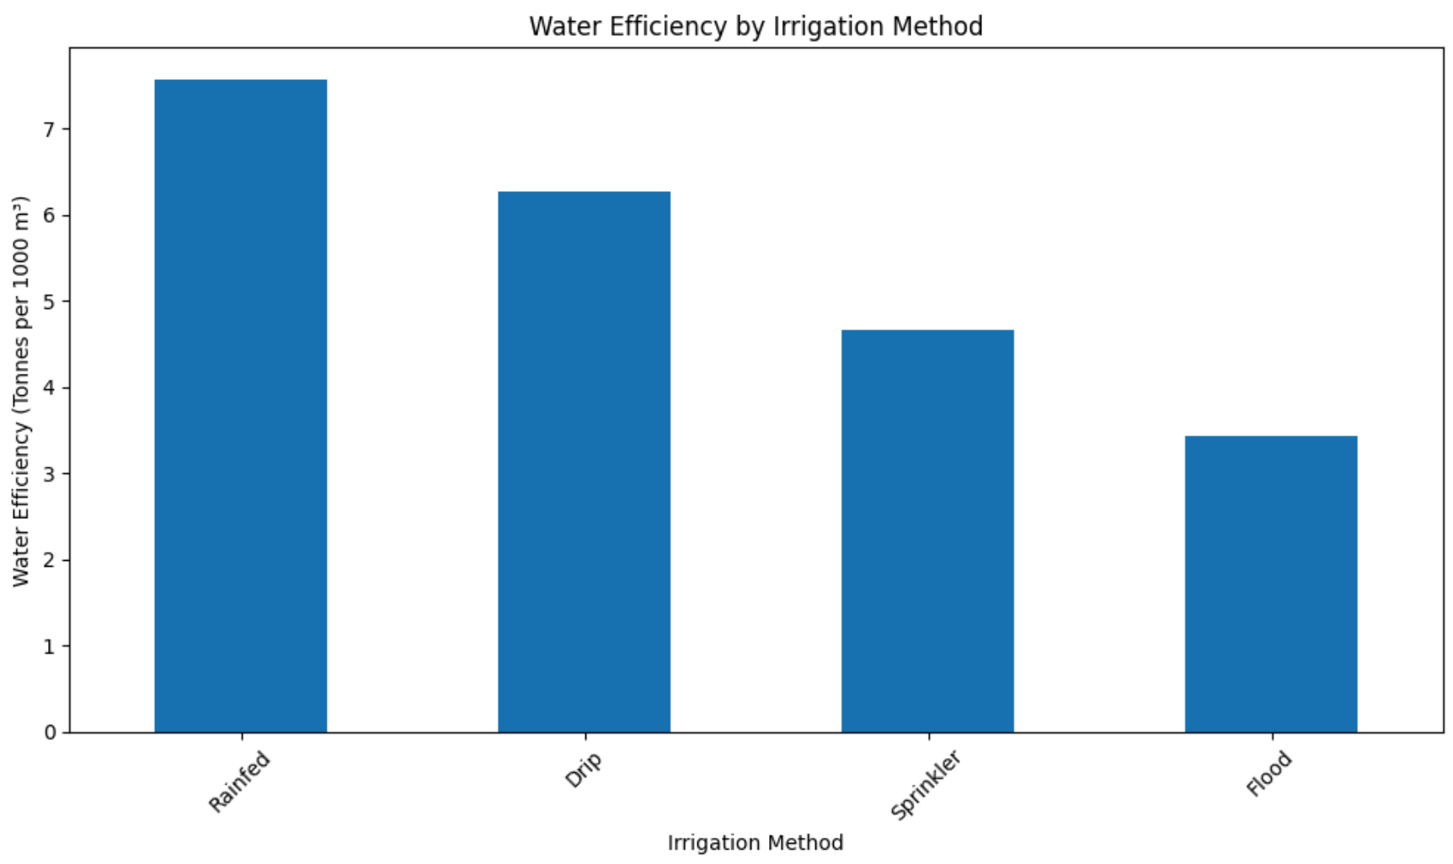
RESULTS
Rainfed Irrigation Is Most Water-Efficient — But Not the Most Productive
Rainfed irrigation achieves the highest water efficiency (~7.6 tonnes per 1000 m³), ahead of Drip (~6.3), Sprinkler (~4.7), and Flood (~3.4). However, this efficiency doesn't translate to output: Rainfed farms record the lowest average yield (4.60 t/ha) and lowest average profit (₹79,050) among all irrigation methods — well behind Drip, which delivers both higher yield (6.58 t/ha) and higher profit (₹2,19,626).
Key takeaway: Water efficiency and productivity don't always align — Drip irrigation offers the better overall balance of resource efficiency and output.

Slide 10
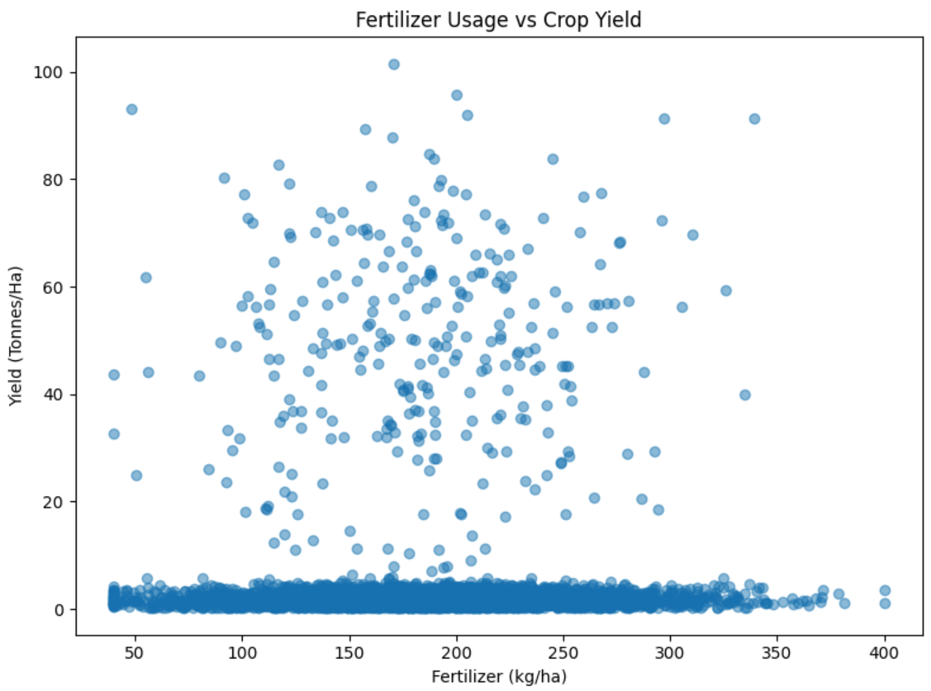
RESULTS
Fertilizer Usage Shows No Measurable Relationship with Yield
Fertilizer application shows virtually no correlation with crop yield (r ≈ 0.00) — yield varies widely, from near 0 to over 90 tonnes/ha, regardless of how much fertilizer is applied, across the full observed range of 40–400 kg/ha. Even within similar fertilizer levels, yields differ by 80+ tonnes/ha, showing that fertilizer amount alone does not explain productivity differences.
Key takeaway: Fertilizer input is not a limiting factor for yield in this dataset — factors like water efficiency and crop type have a far stronger influence on productivity than fertilizer application levels.

Slide 11
Future scope
The project can be further enhanced by integrating real-time agricultural and environmental data from weather stations, IoT sensors, and other reliable data sources. This would allow the analysis to provide more up-to-date information about soil moisture, rainfall, temperature, irrigation, and crop conditions.
Future improvements can also include developing machine learning models to predict crop yield, profitability, and disease or pest risk based on historical and environmental data. A recommendation system could be developed to suggest suitable crops, irrigation methods, and resource usage for specific regions and seasons.
The project can further be developed into an interactive web or mobile dashboard where farmers and agricultural planners can view seasonal performance, compare crops, monitor resource efficiency, and make data-driven decisions. Integration of satellite imagery, soil data, market-price trends, and location-based information could make the system more comprehensive and useful for practical agricultural planning.

Slide 12
GitHub Link
https://github.com/7237Rohit/Seasonal_Agriculture_Performance_Analysis.git

Slide 13

VOIS Course completion certificate
Course name- Data Visualization

Slide 14
Thank you
.
.

