Slide 1


Jun Lee
Jun Lee
My Works

Slide 2
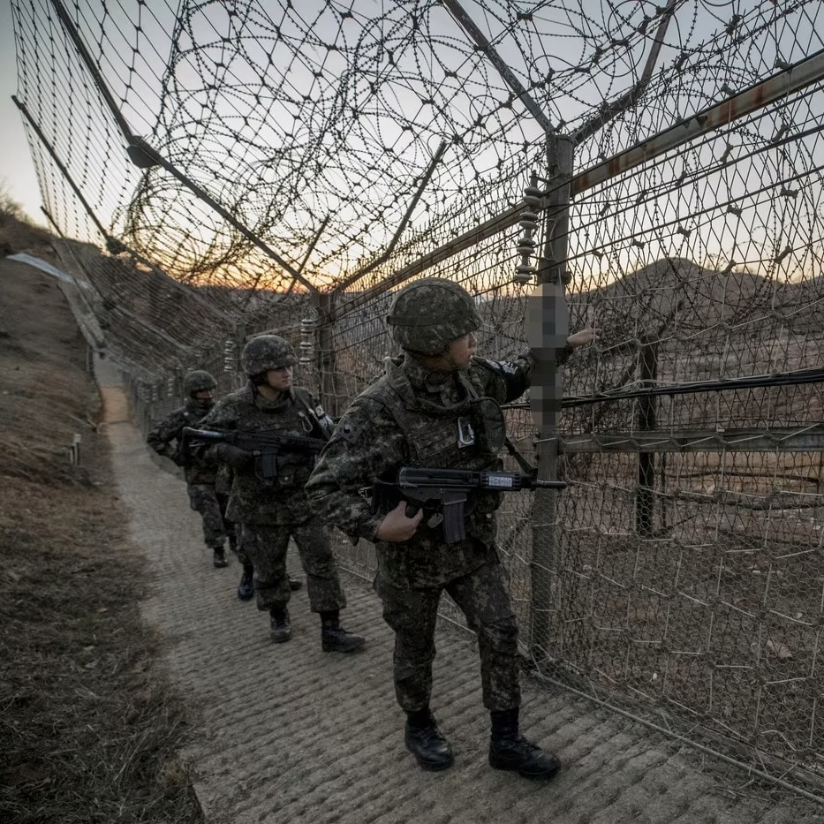
My Works
Military Service
Served for one and a half years at the Demilitarized Zone (DMZ), the military demarcation line between North and South Korea
Operated and maintained communication equipment, ensuring seamless contact between the Guard Post (GP) and higher command in the Demilitarized Zone (DMZ)

Slide 3
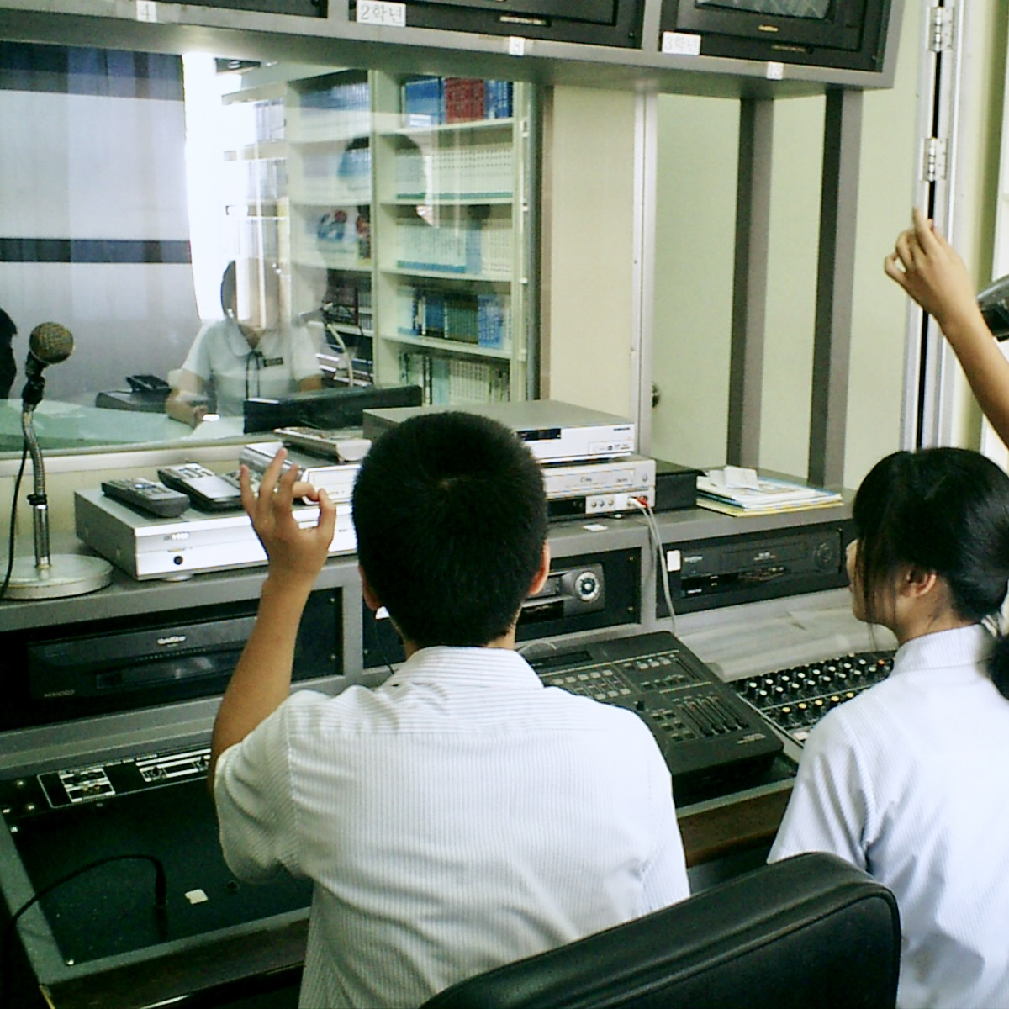
My Works
Broadcasting Club
Assisted with broadcasting and operated cameras for major school events such as festivals, entrance ceremonies, and graduations during high school.
Played student-requested music and delivered news during lunchtime broadcasts to all classrooms, improving communication and organizational skills.

Slide 4

My Works
Music Composer
Composed music across various genres, including R&B and hip-hop, for personal projects.

Slide 5
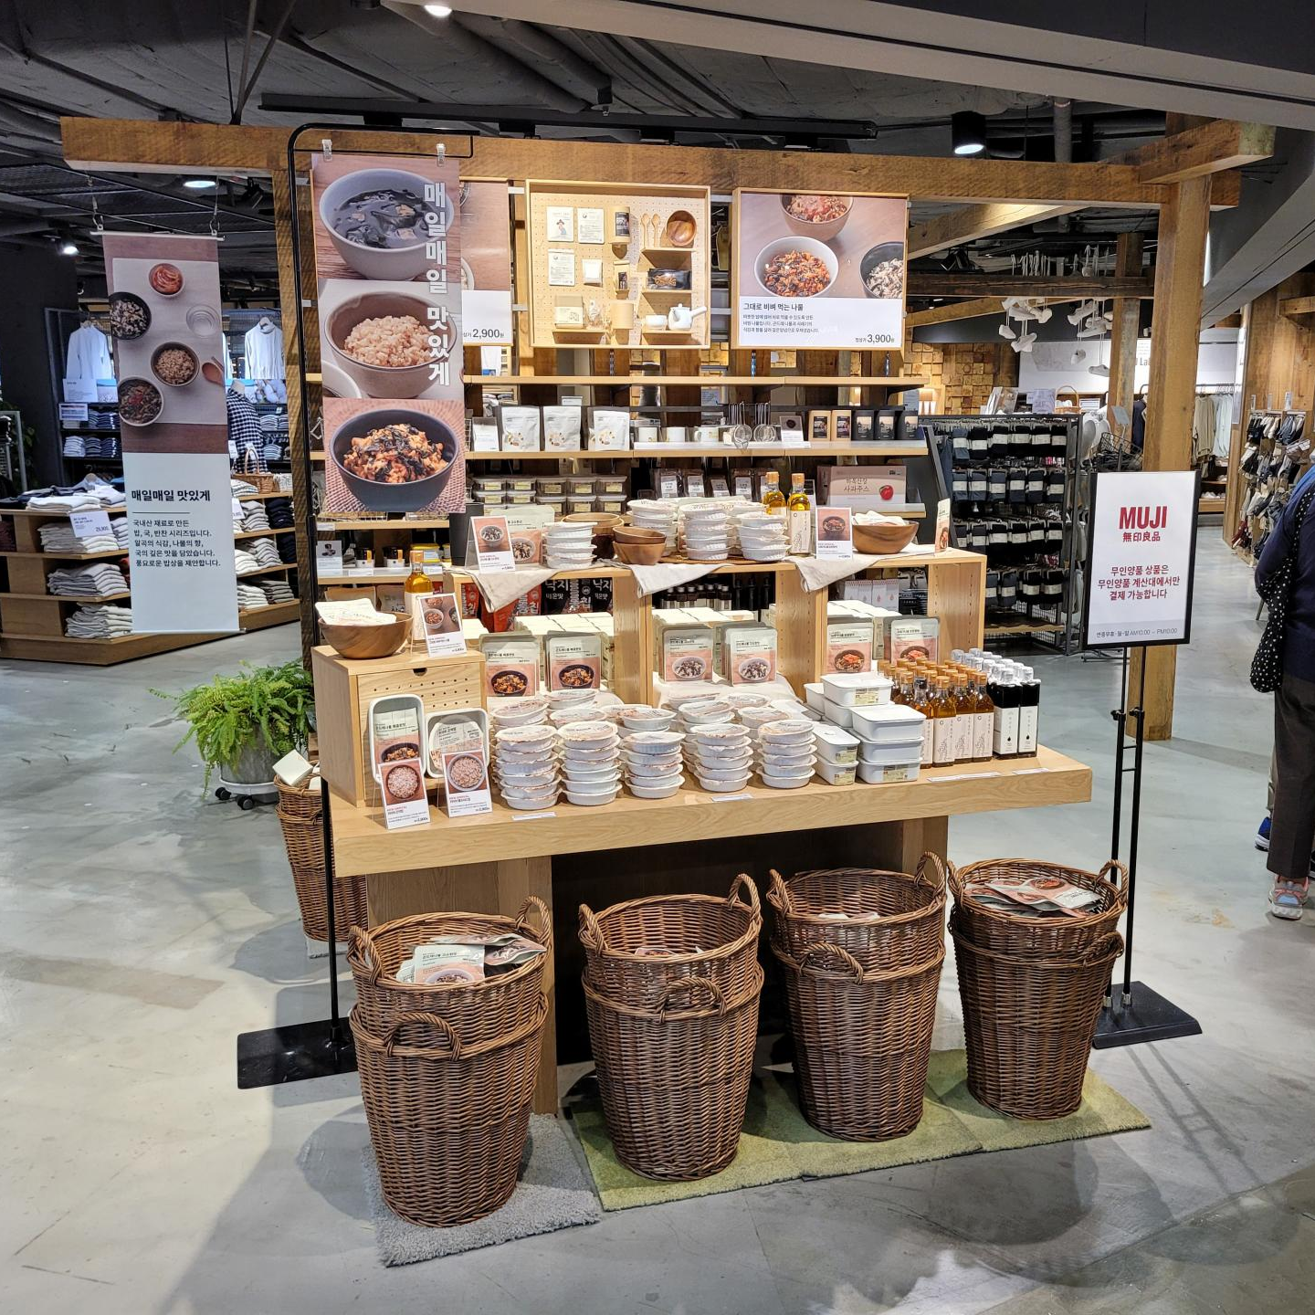
My Works
Retail Associate
Worked as a store associate for six months, ensuring a well-organized and visually appealing store environment.
Improved customer service skills by responding to customer inquiries, solving issues, and providing friendly and attentive support.

