Slide 1


Department of Artificial Intelligence & Data Science
Main Presentation
Under
Industrial Training Presentation(5CAI7-30)
Session: 2024-25(ODD)
Presented by
Student Name: Aayush Pareek
Registration No.: PIET22CA001
Section: F
Presented to
Faculty Name: Mr. Bharat Thathera
Faculty Name: Mr. VAIBHAV SINGH SHEKHAWAT

Slide 2
Project Title :
The project is entitled as :
“ TWEET SENTIMENT ANALYSIS ” which follows under the technology of python, data science and AI/ML

Slide 3
Project Objective :
The main objective of this project is to perform sentiment analysis on tweets. Sentiment analysis involves determining whether a piece of text, in this case, a tweet, is positive, neutral, or negative. This project aims to create a web application where users can input tweets and get sentiment analysis results, providing insights into public opinion and trends.

Slide 4
Project Technology :
Python: The primary programming language used for back-end development and sentiment analysis.
Flask: A lightweight web framework used to create the web application and serve the front-end.
Transformers: Utilized for pre-trained sentiment analysis models from the transformers library by Hugging Face.

Slide 5
Project Technology :
Scipy: Used for softmax function to interpret the model's output.
Jinja2: Templating engine for rendering HTML with dynamic data in Flask.
NLP Models:Specifically, the cardiffnlp/twitter-roberta-base-sentiment model for sentiment analysis.

Slide 6
Project Modules :
Sentiment Analysis:
tw_sentiment.py: Contains the core logic for preprocessing tweets and performing sentiment analysis using a pre-trained RoBERTa model.
analyze_sentiment function: Handles the sentiment analysis logic and returns sentiment scores for positive, neutral, and negative sentiments.

Slide 7
Project Modules :
Twitter API:
twitter_data_search.py, twitter_data_stream.py, twitter_data_users.py:
Scripts for interacting with the Twitter API to search tweets, stream live tweets, and get user data, respectively.

Slide 8
Project Modules :
Web Application:
app.py: Main Flask application file that sets up routes and handles HTTP requests and responses.
templates/index.html: HTML template for the web application interface.
static/styles.css: CSS file for styling the web application.
static/script.js: JavaScript file for client-side interactivity and AJAX requests.

Slide 9
Project Learning Outcome :
Understanding Sentiment Analysis
Utilizing Pre-trained NLP Models
Developing a Flask Web Application
Frontend Development and UI Design
API Integration
Data Handling and Preprocessing
Deployment and Production
Error Handling and Debugging
Collaboration and Version Control
Project Management and Documentation
Future Planning and Scalability

Slide 10
Conclusion & Future Plans :
Conclusion:
This project successfully demonstrates the integration of sentiment analysis into a web application, allowing users to analyze the sentiment of tweets. By leveraging a pre-trained RoBERTa model, the project provides accurate sentiment analysis results, enhancing the understanding of public opinion on various topics.

Slide 11
Conclusion & Future Plans :
Future Plans:
Enhance Sentiment Analysis
User Authentication
Real-time Analysis
Data Visualization
Mobile-Friendly Design
Deploy the Application
Expand Analysis Scope
Web Extension

Slide 12
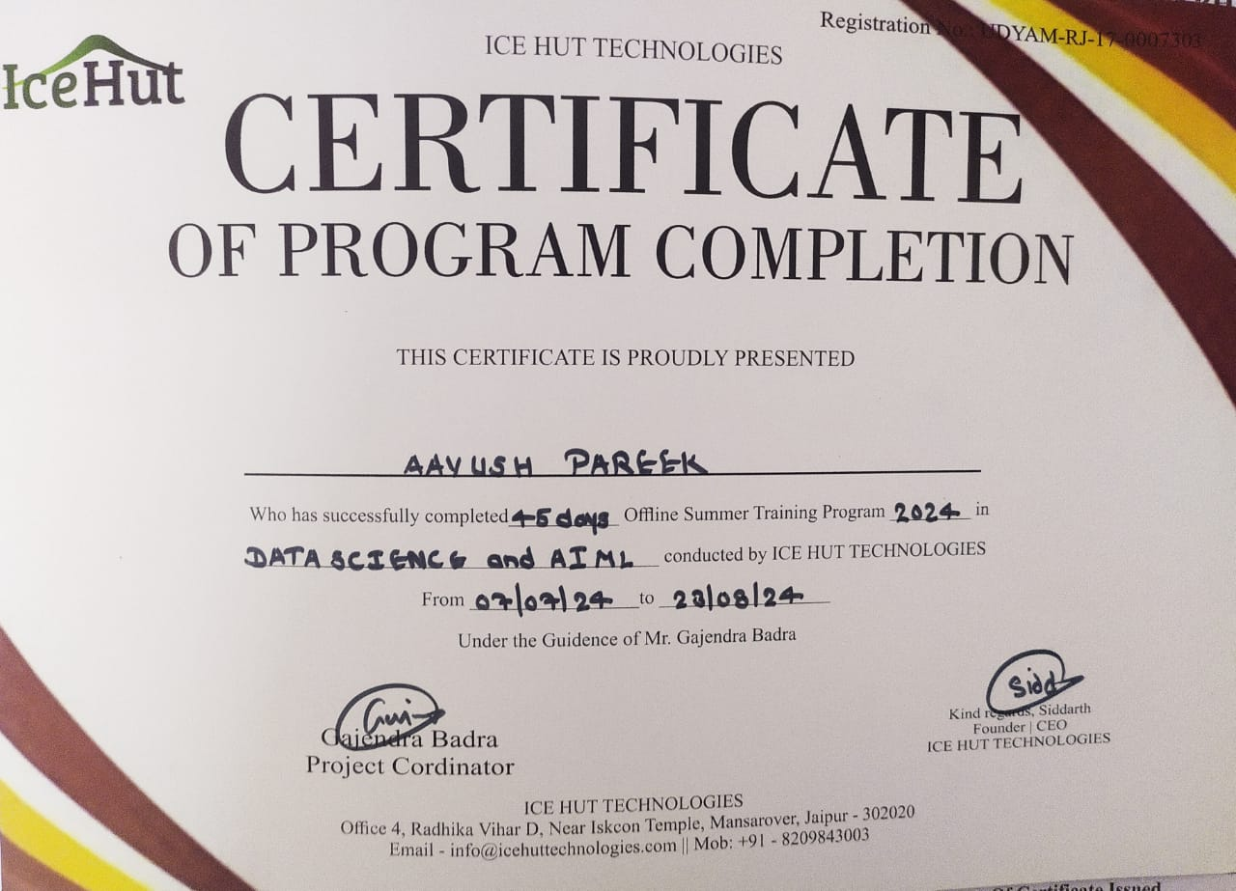
Digital Certificate :

Slide 13
Thanks
&
Query

