Slide 1
Session-Based Cross Domain Recommendation System
Intro to Data Science, CAP5771 - Project
Santhi Daggubati
UFID: 65589133

Slide 2
Milestone 1: Data Collection & Preprocessing
Data Collection:
Three datasets were used of different domains: Movies, Music & Books from Hugging Face Dataset collection.
Movies: IMDb Dataset
Music: Spotify Tracklist Dataset
Books: GoodReads Dataset
Preprocessing:
Unifying Datasets: Assigned unique Item_IDs to each domain (Movies, Music, Books) by prefixing IDs with respective content type (Movie_, Music_, Book_).
Renaming for Consistency: orig_title → Title, genre → Genre
Handled Missing Data(filling and dropping), Standardizing Columns(consistent columns across all datasets), Adding Item_type column(to specify content type: "Movie", "Music", or "Book")

Slide 3
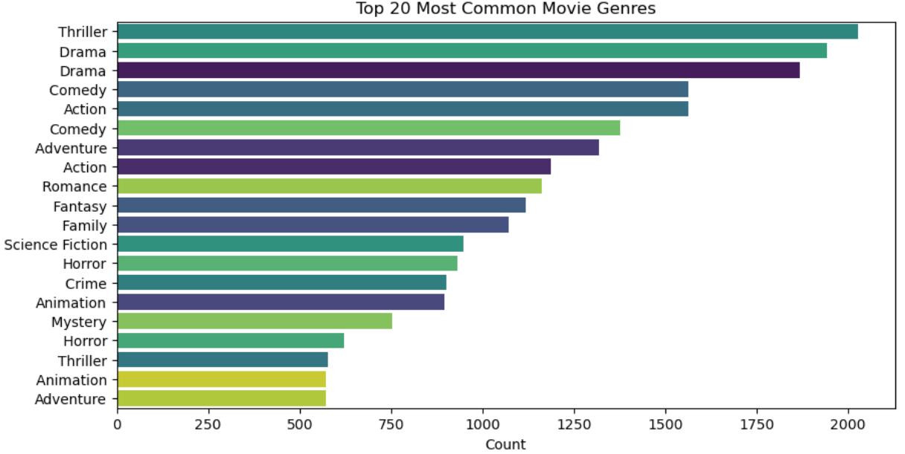
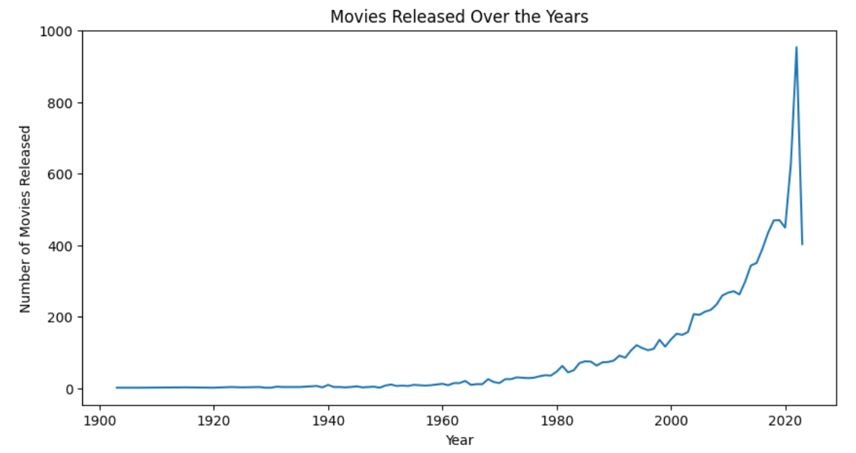
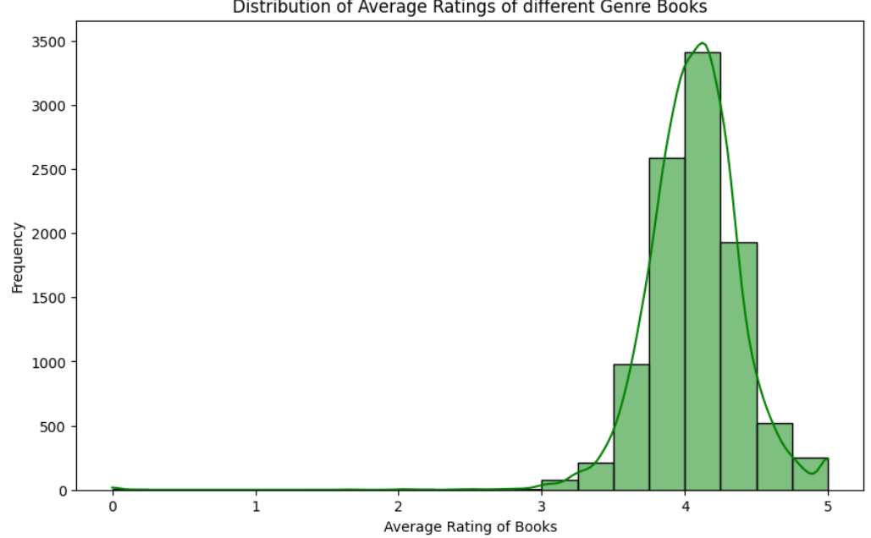
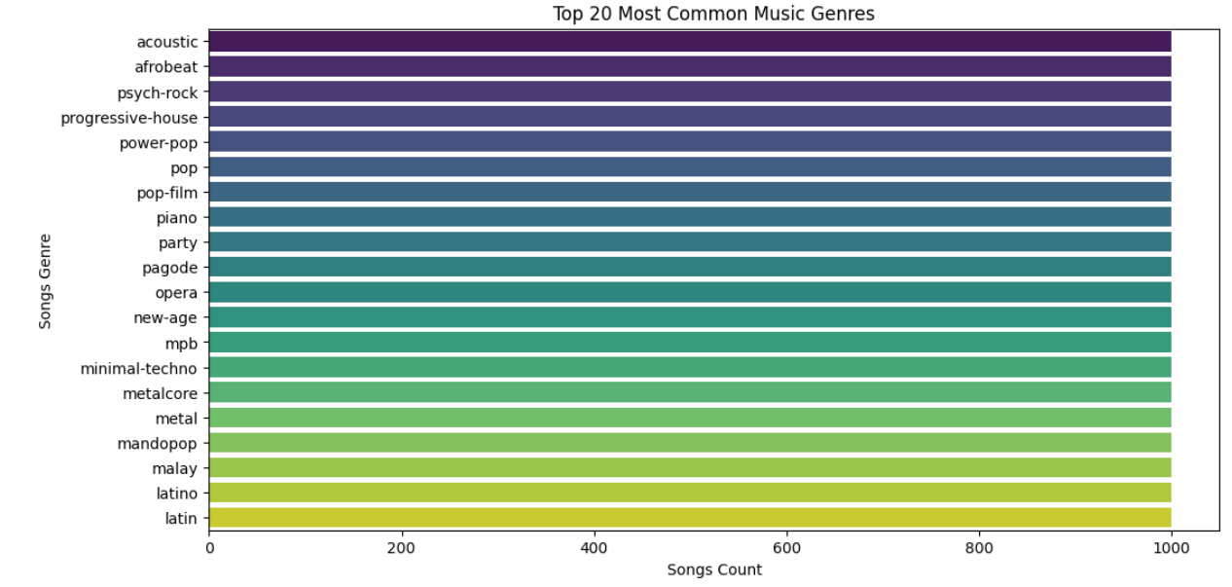
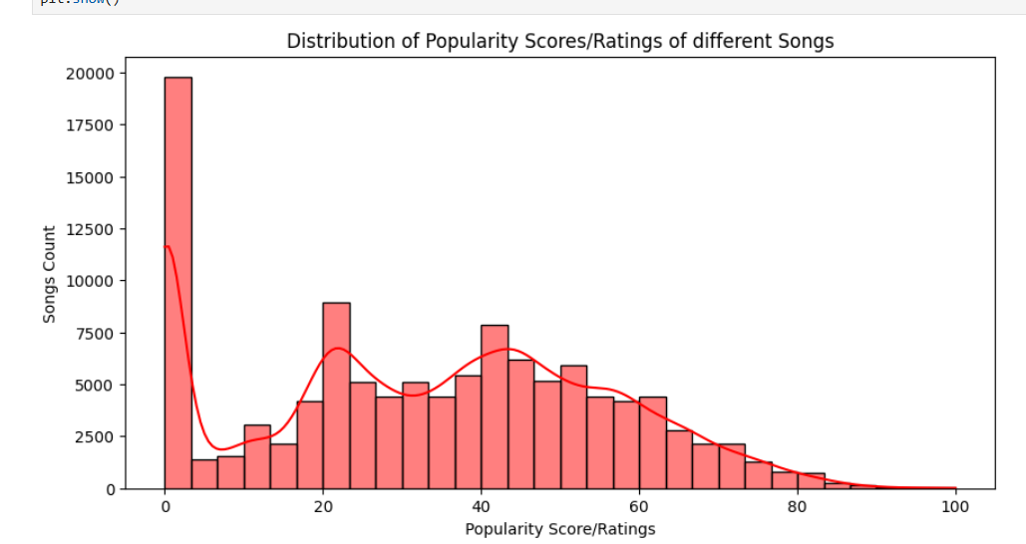
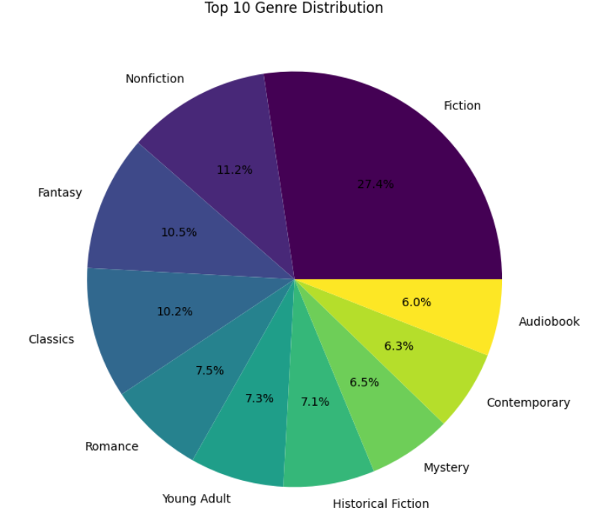
Milestone 1: Visualizations
Movies Dataset Trends: Books Dataset Trends:
Music Dataset Trends:

Slide 4
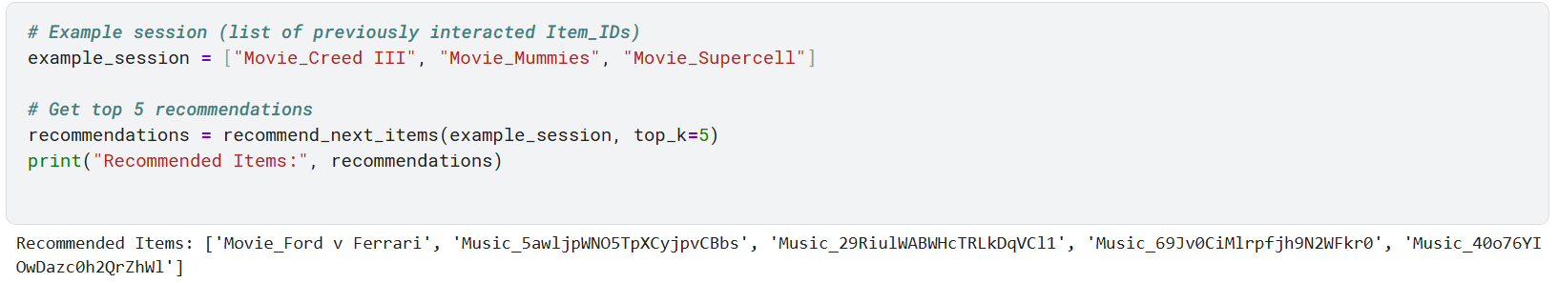
Milestone 2: Model Selection, Training & Evaluation
Model Selection: GRU4Rec
Architecture: GRU4Rec (Gated Recurrent Units)
Embedding Layer: Converts item IDs to dense vectors.
GRU Layer: Captures session-based dependencies.
Fully Connected Layer: Maps GRU output to item probabilities.
Reason: Suitable for sequential recommendations based on past user interactions.
Model Training:
Framework: PyTorch
Training Setup:
Optimizer: Adam (lr = 0.001)
Loss: Cross-Entropy Loss
Epochs: 100 with early stopping
Batch Size: 64
Evaluation: Evaluated using Precision@K, Recall@K, and F1 Score@K (k - top k recommendations)
Evaluation metrics & results:
Precision@10: 0.86
Recall@10: 0.89
F1 Score@10: 0.87

Slide 5
Milestone 3: Model Integration and Deployment
Future Work
Tune hyperparameters of the model for optimal performance(better F1-Score).
Experiment with hybrid models (e.g., combining collaborative filtering.)
Develop an application using React (frontend) and Flask (backend) to deploy the recommendation system and serve real-time recommendations.
Use Large Language Models (LLMs) to create more contextually relevant Item_IDs for better cross-domain integration (e.g., mapping movie, music, and book data to a unified representation).

