Slide 1


Simon Martinelli, 72 Services LLC

Slide 2







About @simas_ch
1972
1995
2000
2007
2009
2011
2012
2013
2021
COBOL
JSR-352
Java Batch
JSR-354
Money/Currency

Slide 3
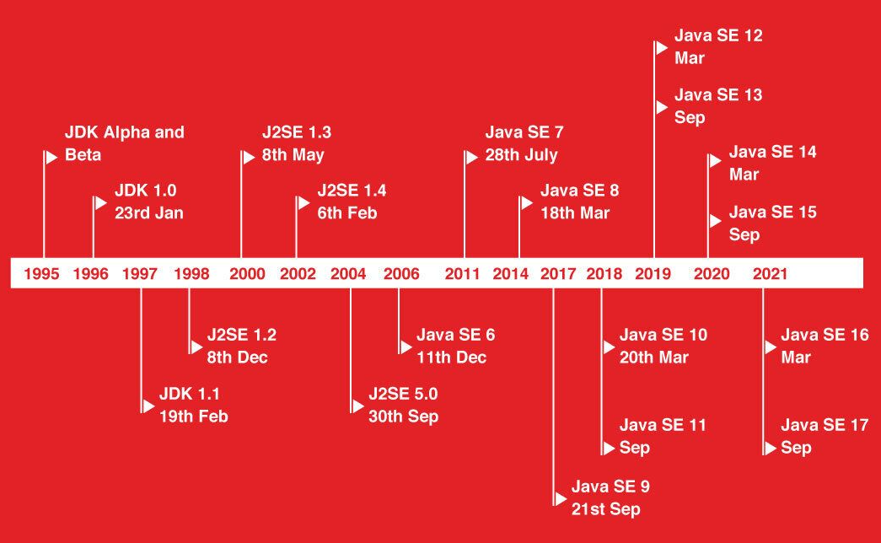
Evolution of Java
LTS
LTS
LTS

Slide 4
API Changes
The Java Version Almanac https://javaalmanac.io/

Slide 5
Maven
<properties> <!-- >= JDK 9 --> <maven.compiler.release>17</maven.compiler.release> <!-- < JDK 9 --> <maven.compiler.source>17</maven.compiler.source> <maven.compiler.target>17</maven.compiler.target> </properties>
<plugin> <groupId>org.apache.maven.plugins</groupId> <artifactId>maven-compiler-plugin</artifactId> <configuration> <!-- overrides properties --> <source>17</source> <target>17</target> <release>17</release> <!-- To test preview features --> <compilerArgs>--enable-preview</compilerArgs> </configuration> </plugin>

Slide 6
Gradle
Gradle >= 7.3 must be used for Java 17
compileJava { options.release = 7 }

Slide 7
Text Blocks (Basics) (Preview 13, Standard 15)
// Text blocks start with a """ followed by optional whitespaces and a newline. // The simplest example looks like this:
String sql1 = """ select * from employee""";
// Trailing whitespaces are removed
String sql2 = """ select *
from employee""";
// \s (escape sequence) can be used to keep the blank after *
String sql3 = """ select * \s
from employee""";

Slide 8
Text Block (Indention)
// A text block differentiates incidental white space from essential white space
String html1 = """ <html> <body> <p>Hello World.</p> </body> </html> """;
String html2 = """ <html> <body> <p>Hello World.</p> </body> </html> """;

Slide 9
Text Blocks (Methods)
// This method is equivalent to String.format(this, args). The advantage is that, as an instance method, // it can be chained off the end of a text block:
String formatted(Object... args)
String output = """
Name: %s
Phone: %s
Address: %s
Salary: $%.2f
""".formatted(name, phone, address, salary);
// The stripIndent method removes incidental white space from a multi-line string, using the same algorithm used by the // Java compiler. This is useful if you have a program that reads text as input data and you want to strip indentation in // the same manner as is done for text blocks.
String stripIndent()
// The translateEscapes method performs the translation of escape sequences (\b, \f, \n, \t, \r, \", \’, \\ and octal // escapes) and is used by the Java compiler to process text blocks and string literals. // This is useful if you have a program that reads text as input data and you want to perform escape sequence processing. // Note that Unicode escapes (\uNNNN) are not processed.
String translateEscapes()

Slide 10
Switch Expression (Preview 13, Standard 14)
// Switch Statement
int numLetters;
switch (day) { case MONDAY: case FRIDAY: case SUNDAY: numLetters = 6; break; case TUESDAY: numLetters = 7; break; case THURSDAY: case SATURDAY: numLetters = 8; break; case WEDNESDAY: numLetters = 9; break; default: throw new IllegalStateException( "Invalid day: " + day); }
// Switch Expression
int numLetters = switch (day) { case MONDAY, FRIDAY, SUNDAY -> 6; case TUESDAY -> 7; case THURSDAY, SATURDAY -> 8; case WEDNESDAY -> 9; default -> throw new IllegalStateException( "Invalid day: " + day); };

Slide 11
Switch Statement yield
Day day = Day.WEDNESDAY; int numLetters = switch (day) { case MONDAY: case FRIDAY: case SUNDAY: System.out.println(6); yield 6; case TUESDAY: System.out.println(7); yield 7; case THURSDAY: case SATURDAY: System.out.println(8); yield 8; case WEDNESDAY: System.out.println(9); yield 9; default: throw new IllegalStateException("Invalid day: " + day); };

Slide 12
Switch Expression yield
Day day = Day.WEDNESDAY; int numLetters = switch (day) { case MONDAY, FRIDAY, SUNDAY -> { System.out.println(6); yield 6; } case TUESDAY -> { System.out.println(7); yield 7; } case THURSDAY, SATURDAY -> { System.out.println(8); yield 8; } case WEDNESDAY -> { System.out.println(9); yield 9; } default -> throw new IllegalStateException("Invalid day: " + day); };

Slide 13
Records (Preview 14)
record Rectangle(double length, double width) { }
public final class Rectangle { private final double length; private final double width; public Rectangle(double length, double width) { this.length = length; this.width = width; } double length() { return this.length; } double width() { return this.width; } public boolean equals... public int hashCode... public String toString() {...} }

Slide 14
Records with Constructor
record Rectangle(double length, double width) { public Rectangle { if (length <= 0 || width <= 0) { throw new java.lang.IllegalArgumentException( String.format("Invalid dimensions: %f, %f", length, width)); } } }

Slide 15
Sealed Classes (Preview 15, Standard 17)
public abstract sealed class Shape permits Circle, Rectangle, Square, WeirdShape { ... } public final class Circle extends Shape { ... } public sealed class Rectangle extends Shape permits TransparentRectangle, FilledRectangle { ... } public final class TransparentRectangle extends Rectangle { ... } public final class FilledRectangle extends Rectangle { ... } public final class Square extends Shape { ... } public non-sealed class WeirdShape extends Shape { ... }

Slide 16
Pattern Matching for instanceof (Preview 14, Standard 16)
// Without Pattern Matching
if (shape instanceof Rectangle) { Rectangle r = (Rectangle) shape; return 2 * r.length() + 2 * r.width(); } else if (shape instanceof Circle) { Circle c = (Circle) shape; return 2 * c.radius() * Math.PI; }
// With Pattern Matching
if (shape instanceof Rectangle r) { return 2 * r.length() + 2 * r.width(); } else if (shape instanceof Circle c) { return 2 * c.radius() * Math.PI; }

Slide 17
Pattern Matching for switch (Preview 17)
static double getPerimeter(Shape shape) throws IllegalArgumentException { return switch (shape) { case Rectangle r -> 2 * r.length() + 2 * r.width(); case Circle c -> 2 * c.radius() * Math.PI; default -> throw new IllegalArgumentException("Unrecognized shape"); }; }
// Selector Expresssion Type
static void typeTester(Object obj) { switch (obj) { case null -> System.out.println("null"); case String s -> System.out.println("String"); case Color c -> System.out.println("Color with " + c.values().length + " values"); case Point p -> System.out.println("Record class: " + p.toString()); case int[] ia -> System.out.println("Array of int values of length" + ia.length); default -> System.out.println("Something else"); } }

Slide 18
Helpful NullPointerExceptions (14)
static void foo(String name) { if (name.equals("Simon")) { // Line 52 // ...
} }
Exception in thread "main" java.lang.NullPointerException: Cannot invoke "String.equals(Object)" because "name" is null
at io.seventytwo.edu.Examples.foo(Examples.java:52)
at io.seventytwo.edu.Examples.main(Examples.java:16)

Slide 19
Compact Number Formatting Support
NumberFormat fmt = NumberFormat.getCompactNumberInstance(Locale.ENGLISH, NumberFormat.Style.SHORT);
System.out.println(fmt.format(1000)); System.out.println(fmt.format(100000)); System.out.println(fmt.format(1000000));
// Output
1K
100K
1M

Slide 20
Day Period Support Added
DateTimeFormatter dtf = DateTimeFormatter.ofPattern("B"); System.out.println(dtf.format(LocalTime.of(8, 0))); System.out.println(dtf.format(LocalTime.of(13, 0))); System.out.println(dtf.format(LocalTime.of(20, 0))); System.out.println(dtf.format(LocalTime.of(23, 0))); System.out.println(dtf.format(LocalTime.of(0, 0)));
// Output
in the morning
in the afternoon
in the evening
at night
midnight

Slide 21
Stream.toList()
// Old List<String> stringList = Stream.of("a", "b", "c").collect(Collectors.toList()); // New List<String> stringList = Stream.of("a", "b", "c").toList();

Slide 22
Local Records, Enums, Interfaces
List<Merchant> findTopMerchants(List<Merchant> merchants, int month) {
// Local record record MerchantSales(Merchant merchant, double sales) {} return merchants.stream() .map(merchant -> new MerchantSales(merchant, computeSales(merchant, month))) .sorted((m1, m2) -> Double.compare(m2.sales(), m1.sales())) .map(MerchantSales::merchant) .collect(toList()); }

Slide 23

72 Services GmbH
Tulpenweg 1 2575 Täuffelen, Switzerland +41 32 544 88 88 info@72.services https://72.services

