Slide 1
Sand Grains Tracking
E3 Project

Slide 2
Introduction
The project consists in analysing the trajectory of grains of sand
.A 4D image
.2 teachers
.Meetings with the teachers
.Pink

Slide 3


2D images processing

Slide 4
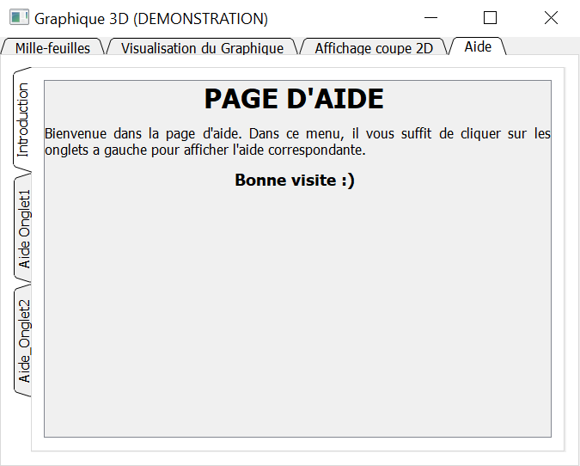
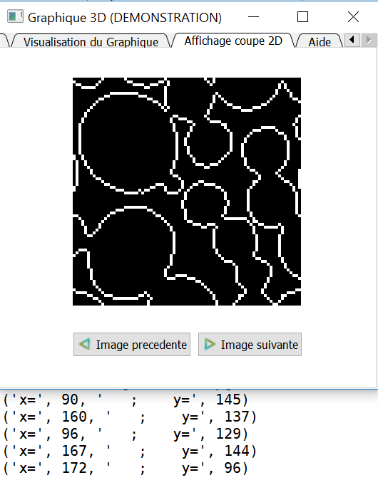
Tabs

Slide 5
Graphical Environnement

Slide 6


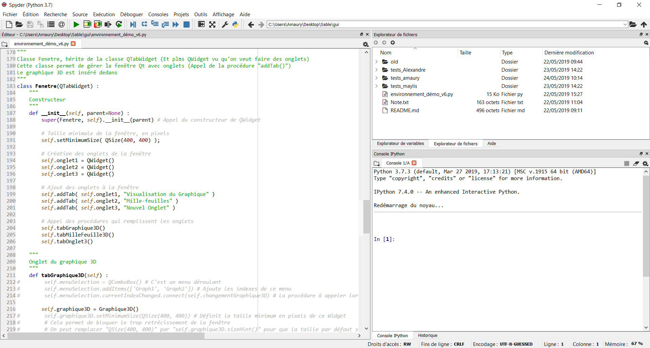
Python, PyQt and Main Window

Slide 7
Python, PyQt, MatPlotLib ?
Python : Programming language
Qt : Widget toolking for creating graphic user interfaces
It is cross-platform (Works on Linux, Windows and any UNIX OS)
Widgets are boxes which can be placed to make an UI.
PyQt : Python library to use Qt with Python
MatPlotLib : Python library to create graphs

Slide 8
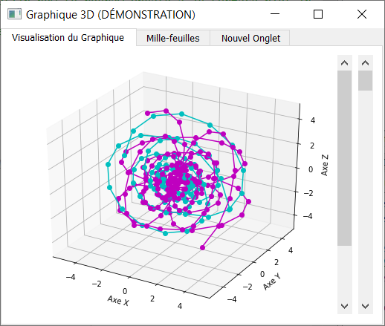
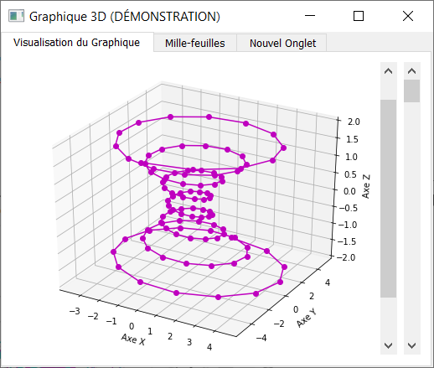
MatPlotLib 3D Graph Display the path took by the grains

Slide 9
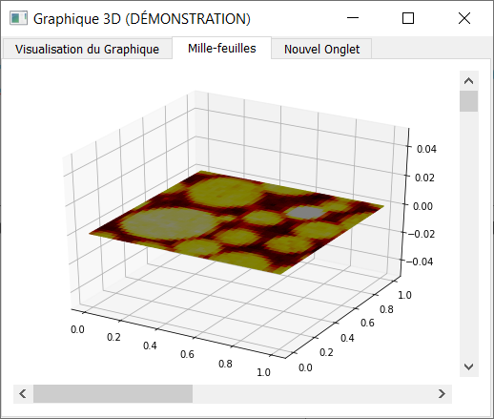
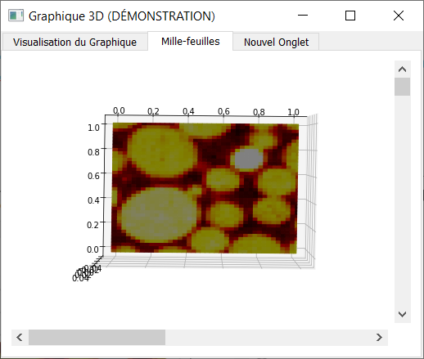
MatPlotLib 3D « Mille-Feuille » Display the original images (4D images)

Slide 10
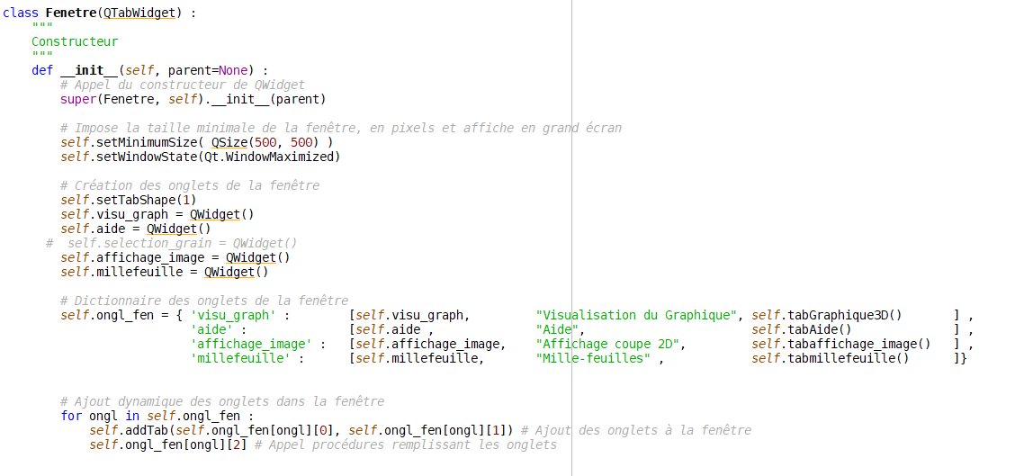
Creation of the Interface with tabs

Slide 11
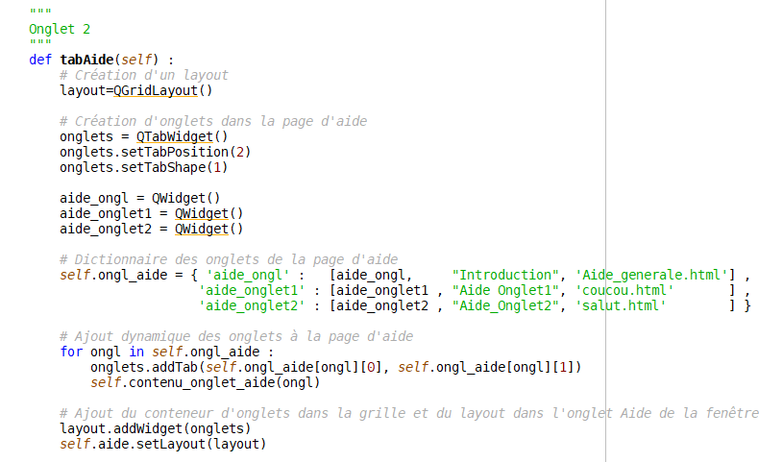
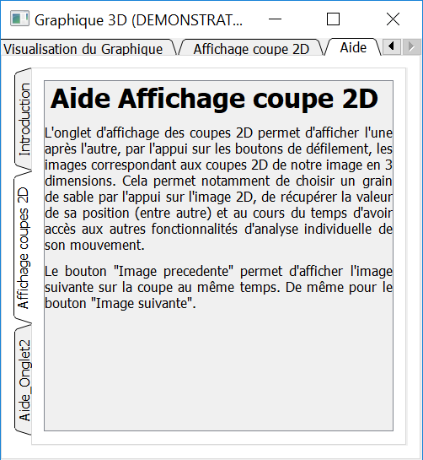
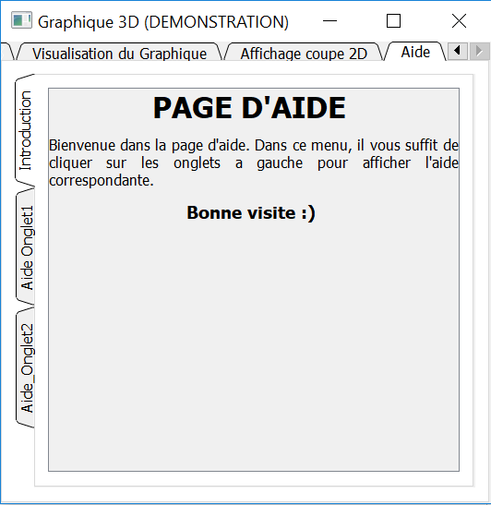
Creation the « help » tab

Slide 12
Selection of a grain of sand

Slide 13
Grains Tracking

Slide 14
Images processing
4D Image preprocessing into 2D layers
Distance map & minimas
Watershed
Artifacts removings
Applying directly to 3D images

Slide 15



2D images processing

Slide 16

Issue encountered with the watershed

Slide 17

3D images
Processing

