Slide 1
Sand Grains Tracking
E3 Project

Slide 2
Introduction

Slide 3
Grains Tracking

Slide 4
Images processing
4D Image preprocessing into 2D layers
Distance map & minimas
Watershed
Artifacts removings
Applying directly to 3D images

Slide 5





2D images processing

Slide 6

Issue encountered with the watershed

Slide 7

3D images
Processing

Slide 8
Graphical Environnement

Slide 9


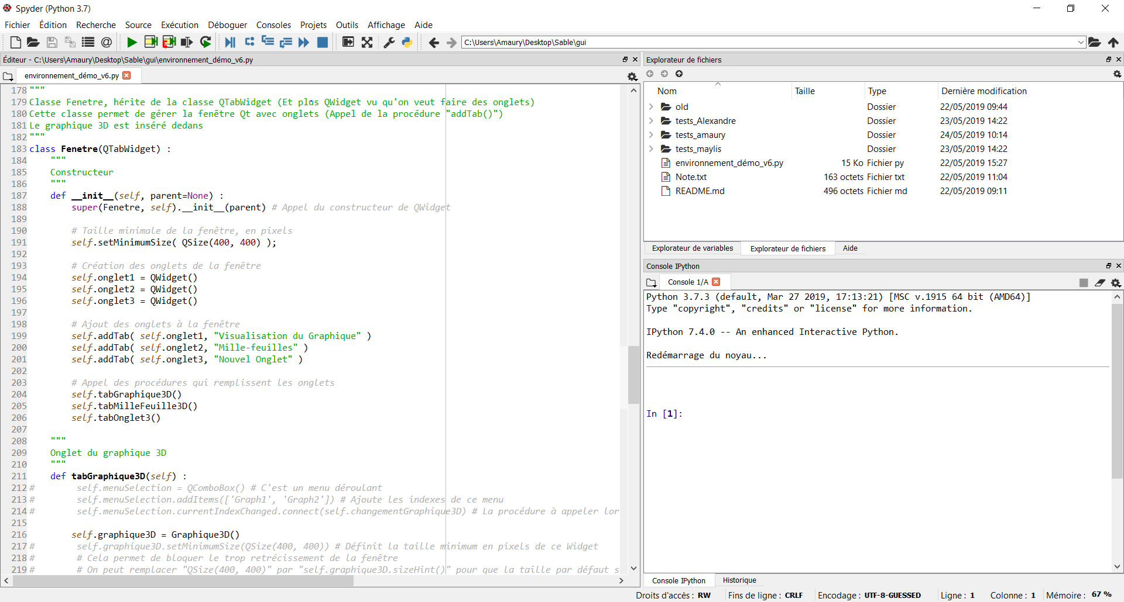
Python, PyQt and Main Window

Slide 10
Python, PyQt, MatPlotLib ?
Python : Programming language
Qt : Widget toolking for creating graphic user interfaces
It is cross-platform (Works on Linux, Windows and any UNIX OS)
Widgets are boxes which can be placed to make an UI.
PyQt : Python library to use Qt with Python
MatPlotLib : Python library to create graphs

Slide 11
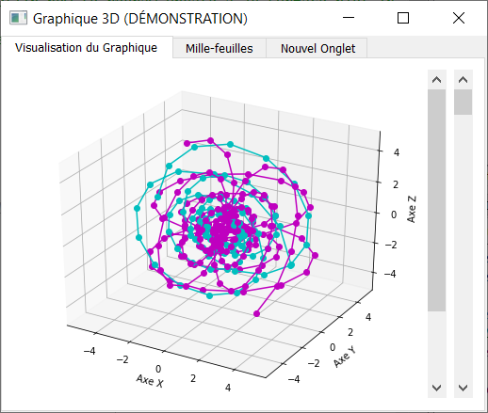
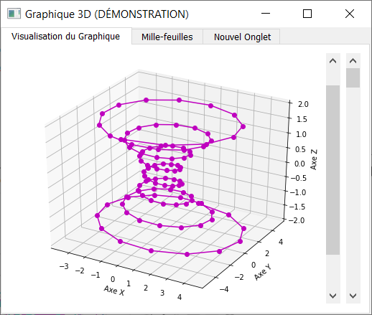
MatPlotLib 3D Graph Display the path took by the grains

Slide 12
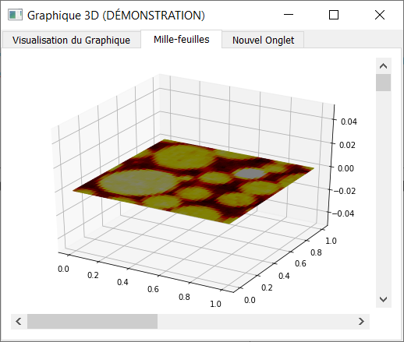
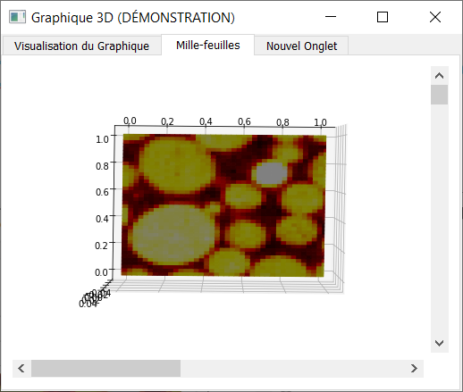
MatPlotLib 3D « Mille-Feuille » Display the original images (4D images)

Slide 13
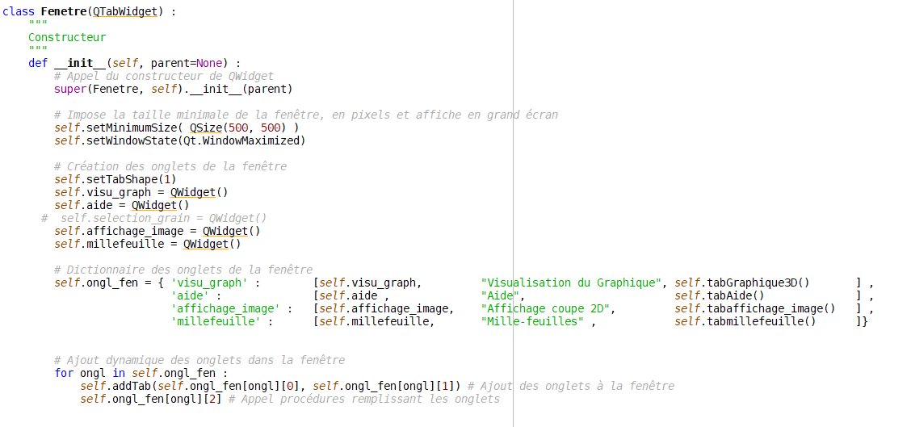
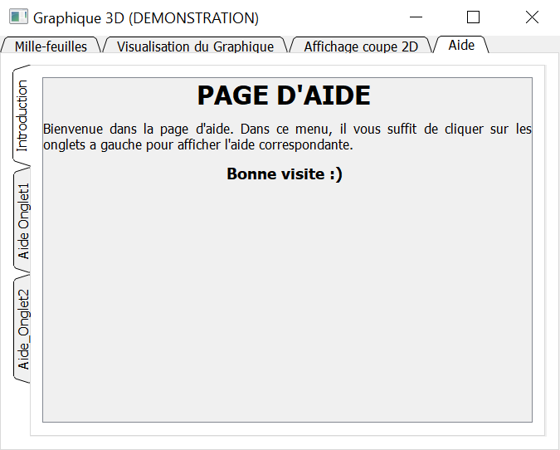
Creation of the Interface with tabs

Slide 14
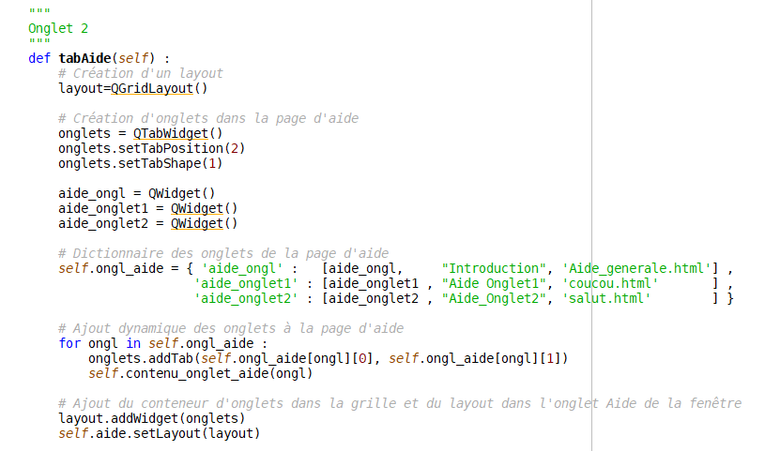
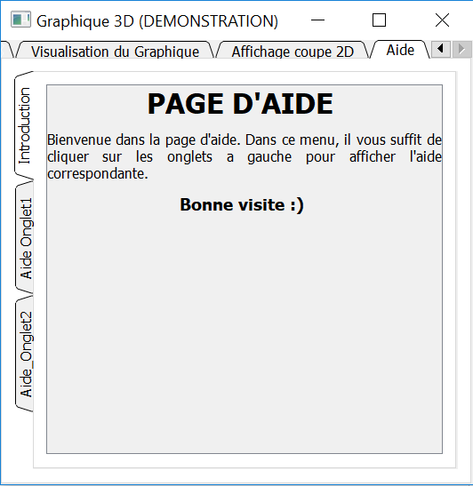
Creation the « help » tab

