Slide 1
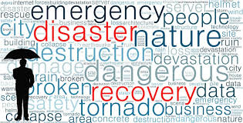
WHAT IS A DISASTER?
The practice of DR revolves around events that are serious in nature. These events are often thought of in terms of natural disasters, but they can also be caused by systems or technical failure or by humans carrying out an intentional attack.
They are significant enough to disrupt or completely stop critical business operations for a period of time. Types of disaster include:
Cyber attacks such as malware, DDoS and ransomware attacks
Sabotage
Power outages
Equipment failure
Epidemics or pandemics, such as COVID-19
Terrorist attacks or threats
Industrial accidents
Hurricanes
Tornadoes
Earthquakes
Floods
Fires

Slide 2
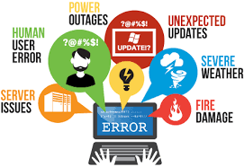
CLOUD DISASTER MANAGEMENT
Cloud disaster recovery (cloud DR) is a combination of strategies and services intended to back up data, applications and other resources to public cloud or dedicated service providers.
When a disaster occurs, the affected data, applications and other resources can be restored to the local data center a cloud provider -- to resume normal operation for the enterprise.
Before the advent of cloud connectivity and self-service technologies, traditional DR options were limited to local DR and second-site implementations.
Local DR didn't always protect against disasters such as fires, floods and earthquakes. A second site -- off-site DR -- provided far better protection against physical disasters, but implementing and maintaining a second data center imposed significant business costs.

Slide 3
WHY IS CLOUD DISASTER RECOVERY IMPORTANT?
According to a research conducted by Uptime Institute, 44% of surveyed organizations experienced a major outage that impacted their business. Most of these outages were a result of power failures.
In such cases, it is critical to have a solid DR strategy in place. When power fails, enterprises can quickly recover their data and resume normal operations.
In addition to providing availability during power failures, disaster recovery strategies can help ensure business continuity during network or power outages, system failures, natural disasters, accidents, cyber attacks, and during software updates.
However, traditional DR, which leans heavily on on premise resources, is often complex and expensive.
Cloud DR offers a more affordable and simpler solution. Often, cloud DR is offered as a software as a service (SaaS) solution, which can be scaled according to the unique needs of the business.
In most cases, the interfaces are simple and user-friendly and the solution can be quickly deployed. In short, Cloud DR offers affordability, flexibility, and scalability.

Slide 4
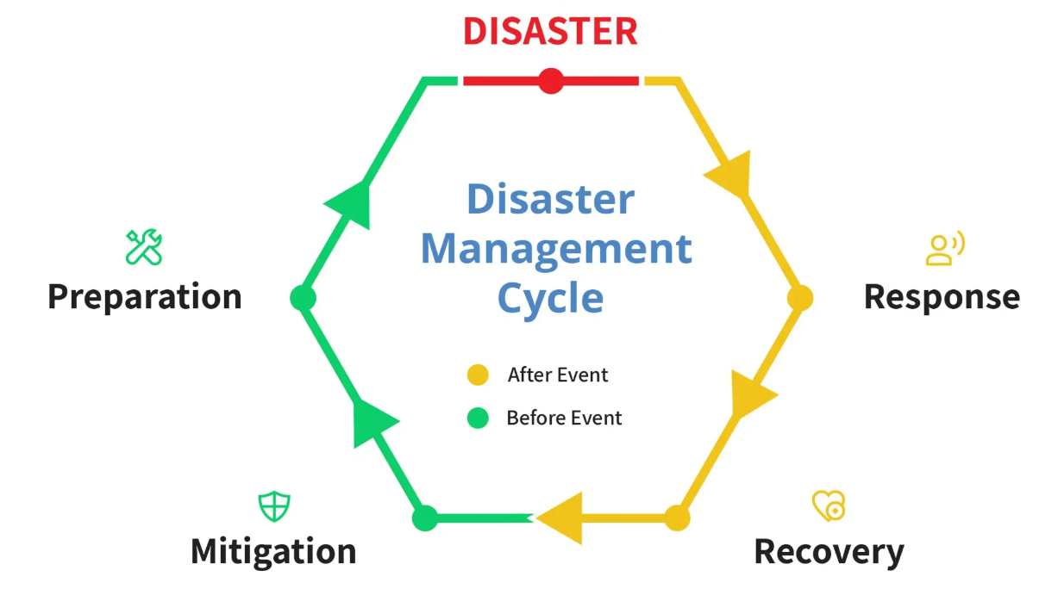

Slide 5
Phase 1: Mitigation
Meaning: To prevent future emergencies and take steps to minimize their effects
The mitigation phase occurs before a disaster takes place. Here, an organization will take steps to protect people and property, while also decreasing risks and consequences from a given disaster situation. The organization’s main goal is to reduce vulnerability to disaster impacts (such as property damage, injuries, and loss of life).
Examples of mitigation may can include measures such as:
Clearing space around buildings to create a defensible space against fires
Adding levees or improving property drainage to protect from flooding Securing furniture to floors and walls to help prevent damage/injuries during earthquakes.
Re-locating structures to less disaster-prone areas.
Phase 2 : Preparedness
Meaning: To take actions ahead of time to be ready for an emergency
The preparedness phase also occurs before a disaster takes place. Here, an organization attempts to understand how a disaster might affect overall productivity and the bottom line.
The organization will also provide appropriate education while putting preparedness measures into place.

Slide 6
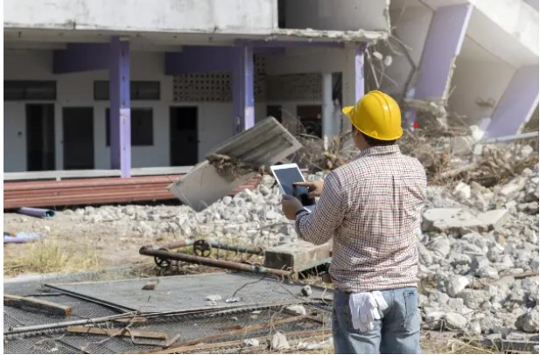
Examples of preparedness include hosting training, education, drills, tabletop exercises, and full-scale exercises on disaster preparedness. This ensures that stakeholders know what to do in the event of an emergency. Updating egress plans also falls under preparedness.
Organizations may also assemble a team to create a business continuity plan and list of resources needed to recover from a disaster.
Phase 3 : Response
Meaning: To protect people and property in the wake of an emergency, disaster, or crisis
The response phase occurs in the immediate aftermath of a disaster. Organizations must focus their attention on addressing immediate threats to people, property, and business. Occupant safety and wellbeing largely depends on your preparedness levels before disaster strikes.
The most notable example of the response phase is ensuring that people are out of harm’s way. The organization can then move on to assess damage, implement disaster response plans, triage cleanup efforts, and start resource distribution as necessary.
Businesses will also need to navigate building closures, preliminary damage assessments, and hampered communication with stakeholders (like staff, vendors, and suppliers) due to shutdowns.

Slide 7
As the response period progresses, focus will typically shift from immediate emergency issues to conducting repairs, restoring utilities, re-establishing operations, and cleaning up.
The organization will also need to begin planning the reconstruction of damaged infrastructure.
Phase 4: Recovery
Meaning: To rebuild after a disaster in an effort to return operations back to normal
The recovery phase takes place after a disaster. This phase is the restoration of an organization following any impacts from a disaster. By this time, the organization has achieved at least some degree of physical, environmental, economic and social stability.
The recovery phase of a disaster can last anywhere from six months to a year (or even longer depending on the severity of the incident).
An example of recovery is creating strategic protocols and action plans to address the most serious impacts of a disaster. The protocols should give clear steps to follow for various disaster events and cover multiple scenarios.

Slide 8

For example, a flood protocol could include:
The organization’s internal plan to mitigate the effects of water (fan deployment, etc.)
The preferred water remediation service and their contact information
If that vendor is unavailable, secondary and tertiary services to contact
In this phase, the organization works to obtain new resources, rebuild or create partnerships, and implement effective recovery strategies. The organization also takes steps to reduce financial burdens, rebuild damaged structures, and reduce vulnerability to future disasters.

Slide 9
Once an organization has thoroughly reviewed its risk factors, recovery goals and technology environment, it can write a DR plan.
The DR plan is the formal document that specifies these elements and outlines how the organization will respond when disruption or disaster occurs. The plan details recovery goals including RTO and RPO as well as the steps the organization will take to minimize the effects of the disaster.
The components of a DR plan should include:
A DR policy statement, plan overview and main goals of the plan.
Key personnel and DR team contact information.
A step-by-step description of disaster response actions immediately following an incident.
A diagram of the entire network and recovery site.
Directions for how to reach the recovery site.
A list of software and systems that staff will use in the recovery.
Sample templates for a variety of technology recoveries, including technical documentation from vendors.
A communication that includes internal and external contacts, as well as boilerplate for dealing with the media.
Summary of insurance coverage.
Proposed actions for dealing with financial and legal issues.

Slide 10
Types of disaster recovery
In addition to choosing a DR site and considering DR tiers, IT and business leaders must evaluate the best way to put their DR plan into action. This will depend on the IT environment and the technology the business chooses to support its DR strategy.
Types of DR can vary, based on the IT infrastructure and assets that need protection as well as the method of backup and recovery the organization decides to use. Depending on the size and scope of the organization, it may have separate DR plans and implementation teams specific to departments such as data centers or networking. Major types of DR include:
Data center disaster recovery
Organizations that house their own data centers must have a DR strategy that considers all the IT infrastructure within the data center as well as the physical facility.
Backup to a failover site at a secondary data center or a colocation facility is often a large part of the plan .
IT and business leaders should also document and make alternative arrangements for a wide range of facilities-related components including power systems, heating and cooling, fire safety and physical security.
Network disaster recovery
Network connectivity is essential for internal and external communication, data sharing and application access during a disaster.
A network DR strategy must provide a plan for restoring network services, especially in terms of access to backup sites and data.

Slide 11
Virtualized disaster recovery
Virtualization enables DR by allowing organizations to replicate workloads in an alternate location or the cloud. The benefits of virtual DR include flexibility, ease of implementation, efficiency and speed. Virtualized workloads have a small IT footprint, replication can be done frequently, and failover can be initiated quickly. Several data protection vendors offer virtual backup and DR as a product.
Cloud disaster recovery
The widespread acceptance of cloud services allows organizations that traditionally used an alternate location for DR to be hosted in the cloud. Cloud DR goes beyond simple backup to the cloud. It requires an IT team to set up automatic failover of workloads to a public cloud platform in the event of a disruption.
DISASTER RECOVERY AS A SERVICE (DRAAS)
DRaaS is the commercially available version of cloud DR. In DRaaS, a third party provides replication and hosting of an organization's physical and virtual servers. The provider assumes responsibility for implementing the DR plan when a crisis arises, based on a service-level agreement.

