Slide 1


Slide 2
What we made
Our goal was to make a fun game with educational content.
As a team, we developed an educational game using geospatial data, weather data, the Dunedin bus timetable and food nutrition data.
We wanted to create a fun experience for the user. To enable this, we added game mechanics such as combat, quizzes and puzzles.

Slide 3
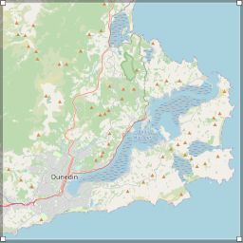
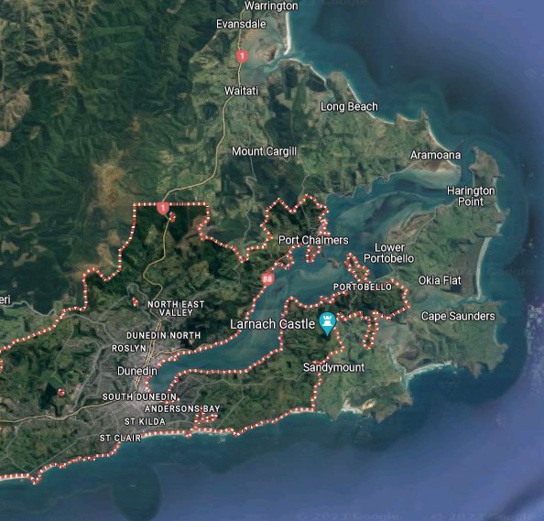
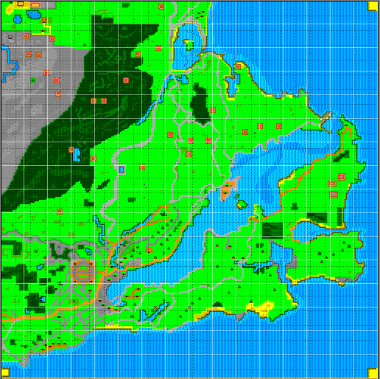
Map Development

Slide 4




Enemy sprites

Slide 5
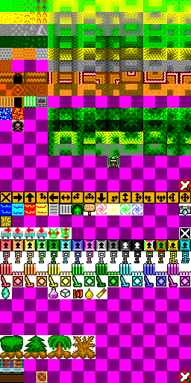




Game art

Slide 6

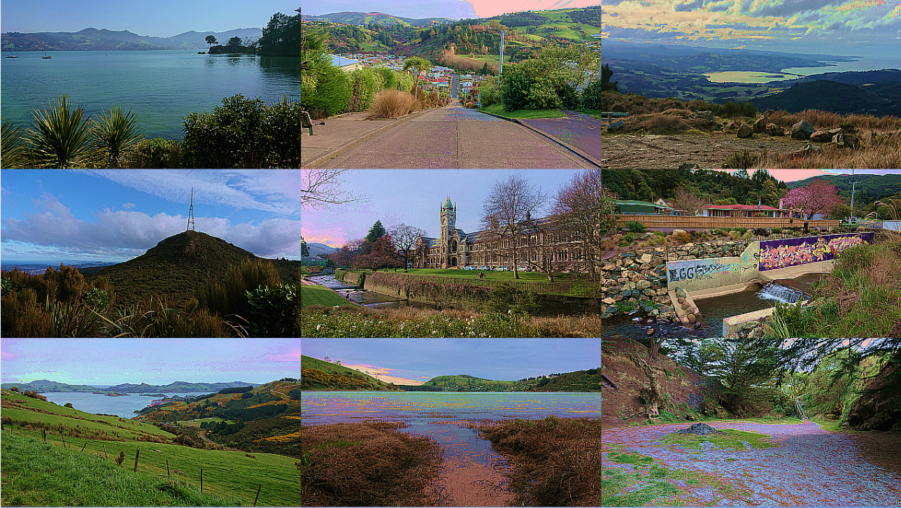
Photographies

Slide 7
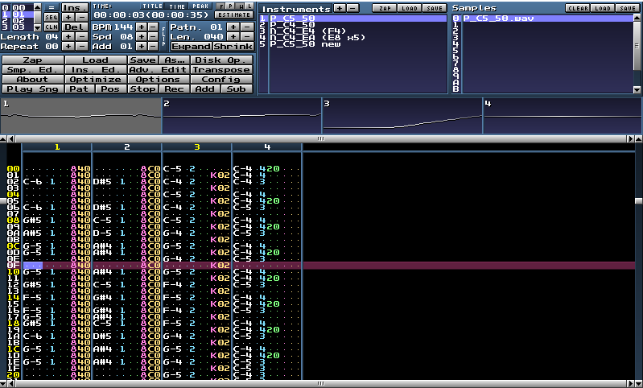
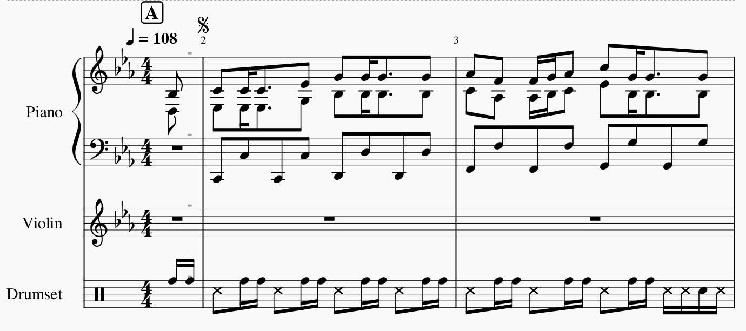
Music
MilkyTracker
MuseScore

