Slide 1
Compressive Strength of RCA Prediction
Leveraging AI for Sustainable Construction
Team Memeber: Shashi Ranjan
TeamId : 635011-U2PD388A

Slide 2

Machine learning is a subset of artificial intelligence that allows computers to learn from data without being explicitly programmed.
It has applications in various fields, including computer vision, natural language processing, and predictive analytics.
In this presentation, we will explore the applications of machine learning in ‘Predicting Compressive Strength of RCA’ .
ALL
ABOUT
MACHINE
LEARNING

Slide 3

Problem Statement
With increasing amount of Construction waste it’s high time to adopt the sustainable development goals in construction also.
It has been seen that lots of construction waste can be reused in new construction work.
Although it is very difficult for normal people to know what amount of construction aggregate to use in fresh construction.
Hence, to make this work easier we need to adopt the emerging technology ‘Machine Learning’.

Slide 4
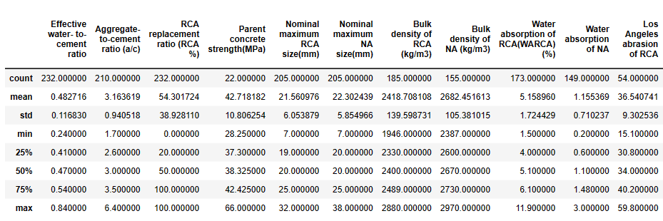
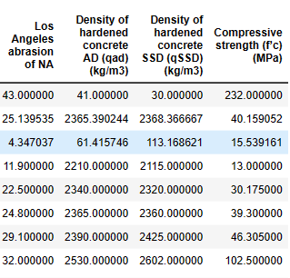
Data Description
Description of the dataset is provided below :
+ 236 rows and 19 colunms
data_copy.describe()

Slide 5
Data Cleaning
The dataset that were provided was not cleaned data, so were expected to clean it then use in our model to predict the output.
Data Cleaning steps that were used :
Removing columns in which target variabled were missing.
I deleted that columns from dataset because if imputaions would have been done withot removing those columns it would have affected the accuracy of the result.
Removing outlieres from the data by imputing with lower_limit and upper_limit values.
Where, lower_limit=1st Quartile - 1.5*Inter Quartile Range
upper_limit=3rd Quartile + 1.5*Inter Quartile Range
The outliers greater then upper_limit is repleced with upper_limit value and the outliers lesser then lower_limit is replaced with lower_limit.

Slide 6
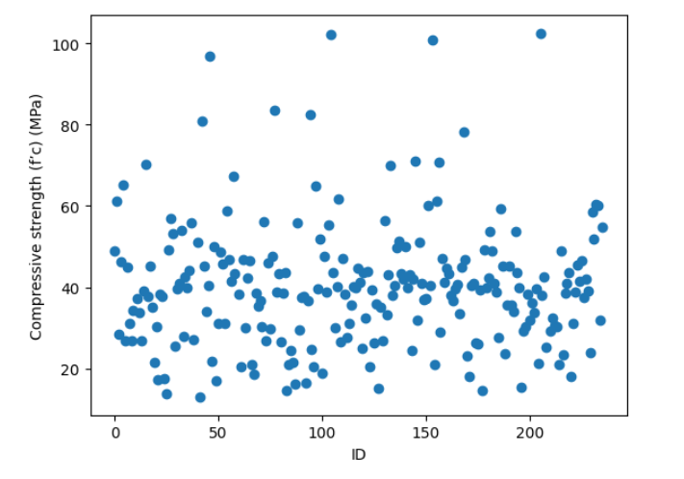
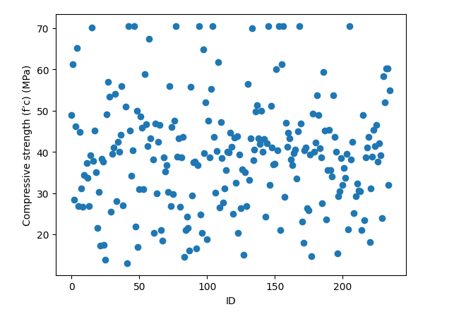
Scatter Plot
Scatter Plot
The below Scatter plot shows the outlies :
The points circled with red are the outliers .

Slide 7
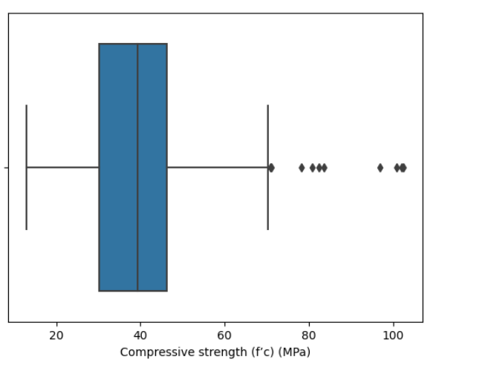
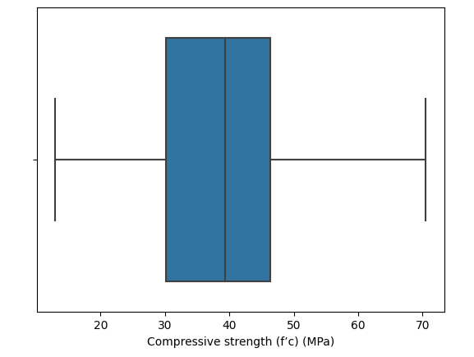
Scatter Plot
Box Plot
The below Box plot shows the outlies :
The points circled with red are the outliers .

Slide 8
Imputaion
Mean imputaion have been applied on the columns that has integer or flaoting point values to fill the missing values.
Columns that have been imputed using mean imputaion are :
‘Effective water- to-cement ratio'
'Aggregate-to-cement ratio (a/c)'
'RCA replacement ratio (RCA %)'
'Aggregate-to-cement ratio (a/c)'
'Parent concrete strength(MPa)'
'Nominal maximum RCA size(mm)'
'Nominal maximum NA size(mm)'
'Water absorption of RCA(WARCA) (%)'
'Water absorption of NA'
'Los Angeles abrasion of RCA'
'Los Angeles abrasion of NA'
These imputed values are saved to a .csv file ‘MeanImputedData.csv’. In the further process this new file is used.

Slide 9
Deleting Unwanted Columns
In ‘MeanImputedData.csv’ file there were certain columns whose datatypes was ‘Object’ and they were not of much use in the prediction. Hence i deleted them.
Columns that have been deleated using drop function :
'Compressive strength tests'
'Elastic modulus tests'
'Flexural strength tests'
'Splitting tensile strength tests'
'Bulk density of RCA (kg/m3)'
'Bulk density of RCA (kg/m3)'
'Density of hardened concrete AD (qad)(kg/m3)'
'Density of hardened concrete SSD (qSSD)(kg/m3)'
Elastic modulus(Ec)(MPa)
Flexural strength(f’r)(MPa)
Splitting tensile strength(MPa)
After deleting the columns, ‘MeanImputedData.csv’ is updated so that it can be used in to preapare the model.
Elastic modulus (Ec) (MPa) | Flexural strength (f’r)(MPa) | Splitting tensile strength (MPa)

Slide 10
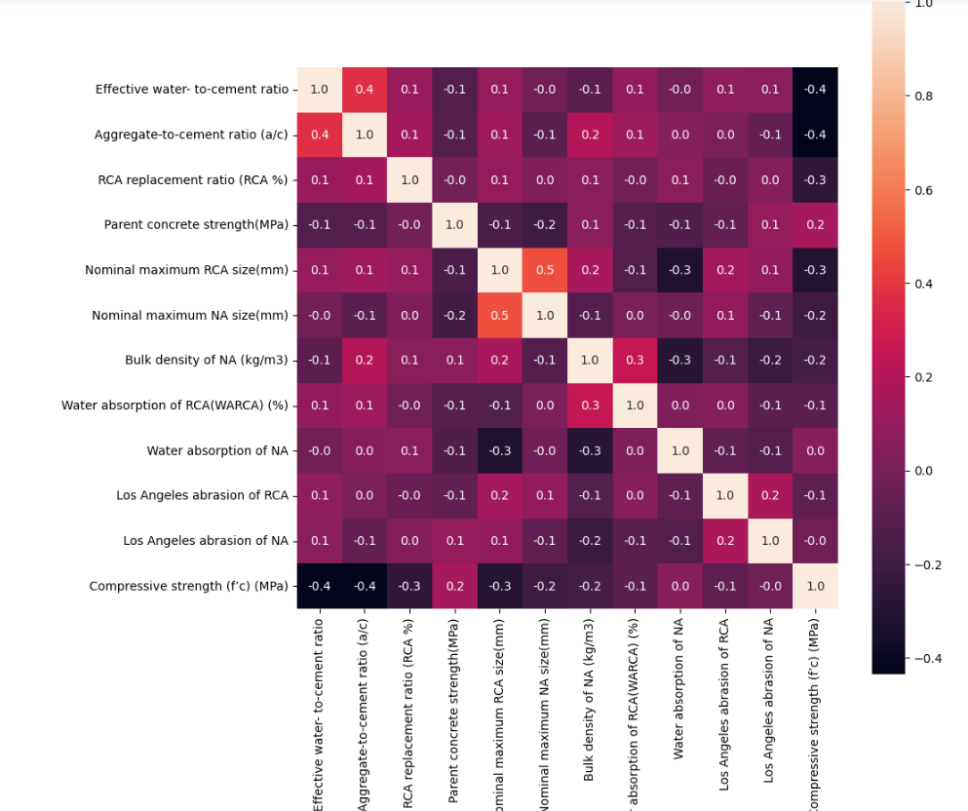
The hetamap in the figure shows the correlation between the elements.
Heat-Map

Slide 11
Machine Learning Models Used
Following are the model applied to predict the Compressive strength of RCA :
Multiple Linear Regression:
Decision Tree Regression
Random Forest Regression
Gradient Boosting Regression
AdaBoost Regressor
XGBoost Regressor

Slide 12
Results
Following are results obtained from those Machine Learning Algorithms :
S.No | Model | Mean Squared Error | Score
1. | Multiple Linear Regression | 111.64 | 0.24369595103796715
2. | Decision Tree Regression | 132.61 | 0.10163528858518911
3. | Random Forest Regression | 132.61 | 0.5393021553791466
4. | Gradient Boosting Regression | 74.45 | 0.50
5. | AdaBoost Regressor | 76.58 | 0.4812255093140996
6. | XGBoost Regressor | 67.36 | 0.5436879380510502

Slide 13
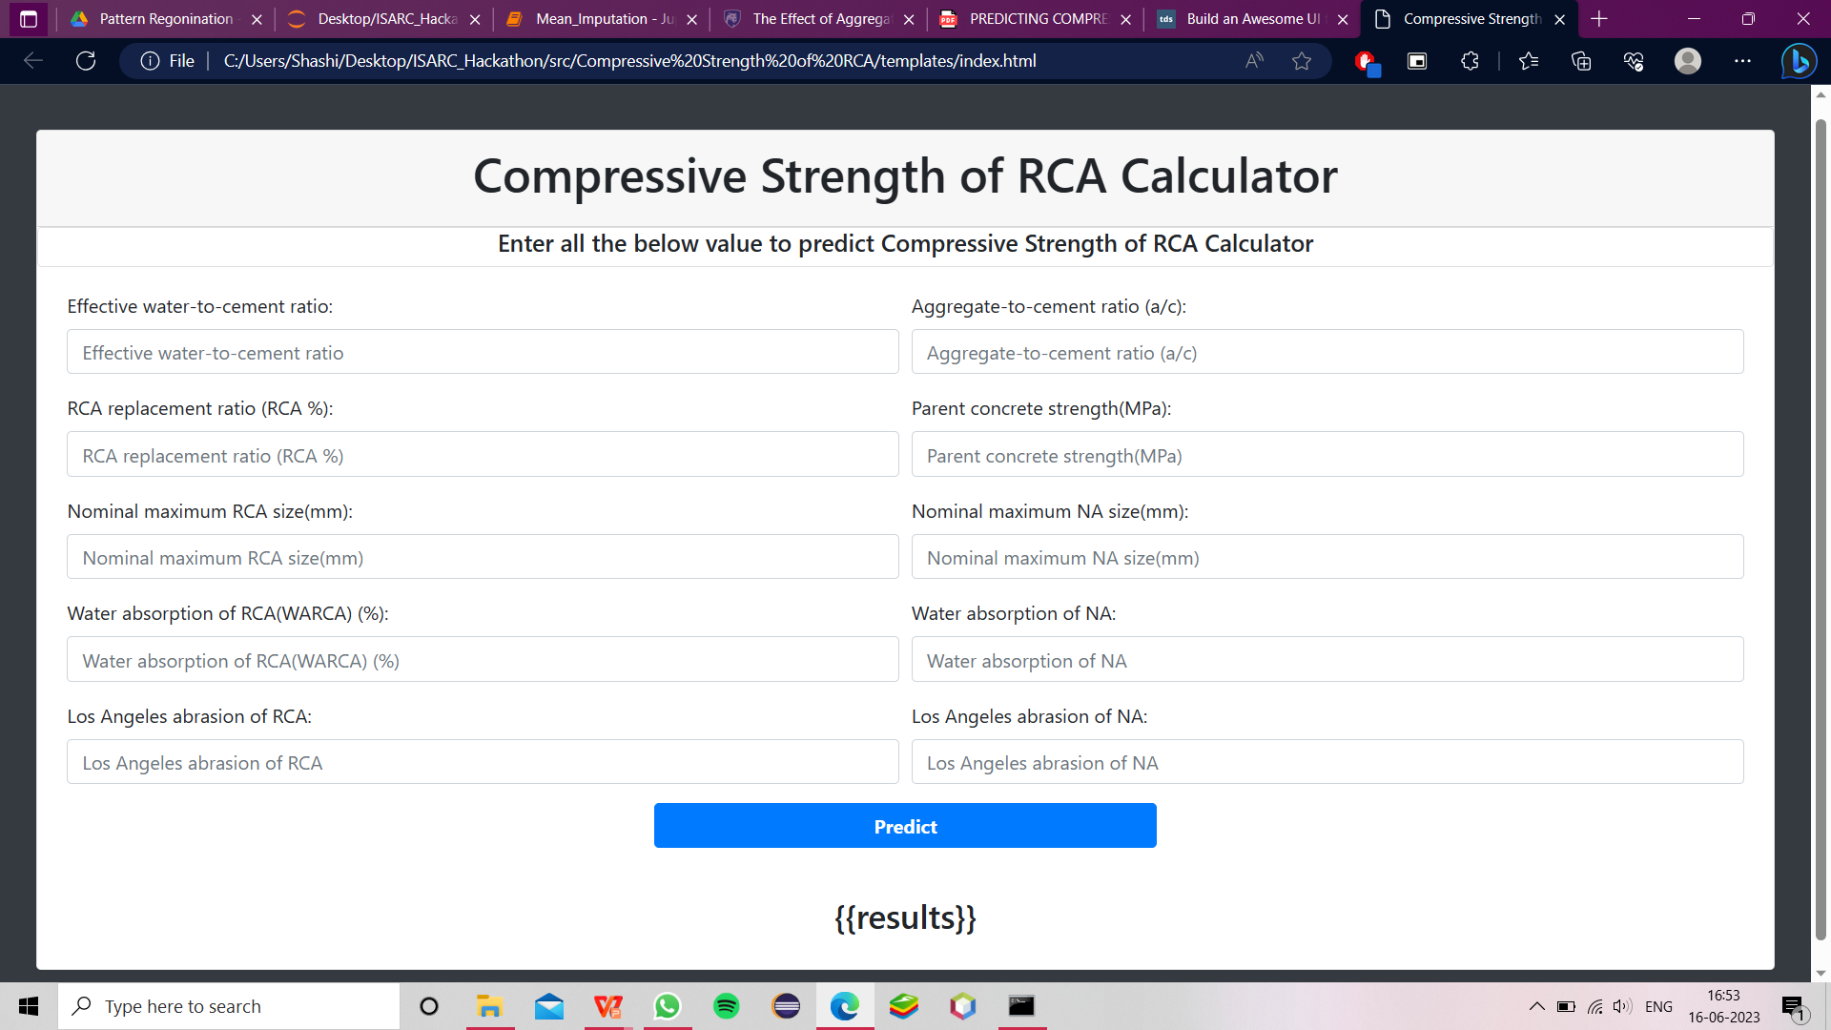
Web Interface

Slide 14
Conclusion
As it can be seen that most accurate result is provided by the XGBoost Regression with
Mean Squared Error .(MSE) 67.36 &
Score 0.5436879380510502
Hence, XGBoost Algorithms is used to predict the ‘Compressive Strength of RCA’.

