Slide 1
Understanding Attrition and Salary Trends
DDSAnalytics
Jeff Nguyen
Notes:
Good day everyone!
My name is Jeff Nguyen
And am based out of Austin, TX and will present our findings where we try to – read title

Slide 2




Executive Summary
Understand how data was cleaned
Review Engineered Features
Explore the data
Identify Trends through ML Techniques
Notes:
To begin we want to…

Slide 3
Data Cleaning
Remove duplicate Observations and identify extreme values
Identify highly correlated values
Feature engineering
Data Cleaning
Notes:
Data Cleaning at the DDSAnalytics for this project involves…
Remove duplicates and identify extreme values
Identify highly correlated values
Preform feature engineering

Slide 4
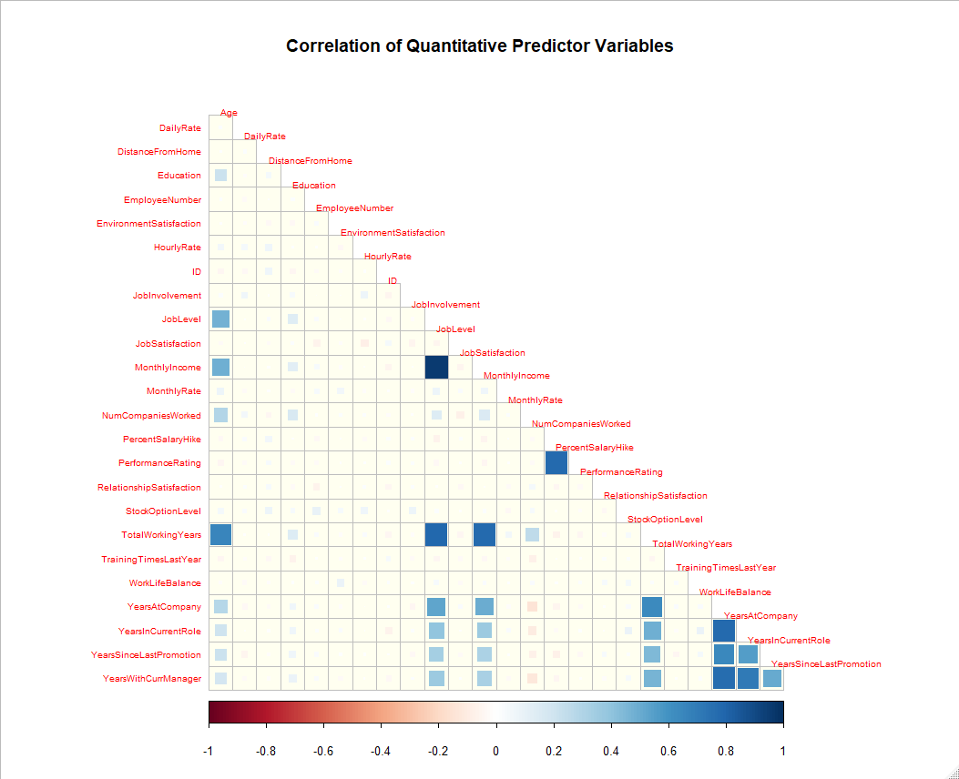
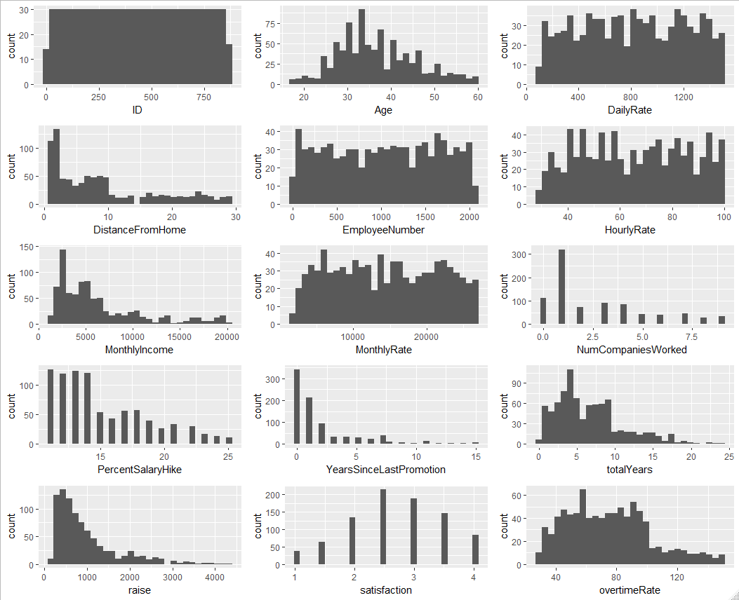
Quantitative Data
Notes:
There were a few large values for MonthyIncome and Raise, however the data was fairly continuous and there were not extreme outliers.
Many features are collinear (shown as darker blue boxes in the plot on the left), several examples include
TotalWorkingYears and Monthly income
YearsInCurrentRole and YearsAtCompany
YearsSincelastPromotion and YearsAtCompany
This could be an issue as it would inflate model predictions
To address these (as we will see on the next slide)
Features can be combined, modified, or removed
There are methods, such as ridge regression that can deal with multicollinearity on the backend as we will see in linear regression later

Slide 5





Feature Engineering
Simplify Business Travel Feature
Reduce levels to Travel and don’t Travel
Raises on a Monthly Dollar Figure
Show a candidate’s potential earnings if the salary hike were to be applied to their current earnings
Create a Tenure Feature
Captures features that deal with work and company time
Consolidate Satisfaction Features
Create averaged value of satisfaction features
Show Hourly Overtime Earnings
Give a dollar amount to a candidate’s hourly earnings when they are earning overtime
Notes:
Features are created to consolidate highly correlated features that are similar in nature for example:
YearsWithCurrManager + YearsInCurrentRole + YearsAtCompany + TotalWorkingYears
These features can be aggregated and averaged out to create a “Tenure” feature
Other engineered features are:
Read through the icons
Engineered features can contribute to improving a model’s performance by combining common sense features

Slide 6
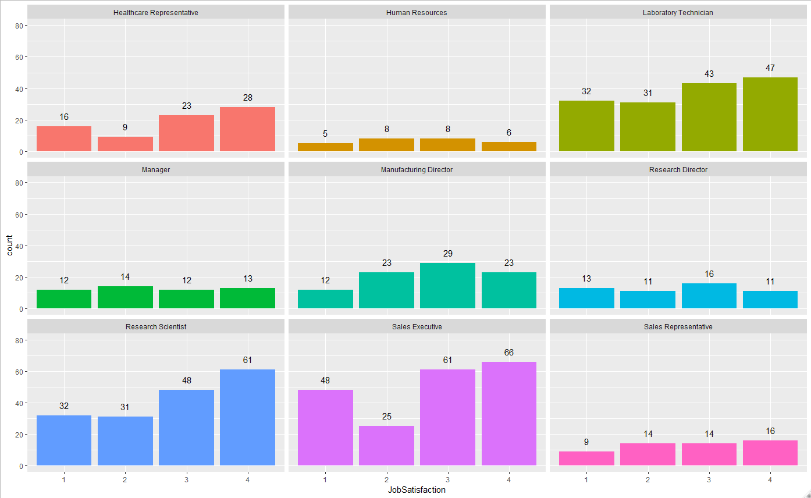
Who has the highest Job Satisfaction?
Notes:
We also took a look at seeing who is most satisfied with their job
JobSatisfaction is deﬁned as 1 “Low”; 2 - “Medium”; 3 - “High”; and 4 - “Very High.”
When looking at JobSatisfaction by career group, Research Scientist and Sales Executives have the most satisﬁed individuals with 35% and 33% of their respective populations reporting “Very Satisﬁed.”
Research Directors have the largest percentage of dissatisfaction at 25% of their respective population reporting “Low” job satisfaction.

Slide 7




Classification Terms
Accuracy
Total number of correct classifications
True Positives + True Negatives / Total
Precision
Rate that correct positive predictions are made
True Positive / Predicted Yes
Sensitivity
Rate at which true positive are made
True Positive / All Positives
Specificity
Rate at which true negatives are made
True Negatives/ All Negatives
Notes:
Before we cover the classification model performance some important terms to understand are…

Slide 8
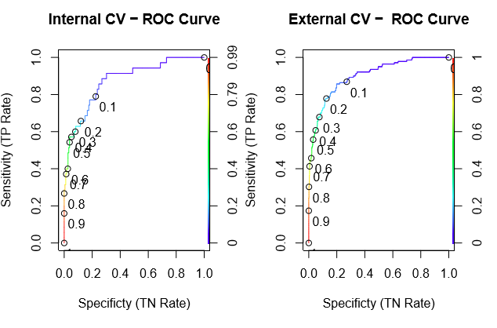
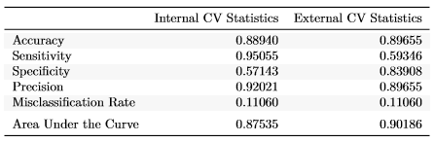
Classifying Attrition: Logistic Regression
Model Performance
ROC/AUC Curves
Give visual on model performance
Helps tune classification cut-offs
External vs. Internal CV Statistics
More accurate
Less sensitive
More specific
Less precise
Predicts 2.5% better than internal
Notes:
One method we use to classify attrition is Logistic regression
This method works well with dichotomous data
High AUC (area under the curve), where larger is better, suggests the model may predict well
External CV suggests that it is
-more accurate
Less sensitive
More specific
Less precise
Predicts 2.5% better than internal

Slide 9
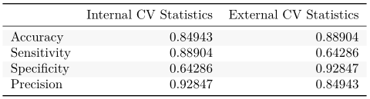

Classifying Attrition: Naïve Bayes
Model Performance
External vs. Internal CV Statistics
More accurate
Less sensitive
More specific
Less precise
Notes:
Naïve Bayes is another classification technique that is not limited to classifying two outcomes such as logistic regression
This model uses Bayes Theorem to assign probabilities to observations that aid in their classification
The comparison of cross validation metrics suggest that the externally validated model is
More accurate
Less sensitive
More specific
Less precise
The externally validated model will be used for prediction given it performance

Slide 10


Comparing Classifiers
Logistic Regression Model
Naïve Bayes Model
Accuracy 89.66%
Sensitivity 59.46%
Specificity 83.91%
Precision 89.66%
Accuracy 84.94%
Sensitivity 88.90%
Specificity 64.29%
Precision 92.85%
Notes:
At DDSAnalytics we needed to compare Logistic Regression and Naïve Bayes to determined which model can be used in production to classify candidates with attrition or no-attrition
Accuracy and Specificity are higher for logistic
Sensitivity and Precision are higher for Naïve Bayes
Given the 60/60 Requirement the Naïve Bayes Model outperforms the logistic model

Slide 11
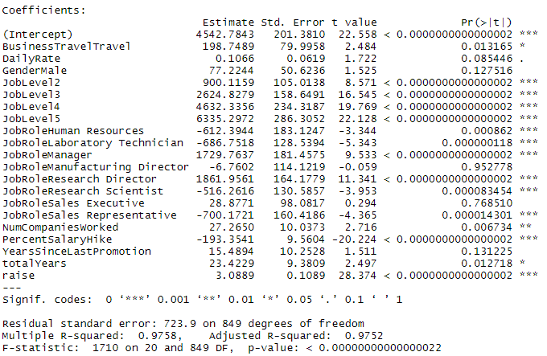

Predicting Salary Trends: Linear Regression
Model Performance
Important Metrics
RMSE is used to gauge performance
Multiple R-squared is used to gauge how well the model fits the data
Ridge regression was used to evaluate the model and helps correct for multicollinearity issues mentioned earlier
Top Contributors to Monthly Pay
Job Role (Research Director)
Job Level (Level5)
Business Travel (Travel)
Notes:
We used Linear Regression to predict the Monthly Income a candidate usually makes.
To judge model performance we looked at
- RMSE (where lower is better)
- Multiple R-squared (where higher is better)
This model, like the previous two models was put through a validation process to prepare it for high performance prediction
- Ridge regression was use to evaluate the model and corrected for multicollinearity
Job Role (Research Director) makes $1861 more than a healthcare representative (holding other features constant)
Job Level (Level5) makes $6335 more compared to a level 1 (holding other features constant)
Business Travel (Travel) makes $4542 more compared to an individual that does not travel
The average salary for the set of all candidates is $4542 starting

Slide 12
Conclusion
Exploratory data analysis allowed for feature engineering to help improve model performance
The Naïve Bayes model out preformed the logistic regression by a small amount in the speciﬁcity and sensitivity range
Both Logistic and Naïve Bayes models are comparable in accuracy and precision
For the linear regression model, we were able to identify that JobRole, JobLevel, and BusinessTravel contributed the most to an individual’s monthly pay.
Notes:
To Conclude (read through conclusion)
We have found that our models will help identify the best candidates for your organization and look forward to implementing these models. Thank you for your time

