Slide 1
Understanding Attrition and Salary Trends
DDSAnalytics
Jeff Nguyen
Notes:
Good day everyone!
My name is Jeff Nguyen
And am based out of Dallas, TX and will present our findings where we try to – read title

Slide 2




Executive Summary
Understand how data was cleaned
Review Engineered Features
Explore the data
Identify Trends through ML Techniques
Notes:
To begin we want to…

Slide 3
Data Cleaning
Remove duplicate Observations
Identify highly correlated values
Feature engineering
Data Cleaning
Notes:
Data Cleaning at the Analytics Lab for this project involves…
Remove duplicates
Identify highly correlated values
Preform feature engineering

Slide 4
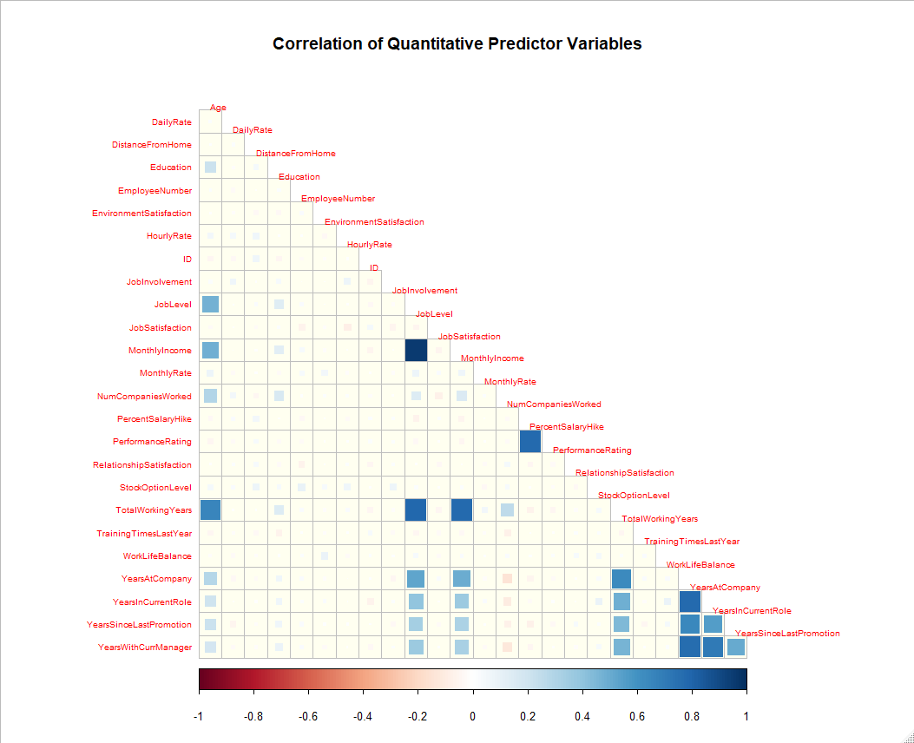
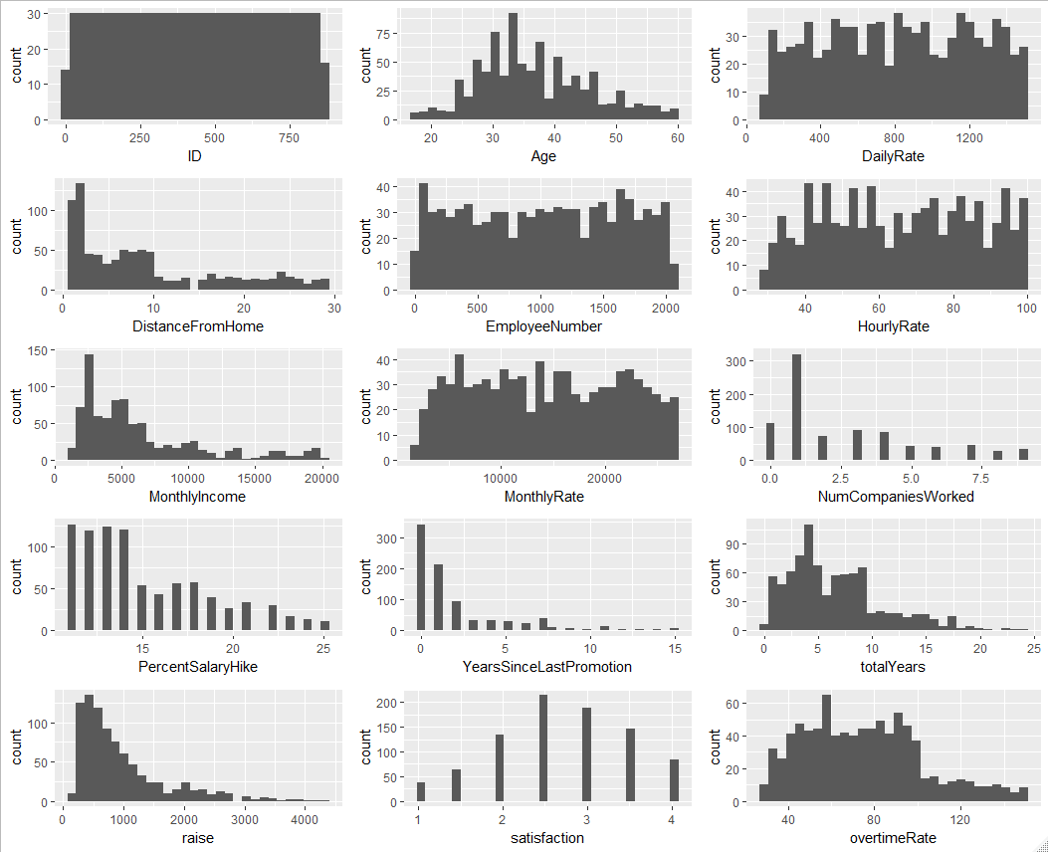
Quantitative Data

Slide 5
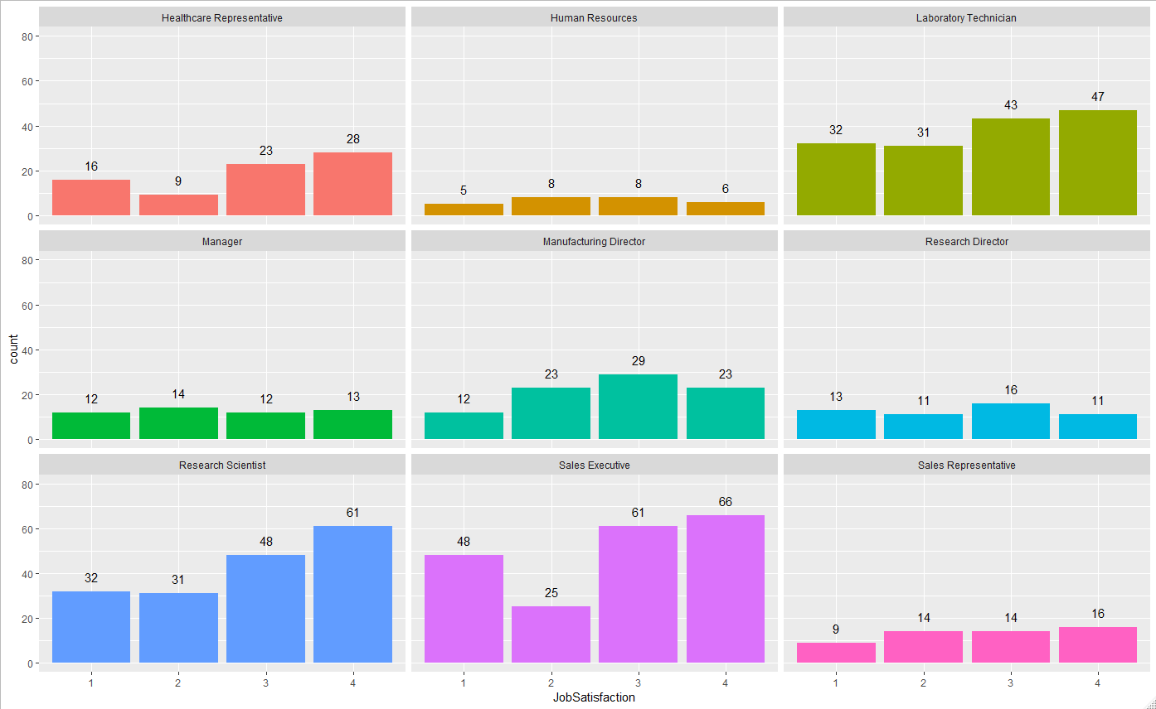
Who has the highest Job Satisfaction?
Notes:
Higher job satisfaction will be shown to have a positive impact on lower attrition. JobSatisfaction is deﬁned as 1 “Low”; 2 - “Medium”; 3 - “High”; and 4 - “Very High.”
When looking at JobSatisfaction by career group, Research Scientist and Sales Executives have the most satisﬁed individuals with 35% and 33% of their respective populations reporting “Very Satisﬁed.”
Research Directors have the largest percentage of dissatisfaction at 25% of their respective population reporting “Low” job satisfaction.

Slide 6





Feature Engineering
Simplify Business Travel Feature
Reduce levels to Travel and don’t Travel
Raises on a Monthly Dollar Figure
Show a candidate’s potential earnings if the salary hike were to be applied to their current earnings
Create a Tenure Feature
Captures features that deal with work and company time
Consolidate Satisfaction Features
Create averaged value of satisfaction features
Show Hourly Overtime Earnings
Give a dollar amount to a candidate’s hourly earnings when they are earning overtime
Notes:
Features are created to consolidate highly correlated features that are similar in nature
- YearsWithCurrManager + YearsInCurrentRole + YearsAtCompany + TotalWorkingYears
Engineered features can contribute to improving a model’s performance by combining common sense features
- Show potential salary with overtime applied

Slide 7
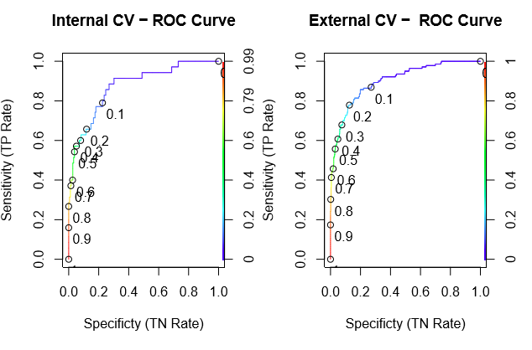
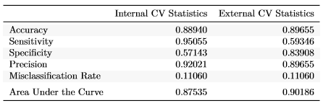
Classifying Attrition: Logistic Regression
Model Performance
ROC/AUC Curves
Give visual on model performance
Helps tune classification cut-offs
External vs. Internal CV Statistics
More accurate
Less sensitive
More specific
Less precise
Predicts 2.5% better than internal
Notes:
High AUC suggests the model may predict well
External CV suggests that it is
-more accuracte
Less sensitive
More specific
Less precise
Predicts 2.5% better than internal

Slide 8
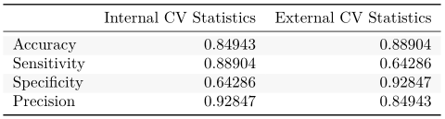

Classifying Attrition: Naïve Bayes
Model Performance
External vs. Internal CV Statistics
More accurate
Less sensitive
More specific
Less precise

Slide 9


Comparing Classifiers
Logistic Regression Model
Naïve Bayes Model
Accuracy 89.66%
Sensitivity 59.46%
Specificity 83.91%
Precision 89.66%
Accuracy 84.94%
Sensitivity 88.90%
Specificity 64.29%
Precision 92.85%
Notes:
Accuracy and Specificity are higher for logistic
Sensitivity and Precision are higher for Naïve Bayes
Given the 60/60 Requirement the Naïve Bayes Model outperforms the logistic model

Slide 10
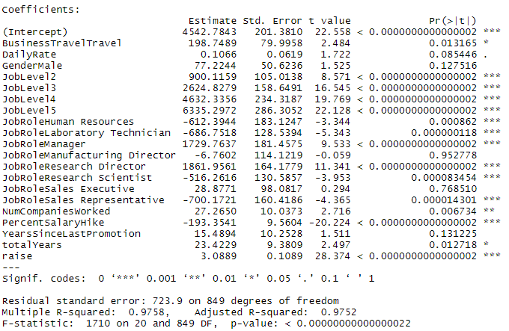

Predicting Salary Trends: Linear Regression
Model Performance
Important Metrics
RMSE is used to gauge performance
Multiple R-squared is used to gauge how well the model fits the data
Top Contributors to Monthly Pay
Job Role (Research Director)
Job Level (Level5)
Business Travel (Travel)
Notes:
RMSE – lower is better

Slide 11
Conclusion
Exploratory data analysis allowed for feature engineering to help improve model performance
The Naïve Bayes model out preformed the logistic regression by a small amount in the speciﬁcity and sensitivity range
Both Logistic and Naïve Bayes models are comparable in accuracy and precision
For the linear regression model, we were able to identify that JobRole, JobLevel, and BusinessTravel contributed the most to an individual’s monthly pay.
Notes:
The models generated provide good predictive ability for attrition and salary trends.
Exploratory data analysis allowed for feature engineering to help improve model performance.
For the classiﬁcation models, thresholds could be adjusted to determine at what probability an observation would be considered “Attrition” or “No-Attrition.”,

