Slide 1
Predicting Affordable and Performant Stocks
Paul Adams & Jeff Nguyen
Notes:
Good Afternoon
My name is Jeff Nguyen and I’m based out of Austin, TX
And I'm here with my colleague Paul Adams based out of Dallas, TX
Thank you for having us show our analysis and forecasting for your investment portfolio.

Slide 2





Executive Summary
About the Data
Model Type and Properties
Candidate Models
Model Comparison
Conclusions
Notes:
It can be difficult selecting a stock that is predictable and profitable for a new investor. Our goal is to show how our models can help you select an affordable, performant stock.
We’re going to cover
The data used to generate the models
Model Type and Properties
Candidate models
Model Comparison
An Conclusions
Before we get into the models, lets go over the data we used

Slide 3


About the Data
NFLX
ACGL
NEO
Identify stocks that show positive, profitable trends
NVDA
IBM
APPL
AMZN
LULU
CO
3202 publicly traded stocks from the NASDAQ
Time Frame: May 30th and October 30th, 2019
Preprocessing resulted in 7 Stocks that fit our model criteria
Notes:
We collected and analyzed 3,200 stocks publicly traded on the NASDAQ
A 100-day window was chosen
This was chosen for its distance from volatile biological and political disruption.
Given this data we had a few model types to choose from -> next slide

Slide 4
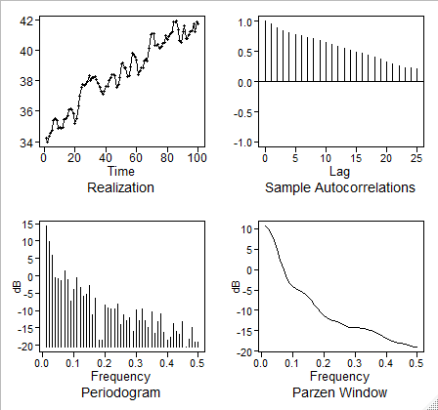
Model Type and Properties: Data Preprocessing
Non-Stationary Model Selected to Model Data
Data was selected for the model through the preprocessing phase
Each stock was iteratively processed through a linear model
Spectral densities were also iteratively checked for each stock
Original Data Spectral Density and ACF
Realization has positive trend
ACF is damping exponentially
The spectral density has a peak at zero suggesting a wandering behavior
Consistency in ACF suggests a positive trend
Notes:
For our analysis we selected a non-stationary process
The preprocessing of the data allowed us to target data that would be non-stationary
This process resulted in us selecting Arch Capital Group Ltd. Stocks for analysis
We then checked the:
Realizations
ACFs
And Spectral Densities to see if data was non-stationary

Slide 5
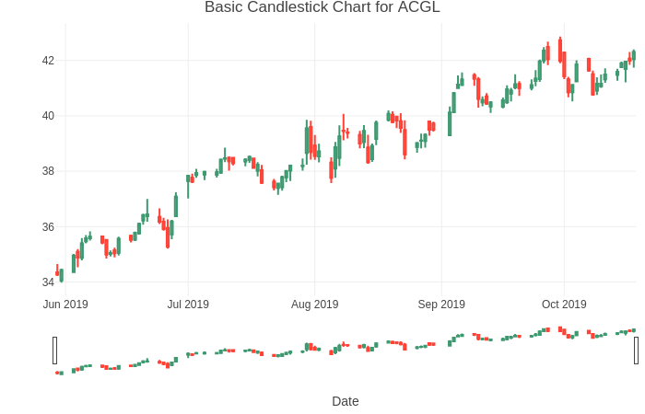
About the Data: Feature Engineering
Stock selection and feature engineering
Stocks were iteratively selected by running a linear model on each stock
Stocks between $5 - $50 per share and displayed spectral densities with peaks at zero and no additional peaks thereafter were selected
Additionally spectral densities with exponentially damping behavior allowed us to identify ideal stocks for signal-plus-noise
Features were created to capture the variation between open/close and high/low prices
Notes:
We looked for stocks with slopes greater than 0.04
We then identified stocks that were between $5-$50 that with spectral densities that were exponentially damping as their serial correlation structures can be captured easily with signal plus noise models
Additional features were created to capture the variation between open/close and high/low prices by subtracting the opening/high price from their respective close/low price
After analyzing the candlestick plot, we decided to use the low price as the target feature of the model.
The reason we chose this is because when a stock is trending up, the low price can quickly identify this trend
This occurs because moving average will often rise above the low price, especially for stronger uptrending behavior.
This further provides insight into potential investment profitability.
This process resulted in 7 stocks

Slide 6
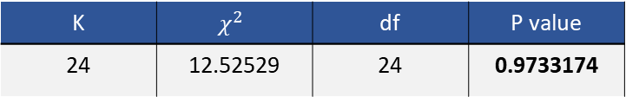
Candidate Model: Signal + Noise
Fitted Regressions
Model | Β₀ Estimate | Β_{t} Estimate | Std. Error | T value | P value
Raw Data | 34.86 | 0.072922 | 0.002122 | 34.36 | <2e-16
Cochran-Orcut | 9.32 | 0.07 | 0.004634 | 15.11 | <2e-16
Ljung-Box Test
K | $$χ^{2}$$ | df | P value
24 | 12.52529 | 24 | 0.9733174
Data Cleaning
$$\left(1−1.0534B+0.3194B^{2}\right)Z_{t}=a_{t}, where {\hat{σ}}_{a}^{2}=0.1178$$
Notes:
As mentioned earlier, we were able to identify a stock that would perform well using a Signal-Plus-Noise model as well as an AH-REE-MAH model.
First, we fit the trading prices over time in a linear model
We then ran the Cochrane-Orcutt test to confirm that the signal is deterministic
Next, we tested the residuals of the linear model with the Ljung-Box test to confirm the residuals are white-noise
As a result the model is listed at the bottom of the slide

Slide 7
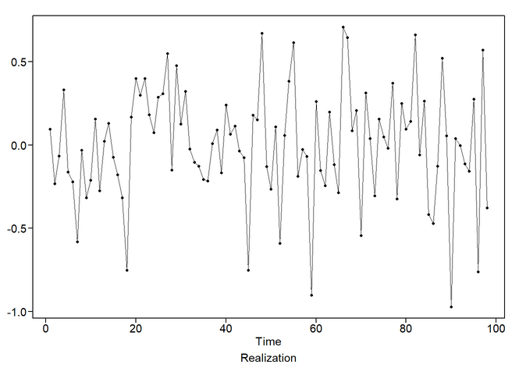
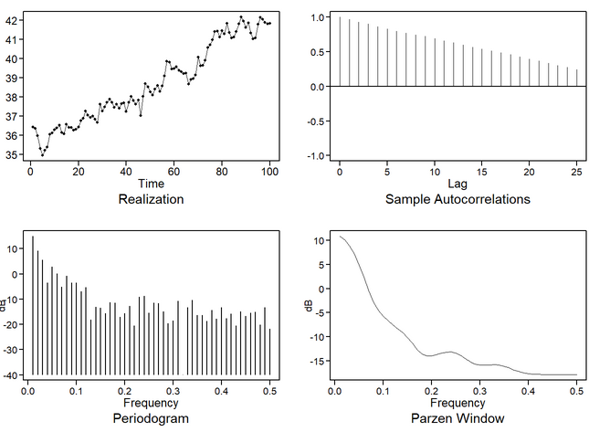
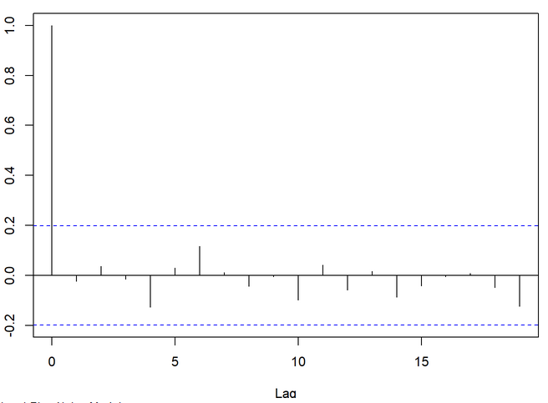
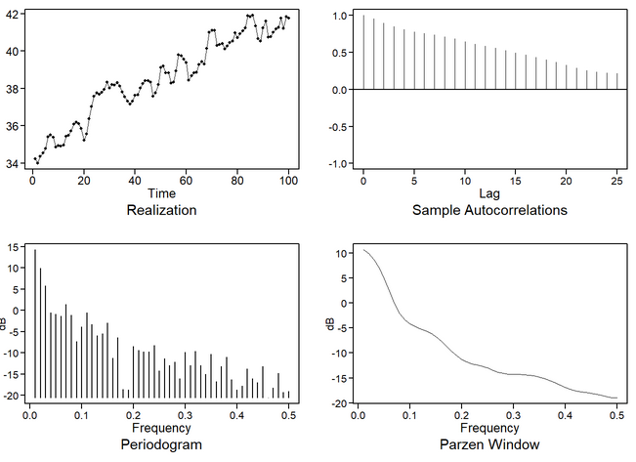
Candidate Model: Signal + Noise Continued
Evaluate model residuals to ensure signal has been pulled out
Simulated Model Data
Check ACF to ensure residuals are white noise
Original data
Notes:
The plots on the left show us the resulting white noise in the residuals after having the signal extracted
The plots on the right show us that the signal + noise model
Closely matches the ACF, Spectral density plots, and realizations of the original data
Alternatively we wanted to see how well an AH-REE-MA model would work -> next slide

Slide 8
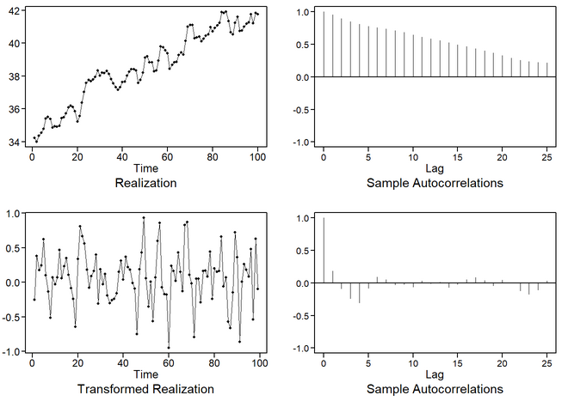
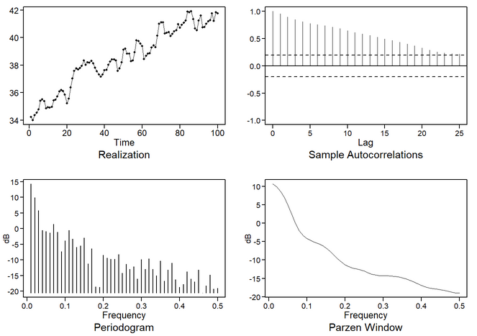
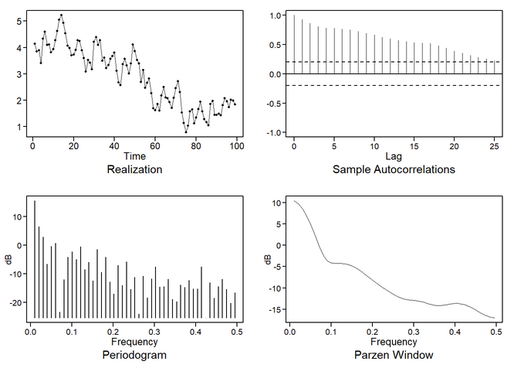
Candidate Models: ARIMA
$$\left(1−0.1227B+0.1183B^{2} −0.1454B^{3}+0.2587B^{4}−0.029B^{5}\right){(1−B)(X}_{t}+38.54)= a_{t},$$
$$where σ_{a}^{2}=0.0759$$
(1-B) Differenced data
Original data
Simulated model data
Notes:
The second model we fit was an AH-REE-MA(5,1,0).
We identified the model by using a factor table that contained a (1-B) factor that was one of the strongest roots
Data was then differenced once to stationarize the realization
Based on AIC scores we identified an AR(5) model that best represents the data
Based on lag analysis we determined there was not enough noise to add an MA term
To test if the resulting model’s residuals no longer contained a signal the Ljung-box test was run
Base on k=24 and p-value=0.9405
We found that there was not enough evidence to say the residuals are not white noise
Additionally a low variance of 0.1173 suggests that the model describes the data well
After differencing realizations were then generated from 99 data points
The spectral density and ACF plots closely match the original realization
The resulting model can be seen at the top of the slide

Slide 9
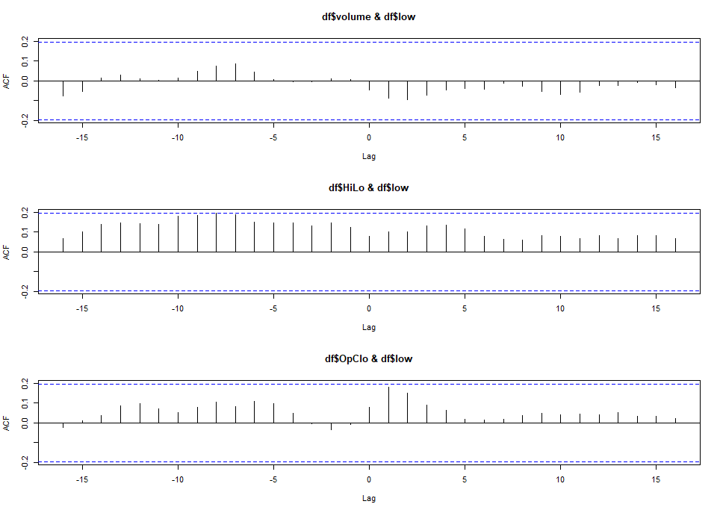
Candidate Models: VAR
VAR Model Captures Relationships between Variables
The spread of a day’s trading was captured by subtracting the stock’s high/low, and open/close pricing.
This was preformed to capture the variability of trading throughout the day
Cross-correlation function suggests we might need a lag at -8 for HiLo and low, however it is within the bound of the CI limits
Notes:
A vector autoregressive model was created to enhance our univariate model with multivariate factors, both additive and multiplicative
This model takes into consideration the cross-correlation structures between features
As previously mentioned, based on the candlestick plot we created for exploratory data analysis, we were interested in exploring the relationship of the ranges of open to close and high to low prices as related to the low price.

Slide 10
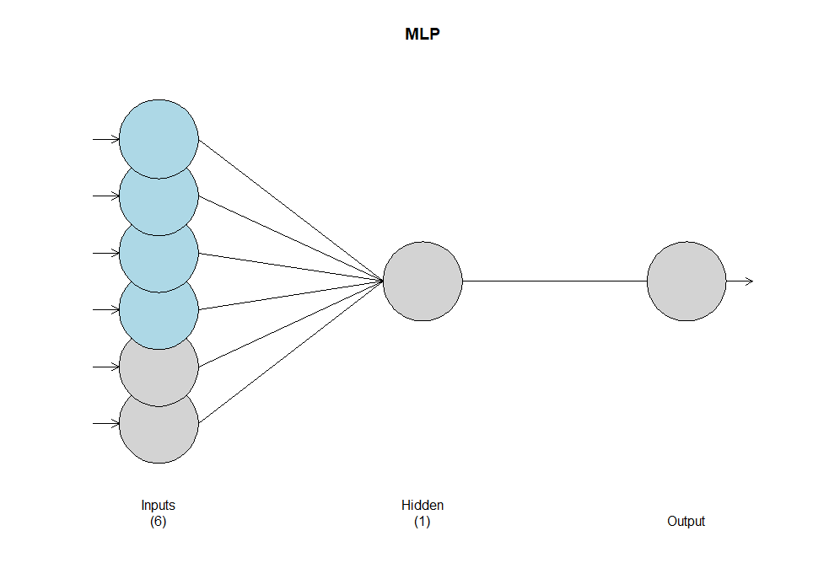
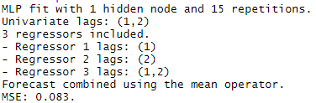
Candidate Models: Neural Networks
Multi-Layer Perceptron
4 regressors (time, volume, hilo, open/close) in blue
2 lags in grey
NN model automatically identifies the appropriate ARIMA model and lags
This can save time when preforming EDA for ARIMA
Notes:
A multi-layered perceptron model was also created
This model operates using a “feedforward” artificial neural network to pass forward information from the input nodes into a hidden layer of nodes that perform logical activation functions before processing into the output node.
When adding additional predictors to the multivariate models, forecasts converge less toward the long-run mean and more toward the behavior of the realization itself.
With this said, the addition of further predictor variables - such as those through NLP of market sentiment analysis - can aid in stabilizing useful multivariate models.

Slide 11

Candidate Models: Ensemble Model
Signal + Noise ARMA(2,1)
$$\left(1−1.2317B+0.4849B^{2} \right){(1−B)(X}_{t}+38.54)= {(1+B)a}_{t},$$
$$where σ_{a}^{2}=0.08494$$
Signal + Noise ARIMA(2,1,1) & Neural Net Ensemble Mode
+
Forecasts for both models were averaged to generate ensemble model
Resulting ASE preforms better compared to ARIMA and Signal + Noise alone
Notes:
The ensemble model combined forecasts of the univariate Signal-Plus-Noise and the multivariate MLP model
Forecasts from both models were averaged to provide an ASE statistic to measure model performance
This model guards against overfitting by using the univariate model to “temper” the multivariate model
Additions of more variables to a multivariate model may lead to over fitting
By creating an ensemble model with a univariate model, essential trends in the data are retained and help anchor the multivariate model

Slide 12
Candidate Models: Comparison
Model Comparison
Model | AIC | ASE* | Rolling ASE (Training Size 95)
Signal + Noise ARMA (2,1) | -2.079 | 0.134 | 0.133
Ensemble | N/A | 0.07 | 0.138
NN | N/A | 0.063 | 0.142
VAR | -2.275 | 0.113 | 0.187
ARIMA(5,1,0) | -2.002 | 0.203 | 0.394
*Forecast Practical horizon set to 5 days – emulates a NASDAQ trading week
Notes:
Lets take a look at how our models preformed:
Our multivariate models include the VAR and MLP models
While the signal plus noise and the ARIMA model were univariate
The ASE scores for all multivariate models outperformed all univariate models.
Rolling ASEs were also calculated for each model where ASEs were iteratively taken for a given training size.
Our top preforming model is the Signal + Noise, with the Ensemble closely following.
To note: The Practical forecast horizon for these models was set to 5 days – which is the same as a NASDAQ trading week
Let’s look at the forecasts for these models to see how closely their predictions follow the original data

Slide 13
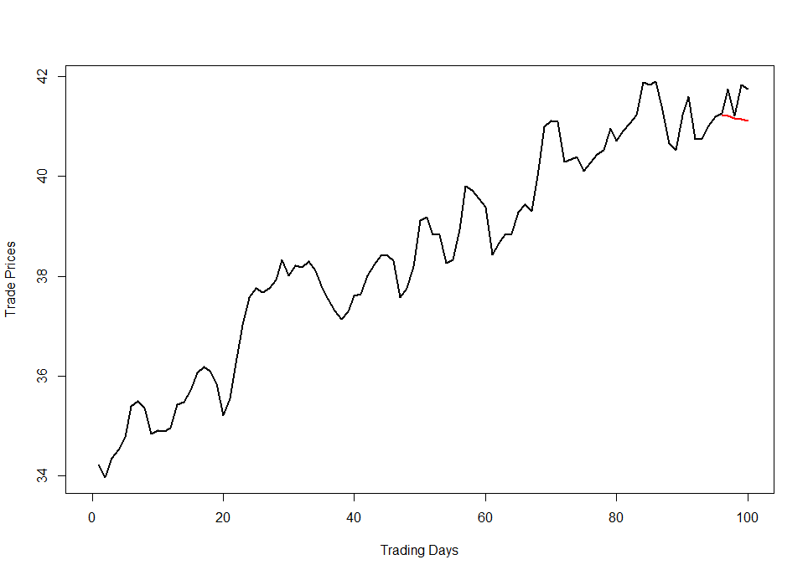
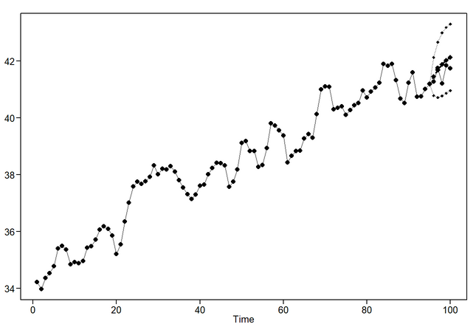
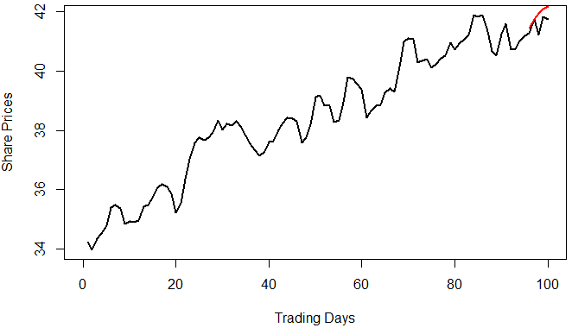
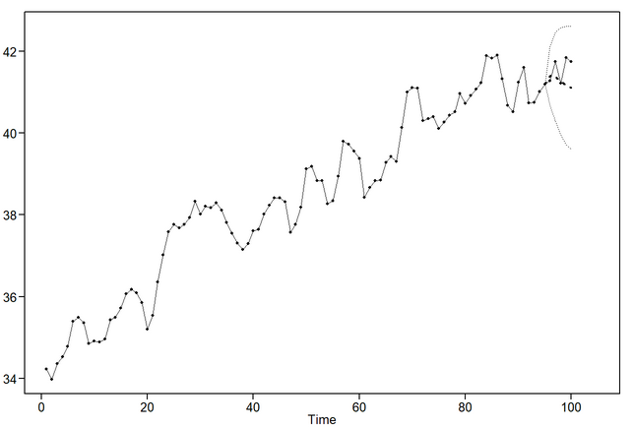
Candidate Models: Forecast Comparison
Signal + Noise Forecast
Vector Autoregressive
ARIMA Forecast
Notes:
ARIMA and VAR forecasts both show a downward trend, while the signal + noise model shows an upward trend
All three forecasts do not follow the realization as well as we would like
For VAR and MLP models we have noticed that as we add features predictions move towards the trend

Slide 14
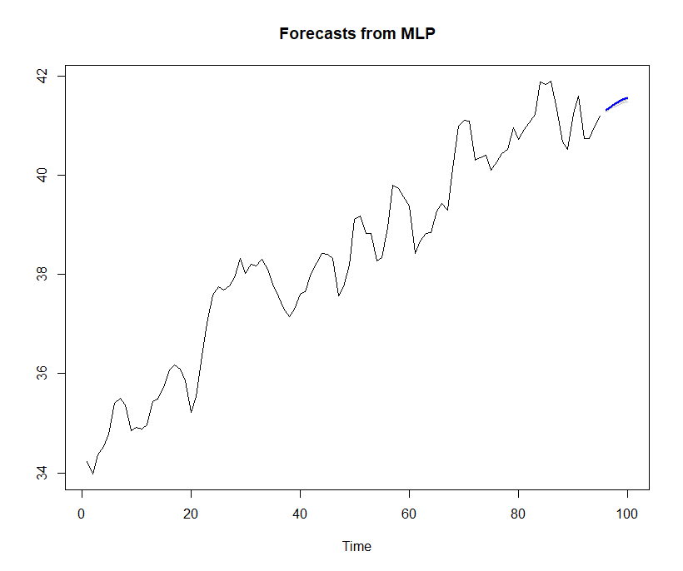
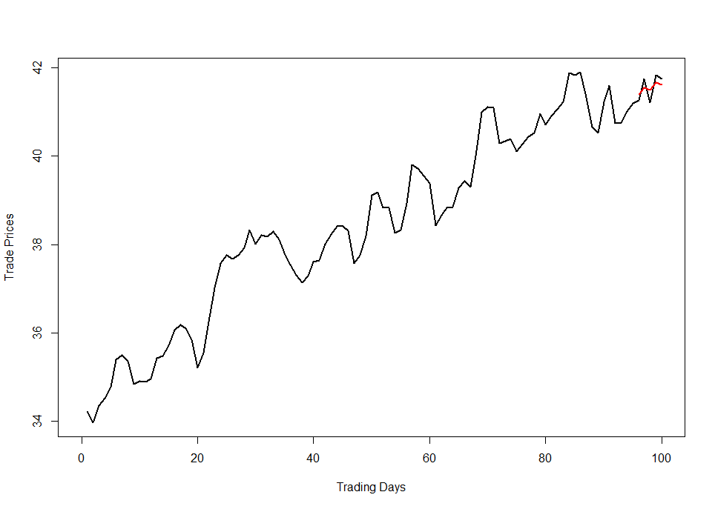
Candidate Models: Forecast Comparison
MLP
Ensemble
Notes:
For our top preforming models
The MLP forecast has a positive trend
While the Ensemble also has a positive trend
When comparing two forecasts we can see that the Ensemble forecasts better match the last 5 observations
This is due to the model taking on some of the ARIMA(2,1,1) properties

Slide 15
Conclusion
The Signal+Noise Model preformed the best as it had the lowest ASE
However we recommend the use of the ensemble model
To increase the forecast horizon, more variables can be included in the model to better describe the data
Notes:
To conclude
The Signal+Noise Model preformed the best as it had the lowest ASE
However, we recommend using the ensemble model
As it’s rolling ASE is very close to the Signal + Noise model, its single realization ASE is also lower
And it also has added protection from overfitting
For future models more features can be added to increase the forecast horizon
We appreciate the time you have taken to see how our models preform and hope that our models can help your investors pick affordable performant stocks.
Thank you and have a nice afternoon!

Slide 16
Appendix
Presentation Link
Jeff Nguyen: https://youtu.be/rNtp4fHCWhw

