Slide 1
Predicting Affordable and Performant Stocks
Paul Adams & Jeff Nguyen
Notes:
Good Morning and thank you for allowing my teammate Jeff Nguyen and myself perform this analysis and forecasting for your investment portfolio.

Slide 2




Executive Summary
About the Data
Model Type and Properties
Candidate Models and Comparison
Next Steps
Notes:
It can be difficult selecting a stock that is predictable and profitable for a new investor. Our goal is to show how our models can help you select an affordable, performant stock.
We’re going to cover
The data used to generate the models
Model Type and Properties
Candidate models
And next steps
Before we get into the models, lets go over the data we used

Slide 3


About the Data
NFLX
ACGL
NEO
Identify stocks that show positive, profitable trends
NVDA
IBM
APPL
AMZN
LULU
CO
3202 publicly traded stocks from the NASDAQ
Time Frame: May 30th and October 30th, 2019
Preprocessing resulted in 7 Stocks that fit our model criteria
Notes:
To provide you with the models we will present today, we collected and analyzed 3,202 stocks publicly traded on the NASDAQ
100-day daily time period between May 30th and October 30th, 2019.
We selected this time range for its distance from volatile biological and political disruption.
Given this data we had a few model types to choose from -> next slide

Slide 4
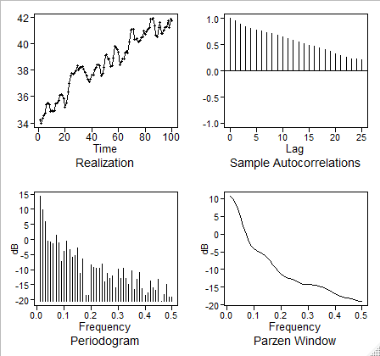
Model Type and Properties
Non-Stationary Model Selected to Model Data
Data was selected for the model through the preprocessing phase
Each stock was iteratively processed through a linear model
Spectral densities were also iteratively checked for each stock
Original Data Spectral Density and ACF
Realization has positive trend
ACF is damping exponentially
The spectral density has a peak at zero suggesting a wandering behavior
Consistency in ACF suggests a positive trend

Slide 5
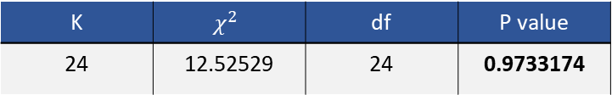
Candidate Model: Signal + Noise
Fitted Regressions
Model | Β₀ Estimate | Β_{t} Estimate | Std. Error | T value | P value
Raw Data | 34.86 | 0.072922 | 0.002122 | 34.36 | <2e-16
Cochran-Orcut | 9.32 | 0.07 | 0.004634 | 15.11 | <2e-16
Ljung-Box Test
K | $$χ^{2}$$ | df | P value
24 | 12.52529 | 24 | 0.9733174
Data Cleaning
$$\left(1−1.0534B+0.3194B^{2}\right)Z_{t}=a_{t}, where {\hat{σ}}_{a}^{2}=0.1178$$
Notes:
As intended, we were able to identify a stock that we estimated would perform well using a Signal-Plus-Noise model as well as an ARIMA model.
First, we fit the trading prices over time in a linear model
then measured it with Cochrane-Orcutt to confirm that the signal is deterministic and not a random trend.
Next, we tested the residuals of the linear model with the Ljung-Box test to confirm there is not enough evidence to consider the residuals to be serially correlated.
Therefore, we were able to forecast using the Signal-Plus-Noise model below:

Slide 6
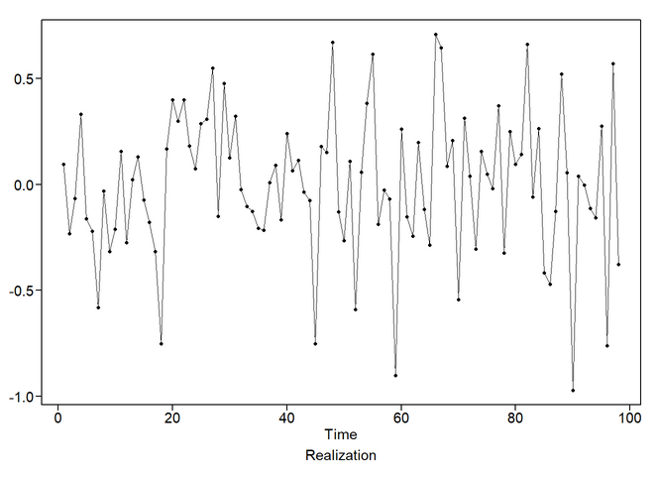
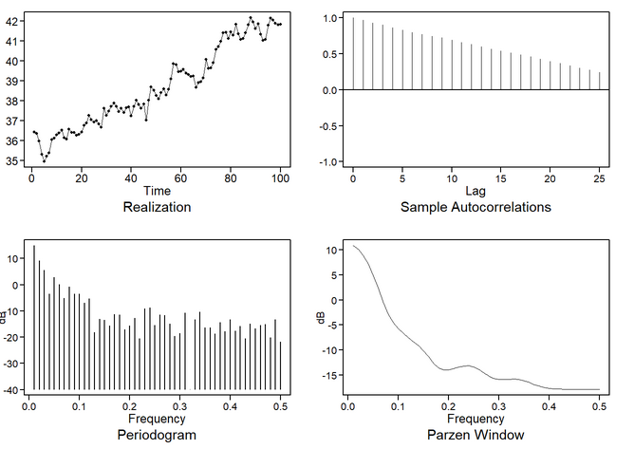
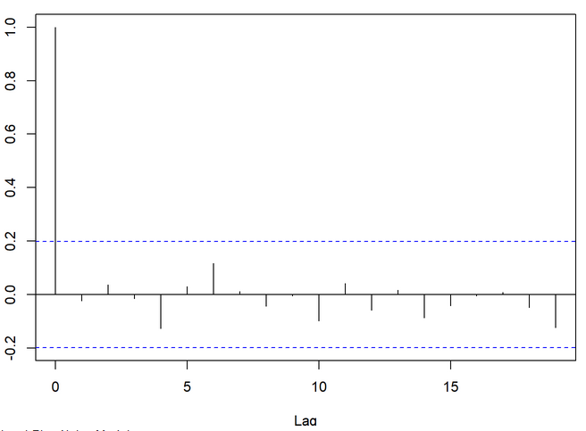
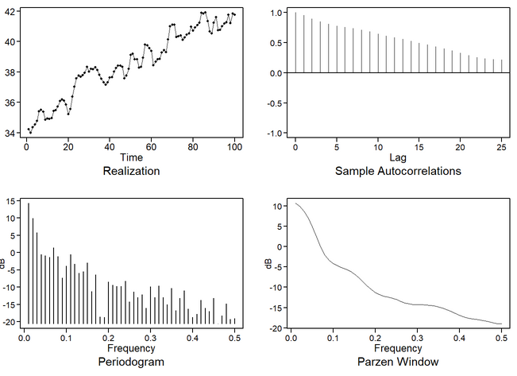
Candidate Model: Signal + Noise Continued
Evaluate model residuals to ensure signal has been pulled out
Simulated Model Data
Check ACF to ensure residuals are white noise
Original data

Slide 7
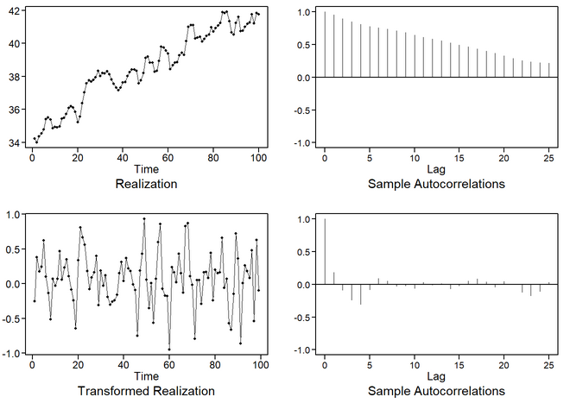
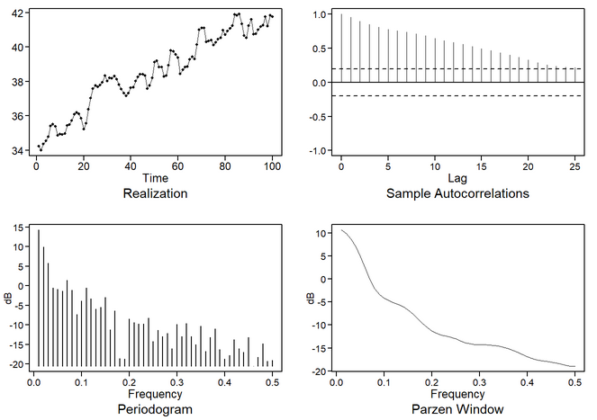
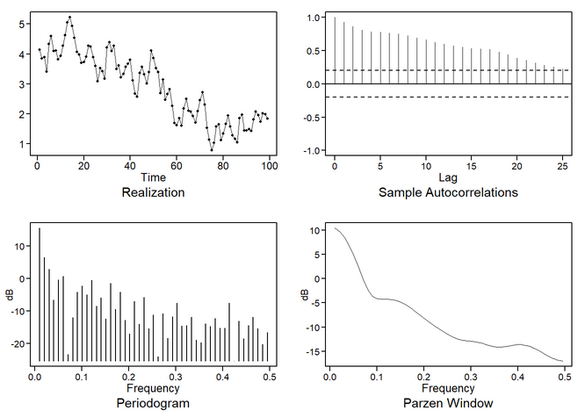
Candidate Models: ARIMA
$$\left(1−0.1227B+0.1183B^{2} −0.1454B^{3}+0.2587B^{4}−0.029B^{5}\right){(1−B)(X}_{t}+38.54)= a_{t},$$
$$where σ_{a}^{2}=0.0759$$
(1-B) Differenced data
Original data
Simulated model data
Notes:
The second model we fit was a ARIMA(5,1,0).
We identified using the factor table that the data contains a significant (1-B) factor as (1-0.9956B).
After building an over-fit table, there was an additional factor close to (1-2B-B^2), but the absolute reciprocal was lower than we felt warranted more than one differencing.
After applying the (1-B) difference, we were able to estimate a model the stationary residuals using an AR(5).
We applied the estimated coefficients of that with a first difference to the original data and forecasted using the model below:
(1-B) is ,multiplied out
(1-B)(1-0.12269667B+0.11827203B^2+0.14543411B^3+0.25874556B^4-0.02916165B^5)*(X_t + 38.53802)

Slide 8
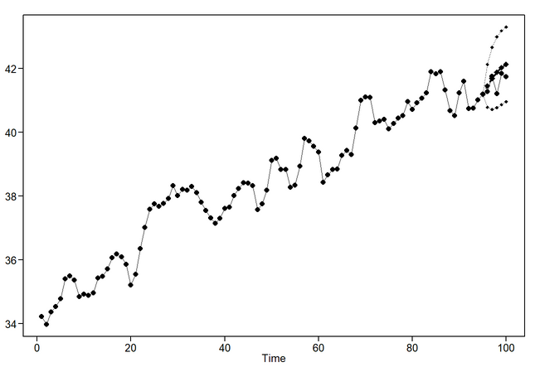
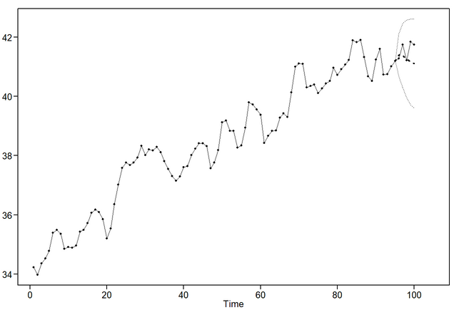
Candidate Models: Comparison
Signal + Noise Forecast
Model Comparison
Model | AIC | ASE*
Signal + Noise | -2.078901 | 0.133713
ARIMA(5,1,0) | -2.001944 | 0.2026529
ARIMA Forecast
*Forecast Practical horizon set to 5 days – emulates a NASDAWQ trading week

Slide 9



Next Steps
Vector Autoregressive Model
Neural Networks
Compare and Select the Best Model
Notes:
Thank you for your time today. For the next phase of our analysis, we will
model a vector autoregressive (VAR)
neural network model.
To identify the best forecasting method for this stock.
Eventually, we will provide you a model and modelling framework that will be repeatable – with variation – for many similar stocks.

