Slide 1
Affordable and Predictable Stocks
Paul Adams & Jeff Nguyen
Notes:
Good Morning and thank you for allowing my teammate Jeff Nguyen and myself perform this analysis and forecasting for your investment portfolio.

Slide 2




Executive Summary
Describe the Data
Model Type and Properties
Candidate Models
Next Steps
Notes:
To begin we want to…

Slide 3


Describe the Data
Identify stocks that show positive, profitable trending
NFLX
ACGL
NEO
NVDA
IBM
APPL
AMZN
LULU
3202 publicly traded stocks from the NASDAQ
Time Frame: May 30th and October 30th, 2019
Stocks were iteratively processed through a linear model
The following conditions were used to identify ideal stocks
Positive slopes that were greater than 0.04
Stock Prices between $5-$50
Spectral Densities start at 0, with no peaks afterwards
7 Stocks were identified using this Criteria
AGCL was chosen from this pool for analysis
CO
Notes:
To provide you with the models we will present today, we collected and analyzed 3,202 stocks publicly traded on the NASDAQ
100-day daily time period between May 30th and October 30th, 2019.
We selected this time range for its distance from volatile biological and political disruption.

Slide 4
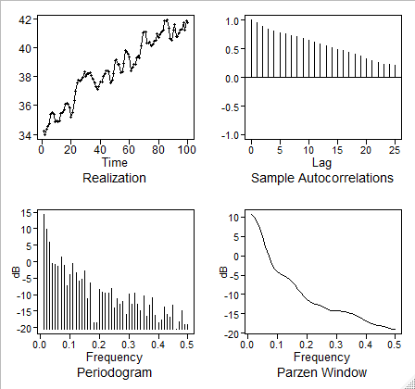
Model Type and Properties
Non-Stationary Model Selected to Model Data
Data was selected for the model through the preprocessing phase
Each stock was iteratively processed through a linear model
Spectral densities were also iteratively checked for each stock
Original Data Spectral Density and ACF
Realization has positive trend
ACF is damping exponentially
The spectral density has a peak at zero suggesting a wandering behavior
Consistency in ACF suggests a positive trend

Slide 5
Candidate Model: Signal + Noise
$$\left(1−1.0534B+0.3194B^{2}\right)Z_{t}=a_{t}, where {\hat{σ}}_{a}^{2}=0.1178$$
Model | Β_{t} Estimate | Std. Error | T value | P value
Raw Data | 0.072922 | 0.002122 | 34.36 | <2e-16
Cochran-Orcut | 0.0698107 | 0.0063528 | 10.989 | <2.2e-16
Data Cleaning

Slide 6
Candidate Models: ARIMA
$$\left(1−1.123B+0.004B^{2} − 0.264B^{3}+0.113B^{4}−0.288B^{5}+0.029B^{6}\right){(X}_{t}+21.22) = a_{t},$$
$$where σ_{a}^{2}=0.0759$$
Data Cleaning

Slide 7



Next Steps
Vector Autoregressive Model
Neural Networks
Compare and Select the Best Model
Notes:
Thank you for your time today. For the next phase of our analysis, we will
model a vector autoregressive (VAR)
neural network model.
To identify the best forecasting method for this stock.
Eventually, we will provide you a model and modelling framework that will be repeatable – with variation – for many similar stocks.

