Slide 1
Predicting Affordable and Performant Stocks
Paul Adams & Jeff Nguyen
Notes:
Good Afternoon
My name is Jeff Nguyen and I’m based out of Austin, TX
And I'm here with my colleague Paul Adams based out of Dallas, TX
Thank you for having us show our analysis and forecasting for your investment portfolio.

Slide 2





Executive Summary
About the Data
Model Type and Properties
Candidate Models
Model Comparison
Conclusions
Notes:
It can be difficult selecting a stock that is predictable and profitable for a new investor. Our goal is to show how our models can help you select an affordable, performant stock.
We’re going to cover
The data used to generate the models
Model Type and Properties
Candidate models
And next steps
Before we get into the models, lets go over the data we used

Slide 3


About the Data
NFLX
ACGL
NEO
Identify stocks that show positive, profitable trends
NVDA
IBM
APPL
AMZN
LULU
CO
3202 publicly traded stocks from the NASDAQ
Time Frame: May 30th and October 30th, 2019
Preprocessing resulted in 7 Stocks that fit our model criteria
Notes:
We collected and analyzed 3,200 stocks publicly traded on the NASDAQ
A 100-day window was chosen
This was chosen for its distance from volatile biological and political disruption.
Given this data we had a few model types to choose from -> next slide

Slide 4
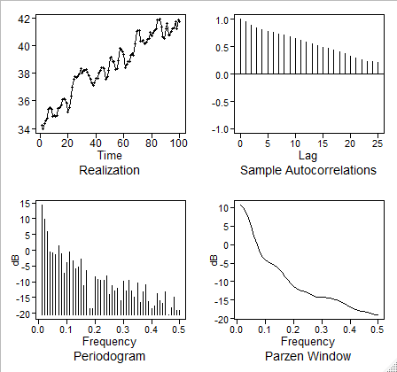
Model Type and Properties: Data Preprocessing
Non-Stationary Model Selected to Model Data
Data was selected for the model through the preprocessing phase
Each stock was iteratively processed through a linear model
Spectral densities were also iteratively checked for each stock
Original Data Spectral Density and ACF
Realization has positive trend
ACF is damping exponentially
The spectral density has a peak at zero suggesting a wandering behavior
Consistency in ACF suggests a positive trend
Notes:
For our analysis we selected a non-stationary process
The preprocessing of the data allowed us to target data that would be non-stationary
This process resulted in us selecting Arch Capital Group Ltd. Stocks for analysis
We then checked the:
Realizations
ACFs
And Spectral Densities to confirm that the data was non-stationary

Slide 5
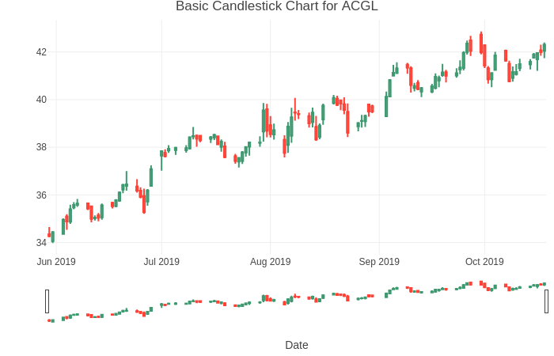
About the Data: Feature Engineering
Stock selection and feature engineering
Stocks were iteratively selected by running a linear model on each stock
Stocks between $5 - $50 per share and displayed spectral densities with peaks at zero and no additional peaks thereafter were selected
Additionally spectral densities with exponentially damping behavior allowed us to identify ideal stocks for signal-plus-noise
Features were created to capture the variation between open/close and high/low prices
Notes:
Stocks that were between $5-$50 that had spectral densities with exponentially damping were selected as their serial correlation structures can be captured easily with signal plus noise models
Additional features were created to capture the variation between open/close and high/low prices by subtracting the opening/high price from the close/low price

Slide 6
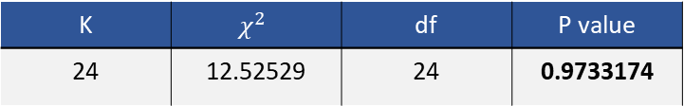
Candidate Model: Signal + Noise
Fitted Regressions
Model | Β₀ Estimate | Β_{t} Estimate | Std. Error | T value | P value
Raw Data | 34.86 | 0.072922 | 0.002122 | 34.36 | <2e-16
Cochran-Orcut | 9.32 | 0.07 | 0.004634 | 15.11 | <2e-16
Ljung-Box Test
K | $$χ^{2}$$ | df | P value
24 | 12.52529 | 24 | 0.9733174
Data Cleaning
$$\left(1−1.0534B+0.3194B^{2}\right)Z_{t}=a_{t}, where {\hat{σ}}_{a}^{2}=0.1178$$
Notes:
As mentioned earlier, we were able to identify a stock that would perform well using a Signal-Plus-Noise model as well as an AH-REE-MAH model.
First, we fit the trading prices over time in a linear model
We then ran the Cochrane-Orcutt test to confirm that the signal is deterministic
Next, we tested the residuals of the linear model with the Ljung-Box test to confirm the residuals are white-noise
As a result the model is listed at the bottom of the slide

Slide 7
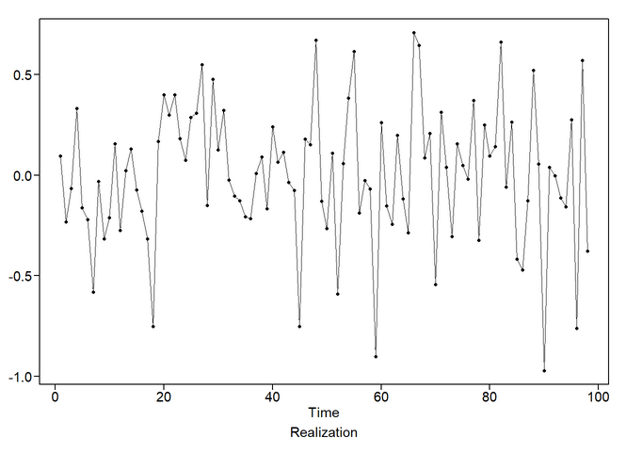
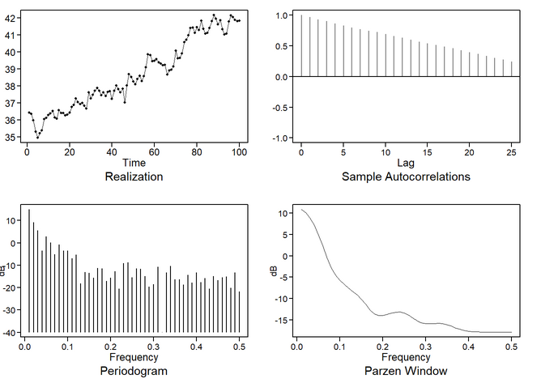
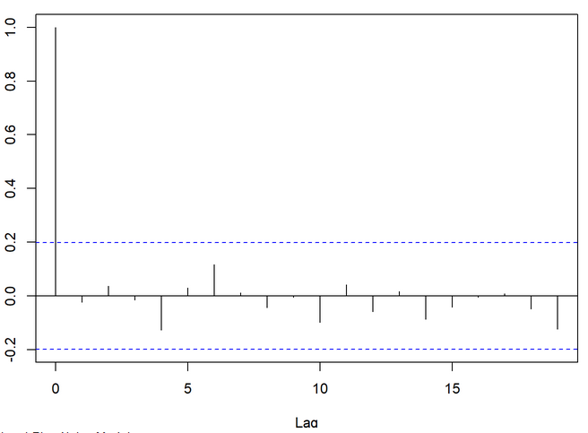
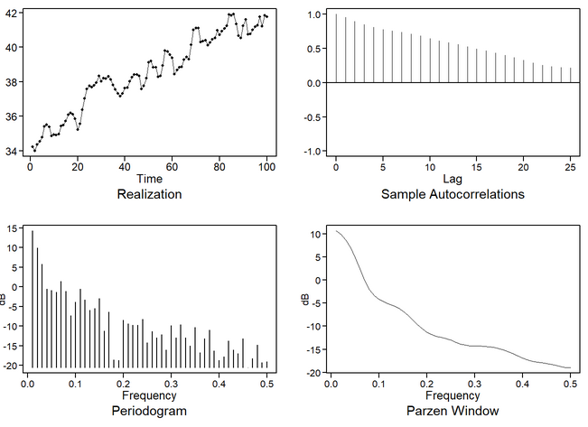
Candidate Model: Signal + Noise Continued
Evaluate model residuals to ensure signal has been pulled out
Simulated Model Data
Check ACF to ensure residuals are white noise
Original data
Notes:
The plots on the left show us the resulting white noise in the residuals after having the signal extracted
The plots on the right show us that the signal + noise model
Closely matches the ACF, Spectral density plots, and realizations of the original data
Alternatively we wanted to see how well an AH-REE-MA model would work -> next slide

Slide 8
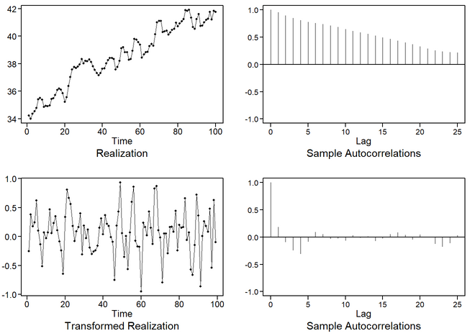
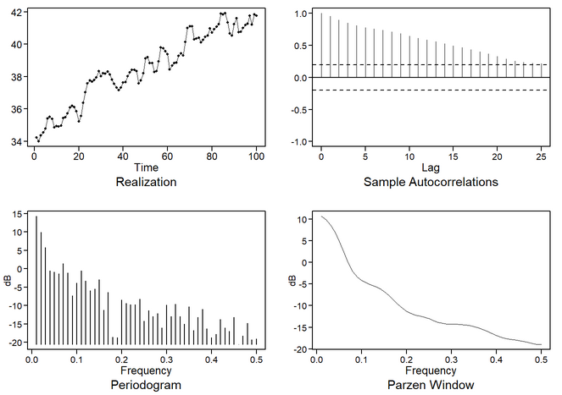
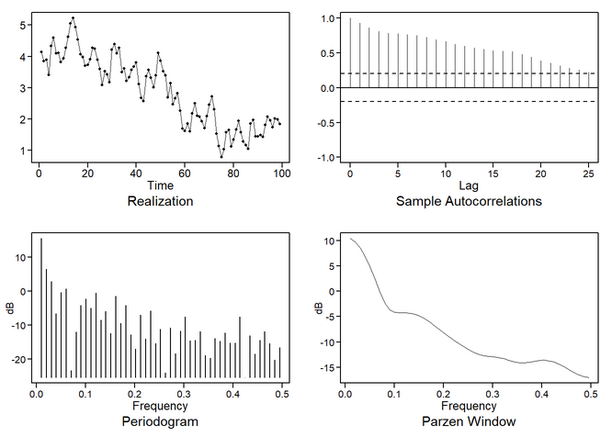
Candidate Models: ARIMA
$$\left(1−0.1227B+0.1183B^{2} −0.1454B^{3}+0.2587B^{4}−0.029B^{5}\right){(1−B)(X}_{t}+38.54)= a_{t},$$
$$where σ_{a}^{2}=0.0759$$
(1-B) Differenced data
Original data
Simulated model data
Notes:
The second model we fit was an AH-REE-MA(5,1,0).
We identified the model by using a factor table that contains a significant (1-B) factor
After applying the (1-B) difference, we were able to isolate a AR(5) model.
The resulting model can be seen at the top of the slide

Slide 9
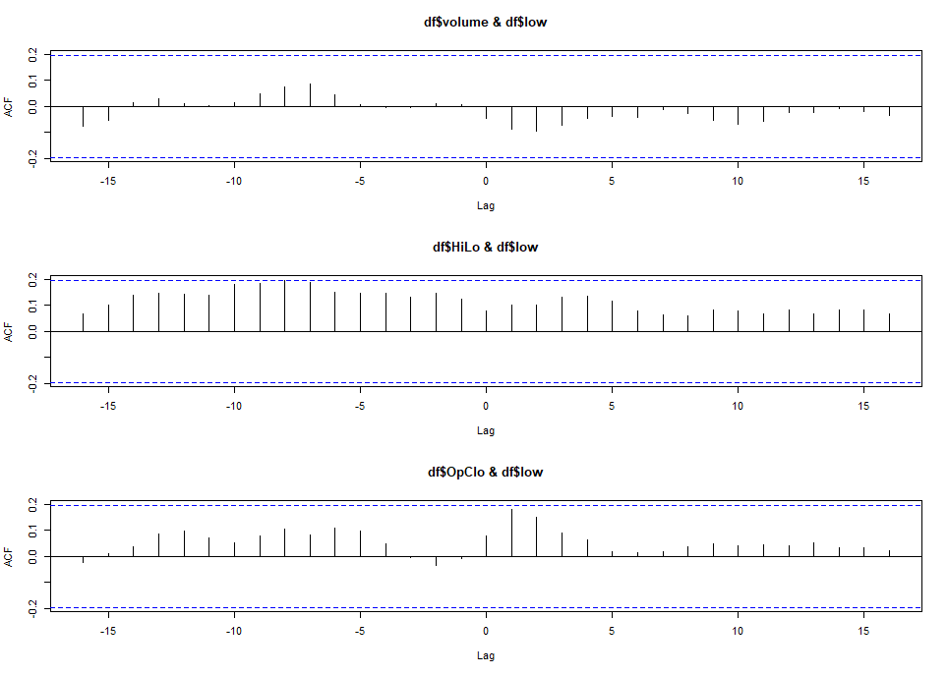
Candidate Models: VAR
VAR Model Captures Relationships between Variables
The spread of a day’s trading was captured by subtracting the stock’s high/low, and open/close pricing.
This was preformed to capture the variability of trading throughout the day
Cross-correlation function suggests we might need a lag at -8 for HiLo and low, however it is within the bound of the CI limits
Notes:
A vector autoregressive model was created incorporate any correlation that occurs between the features potentially allowing for a more robust model

Slide 10
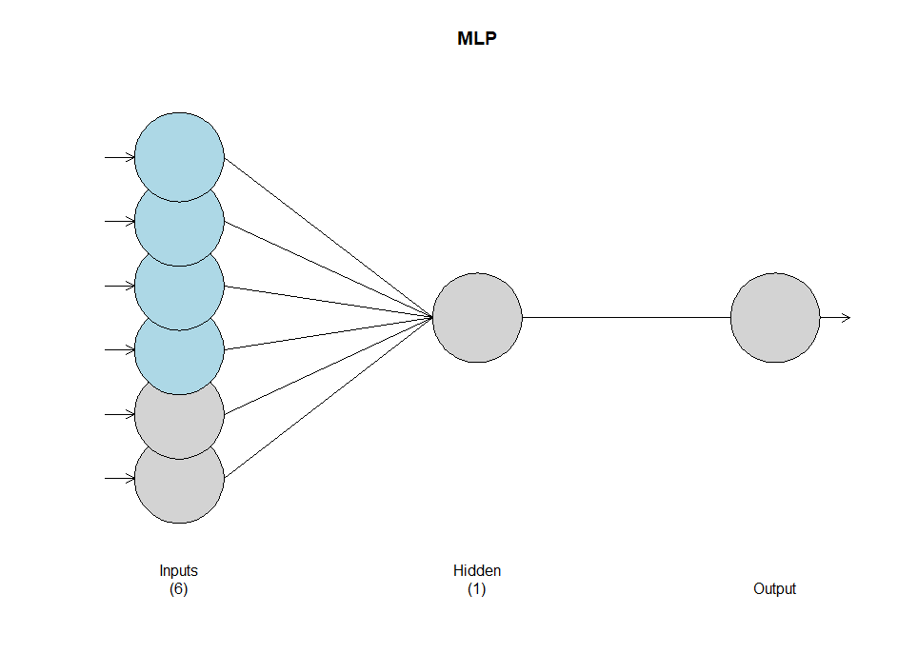
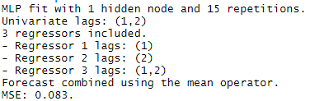
Candidate Models: Neural Networks
Multi-Layer Perceptron
NN model automatically identifies the appropriate ARIMA model and lags
This can save time when preforming EDA for ARIMA
Notes:
Our Multi-layered perceptron model contains:
- 4 regressors (time, volume, hilo, open/close) in blue
- 2 lags in grey

Slide 11

Candidate Models: Ensemble Model
Signal + Noise ARMA(2,1)
$$\left(1−1.2317B+0.4849B^{2} \right){(1−B)(X}_{t}+38.54)= {(1+B)a}_{t},$$
$$where σ_{a}^{2}=0.08494$$
Signal + Noise ARIMA(2,1,1) & Neural Net Ensemble Mode
+
Forecasts for both models were averaged to generate ensemble model
Resulting ASE preforms better compared to ARIMA and Signal + Noise alone
Notes:
This model combines our top two models
The performance is slightly better than out Signal + Noise,
NN alone however still preforms best

Slide 12
Candidate Models: Comparison
Model Comparison
Model | AIC | ASE* | Rolling ASE (Training Size 95)
Ensemble | N/A | 0.07 | 0.138
NN | N/A | 0.063 | 0.142
Signal + Noise ARMA (2,1) | -2.079 | 0.134 | 0.133
VAR | -2.275 | 0.113 | 0.187
ARIMA(5,1,0) | -2.002 | 0.203 | 0.394
*Forecast Practical horizon set to 5 days – emulates a NASDAQ trading week
Notes:
The multi-layer perceptron preformed the best followed by
Signal + Noise
Ensemble
Rolling ASEs were calculated for each model where ASEs were iteratively taken for a given training size.
This allows for more accurate ASEs as they will
The Practical forecast horizon for these models was set to 5 days – which is the same as a NASDAQ trading week

Slide 13
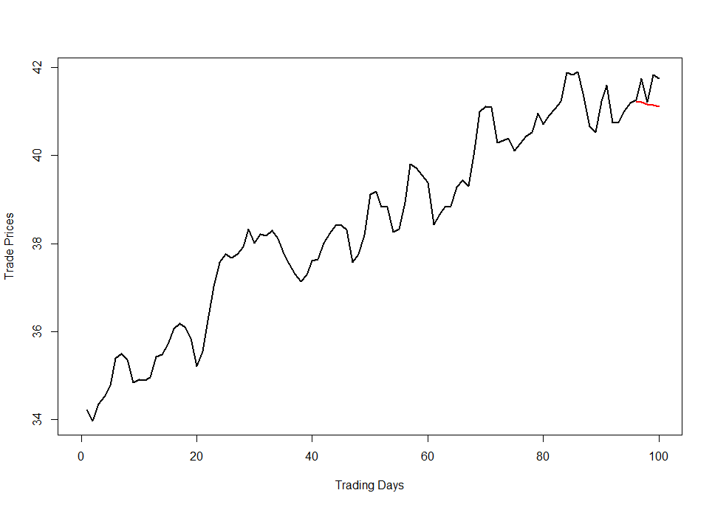
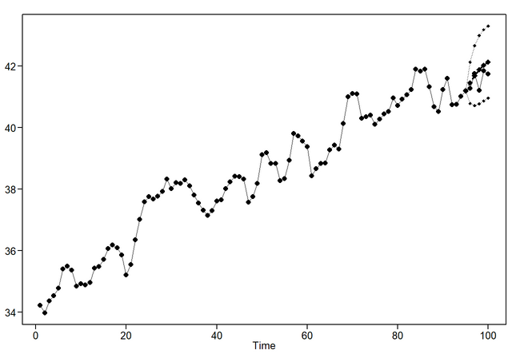
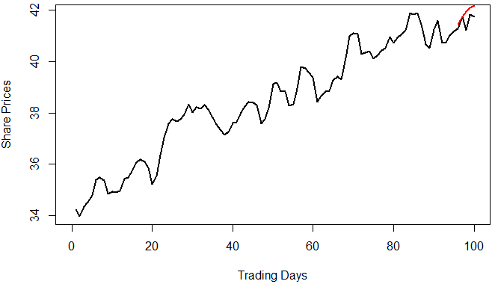
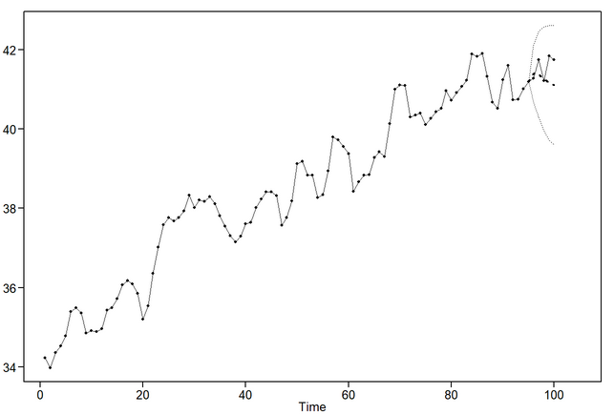
Candidate Models: Forecast Comparison
Signal + Noise Forecast
Vector Autoregressive
ARIMA Forecast
Notes:
- ARIMA and VAR forecasts both show a downward trend, while the signal + noise model shows an upward trend
All three forecasts do not follow the realization as well as we would like
For VAR and MLP models we have noticed that as we add features predictions move towards the trend

Slide 14
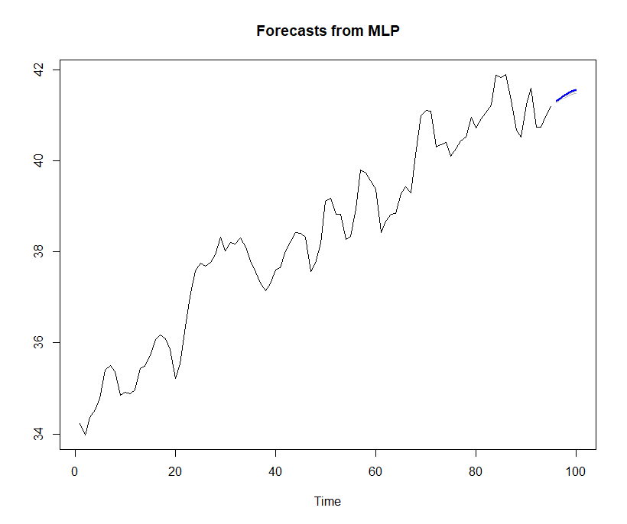
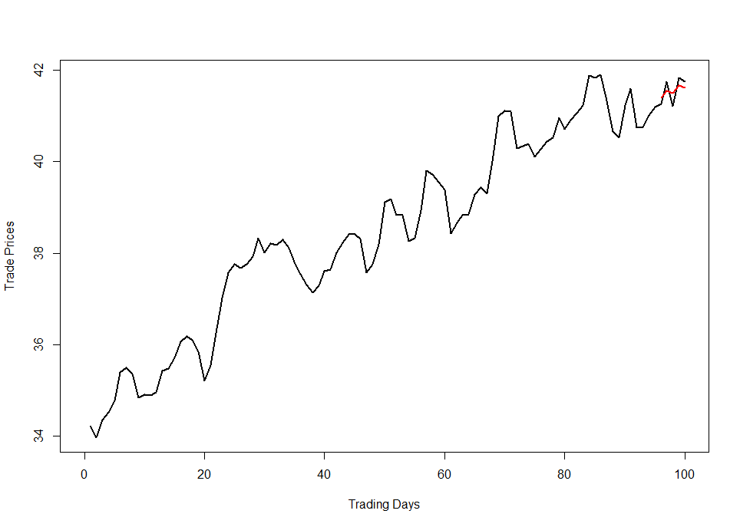
Candidate Models: Forecast Comparison
MLP
Ensemble
Notes:
- When comparing the MLP and Ensemble forecasts we can see that the Ensemble forecasts better match the last 5 observations
- This is due to the model taking on some of the ARIMA(2,1,1) properties

Slide 15
Conclusion
The Ensemble Model preformed the best as it had the lowest ASE
To increase the forecast horizon, more variables can be included in the model to better describe the data

