Slide 1
Map Reduce Architecture
Adapted from Lectures by
Anand Rajaraman (Stanford Univ.)
and Dan Weld (Univ. of Washington)
Prasad
L06MapReduce
Notes:
Problem Characteristics: Large scale – inherently parallel computations
Use novel architecture and cheap components (infrastructure)
for efficient and robust computations
Network commodity PCs
Employ data replication and redundant computations
Use FP inspired programming model : Map Reduce

Slide 2
Single-node architecture
CPU
Machine Learning, Statistics
Memory
“Classical” Data Mining
Disk
Prasad
L06MapReduce

Slide 3
Commodity Clusters
Web data sets can be very large
  Tens to hundreds of terabytes
Cannot mine on a single server (why?)
Standard architecture emerging:
  Cluster of commodity Linux nodes
  Gigabit ethernet interconnect
How to organize computations on this architecture?
  Mask issues such as hardware failure
Prasad
L06MapReduce

Slide 4
Cluster Architecture
2-10 Gbps backbone between racks
1 Gbps between
any pair of nodes
in a rack
Switch
Switch
Switch
CPU
CPU
CPU
CPU
Mem
…
Mem
Mem
…
Mem
Disk
Disk
Disk
Disk
Each rack contains 16-64 nodes
Prasad
L06MapReduce

Slide 5
Stable storage
First order problem: if nodes can fail, how can we store data persistently?
Answer: Distributed File System
  Provides global file namespace
  Google GFS; Hadoop HDFS; Kosmix KFS
Typical usage pattern
  Huge files (100s of GB to TB)
  Data is rarely updated in place
  Reads and appends are common
Prasad
L06MapReduce

Slide 6
Distributed File System
Chunk Servers
  File is split into contiguous chunks
  Typically each chunk is 16-64MB
  Each chunk replicated (usually 2x or 3x)
  Try to keep replicas in different racks
Master node
  a.k.a. Name Nodes in HDFS
  Stores metadata
  Might be replicated
Client library for file access
  Talks to master to find chunk servers
  Connects directly to chunkservers to access data
Prasad
L06MapReduce

Slide 7
Motivation for MapReduce (why)
Large-Scale Data Processing
  Want to use 1000s of CPUs
    But don’t want hassle of managing things
MapReduce Architecture provides
  Automatic parallelization & distribution
  Fault tolerance
  I/O scheduling
  Monitoring & status updates
Prasad
L06MapReduce
Notes:
Why

Slide 8
What is Map/Reduce
Map/Reduce
  Programming model from LISP
  (and other functional languages)
Many problems can be phrased this way
Easy to distribute across nodes
Nice retry/failure semantics
Prasad
L06MapReduce
Notes:
Generality
Efficient and robust implementation

Slide 9
Map in LISP (Scheme)
(map f list [list₂ list₃ …])
(map square ‘(1 2 3 4))
  (1 4 9 16)
Unary operator
Prasad
L06MapReduce

Slide 10
Reduce in LISP (Scheme)
(reduce f id list)
(reduce + 0 ‘(1 4 9 16))
  (+ 16 (+ 9 (+ 4 (+ 1 0)) ) )
  30
(reduce + 0
      (map square (map – l₁ l₂))))
Binary operator
Prasad
L06MapReduce

Slide 11
Warm up: Word Count
We have a large file of words, one word to a line
Count the number of times each distinct word appears in the file
Sample application: analyze web server logs to find popular URLs
Prasad
L06MapReduce

Slide 12
Word Count (2)
Case 1: Entire file fits in memory
Case 2: File too large for mem, but all <word, count> pairs fit in mem
Case 3: File on disk, too many distinct words to fit in memory
  sort datafile | uniq –c
Prasad
L06MapReduce
Notes:
How can file size be too large to fit into memory but wc-pairs can?
All files? Stop-words filtered out?
---
http://www.softpanorama.org/Tools/uniq.shtml
Syntax
uniq [ -cdu [ +n ][ -n ][ input [ output ] ] Options
-c Precedes each line with a count of the number of times it occurred in the input.
-d Deletes duplicate copies. Only one line out of a set of repeated lines is displayed.
-u Displays only lines not duplicated (uniq lines).
-n Ignores the first n fields of an input line when comparing for duplicate lines. A field is a string of nonblank characters. A blank is a space or tab.
+n Ignores the first n characters of an input line when comparing for duplicate lines.

Slide 13
Word Count (3)
To make it slightly harder, suppose we have a large corpus of documents
Count the number of times each distinct word occurs in the corpus
  words(docs/*) | sort | uniq -c
  where words takes a file and outputs the words in it, one to a line
The above captures the essence of MapReduce
  Great thing is it is naturally parallelizable
Prasad
L06MapReduce

Slide 14
MapReduce
Input: a set of key/value pairs
User supplies two functions:
  map(k,v) → list(k1,v1)
  reduce(k1, list(v1)) → v2
(k1,v1) is an intermediate key/value pair
Output is the set of (k1,v2) pairs
Prasad
L06MapReduce

Slide 15
Word Count using MapReduce
map(key, value):
// key: document name; value: text of document
for each word w in value:
emit(w, 1)
reduce(key, values):
// key: a word; value: an iterator over counts
result = 0
for each count v in values:
result += v
emit(key,result)
Prasad
L06MapReduce

Slide 16
Count,
Illustrated
  map(key=url, val=contents):
  For each word w in contents, emit (w, “1”)
  reduce(key=word, values=uniq_counts):
    Sum all “1”s in values list
    Emit result “(word, sum)”
  see 1
  bob 1
  run 1
  see 1
  spot 1
  throw 1
  bob 1
  run 1
  see 2
  spot 1
  throw 1
  see bob run
  see spot throw
Prasad
L06MapReduce

Slide 17
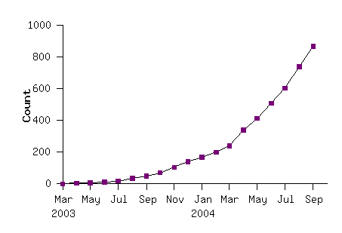
Model is Widely Applicable
MapReduce Programs In Google Source Tree
Example uses:
distributed grep |  | distributed sort |  | web link-graph reversal
term-vector / host |  | web access log stats |  | inverted index construction
document clustering |  | machine learning |  | statistical machine translation
... |  | ... |  | ...
Prasad
L06MapReduce

Slide 18
Implementation Overview
Typical cluster:
      100s/1000s of 2-CPU x86 machines, 2-4 GB of memory
      Limited bisection bandwidth
      Storage is on local IDE disks
      GFS: distributed file system manages data (SOSP'03)
      Job scheduling system: jobs made up of tasks, scheduler assigns tasks to machines
Implementation is a C++ library linked into user programs
Prasad
L06MapReduce

Slide 19
Distributed Execution Overview
User
Program
fork
fork
fork
Master
assign
map
assign
reduce
Input Data
Worker
write
Output
File 0
local
write
Worker
Split 0
read
Split 1
Worker
Split 2
Output
File 1
Worker
Worker
remote
read,
sort
Prasad
L06MapReduce

Slide 20
Data flow
Input, final output are stored on a distributed file system
  Scheduler tries to schedule map tasks “close” to physical storage location of input data
Intermediate results are stored on local FS of map and reduce workers
Output is often input to another map reduce task
Prasad
L06MapReduce

Slide 21
Coordination
Master data structures
  Task status: (idle, in-progress, completed)
  Idle tasks get scheduled as workers become available
  When a map task completes, it sends the master the location and sizes of its R intermediate files, one for each reducer
  Master pushes this info to reducers
Master pings workers periodically to detect failures
Prasad
L06MapReduce

Slide 22
Failures
Map worker failure
  Map tasks completed or in-progress at worker are reset to idle
  Reduce workers are notified when task is rescheduled on another worker
Reduce worker failure
  Only in-progress tasks are reset to idle
Master failure
  MapReduce task is aborted and client is notified
Prasad
L06MapReduce

Slide 23
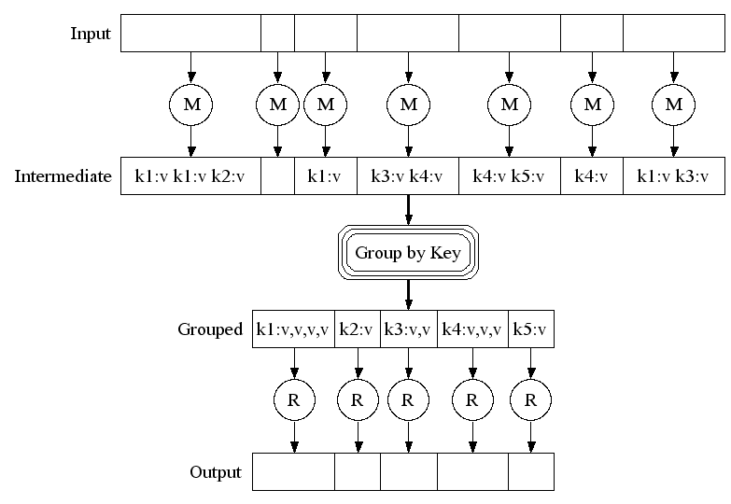
Execution
Prasad
L06MapReduce

Slide 24
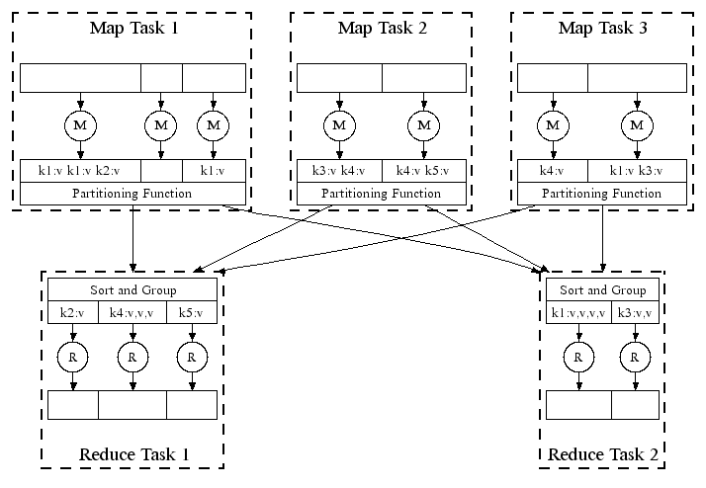
Parallel Execution
Prasad
L06MapReduce

Slide 25
How many Map and Reduce jobs?
M map tasks, R reduce tasks
Rule of thumb:
  Make M and R much larger than the number of nodes in cluster
  One DFS chunk per map is common
  Improves dynamic load balancing and speeds recovery from worker failure
Usually R is smaller than M, because output is spread across R files
Prasad
L06MapReduce

Slide 26
Combiners
Often a map task will produce many pairs of the form (k,v1), (k,v2), … for the same key k
  E.g., popular words in Word Count
Can save network time by pre-aggregating at mapper
  combine(k1, list(v1)) → v2
  Usually same as reduce function
Works only if reduce function is commutative and associative
Prasad
L06MapReduce

Slide 27
Partition Function
Inputs to map tasks are created by contiguous splits of input file
For reduce, we need to ensure that records with the same intermediate key end up at the same worker
System uses a default partition function e.g., hash(key) mod R
Sometimes useful to override
  E.g., hash(hostname(URL)) mod R ensures URLs from a host end up in the same output file
Prasad
L06MapReduce

Slide 28
Execution Summary
How is this distributed?
  Partition input key/value pairs into chunks, run map() tasks in parallel
  After all map()s are complete, consolidate all emitted values for each unique emitted key
  Now partition space of output map keys, and run reduce() in parallel
If map() or reduce() fails, reexecute!
Prasad
L06MapReduce

Slide 29
Exercise 1: Host size
Suppose we have a large web corpus
Let’s look at the metadata file
  Lines of the form (URL, size, date, …)
For each host, find the total number of bytes
  i.e., the sum of the page sizes for all URLs from that host
Prasad
L06MapReduce

Slide 30
Exercise 2: Distributed Grep
Find all occurrences of the given pattern in a very large set of files
Prasad
L06MapReduce

Slide 31
Grep
  Input consists of (url+offset, single line)
  map(key=url+offset, val=line):
    If contents matches regexp, emit (line, “1”)
  reduce(key=line, values=uniq_counts):
    Don’t do anything; just emit line
Prasad
L06MapReduce

Slide 32
Exercise 3: Graph reversal
Given a directed graph as an adjacency list:
src1: dest11, dest12, …
src2: dest21, dest22, …
Construct the graph in which all the links are reversed
Prasad
L06MapReduce
Notes:
Map: Create reversed edges
Reduce: Create adjacency lists

Slide 33
Reverse Web-Link Graph
Map
  For each URL linking to target, …
  Output <target, source> pairs
Reduce
  Concatenate list of all source URLs
  Outputs: <target, list (source)> pairs
Prasad
L06MapReduce

Slide 34
Exercise 4: Frequent Pairs
Given a large set of market baskets, find all frequent pairs
  Remember definitions from Association Rules lectures
Prasad
L06MapReduce

Slide 35
Hadoop
An open-source implementation of Map Reduce in Java
  Uses HDFS for stable storage
Download from:
http://lucene.apache.org/hadoop/
Prasad
L06MapReduce

Slide 36
Reading
Jeffrey Dean and Sanjay Ghemawat,
MapReduce: Simplified Data Processing on Large Clusters
http://labs.google.com/papers/mapreduce.html
Sanjay Ghemawat, Howard Gobioff, and Shun-Tak Leung, The Google File System
http://labs.google.com/papers/gfs.html
Prasad
L06MapReduce

Slide 37
Conclusions
MapReduce proven to be useful abstraction
Greatly simplifies large-scale computations
Fun to use:
  focus on problem,
  let library deal w/ messy details
Prasad
L06MapReduce

