Slide 1


CENTRE FOR DEVELOPMENT OF ADVANCED COMPUTING (C-DAC)
TILT SENSOR APPLICATION USING MPU6050 INTERFACED WITH BEAGLEBONEBLACK
Presenting by:
BHEEMSEN BAHARTI | 230950330005
BURAGADDA LOKESH | 230950330006
BURRA VINAY KUMAR | 230950330007
C.APARNA ABHISHREE | 230950330008

Slide 2
Table of Content
ABSTRACT
BLOCK DIAGRAM
COMPONENTS REQUIRED
SOFTWARE REQUIRED
CIRCUIT DIAGRAM
RESULTS
APPLICATIONS
CONCLUSION
REFERENCE

Slide 3
ABSTRACT
Engineering machinery alignment, human body motion detection, game controllers, ground motion, and land subdivision detection all use tilt as an altitude parameter. A mass's inertial response to a fixed enclosure is measured by tilt sensors. MEMS technology makes sensors smaller and cheaper. This project uses MPU6050 and BeagleBone Black microcontroller which communicate through I2C protocol to measure tilt angle. The accelerometer and gyroscope transform acceleration forces into 'g' values for application-level calibration.

Slide 4
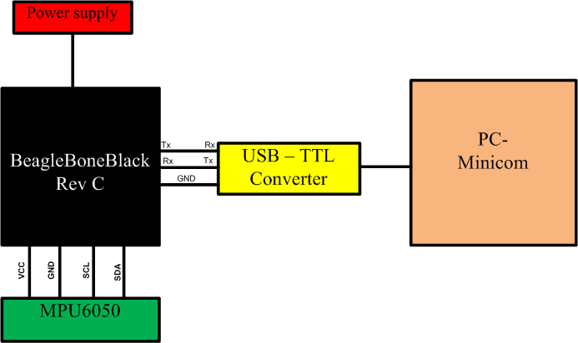
BLOCK DIAGRAM

Slide 5

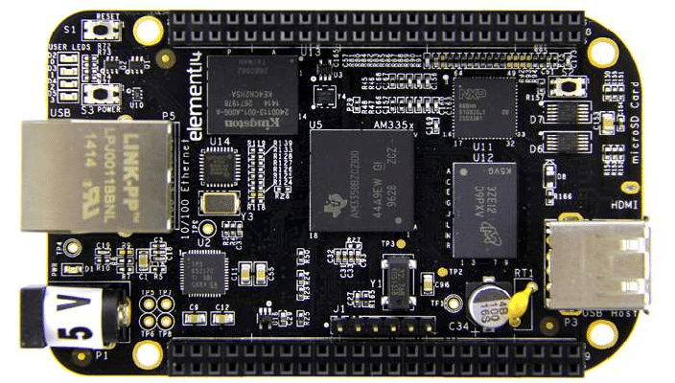
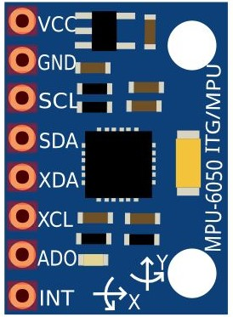
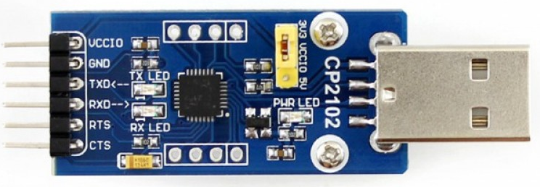
1.BeagleBone Black Rev C
2.MPU6050(Accel and Gyro Sensor)
COMPONENTS
3.USB to TTL convertor

Slide 6
EMBEDDED OS FOR BEAGLEBONEBLACK
BuildRoot-v.2023.02.9:
Buildroot is a framework that simplifies and automates the process of building a complete Linux system for an embedded system, using cross-compilation.
U-Boot-v.2020.04:
It generates MLO and U-boot image.
Linux-6.7.5:
To generate zImage.
Rootfs:
It consists of essentional system files and directories necessary for the system to operate.

Slide 7
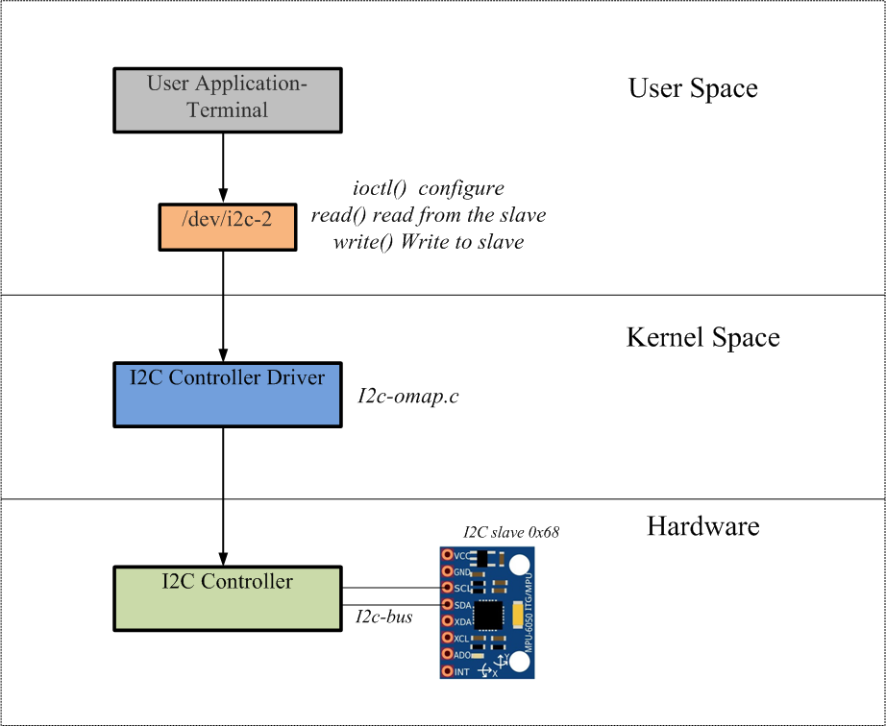
WORKING

Slide 8
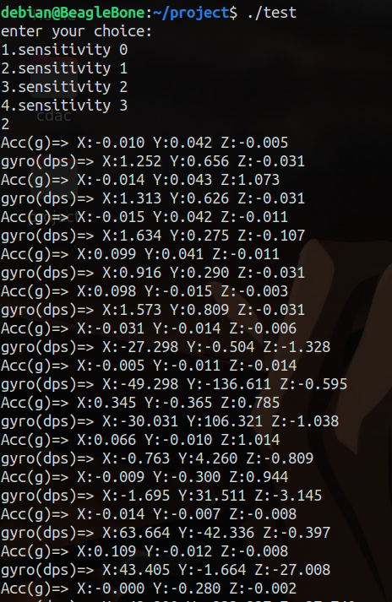
RESULT

Slide 9
APPLICATIONS
Gesture Recognition
Motion Tracking
Fall Detection
Vehicle Stability Control
Robotics Navigation
Sports Performance Analysis
Drone Stabilization
Health Monitoring
Virtual Reality
Navigation Systems of Ships and Aircrafts

Slide 10
CONCLUSION
MPU6050 tilt sensor project that interfaces with a Beaglebone Black was put into action. The research has several real-world applications, including posture detection, turning portrait to landscape mode on mobile phones, building health monitoring, and cruise/aircraft control methods.All three axes of the sensor were subjected to various directions of movement and rotation. Plotting the associated raw and "g" data revealed the change along each axis.

Slide 11
REFERENCE
1
Yan Li, Shen Mingxia, Yao Wen, Lu Mingzhou,, et al. Method of gesturerecognition for lactating sows based on MPU6050 sensor [J], Chinese Journalof agricultural machinery,.2015,46 (5): 279-285.
A Yudhana, J Rahmawan and C U P Negara,, based on Flex sensors andMPU6050 sensors responses on smart glove for sign language translation,Indonesia at 2017 IOP Conf. Series: Materials Science and Engineering 403(2018) 012032 doi:10.1088/1757-899X/403/1/012032
2
3
BBB_SRM Datasheet-https://cdn-hop.adafruit.com/datasheets/BBB_SRM.pdf
4
MPU6050Datasheet-https://pdf1.alldatasheet.com/datasheetpdf/view/1132807/TDK/MPU-6050.html

Slide 12
THANK YOU

