Slide 1
Intercity Car pooling System
Group 17
Guidance by
Mrs. Dhanashree Rangole

Slide 2
GROUP MEMBERS
Ashwini Abhijit Raut
(PRN:230943020016)
Aditi Pravin Helaskar
(PRN:230943020034)
Kajal Kailasrao Dudhe
(PRN:230943020040)
Shivani Deepak Natu
(PRN:230943020087)
Vidya Vishal Pawar
(PRN:230943020112)

Slide 3
Problem Statement
Online Inter-City Carpooling System could be divided into four main parts – Car owner part, User part, Admin part Acknowledgement part. The proposed system aims to provide a user-friendly platform that connects individuals looking to share rides for their daily commutes or occasional trips. In this project, offers comprehensive solution to the challenges posed by urban transportation. By harnessing the power of Java and MS .NET, the system provides a secure, users friendly, and technologically robust platform for individuals to connect, share rides, and collectively contribute to sustainable urban mobility. By connecting individuals with similar travel routes at preferences, the system promotes efficient MySQL used as backend and frontend technology we used two technology, most of the project features are implemented using Spring Boot(Java) and some features are implemented using .Net Core Framework.

Slide 4
ENTITIES
1)Car
2)Customer
3)Driver
4)Payment
5)Ride
6)Review

Slide 5
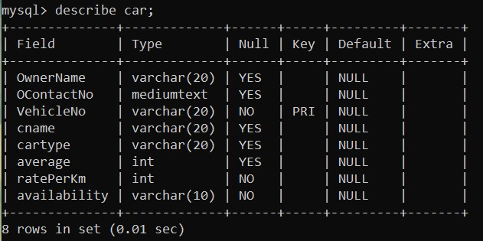
TABLE STRUCTURE FOR EACH ENTITY
1) CAR

Slide 6
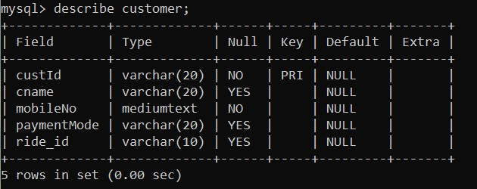
2) CUSTOMER

Slide 7
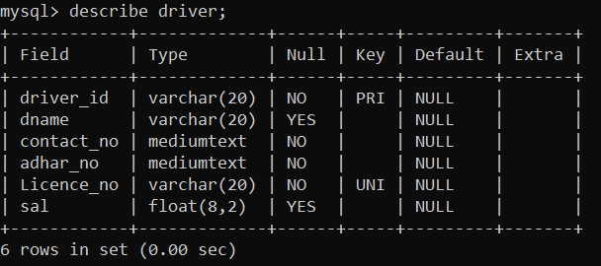
3) DRIVER

Slide 8
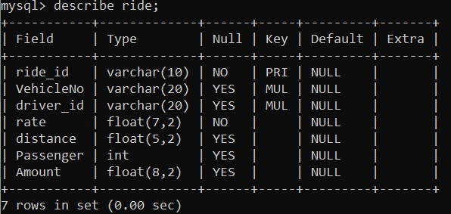
4) RIDE

Slide 9
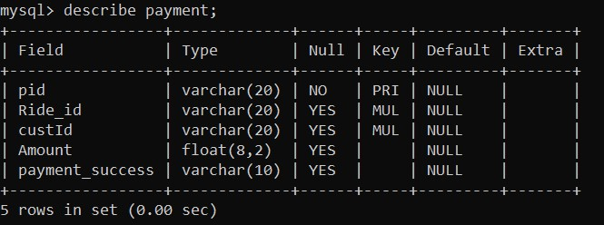
5) PAYMENT

Slide 10
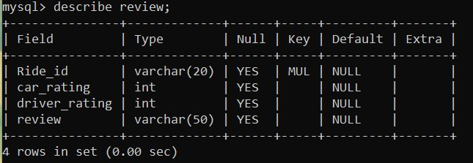
6) REVIEW

Slide 11
RELATIONSHIP
1)One-To-One:
a)Driver: car:- as one driver can drive only one car at a time.
b)Driver: Payment:-as driver receives one payment at a time.
c)Ride: Payment:-as one ride will have only one payment at a time.
d)Customer: Ride:-one customer will have only one ride at a time.
e)Customer: Payment:-One customer has one payment at a time.
2)One to Many:
a)Ride : Customer:- One ride can have multiple customers.
b)Car : ride:- One car can have multiple rides.

Slide 12
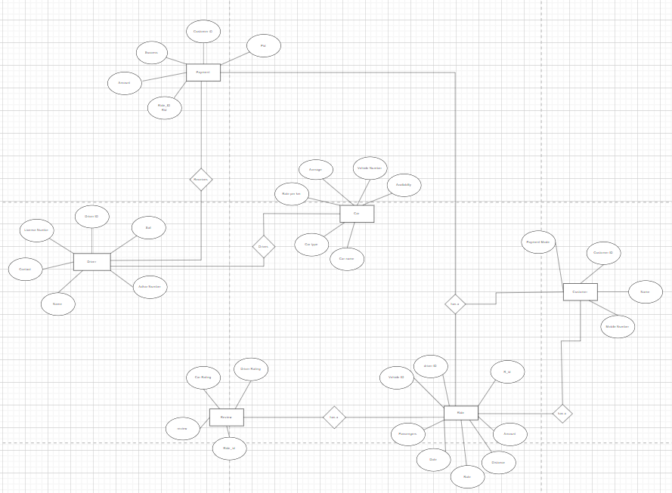
ER DIAGRAMS SCREENSHOT

Slide 13
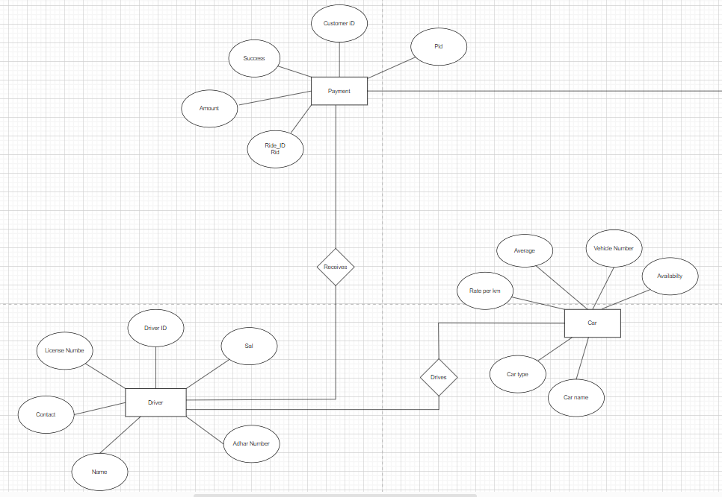
Relation between car, driver and payment table

Slide 14
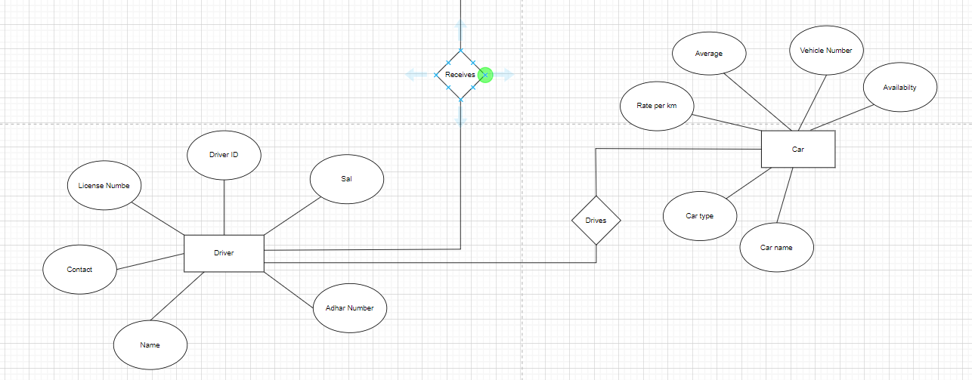
Relation between car and driver table

Slide 15
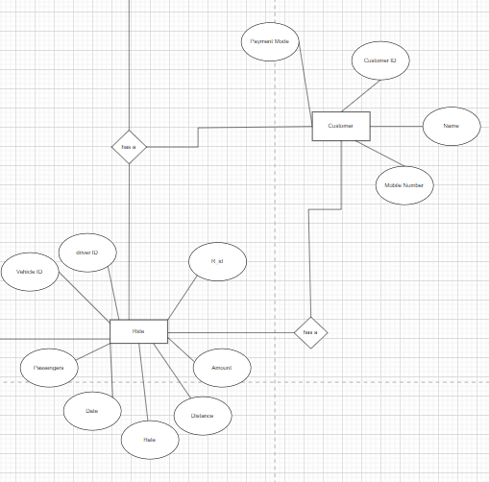
Relationship between customer and ride table

Slide 16
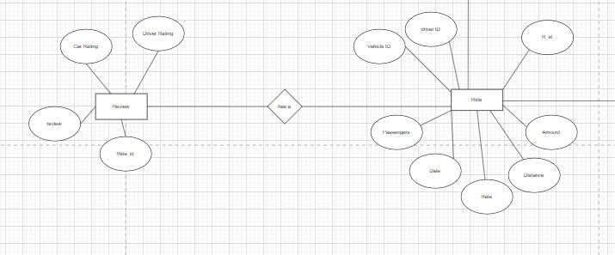
Relation between ride and review table

Slide 17
CLEARING RECORDS
To delete all the tables, drop commands are used.
drop table review;
drop table payment;
drop table ride;
drop table driver;
drop table customer;
drop table car;
drop procedure addride;
drop function amount;
drop trigger trig2;
delete from driver where driver_id='d1';

Slide 18
STORED PROCEDURES
procedure for inserting row in Ride:
delimiter ##
create procedure addride(in id varchar(10),in vno varchar(20),in did varchar(20),in rt float(7,2),in dist float(5,2),in psg int)
begin
insert into ride (ride_id,vehicleNo,driver_id,rate,distance,passenger)
values(id,vno,did,rt,dist,psg);
end ##

Slide 20
FUNCTIONS
Function to calculate total amount:
set global log_bin_trust_function_creators=1;
delimiter ##
create function amount(rt float(7,2),dist float(5,2),psg int) returns decimal(8,2)
begin
declare x decimal(8,2);
set x=rt* dist / psg;
return x;
end##
Updating amount column from ride using amount function:
update ride set amount=amount(rate, distance, passenger);

Slide 21
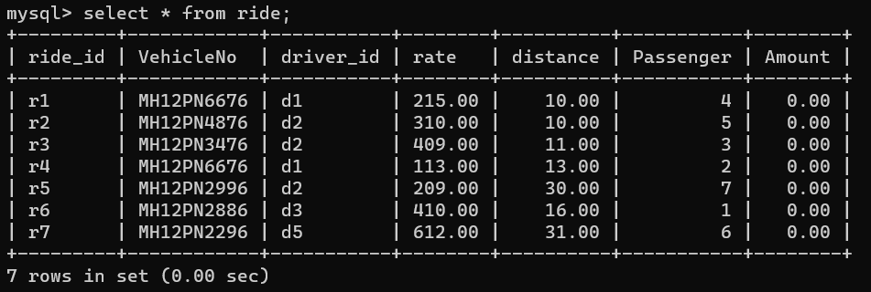
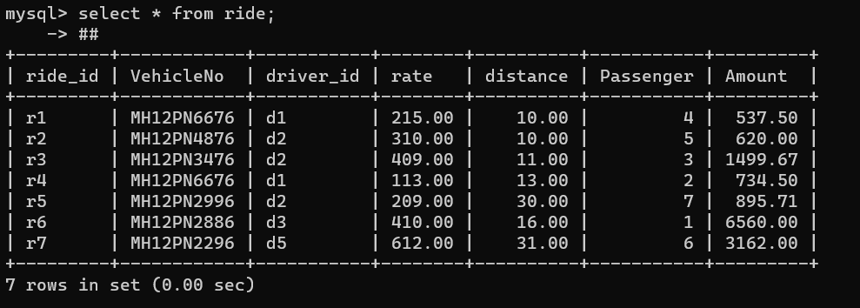
Application of amount function
Before applying function
Updation with amount function

Slide 22
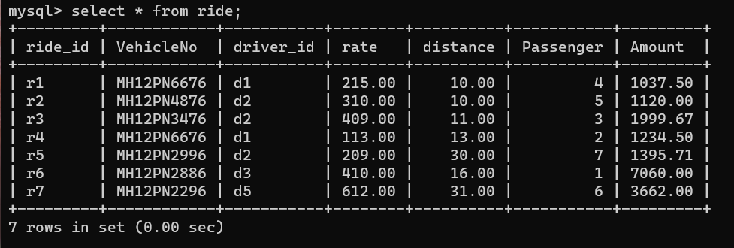
Trigger
Trigger before insert:
create trigger trig2
before insert on ride
for each row
set new. Amount=500+new.amount;
Trigger before update:
create trigger trig3
before update on ride
for each row
set new. Amount=500+new.amount;
Trigger for base fair of 500

Slide 23
Thank You!

