Slide 1
TN MARGINAL WORKERS
ASSESSMENT
(A Socioeconomic Analysis)

Slide 2
INTRODUCTION:
In this phase we are going to calculate the distribution of marginal workers based on age, industrial category, and sex using data aggregation and manipulation and create visualization using python libraries in this dataset.
Dataset link:https://tn.data.gov.in/resource/marginal-workers-classified-age-industrial-category-and-sex-scheduled-caste-2011-tamil

Slide 3
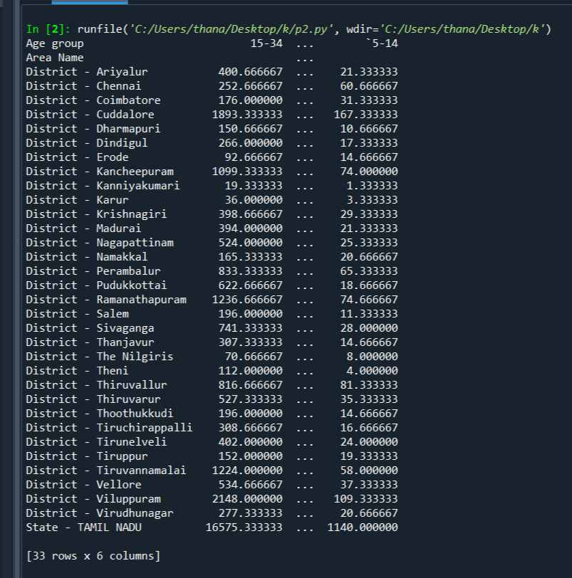
Finding the frequency of people based on age and their district for particular industrial Category using aggregate function:
import pandas as pd
impor matplotlib.pyplot as plt
data=pd.read_csv(“marginal-workers.csv”)
d=data.groupby([“Area Name” ,”Age group “])[“Industrial Category -A-Cultivators-Persons”].mean().unstack()
print(d)

Slide 4
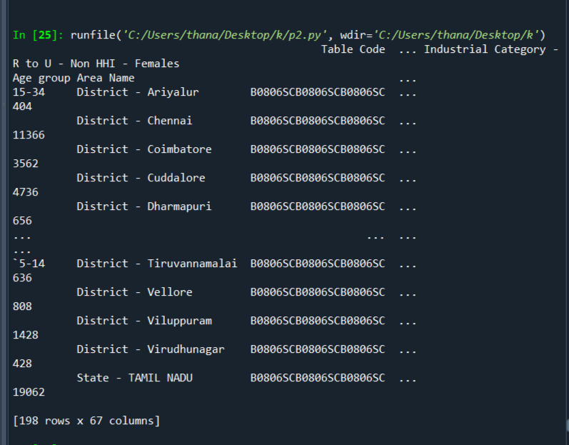
FINDING THE TOTAL NUMBER OF MARGINAL WORKERS BASED ON AGE AND DISTRICT:
import pandas as pd
impor matplotlib.pyplot as plt
data=pd.read_csv(“marginal-workers.csv”)
d=data.groupby([“Age group”,”Area Name”])
print(d.sum())

Slide 5
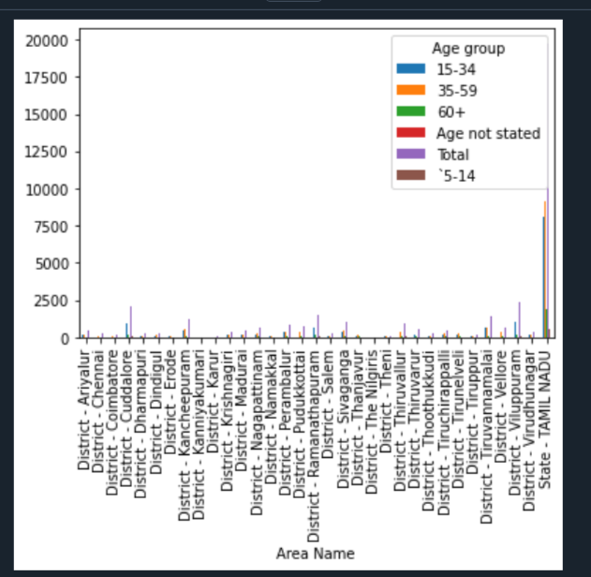
Finding the frequency of people based on age and their district for particular industrial Category :
import pandas as pd
impor matplotlib.pyplot as plt
data=pd.read_csv(“marginal-workers.csv”)
d=data.groupby([“Area Name” ,”Age group “])[“Industrial Category -A-Cultivators-Persons”].mean().unstack()
d.plot(kind=’bar’)
Plt show()

Slide 6
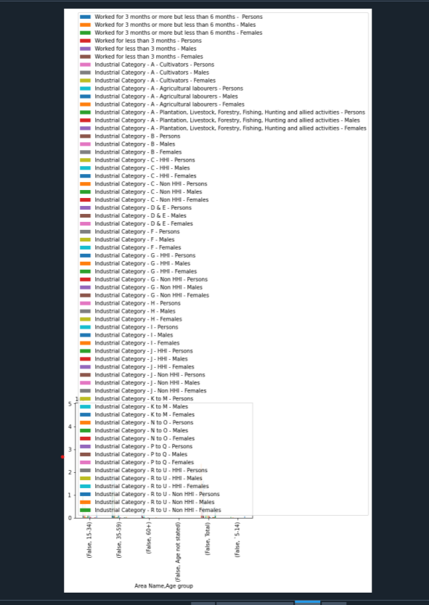
FINDING THE TOTAL NUMBER OF MARGINAL WORKERS BASED ON AGE AND IN A PARTICULAR DISTRICT:
import pandas as pd
impor matplotlib.pyplot as plt
data=pd.read_csv(“marginal-workers.csv”)
d=data.groupby([data[“Area Name”]==”District-Ariyalur”,”Age group”])
d.plot(kind=’bar’
Plt.show()

Slide 7
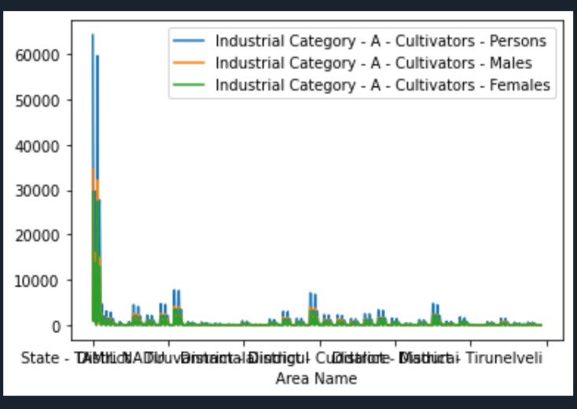
DISTRIBUTION OF MARGINAL WORKERS BASED ON SEX BY THEIR DISTRICT IN PARTICULAR INDUSTRIAL CATEGORY:
import pandas as pd
impor matplotlib.pyplot as plt
data=pd.read_csv(“marginal-workers.csv”)
data.plot(x=”Area Name”,y=[“Industrial Category -A-Cultivators-Persons”, Industrial Category -A-Cultivators-Males”,”Industrial Category -A-Cultivators-Females”])
Plt.show()

Slide 8
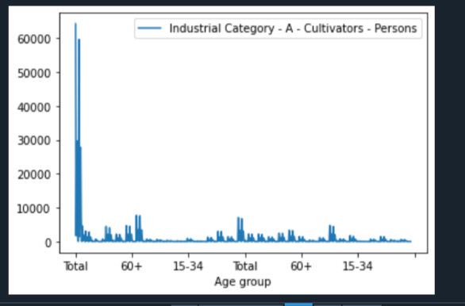
NUMBER OF MARGINAL WORKERS IN PARTICULAR CATEGORY BASED ON AGE:
import pandas as pd
impor matplotlib.pyplot as plt
data=pd.read_csv(“marginal-workers.csv”)
data.plot(x=”Age group”,y=”Industrial Category -A-Cultivators-Females”)
plt.show()

Slide 9
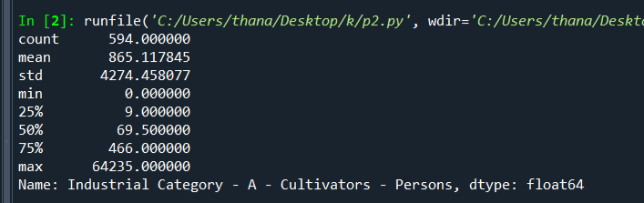
USING AGGREGATE FUNCTION IN INDUSTRIAL CATEGORY:
import pandas as pd
import matplotlib.pyplot as plt
data=pd.read_csv(“marginal -workers”)
Print(data[“Industrial Category -A-Cultivators-Persons”]. describe ())

Slide 10
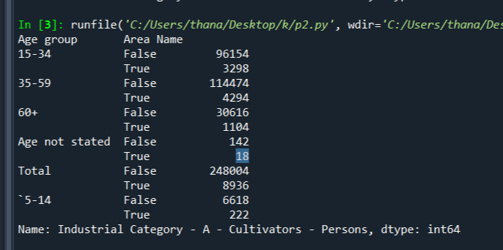
USING DESCRIBE FUNCTION FOR PARTICULAR INDUSTRIAL CATEGORY IN PARTICULAR DISTRICT:
import pandas as pd
import matplotlib.pyplot as plt
data=pd.read_csv(“marginal -workers”)
d=data.groupby([“Age group”],data[“Area Name”]==”District -Kancheepuram”])[“Industrial Category -A-Cultivators-Persons”].sum()
print (d)

Slide 11
Thank you….

