Slide 1
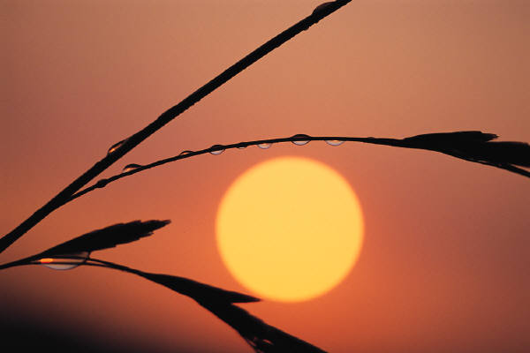
Si ya hamba ku ka nyen ee kwen kho see
We are marching in the light of God Oh Oh

Slide 2
Ra sila sila mielie mielie ngwa-na wa ba-tho! (2x)
O dar-lie wa tsa-ma-ya le-ra-to le fe-di-le (2x)

Slide 3
B B | A B | B B | A B
G G | D G | G G | D G
C B | A B | C B | A B
C G | D G | C G | D G

Slide 4
Thu-la thu’ thu-la mntwana, thu-la
sa-na.
Thul’ u-ma-m’u-zo-fi-ka e-ku-se-ni

Slide 5
C A F A | B G | B G E G | A F
C A F A | B G | B G | A F
A | G | G | A
A | G | G | A

