Slide 1
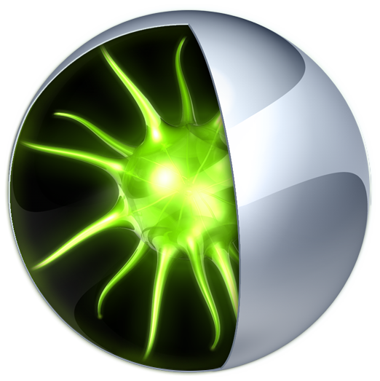
NVIDIA Parallel Nsight NVIDIA DevTech | Anton Obukhov

Slide 2
Что такое Parallel Nsight?
NVIDIA Parallel Nsight (aka Nexus) – Среда разработки приложений для гетерогенных платформ
Parallel Nsight интегрируется в Microsoft Visual Studio с целью обеспечить гетерогенность разработки

Slide 3

Windows Development Environment
CPU
GPU
Visual Studio
GPU Tools
Languages
Edit
Compiler
Build
Shader Debugger
Compute Debugger
Debug
Compute Profiler
Graphics Debugger
Profile
Graphics Profiler
Notes:
Today’s PC windows development environment is broken up into 2 very distinct sides: CPU tools with Visual Studio for coding, building, debugging and profiling your application, and GPU tools living outside of Visual Studio ecosystem to compile Compute kernel and Graphics shader languages, debug and profiler 3D APIs, Debug and profile Compute kernels, etc….
All of these GPU development activities are rather disconnected and distant from the main development environment – which on Windows happens to be Visual Studio – this is a big problem that leads to development time wasted jumping from one tool to another for each domain of computing activity.

Slide 4
… чего хотят разработчики
Visual Studio
CPU
GPU Code Browsing
Intellisense
Edit
GPU
CPU
CUDA Project System
Build
GPU
CPU
GPU Source and Graphics Debugger
Debug
GPU
Profile
CPU
GPU Performance Tools
GPU
Platform Analysis
CPU GPU
Notes:
What developers have been asking all along is to be able to manage their CPU and GPU application code and development activities in our place – Visual Studio. Being able to code, debug, profile, GPU and CPU code in one place. With the evolution of GPU Computing – from the GPU as a graphics processor to the CPU as a compute co-processor – it became clear that need to manage GPU source code required a similar treatment to what developers were used to have for CPU code. Long kernel or uber-shaders with lots of function needing Code Browsing capabilities, project systems to easily create GPU compute-enabled application, being able to debug and profile …
Another element we discovered is how critical it is not isolate the GPU in our GPU tools. Heterogeneous computing is about the CPU and the GPU, and the best way to utilize the 2 is to make sure that one can talk to the other without incurring stalls and transferring data efficiently from one another.
Quite a challenging request!

Slide 5
NVIDIA Parallel Nsight
Возможность разработки для CPU и GPU в едином цикле разработки приложения
Отладка кода на самом GPU
Анализ активности
Интеграция с Visual Studio 2008
Notes:
So here comes NVIDIA Nexus!
This is NVIDIA’s answer to what developers have been asking for. Nexus enables the developer to create applications for heterogeneous platforms – platforms that have a multi-core CPU and a data parallel GPU.
Nexus allows the developer to code, debug and profile GPU code with the same level of comfort as a CPU - within Visual Studio. It also provides the developer with the tools to help understand what is going on on the CPU and the GPUs, to make sure that these computing resources are well fed and the data travelling through the bus between them is optimally set up.
All of this is happening within Visual Studio 2008 SP1 – with a lot of effort spent on creating a smooth user experience that respects Visual Studio design philosophy.

Slide 6



Parallel Nsight Overview
Microsoft Visual Studio 2008 SP1
Parallel Nsight
Build
Debug
Profile
CUDA Project System
DirectX Frame
HLSL Source
DirectX Frame
System Trace: OS, CUDA, DirectX, OpenCL, OpenGL/Cg, and User events
CUDA
DirectX HUD and Experiments
User Application
C/C++
CUDA, OpenCL and DirectCompute
DirectX10/DirectX11 and OpenGL
C-CUDA, OpenCL C-99, and HLSL
HLSL
CPU
GPU
Notes:
Nexus has been built on a client server architecture – where the host, ie the client, is hosted in Visual Studio, and the target, ie the server, runs on any Vista/Win7 32 and 64 bit system.
This architecture model allows Nexus to deal with performance critical user scenarios where running the host on the same system as the application would bias the performance measurements too much. It is important to note that the client and server could be on the same machine too – this enables local activities whenever it makes sense.
With version 1.0 of Nexus, the application developer can build cuda application using a new Visual Studio project system, debug new and existing DirectX and CUDA applications, and profile and analyze its application.
Nexus Debugger supports a native GPU source code debugger for the CUDA and Graphics architecture. Version 1.0 allows developer to debug CUDA-C, DirectCompute and HLSL code for pixel and vertex shaders.
In addition to its debugging capabilities, Nexus supports a comprehensive set of performance analysis activities dedicated to assist the developer within a heterogeneous computing context. Namely, the system trace provides a great way for the developer to visualize the various platform activities on a unique timelines where it is easier to understand the duration of the workload and their interdependencies.
Because of the Visual Studio integration, it becomes easier to spot an issue with Nexus, being correctness or performance related, stop the application, quickly change the code and rerun the application – no need to jump back and forth between a collection of standalone applications.

Slide 7
Native GPU Debugging
Отладка на GPU, без эмуляции
Точное соответствие результатов FPU
GPU останавливается на breakpoint
Исследование различных пространств памяти
Высокая эффективность/скорость отладки
Notes:
Why can’t I use an emulator? Why can’t I run on x86 and debug my CUDA-C or OpenCL C-99 code?
Because it is just not behaving the exact same way on the GPU. A GPU has 10000 of active threads going on in the system. Typical emulation path are serializing or just running a few threads at the same time – making any barrier synchronization issues hard if not impossible to recreate. Any time you want to make your CUDA-C kernel optimal, usage of shared memory is a must have…and therefore one needs to be careful with __syncthreads__. Debugging these kind of issues on emulation impossible.
Furthermore, GPU Debugging shields the developer against any possible arithmetic mismatch between the CPU ALU and the GPU ALU – what you see is what the GPU has.
When you debug the GPU, all the sms are paused – allowing the debugger to inspect the state the processor and reading its memory – there is no need to code additional memory copies to debug what is currently in the GPU memory…
Essentially, native GPU debugging creates a much faster and efficient way to get to the bottom of your code and get your application running.

Slide 8
Parallel Nsight CUDA Debugger
Сериализация запусков kernel’ов
Контроль на уровне Warp’ов и пошаговое исполнение
Visual Studio debugger фокусирование на треде
Поддержка встренных окон Visual Studio
Variables, Watch, Memory, Registers, Modules, Processes, and Threads
Notes:
Nexus GPU Debugger
The Nexus CUDA Debugger serializes the kernel launches in the driver. This allows us to respond to a kernel hitting a breakpoint in a way that is more manageable. Even multi-context CUDA application are serialized.
The granularity of execution of the run control is at the warp level – basically, when we hit a breakpoint, we freeze all the active warps and debug the warp that executes the thread in focus. It is only when we step over a barrier (or syncthread) that the debugger lets all the warps catch up.
It is necessary to support native Visual Studio debugger and environment views including breakpoints, local variables, watch with full expression engine, memory, register, module, process, and thread.

Slide 9
Parallel Nsight CUDA Debugger
Улучшения Parallel Nsight Debugger
Несколько точек останова по данным и на инструкциях
Вычисление выражений «на лету»
CUDA focus picker
Вычисление выражений поддерживает иерархию памяти
CUDA memory (bounds) checker
Notes:
GPU Debugging
The Nexus Debugger had to extend Visual Studio to accommodate of the data and massive thread parallelism nature of GPU Computing.
Since the whole GPU memory is available to the programmer, and while managing your index domain can sometime lead to erroneous and unexpected memory accesses, we had support data break points in a non restricted way – this really help catching kernel memory side effects. Furthermore, we added the ability add an infinite amount of breakpoint to minimize the number of debug sessions…
It is important to note that conditional breakpoint are evaluated on GPU itself – which makes it more faster than for example, evaluating conditions on the CPU for each potential breakpoint. Imagine having to check thousands to millions of conditions per launch in Visual Studio?
The type of conditions is limited to the block and thread ID so that one can definitely efficiently debug their index domain mapping bug. In the future, we will add support for kernel variable evaluation in the break point condition…
We had to extend Visual Studio with a facility to easily navigate through the thousands of threads – it is called the CUDA Focus Picker – a simple GUI to easily pick the thread you want to debug, based on your kernel grid and block dimensions, and what is resident on the GPU.
We also added a CUDA summary view that help view the active warps, PCs, etc… as you step through the CUDA code.
At last, CUDA Memory Checker detects out of range and misaligned accesses before exceptions occur – this is a life saver for these type bug.
But rather than going through the complete list of features, lets go through a demonstration of Nexus’ typical use with a CUDA-C sample that I have prepared…

Slide 10

Heterogeneous Computing Example
CPU
GPU
Time
Initialization
GPU Memory
Patch of 3D vertices
DeviceToHost memcpy
Sine function
High_frequency_sinusoid
glDrawArray(…)
Notes:
My CUDA-C sample is supposed to represent a typical heterogeneous computing sample – where the CPU and GPU collaborate to run the application.
So at the start, the CPU allocate GPU memory and kicks off a kernel that computes some fancy data, which is then sent back to the host…in response, the CPU does some additional derivative work…after the CPU work is completed, we kick off 2 consecutive kernels – a low frequency Sinesoid and a high frequency Sinesoid that both contribute to generating a cloud of point that will be rendered in OpenGL via the graphics interop extensions of CUDA.
This is a typical GPU-computing pattern.

Slide 11
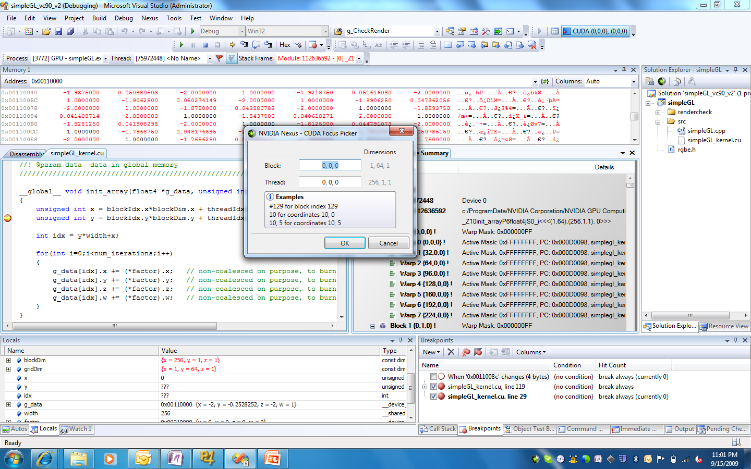
Parallel Nsight C-CUDA Debugger Demo
Notes:
Nexus CUDA Debugger
See Demo script for the NexusGtcDemo

Slide 12
Platform Analysis
Сбор данных об активности
OS – process, thread and module events
CPU API Trace – CUDA driver API, DirectX, OpenGL, OpenCL, Cg2.2 and User Events
GPU Task Trace – C-CUDA and OpenCL launches and memory copies
Отчетность о времени, событиях, вызовах, API, загрузке GPU
Notes:
The Nexus Platform Analysis activity allows the developer to better understand what is happening on the platform as a whole – this really helps getting a birds-eye view of how the application is stressing the computing resources, data travelling back and forth, tasks and system dependencies, and how long workloads take.
A Nexus Analysis session is capable of collecting a variety of OS-level events like process, thread, thread switch and module events - CPU API events for knowing when function calls are taking place and for how long – here we currently support CUDA driver, DirectX 10 and 11, OpenGL 3.2, OpenCL, Cg 2.2. Nexus also allows to trace the GPU workloads resulting from these API calls – drawcall, kernel launches, memory copies,… and capture when and how long do these take to execute.
There is also the possibility for the application developer to annotate the source code with our Custom Event API which will help trace various tasks and sequences in the Host code.
For Nexus 1.0, we are also aiming at snapping call stacks for certain event records to help narrowing where certain calls are coming from.
As part of the analysis activity, a collection of summary pages, statistics and call logs are supported…

Slide 13
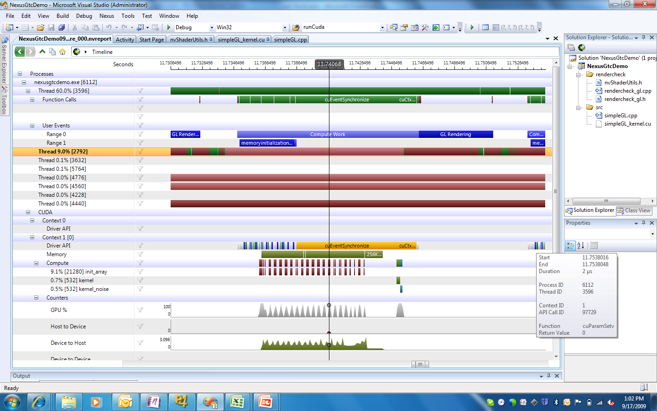
Parallel Nsight Platform Analysis Demo
Notes:
Lets go back to our synthetic heterogeneous computing sample and see what information we can gather by using the Nexus Platform Analysis feature…
Look at the Demo script /Analysis session for the NexusGtcDemo

Slide 14
Профилирование CUDA
Базовая информация
Memory coalescing
Branch divergence
Instructions executed
Warp serialization
Используются счетчики инструкций и часы на GPU
Notes:
Nexus Platform Analysis support a basic CUDA profiling feature. It allows the user to configure the counters to be sampled during a profiling sessions.
The most useful type of counters are memory coaslescing, branch divergence, warp serialization, # instruction executed…
All of the counters are HW counter. In addition to these, other SW counter are available and sampled in the Trace.
In the future, we will be adding more higher level counters such as instructions per cycle, stall reasons, and frame buffer bandwidth.

Slide 15
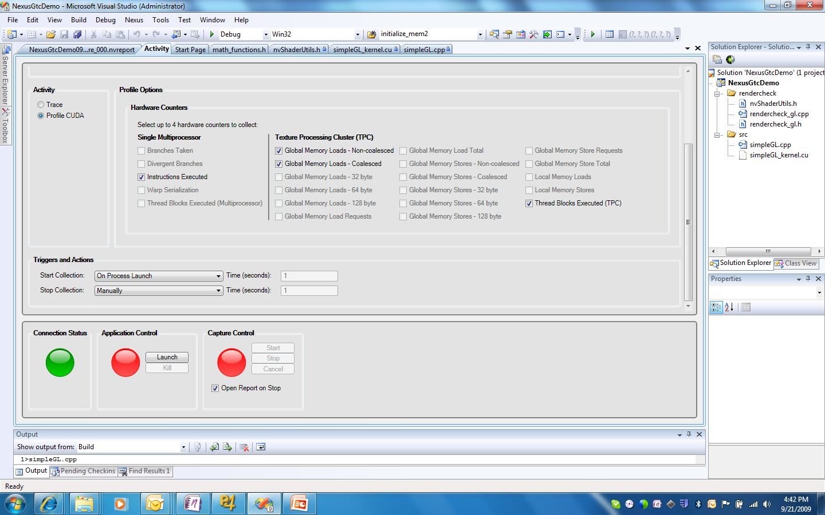
Parallel Nsight CUDA Profiler
Notes:
Here is a just a screenshot of the Profiler

Slide 16
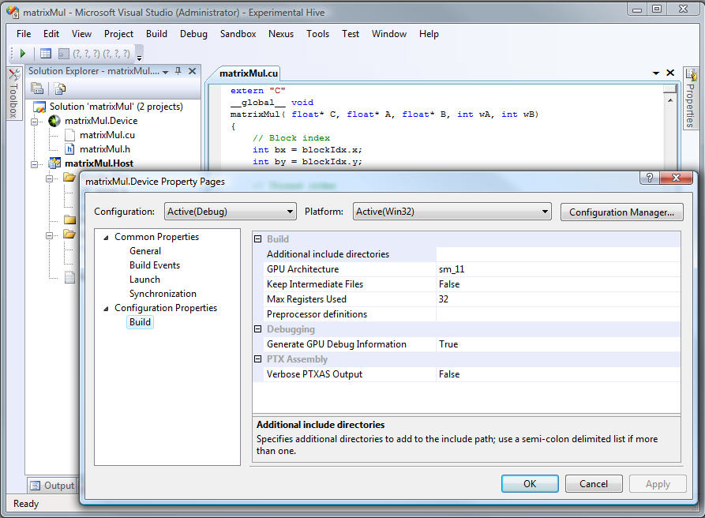
Parallel Nsight Build
C++ project system
Parallel Nsight options
CUDA vsprop files
CUDA project system
NVCC build integration
Error reporting
Debugger session
Notes:
Nexus Build
The Nexus Build systems allows the user to configure its use of visual studio in 2 ways: extend C++ projects or using the new CUDA project system.
Extending existing C++ projects can be done with a separate set of properties that can be attached to the normal project. It can be found in the Project Panel with the Nexus icons – it brings the user all the options for configuring how the application can be launched (command line options, working directory), locally or remotely. It also offers the possibility to configure what files and directories have to be synchronized on the target platform in order to execute a remote activity.
In addition to this, CUDA compilation can defined within the C++ project properties with a custom vsprop files. This mechanism allows the CUDA programmer to configure the compilation options via properties and combobox selection – removing the need to know all the nvcc command line options by heart.
Nexus also introduces a new set of project types for CUDA runtime and CUDA driver type of applications. This CUDA project provides an even tighter integration within Visual Studio where compilation options, build errors and Visual Studio Debugger commands are bound to the native Visual Studio systems. For example, F5 will start a CUDA Debugger session as opposed to Nexus -> Start CUDA Debugger for a C++ project extended by Nexus.

Slide 17
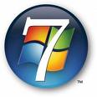
Поддерживаемые OS
32 bit
64 bit
32 on 64
Windows Vista SP1
Windows 7

Slide 18
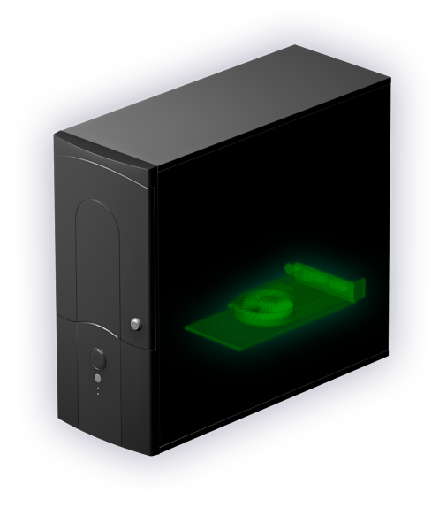
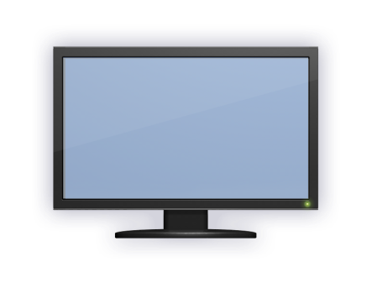
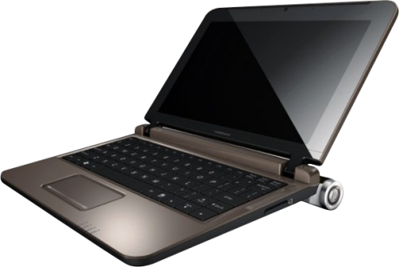
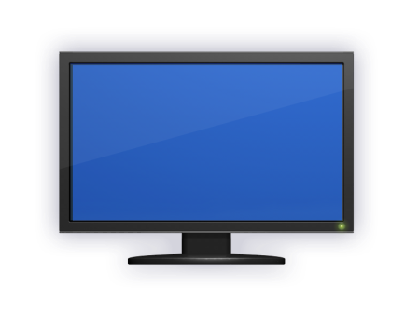
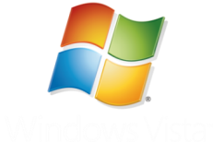
Системные требования
Удаленная отладка
Desktop
Mobile
Notes:
SLI system
SLIMOS system
Remote system
Tesla GT2xx
G92, GT2xx, …and Fermi

Slide 19
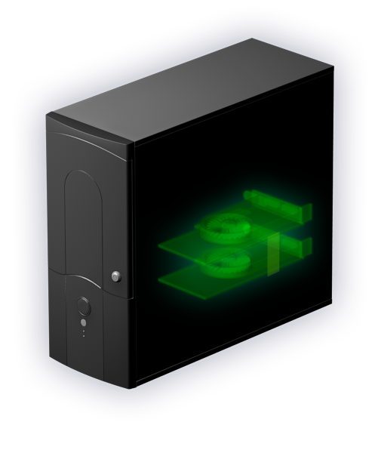

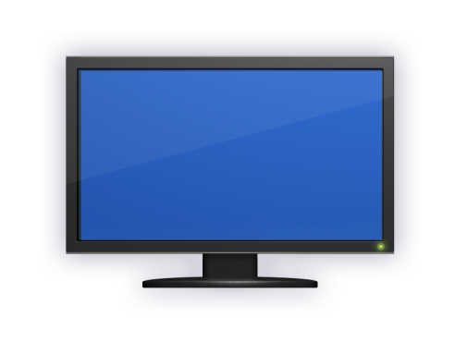

Системные требования
Локальная отладка
SLI Multi-OS
Multi-GPU
Full GPU acceleration
Full GPU acceleration

Slide 20

Системные требования
Локальная отладка
Any NVIDIA Optimus laptop

Slide 21
Живое Демо & Q/A
Настройка Parallel Nsight Project в Visual Studio
Отладка с Parallel Nsight
Анализ и профилирование с Parallel Nsight
Parallel Nsight Memory Checker
Становитесь зарегистрированным разработчиком уже сегодня:
http://developer.nvidia.com/object/nsight.html

