Slide 1
a crash course on machine learning with intel® LIBRARIES
Zhang Zhang
SSG/DPD

Slide 2
Agenda
Introduction
A brief intro to basic machine learning concepts.
A quick intro to Intel Data Analytics Acceleration Library and Intel Distribution for Python.
Lab activities
Warm-up exercises: Learn the gist of PyDAAL API
Linear regression
Classification with SVM
K-Means clustering
PCA
Conclusions

Slide 3
Install Intel® Distribution for Python
Install Anaconda 4.1.11 (https://www.continuum.io/downloads)
Python 3.5 version is recommended
From the Anaconda shell prompt:
conda config --add channels intel
conda create --name idp intelpython3_full python=3
activate idp (Windows)
source activate idp (Linux, OS X)
For detailed instructions:
https://software.intel.com/en-us/articles/using-intel-distribution-for-python-with-anaconda

Slide 4
Download Lab Materials
Clone my repository:
git clone https://github.com/daaltces/pydaal-tutorials.git
Or, download it as a ZIP file:
https://github.com/daaltces/pydaal-tutorials/archive/master.zip

Slide 5
Overview – Machine Learning
Machine Learning
Transformation and analysis
Descriptive statistics
Dimensionality reduction
Anomaly detection
Supervised Learning
Classification
Regression
Unsupervised Learning
Clustering
Supervised learning
Develop predictive model based on input and responses
Regression: Responses are continuous
Classification: Responses are discrete
Unsupervised learning
Group and interpret data based only on input

Slide 6
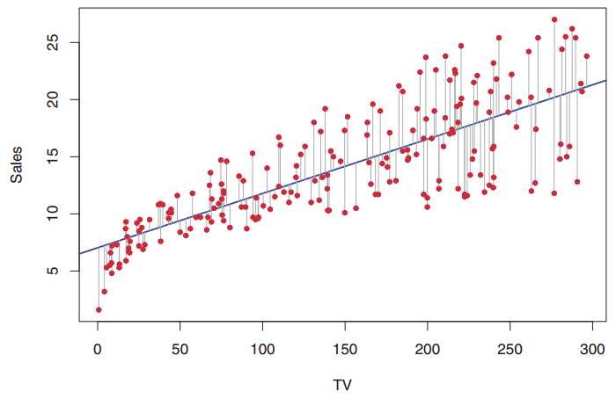
Linear Regression
What is it doing?
A linear model for relationship between features and the response.
Source: Gareth James, Daniela Witten, Trevor Hastie, Robert Tibshirani. (2014). An Introduction to Statistical Learning. Springer

Slide 7
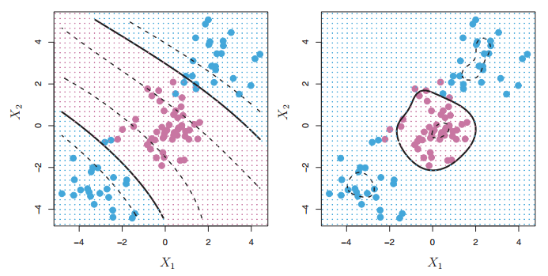
Support Vector Machine (SVM)
Separate data based on the maximum margin hyperplane.
Work well for non-linear decision boundary
Two kernel functions are provided:
Linear kernel
Gaussian kernel (RBF)
Multi-class classifier
One-vs.-One
Source: Gareth James, Daniela Witten, Trevor Hastie, Robert Tibshirani. (2014). An Introduction to Statistical Learning. Springer

Slide 8
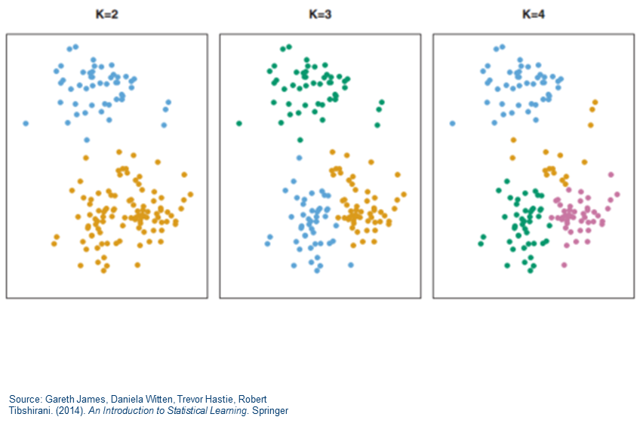
K-Means Cluster Analysis
What is it doing?
Pick k centroids
Repeat until converge:
Assign data points to the closest centroid
Re-calculate centroids as the mean of all points in the current cluster
Re-assign data points to the closest centroid
Can be used to:
See natural grouping in data
Identify outliers
Preprocess data before supervised learning

Slide 9
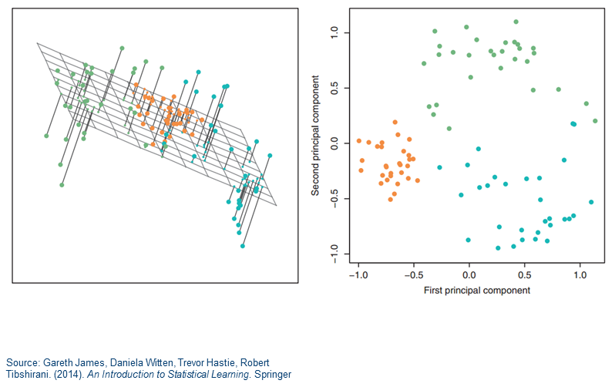
Principal Component Analysis
What is it doing?
Compute eigen decomposition on the correlation matrix
Apply the largest eigenvectors to compute the largest principal components that can explain most of variance in original data
Can be used to
Reduce number of variables
Remove noise

Slide 10





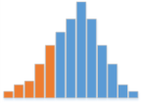
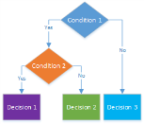
Intel® Data Analytics Acceleration Library (Intel® DAAL)
An industry leading, C++/Java/Python library for machine learning and deep learning optimized for Intel® Architectures.
Scientific/Engineering
Pre-processing
Transformation
Analysis
Modeling
Validation
Decision Making
Web/Social
Business
(De-)Compression
Statistical moments
Quantiles
Variance matrix
QR, SVD, Cholesky
Apriori
Anomaly detection
Linear regression
Classification
Naïve Bayes
SVM
Classifier boosting
Clustering
Kmeans
EM GMM
Collaborative filtering
ALS
Neural Networks

Slide 11
Intel DAAL Main Features
Building end-to-end data applications
Optimized for Intel architectures, from Intel® Atom™, Intel® Core™, Intel® Xeon®, to Intel® Xeon Phi™
A rich set of widely applicable algorithms for data mining and machine learning
Data connectors to a variety of data sources and formats: KDB*, MySQL*, HDFS, CSV, and user-defined sources/formats
Batch, online, and distributed processing
C++, Java, and Python APIs

Slide 12
Intel DAAL Open Source Project
Apache 2.0 license
Accepting community contributions
Allow third-party, open source math libraries (BLAS/LAPACK)
With performance impacts
Fork me on Github: https://github.com/01org/daal

Slide 13
Intel® Distribution for Python
Numerical packages acceleration with Intel® performance libraries (MKL, DAAL, IPP)
Better parallelism and composable multi-threading
(TBB, MPI)
Profiling Python and mixed language codes
(VTune)
Language extensions for vectorization and multi-threading
(Cython, Numba, Pyston, etc)
Integration with Big Data and Machine Learning platforms and frameworks
(Spark, Hadoop, Theano, etc)
Notes:
Python scientific/ML packages acceleration with Intel native libraries
Python packages: NumPy, SciPy, Scikit-Learn, Theano, Pandas, pyDAAL, etc.
Intel native libraries: MKL, IPP, DAAL
Python language extensions that exploit vectorization and threading
Cython + Intel C++ compiler
Numba + Intel LLVM
Better/Composable threading
GIL releasing technologies: Cython, Numba, Pyston
Intel TBB based threading composability for MKL, CPython, Blaze/Dask, Numba
Multi-node parallelism
Python packages: Mpi4Py, Distarray
Intel native libraries: Intel MPI
Integration with Big Data and Machine Learning platforms/frameworks
Spark, Hadoop, TAP, etc.
Better performance profiling
Intel VTune extensions for profiling mixed Python & native/JIT codes

Slide 14
Approaches to Near-Native Performance
Enable hooks to Intel® MKL, Intel® DAAL, Intel® IPP functions in the most popular numerical packages
NumPy, SciPy, Scikit-Learn, PyTables, Scikit-Image, …
Available through Intel® Distribution for Python* and as Conda packages
Most optimizations eventually upstreamed to home open source projects
Provide Python interfaces for Intel® DAAL (a.k.a PyDAAL)

Slide 15
Performance Gain from MKL (Compare to “vanilla” SciPy)
Configuration info: - Versions: Intel® Distribution for Python 2017 Beta, icc 15.0; Hardware: Intel® Xeon® CPU E5-2698 v3 @ 2.30GHz (2 sockets, 16 cores each, HT=OFF), 64 GB of RAM, 8 DIMMS of 8GB@2133MHz; Operating System: Ubuntu 14.04 LTS.
Linear Algebra
BLAS
LAPACK
Sparse BLAS
Fast Fourier Transforms
Multidimensional
FFTW interfaces
Cluster FFT
Vector Math
Trigonometric
Hyperbolic
Exponential
Power
PARDISO* SMP & Cluster
Iterative
Log
Root
ScaLAPACK
Sparse Solvers
Up to 100x faster
Up to 10x faster!
Up to 10x faster!
Vector RNGs
Summary Statistics
And More
Multiple BRNG
Kurtosis
Variation coefficient
Min/max
Variance-covariance
Interpolation
Splines
Order statistics
Trust Region
Fast Poisson Solver
Support methods for independent streams creation
Support all key probability distributions
Up to 60x faster!
Notes:
MKL covers a broad spectrum of mathematical domains, from sparse and dense linear algebra for both multicore and clusters, FFTs for multicore and clusters, vector math, vector RNGs, special routines for statistical analysis and more.

Slide 16
pyDAAL (Python API for Intel DAAL)
Turbocharged machine learning tool for Python developers
Interoperability and composability with the SciPy ecosystem:
Work directly with NumPy ndarrays
Faster than scikit-learn
We’ll see how to use it in this lab

Slide 17
Lab Activities Interactive Tutorial Using Jupyter Notebooks
Lab setup, from the Anaconda prompt:
If your environment is not ‘idp’ yet:
activate idp
Proxy settings:
http_proxy = http://proxy-us.intel.com:911
https_proxy = http://proxy-us.intel.com:912
Start Jupyter Notebook
jupyter notebook
notebooks are running inside your browser

Slide 18
Lab 1: Warm-up Exercise
Learning objectives:
Understand NumericTable - The main data structure of DAAL
Create NumericTable from data sources
Interoperability with NumPy, Pandas, scikit-learn
Get NumPy ndarray from NumericTable
Understand code sequence of using DAAL API
Create an algorithm object
Pass in input data
Set algorithm specific parameters
Compute
Get results

Slide 19
Lab 2: Linear Regression
Learning objectives:
Understand the 2 regression algorithms currently available in DAAL
Linear regression without regularization
Ridge regression
Learn supervised learning workflow
Train a model using known data
Test the model by making predictions on new data
Visualize prediction results

Slide 20
Lab 3: Classification with SVM
Learning objectives:
Understand SVM algorithm usage model
Multi-class classification with SVM
Two-class classification with SVM
Understand quality metrics in classification
Confusion matrix
Metrics computed using the confusion matrix (accuracy, etc.)

Slide 21
Lab 4: Clustering with K-Means
Learning objectives:
Understand the K-Means algorithm supported in DAAL
Learn basic clustering workflow
Initialize cluster centroids
Minimize the goal function
Visualize clusters

Slide 22
Lab 5: Principal Component Analysis
Learning objectives:
Understand PCA algorithms support in DAAL:
Correlation matrix method
SVD method
Evaluate and visualize principal components

Slide 23
References
Intel DAAL User’s Guide and Reference Manual
https://software.intel.com/sites/products/documentation/doclib/daal/daal-user-and-reference-guides/index.htm
Intel Distribution for Python Documentation
https://software.intel.com/en-us/intel-distribution-for-python-support/documentation

Slide 24
What’s Next - Takeaways
Learn more about Intel® DAAL
It supports C++ and Java, too!
We want you to use DAAL in your data projects
Learn more about Intel® Distribution for Python
Beyond machine learning, many more benefits
Keep an eye on the tutorial repository
https://github.com/daaltces/pydaal-tutorials
I’m adding more labs, samples, etc.

Slide 25
Static Slides
Please keep following slides at end of your presentation

Slide 26
Questions?

Slide 27
Session Evaluation
ilnevents.intel.com
on your smartphone or computer

