Slide 1
Cork: Dynamic Memory Leak Detection for Garbage-Collected Languages
A tradeoff between efficiency and accurate, useful results

Slide 2
Introduction
The authors: Maria Jump and Kathryn S. McKinley
Cork: help programmers find and fix memory leaks by identifying data structures that grow during execution of a program
Novel and efficient: Yes
Portable: Yes. It can be used with polymorphic languages like Java or C#; it can be used with any garbage collection routines (reachability vs. liveness)
Scalable: Yes, tested with large and small programs
Accurate and useful: Maybe
Notes:
Maria Jump and K. Mckinley: MJ is an assistant professor of CS at King’s College; KM is a microsoft researcher and professor of CS at the university of Texas Austin.
Reachability and liveness will be discussed in other papers

Slide 3
In the following
What’s the problem?
Memory Leak
The problem with previous work on memory leaks
Contributions and Weaknesses
Is Cork novel, efficient?
Challenges
Is Cork accurate and useful?
Future Work

Slide 4
The problem
Memory Leak
Identify the leak and then find out what is referring to the objects
Notes:
With automatic garbage collection, the garbage collector will periodically free all the objects that can no longer be reached from the running program. Problems arise when an object that is more permanent still refers to a temporary object after the temporary object is no longer needed.
Example (Pauw 1999):
A program has a set of stable objects. When an operation is performed, for example opening a temporary dialog window, temporary objects are created. When the widow is closed, the reference from the stable to the temporary objects is removed and the garbage collector should remove the temporary objects. The problem (memory leak) occurs when the stable objects get to know about some of the new objects. The garbage collector will not reclaim those objects. To resolve the leak, you need to identify the leak and then find out what is referring to these objects.

Slide 5
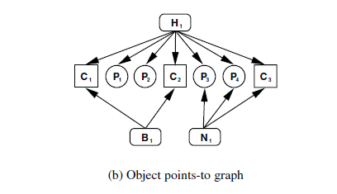
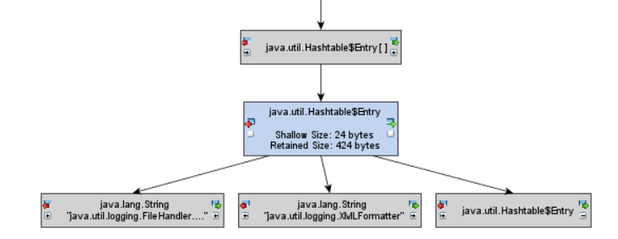
Previous Work
Heap Differencing
Degrade performance
Memory Overhead
Low-level details
Separate Processor
Notes:
Heap Differencing: Take two snapshots of the program’s object population: one just before and one after some “critical operation.” To identify the leak: The objects that are not garbage collectable (as identified by the Java virtual machine’s internal garbage collection routines) are assigned a unique identifier. The objects that are not in the second snapshot are the ones that could not be collected after the operation completed – the leaking objects.
To find out what is referring to the objects, heap differencing captures all the references between the stable and temporary objects. This information can be represented as an Objects points-to graph
According to the authors of the Cork paper, the techniques degrade performance by a factor of two or more, incur substantial memory overheads, rely on multiple executions, and/or offload work to a separate processor. Additionally, they yield large amounts of low-level details about individual objects. These reports require a lot of time and expertise to interpret. Thus, prior work lacks efficiency and precision.

Slide 6
Contributions and Weaknesses
“We improve on the efficiency of these techniques. However, they differentiate in use objects from those not in use, adding additional information to their reports.”
Cork is portable, scalable, and efficient. The tradeoff is accuracy.
A tool for cursory examination
Notes:
Briefly, we can acknowledge that Cork is portable, scalable, and efficient. The tradeoff is accuracy: less information to find out what is causing the leak. The authors even state this in the introduction: “We improve on the efficiency of these techniques. However, they differentiate in-use objects from those not-in use, adding additional information to their reports.” If the tool were readily available, I would use it as kind of a first-look tool to gather information on the types that need to be looked at.

Slide 7
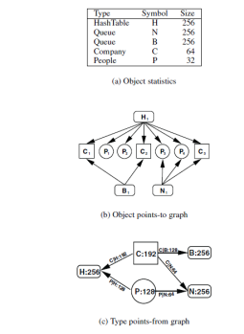
Cork is Novel, Efficient
Previous works looked for objects not in use, Jump had the idea to track type growth
Notes:
Cork is efficient: the figure compares the objects points-to graph with Cork’s Type points-from graph (TPFG). We can see that it is smaller ergo more efficient. Basically what it says, the Company type has a size of 192. Company type C is referenced by Queue B. Of Queue B’s total size of 256, Company type C contributes 128 to the size.

Slide 8
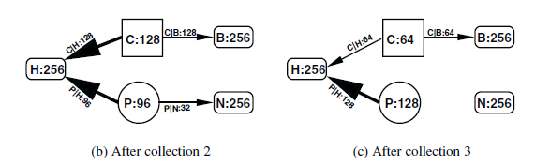
Candidate Leaks
Notes:
To find the growth, Cork compares the TPFG and reports the type nodes whose volumes increase across several collections as candidate leaks. Additionally, for each node that is growing, Cork follows the growing reference edges to pinpoint the growth. In the figure, you can see that type node P is growing from 96 to 128; and you can pinpoint the growth as coming from the Hash table by following the reference edges.

Slide 9
Challenges
Volume Jitters, Ratio Ranking: Growing types are not necessarily memory leaks
Multiple data structures contributing to type nodes
Slice: the type to look at and the dynamic data structure containing them
Inter-procedural: considers the calling structures
Context-insensitive: a unified solution
Notes:
One of the challenges was to remove “volume jitters”. A jitter occurs when the volume of a type fluctuates. To identify the true/real volume growth, they used two different techniques; they discussed the Ratio Ranking Technique in the paper.
Another challenge occurs when you have multiple data structures contributing to the type nodes. You have to cull the data structures; this example is presented in the paper’s run on Eclipse.
Another challenge is to identify which types you want to track. They identify what they want to track by tacking a slice of the TPFG (same figure as above but working backwards). The slice contains the type that needs to be looked at as well as the dynamic data structures containing them. However, it does not find the specific code responsible for the growth; rather, it reports all the code responsible for propagating that type (p. 33 and 34: includes the method and byte-code index or line for each allocation site).

Slide 10
Accurate and Useful?
Memory Leak: identify leak and find/fix the code creating leak
“Cork is accurate: it identifies systematic heap growth with no false positives in 4 of 15 benchmarks we tested.”
SPECjbb2000 and Eclipse: Ratio Ranking and Slicing
Notes:
In the paper, they discussed the tests on the SPECjbb2000 and Eclipse. The techniques used to identify type nodes and data structures of interest (Ratio Ranking Technique and Slicing) revealed multiple types and structures, thus making it difficult to rank their importance (the Eclipse example had a few potential data structures the authors needed to hone). The authors had to go into the code to look for and fix the leaks. So this is a problem…

Slide 11
Future Work
Rayside 2007 Object Ownership Profiling: Report a hierarchy of allocated objects along with size, staleness, and interactions; Slows the program down by a few orders of magnitude and doubles the memory required to run the program – Match tool to the problem
Xu 2008 Precise Memory Leak Detection: track memory consumption AND “staleness” (time since last retrieval) 88.5% run-time overhead; Cork only adds 2.3% to execution time and uses less than 1% of the heap
Notes:
Rayside 2007, Object Ownership Profiling: A Technique for Finding and Fixing Memory Leaks
Cork [22] extends the garbage collector to build a type-points-from graph as it walks over the objects in the heap. This technique has remarkably low time and space overhead. Since the structure that Cork infers uses a type-based abstraction, it would have more difficulty diagnosing problems that require an object-based abstraction, such as tangled ownership contexts or zombie-references. However, if a type-based abstraction is sufficient to describe the memory leak in question, Cork is a very efficient way to track it down.
Xu 2008: the complex run-time reference relationships among objects in modern Java software significantly increases the difficulty of locating the source of the leak, which could lead to imprecise leak reports. It becomes even harder to find the cause of a leak if there are multiple data structures that are contributing to the problem. For example, as reported in [Cork Paper], it took the authors a significant amount of time to find the sources of leaks after they examined the reports generated by Cork.
Xu: in addition, the dynamic analysis leak detection approaches start by considering the leak symptoms (e.g. staleness or growing types), and then attempt to trace back to the root cause of the leak. In short, the complexity of such bottom-up tracking makes it hard to generate precise analysis reports, and ultimately puts a significant burden on the programmer.
Xu uses a top-down approach. The novelty of the described work is two-fold: (1) instead of tracking arbitrary objects and finding leaks by analyzing references to unused objects, the technique tracks only containers and directly identifies the source of the leak, and (2) the approach computes a confidence value for each container based on a combination of its memory consumption and its elements' staleness (time since last retrieval), while previous approaches do not con- sider such combined metrics.
On average, the tool introduced 88.5% run-time overhead for the subject programs (without employing escape analysis, the overhead was very slightly higher). Such overhead is acceptable for debugging, but it may be too high for production runs. In contrast, Cork only adds 2.3% on average to total execution time and uses less than 1% of the heap (this takes us back to the tradeoff mentioned in the introduction: efficiency vs. usefulness).

Slide 12
Future Work Cont’d
Bond and McKinley 2009 Leak Pruning: Piggybacks on the garbage collector) and identifies staleness and data structure usage. Adds 3 to 5% to execution time. Predict which objects are stale/dead when the program is about to run out of memory; that is, it is inactive until about to run out of memory. “Liveness is much harder to determine and is in general undecidable.” I think will talk about this in the next paper(s); but I have something on it if we want to talk about it now.
Mitchel 2007 Yeti: a tool used at IBM to summarize memory usage, identify and fix problems. Yeti runs as a web service; users submit standard heap snapshots (i.e. do not require auto garbage collection routines) and receive reports
Notes:
Bond 2009 Leak Pruning: Leak pruning provides the illusion that the garbage collector is liveness-based rather than reachability based. Managed languages such as Java, C#, Python, and Ruby provide garbage collection and type safety, which eliminate (1) memory corruption errors such as dangling pointers, double frees, and buffer overflows and (2) memory leaks due to unreachable objects. The increasing use of managed languages is due in part to these features. Unfortunately, programs may still leak objects that are reachable, but will not be used again, because garbage collection uses reachability to over-approximate liveness. A reachable object is not live if the program never uses it again. Computing reachability is relatively straightforward; collectors perform a transitive closure over the object graph from program roots (globals, stacks, and registers). Liveness is much harder to determine and is in general undecidable.

Slide 13
References
Xu, G. and Rountev, A., Precise Memory Leak Detection for Java Software Using Container Profiling, 2008
Rayside, D. and Mendel, L., Object Ownership Profiling: A Technique for Finding and Fixing Memory Leaks, 2007
Mitchell, N., et al, Making Sense of Large Heaps, 2007
Bond, M. D. and McKinley, K. S., Leak Pruning, 2009

