Slide 1
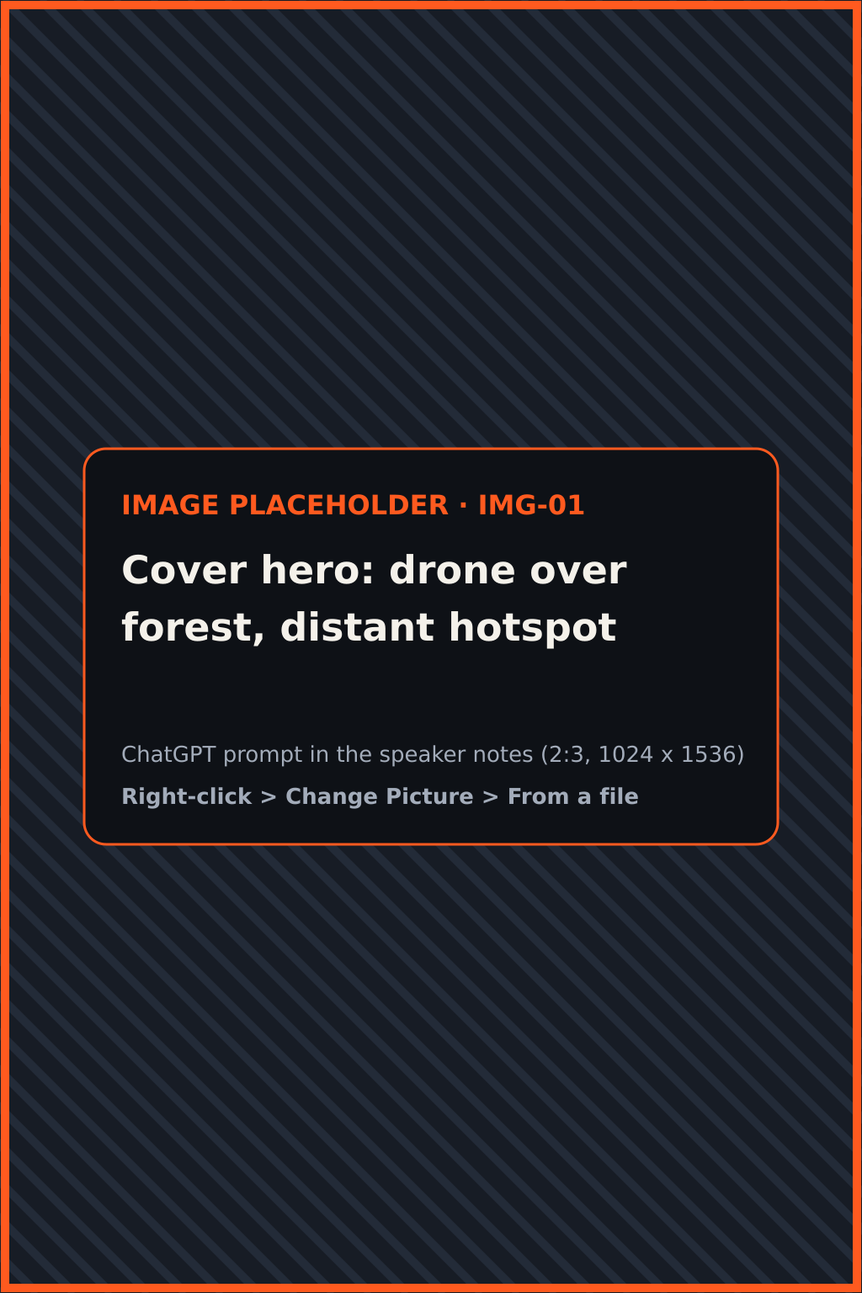
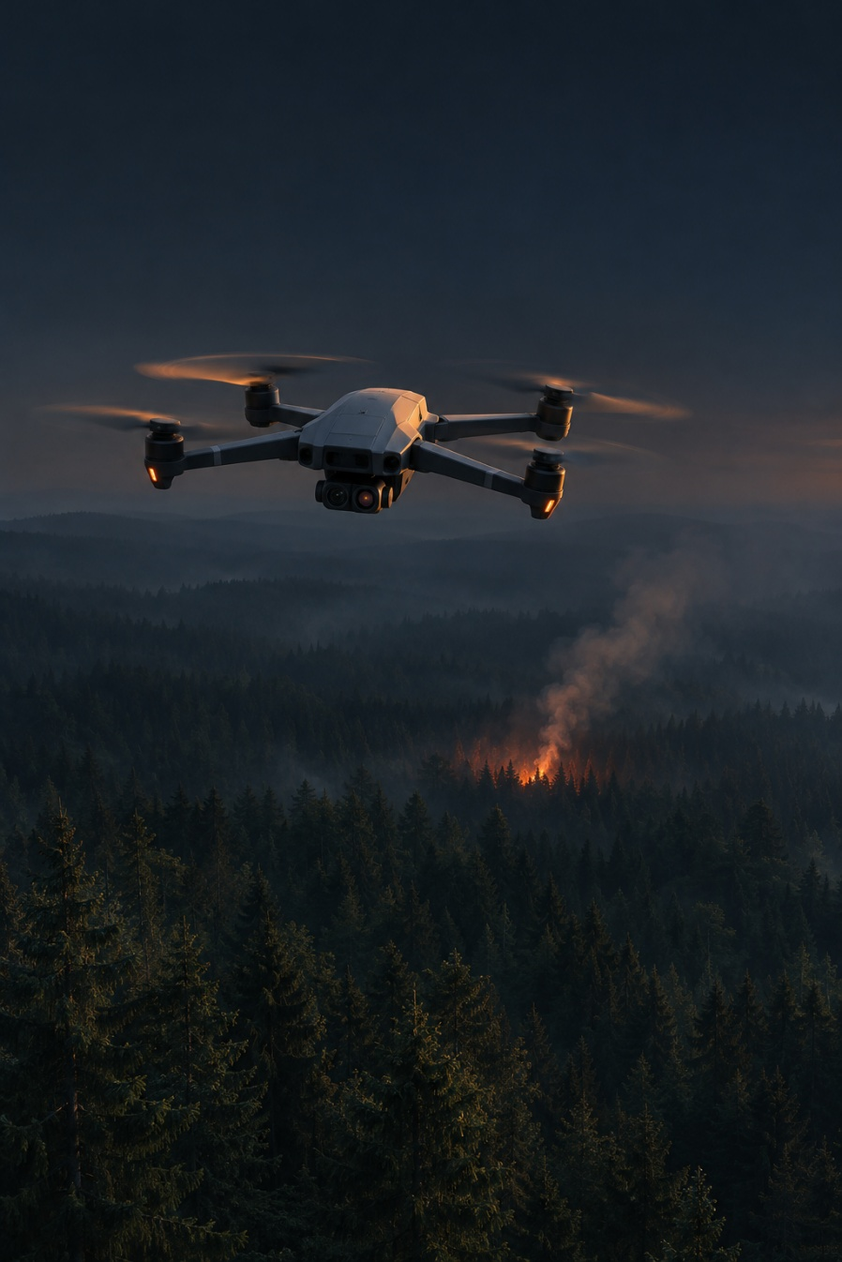



Autonomous fire
hotspot detection
HITECH 2026 · AERIAL ROBOTICS · CASE 1
A UAV that flies a preset route, finds fire with onboard AI and reports its exact position live on a web map.
Autonomous route
Onboard AI
Live web map
Team Brics
CUSTOMER
Omar Alblooshi · Mohammed Alhammadi
ANO “University 2035”
Project defense · Module D
Notes:
~30 s. Introduce the team and the case: University 2035 asked for a UAV that autonomously detects fire hotspots. In one sentence: our drone flies a preset route on its own, detects fire with AI running on board, and puts each detection on a live web map with its coordinates.
IMAGE IMG-01 · Cover hero: drone over forest, distant hotspot (2:3, 1024 x 1536). Generate in ChatGPT with the prompt below, then right-click the placeholder > Change Picture > From a file.
PROMPT: Portrait orientation, 2:3. A small generic quadcopter drone with a compact two-lens camera pod under its body, seen from slightly behind and above, flying over a dense dark conifer forest at dusk. Far ahead, low in the frame, one small glowing orange hotspot among the trees with a thin column of smoke rising and catching the last light. The drone sits in the upper-middle of the frame, sharp and clearly lit by a faint rim light; the forest canopy fills the lower two thirds and fades into blue-black haze. Keep the top quarter of the image as calm dark sky. Style: cinematic, realistic editorial photograph, dark moody palette of charcoal and deep blue-black (#0E1116) with ember-orange (#FF5A1F) and amber (#FFB627) as the only warm accents, soft atmospheric haze, high detail, no people's faces in close-up, no logos, no brand names, no flags, no watermark, no readable text anywhere in the image.

Slide 2


Fires are outgrowing today’s monitoring
THE PROBLEM · DEMAND
+50%
more extreme wildfires expected by 2100
300,000 km²
<1%
of tree cover (30 million ha) lost worldwide in 2024, a record
of wildfire spending goes to planning
Nearly half
of tropical primary forest loss was fire: the leading cause for the first time.
Response
>50%
Planning
<1%
UNEP urges shifting money to prevention and early detection.
Driven by climate and land-use change.
UNEP & GRID-Arendal, 2022
WRI Global Forest Watch / UMD, 2025
UNEP & GRID-Arendal, 2022
The gap is early detection. That is exactly what our system targets.
Notes:
~40 s. Two independent sources show demand. UNEP’s 2022 report projects extreme fires rising 14% by 2030, 30% by 2050, 50% by 2100, and notes that planning gets under 1% of wildfire spending. Global Forest Watch data shows 2024 was a record for tree cover loss, with fire the main driver in the tropics. The gap is early detection, which is exactly what our system targets. Third source: the customer’s own Case 1 specification (next slide).

Slide 3







Every customer need maps to a tested function
TARGET USER · NEEDS
User: forest protection and emergency services
Customer: ANO “University 2035”, Case 1 specification
CUSTOMER NEED
WHAT OUR SYSTEM DOES
PROVEN BY
Cover remote areas without crews
Flies a preset route on its own (PX4 + ArUco)
T7
Module 1
Catch hidden ignition early
RGB + thermal neural detection on board
T1
T2
Send crews to the exact spot
Computes object position within 0.5 m
T3
See the situation live
Web map with object type and time
T5
Module 3
Keep an audit trail
Event log with confidence score
T6
Notes:
~30 s. The target user is forest protection and emergency services; the customer is University 2035. Read across the table: each need from the specification maps to a function, and each function to a test ID you will see on the results slide. This is our traceability: need → function → test.

Slide 4






Each approach misses something we fix
EXISTING SOLUTIONS
Satellite hotspots
Fixed AI camera towers
Piloted thermal drones
Ground patrols
NASA FIRMS: MODIS, VIIRS
Ground-based
e.g. DJI Mavic 3T
On foot or vehicle
LIMITATION
LIMITATION
LIMITATION
LIMITATION
375 m–1 km pixels, passes hours apart, blocked by cloud
Fixed line of sight, costly installation, blind behind terrain
Needs a skilled pilot; a person watches the feed; no automatic log
Slow, labour-heavy, limited reach
OUR ANSWER
OUR ANSWER
OUR ANSWER
OUR ANSWER
Low flight sees small, early sources
Mobile route covers blind spots, no towers
Autonomous flight, onboard AI, automatic geotagged log
One operator supervises from a web map
Sources: NASA FIRMS documentation; DJI Mavic 3T product specs; Pano AI camera-tower deployments (GeekWire, 2023)
Notes:
~40 s. We compared four approaches. Satellites cover huge areas but with coarse pixels and gaps between passes. Camera towers are fixed. Piloted thermal drones still need a skilled pilot and a person watching the screen. Patrols are slow. Our answer combines the mobility of a drone with full autonomy and automatic, geotagged reporting.

Slide 5










From pixels to a point on the map
SYSTEM ARCHITECTURE
1 · SENSING
2 · ONBOARD · ORANGE PI 5 PRO
3 · GROUND STATION
Thermal camera
Detection
Web map
Mileseey TR256i · 256×192 · USB
YOLO on the NPU · ≥10 FPS
Object type + timestamp
RGB camera
USB
Localization
Wi-Fi
Event log
Downward camera · ROS image topic
ArUco pose + box → x, y in metres
Time, x/y, type, confidence
ArUco markers
Mission control
Operator
Indoor position reference
ROS services → PX4 · route, return
Start, watch, “Return”
UART / MAVLink
PX4 flight controller FMU v4 (Pixracer class) · failsafes · RC kill switch
Links: USB · UART/MAVLink · Wi-Fi (HTTP)
Notes:
~50 s. Left to right: the downward camera (which also gives the ArUco position), the thermal camera and the ArUco marker map feed the Orange Pi 5 Pro on the SKYRIS platform. On board, three software blocks: detection runs YOLO on the NPU; localization combines the drone’s ArUco-based pose and rangefinder height with the detection box to compute the object’s x/y in metres; mission control uses the platform’s ROS services (navigate, get_telemetry, land) to fly the route and execute the return command — they talk MAVLink to the PX4 FMU v4 flight controller over UART. Results go over the drone’s own Wi-Fi to the web map and log. The operator can press Return at any time. PX4 failsafes and the RC kill switch sit underneath everything. Failure handling: if markers are lost, the drone holds and lands.

Slide 6
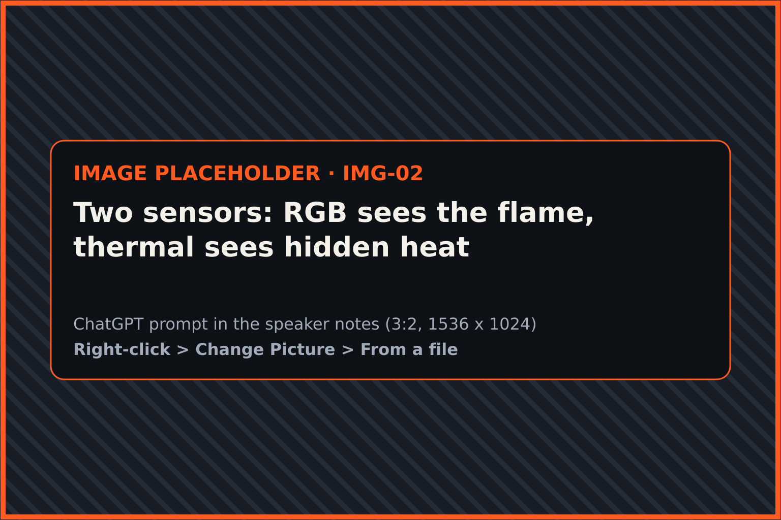
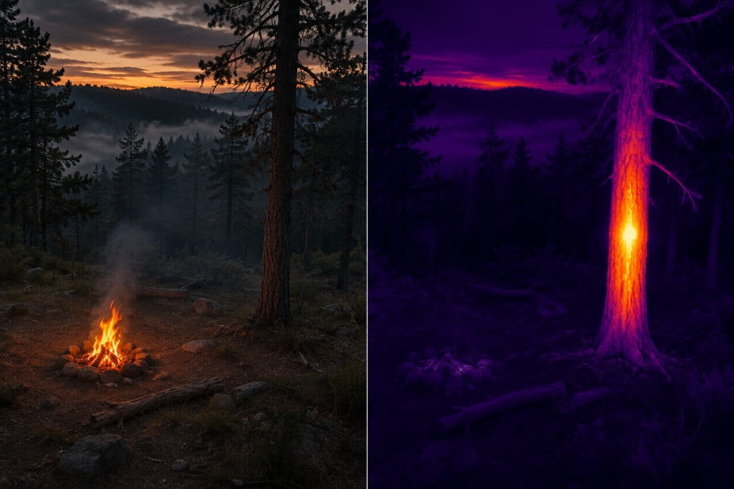




Four choices that shaped the system
KEY ENGINEERING DECISIONS
01
02
Camera for the flame, thermal for hidden heat
Indoor position from ArUco markers
The venue campfire gives off no heat, so we detect it in RGB. The tree is our additional object, and the thermal camera shows which tree hides the heat.
No GPS indoors. Marker pose gives the drone’s position and turns a detection’s pixel into map coordinates.
03
04
All AI runs on board
PX4 for flight safety
THE KEY CALL
Inference on the Orange Pi 5 Pro NPU targets ≥10 FPS and keeps detecting even if the ground link drops.
Proven autopilot with failsafes. The platform’s ROS services keep our code apart from flight control; the kill switch has its own channel.
The simulated campfire produces no heat. Rather than fake a thermal result, each sensor does what it is good at.
Notes:
~40 s. The most important decision: at the venue we found the simulated campfire produces no heat. Rather than fake a thermal result, we detect the flame with the RGB camera and use the thermal camera for what it is good at: telling which tree has the heater inside; the tree is our additional detected object. ArUco markers solve indoor positioning; onboard inference keeps the system independent of the network; PX4 gives us proven safety behaviour.
IMAGE IMG-02 · Two sensors: RGB sees the flame, thermal sees hidden heat (3:2, 1536 x 1024). Generate in ChatGPT with the prompt below, then right-click the placeholder > Change Picture > From a file.
PROMPT: Landscape orientation, 3:2. A split-screen image divided exactly down the middle by a thin vertical line. LEFT HALF: a normal colour camera view, looking down at an angle from a low-flying drone, of a small campfire with bright visible flames in a forest clearing at dusk. RIGHT HALF: a thermal-camera view of a single standing tree trunk in the same forest, rendered in an 'ironbow' thermal palette (deep purple and black for cold surroundings, magenta, orange and bright yellow-white for heat), where the middle of the trunk glows hot from a hidden heat source inside it while everything around it stays cold and dark. Both halves share the same horizon line and framing so they read as two sensors looking at one scene. No interface overlays, no numbers, no labels. Style: cinematic, realistic editorial photograph, dark moody palette of charcoal and deep blue-black (#0E1116) with ember-orange (#FF5A1F) and amber (#FFB627) as the only warm accents, soft atmospheric haze, high detail, no people's faces in close-up, no logos, no brand names, no flags, no watermark, no readable text anywhere in the image.

Slide 7








Strengths and honest limits
ARCHITECTURE REVIEW
BACKUP SLIDE
STRENGTHS
LIMITATIONS
Works offline
Needs markers
Detection and logging run on board; the map syncs when the link returns.
Outdoors, ArUco gives way to GNSS/RTK.
Modular
Low thermal resolution
Cameras, model and map settings change in config.yaml, not in code.
256×192 limits detection range.
Two sensors
NPU budget
RGB sees visible flame; thermal sees hidden heat.
Model size is capped to keep ≥10 FPS.
Evidence: block diagram (slide 5), tests T2 and T3 (slide 11)
Notes:
BACKUP SLIDE: skip it in the 6-minute talk; open it if a question needs it. ~30 s. Two-plus strengths and limitations, each backed by evidence. The limitations are not hidden: markers only work indoors, the thermal camera is low resolution, and the NPU limits model size. Each limitation already has a planned answer on the roadmap.

Slide 8





What’s on board, and why
COMPONENTS
BACKUP SLIDE
SUPPLIED
SUPPLIED
TEAM BRICS
SUPPLIED
PX4 flight controller
Orange Pi 5 Pro
Mileseey TR256i
RGB camera (downward)
Flies and stabilises
AI, positioning, mission · SKYRIS shield
Thermal imaging
Flame + marker detection
FMU v4 (Pixracer) · MAVLink
RK3588S · NPU 6 TOPS
256×192 · USB-C
ROS image topic
Supplied; proven failsafes
NPU sustains ≥10 FPS
Light, plug-and-play
Also feeds ArUco navigation
SUPPLIED
SUPPLIED
TEAM BRICS
2 + 5
ArUco markers
RC link + kill switch
Web app (ours)
Indoor positioning
Override, emergency stop
Map, log, return command
2 added by Team Brics: thermal camera, web app
5 supplied with the SKYRIS platform, kill switch already installed
aruco_pose · marker map
Dedicated channel
Browser over Wi-Fi
Accurate without GPS
Competition safety rule
Any laptop, no install
Notes:
BACKUP SLIDE: skip it in the 6-minute talk; open it if a question needs it. ~25 s. The SKYRIS Technic platform was supplied by the organisers already built: PX4 FMU v4 flight controller, Orange Pi 5 Pro on the SKYRIS shield, downward camera, ArUco navigation software and the RC link with the kill switch. We added the Mileseey TR256i thermal camera and our own web application, plus all the detection and localization software.

Slide 9






Two engineers, clear ownership
TEAM ROLES
BACKUP SLIDE
Omar Alblooshi
Mohammed Alhammadi
Flight control & hardware
Software & AI
EVERYTHING THAT FLIES
EVERYTHING THAT THINKS
PX4 setup and tuning
Dataset and detection model
Sensor mounting and wiring
MAVLink
Onboard pipeline on the NPU
ArUco navigation and flight tests
Localization, web map and event log
Flight safety and test protocol
GitHub repository and docs
Individual contributions are traceable in the GitHub commit history
Notes:
BACKUP SLIDE: skip it in the 6-minute talk; open it if a question needs it. ~20 s. Omar owns everything that flies: PX4, mounting, wiring, navigation and test flights. Mohammed owns everything that thinks: the dataset, model, onboard pipeline, localization and the web interface. Each person’s work is visible in the commit history.
PHOTOS: the two round pictures are placeholders for real team photos (right-click > Change Picture > From a file). Use real photos here, not AI-generated ones.

Slide 10








What we built vs. what we reused
ORIGINAL CONTRIBUTION
BUILT BY TEAM BRICS
THIRD-PARTY, DISCLOSED
Flame + heated-tree dataset and trained detector (186 images)
PX4 autopilot and MAVLink
Pixel-to-map localization from ArUco pose
KEY COMPONENT
OpenCV ArUco module
Mission logic: route, detection events, return command
Web map and event logger
YOLO framework (Ultralytics YOLOv8)
Sensor mounting and integration on the airframe
NPU runtime (RKNN-Toolkit-Lite2)
Highlighted: localization turns a box in the image into x, y in metres. Code: firewatch/geometry.py
SKYRIS Technic image (ROS, aruco_pose, simple_offboard)
Open-source, used as-is
Licences for all dependencies are listed in the repository
Notes:
~30 s. On the left is what we wrote ourselves, on the right the open-source pieces we use. Our key original component is localization: it combines the drone’s pose from ArUco markers with the detection box and camera geometry to place the object on the map to within half a metre.

Slide 11







Measured against the specification
TEST RESULTS · 7 MANDATORY CHARACTERISTICS
CHARACTERISTIC
THRESHOLD
METHOD
RESULT
STATUS
T1
Flame detection accuracy
mAP@0.5 ≥ 85%
Labelled set + scored flight
Pending
Testing
T2
Onboard inference speed
≥ 10 FPS, > 90% of time
FPS log, whole flight
Pending
Testing
T3
Object position error
≤ 0.5 m
Map vs tape-measured
Pending
Testing
T4
Flame found each flight
≥ 1 per flight
Event log per flight
Pending
Testing
T5
Live map display
Type + time shown
Screen recording
Testing
T6
Event logging
4 fields, every event
Log file check
Testing
T7
Return on command
Returns and lands
Formal flight test
Testing
Full protocol, logs and video timestamps: GitHub /tests
Notes:
~60 s. These are the seven mandatory characteristics from our approved technical specification, each with a threshold and method fixed before testing. Walk through the result column. Point out T1 and T3 especially: the accuracy (mAP@0.5 ≥ 85%) and position (≤ 0.5 m) thresholds. Say each measured value only as written in the test report, and point to its log or video in the repository. Results column: read the measured values from the Module B test report after the formal flights; until then they are pending.

Slide 12











Each part works, and so does the whole
MODULES · END-TO-END · FAULT TOLERANCE
END-TO-END SCENARIO
1
2
3
4
5
6
7
Take off
Fly route
Detect flame and heated tree
Compute position
Map + log
Operator “Return”
Land
FUNCTIONAL MODULES
ABNORMAL CONDITIONS
M1
Autonomous navigation
Markers lost
Hold, then land
Check: follows waypoints within 0.2 m
M2
Onboard detection
Ground link lost
Keeps logging, PX4 failsafe
Check: flags flame at confidence ≥ 0.45
M3
Ground interface
Pilot override
Kill switch
Check: event on map within 2 s
Attempts allowed: 3 · Result: Pending · No code or hardware changes
Notes:
~45 s. Three functional modules, each with its own independently verifiable check. Then the full scenario from takeoff to landing, run under fixed conditions with no code or hardware changes. Abnormal conditions are part of the approved plan: losing markers, losing the ground link, and manual override. Say “tested” only for the ones in the test report.

Slide 13
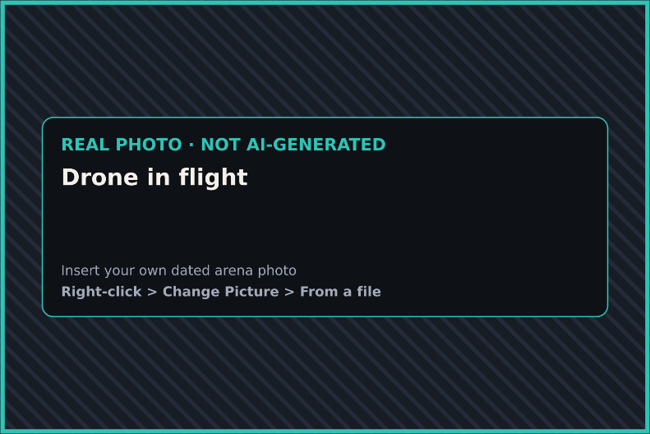
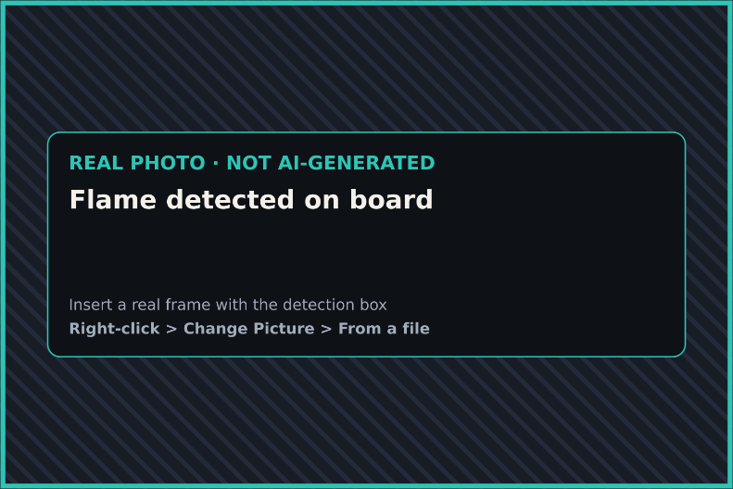
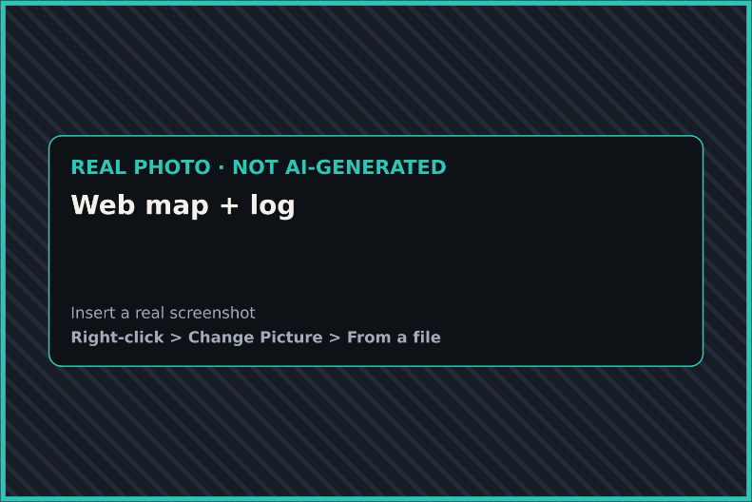


Seen in the arena
EVIDENCE IT WORKS
01
Drone in flight
02
Flame detected on board
03
Web map + log
[insert dated photo]
[insert frame with box]
[insert screenshot]
Formal test video: [link]
Repository: [github.com/…]
Notes:
~40 s. If possible, switch to the live demo or play the 20–30 s video clip here. Otherwise point to the three photos: the drone flying, the onboard detection frame, and the web map with the logged event. Mention the uninterrupted formal-test video and the GitHub link.
PHOTOS: the three pictures on this slide are placeholders for REAL evidence (dated arena photo, real detection frame, real web-map screenshot). Right-click > Change Picture > From a file. Do not use AI-generated images on this slide.

Slide 14






Problems we hit, and how we fixed them
TECHNICAL LIMITATIONS SOLVED
PROBLEM
WHAT WE DID
TARGET
Venue campfire gives off no heat
Added an RGB flame model; kept thermal for the heated tree
mAP@0.5
Target ≥ 85%
No GPS indoors
ArUco marker positioning and pixel-to-map conversion
Error
Target ≤ 0.5 m
No mount for the thermal camera
Secured with mounting tape and cable tie-downs
Checked
before every flight
Artifacts: training logs, position test sheet, flight photos. GitHub /docs
Notes:
~35 s. Three real limitations. The biggest one: the competition campfire produced no heat, so a thermal-only detector could not work. We added an RGB model and kept thermal for the heated tree. Indoors there is no GPS, so we built marker-based positioning. And the thermal camera had no mount, so we secured it firmly and checked it over every flight. Each has a target; quote the measured value from the test report.

Slide 15









60% cheaper than today’s ground patrols
ECONOMIC FEASIBILITY
PAYBACK, MONTHS
ROI
ONE DISTRICT, SAME ROUTE
Ground patrol
Our system
7
651%
Set-up cost (CAPEX)
$0
$32,139
People in the field
2
1
NPV AT 1.3%
IRR
Operating cost / year
$79,420
$24,301
$228.7k
170%
5-year saving
—
60%
Verdict: feasible over 5 years, driven by staff time. Risks: ±30% wages keeps payback ≤ 10 months; vs a piloted DJI Matrice 4T we are only 4% cheaper (payback 3.7 yr).
Payback = investment ÷ annual net saving · NPV = Σ CF / (1+r)^t − investment · ROI over 5 years · Real discount rate 1.3% · Full model: Module C
Notes:
~45 s. Summary of our Module C model; every input and source is in the Module C report and workbook. Customer: a forest protection service that patrols 120 km of fire-risk corridors a day for a 150-day season. Baseline: today’s two-person ground patrol in a 4x4. Our system: two autonomous aircraft supervised by one operator. Set-up cost $32,139 (of which $25,600 is software development). Operating cost $24,301 a year against $79,420: a saving of $55,119 a year, mostly staff time. Payback 0.58 years (7 months), ROI 651% over 5 years, NPV $228.7k at the 1.3% real rate ($173.7k at 10%), IRR 170%. With wages ±30% payback stays between 5.5 and 9.5 months. Honest comparison if asked: against a commercial thermal drone (DJI Matrice 4T) flown by a pilot we are only 4% cheaper and pay back in 3.7 years; there the advantage is automatic detection and logging, not cost.

Slide 16




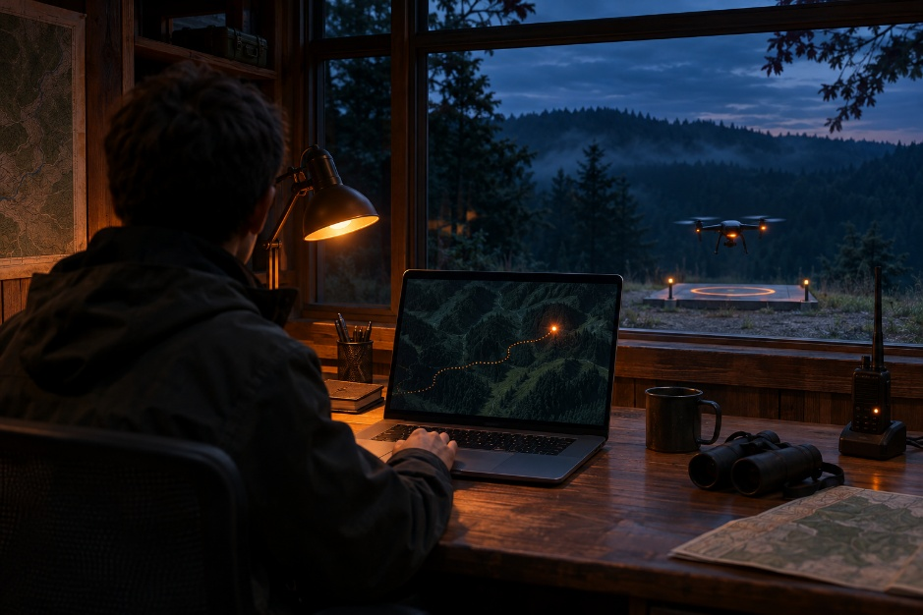





A day at a forest ranger station
PILOT DEPLOYMENT
1 · USER
2 · INPUT
3 · OUR ROLE
4 · OUTPUT
Ranger station operator
Patrol route, area map, schedule
Autonomous patrol, onboard detection
Hotspot map, log, alert to dispatcher
INTEGRATION CONDITIONS
GNSS/RTK replaces ArUco outdoors
LTE or long-range radio link
Weatherproof airframe
Flight permit for the area
ALREADY VERIFIED
Steps 3 → 4: detection reaches the operator’s map with type and time (test T5).
Notes:
~35 s. Picture the pilot: an operator at a ranger station sets a route and schedule; the drone patrols on its own and sends any hotspot to the map and to the dispatcher. To get there we need GNSS instead of markers, a longer-range link and weatherproofing. The core step, detection reaching the operator’s map, is already proven by test T5.
IMAGE IMG-03 · Pilot deployment: ranger station operator and patrol drone (3:2, 1536 x 1024). Generate in ChatGPT with the prompt below, then right-click the placeholder > Change Picture > From a file.
PROMPT: Landscape orientation, 3:2. Interior of a small forest ranger station at dusk. In the foreground, seen from behind and slightly to the side so the face is not visible, an operator in a plain dark jacket sits at a wooden desk with an open laptop. The laptop screen shows an abstract dark map of forest terrain with a single glowing orange dot marker and a thin dotted route line, with no legible words or numbers. Through a wide window behind the desk: a forest ridge under a deep blue evening sky, and a small generic quadcopter drone hovering just above a simple landing pad outside. Warm desk-lamp light on the desk, cool blue light outside. Style: cinematic, realistic editorial photograph, dark moody palette of charcoal and deep blue-black (#0E1116) with ember-orange (#FF5A1F) and amber (#FFB627) as the only warm accents, soft atmospheric haze, high detail, no people's faces in close-up, no logos, no brand names, no flags, no watermark, no readable text anywhere in the image.

Slide 17












From the arena to the forest in three stages
ROADMAP
STAGE 1
STAGE 2 · 3–9 MONTHS
STAGE 3 · 9–18 MONTHS
NOW
3 MONTHS
9 MONTHS
18 MONTHS
STAGE 1 · 0–3 MONTHS
STAGE 2 · 3–9 MONTHS
STAGE 3 · 9–18 MONTHS
Outdoor prototype
Field pilot
Fleet product
DELIVER
GNSS/RTK navigation, weatherproof build
DELIVER
LTE link, alerts to dispatcher
DELIVER
Multi-drone scheduling, docking station
NEEDS
RTK module, outdoor test site, 2 engineers
NEEDS
Partner forest area, flight permits
NEEDS
Funding ≈ $5.9k for 3 aircraft, 1–2 partners
DONE WHEN
5 outdoor flights, position error ≤ 1 m
DONE WHEN
30 days of patrols, false alarms ≤ 5%
DONE WHEN
3 drones patrol autonomously for 1 month
Notes:
~30 s. Three stages, each with a deliverable, resources and a measurable finish line. Stage 1 removes the marker limitation by moving outdoors; stage 2 is a real pilot with a partner; stage 3 scales to a fleet with docking stations.

Slide 18

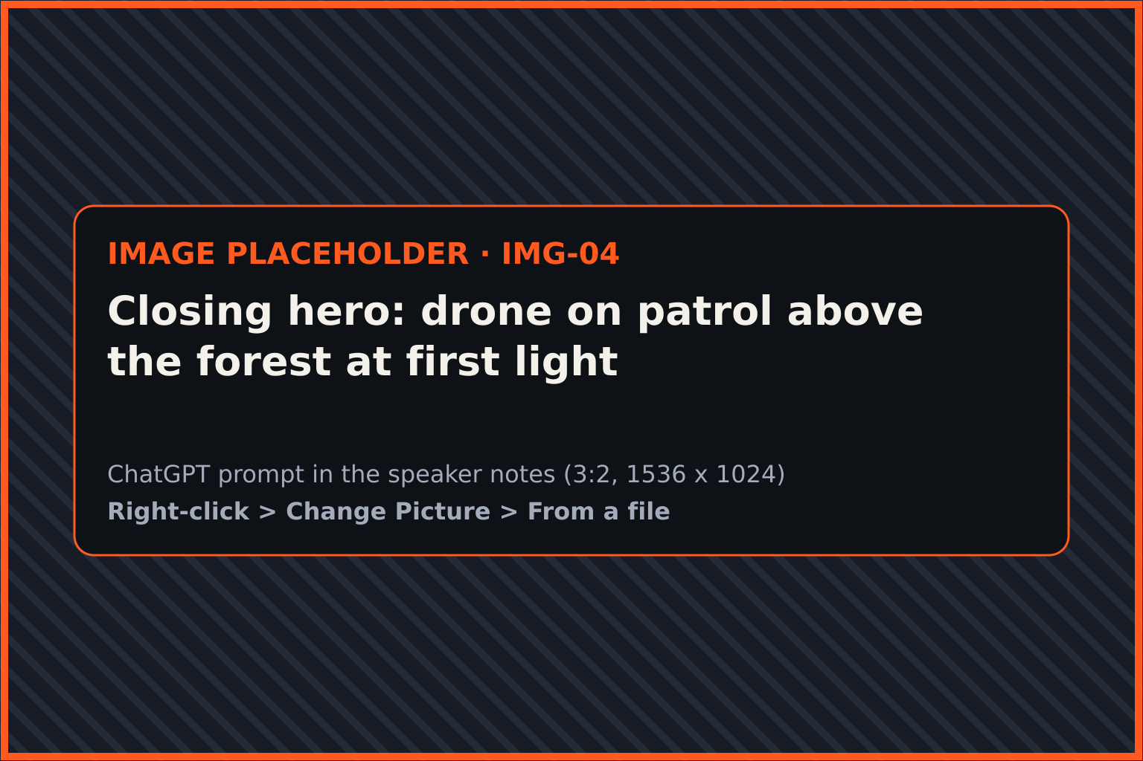
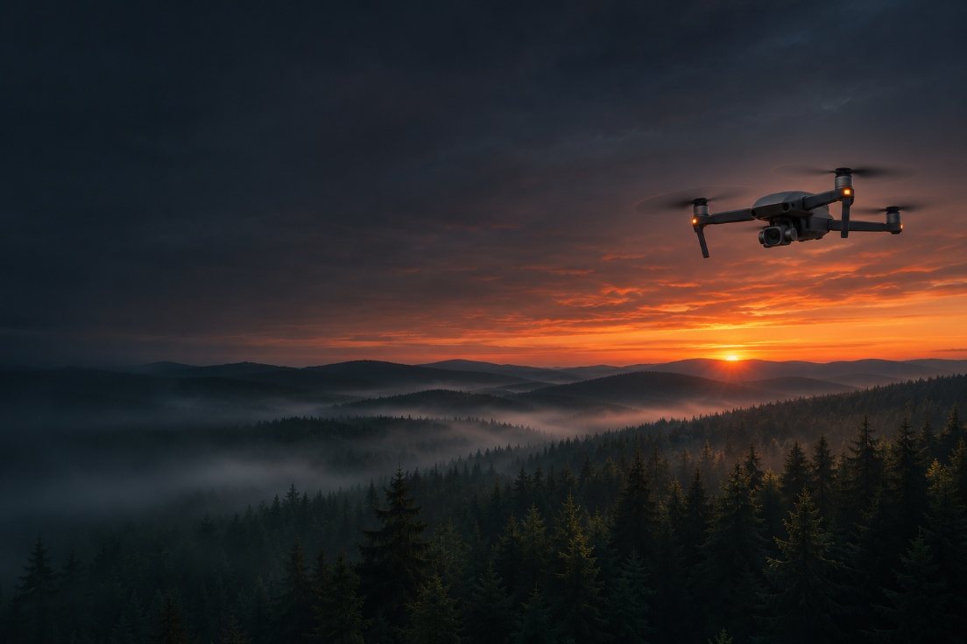




Flies itself. Finds fire. Says where.
TEAM BRICS
Flies itself.
Finds fire.
Says where.
Thank you. We’re happy to take your questions.
GitHub: [github.com/…]
Demo video: [link]
Notes:
~15 s. Close with the one-line summary and invite questions. Have the live demo, the web map and the GitHub repository open in tabs for the Q&A.
IMAGE IMG-04 · Closing hero: drone on patrol above the forest at first light (3:2, 1536 x 1024). Generate in ChatGPT with the prompt below, then right-click the placeholder > Change Picture > From a file.
PROMPT: Landscape orientation, 3:2. A wide, calm aerial scene at first light: a small generic quadcopter drone with a camera pod hovering in the right third of the frame above an endless dark conifer forest and rolling ridgelines. A thin band of ember-orange and amber sunrise glows along the horizon; mist lies in the valleys. The forest is healthy and untouched, no fire, no smoke. The left third of the frame is quiet dark sky and mist with nothing in it. Style: cinematic, realistic editorial photograph, dark moody palette of charcoal and deep blue-black (#0E1116) with ember-orange (#FF5A1F) and amber (#FFB627) as the only warm accents, soft atmospheric haze, high detail, no people's faces in close-up, no logos, no brand names, no flags, no watermark, no readable text anywhere in the image.

Slide 19
Sources (1 of 2)
REFERENCES
DEMAND
1. UNEP & GRID-Arendal (2022). Spreading like Wildfire: The Rising Threat of Extraordinary Landscape Fires. unccd.int
2. WRI / University of Maryland GLAD Lab (2025). Global forest loss shatters records in 2024, fueled by massive fires. wri.org
3. Global Forest Watch (2025). 2024 tree cover loss data explained. globalforestwatch.org
4. ANO “University 2035”. Case 1 specification, HiTech 2026 Flying Robotics Competition Tasks.
EXISTING SOLUTIONS
5. NASA FIRMS — Fire Information for Resource Management System (MODIS, VIIRS). firms.modaps.eosdis.nasa.gov
6. GeekWire (2023). Wildfire startup puts AI-powered eyes in the forest (Pano AI). geekwire.com
7. Global Drone HQ (2026). DJI Mavic 3 Thermal (M3T) specs & price guide. globaldronehq.com
8. DJI (2025). Matrice 4 Series announcement and specifications. dji.com
ECONOMIC MODEL (MODULE C)
9. U.S. Bureau of Labor Statistics, OEWS May 2023: 19-4071 Forest and Conservation Technicians. bls.gov
10. IRS standard mileage rate, 76 ¢/mile from 1 July 2026 (CPA Practice Advisor). cpapracticeadvisor.com
11. U.S. EPA. Greenhouse gas emissions from a typical passenger vehicle. epa.gov
12. OMB M-26-09 (2026). Discount Rates for OMB Circular No. A-94. whitehouse.gov
13. Huang & Wichmann (2024). Reporting delays and wildfire suppression costs. PLOS ONE.
14. National Interagency Fire Center. Federal suppression costs, 2023. nifc.gov
15. Retail prices, Nov 2026: Holybro, Newegg, Mileseey, BuddyRC, Drone Nerds, Dronefly.
HARDWARE AND PLATFORM
16. SKYRIS Technic platform documentation (organisers’ drone, PX4 FMU v4, OPi Pro Shield).
17. Mileseey TR256i thermal camera: 256 × 192, 25 Hz, 56° × 42°. mileseeytools.com
18. CNX Software (2022). Orange Pi 5 / RK3588S, 6 TOPS NPU. cnx-software.com

Slide 20
Sources (2 of 2)
REFERENCES
SOFTWARE
19. PX4 Autopilot (px4.io) and the MAVLink protocol (mavlink.io).
20. ROS — Robot Operating System. wiki.ros.org
21. OpenCV: ArUco module and camera calibration. docs.opencv.org
22. Ultralytics YOLOv8: training and export. docs.ultralytics.com
23. Rockchip RKNN-Toolkit2 / Lite2: NPU conversion and runtime. github.com/airockchip/rknn-toolkit2
24. pymavlink (github.com/ArduPilot/pymavlink) and Roboflow labelling (roboflow.com).
METHODS
25. Everingham et al. (2010). The PASCAL VOC Challenge. IJCV — mAP@0.5 definition.
26. Pinhole camera model and ray–plane intersection, used for our localization (firewatch/geometry.py).

